Slide 1




100 Hotspots
Snapshot of Socially Excluded and Vulnerable communities and sdgs in India
11th july 2019
Annie Namala
WADA NA TODO ABHIYAN

Slide 2
LNOB -100 hotspots Context & Relevance
India is critical to achieving SDGs globally; India achieves SDGs when LNOB (socially excluded vulnerable population) groups achieve SDGs.
India recognises LNOB groups broadly as scheduled castes, scheduled tribes, nomadic groups, religious minorities, persons with disability to name some- under the Constitution, multiple legislations, policies and provisions.

Slide 3
Continuing gaps
The broad categories do not identify specific vulnerable population groups – context, constraints, development status vary.
SDGs tracking and reporting by the government is based on metadata and aggregations.
The periodicity of current national data systems like the Census, National Family Health Survey (NFHS), SRS Reports have long intervals of 4,5,10 years.

Slide 4
Purpose - promote community advocates
Examine: Gather development data on the smaller and less visible population to identify risk of being left behind
Engage: with CSOs/CLOs/CBOs/PRIs to highlight specific vulnerabilities of the LNOB groups
Empower: Building capacities of the LNOB groups to articulate their issues and report on the SDG progress.
(each community 2-4 SDG community advocates equipped)

Slide 5
APPROACH
Disadvantages complex, inter-linked – Multiple, comprehensive set of targets/ indicators to be tracked
Track status and access to provisions and schemes as proxy to tracking progress
Compare and report on gaps in access and inequalities with national averages, international standards
Good practices and recommendations from community advocates
Use of technology where possible and train the community advocates

Slide 6
Research Methodology
Used mixed research methods i.e. Quantitative as well as Qualitative. The data has been collected on the LNOB strategy through two lenses:
Primary data through household survey, FGDs, Key Informants, etc. on the current situation of the LNOB constituencies
Analysis of the access to the Key Welfare Schemes and Development Institutions by the LNOB communities and thereby policy prescriptions by the communities to improve the access and quality of services
Secondary data (from the Census of India, NFHS, various Ministries, etc.) to calculate the gap between the situation of the identified vulnerable groups and the National/State average.

Slide 7
Community driven data
Randomised household sample from 100 households in each hotspot
Survey tool is in congruence with government survey tools – so compatible and comparable
Robust mobile application – real time, on and off line, immediate monitoring and handholding possible, 14 targets – 22 indicators now
Community advocates and CSOs trained and able to use the tool
Application also provides simple analysis
FGD tools customised for each community, with special focus on children, women and youth

Slide 8
SDG 1: End Poverty in All its forms Everywhere
Notes:
Inequality in status

Slide 9
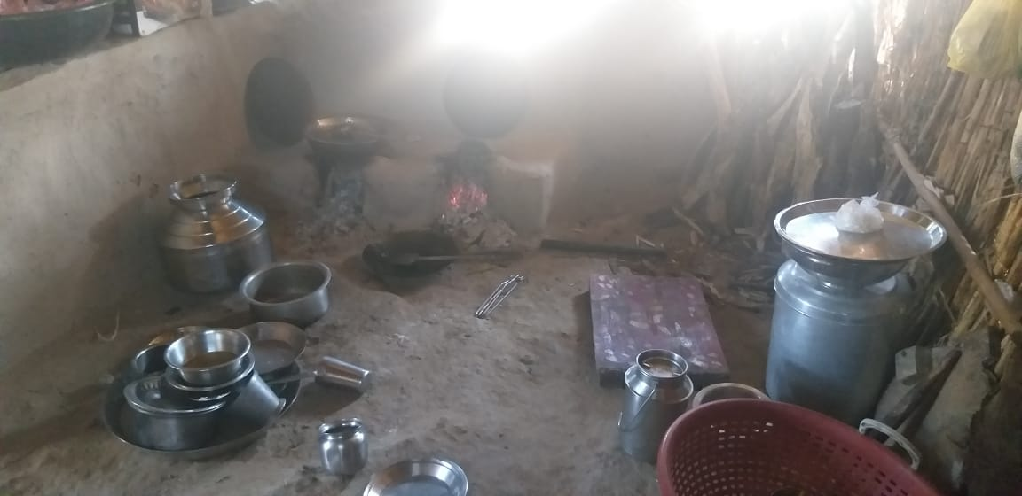

Slide 10
SDG 2: End Hunger, Achieve Food Security and Improved Nutrition
Notes:
Lack access to welfare provisions

Slide 11
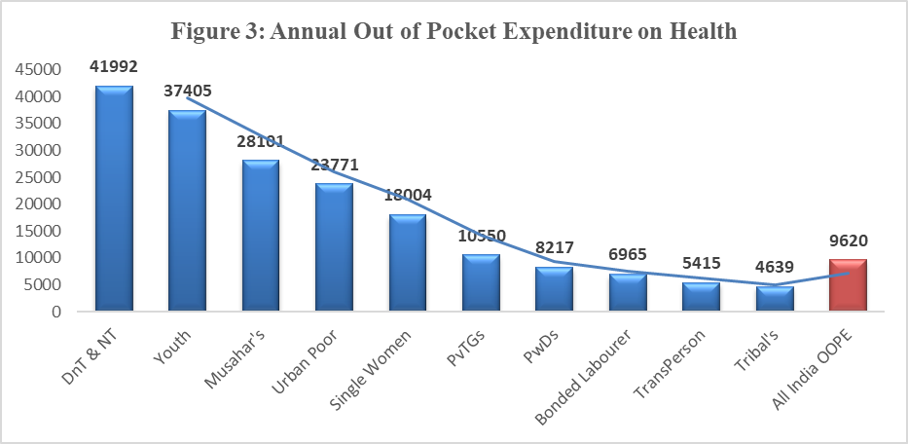
Notes:
Spend more on well being

Slide 12
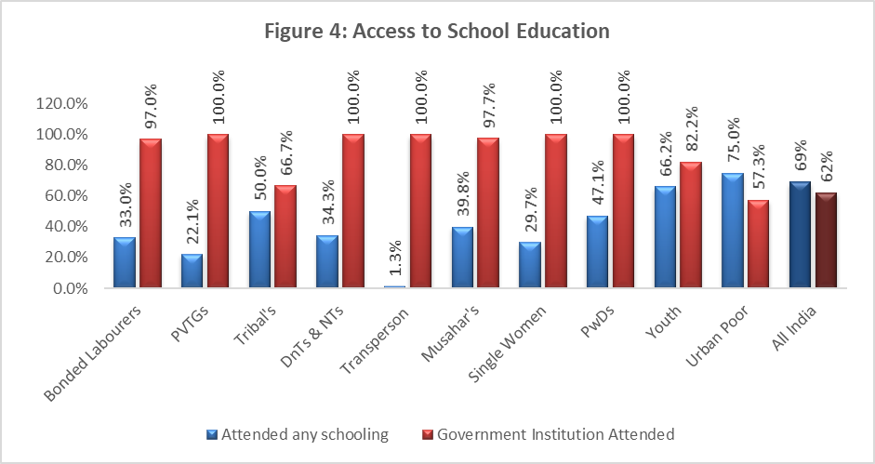
Notes:
Gaps in opportunities - education

Slide 13
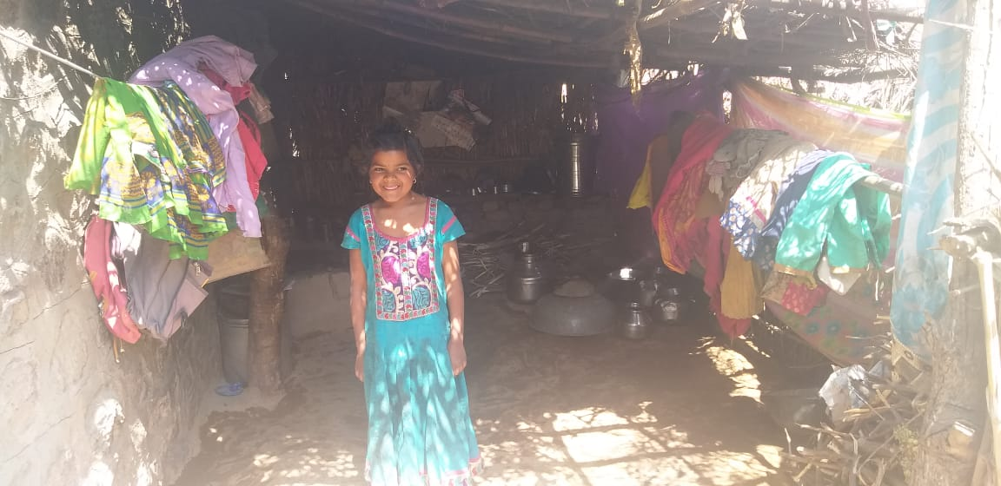

Slide 14
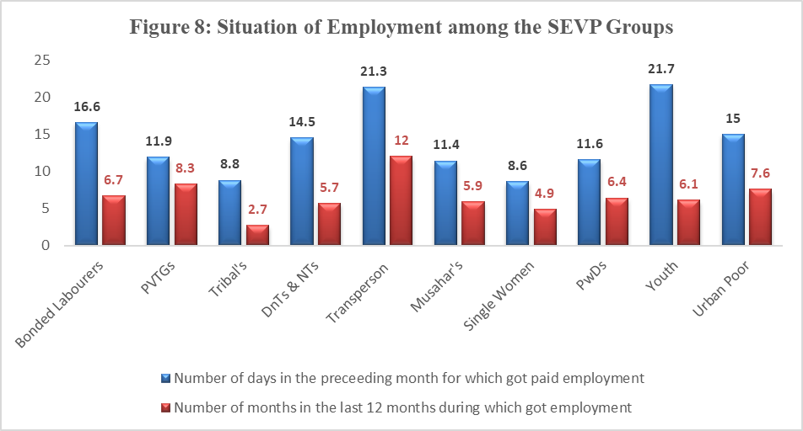
Notes:
Lack opportunities

Slide 15
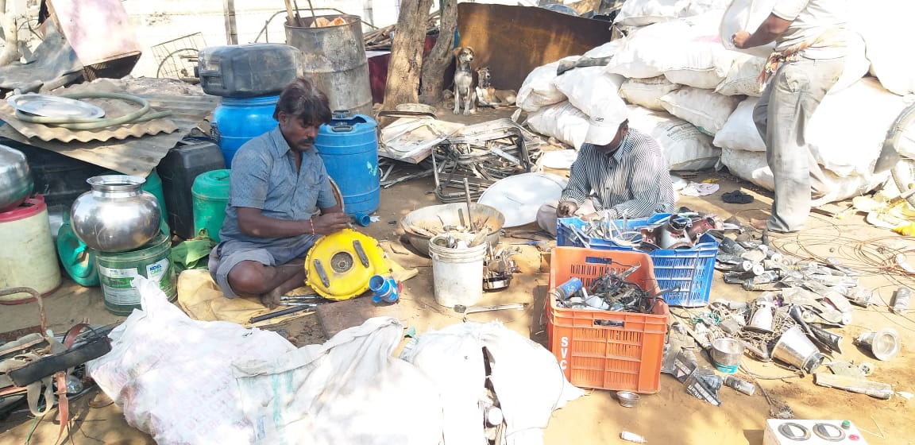

Slide 16
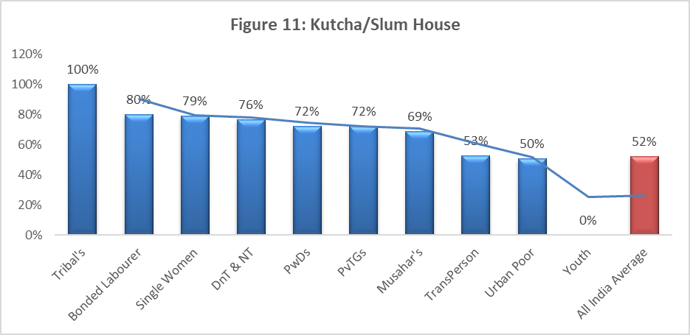

Slide 17
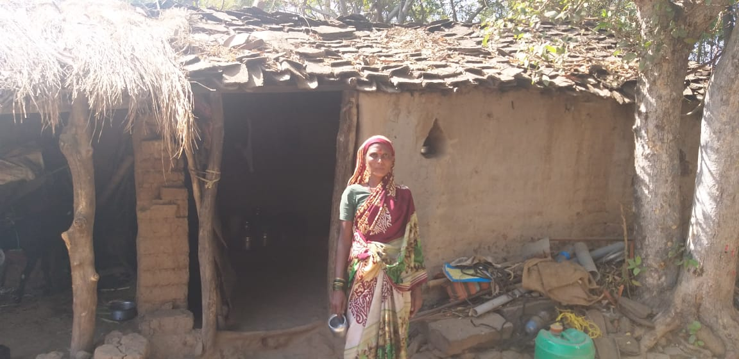

Slide 18
Strength of the study
The research approach used in the study is successful in filling the existing knowledge gaps on the various drivers and outcomes of marginalization and vulnerability at community level
The approach was successful in producing accurate and timely data adding value to existing relevant indicators.
The Participatory Research Approach resulted in capacitating and creating resource persons within the SEVP Groups’ communities on various SDG processes.

Slide 19
Limitations of the Study
Current data on access to justice, climate issues limited
Wide spread and diverse communities, logistically and financially challenging
Capacities and opportunities for advocacy need strengthening
Small sample – not monitor some important indicators like Maternal Mortality Ratio, Child Mortality rates, etc.

Slide 20
Way Forward
The hotspot reports inequalities – between and across
LNOB groups able to and keen to participate
Good quality citizen driven data can be collected to monitor SDGs progress.
Build participation and policy advocacy spaces at local/ national levels
Create global spaces for LNOB reporting and advocacy

Slide 21
Thank You

