Slide 1
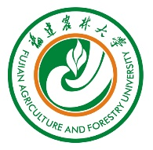


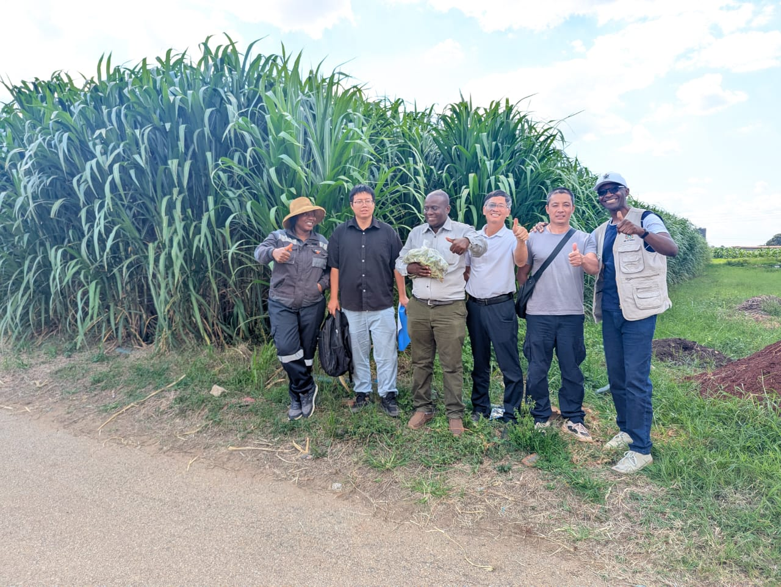
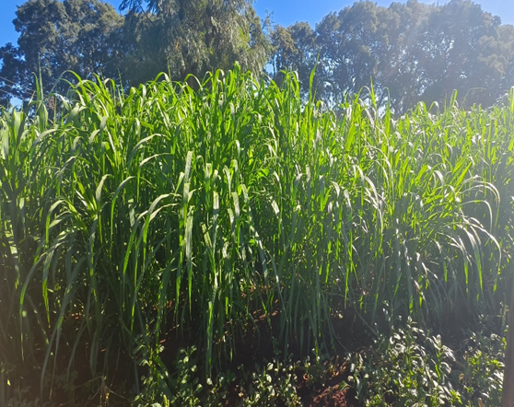
Adoption of Juncao technology in Zimbabwe for mushroom production, livestock feed and environmental protection.
International Study Tour on “Promoting Juncao Technology for Resilient Food Systems, Poverty Eradication and Climate Adaptation in China” 18-21 August 2026
Notes:
Please fill in the grey part according to your country’s situation.

Slide 2
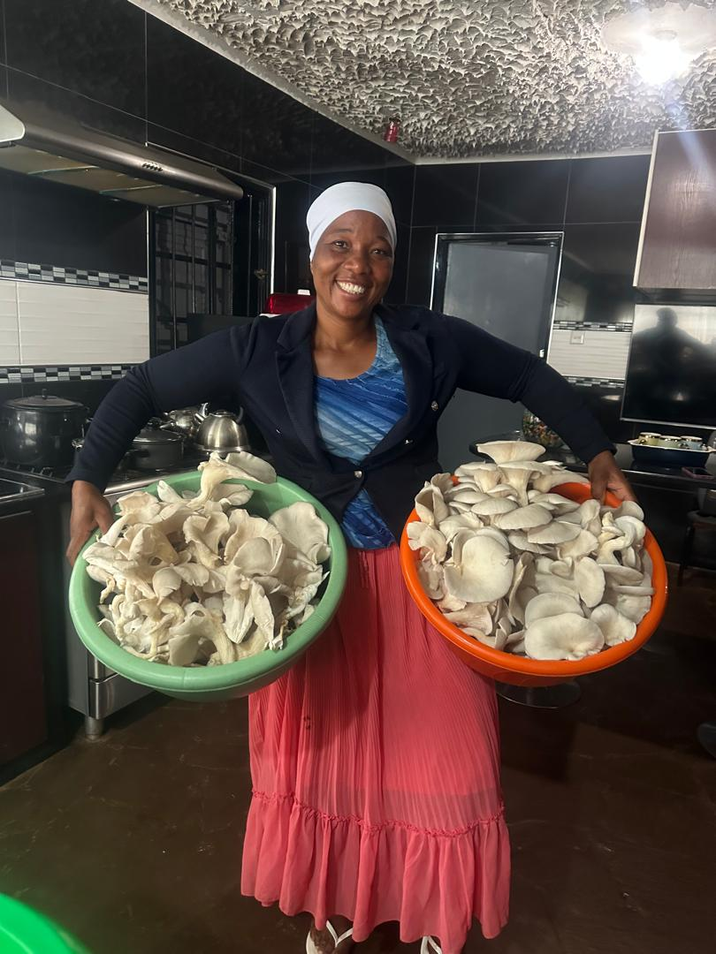
Presentation Outline
Country Context and Current Situation
Why Juncao Technology for Zimbabwe?
Juncao Project Overview and Progress
Opportunities and Early Impact
Challenges and Lessons Learned
Areas for Further Support from UNDESA/FAFU
Key Takeaways from the China Study Tour
Conclusion and Commitment
Notes:
Please fill in the grey part according to your country’s governmental structure. (Ex. Local⇒District)

Slide 3
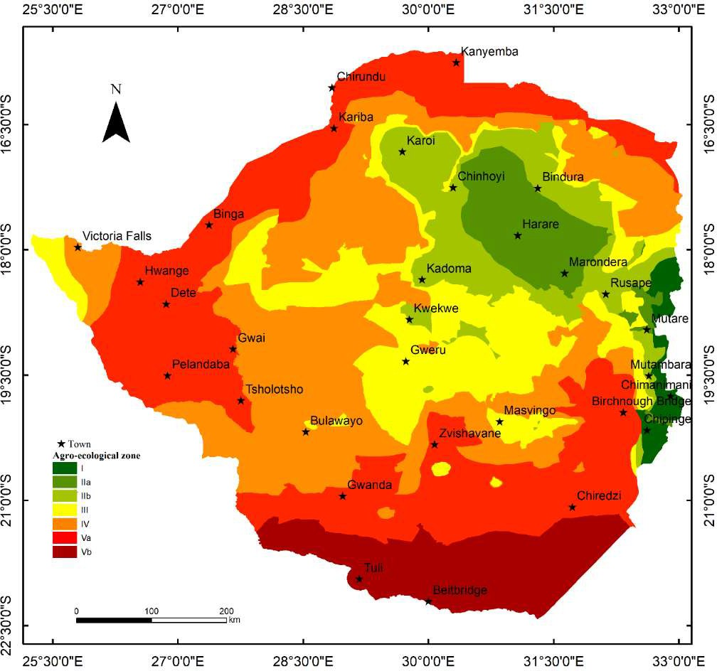
Background - Agro-Ecological Zones, 2020
Region | Area (km2) | Proportion of country (%)
I | 6008.8 | 1.5
IIa | 22085.4 | 5.7
IIb | 36304.7 | 9.3
III | 63215.2 | 16.2
IV | 113594.9 | 29.1
Va | 115041.2 | 29.4
Vb | 34499.8 | 8.8
Total Area | 390750 | 100
Notes:
Please write down the below points very briefly.
・Basic Country (Province) Profile
・Introduction of Country’s Agricultural Policy or Strategic paper, Programmes and Projects related to the SHEP Approach, i.e. “Farming as Business”, Market Oriented Agriculture, Commercialized Farming, etc.

Slide 4
Cultivated varieties
Background - Agro-Ecological Zones, 2020
Zimbabwe is predominantly semi-arid with diverse agro-ecological regions.
Eastern highlands: >1000 mm rainfall; southern and western areas: <400 mm, erratic rainfall.
Agriculture is the backbone of livelihoods, but climate change and recurrent droughts threaten food security.
National livestock herd (2024): 5.74 million beef cattle, 4.68 million goats, 0.75 million sheep – feed and grazing constraints are major.
Deforestation, land degradation, and reservoir siltation are increasing environmental pressures.

Slide 5
Cultivated varieties
Why Juncao Technology for Zimbabwe?
High yield: Giant Juncao grass can produce up to 237 MT/ha with 12.7–18% crude protein.
Versatile uses: Mushroom substrate, livestock feed, ecological restoration, and soil conservation.
Cost reduction: Replaces grain in feed rations, cutting feed costs by up to 50% .
Water efficient: High water-use efficiency – suitable for semi-arid regions.
SDG alignment: Contributes to at least 13 of the 17 SDGs , including SDG 1, 2, and 13.

Slide 6
Cultivated varieties
Outline of Juncao Project in Zimbabwe
Overview of the Juncao Project
Outputs
Period: Feb 2025 – Feb 2028
Overall Goal: Promote sustainable agricultural development and rural poverty alleviation through utilizing specialized "Juncao" grass as a substrate for mushroom cultivation and high-quality livestock feed.
Project Purpose:
Poverty Alleviation and Economic Growth: To raise rural incomes by enabling low-cost, high-return mushroom farming and reducing reliance on expensive animal feed.
Environmental Protection and Ecology: To reduce deforestation by providing an alternative to wood-based substrate for fungi, while fixing carbon, mitigating soil erosion, and rehabilitating degraded land.
Support for Sustainable Development Goals (SDGs): To contribute directly to 13 of the 17 UN Sustainable Development Goals, including "No Poverty" (SDG 1), "Zero Hunger" (SDG 2), and "Climate Action" (SDG 13).
Capacity Building and Empowerment: To enhance the technical skills of farmers
Enhancing Food Security: To boost livestock productivity (milk and meat) through nutritious forage and provide a nutritious food source (mushrooms) in developing regions.
  To establish centre of excellence sites across 8 provinces (currently 2 have been established at Gwebi Agricultural College and Chinhoyi University of Technology)
  To establish farmer outreach programmes
  Capacity building for environment, research and extension services

Slide 7

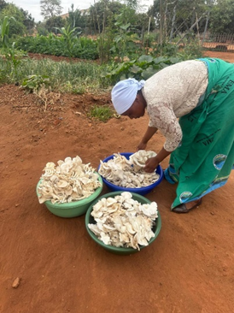
MUSHROOM PROJECT IN ZIMBABWE
Cultivated varieties
Progress Achieved (February 2025 – August 2026)
Established of Juncao Technology demonstration Centre.
Zimbabwe received 5 Experts on 14 February 2025 as well as high level Officials from UNDESA & FAFU
This culminated to the official start of the project on 15 February 2025
. The 250 giant Juncao grass cuttings were planted on 20 February 2025
March 2025 A National Capacity Building Workshop On ‘Promoting Juncao Technology for Resilient Food Systems, Poverty Eradication and Climate Adaptation in Zimbabwe was conducted
The technology is gaining momentum across Zimbabwe 10 provinces, More than 281 Juncao grass cultivation and application demonstration sites have been established nation wide together with 196 Juncao mushroom cultivation
0.5ha with around 20,000 cuttings have been planted at Gwebi.
The project has distributed 158,715 Juncao cuttings, and established 69 Juncao planting demonstration sites. Universities, Village Business Units & Lead farmers.
Ministry of Enviroment Wildlife and Climate was given 200 cuttings for multiplication in their nurseries for environmental management
26 training sessions have been conducted benefiting a total of 1180 participants
UNDESA equipment: Provided at a cost of USD 113,072 to support the demonstration centre.

Slide 8
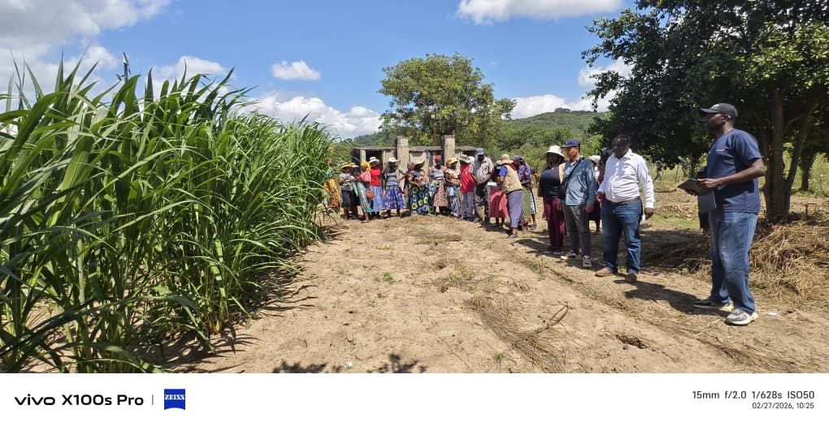
Cultivated varieties
Collaboration with Other Partners
The Ministry of Agriculture, Mechanisation and Water Resources Development, China Aid & WFP entered into a tripartite arrangement to introduce Juncao in 6 Village Business Units in Mashonaland Central (Rushinga), Masvingo, Matabeleland South (Matopos).
194 farmers were trained in the joint WFP sessions held in Kuhwira garden– Ward 18 and Huruma garden – Ward 16 in Rushinga Mashonaland Central Province, as well as Ward Chebvute garden 17 and Chibidi garden Ward 24 of Masvingo District.
Chebvute garden, Ward 17 Masvingo.
INTERNATIONAL TRAINING & STUDY TOURS : The division for Sustainable Development Goals of the Department of Economic and Social Affairs (UNDESA) and National Engineering Research for Juncao Technology of the Fujian Agriculture and Forestry University in China co-organised Trainings and Study tours in Rwanda, China and Fiji for 448 (271 men & 164 women) (Government Officers, University Lecturers & Farmers
Organization / Sector engaged | Number of Participants
Farmers | 295
AGRITEX / Agricultural Business Advisory Services | 103
Ministry of Agriculture, Mechanisation and Water Resources Development | 35
Chinhoyi University of Science &Technology | 10
University of Zimbabwe | 10
Total | 453

Slide 9
Opportunities in mushroom production
Cultivated varieties
Opportunities offered by Juncao Technologies
Addresses challenges of unavailable substrate, limited spawn, and poor yields.
Demonstrates potential for income generation (e.g., Borrowdale mushroom project).
Livestock Feed - Juncao grass can supplement grazing, improving milk and meat production.
Reduces feed costs and pressure on grazing land.
Helps secure the growing national herd.
Environmental Restoration - Potential for gulley reclamation, wasteland rehabilitation, and carbon sequestration.
Contributes to soil and water conservation in degraded landscapes.

Slide 10
CHALLENGES
Cultivated varieties
Challenges and Lessons Learnt
Limited local spawn production: Most spawn currently imported from South Africa.
Substrate availability: Not yet consistently available across all provinces.
Yield variability: Low yields where production practices are not yet standardised.
Climate risks: Persistent dry spells and droughts threaten Juncao cultivation without irrigation.
Extension capacity: More training of trainers needed to reach all districts.
Institutional coordination: Stronger multi-sectoral engagement needed across ministries and partners.

Slide 11
Areas for Further Support from UNDESA and FAFU
Support Area | Specific Request
Spawn production | Establish local spawn production units to reduce import dependence
Multiplication centres | Establish Juncao multiplication centres in all 10 provinces
Capacity building | Expand Training of Trainers, exchange visits, and technical backstopping
Research and adaptation | Joint trials on drought tolerance, yield performance, and feed quality in Zimbabwean conditions
Irrigation and water efficiency | Technical support for low-cost, climate-smart irrigation for Juncao
Value addition and marketing | Develop pelletising, silage-making, and certification standards for regional export
Policy integration | Technical input to mainstream Juncao into national agriculture and climate adaptation policies
Partnership expansion | Strengthen collaboration with WFP, FAO, UNDP, IFAD, and private sector

Slide 12
Cultivated varieties
Key Take Aways
Arid and semi-arid applications: Juncao technology is highly relevant to Zimbabwe’s dry regions in addressing mainly reservoir siltation , low cost livestock feed
Innovative models: Integrated systems combine mushroom cultivation, livestock feed/fodder production, and ecological restoration , creating new opportunities for fodder entrepreneurs .
Policy support: Strong government backing and institutional frameworks are critical drivers of scalability and long-term success.
Community adoption: Effective demonstration sites and farmer-led enterprises significantly accelerate technology uptake at grassroots level.
Implications for Zimbabwe: Adapt low-tech, low-cost approaches to local conditions and leverage South-South cooperation for effective technology transfer.

Slide 13
Cultivated varieties
Way Forward
Expand infrastructure: Increase the number of Juncao multiplication centres across all provinces.
Strengthen capacity: Upscale Training of Trainers (ToT) courses on Juncao technology for extension staff and lead farmers.
Extend coverage: Establish Juncao nurseries in all Village Business Units to ensure community-level access.
Add value: Develop value-added products from Juncao grass, including pellets, fibre, and silage .
Explore export markets of Juncao cuttings and value-added products (e.g., pellets) into the SADC region .
Boost partnerships: Strengthen collaboration with development partners WFP, UNDP, FAO, IFAD — and engage small entrepreneurs .
Promote environmental use: Introduce Juncao for gully reclamation and waste-land rehabilitation as a climate adaptation tool.
Ensure quality & export readiness: Establish certification standards for Juncao nurseries and products to enable regional and international trade .
Scale mushroom production: Upscale mushroom cultivation for improved nutrition and household income generation .

Slide 14
Cultivated varieties
Conclusion and Commitment
Zimbabwe remains fully committed to scaling Juncao technology as a climate-smart, multi-purpose innovation .
The project already demonstrates measurable progress in training, demonstration, and early adoption.
With continued UNDESA and FAFU technical support , Zimbabwe can become a regional hub for Juncao application in semi-arid agriculture.
We thank UNDESA and FAFU for 40 years of innovation and for the opportunity to participate in this study tour.
We look forward to deepening South-South and triangular cooperation and to concrete follow-up actions.

Slide 15
