Slide 1

Kenya’s experience Juncao Tour to China, August, 2026
MINISTRY OF AGRICULTURE AND LIVESTOCK DEVELOPMENT
STATE DEPARTMENT FOR LIVESTOCK DEVELOPMENT
Kariuki N. N.
Even Hotel, Yinchuan cirty, Ninxhia China
21^{st.} August, 2026

Slide 2
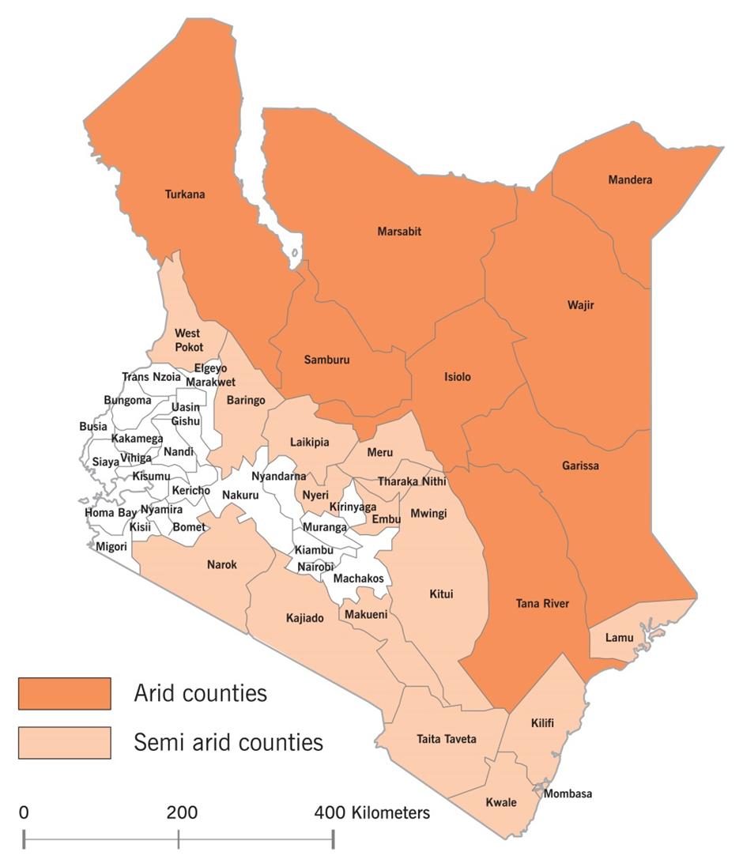
The Kenyan context
Total Area = 582,646 Sq Km
Population
  Human = 55 (2025) Million
  Projection = 65 (2030)
  = 96 (2050)

Slide 3
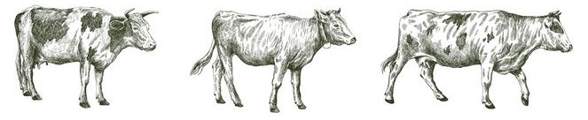
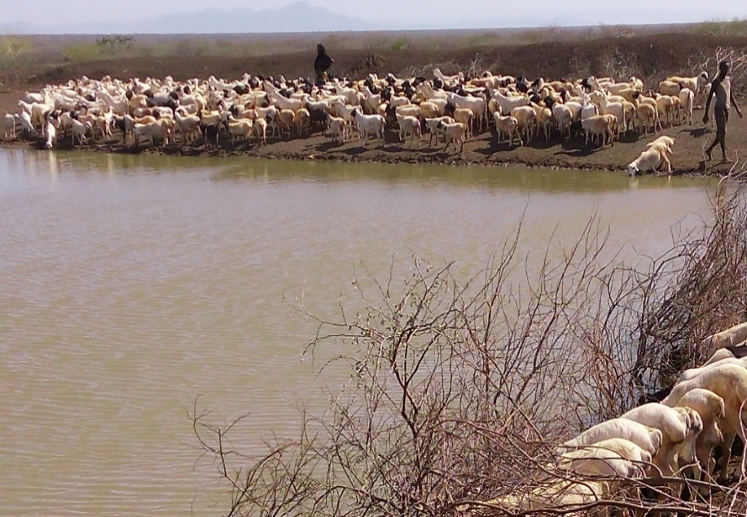
Livestock population-2024 statistics
Sector | Population (Millions)
Poultry | 71.2
Beef Cattle | 17.2
Dairy | 5.2
Sheep | 26.2
Goat | 38.4
Pig | 0.9
Camel | 4.8
Rabbits | 0.8
Notes:
3

Slide 4
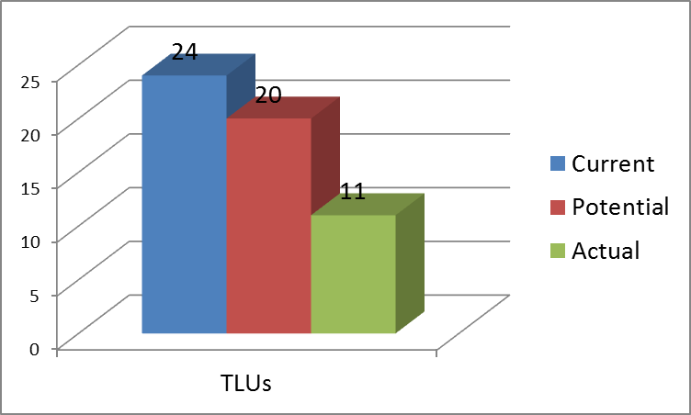
Current, Potential and Actual stocking rates (Million TLU)

Slide 5
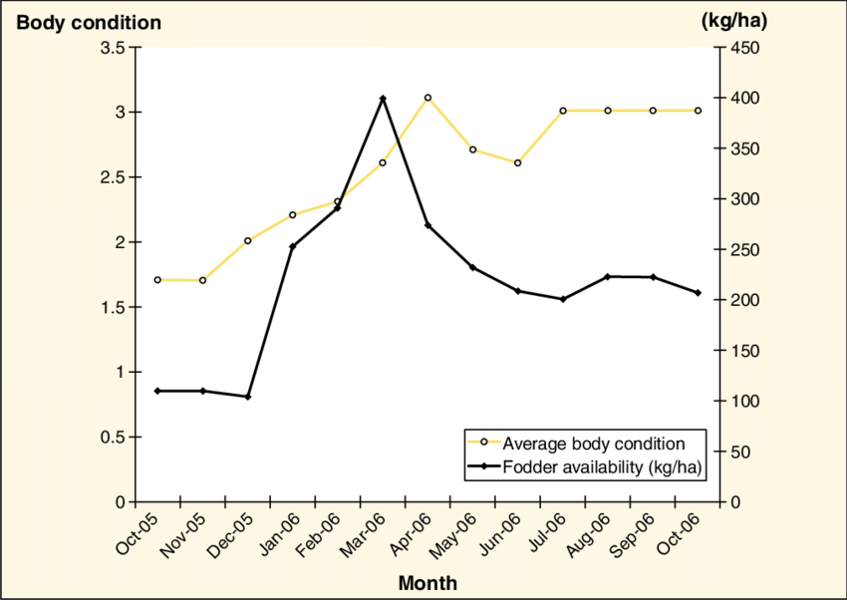
Seasonal feed resources fluctuation……….…?

Slide 6
Kenya
Opportunities:
Increasing Population growth
Improved National economic development
Increasing demand for animal source proteins
(2030: 1.6 Million MT meat, 10.5 Liters milk, 8.9 Billion Eggs)
Main challenges
Inadequate feed availability/accessibility (
Inadequate quality
Increasing cost of feed/affordability
Inadequate data and information

Slide 7
Opportunities:
        Increasing Population growth
        Improved National economic development
        Increasing demand for animal source proteins
        (2030: 1.6 Million MT meat, 10.5 Liters milk, 8.9 Billion Eggs)

Slide 8
Domain challenges:
        Inadequate feed availability/accessibility (
        Inadequate quality
        Increasing cost of feed/affordability
        Inadequate data and information

Slide 9
Animal Feed status Demand and Supply (Million MT) DM per Year
Study | Demand | Supply | Deficit levels | Remarks
Feed inventory of 2022 | 55 | Potential = 46 Actual = 25 | Potential = 9 Actual = 30 | Source: MoALFC/FAO/ IGAD study of 2022
………… in terms Billion of Bales per Year
National Feed Balance | 4.3 Billion bales | Potential = 3.6 Actual = 1.9 | Potential=0.7 (16%) Actual = 2.4 (56%) | Source: MoALFC/FAO/ IGAD study of 2022
National Herd = 74 Million equivalent to 24 million TLUs 1 TLU consumes 2.3 Tons of DM per year 1 Bale = 15 kg (FM) = 0.01275 Tons (DM)

Slide 10
Promotion of Commodity Value Chains
    Energy Sources
    Whole maize grain
    Whole Sorghum grain
    Cassava roots
    Protein Sources
        Fish meal
        Insect meal
    Rangeland feeds
      Pastoral
      Ranch
      Smallholder
    Fodders
      Hay
      Silage
      Lucerne
    Protein Sources
        Soya
        Sunflower
        Cotton
        Canola
    Green chop
        Maize fodder
        Napier grasses

Slide 11
Juncao, what an Experiences!!
  Environmental Rehabilitation
  Animal Feeds
  Poverty Reduction

Slide 12
Next Steps
High level National tour
Fast track the Collaboration agreement
Support importation of planting materials
Continuous technology transfer
Support to School feeding Program
Ecological Rehabilitation (tana River, Chalbi desert, Gulleys)
Technology access (Mechanization, Irrigation and Warehousing)
Expansion into livelihood diversification (Mushroom Cultivation)

Slide 13
END
Thank you for Listening

