Slide 1


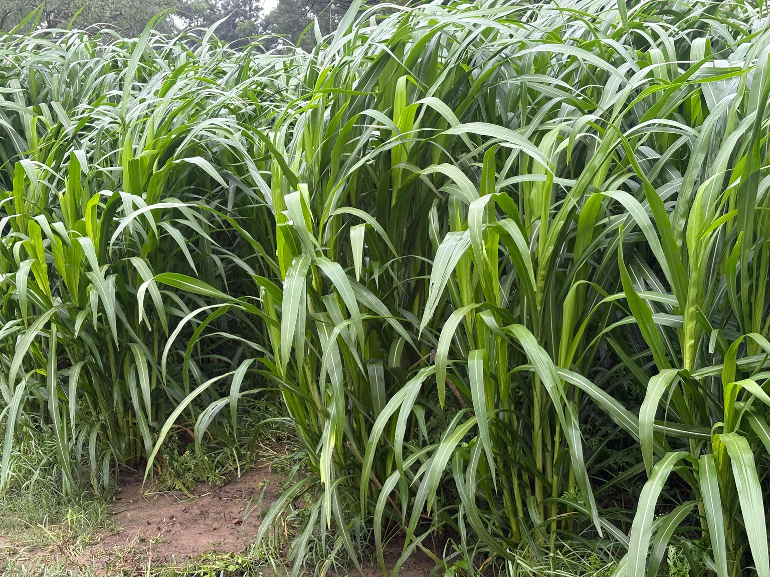
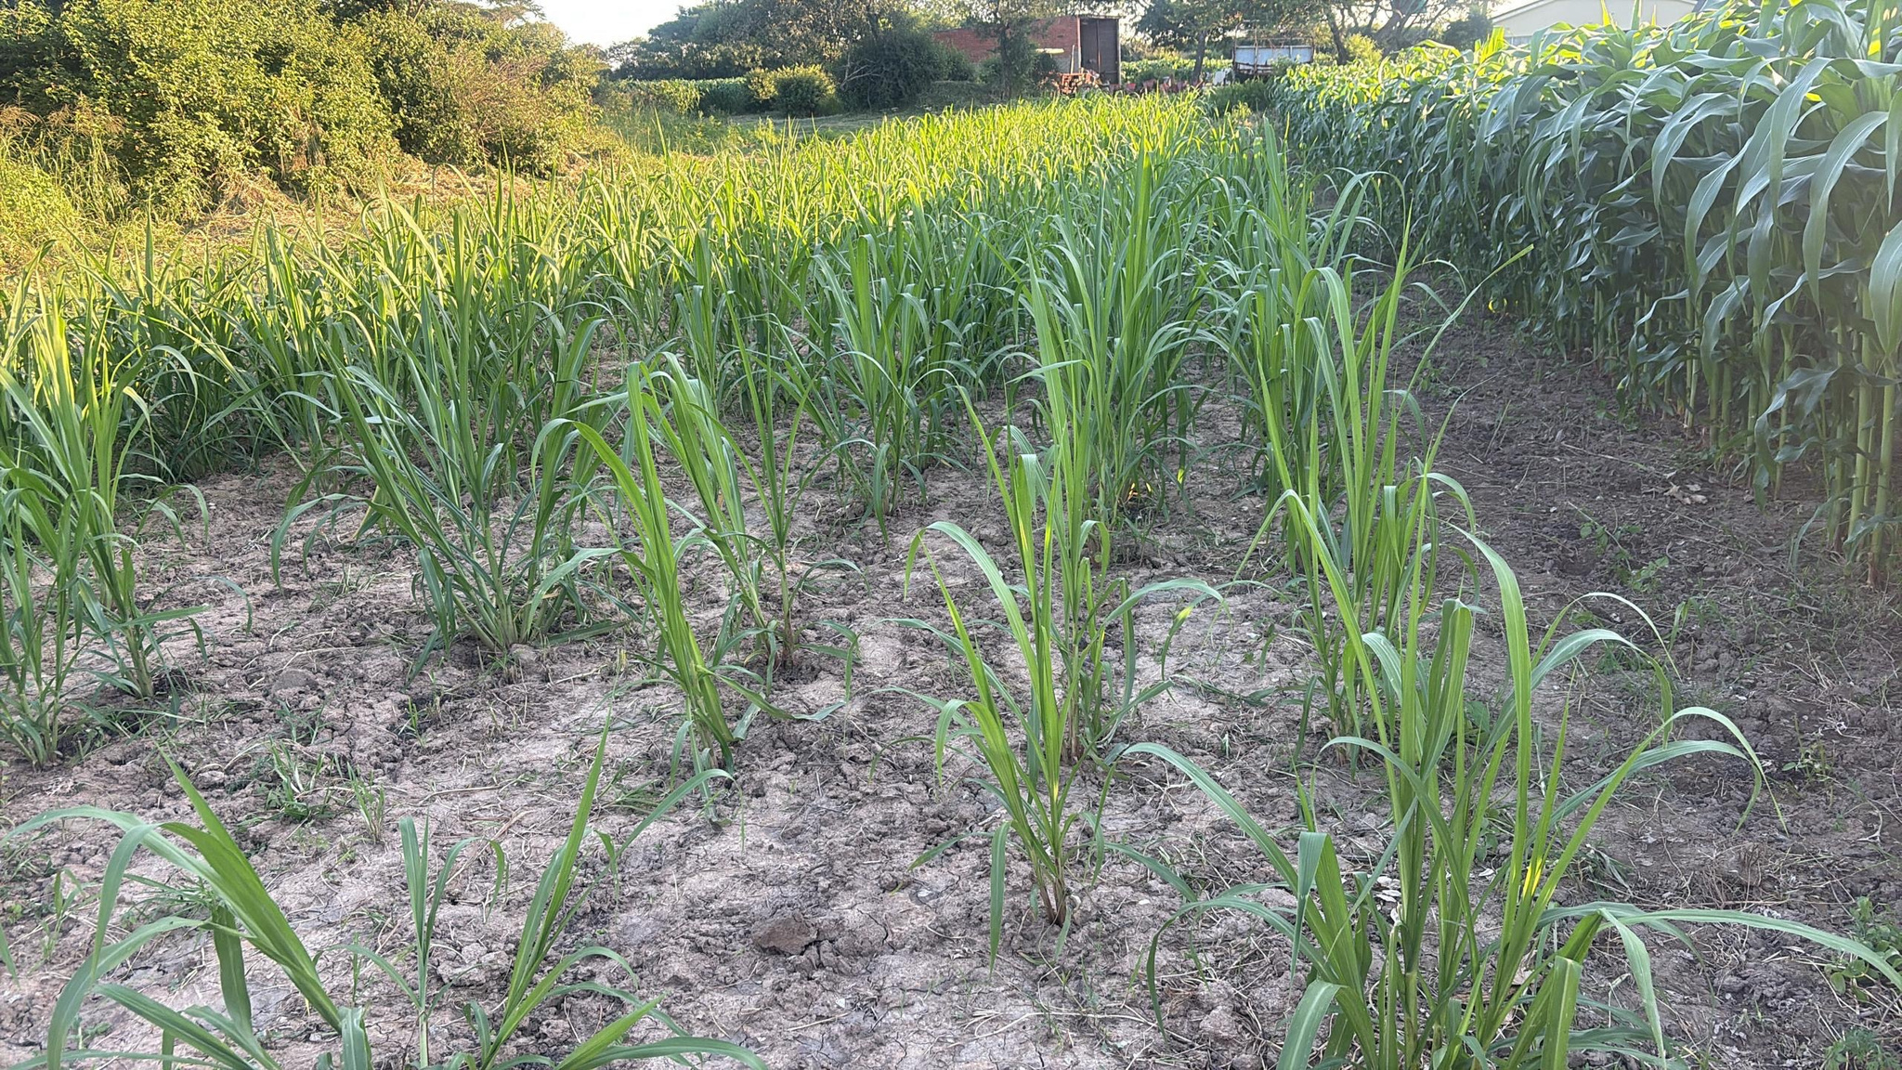












Biano Simmentals
FARMER PERSPECTIVE
ON JUNCAO FODDER SYSTEMS
March 2026
Presented by:
Obert Chinhamo
Biano Farm Zimbabwe
Simmental Stud Breeder
30 January 2026

Slide 2
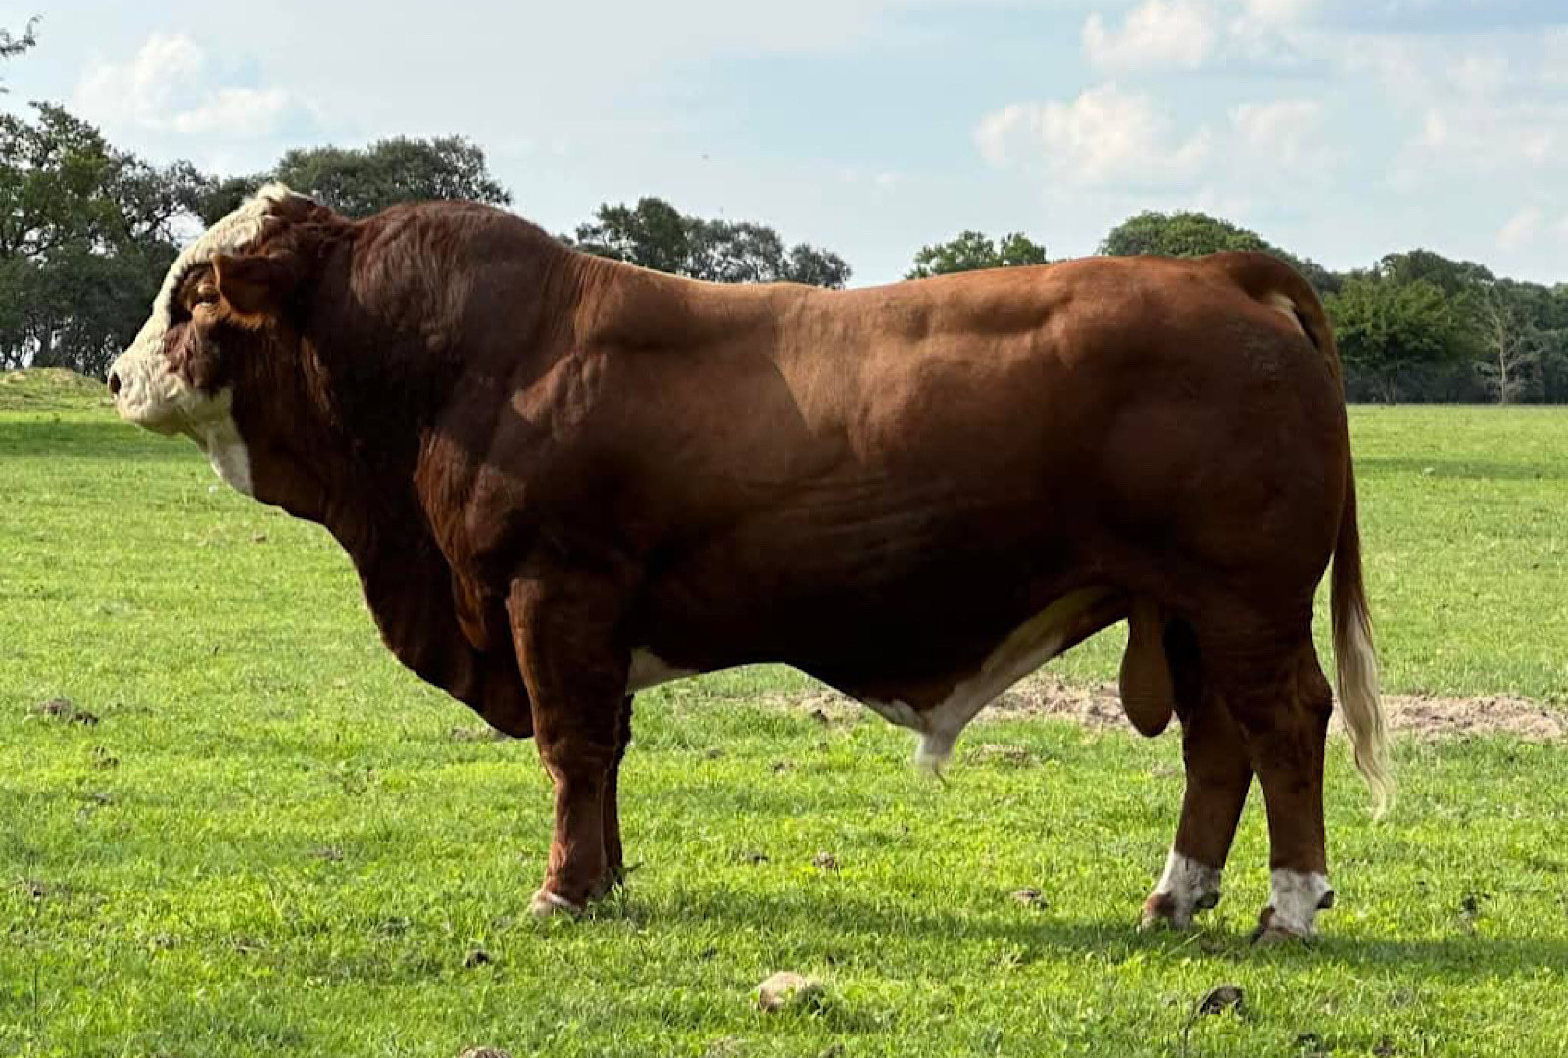

ABOUT BIANO FARM
  Simmental cattle stud breeding program
  Focus on producing high-quality breeding cattle
  Multiple award-winning animals at agricultural shows
  Commitment to genetic improvement of Zimbabwe’s cattle industry

Slide 3








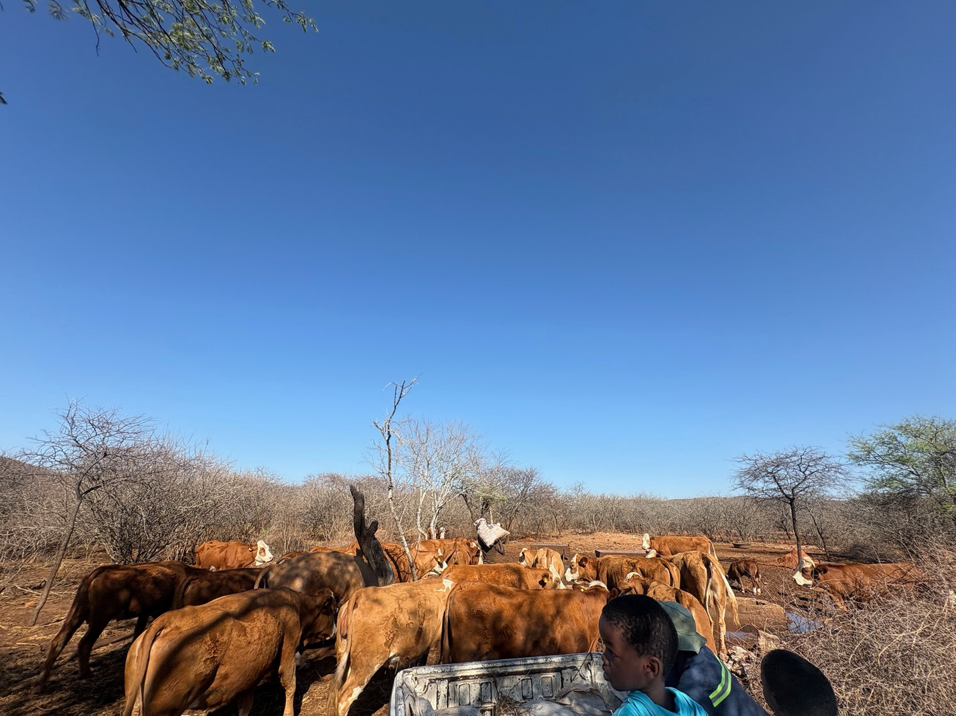
CATTLE FEED REQUIREMENTS
Feed Requirements for Our Herd
Average intake per animal:
  12–15 kg dry matter/day
  360–450 kg/month
Cost of commercial feeds
  $18–$25 per bag
  High cost during dry seasons
Feed sources:
  Natural grazing
  Hay
  Silage
  Crop residues
  Commercial stockfeed supplements

Slide 4

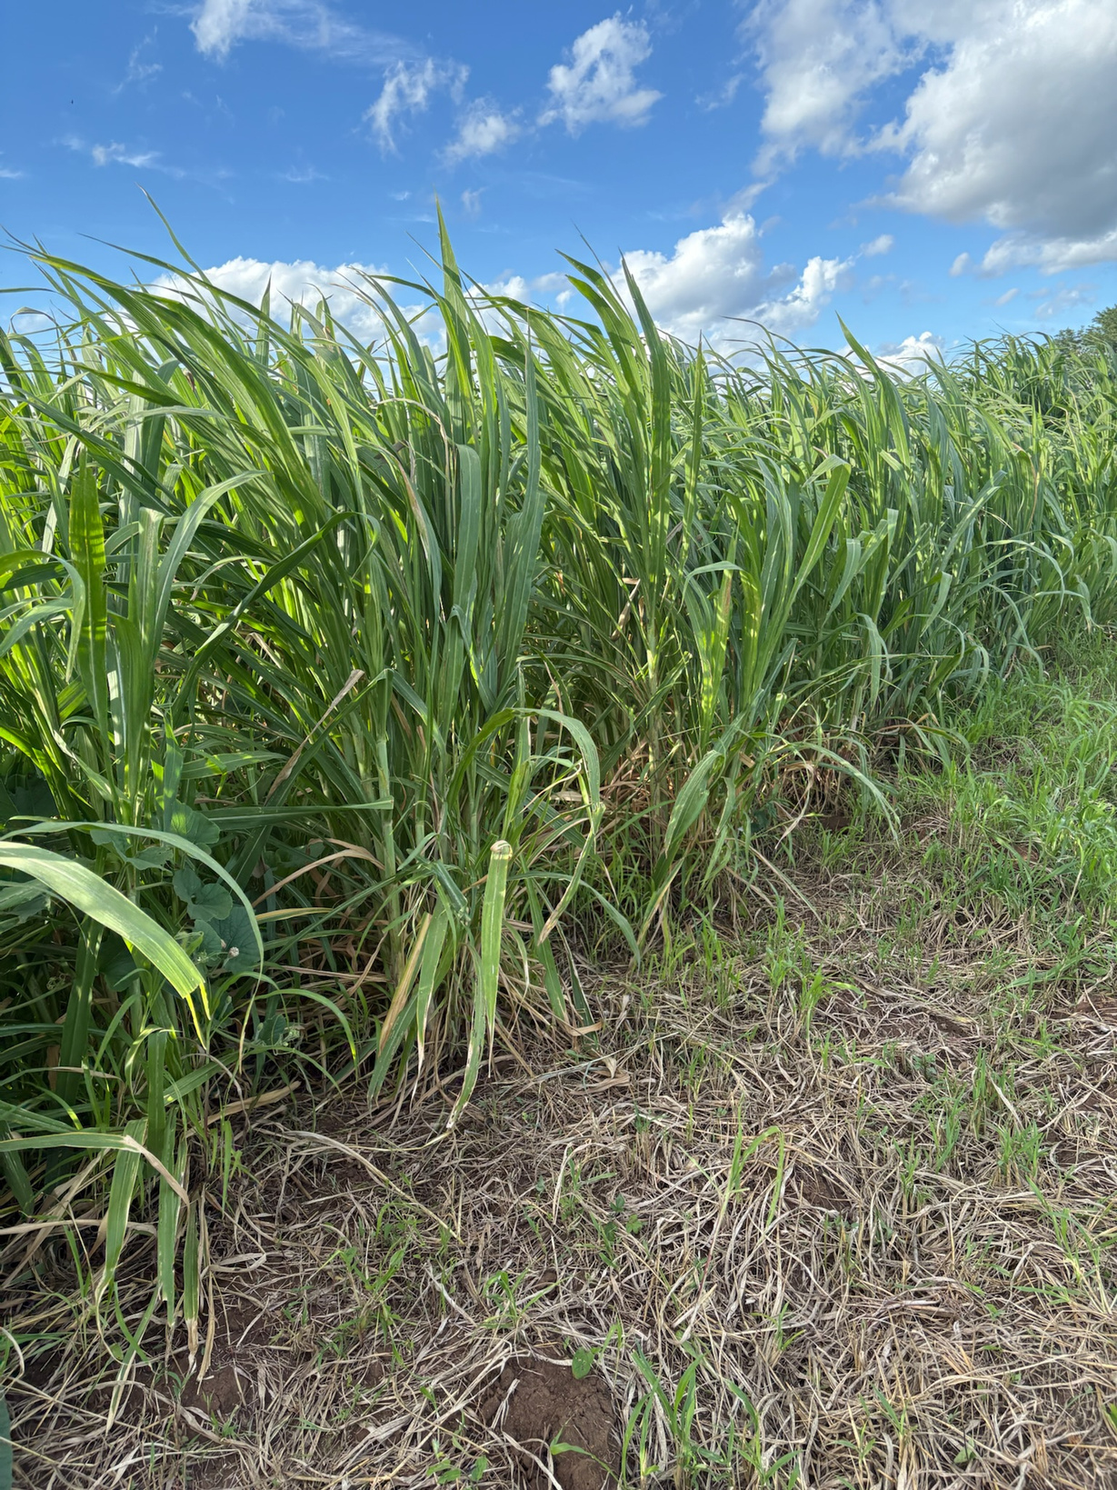


CHALLENGES FARMERS FACE
Feed Challenges for Livestock Farmers
DROUGHT AND SEASONAL FEED SHORTAGES
LIMITED ACCESS TO RELIABLE FODDER CROPS
Reduced grazing and poor pasture quality during dry months
Few high-yield, drought tolerant forage options available
HIGH COST OF COMMERCIAL FEEDS
NEED FOR CLIMATE-RESILIENT FORAGE SYSTEMS
Unsustainable long-term, especially for large herd
Increasing pressure to adapt to unpredictable weather patterns

Slide 5



EXPERIENCE WITH JUNCAO
Very high biomass production
High volume of plant material produced in a small area
Our Experience with Juncao (Early Observations)
Can be used for:
  Fresh feeding
  Silage
  Hay
Farmer benefit:
Reduced dependence on expensive feeds

Slide 6






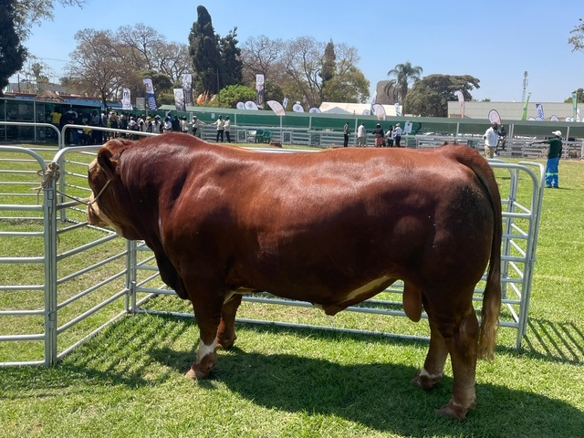







EXPECTATIONS FROM GOVERNMENT
Support Needed for Wider Adoption
  Access to planting material
  Farmer training programs
  Demonstration plots
  Support for silage technology
  Research on nutritional value

Slide 7

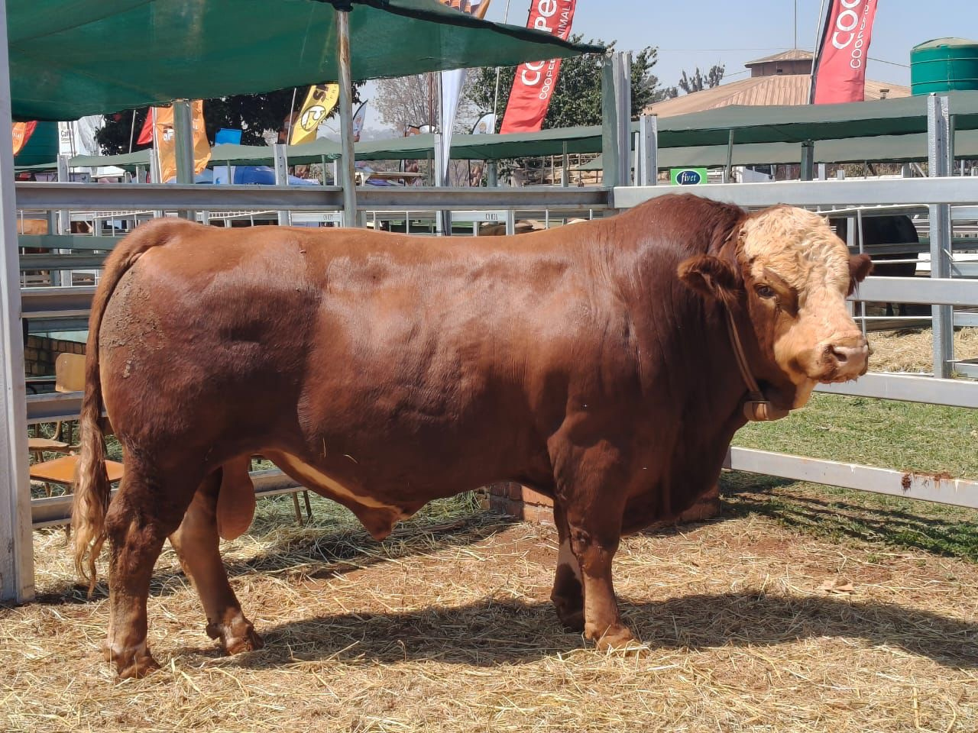
FUTURE PLANS
Future Plans at Biano Farm
  Expand Juncao production area
  Integrate into silage systems
  Demonstrate to other farmers
  Promote climate-smart livestock feeding
Sustainable fodder production is key to the future of Zimbabwe’s livestock industry.

Slide 8

THANK YOU

