Slide 1







Taking stock and building bridges: 2023 to 2027 GSDR Insights from the GSDR 2023 dissemination workshop in Delhi
Dr. Hannah Janetschek, GIZ

Slide 2
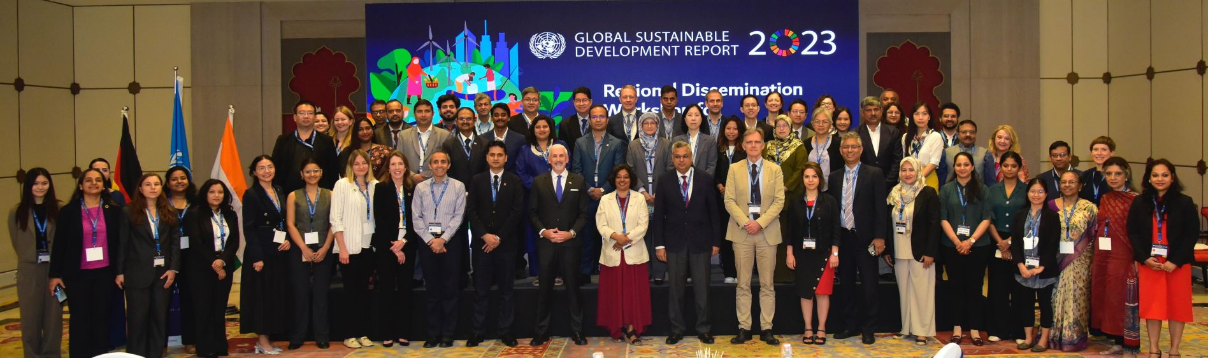
The Regional Dissemination Workshop in Delhi
Over 70 participants from 20 countries and UN organisations
3-day workshop with interactive working group sessions and field trip
Extensive peer learning and capacity sharing
Over 10 countries have presented their VNR in 2025

Slide 3
The Regional Dissemination Workshop in Delhi
Legal disclaimer:
Country borders or names do not necessarily reflect the GIZ official position. This map is for illustrative purposes and does not imply any opinion on the part of the GIZ, concerning the legal status of any country or territory or concerning the delimitation of frontiers or boundaries.

Slide 4
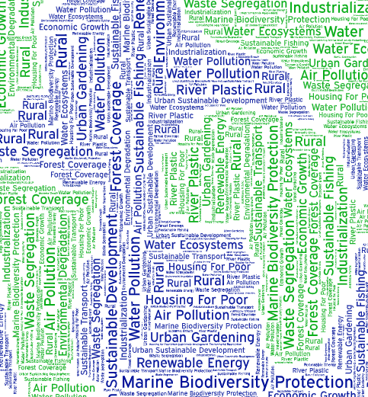
Key Themes
Photo byPixabay

Slide 5

Key aspects in the VNR process applied in the region
Multi-Stakeholder Engagement
Data Collection and Analysis
Drafting & Validation
Finalization and Submission to the UN
National Follow-Up and Implementation
Photo byPixabay

Slide 6

How to use the GSDR in VNRs
Emphasizing Interlinkages and Synergies – strengething policy coherence
Promoting Evidence-Based Decision Making
Fostering Multi-Stakeholder Engagement
Adapting Global Insights and Good Practices
Promoting Inclusivity and Adaptive Capacities
Leveraging Global Partnerships and Innovation
Photo by United Nations

Slide 7

Common Challenges in Producing VNRs
Data Challenges
Coordination Challenges
Engagement with Non-State Actors
Financial Constraints
Political Instability
Photo by Magda Ehlers

Slide 8

Remaining Questions for VNRs
What does it take and what does it mean to "align sectoral policies" for policy coherence?
How to deal with non-continuity in policy programs due to change of governments?
How do overcome bureaucratic obstacles /technocratic hierarchies for comprehensive and disaggregate data collection and analysis?
How to develop scenarios (forward looking) from integrated SDG reporting and identify key priorities of action (cost of action and cost of inaction)?
How to effectively coordinate between local and national level for integrated SDG delivery?
What to do, when a mediator role/institution to coordinate all ministries and all stakeholders for a VNR is not existent?
What role does AI and digitalization play for SDG delivery?
Photo by Magda Ehlers

Slide 9

Capacities and Tools Needed for National Action Plans
Capacity Building (institutional, technical, also for local governments and civil society)
Interdepartmental Coordination Mechanisms
Multi-Stakeholder Engagement
Technical Capacities (climate, policy, data, technology)
Sustainable Financing and Resource Mobilization
Advancing on Data, Monitoring, and Evaluation Systems
Integration Tools for SDG interdependencies
Scenario Planning and Futures Thinking
Local Level Engagement and link to national level
Photo by Nacho Juárez

Slide 10
Thank you! Dr. Hannah Janetschek
Head of Project: SDG-Review and Implementation, GIZ GmbH
Mobile: +49 152 5665 8432
Mail: hannah.janetschek@giz.de

