Slide 1
SDG Progress in Asia-Pacific
Dayyan Shayani
5 November 2025
Statistics Division

Slide 2

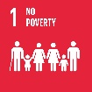




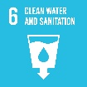











Asia-Pacific SDG Progress
TARGET 2030
2015
2024
No poverty
Zero Hunger
Good health and well-being
Quality education
Gender equality
Clean water and sanitation
Affordable and clean energy
Decent work and economic growth
Progress
Industry, innovation and infrastructure
Regression
Reduced inequalities
Insufficient indicators
Sustainable cities and communities
Evidence strength
Responsible consumption and production
Climate action
Life below water
Life on land
Peace, justice and strong institutions
Partnerships for the Goals

Slide 3
Asia-Pacific will miss 86% of the 117 measured targets by 2030
GOAL 1 No poverty
GOAL 5 Gender equality
GOAL 9 Industry, innovation and infrastructure
GOAL 13 Climate action
GOAL 17 Partnerships for the Goals
1.1 International poverty
1.2 National poverty
1.3 Social protection
1.4 Access to basic services
1.5 Resilience to disasters
1.a Resources for poverty programs
1.b Poverty eradication policies
5.b Technology for women empowerment
5.1 Discrimination against women and girls
5.5 Women in leadership
5.2 Violence against women and girls
5.3 Early marriage
5.4 Unpaid care and domestic work
5.6 Reproductive health access and rights
5.a Equal economic rights
5.c Gender equality policies
9.c Access to ICT and the Internet
9.1 Infrastructure development
9.2 Sustainable/inclusive industrialization
9.3 Small-scale industry access to finance
9.4 Sustainable and clean industries
9.5 Research and development
9.a Resilient infrastructure
9.b Domestic technology development
13.1 Resilience and adaptive capacity
13.2 Climate change policies
13.3 Climate change awareness
13.a UNFCCC commitments
13.b Climate change planning and management
17.3 Additional financial resources
17.1 Tax and other revenue collection
17.4 Debt sustainability
17.6 Science and tech international cooperation
17.7 Transfer of technologies
17.8 Capacity-building for ICT
17.9 Capacity-building for SDGs
17.10 Multilateral trading system (WTO)
17.11 Exports of developing countries
17.12 Duty-free market access for LDCs
17.17 Partnerships (public/private)
17.18 National statistics availability
17.19 Statistical capacity
17.2 ODA commitment by developing countries
17.5 Investment promotion for LDCs
17.13 Global macroeconomic stability
17.14 Policy coherence for SD
17.15 Respect each country’s policy space
17.16 Global partnership for SD
GOAL 14 Life below water
GOAL 2 Zero Hunger
14.1 Marine pollution
14.5 Conservation of coastal areas
14.6 Fisheries subsidies
14.b Small-scale artisanal fishing
14.7 Marine resources for SIDSs and LDCs
14.2 Marine and coastal ecosystems
14.3 Ocean acidification
14.4 Sustainable fishing
14.a Research capacity and marine technology
14.c Implementing UNCLOS
2.1 Undernourishment and food security
2.2 Malnutrition
2.4 Sustainable agriculture
2.5 Genetic resources for agriculture
2.a Investment in agriculture
2.3 Small-scale food producers
2.b Agricultural export subsidies
2.c Food price anomalies
GOAL 10 Reduced inequalities
GOAL 6 Clean water and sanitation
10.a Special and differential treatment (WTO)
10.2 Inclusion (socioeconomic, political)
10.4 Fiscal and social protection policies
10.b Resource flows for development
10.c Remittance costs
10.7 Safe migration and mobility
10.1 Income growth (bottom 40 per cent)
10.3 Eliminate discrimination
10.5 Regulation of financial markets
10.6 Inclusive global governance
6.1 Safe drinking water
6.2 Access to sanitation and hygiene
6.4 Water-use efficiency
6.5 Transboundary water cooperation
6.a International cooperation on WS
6.b Participatory WS management
6.6 Water-related ecosystems
6.3 Water quality
GOAL 3 Good health and well-being
GOAL 15 Life on land
3.1 Maternal mortality
3.2 Child mortality
3.3 Communicable diseases
3.4 NCDs and mental health
3.7 Sexual and reproductive health
3.9 Health impact of pollution
3.a Tobacco control
3.b R&D for health
3.c Health financing and workforce
3.d Management of health risks
3.5 Substance abuse
3.8 Universal health coverage
3.6 Road traffic accidents
15.a Resources for biodiversity and ecosystems
15.b Resources for forest management
15.1 Terrestrial and freshwater ecosystems
15.2 Sustainable forest management
15.4 Conservation of mountain ecosystems
15.8 Invasive alien species
15.5 Loss of biodiversity
15.3 Desertification and land degradation
15.6 Utilization of genetic resources
15.7 Protected species trafficking
15.9 Biodiversity in national and local planning
15.c Protected species trafficking (global)
GOAL 7 Affordable and clean energy
GOAL 11 Sustainable cities and communities
7.a International cooperation on energy
7.1 Access to energy services
7.3 Energy efficiency
7.b Investing in energy infrastructure
7.2 Share of renewable energy
11.1 Housing and basic services
11.6 Urban air quality/waste management
11.b Disaster risk management policies
11.5 Resilience to disasters
11.2 Public transport systems
11.3 Sustainable urbanization
11.4 Cultural and natural heritage
11.7 Urban green and public spaces
11.a Urban planning
11.c Sustainable and resilient buildings
MAINTAIN progress to achieve target
ACCELERATE progress to achieve target
REVERSE trend to achieve target
Progress CANNOT be assessed
GOAL 8 Decent work and economic growth
8.a Aid for trade
8.1 Per capita economic growth
8.2 Economic productivity and innovation
8.3 Formalization of SMEs
8.5 Full employment and decent work
8.6 Youth NEET
8.10 Access to financial services
8.4 Material resource efficiency
8.8 Labour rights/safe working environment
8.9 Sustainable tourism
8.b Strategy for youth employment
8.7 Child and forced labour
GOAL 12 Responsible consumption and production
GOAL 16 Peace, justice and strong institutions
GOAL 4 Quality education
16.1 Reduction violence and related deaths
16.6 Effective institutions
16.2 Human trafficking
16.3 Justice for all
16.5 Corruption and bribery
16.a Capacity to prevent violence
16.b Non-discriminatory laws
16.4 Illicit financial and arms flows
16.7 Inclusive decision-making
16.8 Inclusive global governance
16.9 Legal identity
16.10 Public access to information
4.1 Effective learning outcomes
4.2 Early childhood development
4.3 TVET and tertiary education
4.4 Skills for employment
4.5 Equal access to education
4.6 Adult literacy and numeracy
4.a Education facilities
4.b Scholarships
4.c Qualified teachers
4.7 Sustainable development education
12.6 Corporate sustainable practices
12.4 Managing chemicals and wastes
12.5 Reduction in waste generation
12.a Support for R&D capacity for SD
12.b Sustainable tourism monitoring
12.c Fossil-fuel subsidies
12.2 Sustainable use of natural resources
12.1 Programmes on SCP
12.3 Food waste and losses
12.7 Public procurement practices
12.8 Sustainable development awareness
Notes:
When we assess progress at the target level, we again see a mixed picture.
Now, I know you may not be able to read all the details on this slide, but the colors tell the story clearly.
There are 117 targets where we have enough data to measure progress—these are shown in red, amber, and green.
Let’s start with the good news: 16 of these targets—just a small fraction—are on track to meet the 2030 deadline. Those are shown in green.
But the rest of the picture is far more concerning. The amber targets indicate we are off track, and the red ones show we are actually moving in the wrong direction.
Of the 117 targets we can measure, 86% are set to be missed by 2030.
Even more alarming, 18 targets are in red, meaning they are not progressing at all.
And then, we have the grey—one-third of all targets—where we simply don’t have enough data to assess progress.

Slide 4
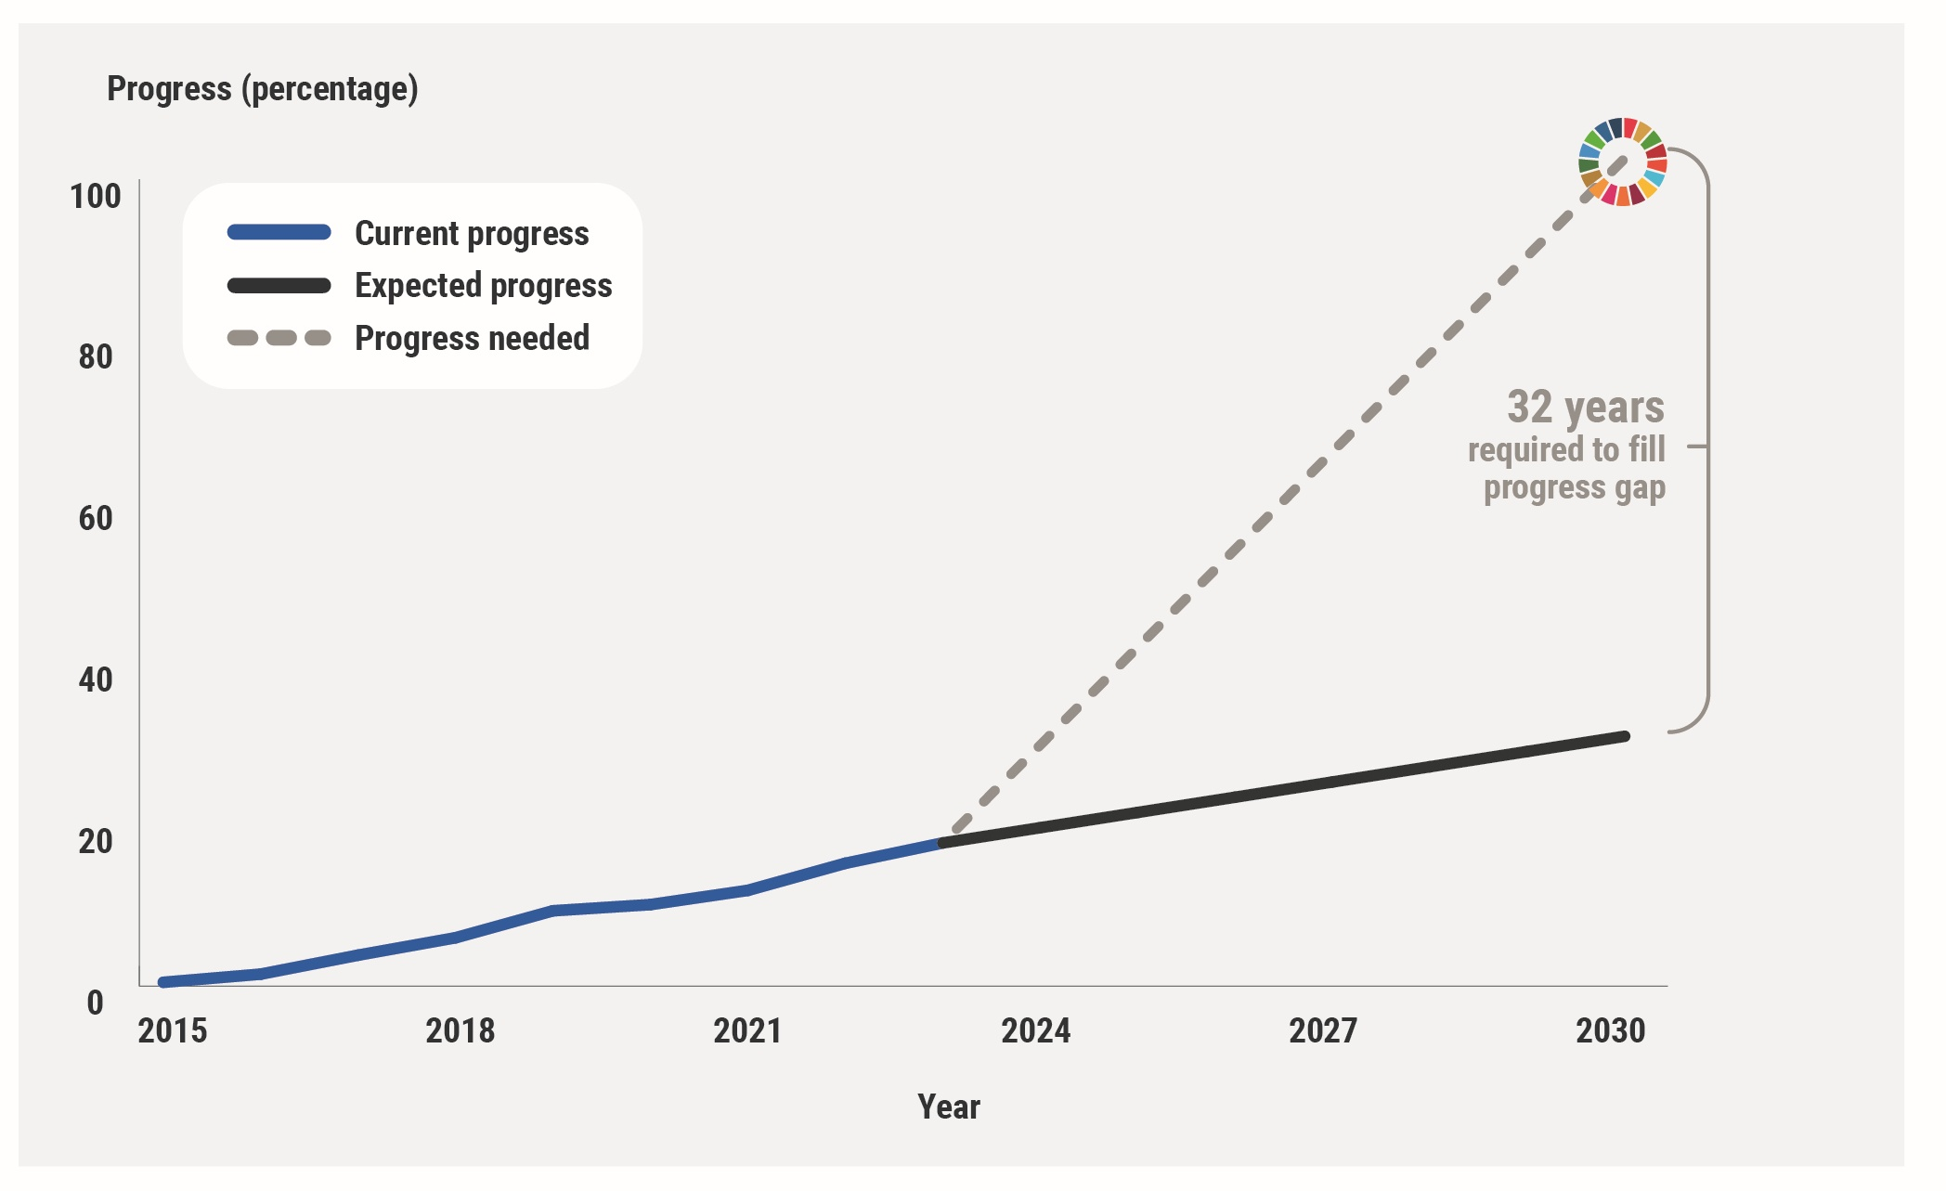

32 additional years to achieve the SDGs

Slide 5
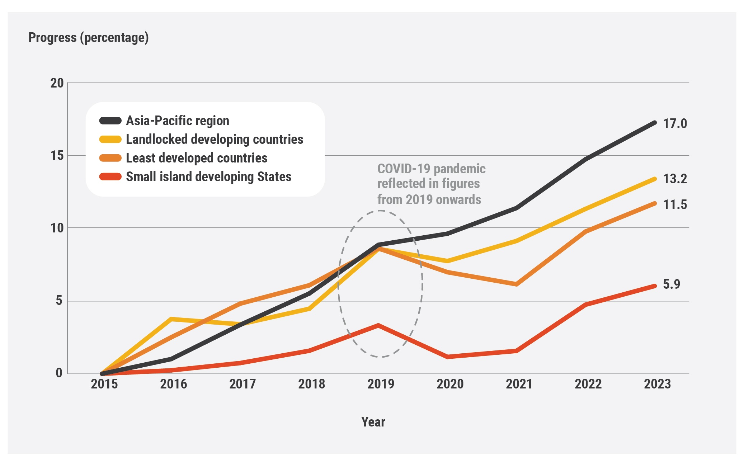
SIDS progress on the SDGs erased by the pandemic

Slide 6
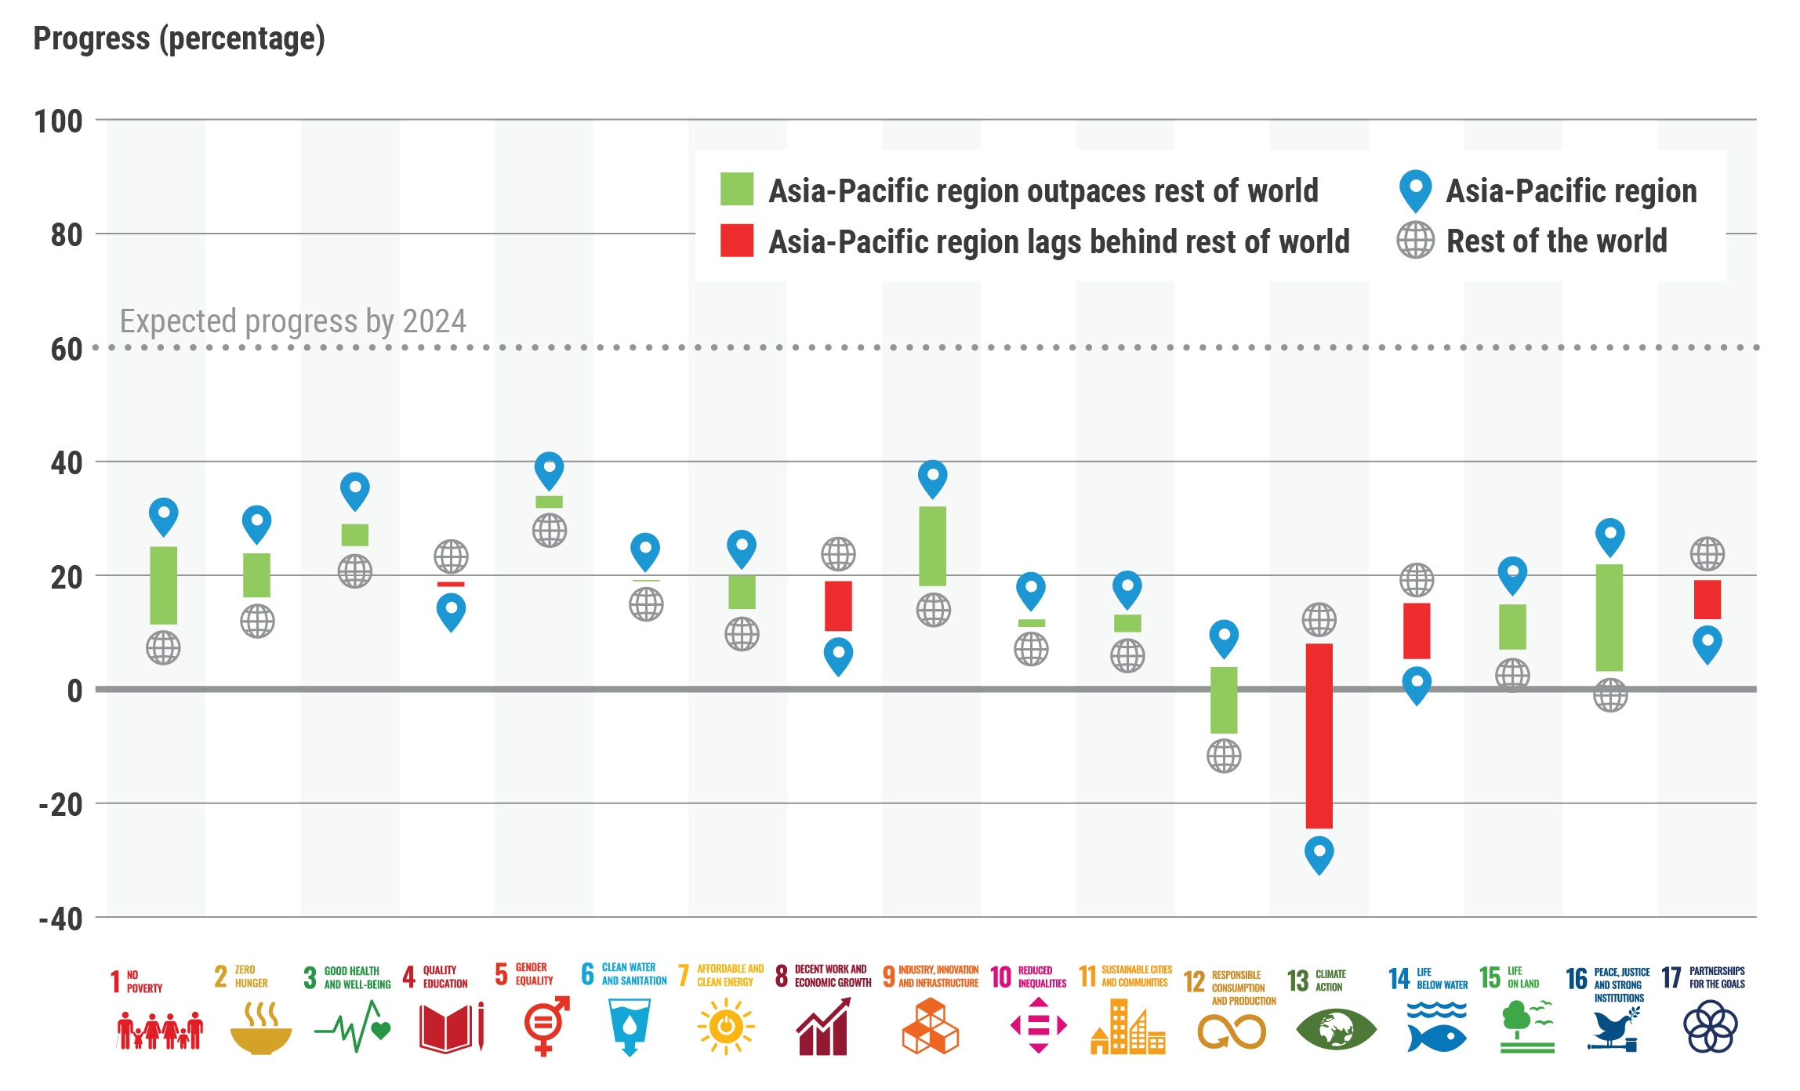
Asia-Pacific and the World Compared
Notes:
This year, we have taken a closer look at how the Asia-Pacific region is progressing on the 17 SDGs compared to the rest of the world using the same set of indicators and target values.
The results are mixed.
On the majority of the goals, our region is outperforming the rest of the world —those are the ones you see highlighted in green.
This is encouraging and shows that progress is being made.
However, there are four goals where our region is significantly behind the rest of the world —and these are the ones highlighted in red.
They are decent work and economic growth (Goal 8), climate action (Goal 13), life below water (Goal 14), and partnerships for the goals (Goal 17).

Slide 7
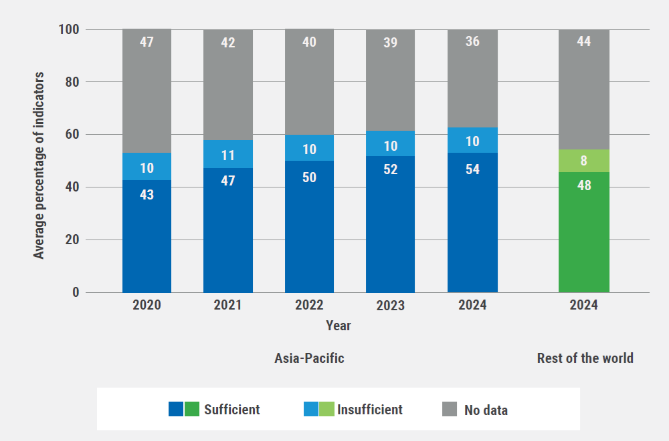
Only 54% of the indicators have two or more data points
Notes:
Right now, 54% of the indicators have two or more data points—a slight improvement from last year.
While this is progress, it’s still not enough to track trends effectively and make informed decisions.
That said, our region is doing better than the global average, which stands at 48%.

Slide 8
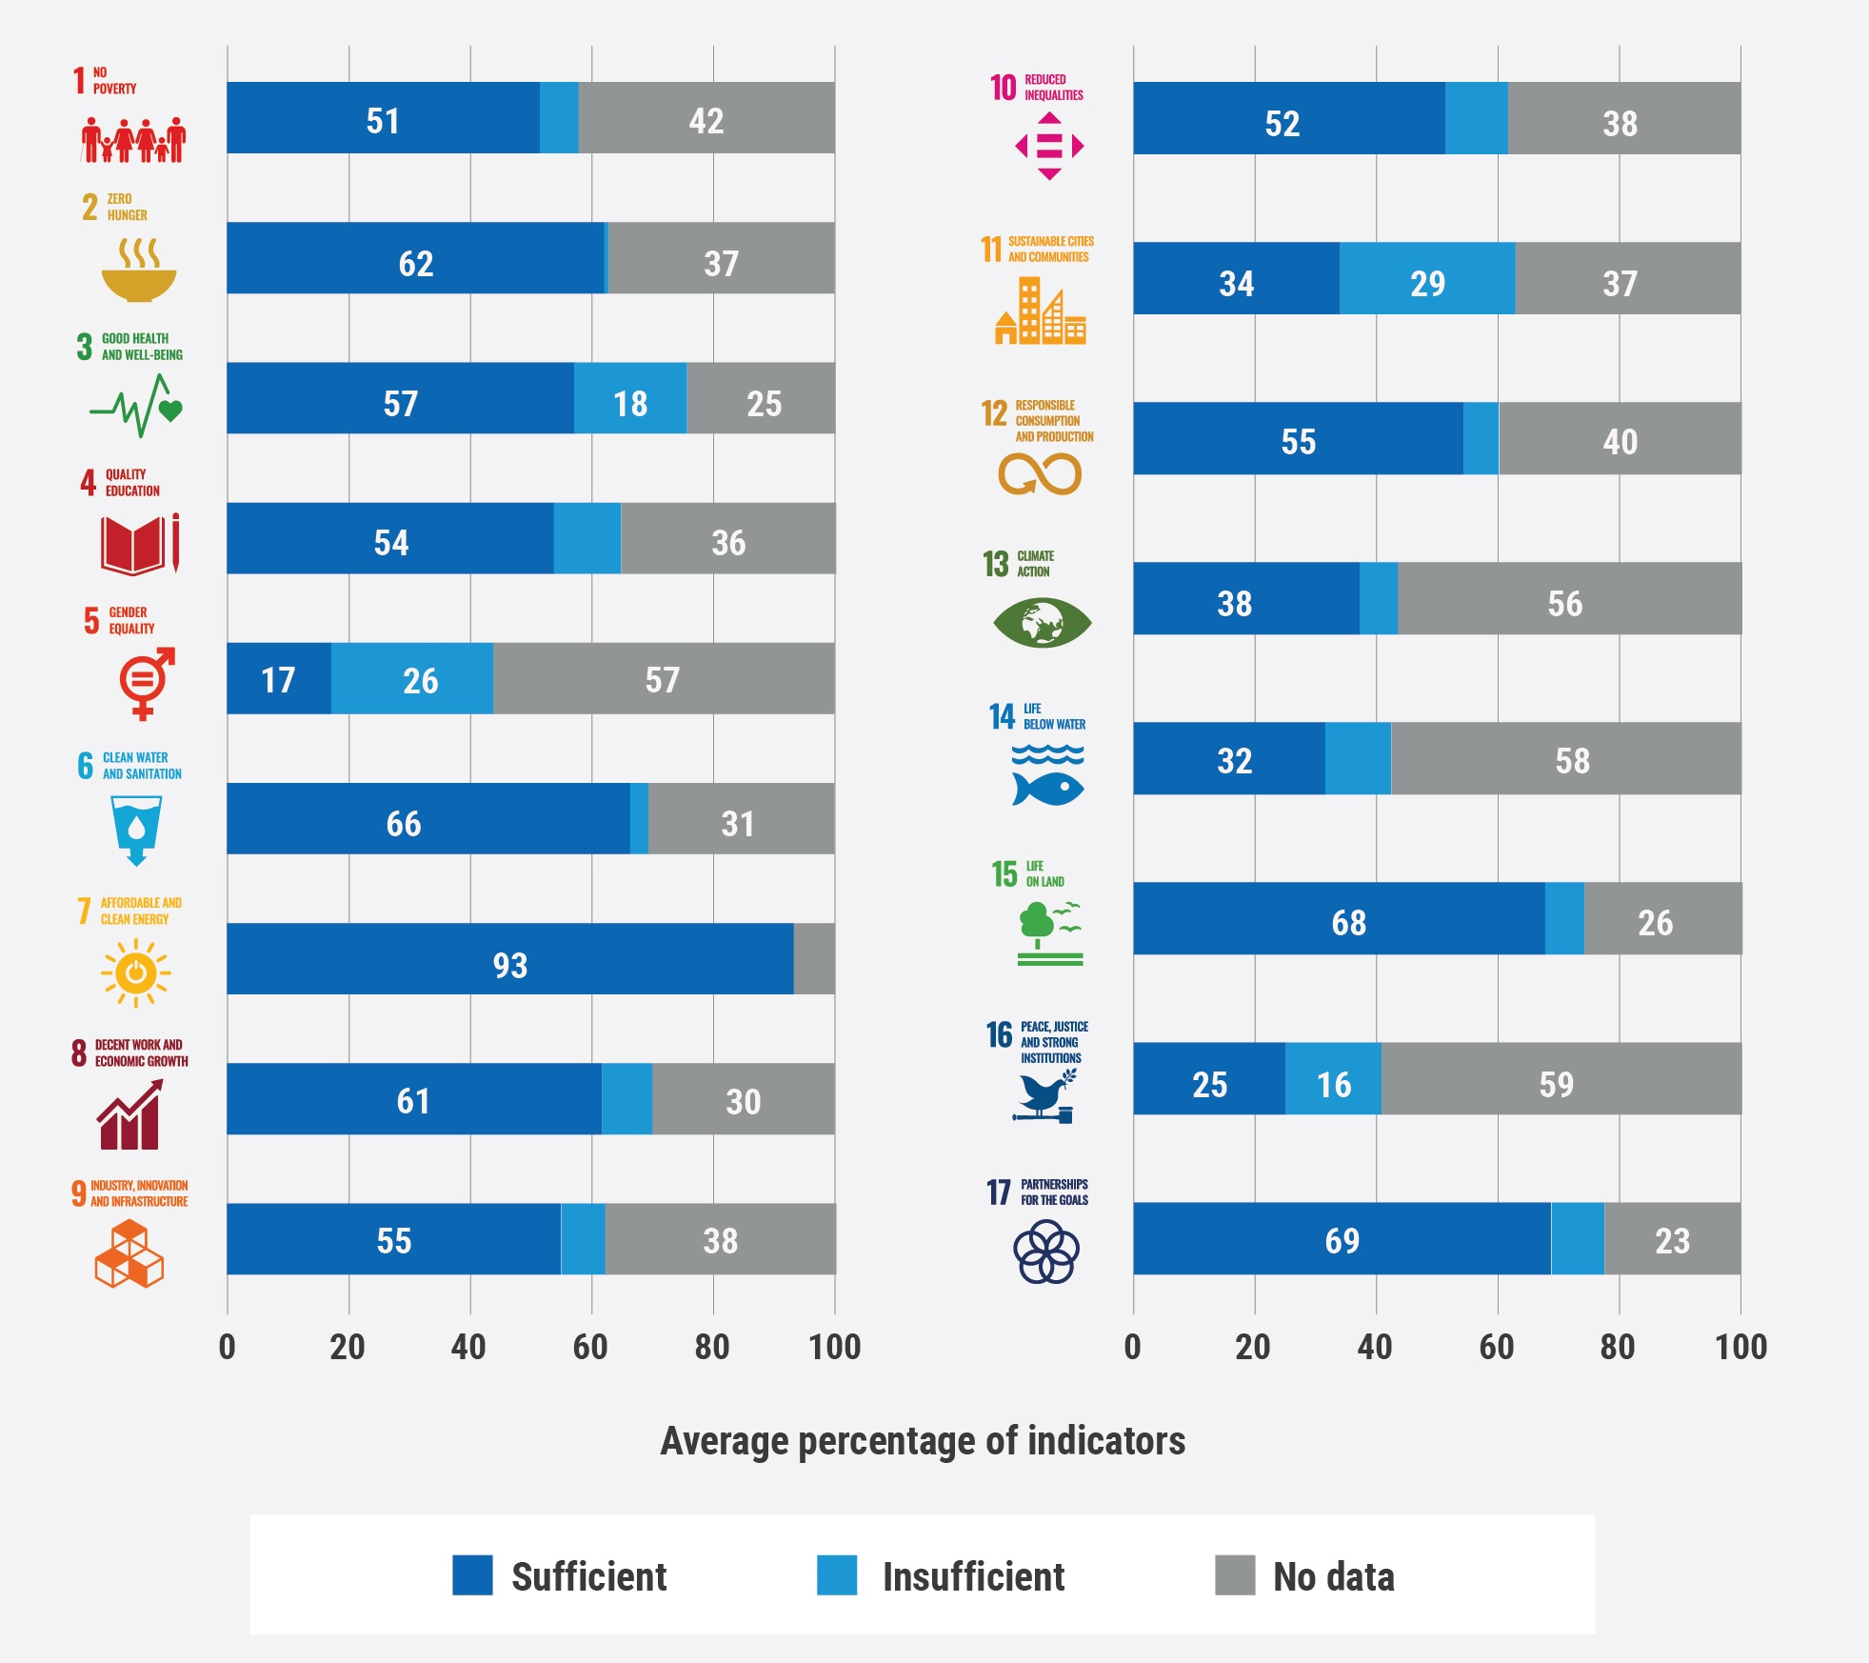
Gender equality (Goal 5) and peace, justice and strong institutions (Goal 16) continued to have the least available data.
Notes:
When we take a closer look at where the most significant data gaps exist, some key trends emerge.
The Asia-Pacific region faces a major data shortfall in two critical areas: Goal 5—Gender Equality and Goal 16—Peace, Justice, and Strong Institutions.
These gaps make it harder to measure progress and drive meaningful change in these essential areas.
In addition, data availability remains particularly low for Goal 14—Life Below Water, Goal 13—Climate Action, and Goal 11—Sustainable Cities and Communities.
These are all crucial for sustainable development, yet we lack the data needed to fully understand and tackle these challenges.
Compared to other goals, data availability is higher for Goal 7—Clean Energy, Goal 17—Partnerships for the Goals, and Goal 15—Life on Land. This gives us a stronger foundation to build on as we work towards achieving these targets.

Slide 9
Monitoring the SDGs: overcoming challenges
Integrated national SDG indicator frameworks
SDG data roadmaps
Tracking national and provincial progress

Slide 10
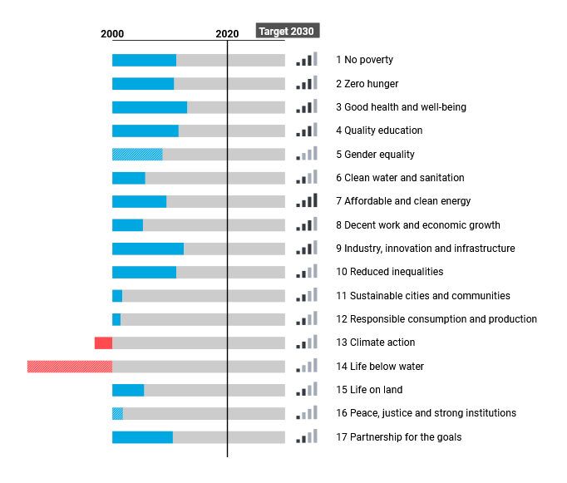


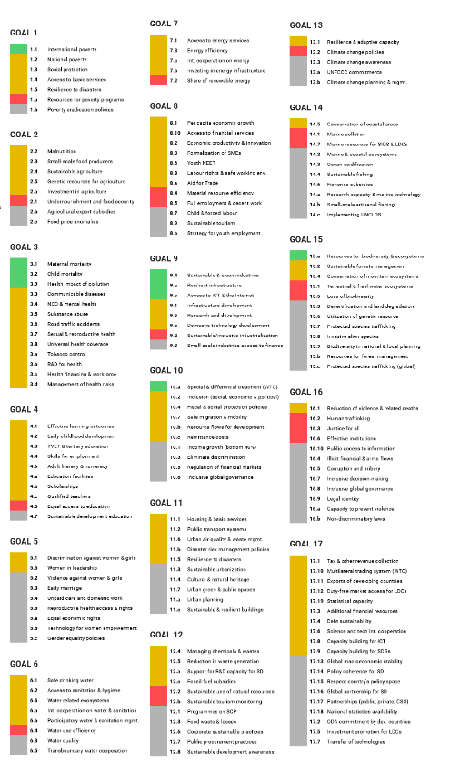

Tracking national and provincial progress
National indicators, data, and target values

Slide 11
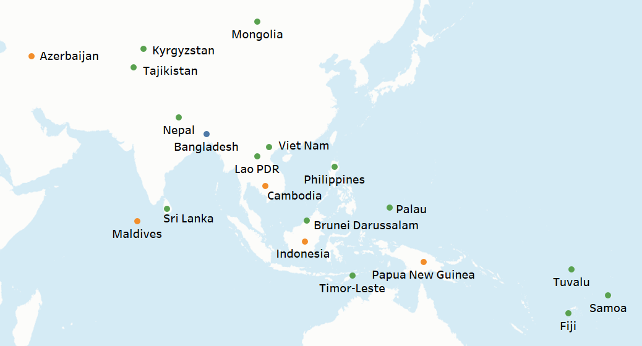


Tracking national and provincial progress

Slide 12
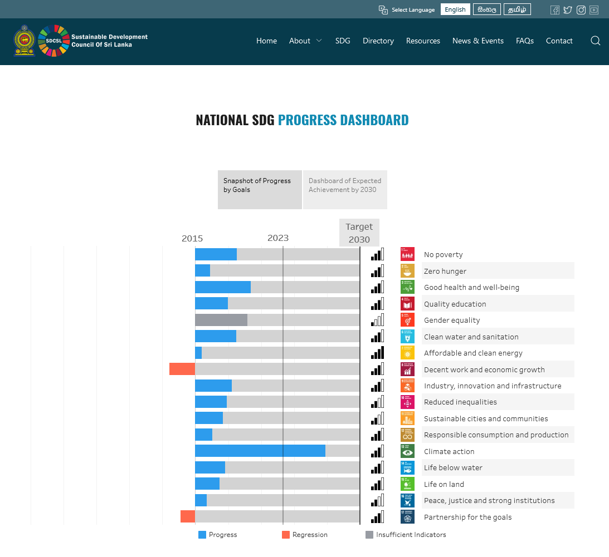
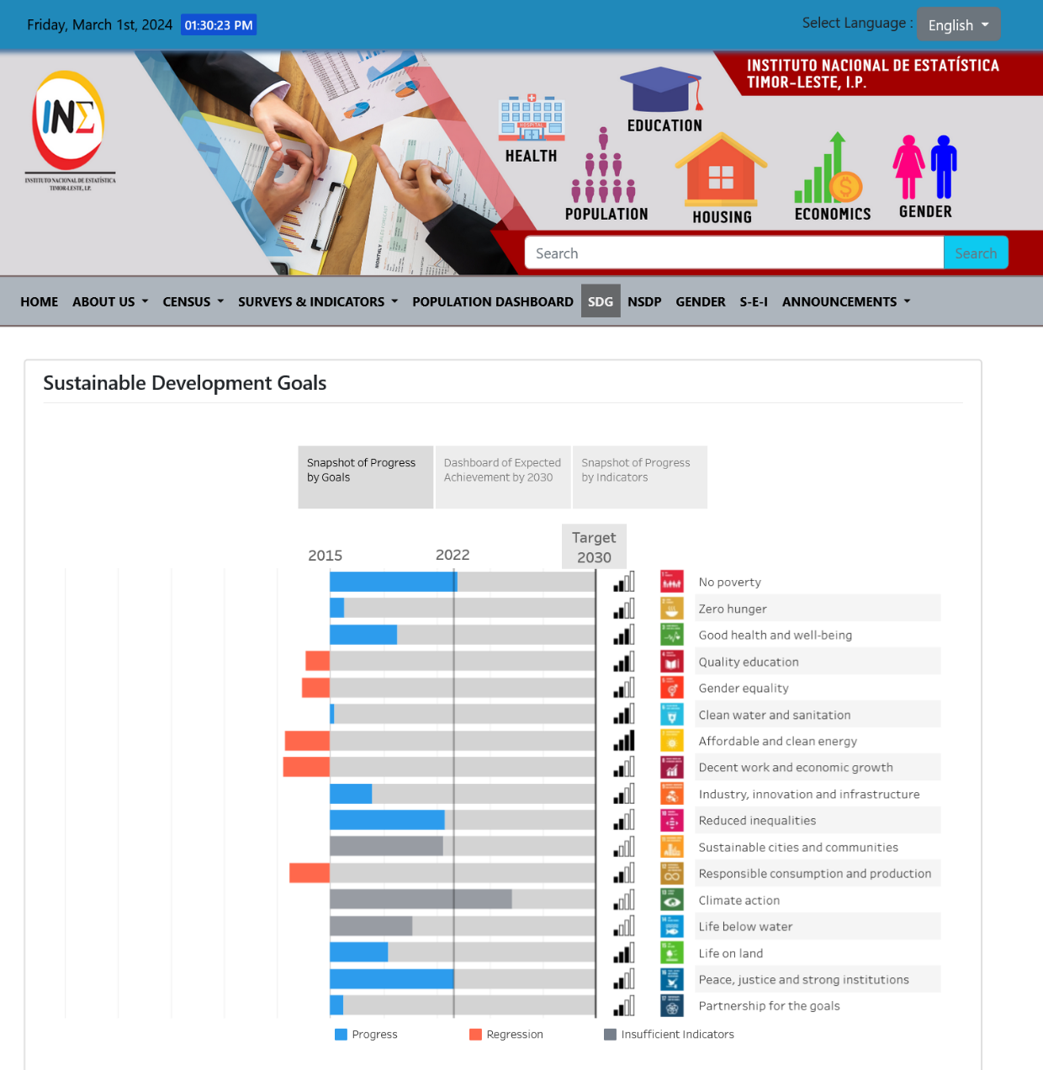
Tracking national and provincial progress
Sri Lanka
https://sdc.gov.lk/en/sdg-lka-23
Timor-Leste
https://inetl-ip.gov.tl/sdg/

Slide 13
Integrated national SDG indicator frameworks
National Development Plan
SDGs
Sector/Local Plans

Slide 14
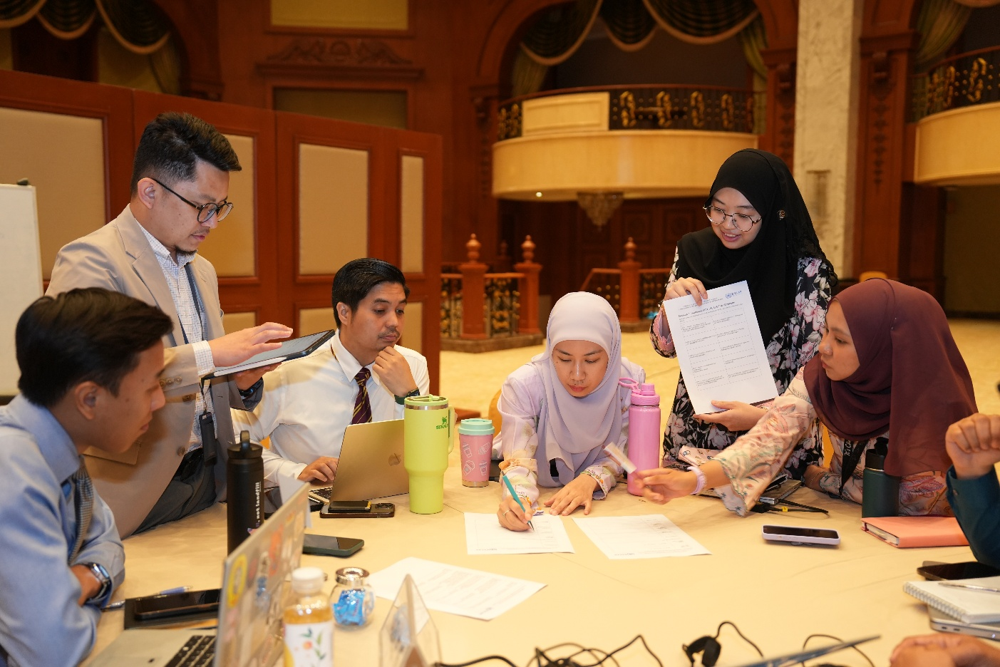
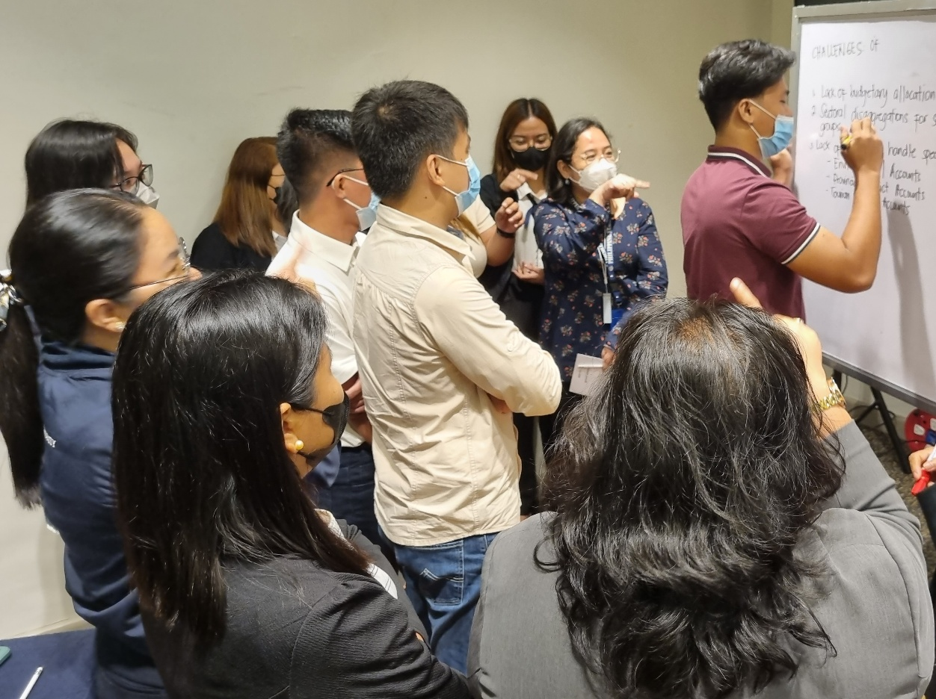
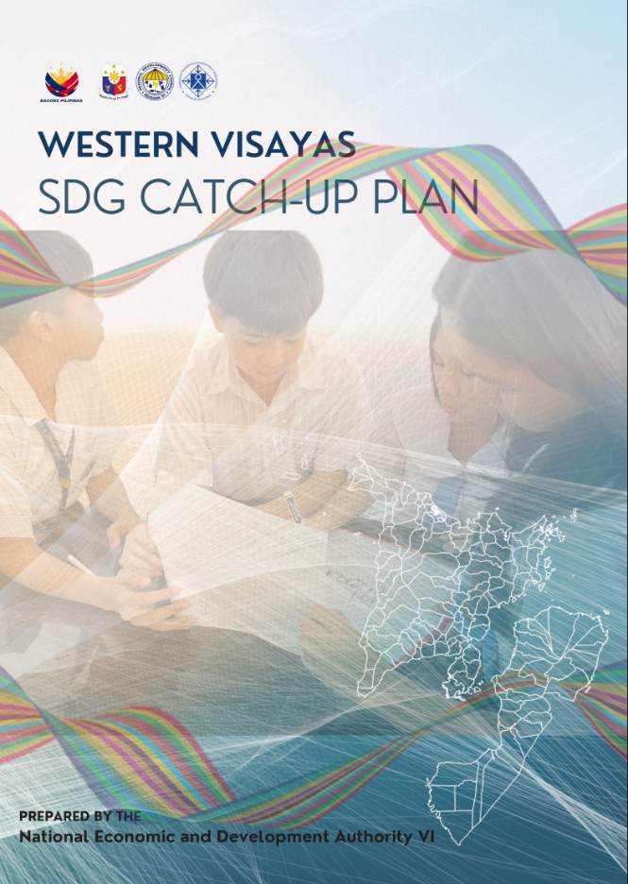
Integrated national SDG indicator frameworks
Brunei Darussalam
Integrated SDG Action Plans on priority areas identified by SDG tracking
Philippines
SDG Catch-up Plans for regions, based on evidence and integrated planning

Slide 15
SDG data roadmaps
National Statistical System
National Statistical Office (NSO)
Data producer
Data producer
Data producer
Data producer
SDG data coordination mechanism (working group)
Identify data gaps and plan actions with international agencies and stakeholders
Platforms for SDG data exchange, dissemination, and analysis

