Slide 1

2025 Capacity Building Workshop in Beijing and SIDS Tailored Support Plans
WANG Lei
International Research Center of Big Data for Sustainable Development Goals
CAST-UN Consultative Committee on Disaster Reduction

Slide 2

Outlines
Background
2025 Capacity Building Workshop in Beijing and
SIDS Tailored Support Plans

Slide 3
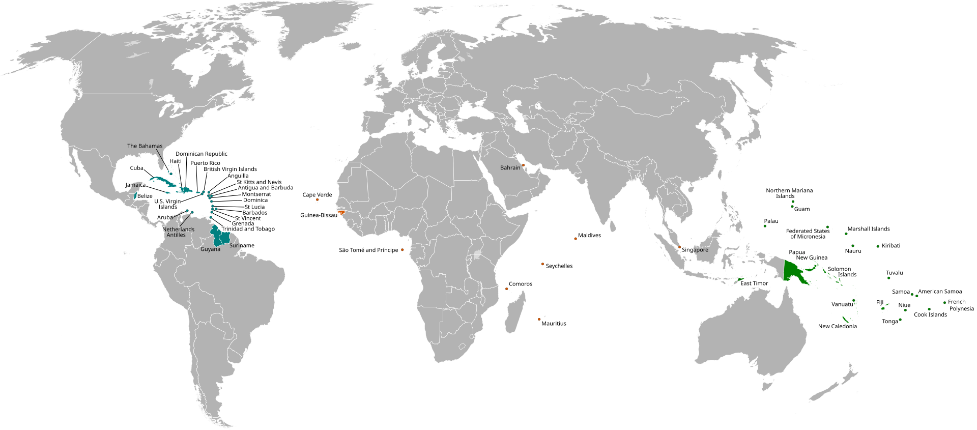
Small Islands Developing Countries (SIDS)
SIDS have limited resources and fragile ecosystems, making them
the most vulnerable to the impacts of climate change
39 sovereign states
18 dependent territories

Slide 4
UN Programmes of Action in Support of SIDS
A. Build Economic Resilience
B. Scale-up climate action and support, including climate finance, in line with existing commitments and obligations under UNFCCC and the Paris Agreement Agreed ad ref
C. Scale-up biodiversity action
D. Conserve and sustainably use the ocean and its resources
E. Mainstream disaster risk reduction
F. Safe and healthy societies
G. Data collection, analysis and use
H. Science, technology, innovation and digitalization
I. Productive populations Agreed ad ref
1994: Barbados Programme of Action
2005: Mauritius Strategy
2014: SAMOA Pathway
2024: Antigua and Barbuda Agenda for SIDS (ABAS): A Renewed Declaration for Resilient Prosperity

Slide 5

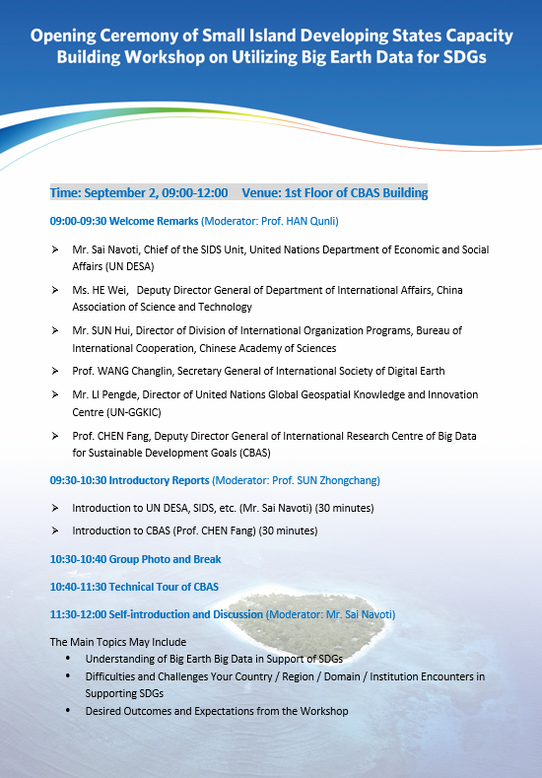
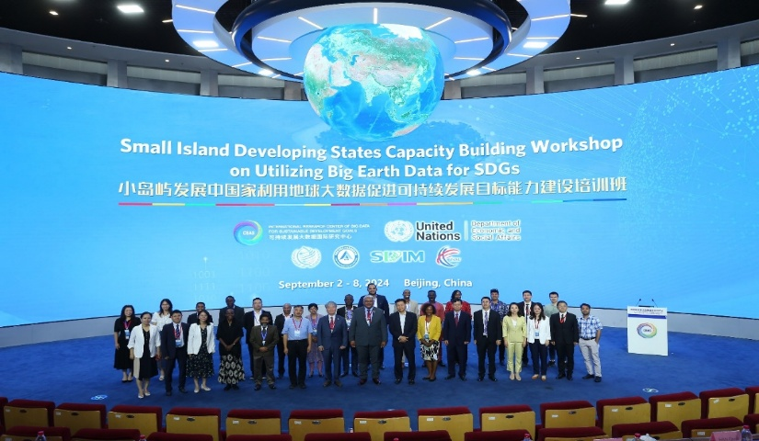
Capacity Building Workshop for SIDS 2024
Co-organized UN DESA and CBAS on Using Big Earth Data Technologies for SDGs, Participants from 10 SIDS countries joined the workshop

Slide 6
Capacity Building Workshop for SIDS 2025
22 participants from 11 SIDS and 3 UN Staff will join the workshop 2025
Region | 2024 List Countries (10 ) | 2025 List Countries (11)
Africa | Cape Verde, Guinea-Bissau, São Tomé and Príncipe, Mauritius | Cape Verde, Guinea-Bissau, Seychelles, Mauritius
Caribbean | Dominican Republic, Jamaica | Bahamas, Dominican Republic, Jamaica, Suriname
Indian Ocean | Maldives, Mauritius | Seychelles, Maldives, Mauritius
Pacific | Papua New Guinea, Kiribati | Papua New Guinea, Fiji
Southeast Asia | Timor-Leste | -

Slide 7
Capacity Building Workshop for SIDS 2025 at glance
Time | Events
Aug. 31 | Registration
Sep. 1 am | Opening Ceremony Technical Tour of CBAS
Sep. 1 pm -Sep. 5 | Capacity building courses -Session 1: Navigating SDGs with Big Earth Data: A Comprehensive Overview -Session 2: From Satellites to Sustainability: Land-Cover Dynamics and Disaster Risk Reduction -Session 3: Big Earth Data: Driving Urban, Marine, and Global Sustainable
Sep. 6 -Sep. 8 | The 5th International Forum on Big Data for Sustainable Development Goals 6 special sessions and 40+ Parallel sessions Closing Ceremony of Capacity Building Workshop
Sep. 9 | Filed tour

Slide 8
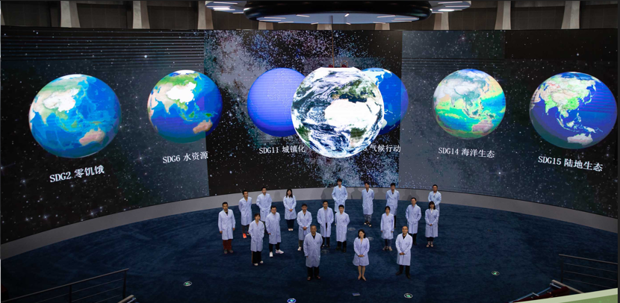



Technical Tour of CBAS

Slide 9
Courses of Capacity Building Workshop
Session 1: Navigating SDGs with Big Earth Data: A Comprehensive Overview
  Big Earth Data in Facilitating Sustainable Development Goals
  Global SDG Products and Applications Based on Big Earth Data
Session 2: From Satellites to Sustainability: Land-Cover Dynamics and Disaster Risk Reduction
  GLC_FCS30D: The First Global 30m Land-Cover Dynamics Monitoring Product with A Fine Classification System for the Period from 1985 to 2022
  SDGSAT-1 Satellite Data and Open Science Program
  Mainstreaming DRR for Development Safety: New Global Research Framework for Actions
  Big Earth Data for Disaster Risk Reduction

Slide 10
Courses of Capacity Building Workshop
Session 3: Big Earth Data: Driving Urban, Marine, and Global Sustainable
  Big Earth Data in Support of the Urban Sustainable Development
  Storm Surge Simulation & SDGs Comprehensive Evaluation and Forecast
  Marine Big Data Mining and Digital Twin Supporting Marine SDGs
  Land Degradation Neutrality Products and Capacity building with Big Earth Data
  AI Powered Big Earth Data Processing and Mining on SDG Cloud Platform
  Big Earth Data Analysis and Decision Support System for Belt and Road Areas
Offline meeting + online livestream
Recordings will be shared on DESA website

Slide 11























The 5th International Forum on Big Data for Sustainable Development Goals (FBAS 2025)
Digital Intelligence Driving Sustainable Development: The 10th anniversary of the 2030 Agenda
September 6-8, 2025
Beijing, China
Theme
Participants
3000+
Institutions
500+
Countries
80+
Topics
International Forum on Big Data for Sustainable Development Goals has been successfully held for four sessions from 2021 to 2024. It brings together more than 3,000 experts and scholars from more than 80 countries and 500 domestic and foreign institutions. The 5th International Forum on Big Data for Sustainable Development Goals will be held in Beijing from September 6th to 8th, 2025.
Host
Chinese Academy of Sciences
Big Data Technology Serving Global Sustainable Development
Organizers
International Research Center of Big Data for Sustainable Development Goals
AI Empowering Sustainable development
Aerospace Information Research Institute, Chinese Academy of Sciences
Abstract Extended Deadline: July 20
Policy and Digital Intelligence Industry Promoting Regional Sustainable Development
Keynote Speakers
(Alphabetical order by last name)
Development of Global Partnership Facilitating the Implementation of SDGs
Youth Innovation: Sharing for the Future
Quarraisha Abdool Karim
President of the World Academy of Sciences
Johannes Cullmann
Scientific Advisor to the 77th President of the UN General Assembly
GUO Huadong
Director General of the International Research Center of Big Data for Sustainable Development Goals
Ameenah Gurib-Fakim
Former President of the Republic of Mauritius
Csaba Kőrösi
77th President of the UN
General Assembly
Ibrahim Thiaw
Under-Secretary-General and Executive Secretary of the UNCCD
Danilo Türk
Former President of the Republic of Slovenia
WANG Jian
Director of Zhejiang Laboratory, Founder of Alibaba Cloud
For more information, please visit official website:
https://www.fbas.org.cn/fbas2025/web/index/index.html
Supporting organizations
International Partners

Slide 12
Some related sessions of FBAS 2025
S1: Accelerating the SDGs with Digital Technologies for All
(Digital SDG Programme)
S4: Big Earth Data Facilitating SDGs for African and SIDS Countries:
Challenges and Opportunities
S5: International Collaboration on Water and Disasters:
Research, Education and Pathways to Sustainable Development
B4: Data and AI for Disaster Risk Reduction
B11: AI for Eary Warning Environment
C1: Big Earth Data and Al for Disaster Risk Reduction in B& R Region
C3: Big Data for the Global South: Solutions for Sustainable Development
E4: Youth Session: Climate and Disasters

Slide 13

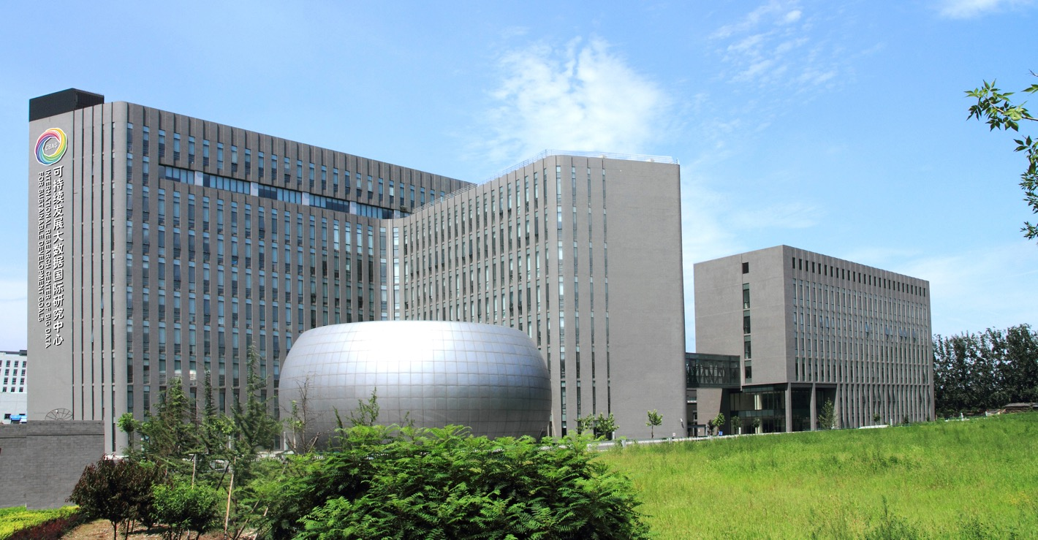
Thank you!
Save the date:
September 1-9, 2025
Join us at the Capacity Building
Workshop
for SIDS 2025
in Beijing

