Slide 1
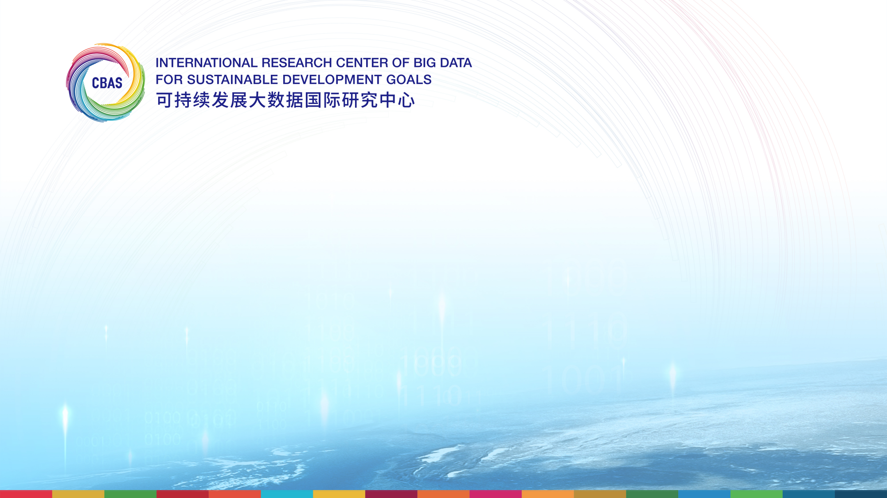
Overview:
“Workshop on Building Capacity and Exploring
Resources for Implementing STI4SDG Roadmaps”
Addis Ababa. October 8 – 9, 2024
Gretchen Kalonji
Special Advisor and Professor, International Research Center of
Big Data for Sustainable Development Goals (CBAS)
UNDESA – CBAS SIDS Knowledge-sharing and Briefing Event
July 18, 2025

Slide 2
Organizers and Participants:
Organized by UN Department of Economic and Social Affairs (DESA)/ Division for Sustainable Development Goals (DSDG), in collaboration with UN Economic Commission for Africa (ECA). Substantial institutional support from UNESCO, Future Africa, European Commission – Joint Research Center (EC/JRC), International Science Council (ISC), Africa-Europe Science and Innovation Collaboration Platform (AERAP), and the International Research Center of Big Data for Sustainable Development Goals (CBAS).
Participants included more than 70 representatives from government, the scientific and engineering communities, the donor community, private sector, academia, and other international and UN entities.
Outcomes of the Workshop and Salient Features:
Outcomes included: Contributions to the ongoing development of the global Guidebook for STI4SDGs Roadmaps, and specific recommendations on capacity building, regional and international collaboration, strategic STI investment planning, strengthening institutional frameworks for STI ecosystems, developing capacity in big earth data and AI to support SDG monitoring and policy making, etc.
Salient features included: Bringing together the science and engineering communities, through active participation of both the ISC and the World Federation of Engineering Organizations (WFEO); highly illuminating contributions on national case studies from Ethiopia, Kenya and Ghana; a focus on closing the existing funding gaps and ensuring equitable access to STI resources globally, and; a focus on universities and university systems as critical components in transformation of STI ecosystems.

Slide 3
Pathways for moving forward on partnerships with SIDS on STI for Sustainable Development: Potential contributions of CBAS, together with UN DESA and other partners
Scaling-up the scope and impact of existing short-term CBAS training programs on big data and AI for sustainable development.
Working with universities and university systems in SIDS on incorporating such topics in the curriculum, across the disciplines. It would be exciting to work with innovative multi-campus university systems in SIDS, such as the University of the South Pacific, and the University of the West Indies. Lessons from their experience could have significant benefit for higher education worldwide.
Building on CBAS’s extensive networks of International Centers of Excellence, such as the newest, in Cibinong, Indonesia on coastal monitoring and resilience, and on the international working groups of CBAS
Working with governmental agencies in SIDS on programs to make CBAS open data and platforms more widely used in monitoring SDG progress and in concrete policy decisions.
Collaborating through existing large-scale initiatives, such as the UN International Decade of Science for Sustainable Development, efforts of the International Science Council, efforts of the World Federation of Engineering Organizations (WFEO), such as their strategic initiative on Engineering Capacity Building in Africa (https://www.wfeo.org/report-on-the-launching-of-the-engineering-capacity-building-for-africa-programme/), and UNESCO’s extensive SIDS-related efforts, including “IslandWatch” and the “SIDS Acceleration Program”, with its 6 pillars of climate environment action, oceans and blue economy, culture, DRR, digital technologies for education, and inclusive societies .

Slide 4


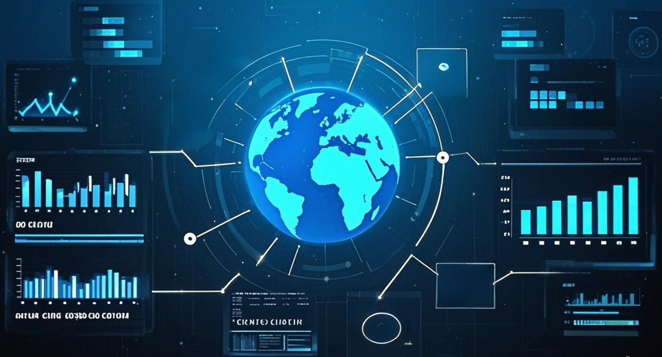


The new 10-year program of CBAS: the DSP
Initiating the DSP to Bridge the Gaps in “Data-Knowledge-Governance”
Data Deficiencies
Knowledge-Capacity Gap
Barriers to Governance
Digital Sustainable Development Goals Programme (DSP)
SDG Satellite Constellation
SDG Big Data Platform
SDG AI Model
SDG Multi-disciplinary Research
SDG Data and Report Standardization

