Slide 1


CAPACITY DEVELOPMENT FOR STRATEGIC FORESIGHT
Adriana Alberti, Chief, Programme Management and Capacity Development Unit, Division for Public Institutions and Digital Government (DPIDG), UN DESA
Azeema Adam, Senior Inter-Regional Advisor on Strategic Foresight and Systems Thinking, DPIDG, UN DESA

Slide 2
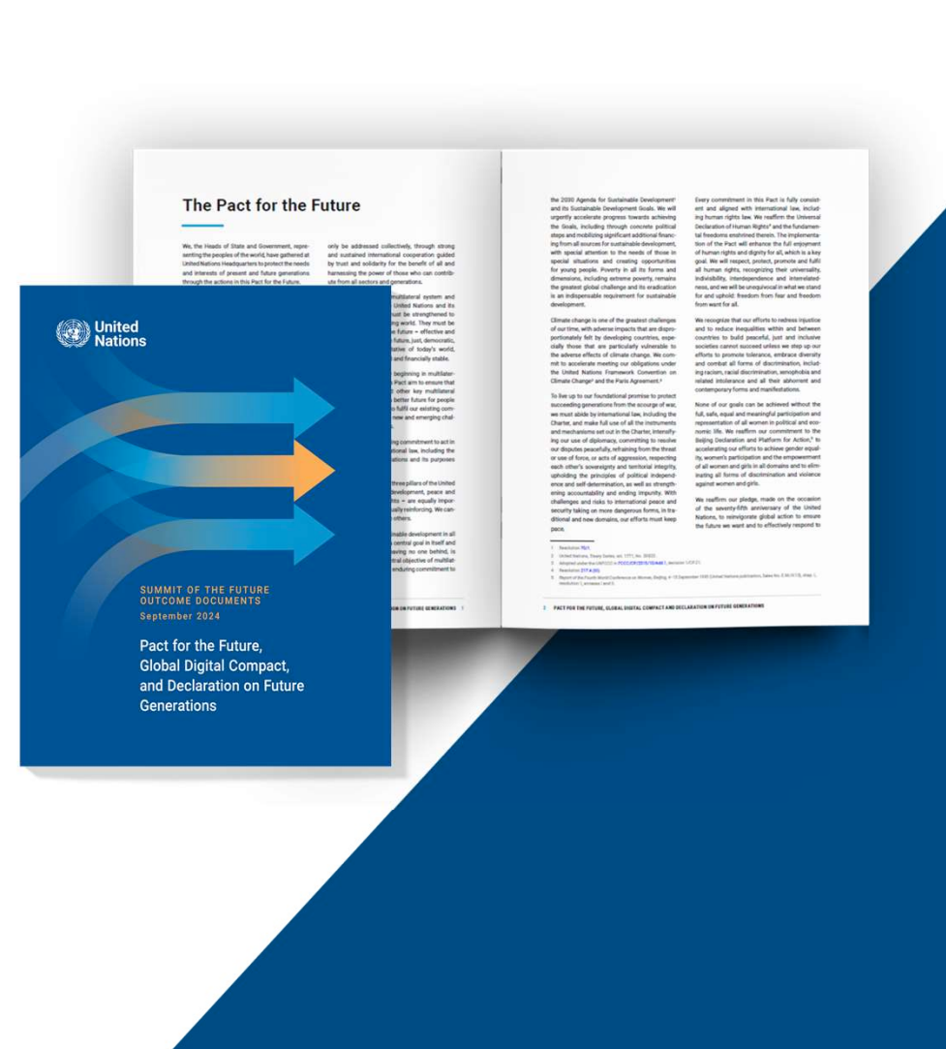
Pact for the Future
ACTION 24
The Pact calls for “leveraging science, data, statistics, and strategic foresight to ensure long-term thinking and planning, and to develop and implement sustainable practices and the institutional reforms necessary for evidence-based decision-making, while making governance more anticipatory, adaptive, and responsive to future opportunities, risks, and challenges”.
Notes:
The Pact calls for “leveraging science, data, statistics, and strategic foresight to ensure long-term thinking and planning, and to develop and implement sustainable practices and the institutional reforms necessary for evidence-based decision-making, while making governance more anticipatory, adaptive, and responsive to future opportunities, risks, and challenges” (para. 24).

Slide 3

Pact for the Future
ACTION 27
Emphasizes “investing in capacity to better prepare for and respond to future global shocks, crises, and challenges, and using evidence-based planning and foresight to avoid and mitigate risks, ensuring that the poorest and most vulnerable do not bear disproportionate costs and burdens of mitigation, adaptation, restoration, and resilience-building”.
ACTION 29
It calls for “enhancing cooperation with stakeholders, including civil society, academia, the scientific and technological community, and the private sector, and encouraging intergenerational partnerships by promoting a whole-of-society approach to share best practices and develop innovative, long-term, and forward-thinking ideas to safeguard the needs and interests of future generations”.
Notes:
It highlights the need for anticipatory governance, where decision-makers utilize foresight methodologies to predict and prepare for future challenges and opportunities. The Pact also emphasizes “investing in capacity to better prepare for and respond to future global shocks, crises, and challenges, and using evidence-based planning and foresight to avoid and mitigate risks, ensuring that the poorest and most vulnerable do not bear disproportionate costs and burdens of mitigation, adaptation, restoration, and resilience-building” (para. 27).
Furthermore, it calls for “enhancing cooperation with stakeholders, including civil society, academia, the scientific and technological community, and the private sector, and encouraging intergenerational partnerships by promoting a whole-of-society approach to share best practices and develop innovative, long-term, and forward-thinking ideas to safeguard the needs and interests of future generations” (para. 29).

Slide 4
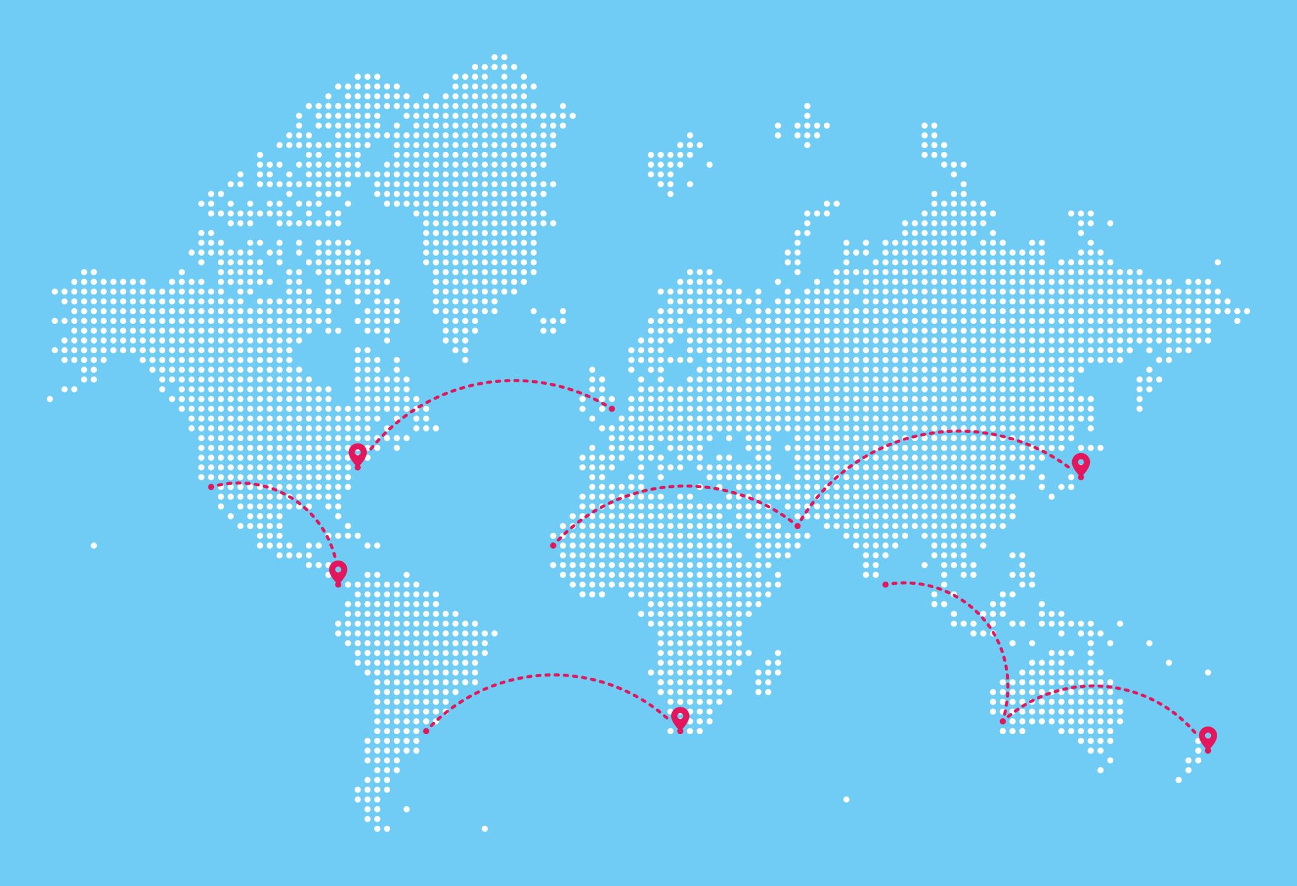
The Need for New Approaches in Governance
Systems Thinking Analyze complex systems, understand how factors interact, identify leverage points for effective interventions
Strategic Foresight Structured methodology for anticipating future challenges using tools like scenario planning and horizon scanning
Together, they enable anticipatory, future-ready governance
Consider your recent projects: How often have isolated interventions struggled to create lasting change?
🌍 We live in a Volatile Uncertain Complex Ambiguous world
Modern challenges require change in our approach
  Climate Risks
  Economic Shifts
  Digital Transformation
Why?
  Issues are interconnected—climate change disrupts economies, undermining social stability.
  Siloed decision-making limits institutional coherence and long-term impact.
Governance must shift from reactive crisis response to anticipatory, systems-informed policy

Slide 5
Big Earth Data & Strategic Foresight —
A Complementary Approach for SIDS
🌍 Why They Work Better Together
  Big Earth Data tracks what is happening now (e.g., sea-level rise, deforestation, erosion)
  Strategic Foresight explores what could happen next (e.g., scenarios, risks, opportunities)
  Together, they support anticipatory, coherent, and risk-informed STI and DRR strategies
✅ Shared Value for SIDS
  Make planning more visual, grounded, and future-ready
  Connect science, data, and long-term governance decisions
  Support integration across climate, disaster, and development policies

Slide 6
DESA Project in Pacific SIDS (2026–2028)
🌊 Project Focus
  Strengthen anticipatory governance in selected Pacific SIDS
  Enhance institutional capacity in strategic foresight and systems thinking
  Integrate foresight into national planning to support climate resilience and DRR
📡 How Big Earth Data Can Complement the Project
  Scenario planning: Use environmental trends (e.g. sea-level rise) to inform foresight exercises
  Systems analysis: Identify vulnerabilities and sector linkages (e.g. agriculture, infrastructure)
  Policy alignment: Apply spatial insights to strengthen DRR and climate strategies
  Training: Integrate geospatial data into foresight learning for SIDS contexts
🧭 Big Earth Data can enhance climate foresight—when used alongside national planning systems and institutional capacity.

