Slide 1
An Expert Group Meeting in preparation for HLPF 2025
Jan 22, 2025
Bridging the Digital Divide: Empowering Women and Girls through Gender-Responsive Technology and Innovation
President of WISET
Aree Moon, Ph.D.

Slide 2
About this session
Bridging the Digital Divide: Empowering Women and Girls through Gender-Responsive Technology and Innovation
Addressing systemic barriers in technology to foster inclusion and equity
Day/Time: 8:10 am – 10:10 am (2h) , 22 January 2025
Overview: Discuss recommendations for accelerating progress on SDG 5, managing trade-offs and generating synergies across the 2030 Agenda
Facilitator: Aree Moon, President, Korea Foundation for Women in Science, Engineering and Technology (WISET)

Slide 3
Participants
1. Reema Nanavaty, Self-Employed Women's Association (SEWA)
2. Isnawati Hidayah, Young Scientist Group World Food Forum; ROTASI Institute; Leiden University and Sapienza University of Rome (Online)
3. Catherine Ngila, African Foundation for Women & Youth in Education & STI
4. Laxman Belbase, MenEngage Alliance
5. Diane Ndarbawa, Association Pour une meilleure insertion socioprofessionnelle des filles et femmes du Cameroun (Online)
6. HRH Princess Dr. Nisreen El-Hashemite, Royal academy of Science International Trust (Online)
7. Albert Motivans, Equal Measures 2030
8. Eugenia McGill, Columbia University, School of International and Public Affairs
9. Kemi DaSilva-Ibru, Equality Now Africa
10. Timothée Macé Dubois, Schneider Electric
11. Zara Rapoport, CARE (Online)
12. Antonia Kirkland, Equality Now
13. Madhavi Ariyabandu, Diryog Nivaran - South Asia Network for Disaster Mitigation (Online)
14. Claudia Flores, Working Group on Discrimination against Women and Girls (Online)

Slide 4
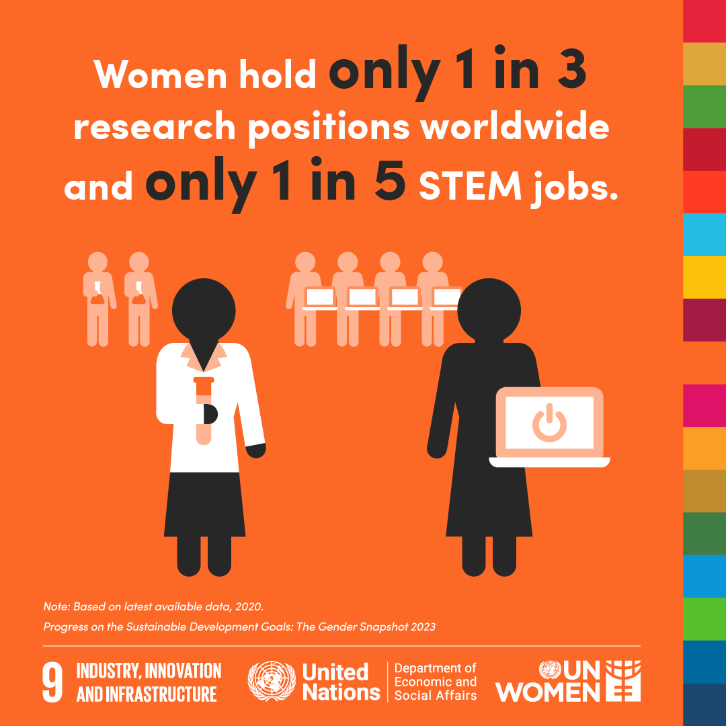
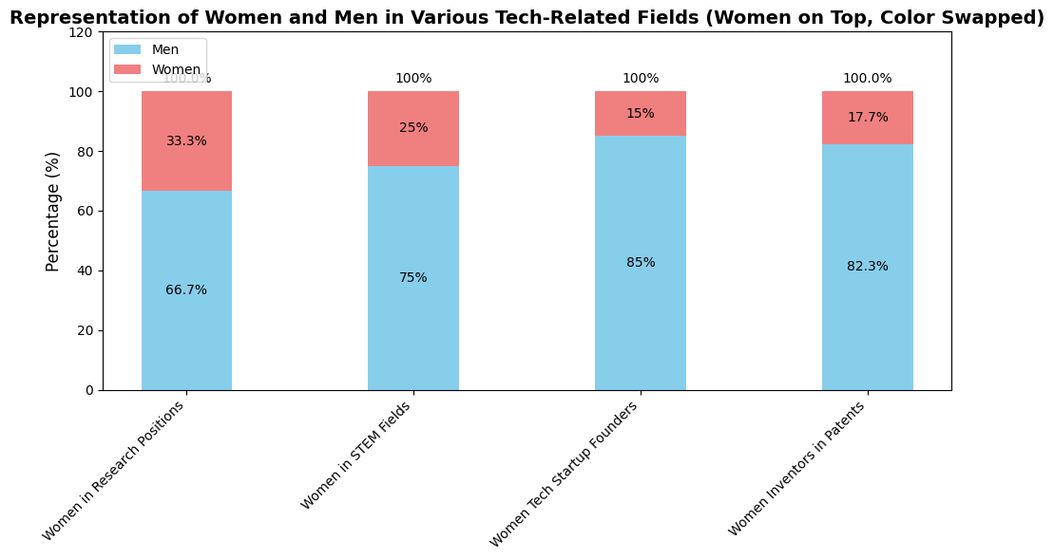
The Digital Gender Divide
Women hold only 1 in 3 research positions worldwide
In 2022, women comprised less than 25% of employees in STEM fields
15% of tech startup founders are women
Only 17.7% of inventors named in international patents are women
Over 70% of AI training data is male-centric
The percentage of women in STEM-related fields in 2022
33.3%
25%
15%
17.7%
66.7%
75%
85%
82.3%
Research position
Employees
in STEM
Tech Startup
Founders
Inventors in Patents

Slide 5
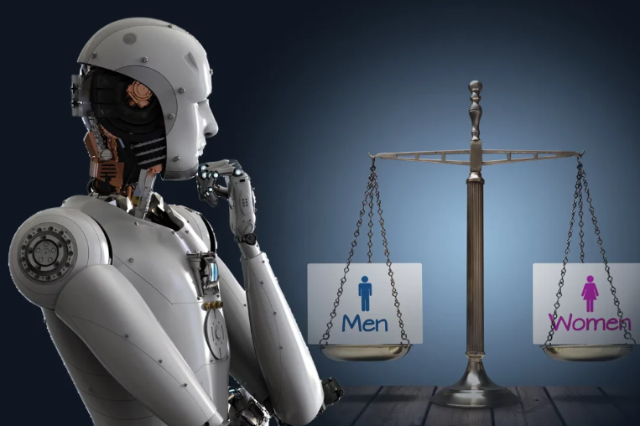
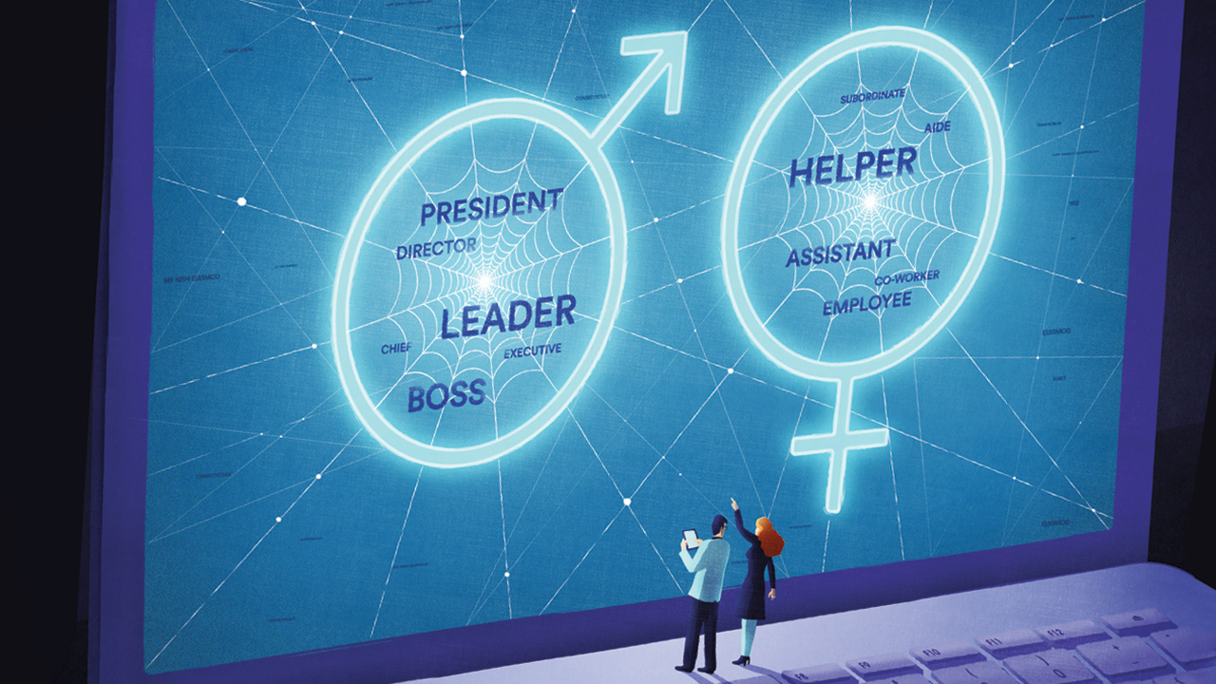
Technological Advancement and Gender Inequality
Emerging technologies like AI can reinforce biases against women and minorities.
However, when used responsibly, they can address gender inequalities.
Women are more likely to hold jobs at risk of AI replacement (3.7% female vs. 1.4% male employment)
They have the Potential for widening inequalities

Slide 6
Challenges in Bridging the Digital Divide
Structural Barriers
Lack of access to affordable and quality digital infrastructure
Under-representation in education and professional fields related to STEM
Systemic Biases
Gender biases embedded in AI and digital systems that perpetuate inequality
Insufficient gender-responsive policy frameworks in technology development
Intersectional Inequalities
Women from marginalized communities face compounded barriers due to ethnicity, age, disability, and socio-economic status

Slide 7
Session Objectives
Session Goals
To showcase innovative, women-centered tech solutions for equality
To highlight partnerships for scaling gender-responsive innovations
To identify strategies for increasing women’s leadership in STEM
To explore policy frameworks to harness AI and tech for bridging inequalities
Strategies for Increasing Women in STEM - Focus Areas
Increasing participation of women in STEM fields
Ensuring inclusion in design and decision-making phases of innovation

Slide 8
Guiding Qustions
How can science, technology and innovation (STI) be used to address challenges specifically faced by women? What are some case studies of women-centered tech and innovation solutions?
How can STI initiatives also address interlinkages and intersectionalities of exclusion related to gender, age, ability, ethnicity and others?
What are some policies that help ensure resources are directed toward gender-responsive research and innovation?
How can businesses, civil society, private sector, governments and other stakeholders create an enabling ecosystem for women’s leadership and participation in STI?
What policies or regulatory frameworks are needed so that technological change, such as the development of AI, bridges gaps and inequalities rather than leaving women and girls behind? And what are examples of AI being leveraged to close the gaps and inequalities?

Slide 9
Recommendations by Aree Moon
1. Expanding Access to Digital Education for Women and Girls
2. Leveraging Digital Technologies to Advance Women’s Economic Empowerment
3. Improving Digital Literacy for Women of All Ages
4. Ensuring Access to Digital Devices and Internet Connectivity
5. Supporting Gender-Responsive Digital Technology Research and Development
6. Fostering Women's Leadership in Technology: Training, Mentorship, and Networking for Career Growth
7. AI-Driven Solutions for Combating Online Gender Discrimination

Slide 10
Discussion
Bridging the Digital Divide: Empowering Women and Girls through Gender-Responsive Technology and Innovation

Slide 11
Participants
1. Reema Nanavaty, Self-Employed Women's Association (SEWA)
2. Isnawati Hidayah, Young Scientist Group World Food Forum; ROTASI Institute; Leiden University and Sapienza University of Rome (Online)
3. Catherine Ngila, African Foundation for Women & Youth in Education & STI
4. Laxman Belbase, MenEngage Alliance
5. Diane Ndarbawa, Association Pour une meilleure insertion socioprofessionnelle des filles et femmes du Cameroun (Online)
6. HRH Princess Dr. Nisreen El-Hashemite, Royal academy of Science International Trust (Online)
7. Albert Motivans, Equal Measures 2030
8. Eugenia McGill, Columbia University, School of International and Public Affairs
9. Kemi DaSilva-Ibru, Equality Now Africa
10. Timothée Macé Dubois, Schneider Electric
11. Zara Rapoport, CARE (Online)
12. Antonia Kirkland, Equality Now
13. Madhavi Ariyabandu, Diryog Nivaran - South Asia Network for Disaster Mitigation (Online)
14. Claudia Flores, Working Group on Discrimination against Women and Girls (Online)

