Slide 1
UN Expert Group Meeting on
Sustainable Development Goal 5 (SDG 5)
Gender Equality and its interlinkages
with other SDGs
21st January 2025
Anne-Sophie Stockmarr
Global Lead, Political Advocacy & UN representative
International Planned Parenthood Federation
New York Liaison Office

Slide 2
IPPF is a global advocate and health-care provider for SRHR
IPPF works with 150 MAs and collaborative partners across the globe (40.000 clinics​)
In 2023, 71 .2 million clients received services
224 million SRH services were delivered
12 % of these services in humanitarian settings, including in Afghanistan, Gaza, Ukraine, Sudan, Myanmar​
IPPF delivers care to people in need no matter where they are, no matter who they are, including
the most
marginalized
communities
IPPF has a unique understanding of the challenges that we are still facing in achieving the SDGs

Slide 3
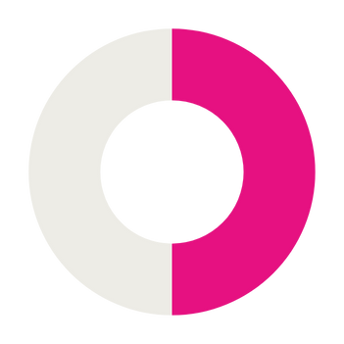
STATISTICS AND FACTS
Sexual and Reproductive Health and Rights:
A pathway to achieving the SDGs
3 out of 4
Not one country is on track to achieve gender equality by 2030.
3 out of 4 adolescents in low-income countries do not have access to crucial sexual and reproductive health information.
Backlash against the universal right to sexual and reproductive health and rights restrains progress towards gender equality and bodily autonomy.
Without gender equality, of SDG targets will remain unattainable.
74%
Half of all pregnancies are still unintended
– 331,000 every day –
due to remaining service gaps, a lack of contraceptive choices that are acceptable and affordable to users, and insufficient protections of women’s right to bodily autonomy
50%
56%
Only 56% of women worldwide can freely make their own decisions about their sexual and reproductive health.
An estimated 44% of partnered women are unable to make their own decisions about health care, contraception or sex.
24% are unable to say no to sex
and 25% are unable to make decisions about their own health care

Slide 4
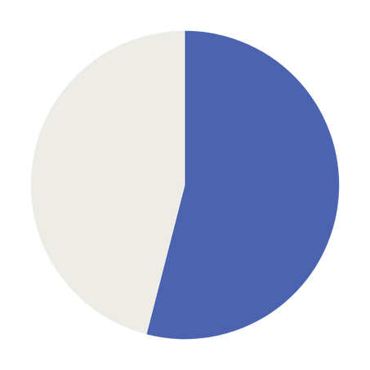
STATISTICS AND FACTS
Sexual and Reproductive Health and Rights:
A pathway to achieving the SDGs
The proportion of women killed in armed conflicts
compared with the previous year; the number of cases of CRSV was
higher than in 2022, and the number of girls affected by grave violations in situations of armed conflict increased by .
It underlines that the situation of women and girls affected by intersecting forms of discrimination is particularly alarming.
doubled
54%
of countries do
not have laws
that base the
legal definition
of rape on the
lack of freely
given consent.
1 in every 8 women and
girls aged 15-49 was subjected to sexual and/or physical violence by an intimate partner in the previous year (12.5%), a ratio reaching almost
1 in every 3 women and girls or worse in 13 countries (Afghanistan, Kiribati, DRC...)
50%
35%
800
Almost women still die every day from preventable pregnancy and childbirth-related causes
230 million
Globally, over girls and women worldwide have undergone female genital mutilation

Slide 5
Lessons learned
Without access to sexual and reproductive health and rights, women and girls will continue to be disproportionately affected by unintended pregnancies, gender-based violence and child marriage.
Access to SRHR is not only an essential component of gender equality, the right to health and universal health coverage. It is a precondition for any policy or programmatic response to address and reduce women and girl’s poverty.
When women and girls have access to SRHR – and right to make decisions about their own bodies - they are better positioned to pursue education and employment opportunities, which contributes to breaking cycles of poverty.
Discriminatory social and gender norms limit women’s decision-making power and bodily autonomy as do structural issues constraining access to education, employment and political leadership.

Slide 6
Lessons learned
Individuals who face multiple and intersecting forms of discrimination based on for example race, socioeconomic status and poverty, or sexuality face the toughest challenges.
The Global data on maternal mortality rates, for example, show dramatic regional inequalities, with poor women and girls from low-income countries being 70 percent more likely than women in high-income countries to die as a result of preventable complications arising from pregnancy, childbirth, and unsafe abortion.
Therefore, without realizing people’s sexual and reproductive health and rights and the needs of the most marginalized communities, we will not only fail to achieve SDG 5 and make progress on gender equality but also jeopardize the attainment of all the SDGs.
In essence, the realization of SRHR is not a sectoral priority but a systemic enabler that amplifies progress across the SDGs. By ensuring universal access to SRHR, we create a ripple effect.

Slide 7
Recommendations
Addressing persistent barriers
Progress requires confronting deep-rooted patriarchal structures and discriminatory social norms. Transformative change will only occur when we collectively dismantle these barriers through legal reforms, and societal shifts in attitudes.
Ensuring universal access to SRHR services to all and integrating SRHR into healthcare systems
Prioritizing SRHR for the most marginalized populations
who face the most significant barriers to the realization of their human rights, including SRHR services, perpetuating cycles of poverty, exclusion, and inequality.

Slide 8
Recommendations
Mobilizing sustainable financing for SRHR and gender equality.
It is essential to invest in gender-responsive institutions, policy and increase financing. Women and girls are marginalized from financial resources and poorly represented in economic decision-making at all levels.
Address the gaps in data collection and analysis
and ensure that global commitments are supported by robust, accessible accountability follow-up mechanisms to monitor and evaluate progress. A lack of disaggregated data obscures inequalities and hinders effective monitoring.

Slide 9
Thank you

