Slide 1
Improving Quality Infrastructure to
Facilitate the Development of SMEs
Reported by: Xu Jin
Development Research Center of the State Administration for Market Regulation
Date: November 11, 2024

Slide 2
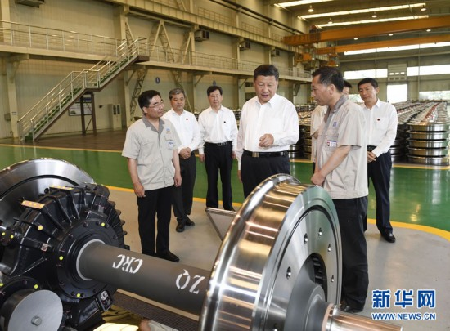
SMEs are important to each household and have been a vital force to advance innovation, facilitate employment, and improve people's livelihood. — Chinese President Xi Jinping

Slide 3
Quality Infrastructure (QI)
Effectively supporting international trade and sustainable development
Fostering productivity
Enhancing quality
……

Slide 4
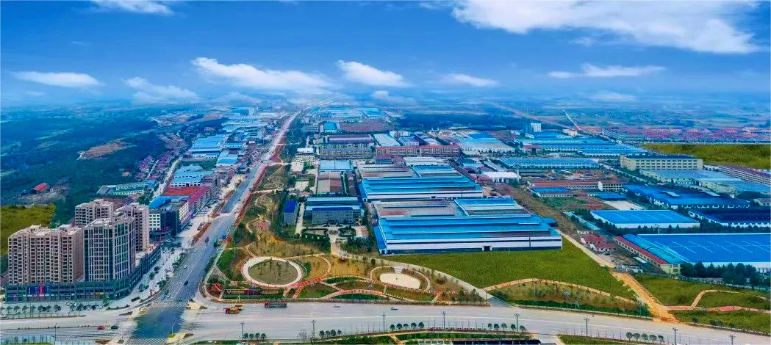
China
Nearly 200 million business entities
More than 50 million micro, small and medium- sized enterprises (MSMEs)
1/4 of the total number
More than 50% of the tax revenue
More than 60% of the GDP
More than 70% of technological innovation achievements
More than 80% of urban employment
More than 90% of market entities

Slide 5
metrology
China has established an array of high-level national measurement benchmarks and standards to address the needs of SMEs in aspects such as quality improvement and technological innovation.
Regular "Measurement Service Tours" are provided to provide measurement technology consultation, training, and other services for SMEs.
The "SME Measurement Partnership Program" is promoted to help SMEs refine their measurement management systems.

Slide 6
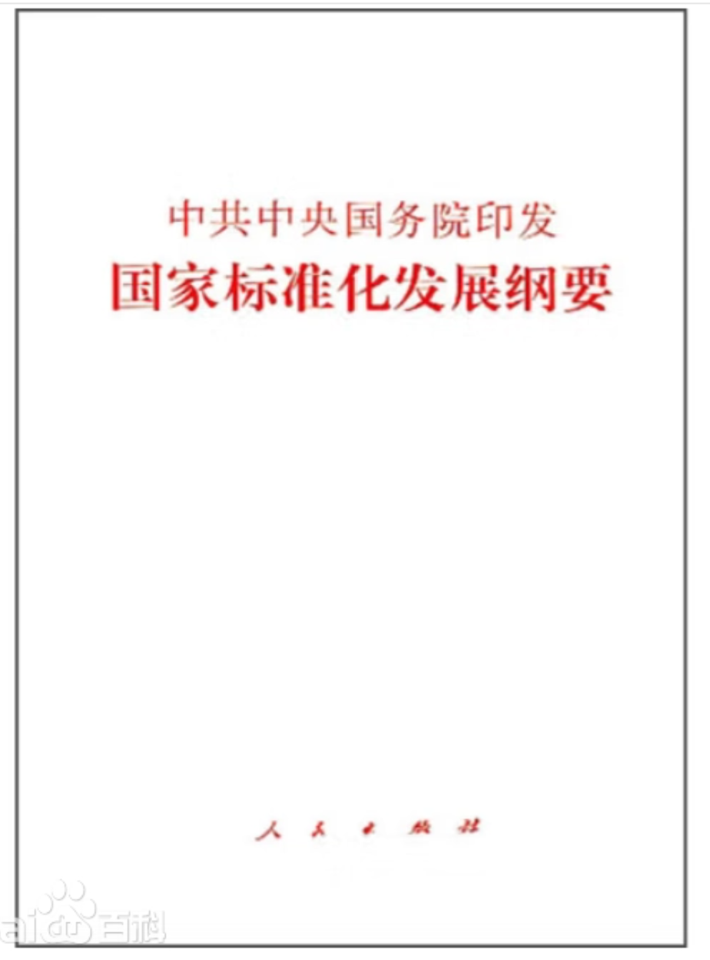
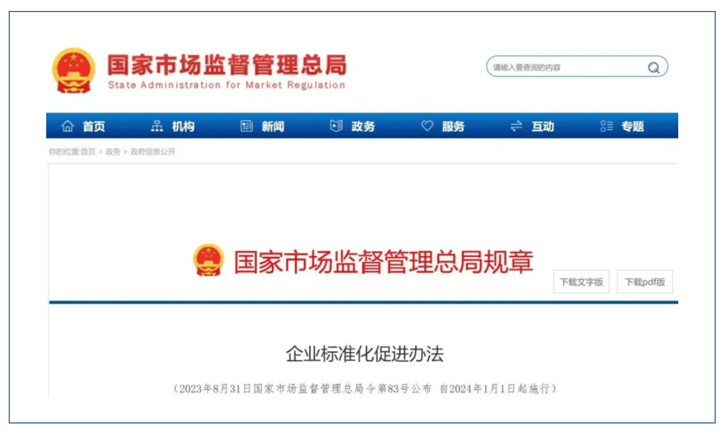
standards
1
2
About 66% of MSMEs recognize that standards lead to improved product and service quality, empowering them to take the lead in innovation and transformation.
Outline to Promote Standardized Development at the National Level
Measures for the Promotion of Enterprise Standardization are introduced.

Slide 7
conformity assessment
We have provided targeted and one-stop services for MSMEs, including certification, accreditation, inspection, and testing, which facilitate the enhancement of their quality management capabilities and market competitiveness.
Since 2023, we have introduced more than 1,000 relevant incentive policies and offered free training to 1.3 million participants from approximately 350,000 enterprises.
SMEs participating in the promotion initiative experienced an average over 10% increase in annual revenue and product sales, an over 8% rise in profit margins, and a 6% reduction in quality cost control rate.

Slide 8
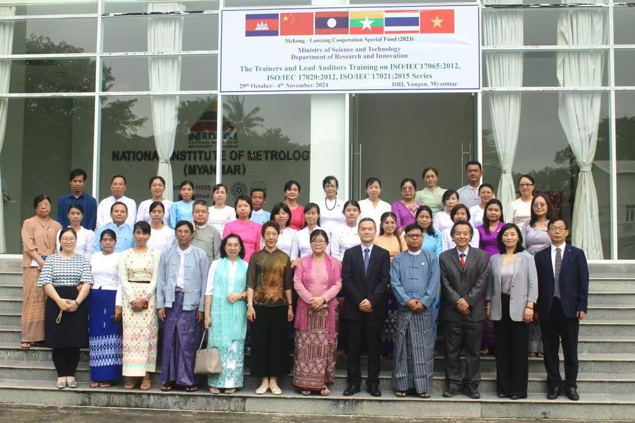
SAMRDRC has collaborated with Myanmar, Laos, and Cambodia to carry out training focused on capacity building in conformity assessment, supporting MSMEs across various countries in achieving common development.

Slide 9
China attaches great importance to and strives to implement the UN 2030 Agenda for Sustainable Development. Achieving the healthy and sustainable development of MSMEs is a key goal of this initiative.

Slide 10
Only when MSMEs thrive
can the world economy flourish;
only when MSMEs are robust
can the world economy achieve lasting strength.

Slide 11
Let MSMEs assume a more prominent role in driving global economic and social progress while effectively contributing to the implementation of the UN 2030 Agenda for Sustainable Development.
Development Research Center of the State Administration for Market Regulation

