Slide 1
Small Business in Fragility: from Survival to Growth
Valentina Rollo
Head of Research
International Trade Centre
Addis Ababa, 11 November 2024
Notes:
This report is part of a series, launched annually by the International Trade Centre. Each report provides an in-depth analysis on a particular topic related to the competitiveness of small and medium-sized enterprises (SMEs). The 2023 edition, assesses the impact of fragility on business performance.
For many of you, it may sound strange that an organization such as the ITC would be producing its flagship report on the topic of fragility – and this is assuming you know ITC at all.
So perhaps let me start with that. The International Trade Centre is the joint agency of the World Trade Organization and the United Nations, whose mission is to support the competitiveness of micro, small and medium-sized enterprises. We have done so for the last 60 years, and in these last decades we have successfully supported millions of enterprises to thrive in domestic and global markets.
In the last few years, however, we have found ourselves engaged in fragile and conflict-affected settings – incidentally or deliberately. There were occasions in which we were in countries and things took a turn for the worse. In these cases, we had to pivot very rapidly. But it has also been the case that we have been increasingly called to implement projects in these contexts, as donors and partner governments believe that what we do can contribute to long-term stability.
But our management has understood that operating in these contexts is not business as usual. It requires both operational and programmatic changes, in addition to extensive partnerships with those whose mission can complement and be complemented by ours. The report that I am about to present is one the steps in making ITC more fit for purpose to operate fragile and conflict affected settings, and so is bringing the Geneva peace and trade community together to discuss how we can collaborate more, and better.

Slide 2
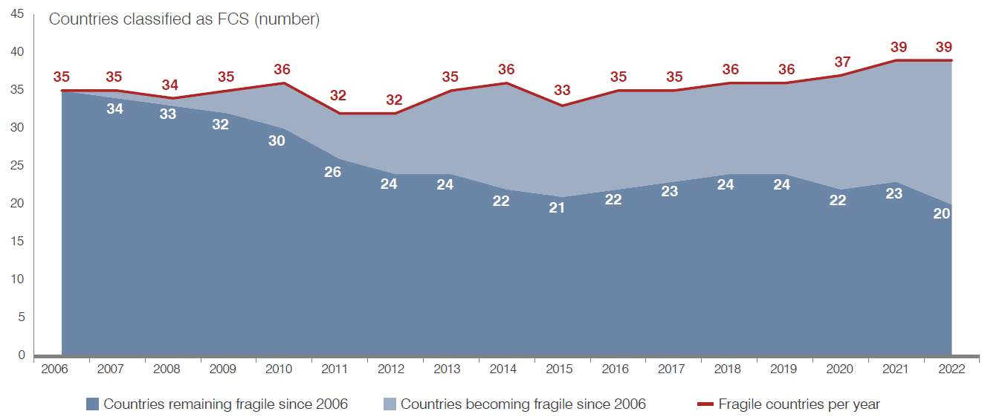
Our world is becoming more fragile
Quadruple shock of COVID, conflict, climate change and higher cost of living pushing more countries into fragility
Of the 35 countries classified as fragile or conflict affected in 2006, only 15 have managed to break out of fragility, and 19 have fallen into it.
Notes:
I just said that ITC is increasingly engaged in fragile and conflict-affected settings. Unfortunately, this is not surprising, as the context around us is becoming more fragile.
One year ago, when our management chose the topic of this report, it felt timely, as the world was grappling with multiple and reinforcing crises such as climate change, and cost of living shocks in the post-COVID world.
It is disheartening to see that it became even more so, with conflict erupting across the globe.
As the types of crises that trigger fragility hit new places, others have found themselves trapped for decades. Of the 35 states classified as fragile by the World Bank in 2006, less than half (15) have since managed to break the cycle. Some of those that had moved out of fragility fell back again, however, and 19 countries that were not fragile in 2006 became so by 2022.
Why does this matter? It matters because crises, and especially conflict, threaten livelihoods today, and cast a shadow on the future.

Slide 3
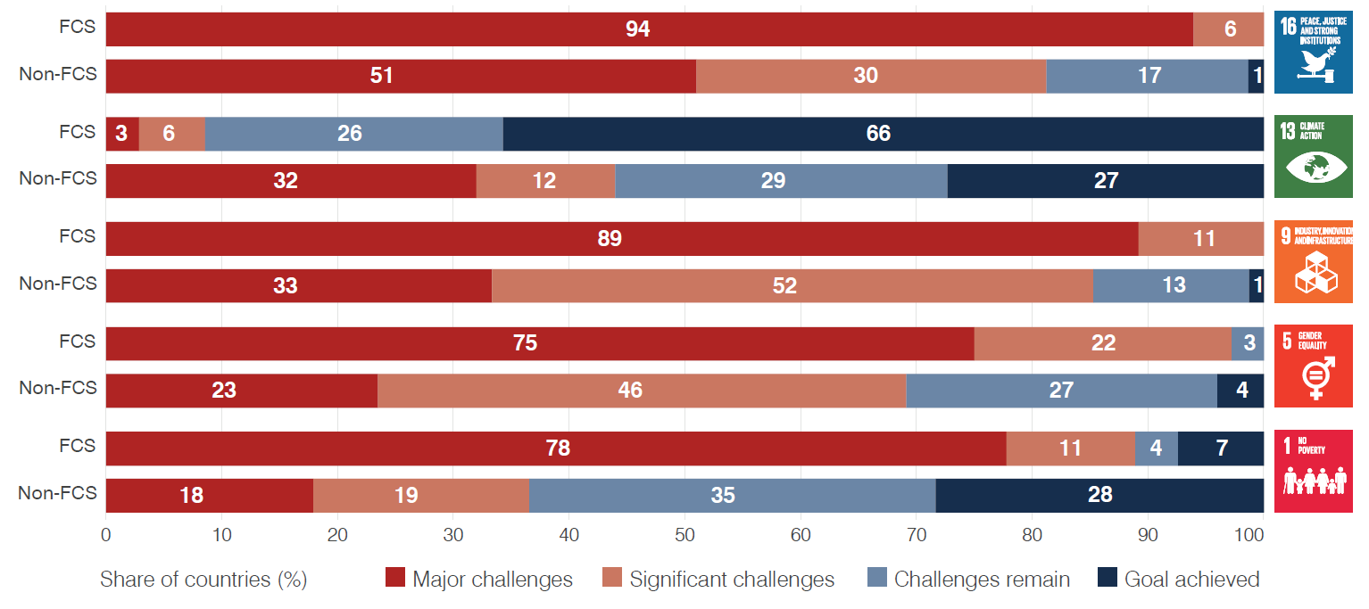
Fragility threatens livelihoods
Countries affected by fragility are struggling to achieve most of the SDGs
Notes:
Today, fragility hampers people’s ability to lead peaceful and prosperous lives.
Countries affected by fragility are struggling to achieve most of the Sustainable Development Goals (SDGs).
For instance, four in five countries classified as fragile reported facing major challenges in meeting SDG 1 (No poverty), compared with one in five not affected by fragility.
Three in every four countries affected by fragility reported major challenges in achieving SDG 5 (Gender equality), compared with less than one quarter of those not impacted.
Similarly, nine out of ten countries affected by fragility report major challenges in achieving SDG 9 (Industry, innovation, and infrastructure), compared with three out of ten of those not affected.
Certainly, there are many other factors that connect fragility to challenges in meeting the SDGs, including income, for instance. But the truth is, if we, as an international community, are to meet the goals that we collectively set, more attention needs to be given to these fragile and conflict-affected settings.

Slide 4
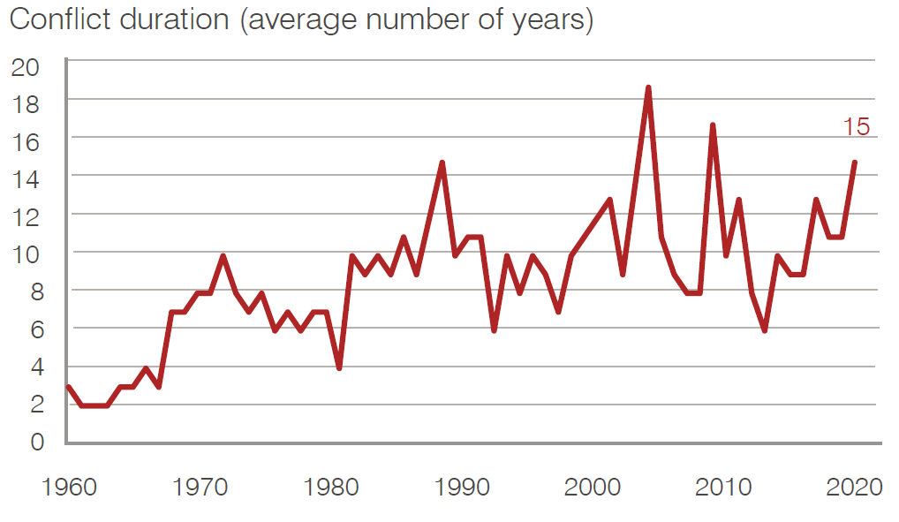
… and in the future
Conflict is dragging out over time, involving more countries and with more spillover effects
Notes:
Now looking at the future, fragility is not only more pervasive, but also more persistent.
In 2021, 33 countries were involved in at least one conflict – a number that has increased considerably since World War II.
Instability is also spilling across borders. In 1991, only 4% of civil wars involved foreign forces. By 2021, the number had risen 12-fold to 48%. In addition, the number of people forced to flee their homes, some to neighbouring countries and beyond, has doubled in the past decade, to roughly 100 million.
The challenge to global development posed by conflict has thus become more acute, especially as many drag out over time, involving more countries and with more spillover effects.
For these reasons, the Doha Programme of Action 2022–2031 argues that there can be ‘no sustainable development without peace and no peace without sustainable development’.
For ITC, if small businesses are critical in fostering sustainable development, then there is potentially a role for them in fostering peace. But we had to understand this relationship better.

Slide 5
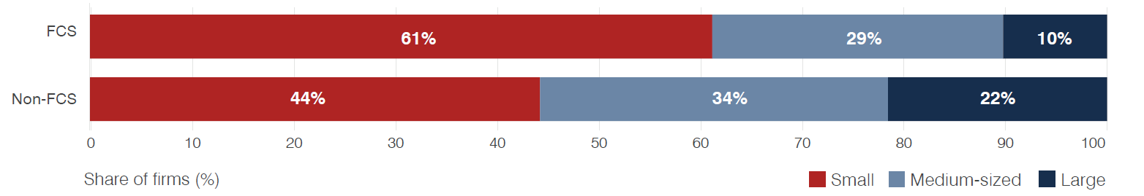
Why small businesses matter in fragility?
In fragile settings, MSMEs comprise 90% of all businesses, with a stronger presence of smaller firms
If they survive, they can provide some of the jobs, goods and services needed to meet basic societal needs, helping sustain the livelihoods of millions
If they are set on a growth trajectory, they are more likely to take off once peace takes hold, helping sustain long-term stability
Notes:
So why small businesses matter in fragility?
In fragile settings, MSMEs comprise 90% of all businesses, with a stronger presence of smaller firms
If they survive, they can provide some of the jobs, goods and services needed to meet basic societal needs, helping sustain the livelihoods of millions.
But also, if they are to go beyond merely surviving, and are set on a growth trajectory, assuming proper conditions are in place, they could help sustain long-term stability.

Slide 6
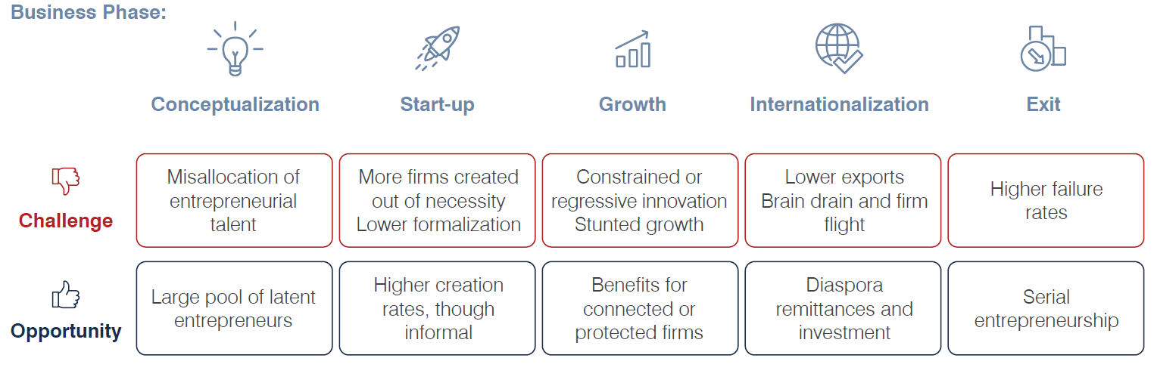
Most firms are hurt by fragility...
Notes:
The problem is that businesses are really undercut in these environments.
From the literature, and cross-country analysis, we know that most firms are hurt by fragility – though many studies also point to opportunities – across a firm’s life cycle. We know, for instance, that the cost of starting a business in fragile settings is twice the world average, and more than 15 times the cost in high-income countries.
Survivalist entrepreneurship is also evident in the form of self-employment. Because informality is prevalent and salaried occupations are rare, self-employment becomes a coping mechanism. Between 2006 and 2020, around 70% of all employment in fragile and conflict affected situations was self-employment, compared with a world average slightly below 50%.
Firms intending on formalizing and growing are deterred by the excessive cost and time, meaning they remain informal and fairly small. This is exacerbated by the fact that innovation among firms in fragile settings is scarce, or frugal at best.
Internationalizing firms also face significant hurdles. Unsurprisingly, ITC analysis shows that as areas become more fragile, the number of exporters decreases substantially.
Finally, while more informal and necessity-driven firms are created as fragility increases, business failure is also more common.

Slide 7
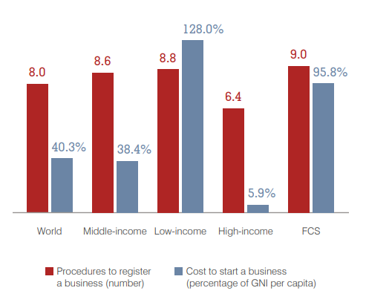
Greater start-up costs
The cost of starting a business in fragile settings is:
twice the world average, and
more than 15 times the cost in high-income countries.
Notes:
For emerging entrepreneurs, starting a formal business is difficult and costly. In fragile contexts uncertainty heightens costs, and institutions responsible for basic start-up procedures, such as property registration and contract enforcement, are undermined or inefficient. Starting a business in fragile settings costs twice the world average and more than 15 times than in high-income countries.

Slide 8
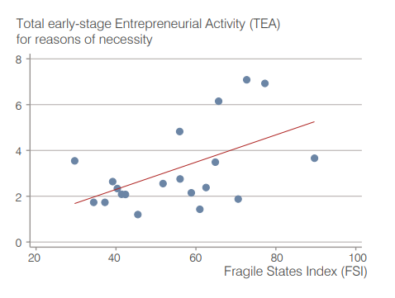
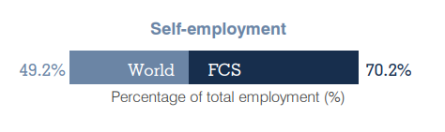
Self-employment is high, mostly out of necessity
Because informality is prevalent and salaried occupations are rare, self-employment becomes a coping mechanism.
Notes:
Survivalist entrepreneurship is also evident in the form of self-employment. Because informality is prevalent and salaried occupations are rare, self-employment becomes a coping mechanism. Between 2006 and 2020, around 70% of all employment in fragile and conflict affected situations was self-employment, compared with a world average slightly below 50%.

Slide 9
Innovation is survival-driven
Firms intending on formalizing and growing are deterred by the excessive cost and time.
They remain informal and small.
Innovation among firms in fragile settings is scarce, or frugal at best.
Notes:
Firms intending on formalizing and growing are deterred by the excessive cost and time, meaning they remain informal and fairly small. This is exacerbated by the fact that innovation among firms in fragile settings is scarce, or frugal at best.

Slide 10
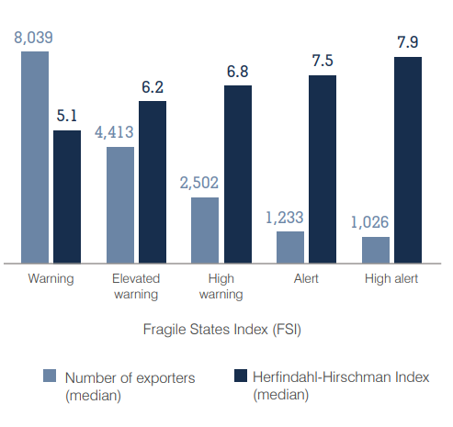
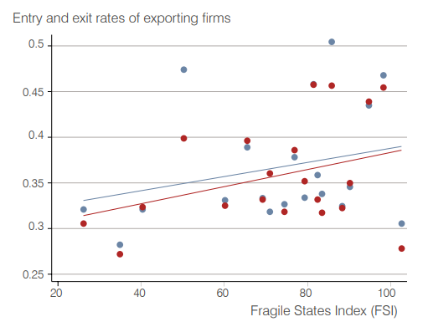
Business failure more common
As areas become more fragile, the number of exporters decreases substantially.
While more informal and necessity-driven firms are created as fragility increases, business failure is also more common.
Notes:
Internationalizing firms also face significant hurdles. Unsurprisingly, ITC analysis shows that as areas become more fragile, the number of exporters decreases substantially.
Finally, while more informal and necessity-driven firms are created as fragility increases, business failure is also more common.

Slide 11
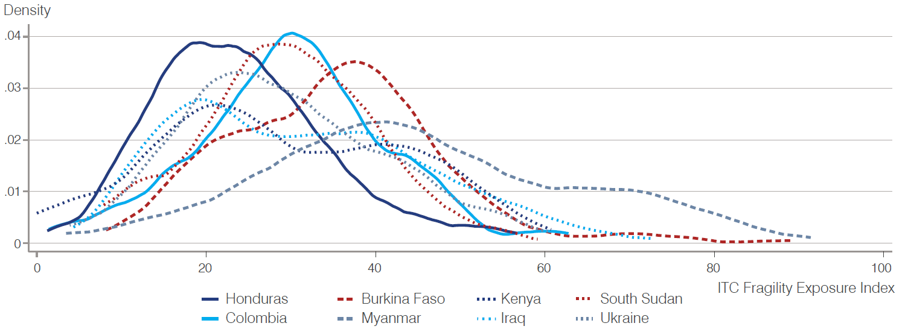
...but impacts vary
Notes:
All of that we already knew. But at ITC, we work with firms – and to do so effectively, we had to go beyond country-level impacts and averages.
Normally, when we look a fragility indices, they pertain to an entire country – there is a country score. Not to say these are not helpful – they are – but they are blunt, instruments to guide firm-level interventions, as they do not allow us to understand how fragility’s impacts vary across space and firms.
To overcome this limitation, ITC surveyed over a thousand companies in 8 countries and developed an index of fragility based on firms’ reported experiences. So each firm could have it’s own fragility index. When we plot these indices, which is what you see here, we observe tremendous variation not only across, but also within countries.

Slide 12
….but impacts vary
Levels
Pillars
Country
Region
Exact location
Company
Individual
Security pillar
Economic pillar
Social pillar
ITC Fragility Exposure Index aggregates firm-level scores and shows how firms are differently exposed to the same overarching state of fragility
Notes:
Our first finding is that business location plays a role in determining how exposed a firm is to fragility and how intensely it will experience its impacts. This applies to the countries in which they are, but also the regions within such countries.
Another finding is that the type of fragility to which firms are exposed, matters. For example, if fragility is reflected in higher criminality, a larger firm with recourse to private security is likely to be less affected than smaller firms without such resources, though this comes at the expense of other, more productive investments.
We grouped these types of fragility into three pillars:
- The security pillar assesses if and how a business is affected by insecurity and violence induced by fragility.
- The economic pillar identifies whether and how fragility affects a firm’s economic performance and opportunities.
- And the social pillar measures the effects of fragility on the company’s relationships, as reflected in trust in people, networks, business support organizations (BSOs) and local and national institutions.

Slide 13
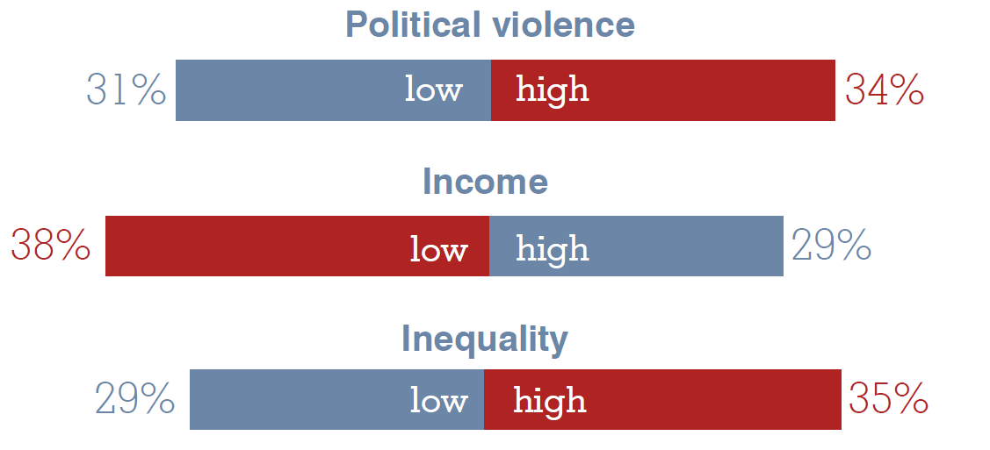
Business location matters
Firms’ perception of fragility in regions with:
Notes:
In terms of location, while a country may be entirely classified as fragile, sub-nationally conditions may differ widely.
Evidently, firms located in conflict hotbeds, such as areas with high levels of political violence, tend to be more exposed to and potentially impacted by fragility. So more firms there report high levels of fragility (meaning more of them have high fragility indices).
Similarly, more firms in poorer areas tend to experience fragility more intensively.
Interestingly, it is not just poverty, but also inequality that drives experiences of fragility. In more unequal regions, characterized by a higher Gini coefficient, more firms have high fragility indices.

Slide 14
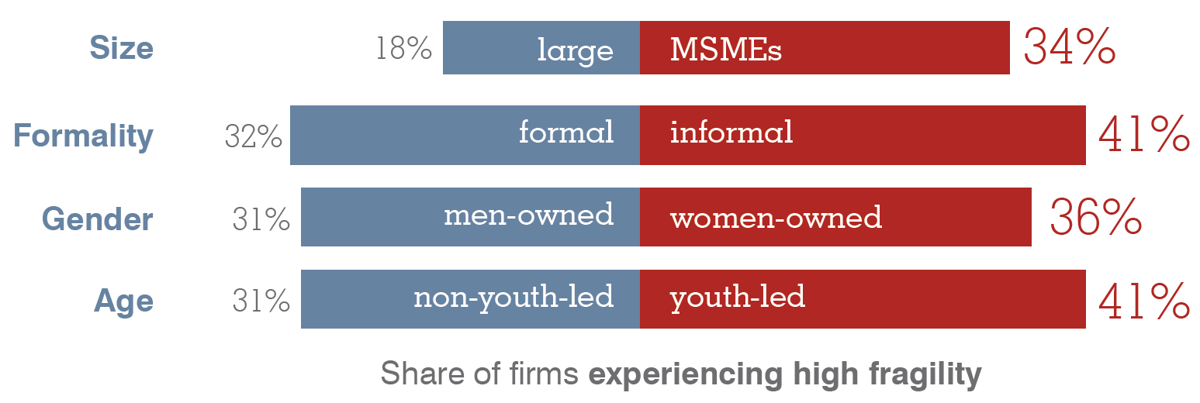
Firm characteristics matters
Notes:
Besides location, firms with certain characteristics may be more of less exposed and affected.
Among those surveyed by ITC, smaller firms were more likely to experience fragility more intensively: 34% of micro, small and medium-sized companies reported experiencing high levels of fragility, compared with 18% of large firms.
Informality further exacerbates the effects of fragility, with informal firms almost 10 percentage points more likely to report experiencing a high intensity of fragility than formally registered ones.
Women-led firms tend to be at a disadvantage even in non-fragile settings. Businesses owned and led by women typically lack access to public infrastructure services, finance and social protection.
Finally, when it comes to age, youth-led companies reported higher levels of fragility, compared with non-youth-led companies
These firms tend to be disadvantaged in most instances because they tend to have little or no recourse to formalized credit and facing exclusion from institutions that can provide the services they need to survive in times of fragility. In places affected by fragility, these can be exacerbated by fragility-specific factors such as higher incidence of violence, or unsupportive social norms.

Slide 15
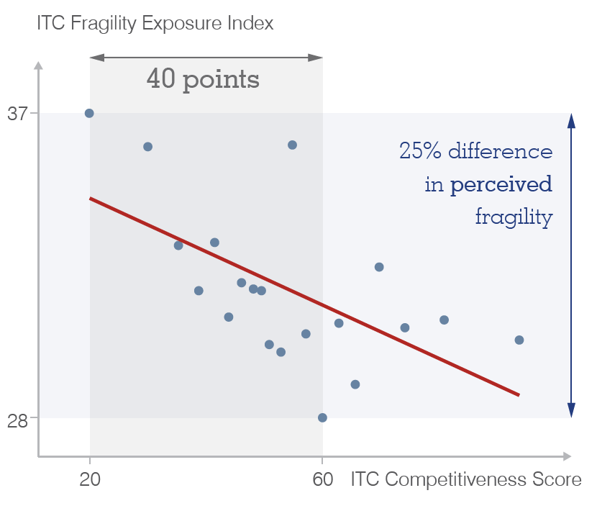
And actions matter, too
What firms do, not just where and what they are, influence their experience of fragility
Notes:
Identifying which firms are potentially more exposed to the background level of fragility, and through which channels, is a useful step in designing support programmes. However, we must go beyond what and where firms are and identify what they can do to increase their ability to cope with fragility.
Because the fragility survey covered companies whose competitiveness ITC had previously assessed through its standard SME Competitiveness Survey (SMECS), we were able to combine responses and provide insight on whether competitiveness factors were associated with the firms’ experience of fragility.
Fragility undoubtedly affects firm competitiveness, often for the worse. Conversely, competitiveness can serve as a buffer to fragility’s impacts. Specifically, when firms take action to improve their competitiveness, they may also reduce their exposure to fragility. For instance, by putting in place internal measures to raise its competitiveness score from 20 points, which is at the low end of the competitiveness distribution, to the average of 60 points, a firm’s experienced fragility can drop by over 25%, with no other changes taking place at the business ecosystem or national level.

Slide 16
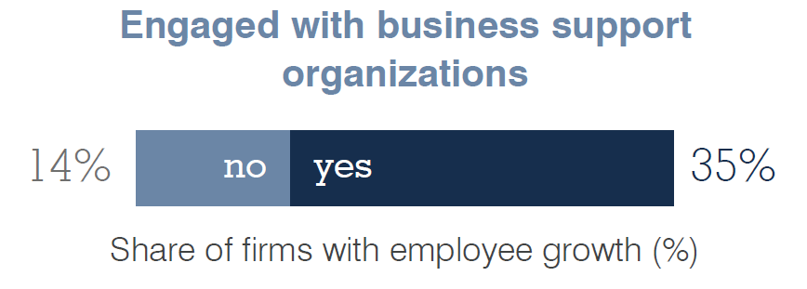
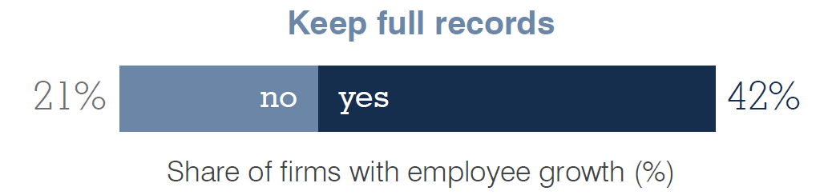
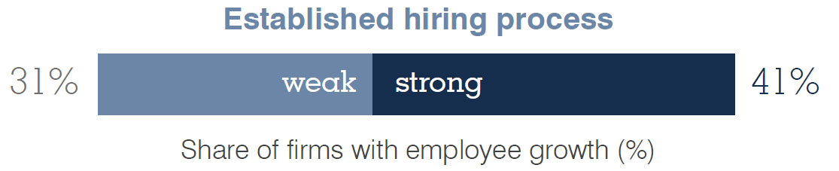
Firms must compete, connect and change
Improve financial management
Build connections
Identify and retain skilled staff
Notes:
Combining data from the two surveys we spoke about earlier, ITC assessed whether, and to what extent, pre-existing competitiveness factors influence business outcomes under fragility. Specifically, ITC has pinpointed three firm-level actions that can partially make up for what the environment lacks:
Build connections with institutions, peers and buyers – social fragility;
Improve financial management – economic fragility;
Identify and upgrade staff skills – economic and social fragility.
First, firms engaged with BSOs were more than 20 percentage points more likely to hire employees – a positive sign of growth – than companies without such connections.
Second, having strong internal financial management mechanisms can lessen the impacts of fragility. Companies that keep full economic records were twice as likely to report employee growth.
Finally, establishing a professional hiring process and identifying talent can help firms weather fragility’s economic impacts. Enterprises with an established hiring process were more likely to expand their labour force. A strong hiring process increases the likelihood of finding employees with the right set of skills. This matters as skilled workers are more efficient at adapting operations to new contexts, allowing firms to continue operating in periods of instability.

Slide 17
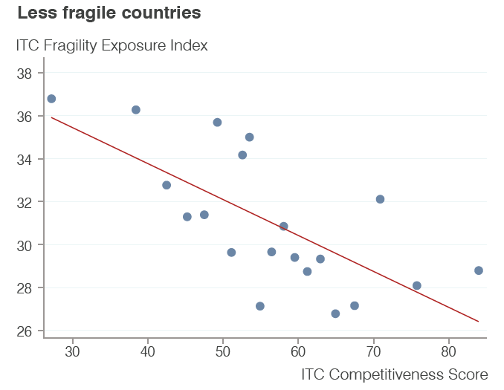
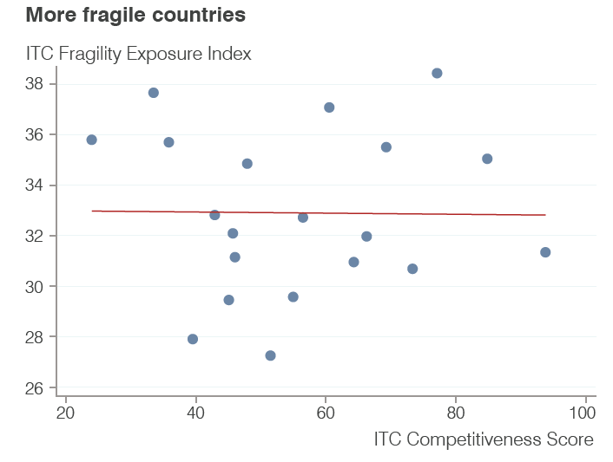
But there are limits to what firms can do
As the environment becomes more fragile, the relationship between competitiveness and fragility disappears.
Applicable to compete, connect and change
Applicable to compete, ONLY
Firms are largely concerned about survival, not growth
Notes:
However, firms’ own actions can only help in certain contexts, and do not protect them from all of fragility’s manifestations. In fact, as fragility becomes worse or more widespread, firm-level actions no longer protect firms to the same extent, or at all.
Specifically, ITC analysis finds that, in less fragile countries, higher competitiveness is correlated with lower fragility. This means that actions aimed at increasing competitiveness can lessen firms’ exposure to fragility.
However, as the environment becomes more fragile, the relationship disappears. This suggests that, while firms’ actions do matter, factors in the national environment, over which companies individually have little influence, are just as important in determining their competitiveness – and experiences of fragility.
This is particularly the case when fragility is characterized by high levels of insecurity, as we found very little evidence that firm-level actions can blunt the impacts of fragility through the security pillar. What is worse, in these contexts, we may sometimes expose firms to more fragility by boosting their competitiveness – think of firms being more exposed to extortion or acts of violence.

Slide 18
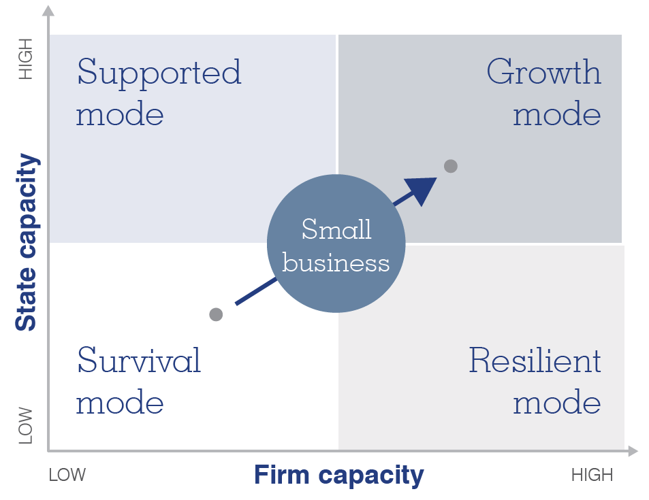
An effective strategy must be holistic
Notes:
Two critical implications come out of the preceding analysis.
First, there seems to be a window of opportunity in which firm-level support can yield positive outcomes, and this tends to be before fragility and violence engulf firms and their business ecosystem entirely.
Second, firm-level interventions are insufficient to secure the survival and growth of firms. It is also necessary to directly deal with the overarching situation of fragility and rebuild the state’s capacity to ensure a supportive and stable environment.
And this is where I turn to our scene setter and panel, to focus on these policy level interventions that are necessary to create the foundation for small firms to survive and thrive.

Slide 19
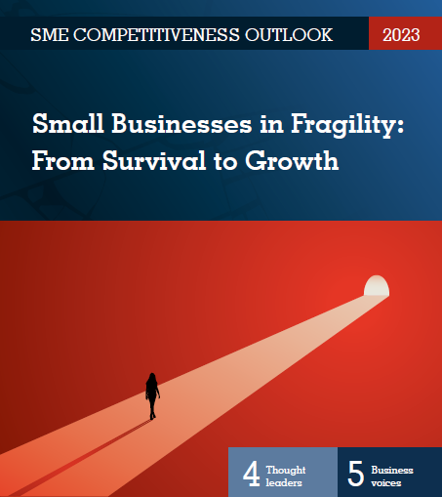

Thank you!
www.intracen.org
@ITCnews
@InternationalTradeCentre

Slide 20
Fragility and SME Competitiveness Surveys
Enhancing policy through data collection

Slide 21
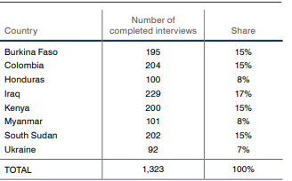
ITC Small Business in Fragility Survey
Implemented between November and December 2022 in eight countries.
Asking how businesses experience fragility and the coping mechanisms they adopted in response.
1095 of the interviews in 6 countries could be merged with their SMECS responses.

Slide 22
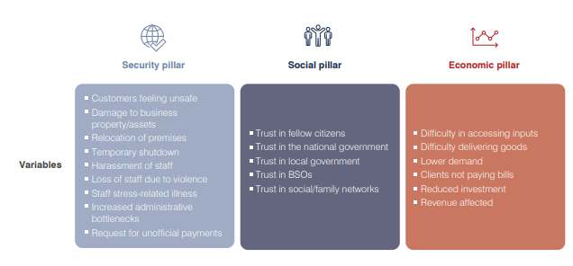
ITC Fragility Exposure Index
Firm level fragility is a multidimensional concept, expressed through factors that often influence one another.
The ITC Fragility Exposure Index models this multidimensionality following the conceptual framework from Baliki et al. (2022).

Slide 23
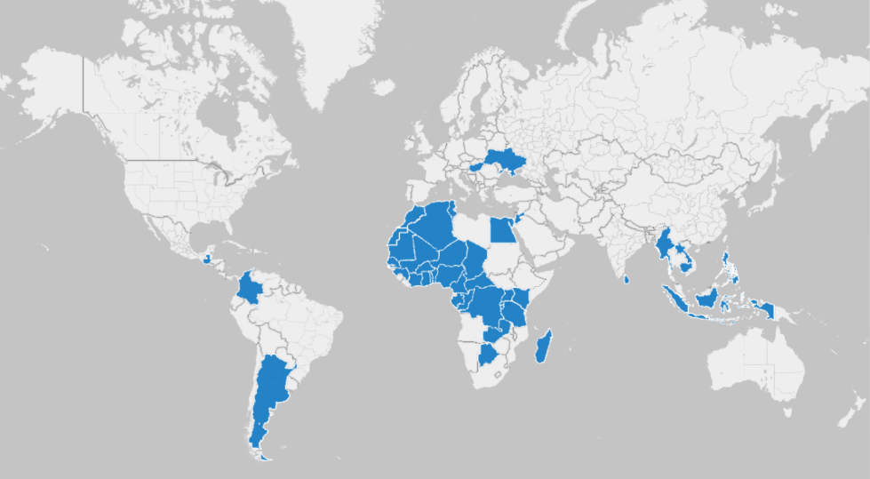

ITC SME Competitiveness Survey
A global enterprise-level data collection exercise designed by the International Trade Centre (ITC);
Over 42,000 companies surveyed in 58 countries;
Identity the strengths and weaknesses of enterprises, as well as track the soundness of their business ecosystem;
Data is made available to help improve the environment for enterprises;
All sectors covered.
Notes:
Gathers data from enterprises using this approach to competitiveness
Designed and supported by ITC with local partners
Used to measure fulfillment of corporate and project mandates
Adapted to national and/or project needs

Slide 24
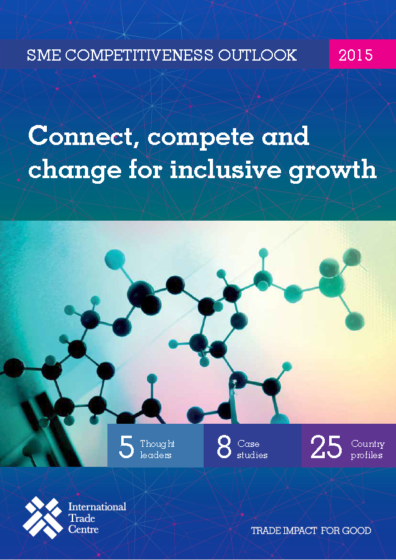
ITC’s definition of competitiveness
Competitiveness is the demonstrated ability to design, produce and commercialize an offer…
…which fully, uniquely and continuously fulfils the needs of targeted market segments, …
…while connecting with and drawing resources from the business ecosystem,….
and achieving a sustainable return on the resources employed.
Notes:
Academically sound: used in Masters and based on Peer reviewed article

Slide 25
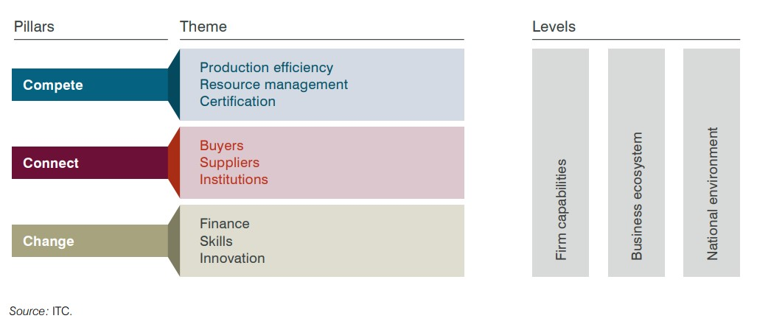
Enterprise Competitiveness Grid
By combining information from the three levels, we can go beyond simply saying ‘certification is a problem’ or ‘finance is a problem’ for SMEs.
The better a problem is diagnosed, the better more targeted the policy solution can be.

Slide 26
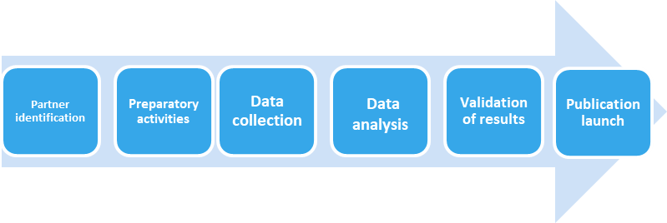
Process
Surveys usually take place in partnership with a domestic trade and investment support organization.
The partner organization interviews hundreds of companies using the ITC questionnaire, supported by ITC through training and capacity building.
ITC analyses the data, producing a publication with the resulting insights.
Notes:
For the survey, ITC:
Works in partnership with a business support organization in the developing country to gather and analyse SME competitiveness data;
Supports the partner organization to select a sample of companies and interview and train a team of interviewers;
Provides a standard ITC questionnaire, and helps customize it to reflect local conditions.
The partner uses the questionnaire to collect data from hundreds of the country’s enterprises, with specially designed software.

Slide 27
For more information
smecompetitiveness@intracen.org
https://intracen.org/resources/data-and-analysis/research-and-data

