Slide 1
DESA MSMEs International Workshop
Strengthening Supply Chains to Elevate MSME Resilience and Enhance MSME Contributions to SDGs in the Times of Multiple Crises.
Glory Eze
Sustainable Supply Chain & SME Lead, Africa
UN Global Compact
glory.eze@unglobalcompact.org

Slide 2
Table Of Contents
About the United Nations Global Compact (UN Global Compact)
Our presence in Africa
MSMEs in Africa & the impact of multiple crises in MSMEs
The need to strengthen supply chains
Introducing the UN Global Compact’s ‘SPARK’ initiative and how it supports MSMEs
Enhancing MSMEs contribution to SDGs
Conclusion: Summary of key points

Slide 3
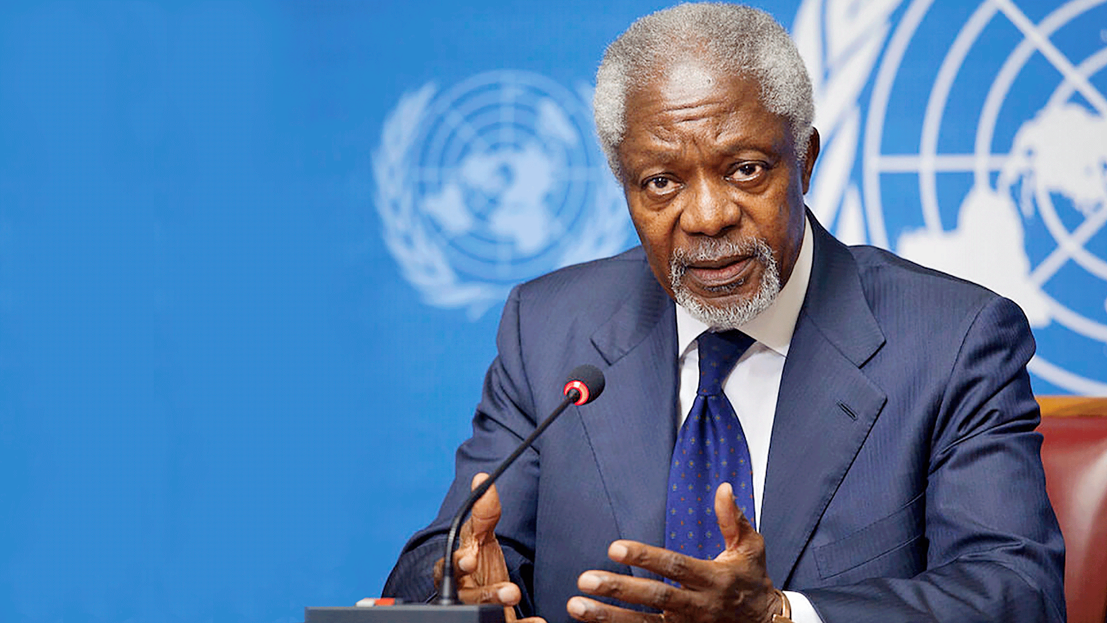
THE WORLD IN 1999
A HUMAN FACE TO THE GLOBAL MARKET
I propose that you, the business leaders… and we, the United Nations, initiate a global compact
of shared values and
principles …...
Kofi Annan, UN Secretary-General (1997–2006)

Slide 4
UN GLOBAL COMPACT: OVERVIEW
25,000+ businesses committed to the Ten Principles of the UN Global Compact
160+ countries with UN Global Compact participants
3,800+ non-business participants
62 Local Networks
138 million employees

Slide 5
UN Global Compact presence in Africa
10 Country Networks
4 Expansion Countries
12 Rest of Africa
1,200+ participating companies
914 SMEs (MSMEs incl.)
~1M
Country Networks
Egypt,Ghana,Kenya,Nigeria,South Africa, Tanzania, Tunisia, Morocco,DRC, Mauritius & Indian Oceans
10
4
$165B+
Expansion Countries
Angola, Botswana,Côte D’Ivoire, Rwanda
12
Rest of Africa

Slide 6
MSMEs in Africa
Impact of multiple crises
COVID-19 pandemic
Climate change
Economic uncertainty
Disrupted supply chains, reduced demand, and increased costs
Exacerbated existing vulnerabilities - financial instability, lack of access to markets and technology.
Account for 80% employment and 50% GDP in Africa.
Play a critical role in economic growth, poverty reduction, and social development.
Face unique challenges, including:
Limited access to resources.
Limited access to finance and digital payments
Limited access to markets
Limited access to technology
Limited or lack of competitiveness
Knowledge gap

Slide 7
The need to strengthen supply chains
Enhance MSME resilience and adaptability
Improve supply chain transparency and traceability
Increase access to markets, finance and technology
Promote sustainable and responsible practices

Slide 8
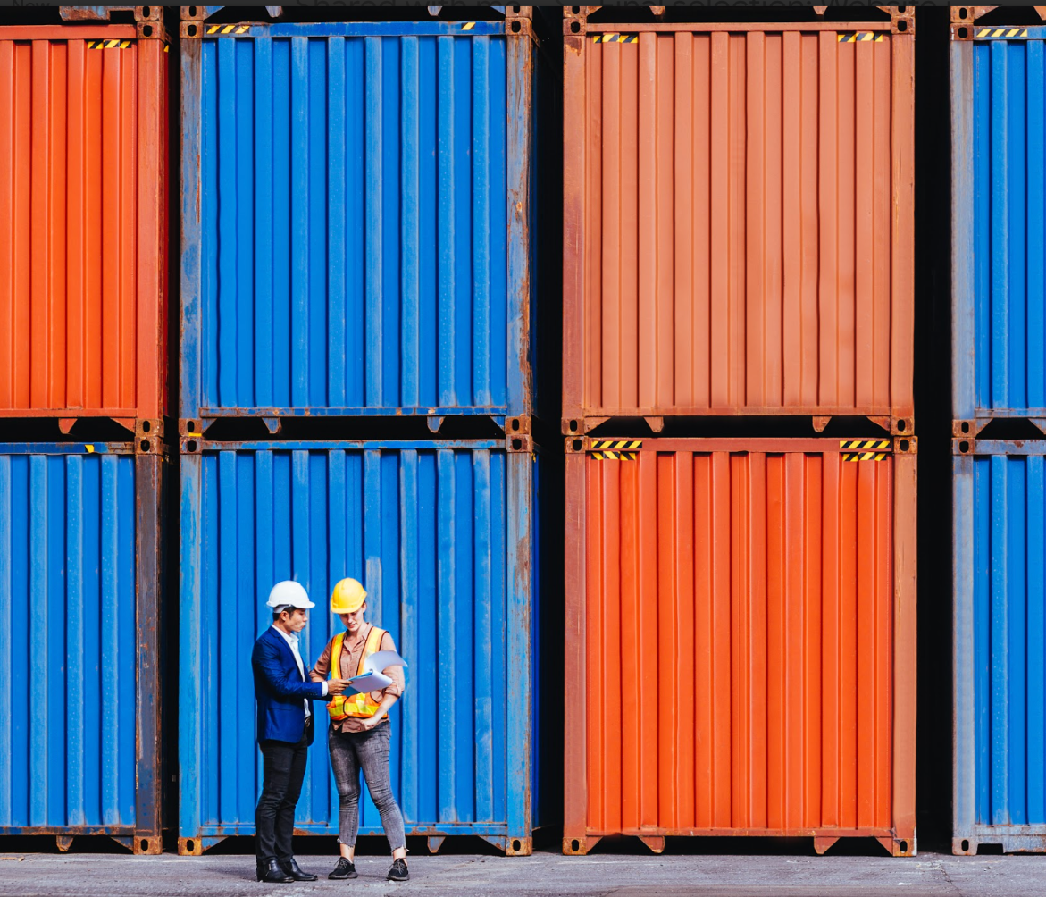
A global community designed for businesses with 1- 250 employees participating in the UN Global Compact

Slide 9
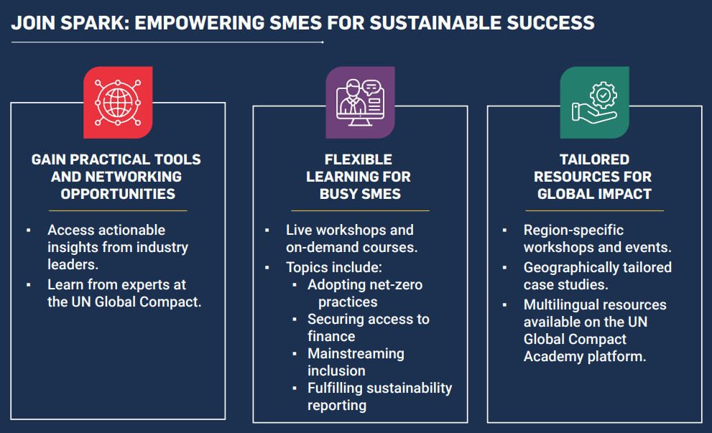
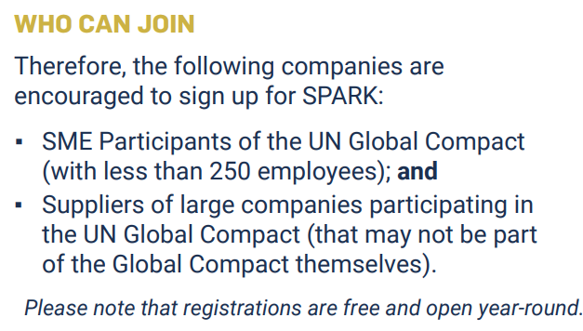

Slide 10
TAILORED MODULES FOR 2025
Mix of self paced courses on and live sessions, including new global and regional deep-dive sessions
Foundations of Sustainability for SMEs
Developing a Sustainability Strategy
Setting measurable sustainability goals
Building a sustainable business model
Implementing Sustainable Practices
Accessing finance & funding opportunities
Sustainable Supply Chain Management.
Measuring and Scaling Impact
Scaling Sustainability Initiatives Across Your Business
Tracking Progress and Reporting Sustainability Initiatives
Ongoing enrollment throughout the year. All participants receive certificates of completion.

Slide 11
THE UN GLOBAL COMPACT: STRATEGIC AMBITION
Accelerate and scale the global collective impact of business by upholding the Ten Principles and delivering the SDGs through ambitious, accountable companies and environments that enable change

Slide 12
Enhancing MSMEs’ contribution to SDGs

