Slide 1

Strengthening MSME Clusters and Territories for Resilient Growth
Mr. Fabio Russo
Chief, MSME Development And Job Creation Unit, UNIDO
11 November 2024

Slide 2
MSMEs Face Diverse Risks and Resilience Challenges
The major crises, such as COVID-19, put in the spotlight MSME vulnerability to exogenous shocks and risks.
However, many MSMEs regularly face substantial risks related to climate, market fluctuations or financial challenges.
These vulnerabilities necessitate that MSME resilience becomes a critical policy objective accompanied by targeted support programmes across developing countries.
However, MSMEs are not a homogenous group, and their risks and needs vary by sector and geography.

Slide 3

What is a cluster?
For UNIDO, a cluster is a sectoral and geographical concentration of enterprises and/or individual producers that produce a similar range of goods or services and face similar challenges and opportunities.
A cluster is a collaborative environment where (M)SMEs and networks of MSMEs, are the center and they cooperate with government Institutions, academia, research institutionss, NGOs, financial institutions, media, etc. to enhance the cluster ecosystem.

Slide 4

Why supporting clusters for SME resilience?
In times of crises, they offer environments to foster MSME reaction, resilience and competitiveness through collective and systemic solutions.
By engaging in clusters, MSMEs overcome isolation and can achieve solutions and results that are out of reach for individual enterprises through:
  Joint actions among firms
  Joint actions between firms & their support institutions
As a result, the overall ecosystem can become more resilient and dynamic, extending advantages even to those outside the cluster.

Slide 5
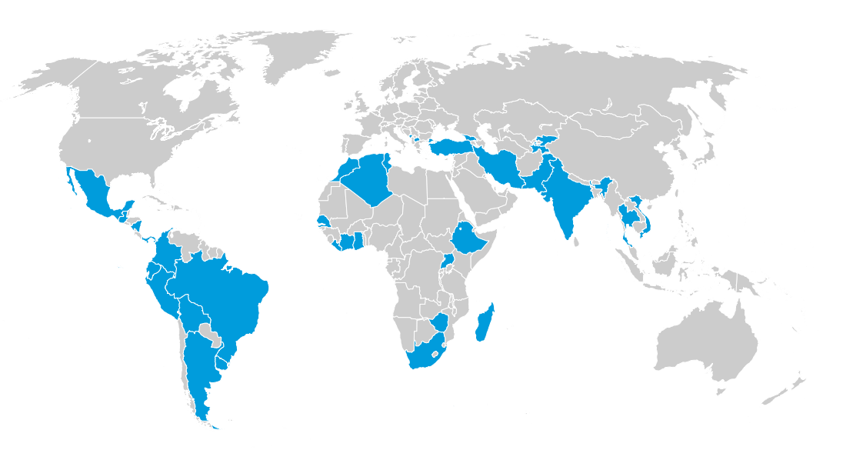
UNIDO’s approach to supporting clusters
Over the past 30 years, UNIDO has been involved in the implementation of cluster and network development projects in many countries around the globe.
Cluster development is a very adaptable and flexible approach;
  Process upgrading and quality improvement
  Market access and product development
  Innovation
UNIDO has developed a modular approach to guide the formulation and implementation of cluster development initiatives.

Slide 6
TUNISIAN PRICKLY PEAR CLUSTER
The fruit of the poor turns into a cosmetic flagship product.

Slide 7
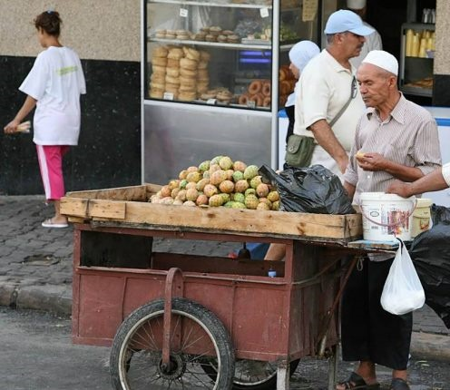
Rural Development Crisis in Tunisia
  High Emigration Rates: Due to limited employment opportunities, particularly for young people, rural Tunisia experienced high rates of emigration. Many young men and women left their villages to seek work in urban areas or abroad.
  Economic Dependence on Low-Value Crops: Rural communities were dependent on traditional crops that were not economically viable, given Tunisia’s arid climate. Rural farmers also had minimal access to processing facilities and were unable to produce or market higher-value prickly pear products. There was a need for value addition in unique products that offer competitive edge in international markets.
  Lack of Drought-Resilient Agricultural Options: Water scarcity and rising temperatures had made traditional farming more difficult. While the prickly pear cactus was naturally suited to Tunisia’s arid conditions, it remained underutilized. Prickly pears were used as livestock feed and cheap summer fruits.
  Social Vulnerability and Gender Disparities: Economic hardship disproportionately affected women, who often faced limited employment opportunities and fewer resources. Without viable local work, many women remained economically dependent, which further strained household resilience and limited broader community development.

Slide 8
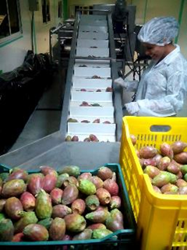
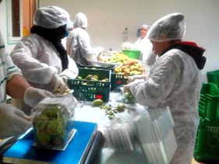
Untapped potential of the cluster
  Cactus plantations in Tunisia: Tunisia is one of the countries with most cactus plantations worldwide. In the biggest production region, there are 100 000 hectares and 14 000 farmers.
  Organic certification: Increased value addition through conversion to organic farming was relatively easy from an agronomic point of view, since farmers were using traditional farming methods.
  Organic prickly pear seed oil : This high-priced cosmetic product that was barely produced in Tunisia had a good market potential in the natural cosmetics niche due its anti-aging properties.
  Entrepreneurship promotion: In whole Tunisia, there were only 5 processing companies. However, initial investments needed to set up a prickly pear seed oil company were relatively low and rapid entrepreneurship development seemed possible.
  Diversification of product range: All parts of the cactus can be valorized in the agrofood or cosmetics sector (paddles, fruit pulp, seeds, flowers) and can drive economic initiatives.
  Limited development of the Tunisian cosmetics and cosmetic ingredients sector: Organic prickly pear seed oil had the potential to rapidly become Tunisia´s cosmetic flagship product, since the number of autochtonous competing products was limited. The product faced the advantages and disadvantages of being the "first".
  Opportunities for collaboration: MSMEs felt the strong need to collaborate, since they knew that individually they were uncapable to develop this new agroindustrial sector.

Slide 9
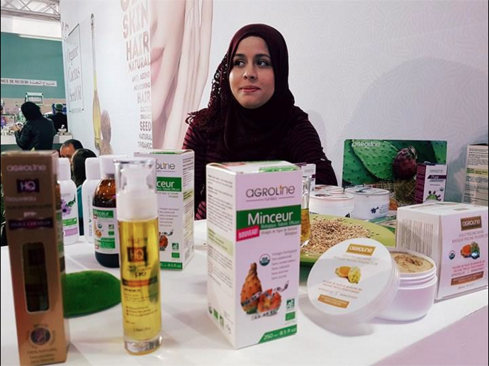
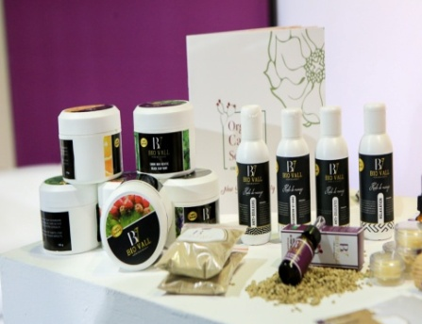
  Cactus Processing Companies increased from 5 in 2013 to 73 in 2024, representing a 14-fold growth, creating a more diversified and sustainable economy around cactus products.
  Female Ownership and Workforce: 55% of SMEs are owned and 80% of jobs are occupied by women, strengthening social resilience.
  Establishment of a cactus MSME association and collective marketing efforts led to increased exports and 52 MSMEs exporting globally, increasing income diversification in the region.
  Establishment of organic agroindustrial sector: 67 SMEs hold organic certifications and organic production has grown significantly, increasing from 650 hectares in 2013 to 3,000 hectares in 2024.
  Circular Economy Practices: Utilizing various parts of the cactus plant (beyond just prickly pear seeds) ) improves value addition, generates additional revenues and prevents waste. Cactus plants prevent desertification, allowing to fight against water and wind erosion, and the spreading of fires.
  Public-private partnerships: The public sector´s support was essential to develop the first national standard for cactus seed oil and promotion of cactus products abroad
Project achievements

Slide 10

GEORGIAN MARINE FISHING CLUSTER
From being squeezed out of the market to collective solutions

Slide 11
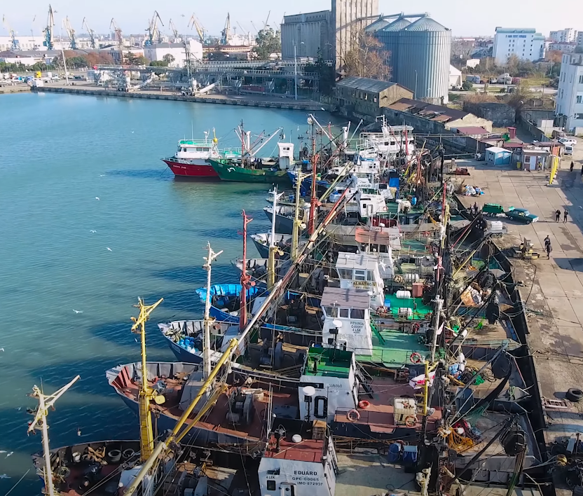
Georgian Fishing Industry Under Pressure
  Intense Market Competition and Underutilization of Quotas: Georgian fishermen struggled to compete with foreign fishing companies, which possessed better technology and capacity, resulting in underutilization of local fishing quotas.
  Economic Vulnerability and Regulatory Challenges: Many Georgian fishermen faced financial instability due to economic volatility and rising interest rates from banks, pushing some toward insolvency.
  Environmental Sustainability and Infrastructure Limitations: The increased presence of larger fishing vessels raises concerns about overfishing and the long-term sustainability of fish stocks. Furthermore, inadequate docking space in ports, such as Poti, limits the operational efficiency of local fishing companies, hampering their ability to utilize modern vessels effectively.
  Limited Collaboration and Support: There was a lack of effective communication and collaboration among industry stakeholders, which hindered efforts to address systemic challenges and advocate for the needs of Georgian fishermen.

Slide 12
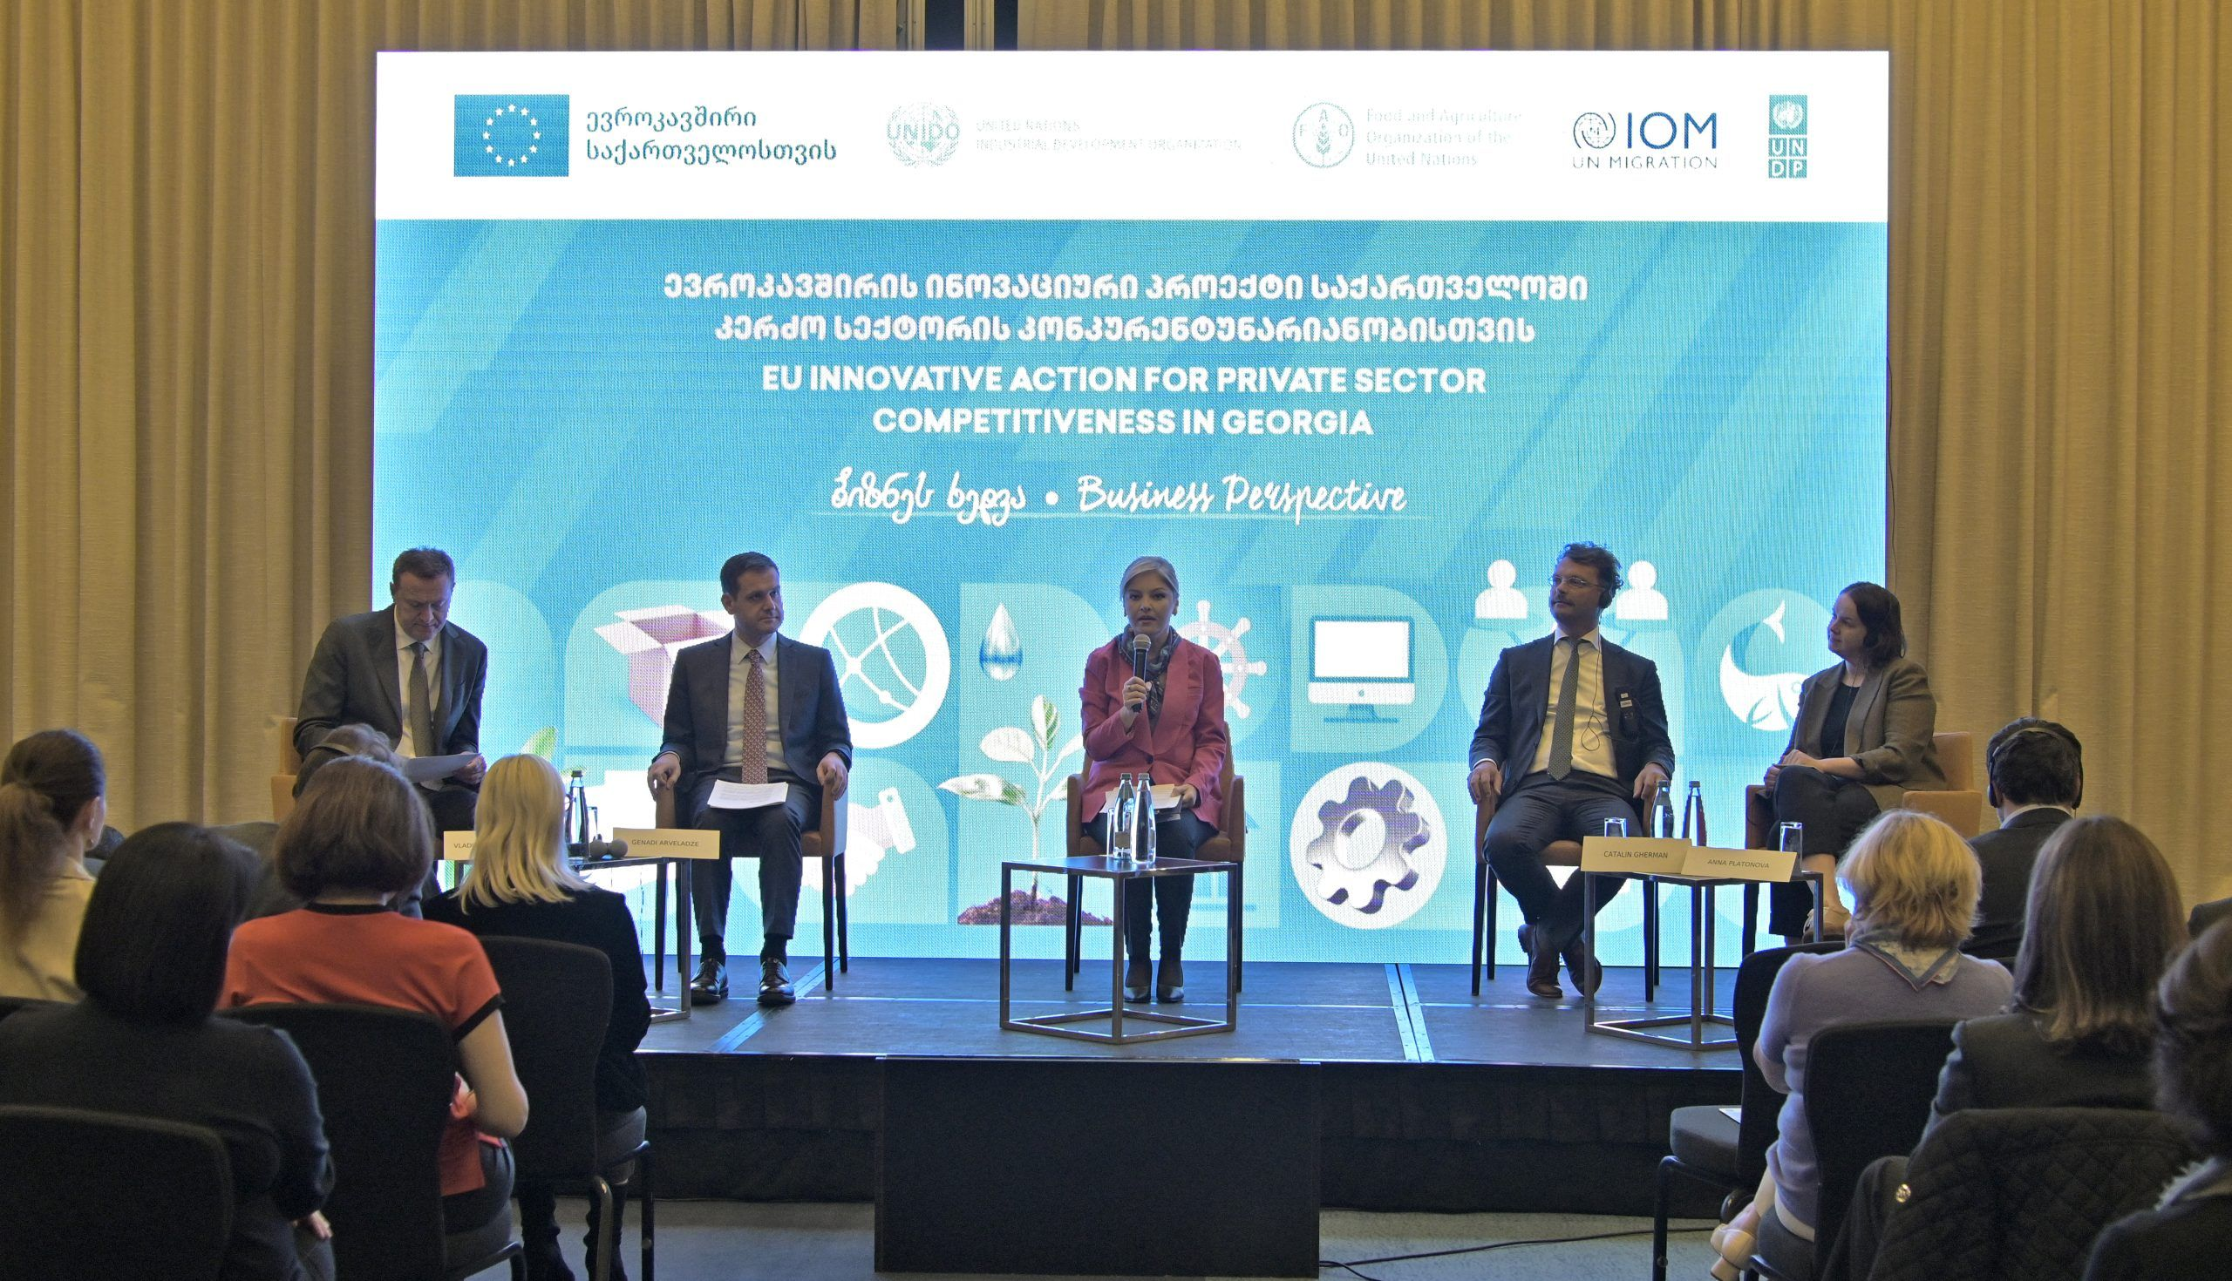
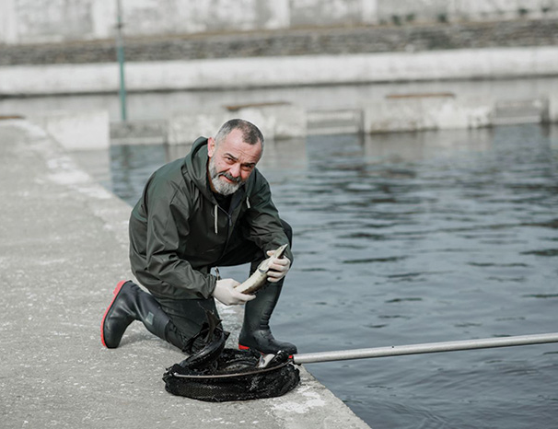
  Georgian Marine Fishing cluster became an active intermediary between its members, state agencies and supporting industries.
  A cluster strategy and action plan was developed with a clear five-year roadmap, emphasizing economic growth, social inclusion, and environmental responsibility.
  Helped introduce and approve a legal amendment in Georgia that allows fishing companies to use newly leased ships in the Black Sea. This change enables cluster members to better utilize their fishing quotas and resources.
  Supported marine fishing companies in negotiations with shipbuilding companies for timely delivery of new fishing vessels, and with banks to refinance business loans.
  Enhanced visibility and credibility of the cluster and the sector through national conferences.
Project achievements

Slide 13

THANK YOU

