Slide 1
MANAGERIAL FINANCE FOR CREATIVES
Pablo Gabriel Malvar
Philippine Creatives Industry Development Council Member
Chartered Financial Analyst
04 JULY 2024
Notes:
Title Page/ Cover Page/ Last page

Slide 2
MANAGERIAL FINANCE
OVERVIEW AND THE IMPORTANCE OF MANAGERIAL FINANCE FOR ENTREPRENEURS AND CREATIVE COMPANIES
Notes:
Spacer/ Category Page

Slide 3
BUSINESS MODEL CANVAS
UNDERSTANDING THE BUSINESS AS A BUILDING BLOCK.
FINANCE AS A TOOL. WILL NOT USEFUL WITHOUT UNDERSTANING THE VALUE PROPOSITION, MARKET, DSITRIBUTION, ASSETS, PROCESS OF THE BUSINESS.
Notes:
Spacer/ Category Page

Slide 4
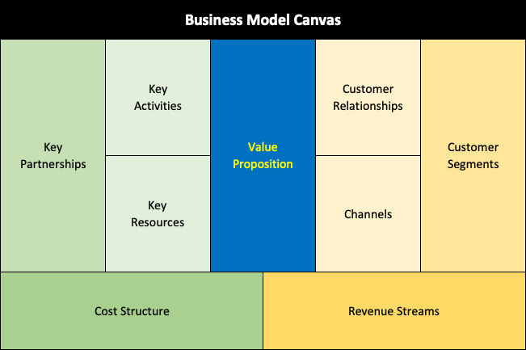
BODY TITLE
Notes:
Body page Dark Back

Slide 5
CASE STUDY DISCUSSION
VIVAMAX
Applying the Business Model Canvas
Notes:
Body page Dark Back

Slide 6
MANAGERIAL FINANCE
THE BALANCE SHEET
Notes:
Spacer/ Category Page

Slide 7
MANAGERIAL FINANCE
THE INCOME STATEMENT
Notes:
Spacer/ Category Page

Slide 8
MANAGERIAL FINANCE
THE CASH FLOW STATEMENT
Notes:
Spacer/ Category Page

Slide 9
MANAGERIAL FINANCE
FINANCIAL ANALYSIS USING RATIOS:
(LIQUIDITY, PROFITABILITY, LEVERAGE, EFFICIENCY)
Notes:
Spacer/ Category Page

Slide 10
DISCUSSION OF FINANCIAL STATEMENTS
SAMPLE:
Why does THE business always seem to need cash when net income is strong?
Net income has little or no profit yet cash position is high?
What is the company’s financial health? Are there enough funds to continue the business?
MANAGERIAL FINANCE
Notes:
Spacer/ Category Page

Slide 11
GUIDED EXERCISE FOR PARTICIPANTS:
Build revenue and cost projections for an independent film project. Assess marketability of the project. Assessing the viability of the project and likelihood of getting funding.
MANAGERIAL FINANCE
Notes:
Spacer/ Category Page

Slide 12
CASE STUDY: GUIDED WALKTHROUGH AND ANALYSIS OF ABS-CBN’S FINANCIAL STATEMENTS TO ASSESS PROSPECTS FOR THE COMPANY.
MANAGERIAL FINANCE
Notes:
Spacer/ Category Page

