Slide 1
Regional Perspectives:
National structures promoting localization in African countries
Publication Launch
“Accelerating progress on the 2030 Agenda from local to global levels: The critical importance of SDG localization”.
Lusungu Kayani, Social Affairs Officer, UNECA
Friday, 12 July, 2:30-4:00 pm
UN Library Reading Room

Slide 2
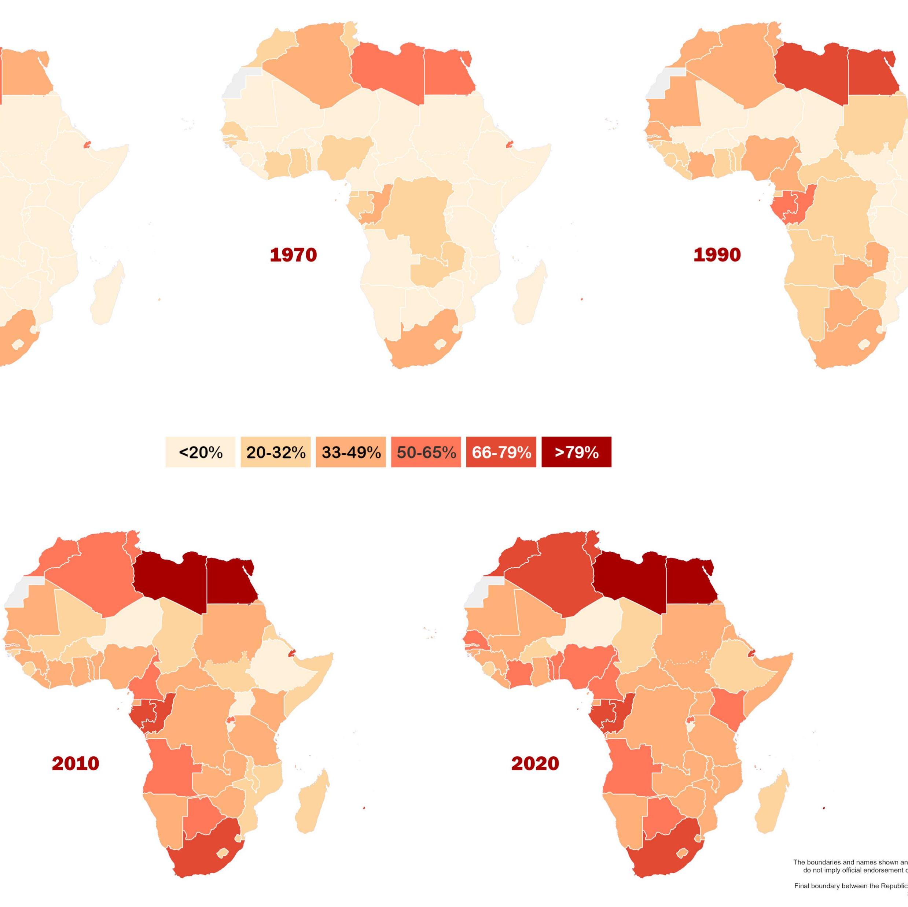
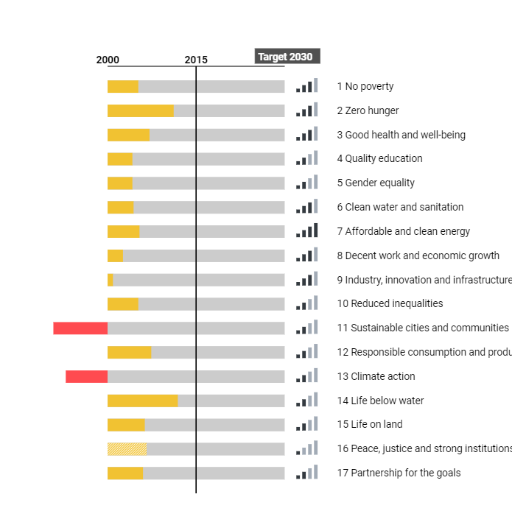
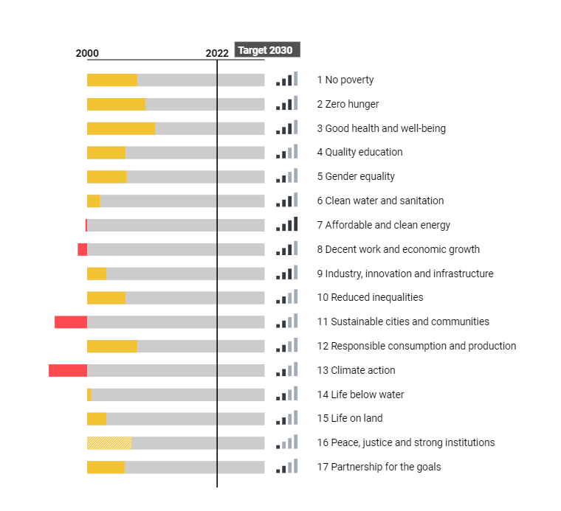
Regional context
Stalled progress and growing inequities-SDG & Agenda 2063
Region vulnerable to extreme poverty and inequality-increasingly evident in towns and cities
More than half of workers living in extreme poverty in Africa
VLR tool for localization, silo busting and cross sector coordination

Slide 3
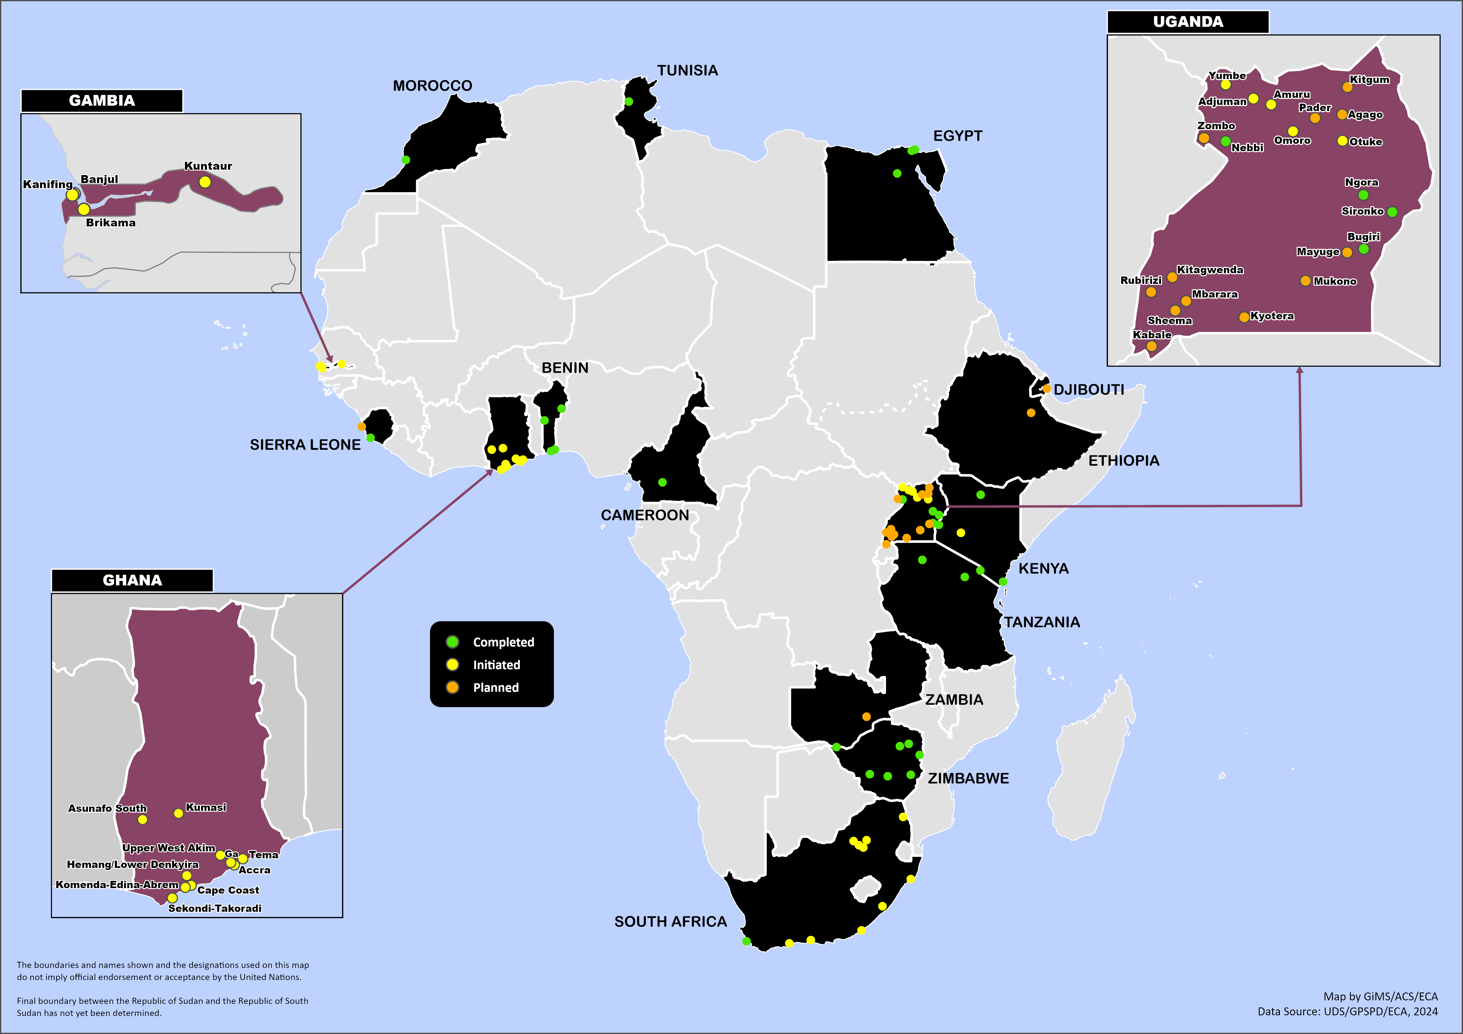
VLR Momentum in Africa Region
In the Africa region, VLR momentum is high.
VLRs will feed into 2024 VNRs for Uganda and Zimbabwe
National coordination mechanisms contribute to the scale and production across region
Local authorities integrated in national processes, improving multilevel dialogue

Slide 4





Subnational government plays a critical role in tracking and monitoring implementation
Scaling VLRs country-wide effective in national-local messaging
Improved multilevel governance and address data gaps
Multistakeholder drafting teams enhance inclusivity
Nationally coordinated reporting templates effective for consolidating data
Key Messages

Slide 5

Linking national and local processes-examples from the region - Uganda
National institutional frameworks reinforce SDGs at local level
SDG Secretariat instrumental and has domesticated Africa Regional VLR Guidelines –Guidelines for Localizing the 2030 Agenda for the SDGs in Uganda (15 LGs supported in VLRs
Parliamentary forum for SDGs mobilizes MPs for SDG localization
Through these efforts: SDGs translated into 13 local languages
VLRs scaled in districts across country
SDG Assessment tool developed to capture data in a standardized way
→ VLR outcomes embedded in objectives and performance monitoring indicators of District Development Plans
→VLR outcomes fed into 2024 VNR processes

Slide 6
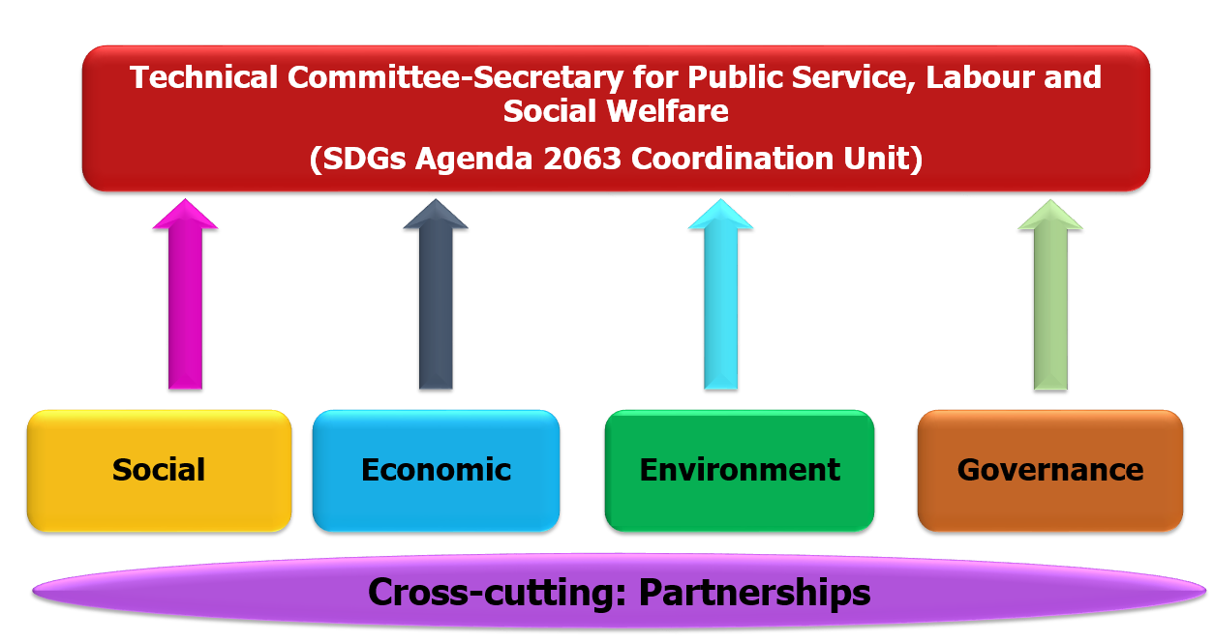
Linking national and local processes-examples from the region - Zimbabwe
2024 VNR benefiting from robust local review processes
SDG Agenda 2063 Coordination Unit under Secretary for PSLSW
National level clusters aligned to sustainable development agenda, NDS, and Zimbabwe SD Cooperation Framework
5 VLRs: between 2022-2024: Murewa, Mutasa, Bikita Rural District Council, Zvishavane Town Council, & Bulawayo City VLRs
Muli stakeholder drafting team established, inclusive of ministries, special interest groups, csos, faith groups, youth etc. utilized media, including radio, and TV

Slide 7
Recommendations
To national governments
To produce a robust and comprehensive VNR, a process of integrating the outcomes and key messages from local reviews should be identified at the national level.
The availability of granular data is critical to setting priorities and monitoring progress on the SDGs.
National Statistics Offices can help build local and regional government capacity to collect disaggregated and timely data through the development of standardized templates and procedures for data collection.
To raise awareness across stakeholders, it is recommended that a defined process of engagement is established at the national level to sensitize stakeholders on the global goals, the tools available to facilitate localization, as well as to share best practices on lessons learned.
To local governments
To better engage stakeholders, local governments should adopt innovative methods for consulting the community, for example through coordination platforms or local committees.
To the UN System
The UN system can continue to support localization in the region by organizing opportunities for peer learning and knowledge sharing and providing technical support to national Governments and local authorities to undertake such reviews.

Slide 8
Thank you

