Slide 1

Breaking the SDG finance gridlock through strengthening local government finance
Policy Recommendations and Actionable Proposals
Daniel Platz
Senior Economic Affairs Officer
DCF Team Leader

Slide 2

FfD4 is a key opportunity for strengthening local development local finance
Fourth International Conference on Financing for Development (FfD4)
  Huge opportunity for international community to strengthen SDGs achievment via local development finance
  Spain 30 June to 3 July 2025
§ 34 ADDIS ABABA AGENDA:
„We further acknowledge that expenditures and investments in sustainable development are being devolved to the subnational level, which often lacks adequate technical and technological capacity, financing and support. […]“

Slide 3
Importance of Subnational Investments
Local/regional governments responsible for 60% of public investments in developed countries
Local/Regional governments responsible for 65% of SDGs and targets
37% public investments worldwide

Slide 4
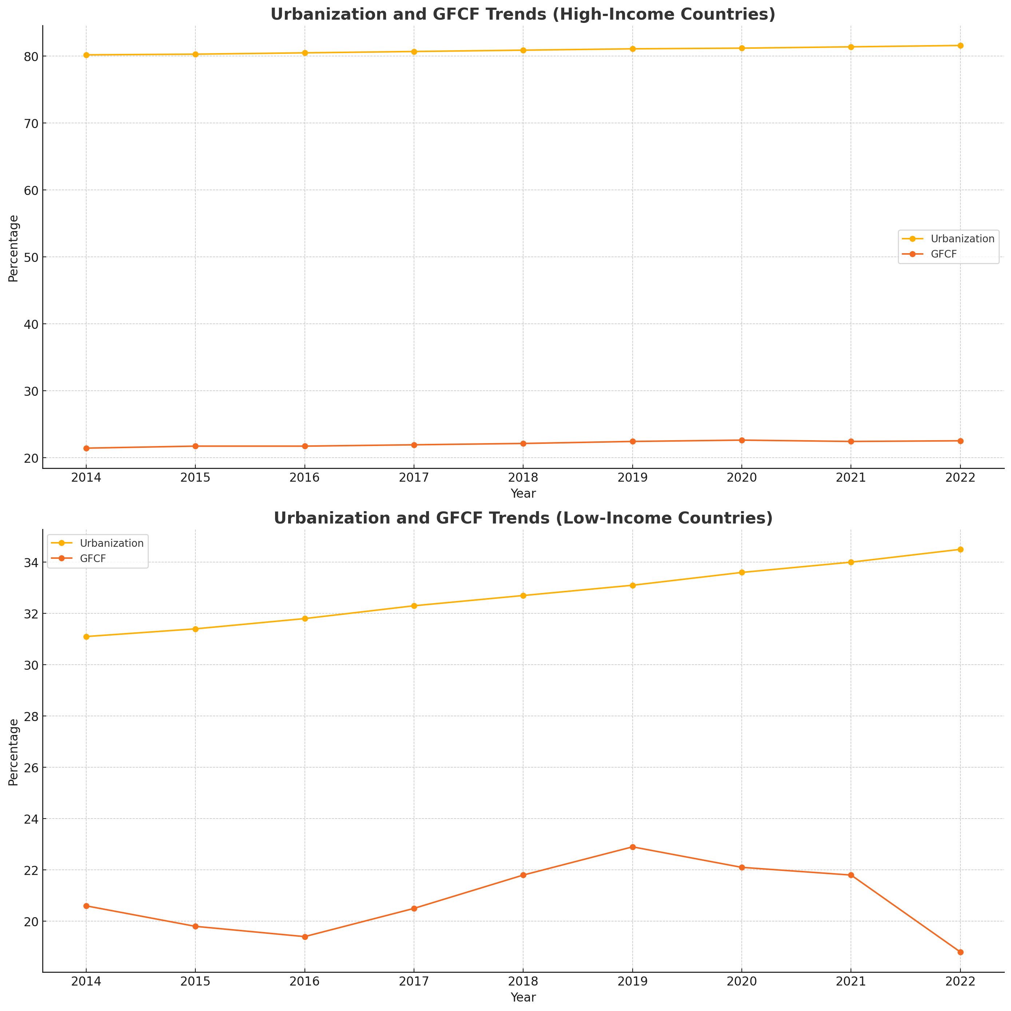

Urbanization outpaces capital investments
High income: Stable rates of fixed income capital and urbanisation
Low income: Increasing urbanization, but capital formation decreasing

Slide 5

Financing of Local Governments lagging behind
Own source revenue (OSR) lagging behind in developing countries
Fiscal transfers insufficient, despite high dependency (over 50% of subnational revenues in most countries, higher in developing countries)
Very limited access to borrowing
Limited bilateral ODA (Only 1.3% of bilateral ODA provided to cities and regions in developing countries)

Slide 6
Local Governments Are Good Stewards of Finance
Progress on Public Financial Management (PFM)
Budget management capacities have increased over the last 25 years
Local government investments: visible and fast-paced
Public Trust
Increased trust due to visibility at local level can increase tax compliance
Notes:
Malawi, Uganda, Rwanda e.g. avg subnational gov revenue of 9.7 % ot total gov revnenue
Grants and subsidies from the central governments are the primary source of subnational government revenue in a large majority of countries around the world.
The income level of countries is correlated with the level of subnational debt, both as a percentage of GDP and as a percentage of general government debt
But many local governments still have reduced capacities, both legal and in terms of human resources, to manage their own finances

Slide 7
1. Intergovernmental Fiscal Transfers (IGFTs)
IMPORTANCE
Addresses fiscal imbalances and financing gaps, promoting SDGs
CURRENT STATE
IGFTs key revenue source for local governments but insufficient
ACTIONS
Ensure predictability and security of transfers
Base grants on revenue potential and expenditure needs
Reduce transaction costs with common reporting systems and strategic grant focusing
Issues with insufficient transfer sizes, unclear distribution criteria, and high transaction costs

Slide 8
2. Own Source Revenues (OSR) and Asset Management
IMPORTANCE
OSR sources like user fees, local taxes and licenses can bridge financing gaps
CURRENT
STATUS
Limited local taxing power
ACTIONS
Improved local tax policy and administration
Enhances local government autonomy and accountability
Infrastructure Asset Management (IAM) and Public Financial Management (PFM)
Inadequate management of local infrastructure assets (lifecycle issues)
Ensures revenue adequacy, buoyancy, stability, and equity
Tax admin capacity challenges

Slide 9
3. Domestic capital markets
IMPORTANCE
Large scale financing needs: Traditional financing can't meet growing public service demand
Domestic capital markets can support large-scale investments in infrastructure
CURRENT STATUS
underdeveloped capital markets, restrictive laws, low creditworthiness, limited managerial capacity, and weak borrowing incentives at the local level
ACTIONS
Deepen domestic capital markets
Improving creditworthiness of cities and local governments
Blending Public and Private Finance
Notes:
Solutions:
-Blending Public and Private Finance:
Combine IGFTs, OSRs, and private sources to finance green projects.
Example: Paragraph 34 of the Addis Ababa Action Agenda emphasizes strengthening debt management and municipal bond markets.
Improving Creditworthiness:
Enhance policies and practices to improve local government creditworthiness.
Example: Tanga water revenue bond in Tanzania for sustainable investment.
Holistic Support:
Strengthen own source revenues, intergovernmental fiscal rules, and municipal borrowing frameworks.
Broaden and deepen domestic capital markets with an enabling environment.
Innovative Measures:
Use intermediary instruments to channel climate finance to local governments.
Non-sovereign regional or global guarantees for transformative investments.

Slide 10
4. New Idea: Guarantee funds for cities
CHALLENGE
Global foreign direct investment (FDI) fell by 42% in 2020 due to COVID-19
ACTIONS
Mitigate risks and increase investor confidence in local governments thorough multilateral investment guarantees
Limited public/private guarantors for sub-sovereign infrastructure
Existing mechanisms insufficient for local government development finance needs
Reduce cost of capital for municipal borrowing
Accelerate transformative investments
Notes:
Solutions:
Partial/Full Credit Guarantees:
Central government or international development partner guarantees.
Tailored to local characteristics.
Example: Philippines’ LGUGC, Cameroon’s public body, Nepal’s autonomous agency.
Blended Finance:
Combine guarantees with public-private partnerships, direct grants, and concessional lending.
Local government revolving recovery funds for short-term liquidity.

Slide 11
5. New idea: Infrastructure Asset Management (IAM)
CHALLENGES
Missed out on tax revenue and disincentivized tax compliance by undermanaged assets
ACTIONS
ensure these assets are managed to support reliable, resilient, inclusive, and sustainable essential services in the long term
OSR directly and indirectly linked to physical assets owned/managed by local governments
Frequently infrastructure assets not adequately managed over lifetime and portfolio
Putting in place an IAM framework and corresponding policies

Slide 12
Outlook
Key to boost SDGs:
Enable local government financing
Fourth International Conference on Financing for Development (FfD4)
Spain
30 June to 3 July 2025

