Slide 1
Harnessing Local E-Government
for the 2030 Agenda
Notes:
My name is
Wai Min Kwok, Senior Governance and Public Administration Officer, UNDESA Division for Public Institutions and Digital Governance
I will present the policy brief “Harnessing local e-government for the 2030 Agenda” developed by the Digital Government Branch, DPIDG, UN DESA.

Slide 2
Background – Local Online Service Index
2018
40 cities
60 indicators
2020
100 cities
80 indicators
2022
193 cities
86 indicators
Notes:
BRIEFLY INTRODUCE UN E-GOV SURVEY & LOSI
The United Nations Department of Economic and Social Affairs (UN DESA) publishes the United Nations E-Government Survey biennially to evaluate the digital transformation in 193 Member States using the E-Government Development Index (EGDI) and supplementary indexes like E-Participation Index (EPI) and Local Online Service Index (LOSI).
PROBABLY SOMEONE ELSE WILL SAY BELOW.
The 2023 Global Sustainable Development Report underscores the critical role of digital transformation in achieving the ambitious goals of the 2030 Agenda. Local e-government, leveraging Information and Communication Technologies (ICTs), has emerged as a powerful tool for advancing the Sustainable Development Goals (SDGs). Local and regional authorities, being the closest governing bodies to communities, are responsible for delivering a wide range of essential services such as education, healthcare, and public safety. With 65% of SDG targets falling under their jurisdiction, these local entities play a crucial role in driving progress. This makes the localization of SDGs through e-government solutions not just beneficial, but imperative for effective implementation and the realization of the 2030 Agenda's vision.

Slide 3
Challenges in Local E-Government Development
1
National and Local Discrepancy
41% of cities fall short in comparison to their countries' Online Service levels, highlighting a gap in public service delivery due to limited resources, impeding local governments' ability to invest in digital infrastructure
2
Urban and Rural Divide
ITU data reveals a stark digital divide: 81% of urban residents had internet access in 2023 versus 50% in rural areas, dropping to 17% in low-income countries' rural regions. Digital divides persist not only between urban and rural areas but also within cities and regions, encompassing disparities in internet access, usage, and digital literacy due to uneven distribution of educational and technological resources.
3
Lack of Skilled Personnel
The shortage of skilled personnel to manage digital systems challenges local governments, potentially causing service disruptions and inadequate support for residents' digital needs.
4
Resources disparity
The LOSI evaluation of 2022 reveals an unequal distribution within the highest LOSI tier. While 20 cities in Europe, 10 in Asia, 6 in the Americas, and 2 in Oceania meet this criterion, the striking absence of major cities in African nations is a cause for concern, highlighting a significant disparity across various regions.
Notes:
LIST THE CHALLENGES THAT THE POLICY BRIEF HIGHLIGHTED

Slide 4
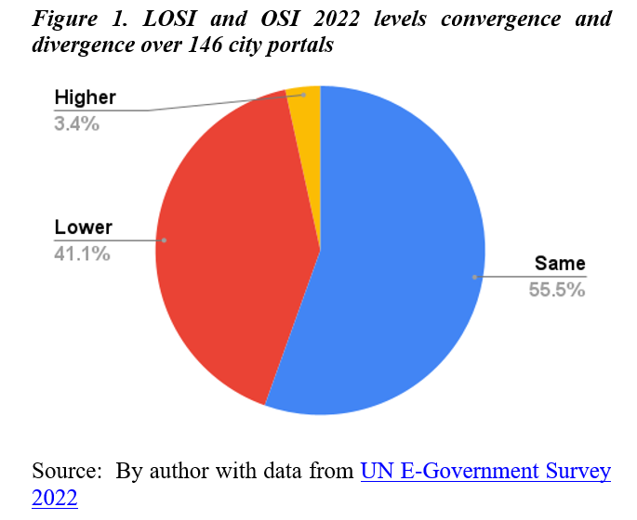
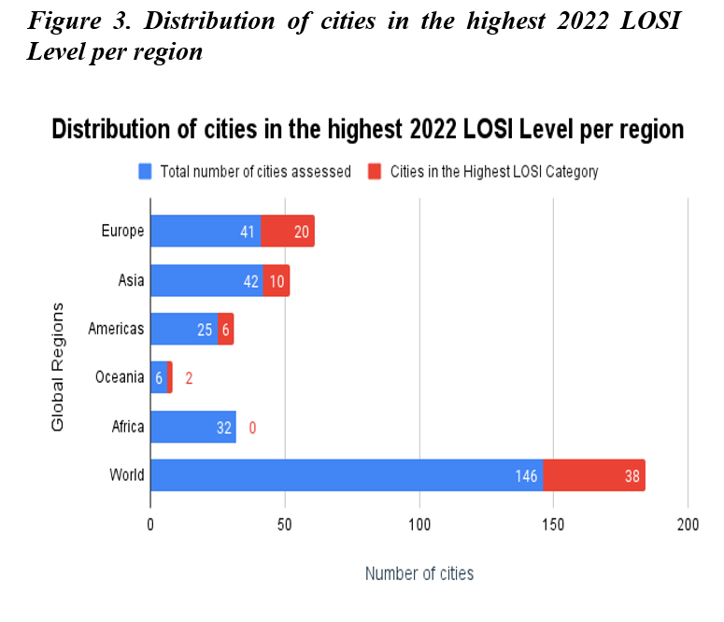
Challenges in Local E-Government Development
Notes:
To highlight challenges, I will show you two figures from the policy brief.
Figure 1: The 2022 UN E-Government Survey shows significant local e-government progress, with a 54% increase in high-performing cities since 2020. However, challenges persist, as only 55% of evaluated city portals align with national counterparts, highlighting the need for equitable digital infrastructure across all government levels.
Figure 3: The LOSI evaluation of 2022 reveals an unequal distribution within the highest LOSI tier. While 20 cities in Europe, 10 in Asia, 6 in the Americas, and 2 in Oceania meet this criterion, the striking absence of major cities in African nations is a cause for concern, highlighting a significant disparity across various regions.

Slide 5
Seizing Opportunities: Advancing Local E-Government for Sustainable Development
Opportunity
Implementing Strategy
Best Practice
SDG and Target
Recognizing local governments' diverse challenges is crucial to unlocking technology's potential for sustainable development. Understanding their needs enables effective policy-making to localize SDGs through digital tools, requiring a unified, whole-of-government approach with comprehensive guidance. This section presents seven targeted opportunities to address local e-government challenges in achieving SDGs.
Establish a dedicated fund at the national level to support local and regional governments in developing and maintaining digital infrastructure
India's Smart Cities Mission. A dedicated national fund and capacity-building program supporting local governments in developing digital infrastructure and enhancing governance and services
SDG 11 (Sustainable Cities and Communities), Target 11.3.
Promoting National and
Local Alignment
Launch targeted initiatives for rural connectivity, including:
i) partnerships with telecommunication companies to expand broadband coverage, and ii) subsidized data plans for rural residents.
The Philippines' Free Wi-Fi for All Program is a notable example of efforts to bridge the Internet access gap. Through partnerships with telecom companies, the initiative expands broadband coverage in rural areas, subsidizes data plans, and promotes digital literacy
SDG 9 (Industry, Innovation, and Infrastructure), Target 9. C
Bridging the Internet Access Divide
Institute specialized training programs for local personnel, focusing on e-governance policies, digital platforms, and data management
The Danish Government Digital Academy equips civil servants with essential digital skills. It offers tailored courses, such as 'Government Officials within the Digital Public Sector' and 'Cyber and Information Security,' focusing on areas like strategy, data management, and collaboration, guided by the Model of Digital Skills.
SDG 8 (Decent Work and Economic Growth), Target 8.6
Enhancing Digital Workforce
Notes:
MENTION THAT THE POLICY BRIEF HIGHLIGHTS OPPORTUNITES IN THE AREA OF LOCAL E-GOVERNMENT DEVELOPMENT TO ADDRESS THESE CHALLENGES
These suggestions are given as an example and should be part of a broader strategy that aligns and integrates local priorities/ actions with the broader sustainable development agenda. There should also be coherence and coordination amongst the different levels.
While only one innovative practice is presented for each implementation strategy due to space limitations, it is important to note that there are numerous innovative practices from around the world that address similar challenges and objectives. The examples provided serve to highlight the potential approaches and solutions available, but they are not exhaustive.
MAYBE READ ONE OR TWO EXAMPLES

Slide 6
Seizing Opportunities: Advancing Local E-Government for Sustainable Development
Opportunity | Implementation Strategy | Best Practice | SDG and Target
Promoting Equitable Resource Distribution | Conduct a thorough assessment of resource distribution among cities, identifying gaps and allocating resources based on need. Implement policies to incentivize private sector investment in less privileged cities, fostering a balanced distribution | The Making Cities Resilient 2030 (MCR2030) initiative, led by the United Nations Office for Disaster Risk Reduction empowers cities to assess resilience, identify resource gaps, and implement policies for equitable distribution | SDG 11 (Sustainable Cities and Communities), Target 11.A
Integrated Data Empowerment | Establish and enforce standardized protocols for seamless data sharing and interoperability across government levels. Create a centralized platform for efficient data exchange, fostering collaboration between diverse government entities and promoting evidence-based decision-making. | Singapore exemplifies Integrated Data Empowerment by enforcing standardized protocols for seamless data sharing. Their centralized platform promotes collaboration and evidence-based decision-making. | SDG 16: Peace, Justice, and Strong Institutions, Target 16.6
People-Driven Service Transformation | Implement co-design and inclusive decision-making practices for local online services aligned with the SDGs. Launch a dynamic online hub for accessible guidelines, encouraging active resident participation in service development and evaluation. | Reykjavik, Iceland, "Better Reykjavik" initiative, enables residents to propose and prioritize ideas, actively involving them in decision-making. | SDG 16: Peace, Justice, and Strong Institutions, Target 16.7
The LOSI Network - A Global Platform to Champion Local E-Government | Leverage UN DESA tools, such as the LOSI Network, and comprehensive guidance on the Application of LOSI Methodology to empower stakeholders, inform policy, gather insights, and drive action for advancing local e-government and sustainable development, promoting the LOSI methodology globally | Several UN Member States, including Jordan, Brazil, India, Uzbekistan, and the State of Palestine, have implemented the LOSI methodology across their municipalities, using findings to inform policy decisions and improve local e-government practices.
Notes:
FROM THESE OPPORTUNITES, HIGHLIGHT LOSI NETWORK

Slide 7
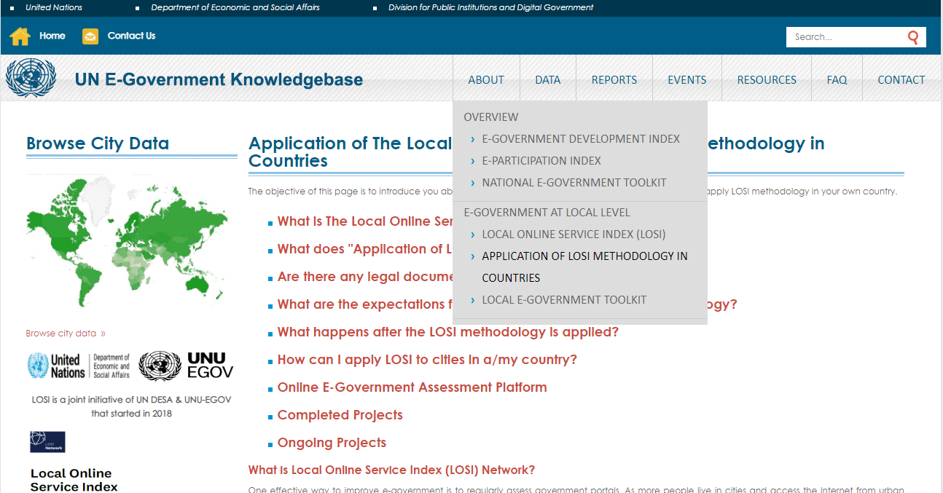
LOSI Network
https://publicadministration.un.org/egovkb/

Slide 8
Policy Recommendations
1
Strengthen collaboration and resource allocation between national and local governments
3
Provide training and support to local government officials on how to effectively manage and maintain digital systems
To ensure equitable access to digital infrastructure and capacity building establishing national funds specifically for local e-government initiatives, providing technical assistance to local governments, and developing standardized e-government platforms that can be easily adapted by local authorities.
developing online training modules, offering in-person workshops, and establishing peer-to-peer learning networks among local governments
2
Invest in expanding internet access and digital literacy programs in rural areas
4
Encourage regional cooperation and knowledge sharing among local governments in different parts of the world
partnering with private sector companies to provide affordable internet access, establishing community technology centers, and developing targeted digital literacy training programs for rural residents
The LOSI Network offers access to a global community of e-government stakeholders and serves as a catalyst for collaboration, facilitating active peer-to-peer learning exchanges and the development of impactful joint training programs.
5
Mainstreaming Local E-Government in National Development Strategies
integrating local e-government objectives and targets into national development plans and policy frameworks and establishing mechanisms for multi-level governance coordination and collaboration to synchronize efforts between national, regional, and local authorities.
Notes:
THESE ARE THE POLICY RECOMMENDATIONS OF THE POLICY BRIEF

Slide 9
Notes:
FINISH WITH UN E-GOV SURVEY 2024

