Slide 1
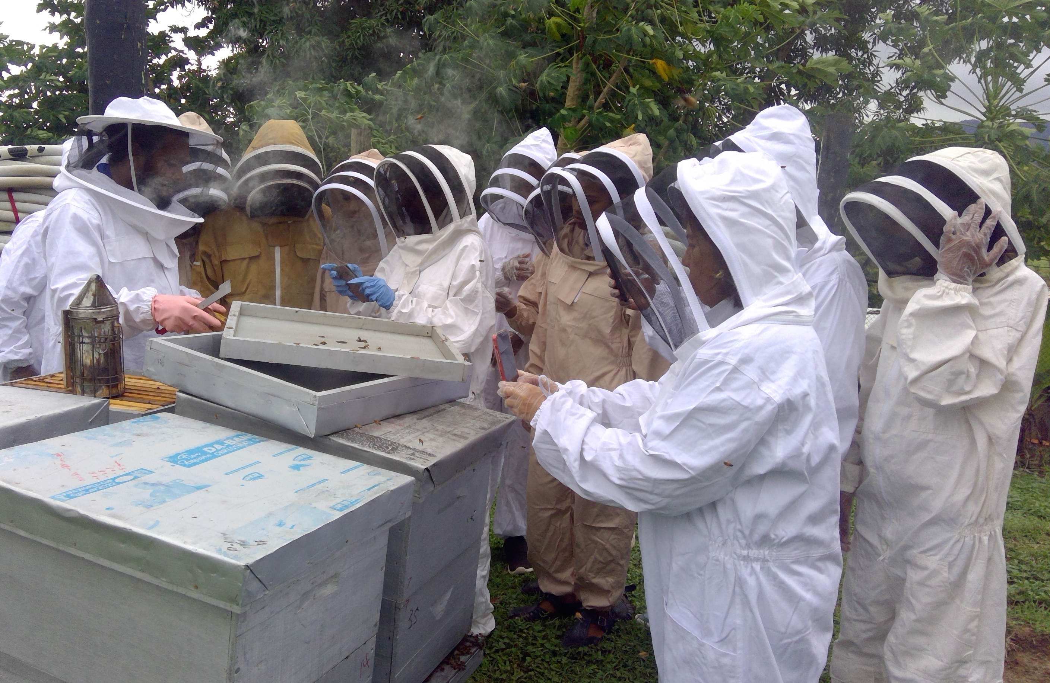
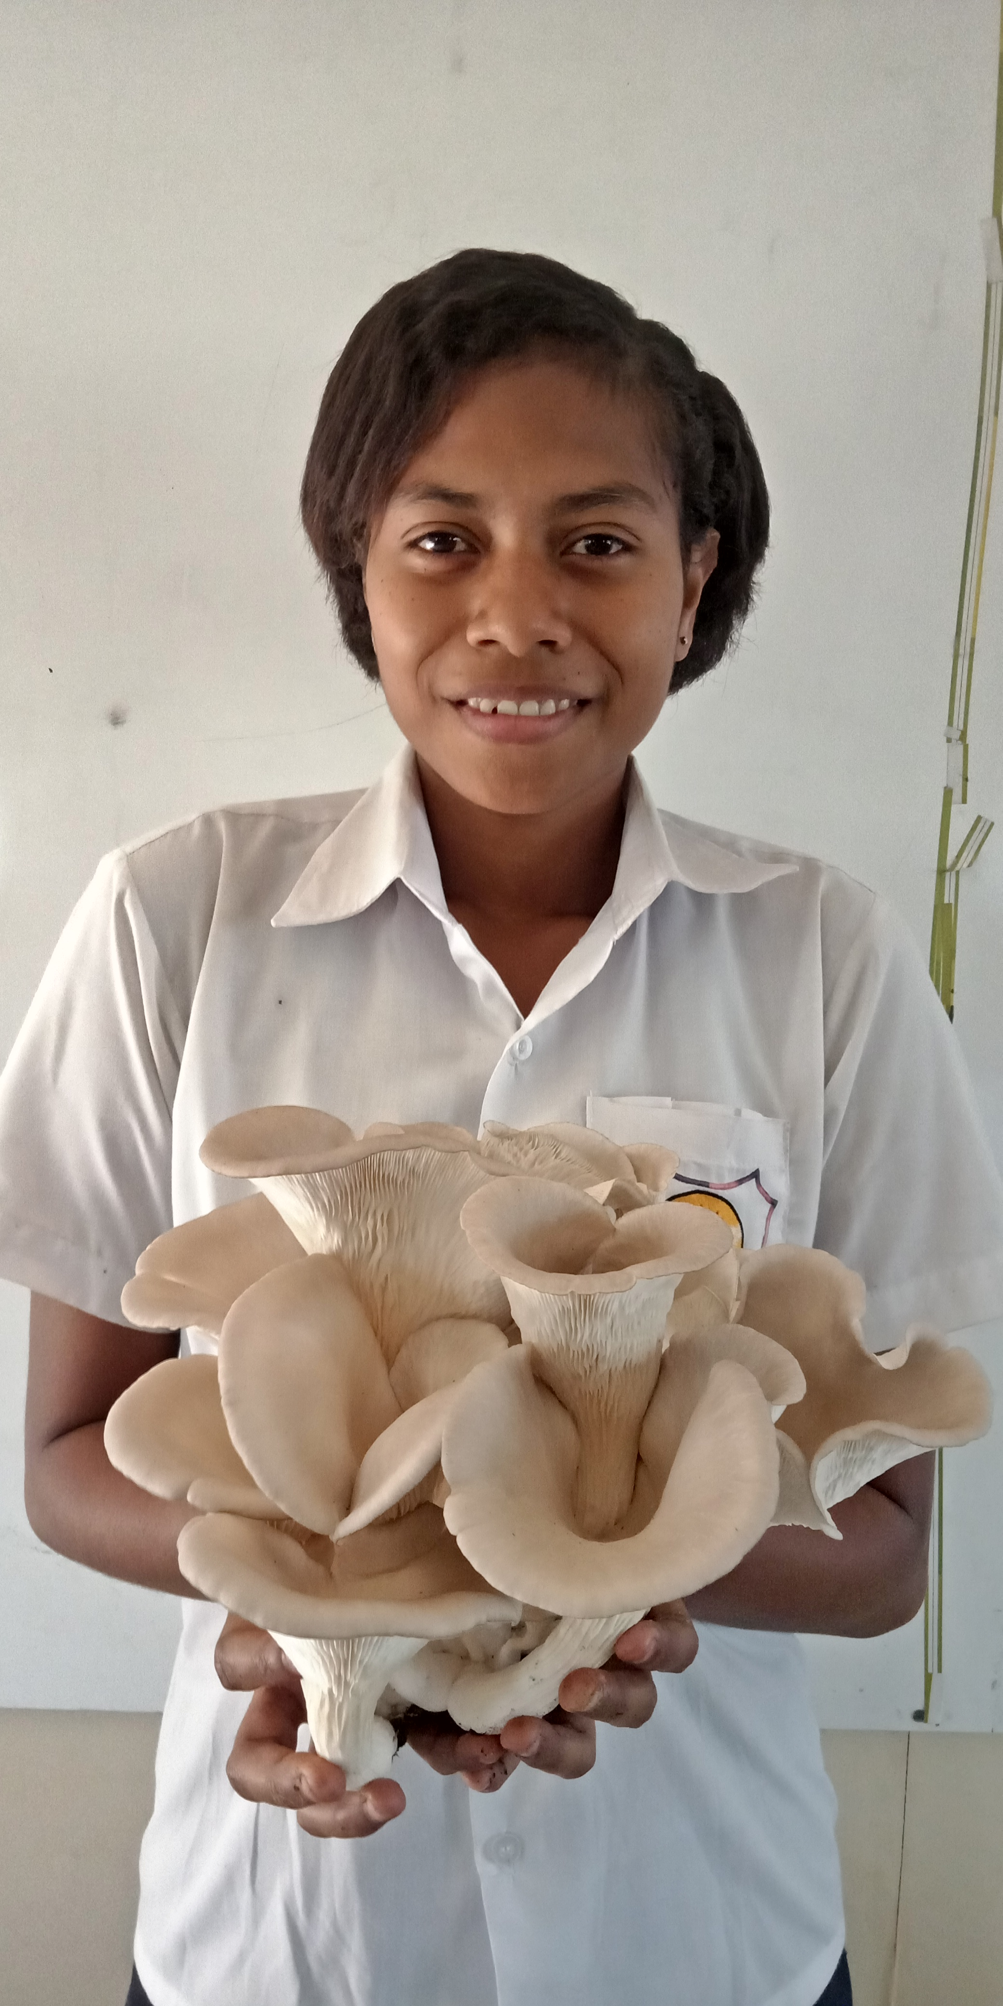
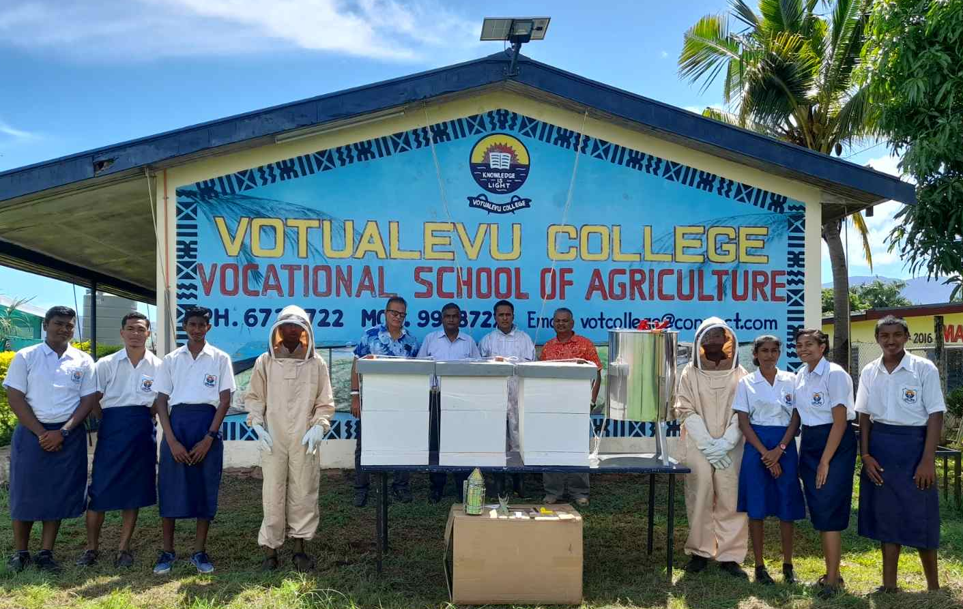
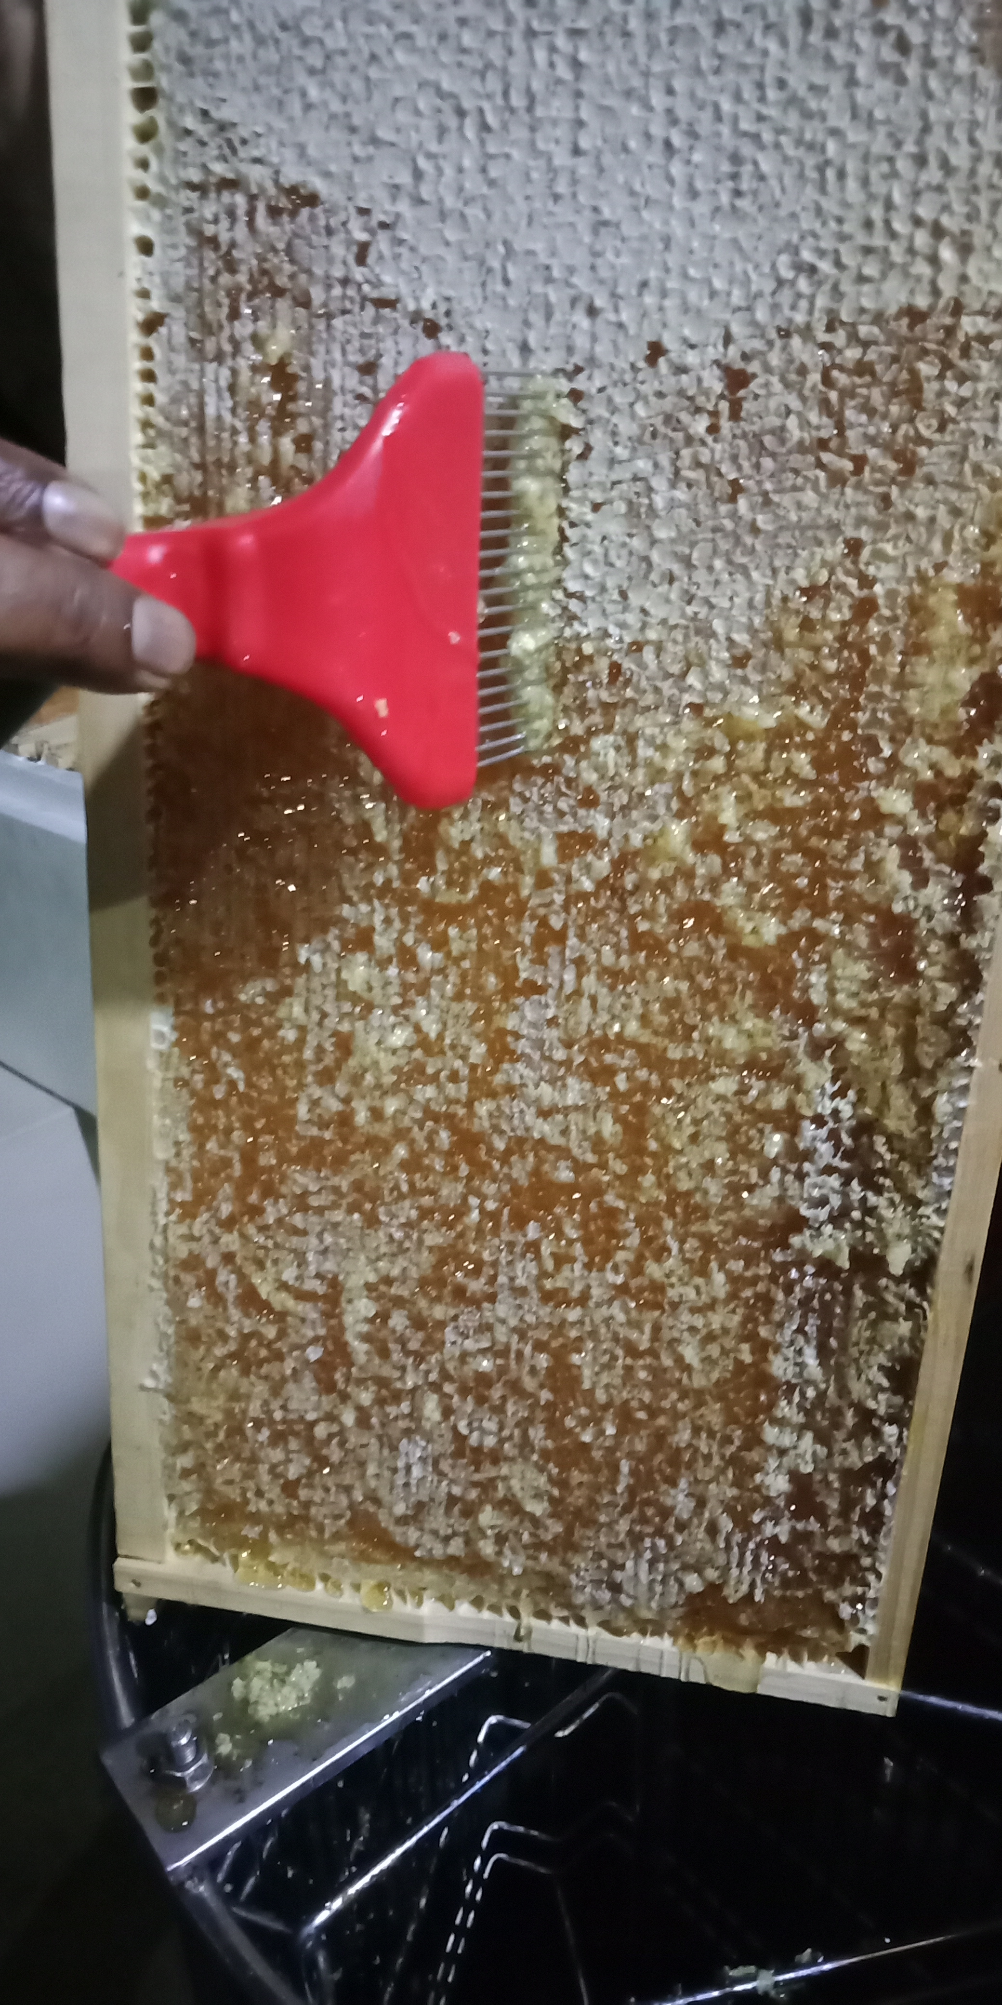
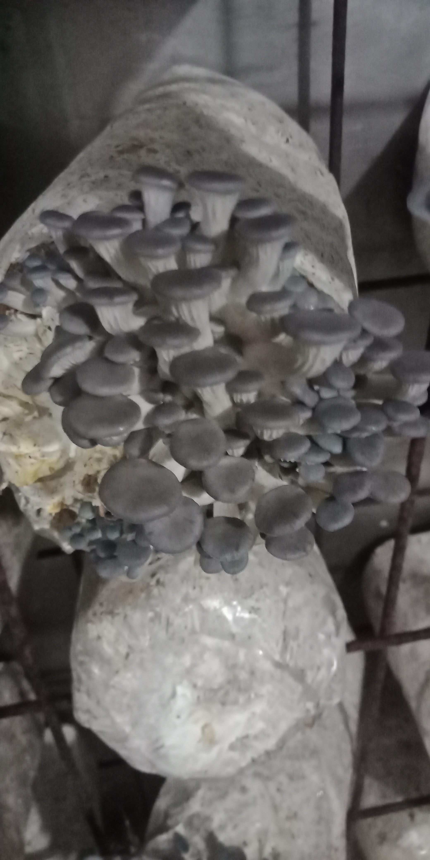
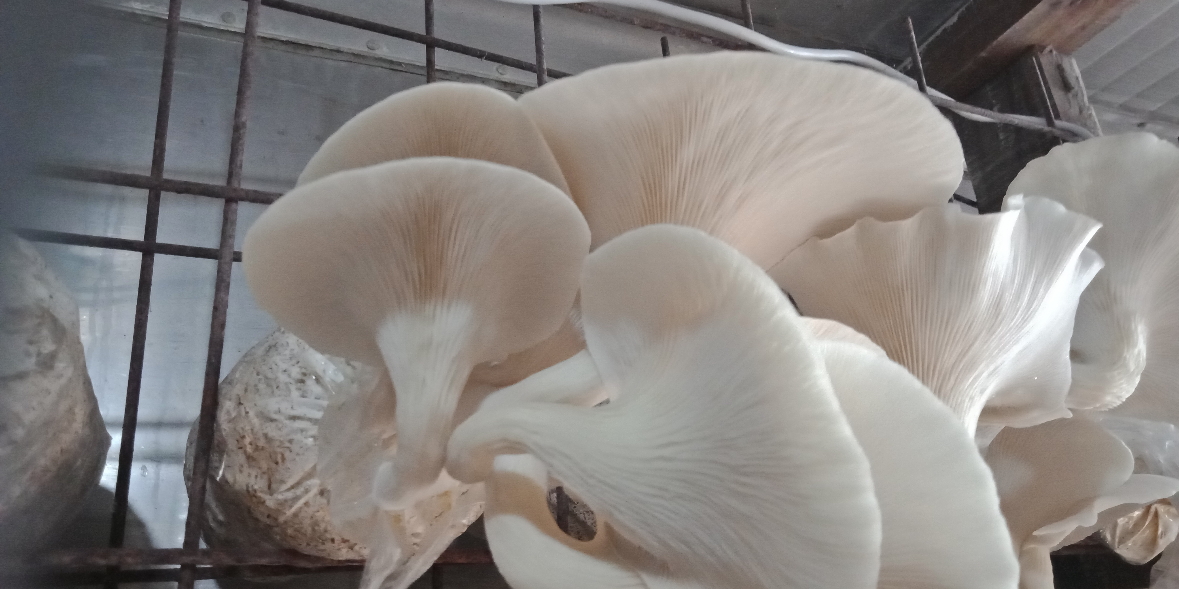
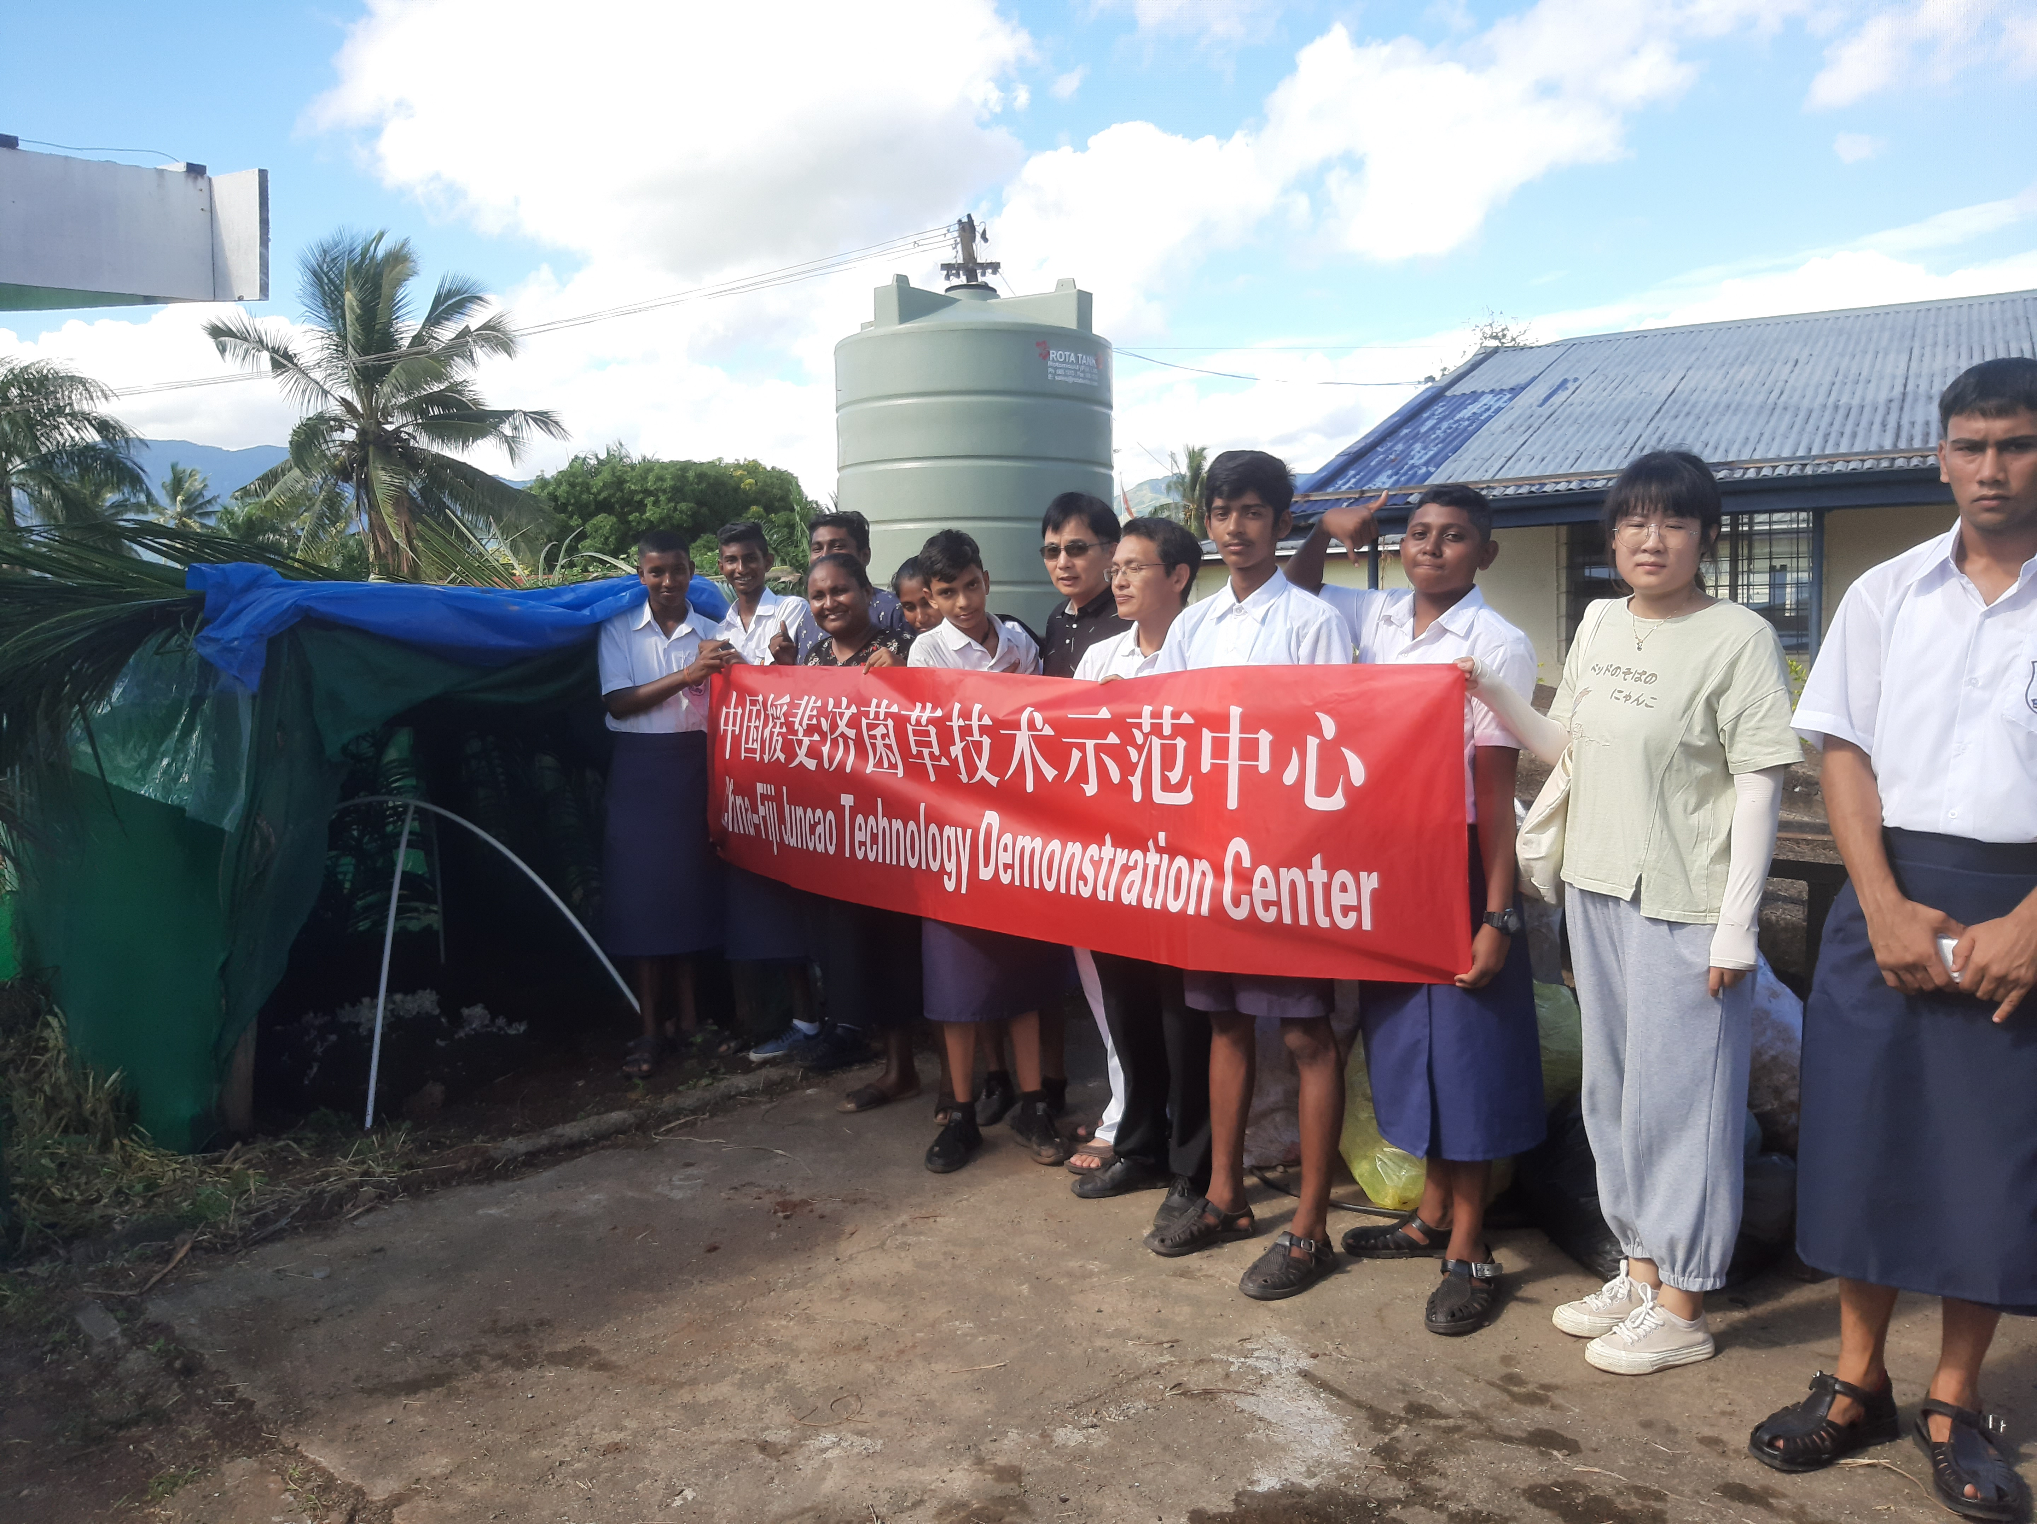
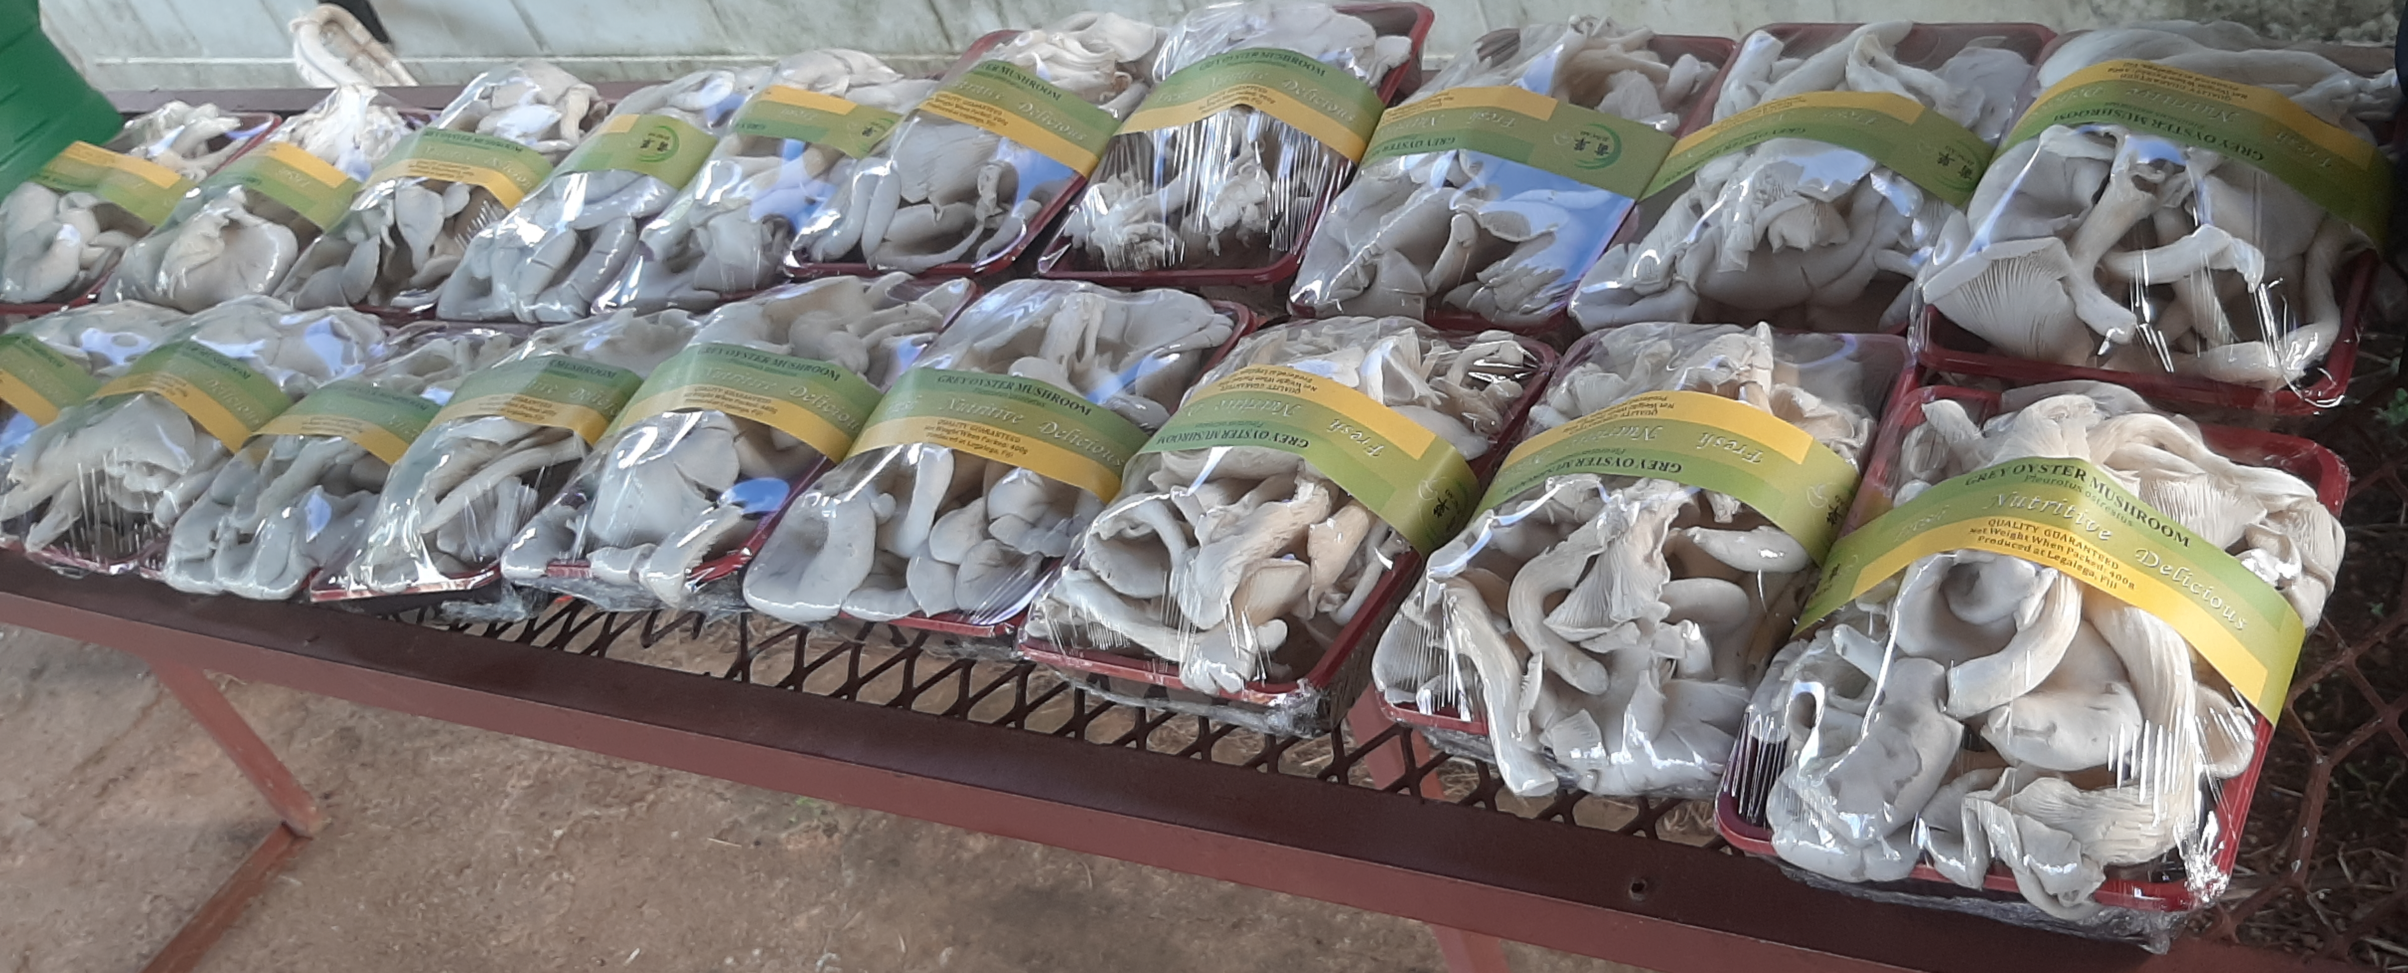
VOTUALEVU COLLEGE
VOCATIONAL AGRICULTURE

Slide 2
VOTUALEVU COLLEGE VOCATIONAL AGRICULTURE
VOCATIONAL Center at Votualevu College was the first Vocational School to provide skilled based education in Fiji established back in 1965. The Vocational center was founded by local farmers to provide skilled based education to the children of Votualevu and greater Nadi Area. In the modern time of today our Vocational center has evolved to a leading institution with implementation of advance technology in in the field of Agriculture. In the recent years we have collaborated with Juncao Center. .This Collaboration has made us have access to China Aid, with the help of this Aid we have seen great development at our center. Our students have mastered the skill of Juncao Technology, this has resulted in we getting into commercial mushroom farming. We have diversified into many aspects of Juncao technology. Bellow are various activities we carry out at our center.

Slide 3
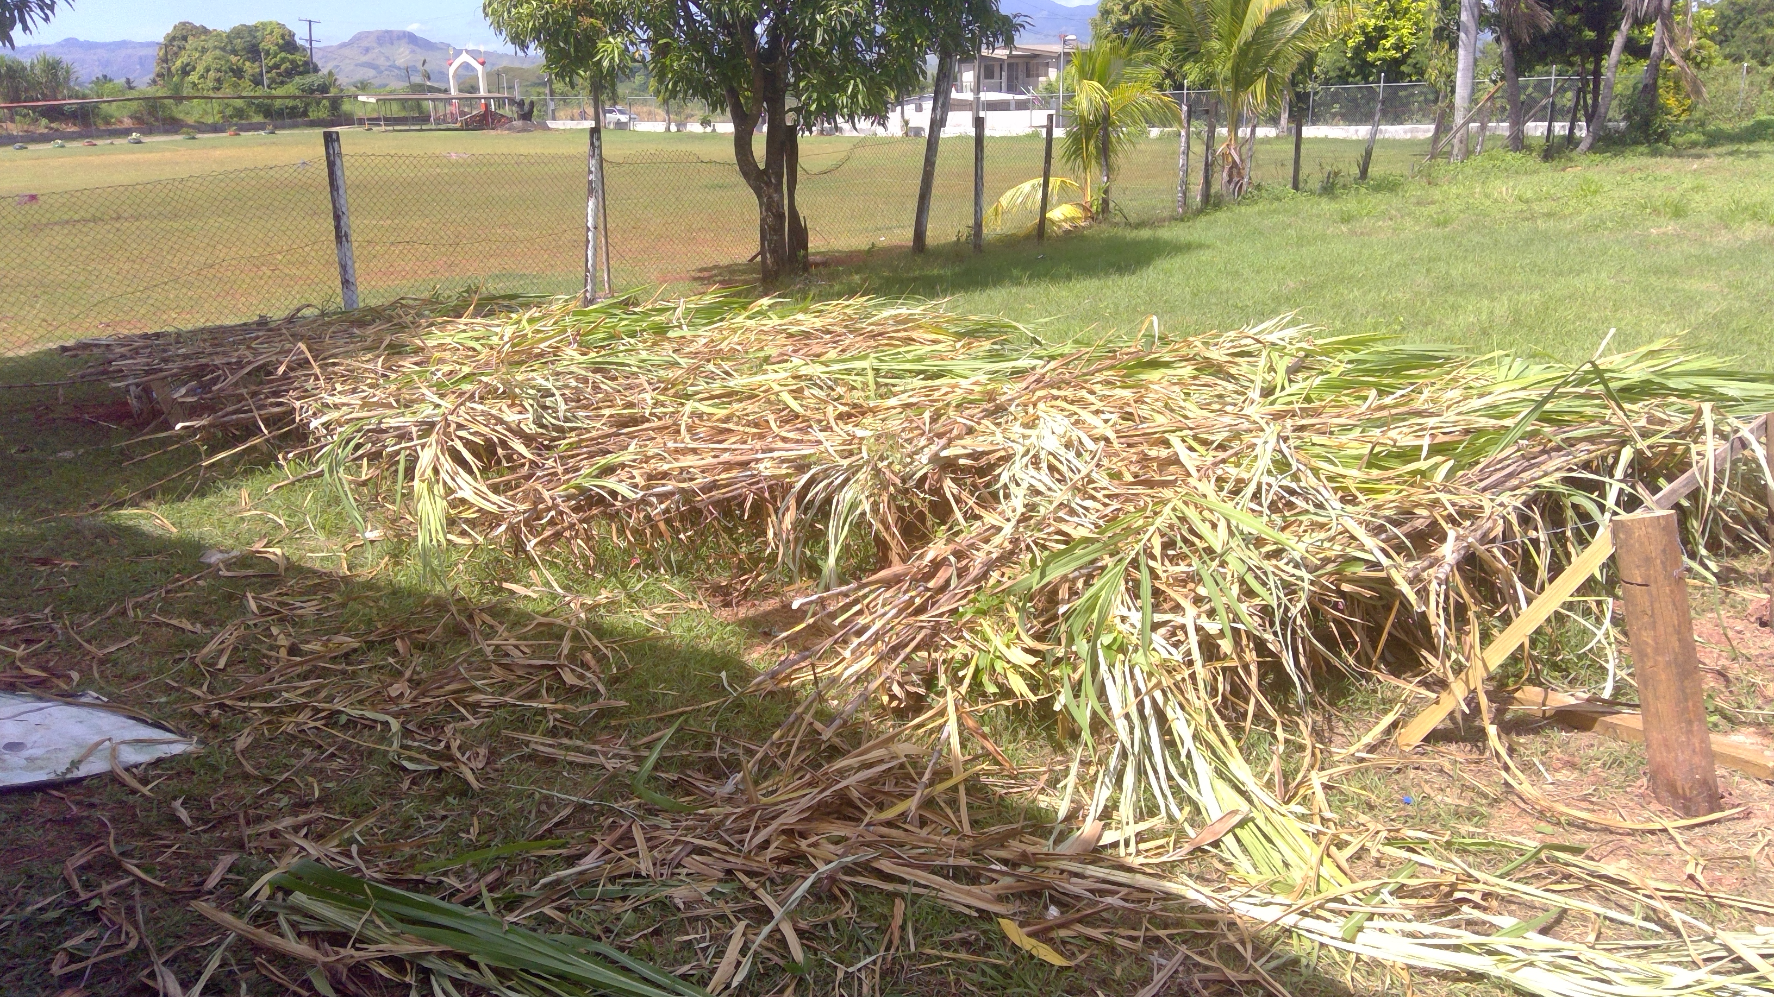
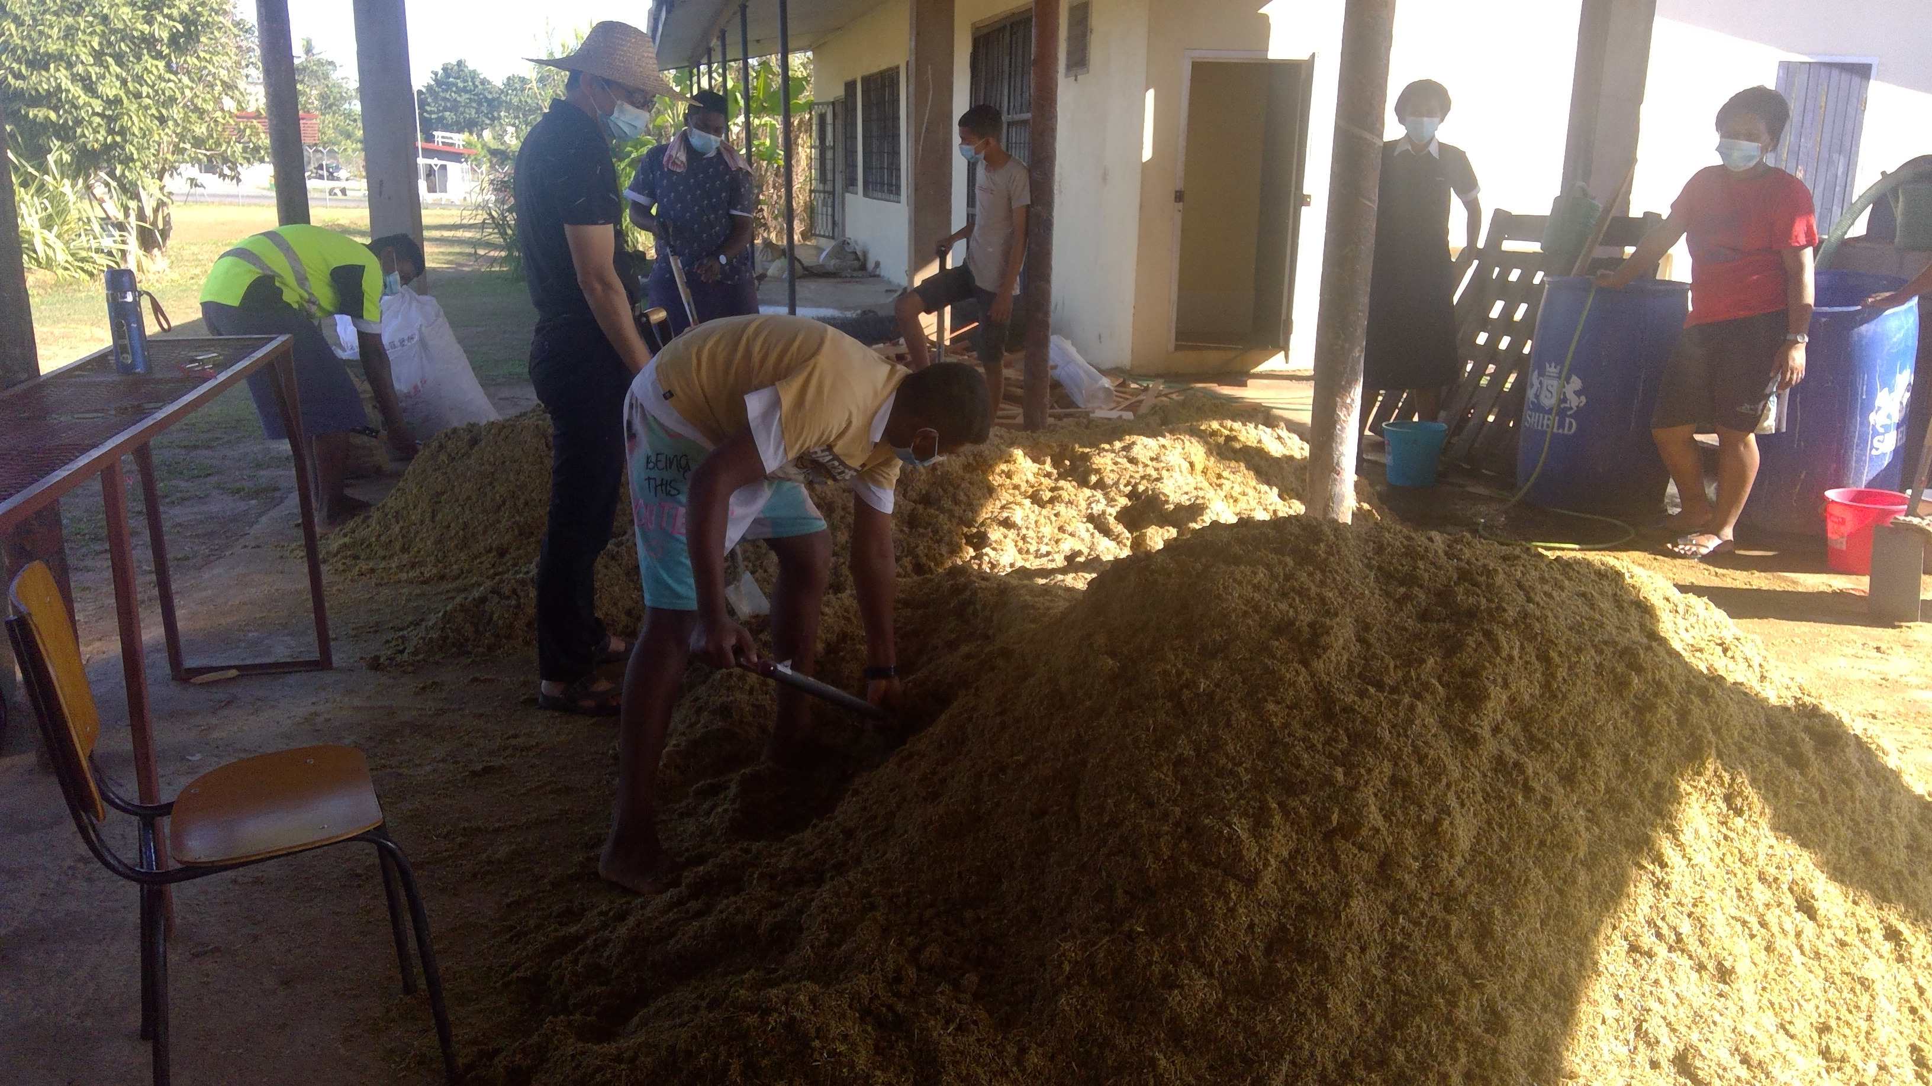
Harvesting & Processing of Juncao Grass
Juncao grass is harvested at 9 to 12 months to ensure it has high nutritional value so it can sustain mycelium growth and support fruiting
Juncao grass is dried on rack to avoid decomposition. It needs continuous drying to reach 8% Moisture before it is shredded.
Dried grass is Milled to powder so it becomes easy to mix lime and wheat bran

Slide 4
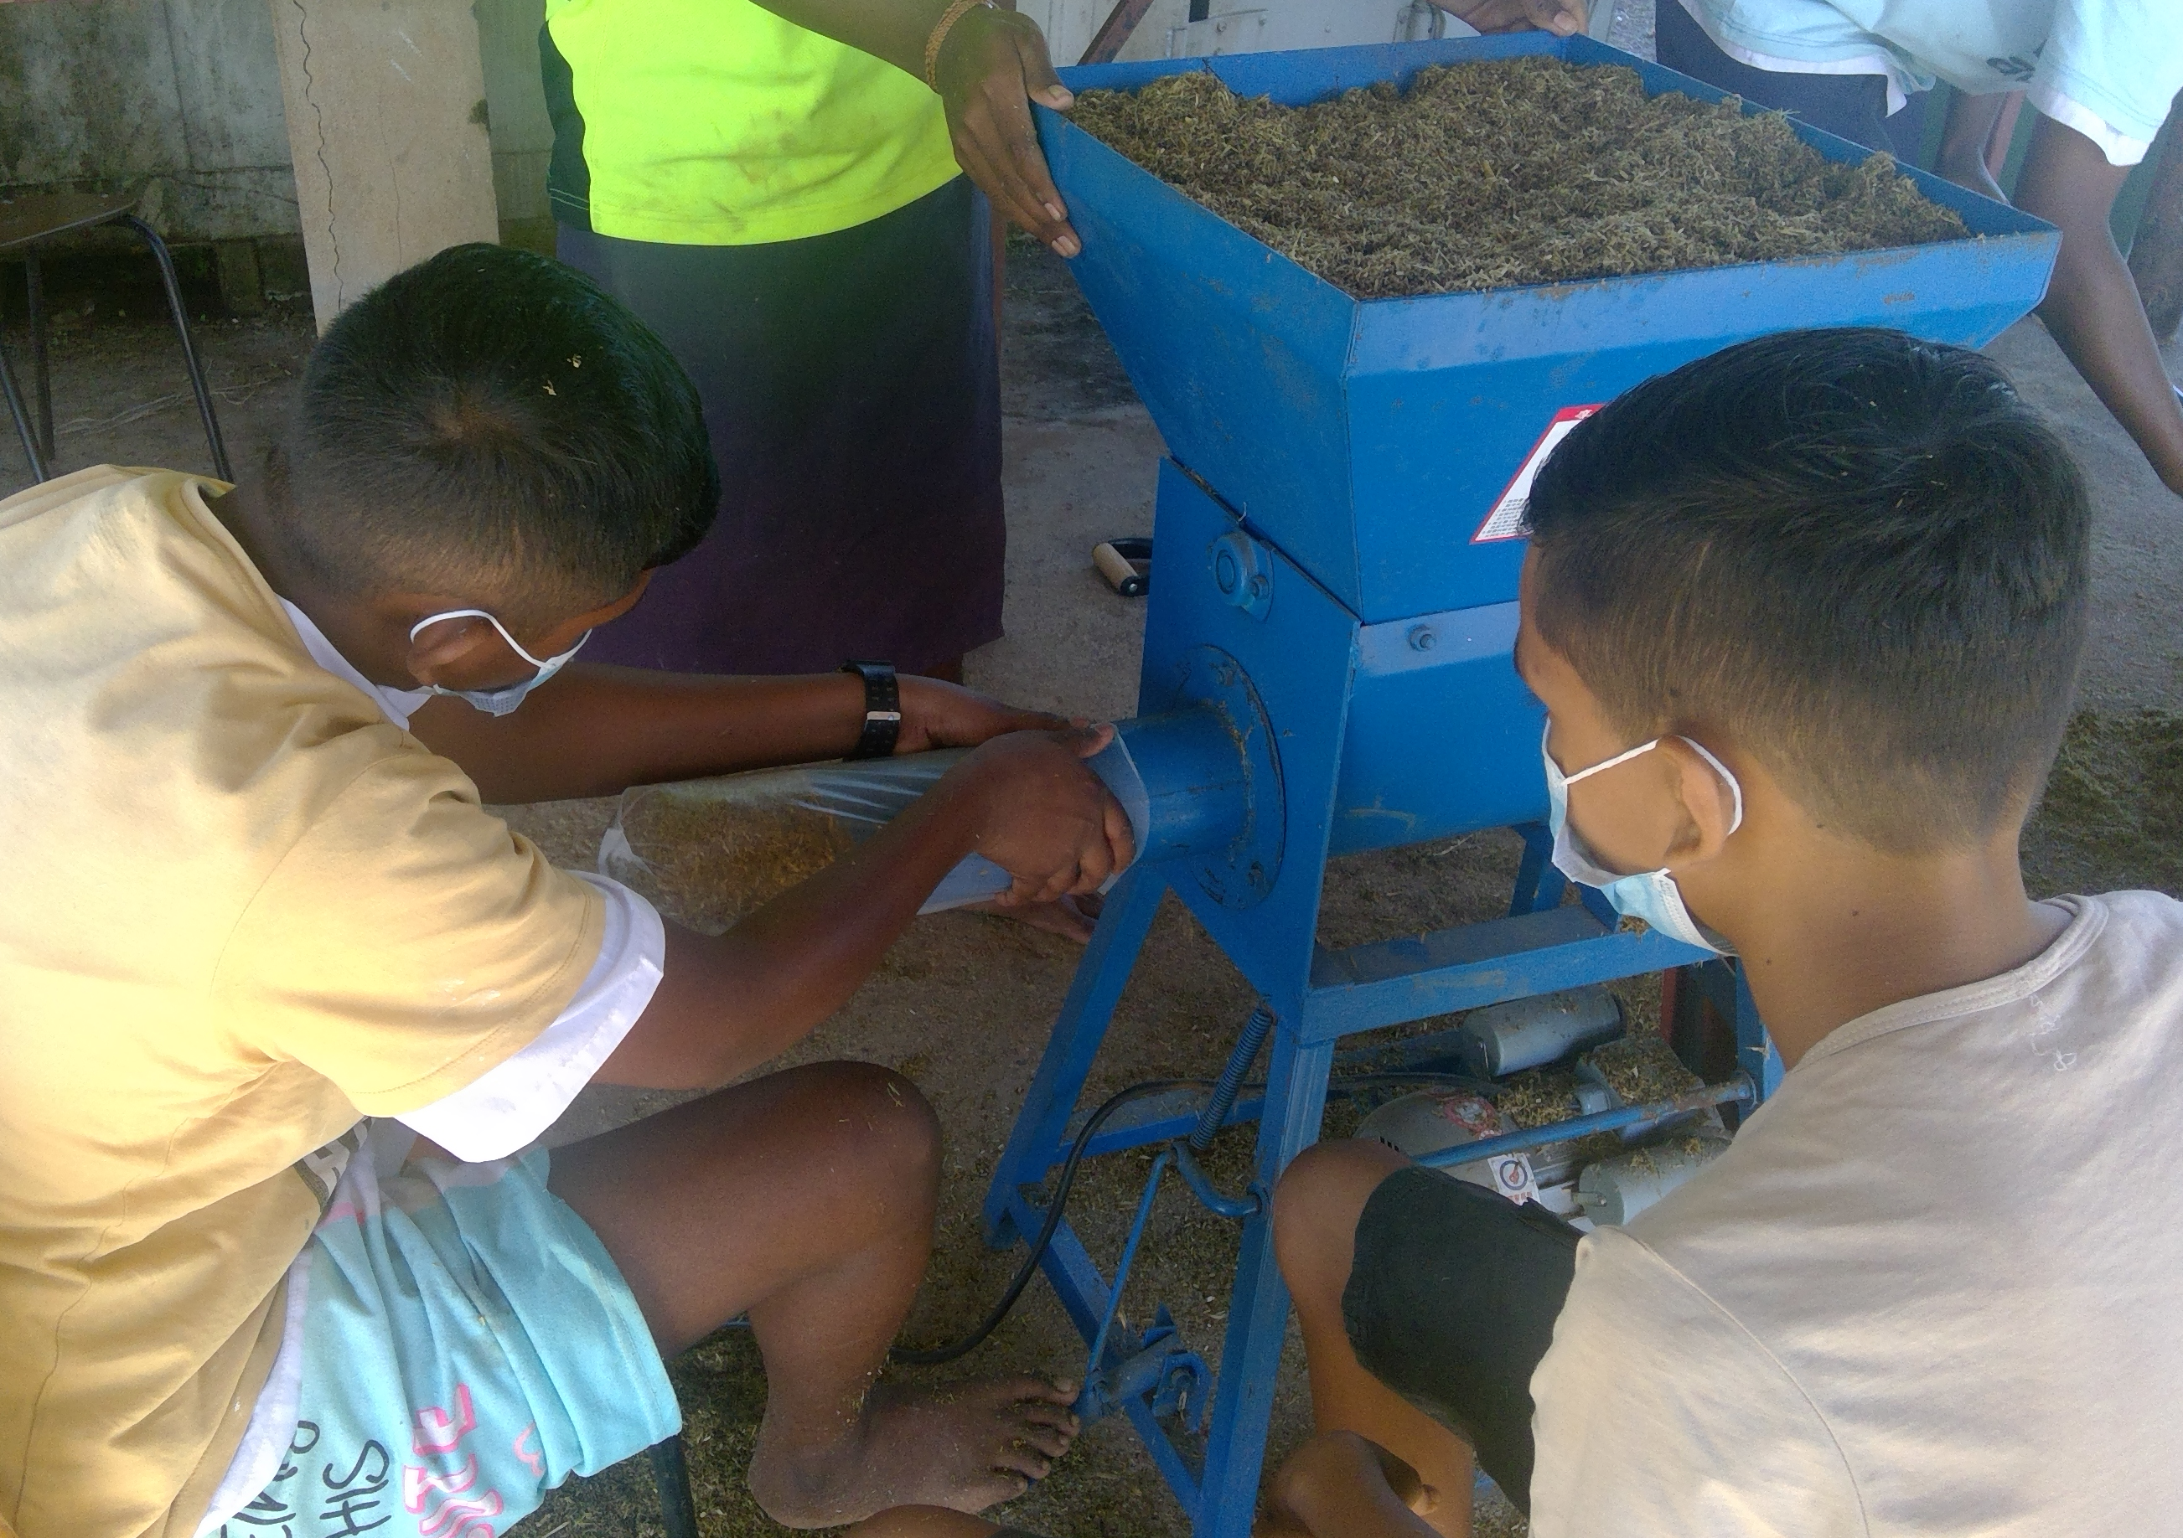
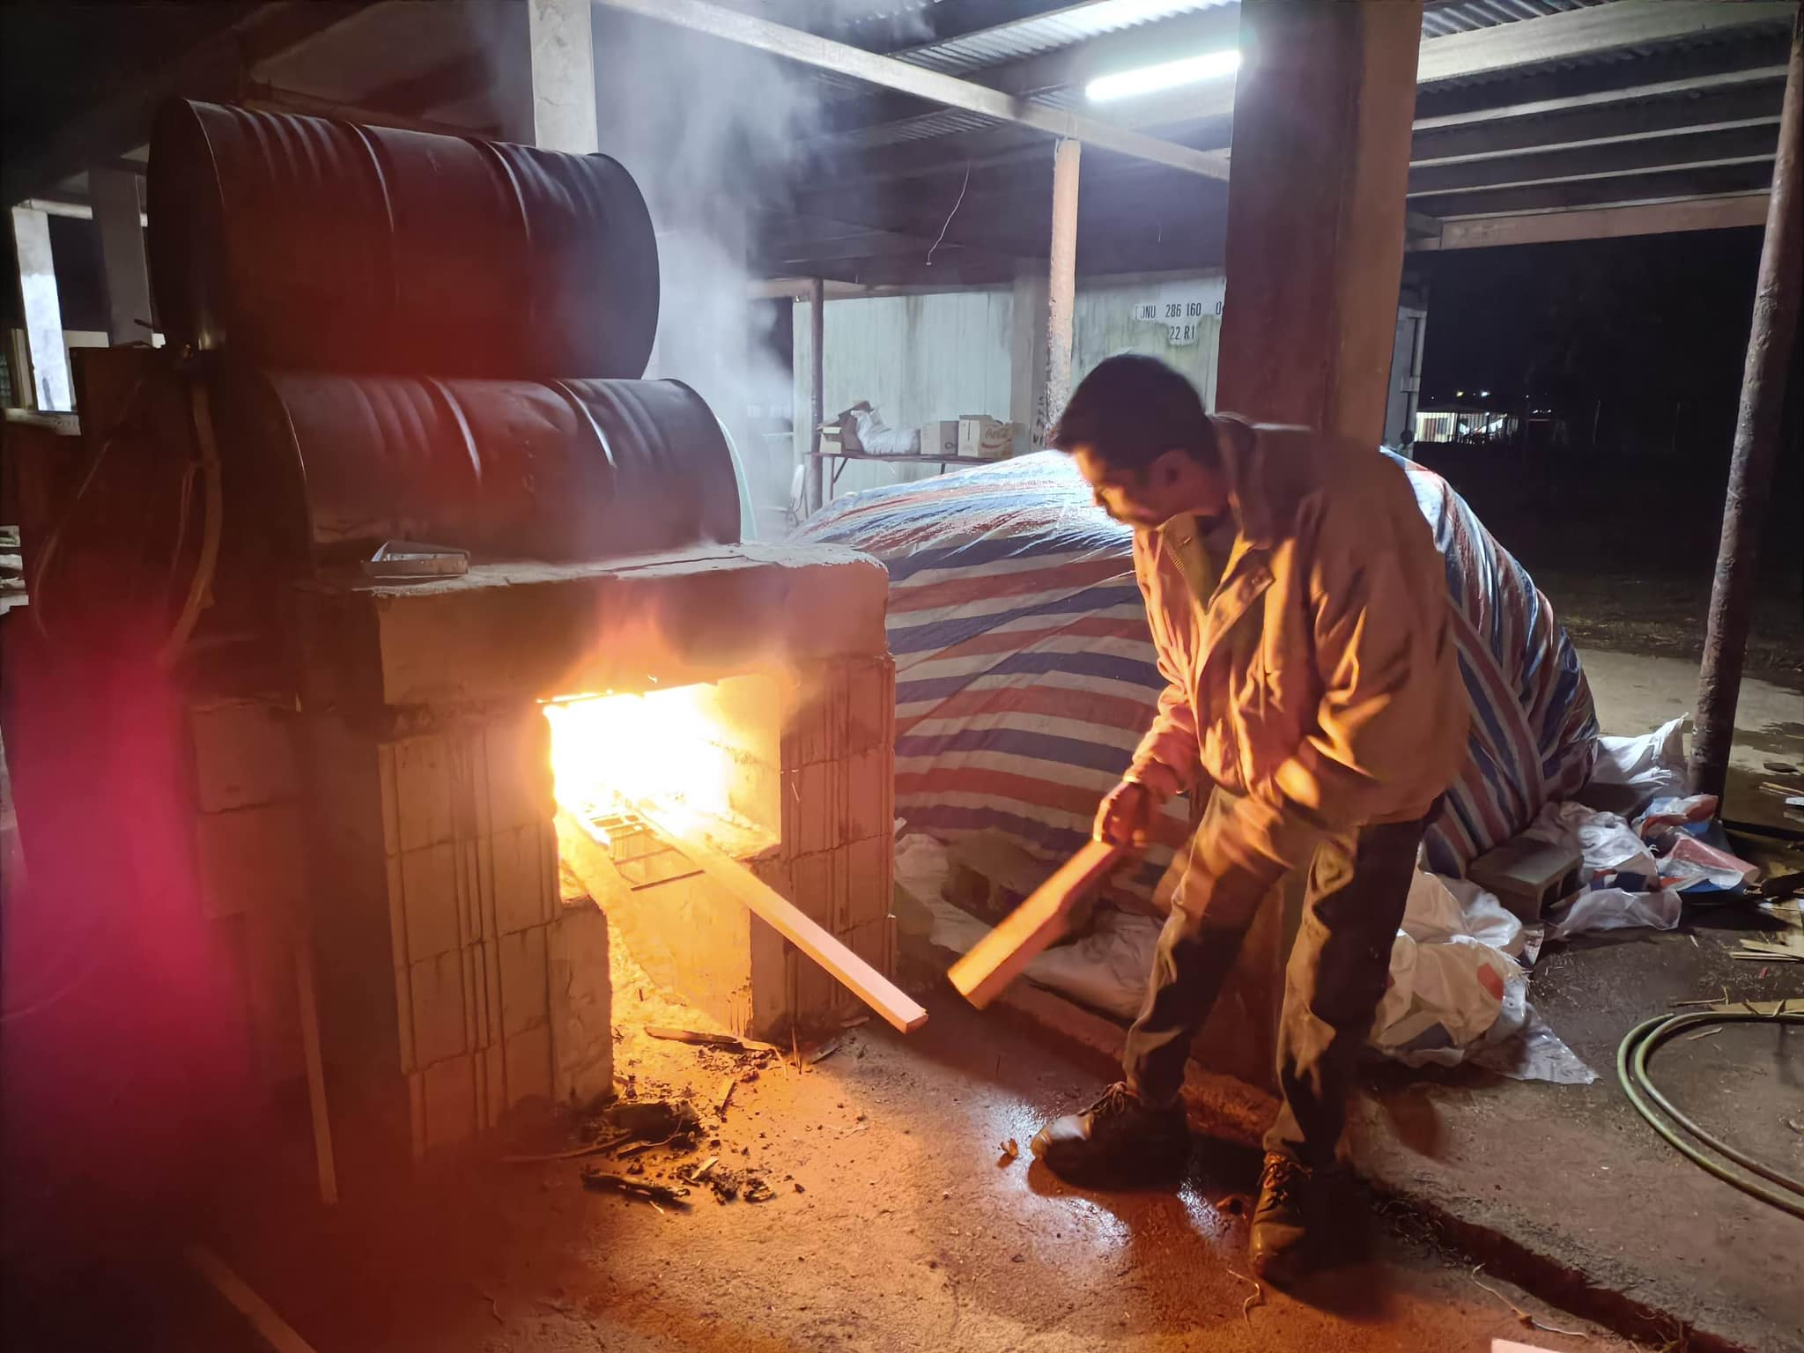
Mixing ,Bagging and Sterilization of Substrate
Mix to a correct ratio of
Juncao Grass 88%
Wheat Bran 10%
Lime 2%
Pack in UV Resistant Plastic Bags so it can withstand 13 hours of Sterilization by heat at a temperature of above 100 degrees Celsius
13 Hours of continuous Atmospheric
Sterilization of our substrates using hot water steam

Slide 5
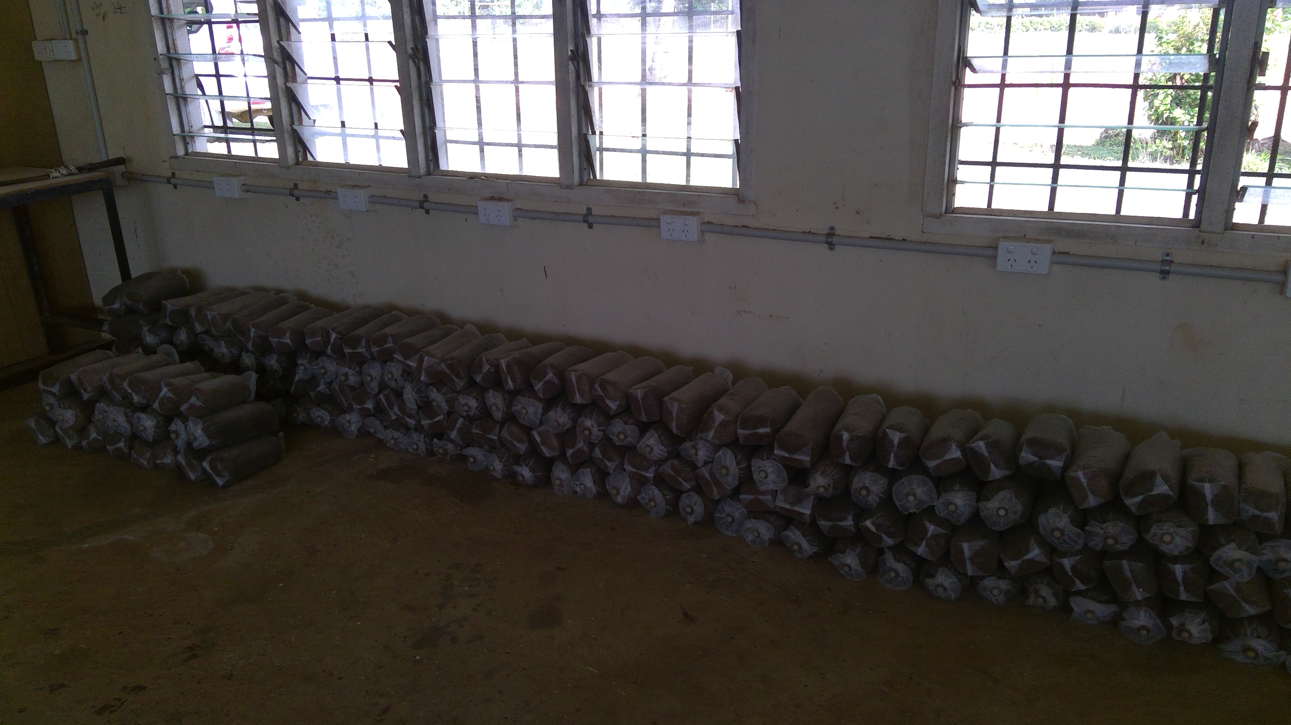
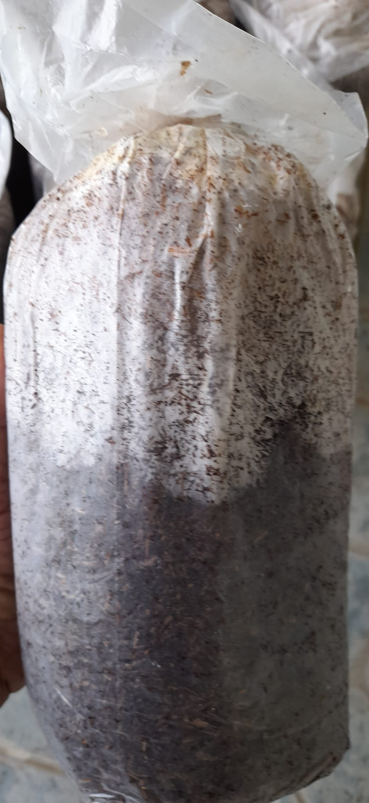
Inoculation & Incubation of Fruiting Substrates
Mother spawn is inoculated on sterilized substrates
A 30 day incubation will ensure that mycelium will spread from top to bottom of each substrate
Colonization has reached 50%

Slide 6
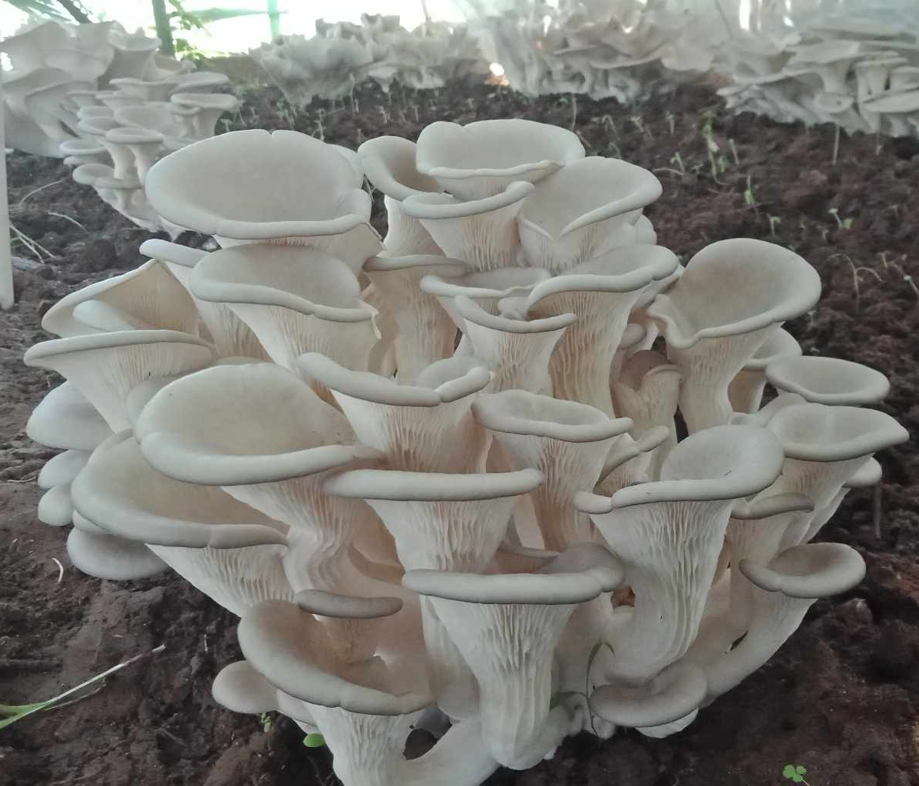
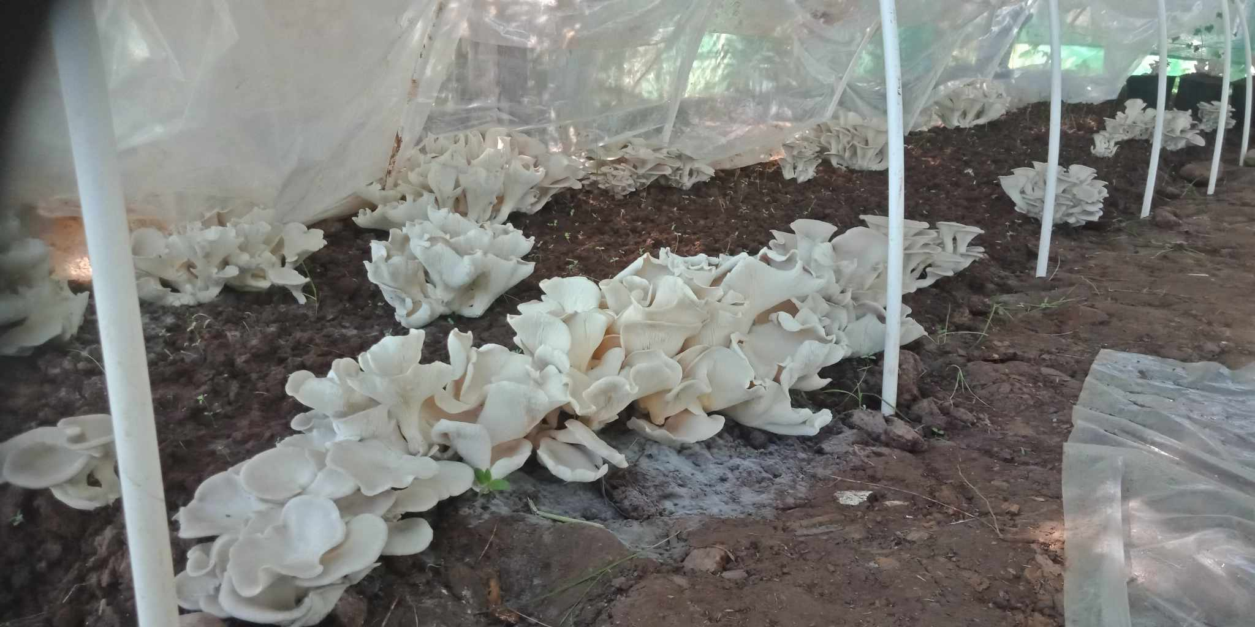
Final Product

Slide 7
Harvested Product

Slide 8
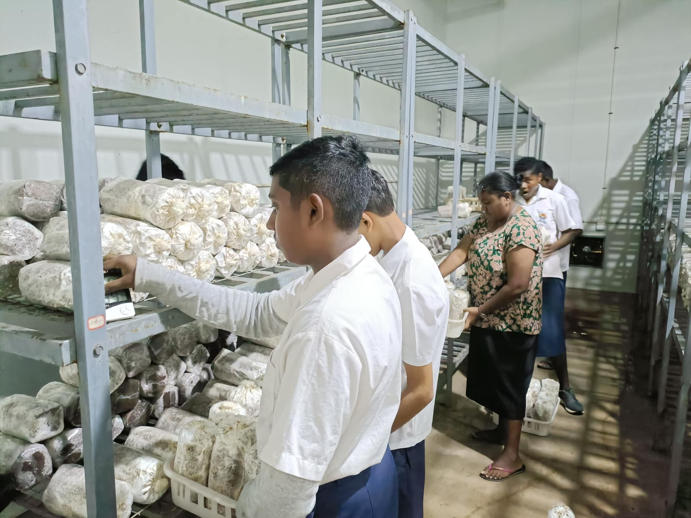
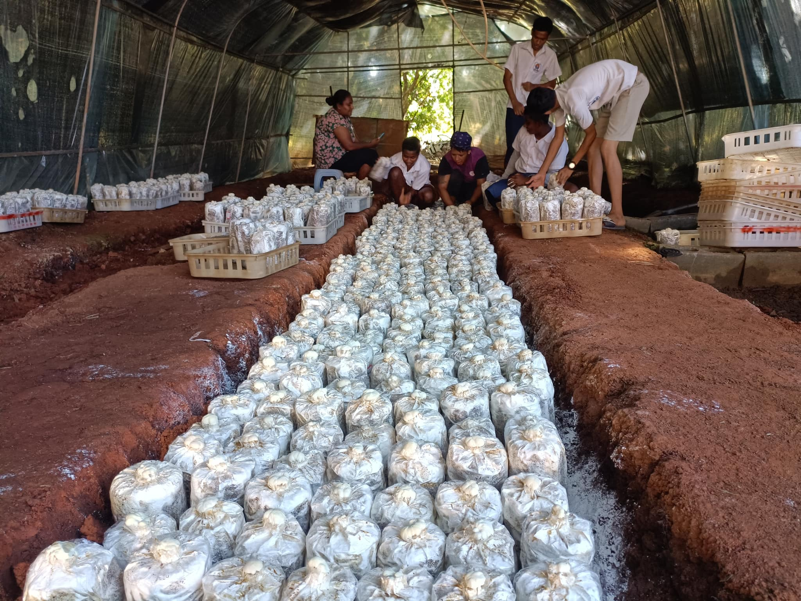
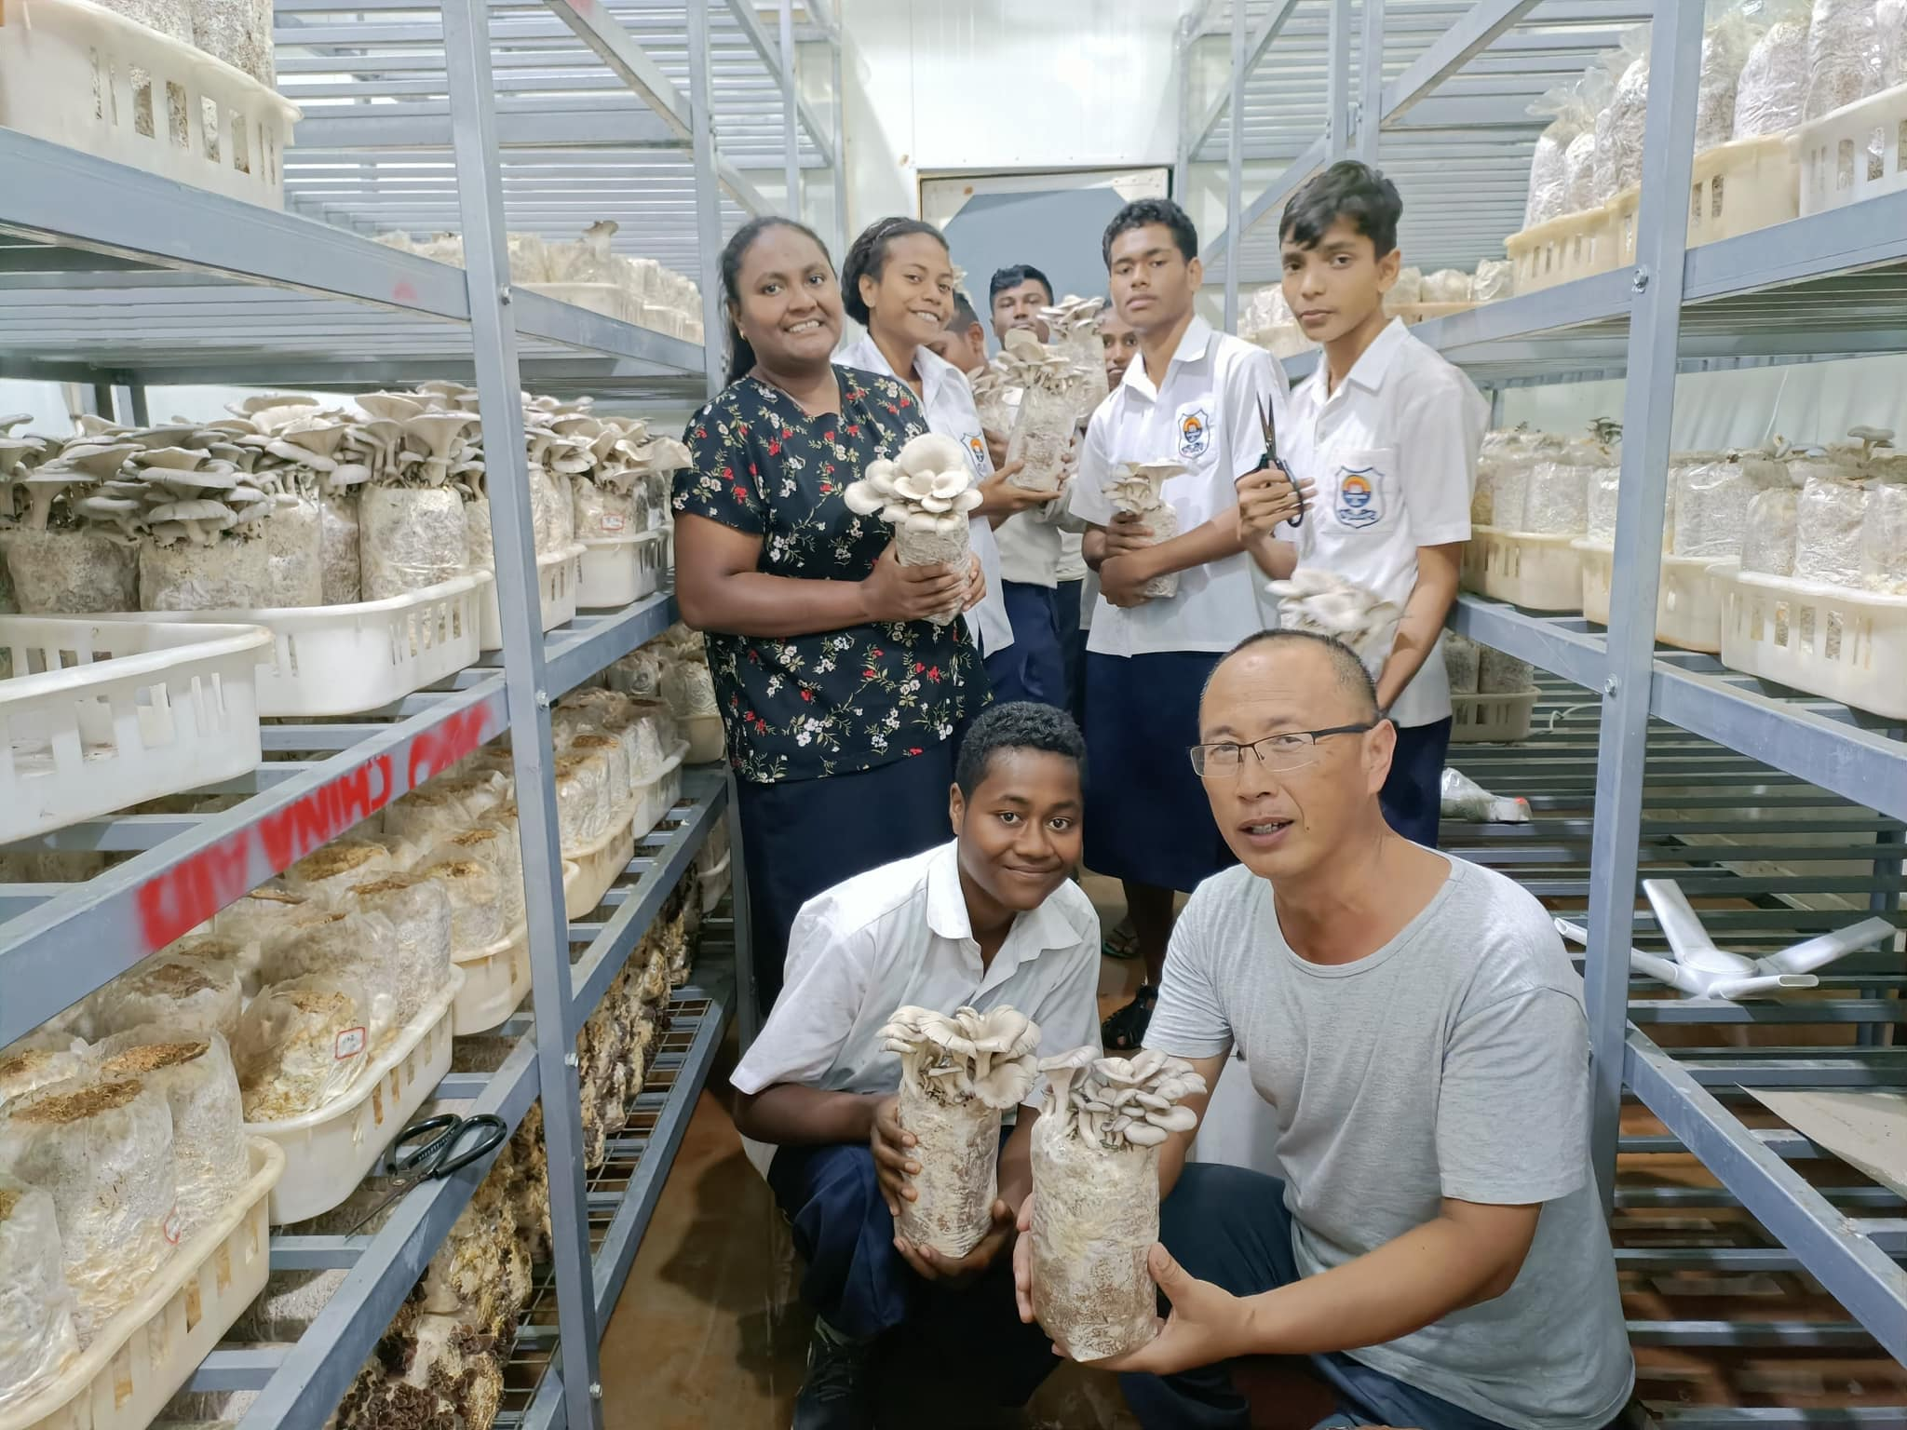
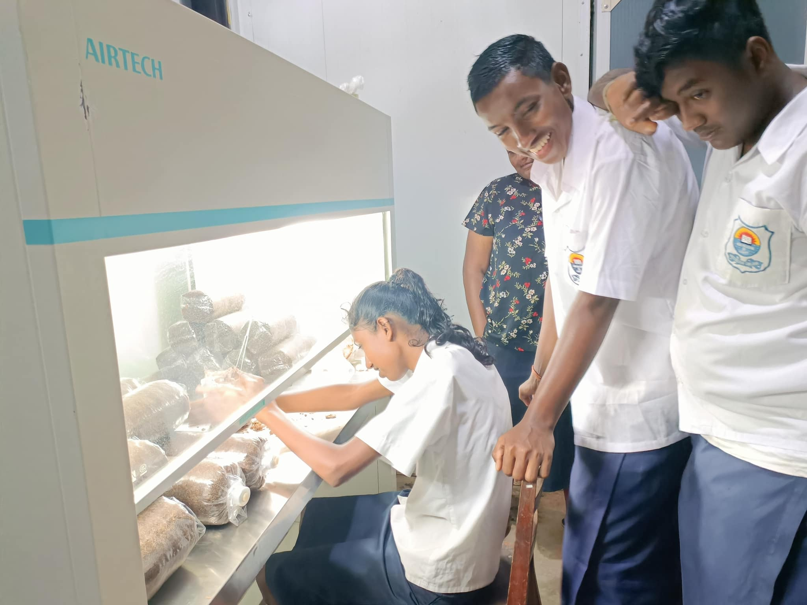
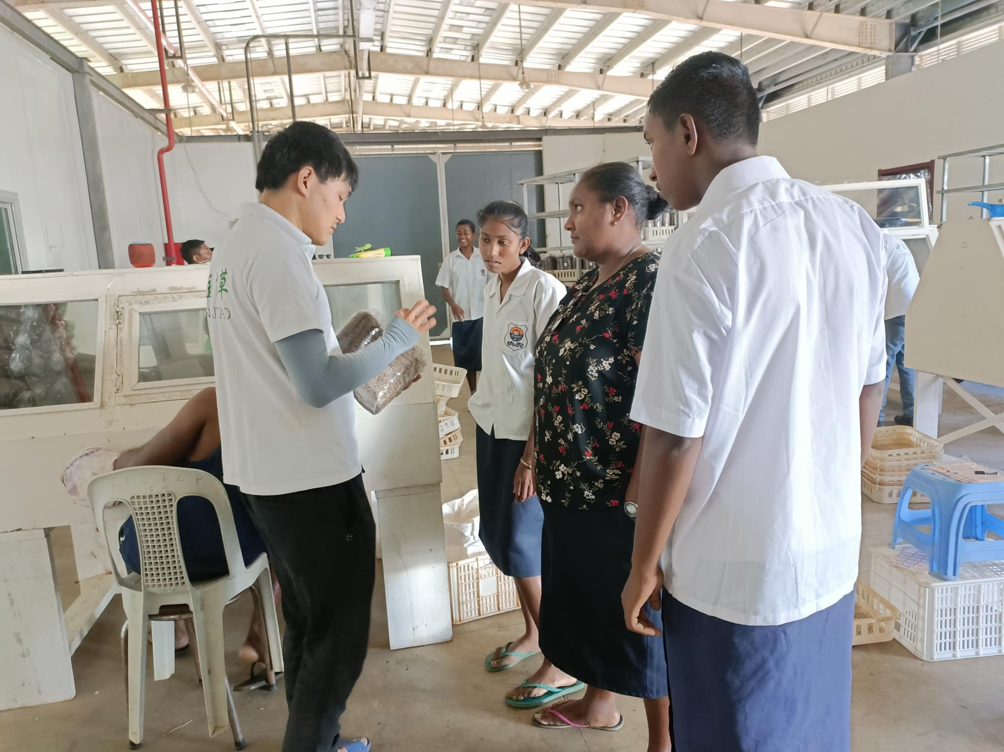
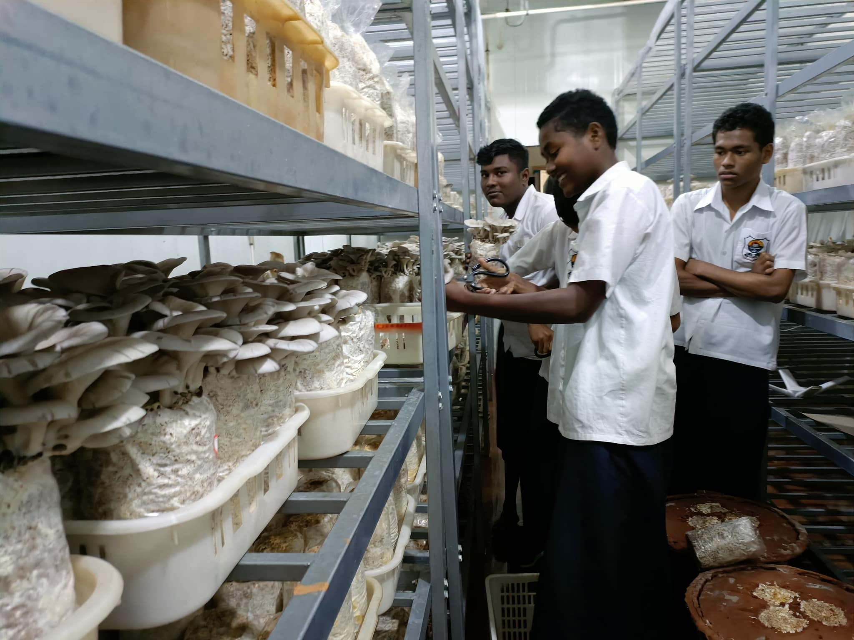
Skill Development-Students
Industrial Training at Juncao Training base Legalega Nadi

Slide 9
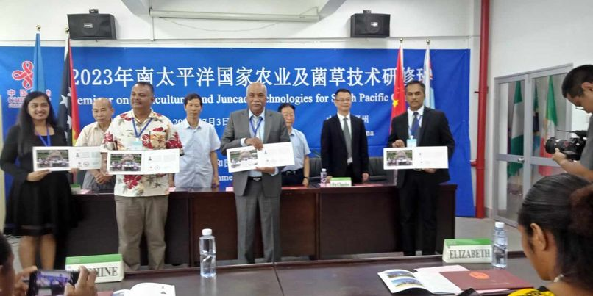
Skill Development- Teachers Training at Fujian Agricultural and Forestry University in Fuzhou China

