Slide 1
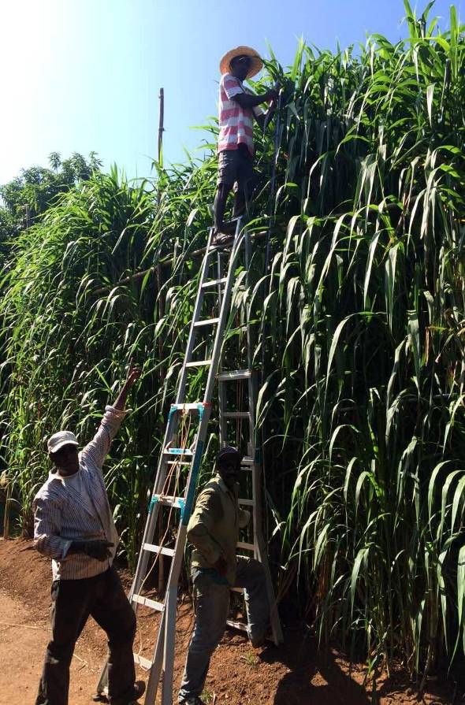
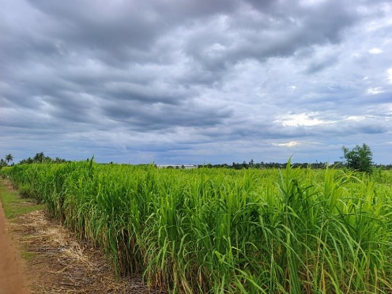
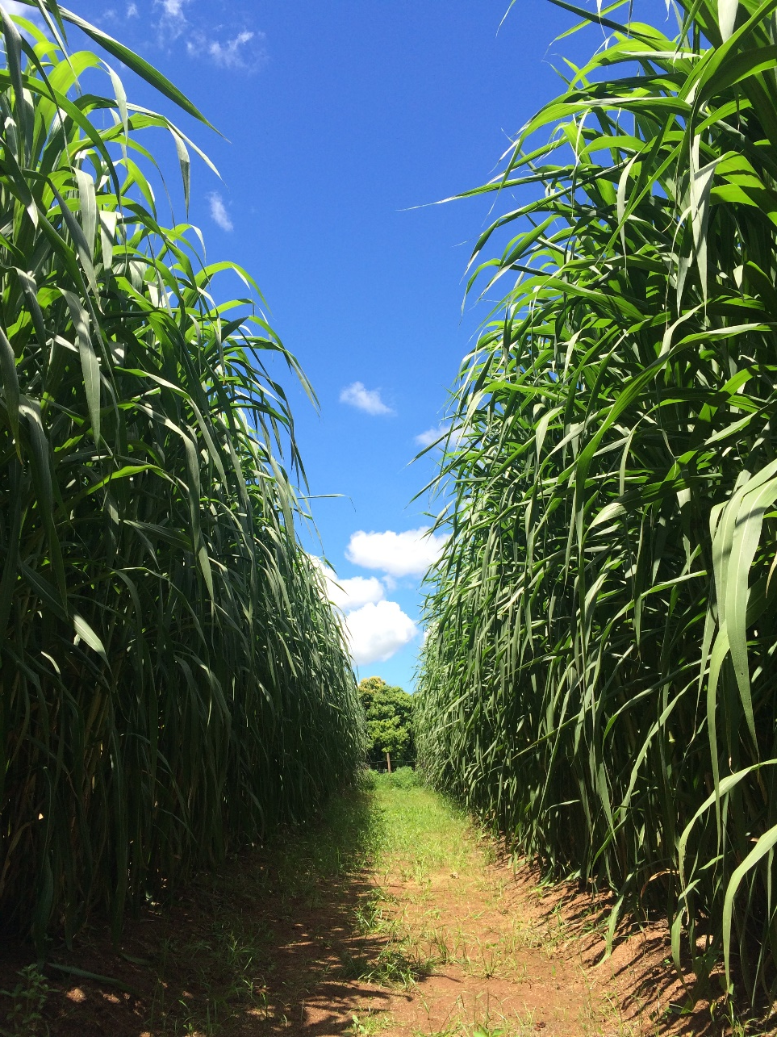
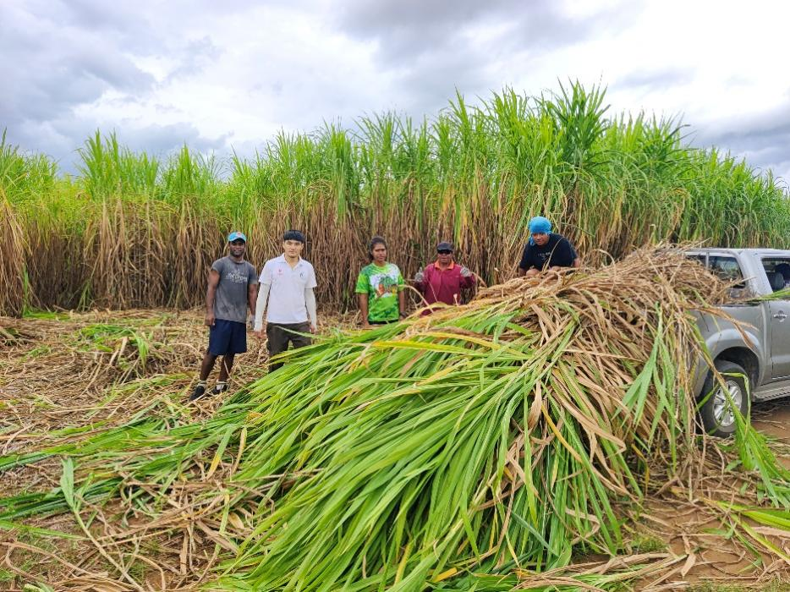
Juncao grass

Slide 2
Field Visit Site
1. Bula Agro Juncao Technology Demonstration Site
2. Votualevu College Juncao Technology Demonstration Site
3. Tadra Farm Juncao Technology Demonstration Site
4. Yaqara Juncao Technology Demonstration Site
5. Sigatoka Juncao Technology Demonstration Site
6. Double Tree Resort Juncao Technology Demonstration Site

Slide 3
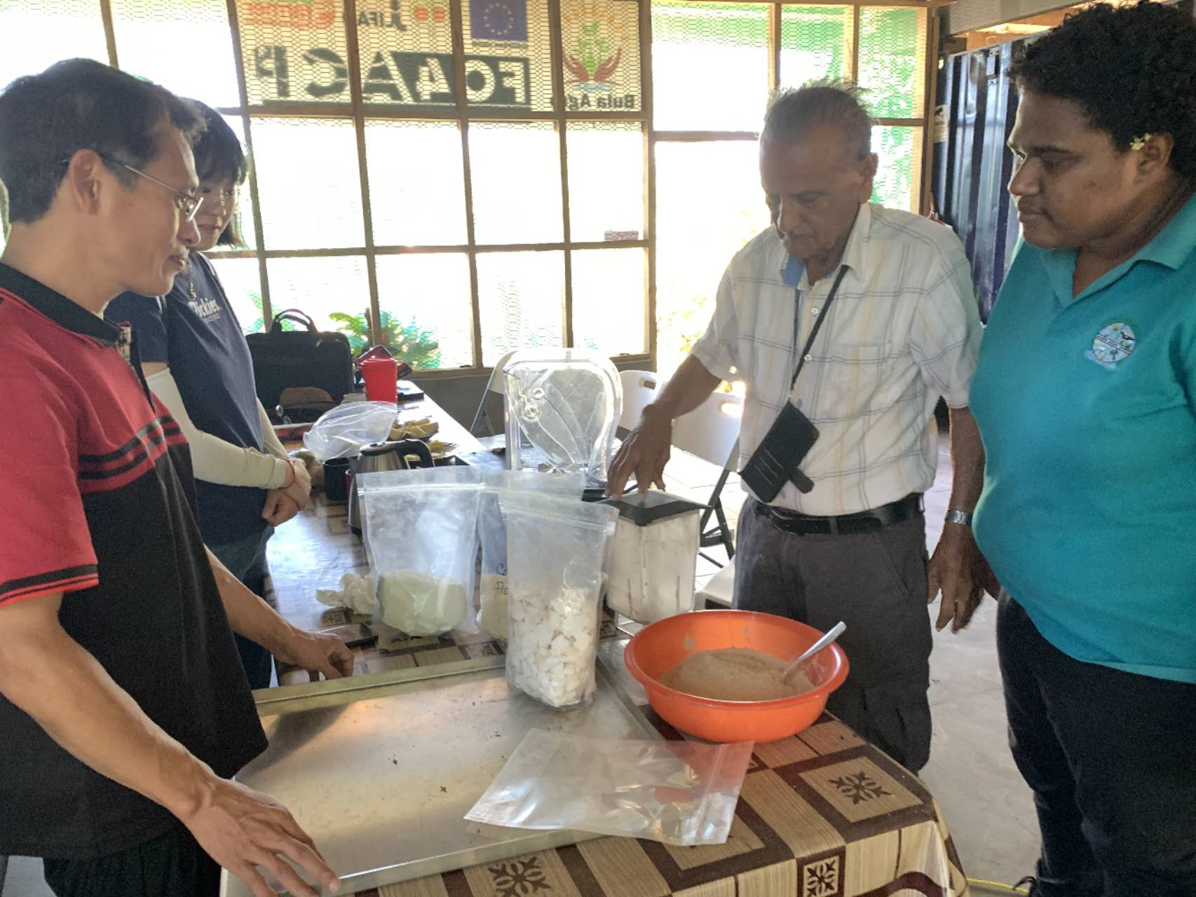
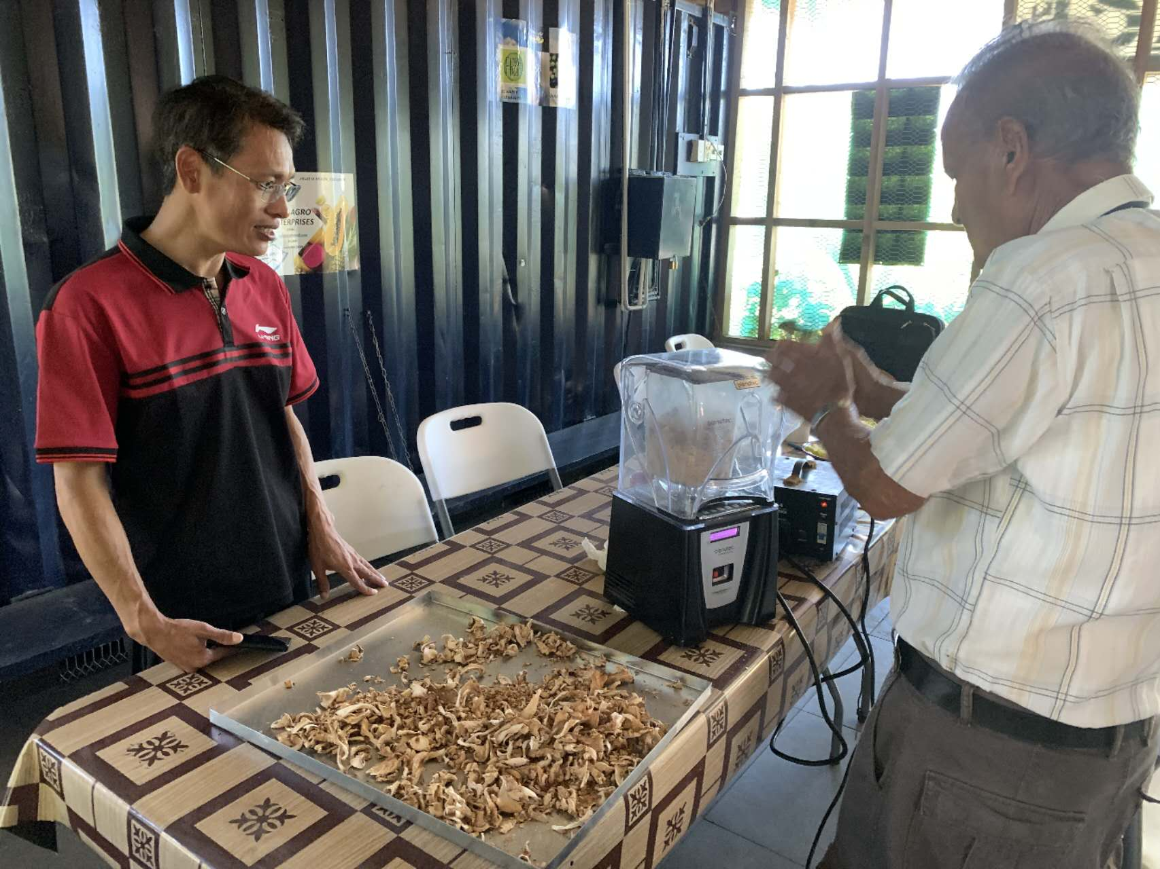
1. Bula Agro Juncao Technolgy Demonstration Site
BulaAgro farm making mushroom soup

Slide 4
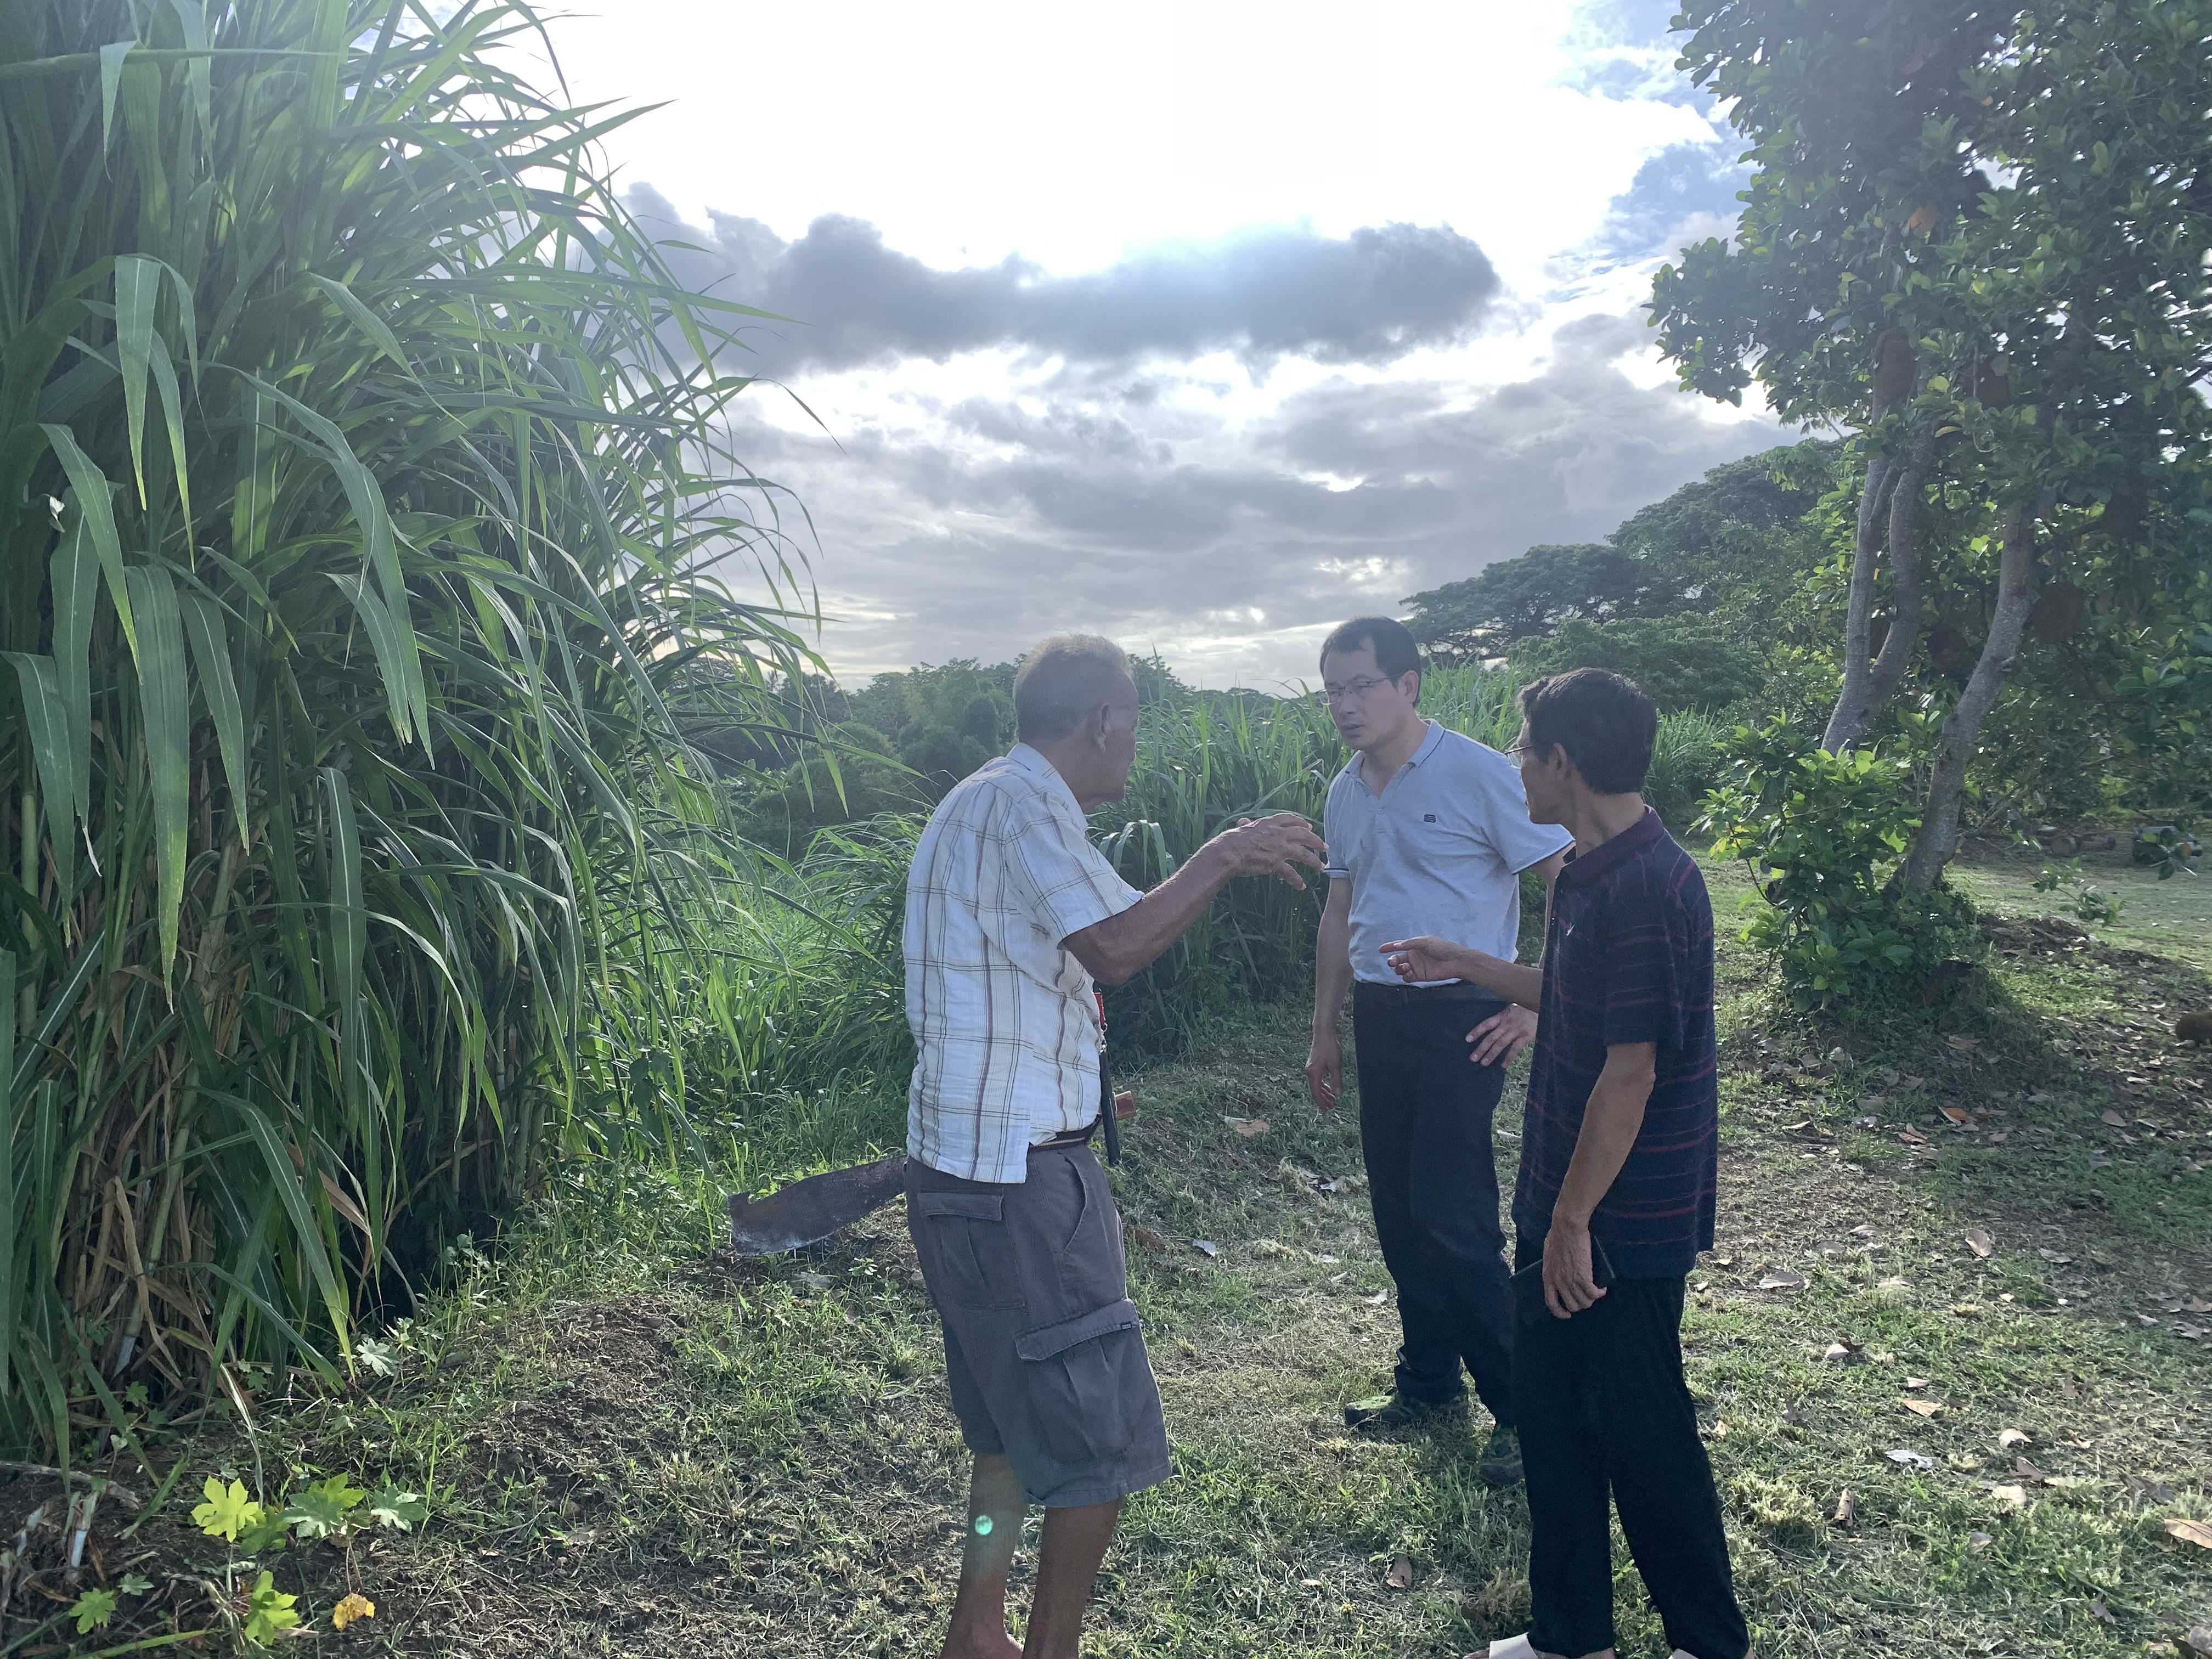
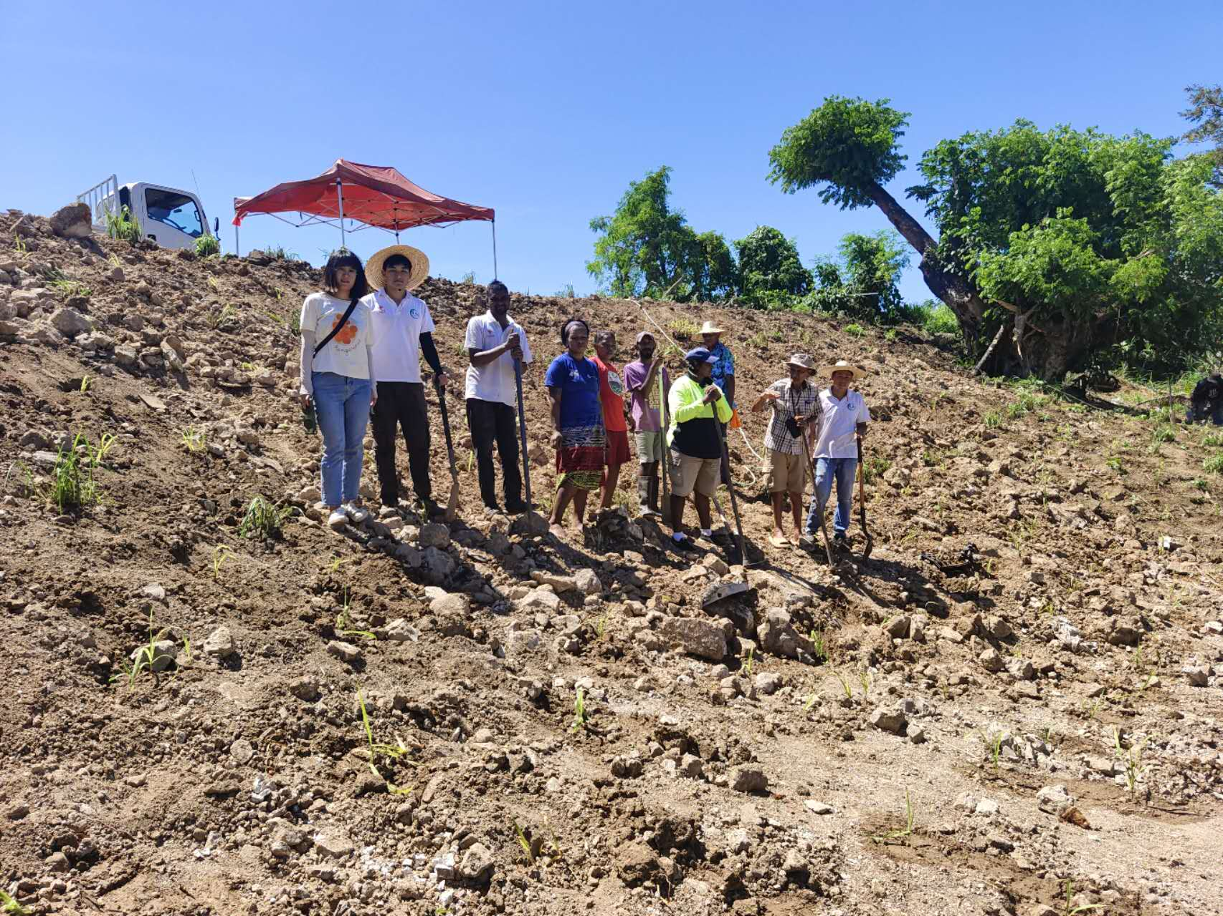
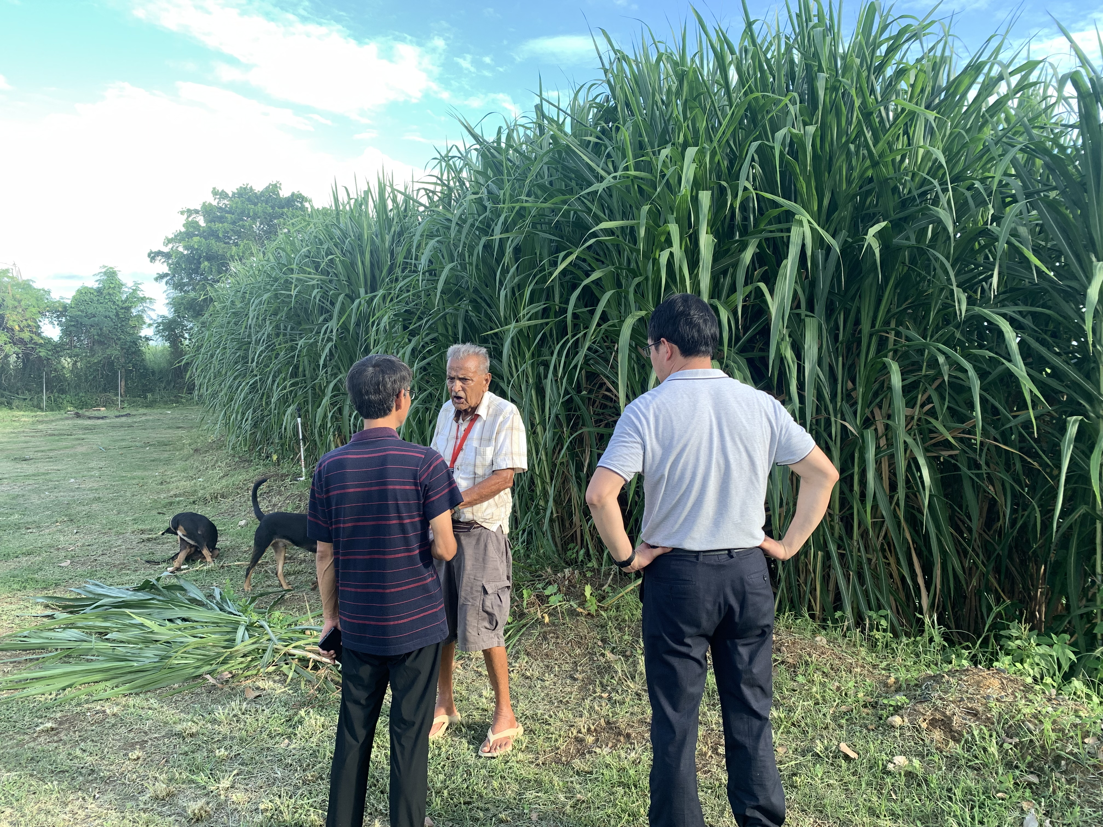
Bula Agro Planting Juncao Grass to Prevent Water and Soil Erosion

Slide 5
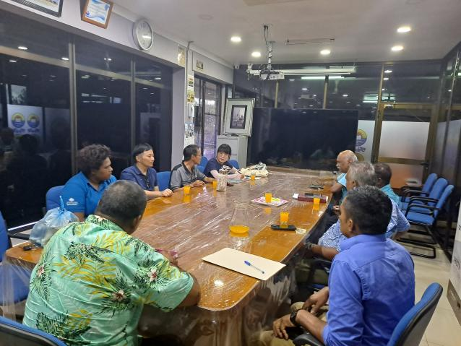
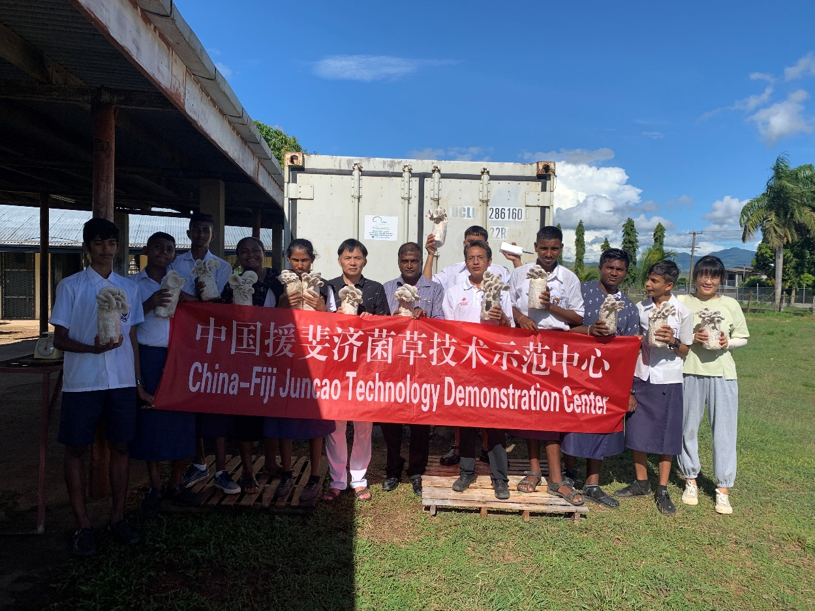
2. Votualevu College Juncao Technolgy Demonstration Site
VTC
Meeting with Votualevu College

Slide 6
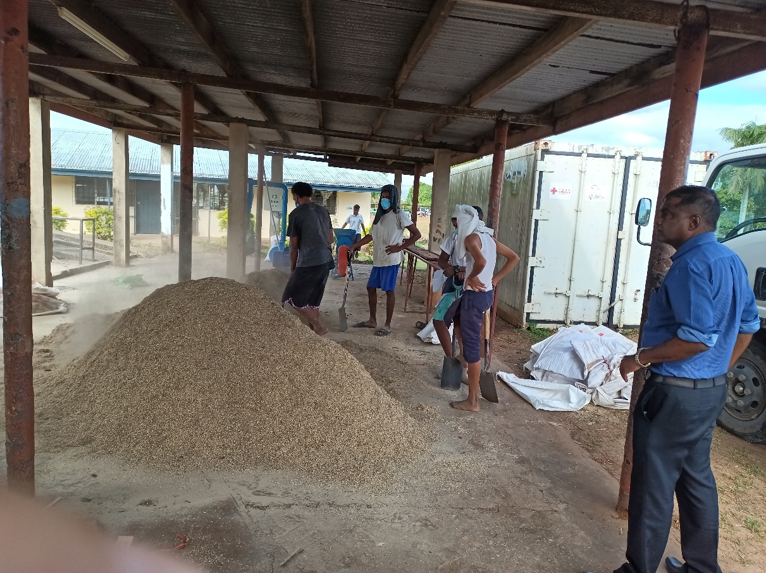
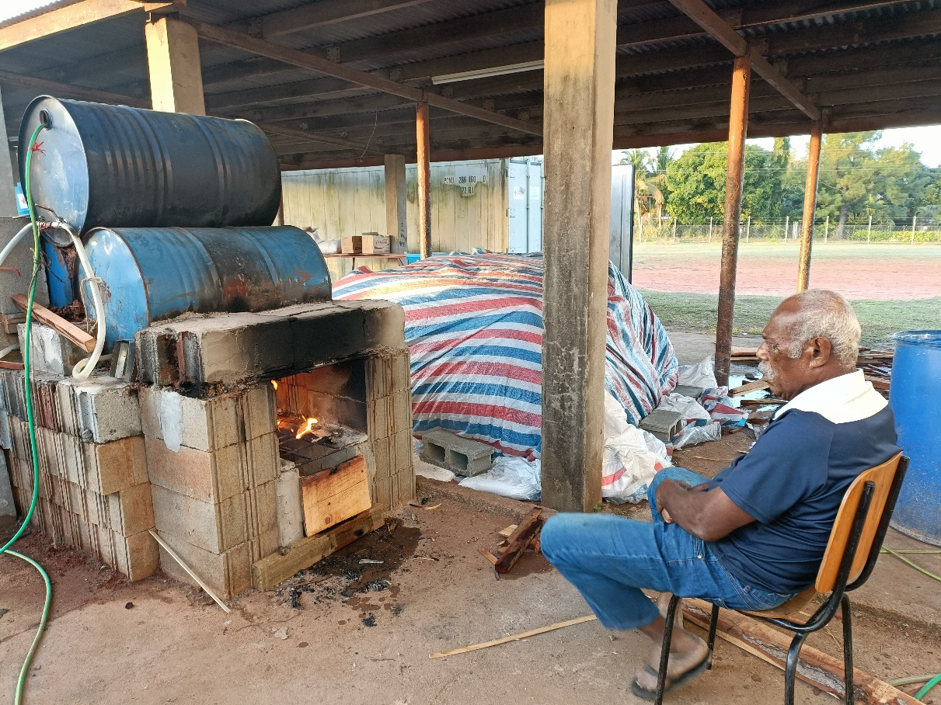
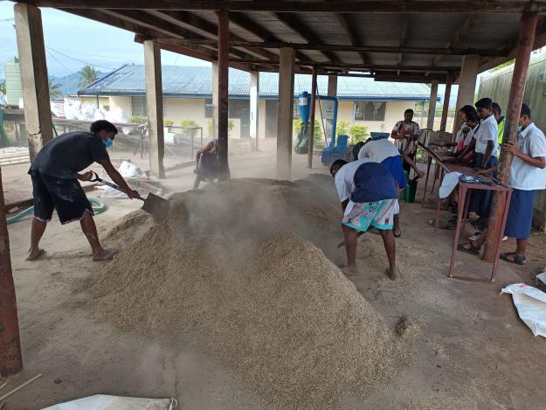
VTC
Guiding Votualevu College to produce Juncao mushroom substrate tubes independently

Slide 7
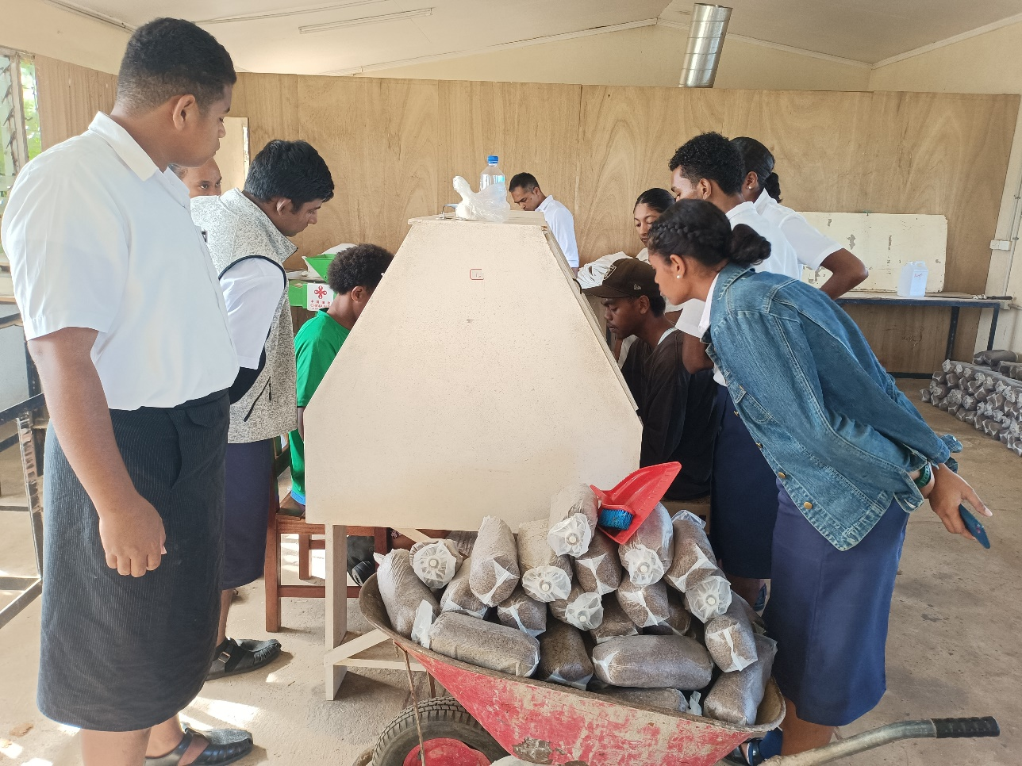
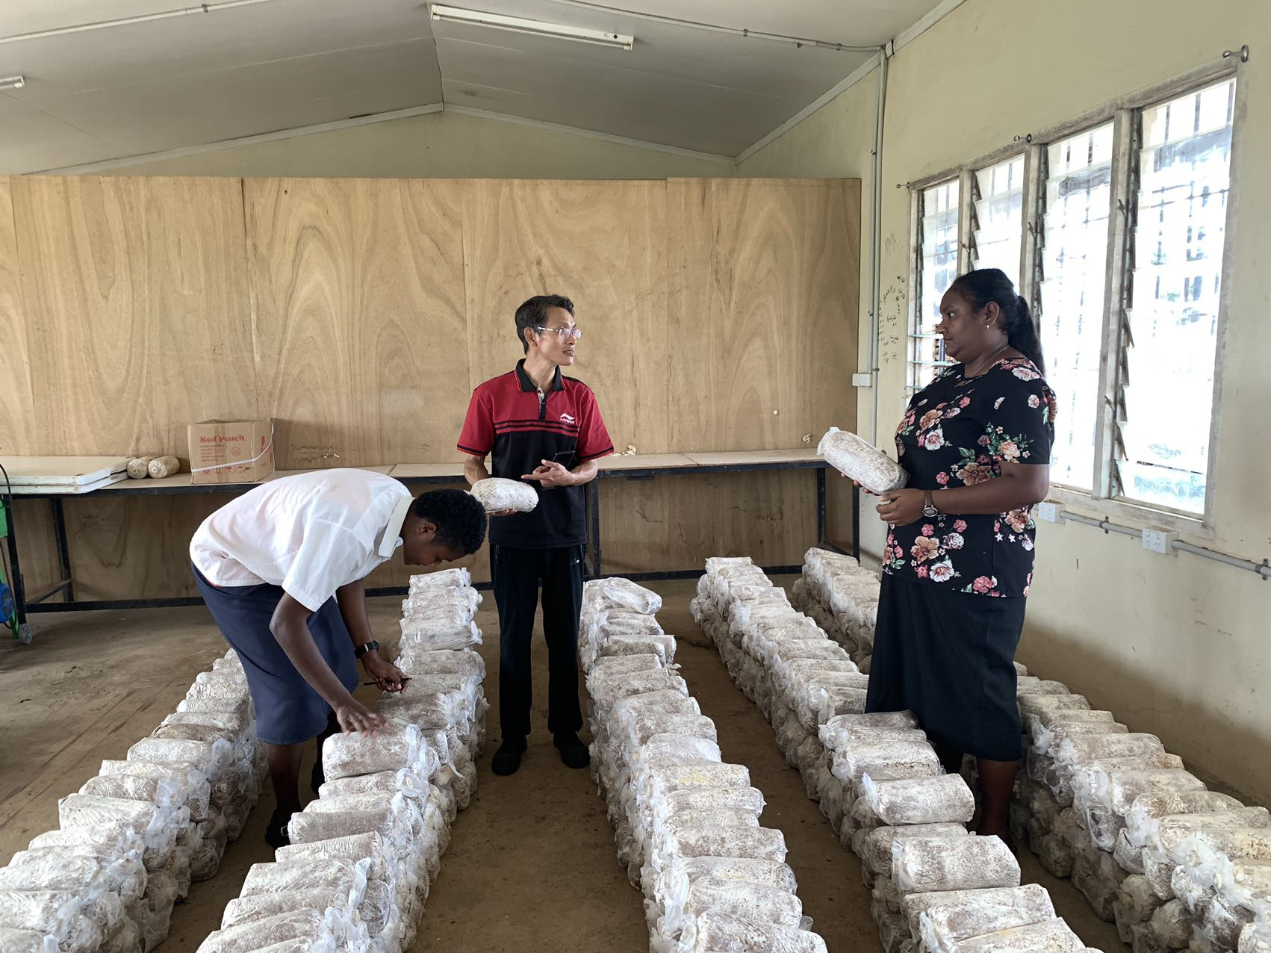
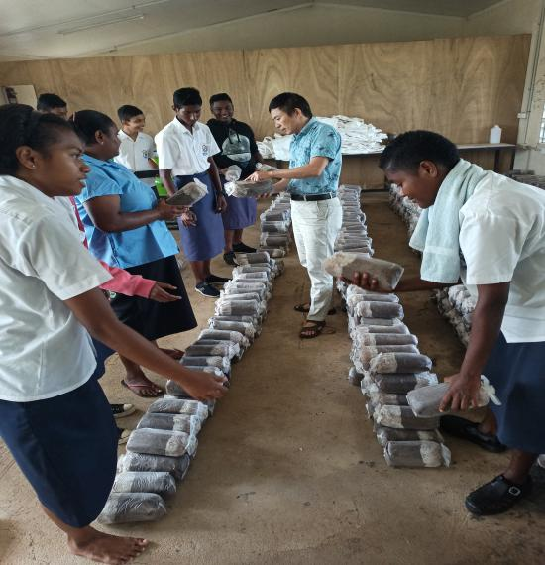
VTC
Guiding Votualevu College to produce Juncao mushroom substrate tubes independently

Slide 8
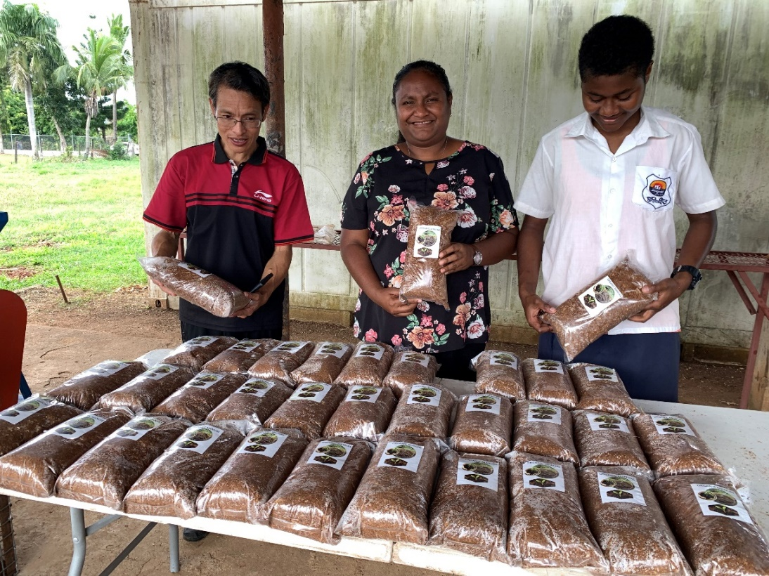
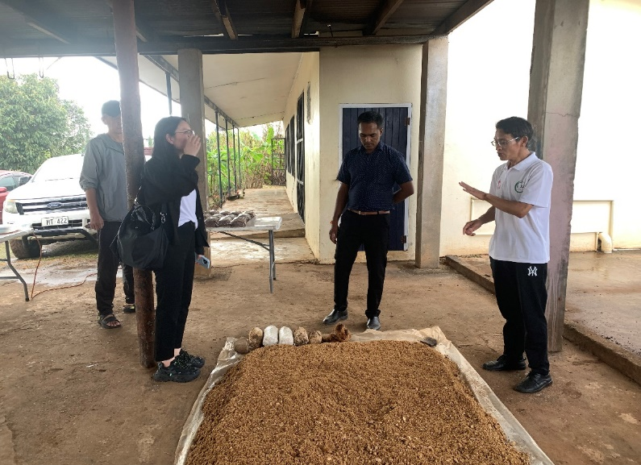
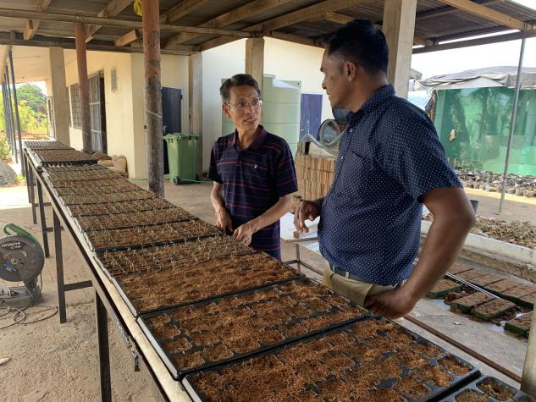
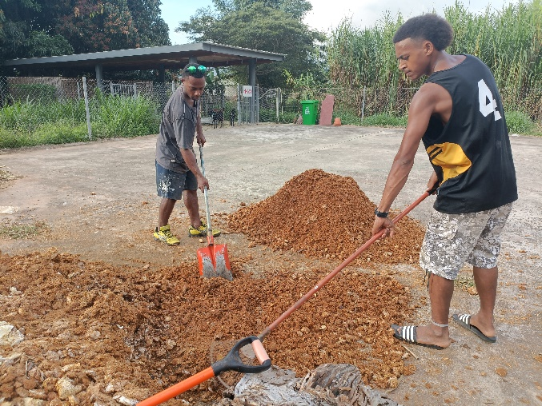
VTC
Votualevu College using spent mushroom substrate residue to make fertilizers

Slide 9
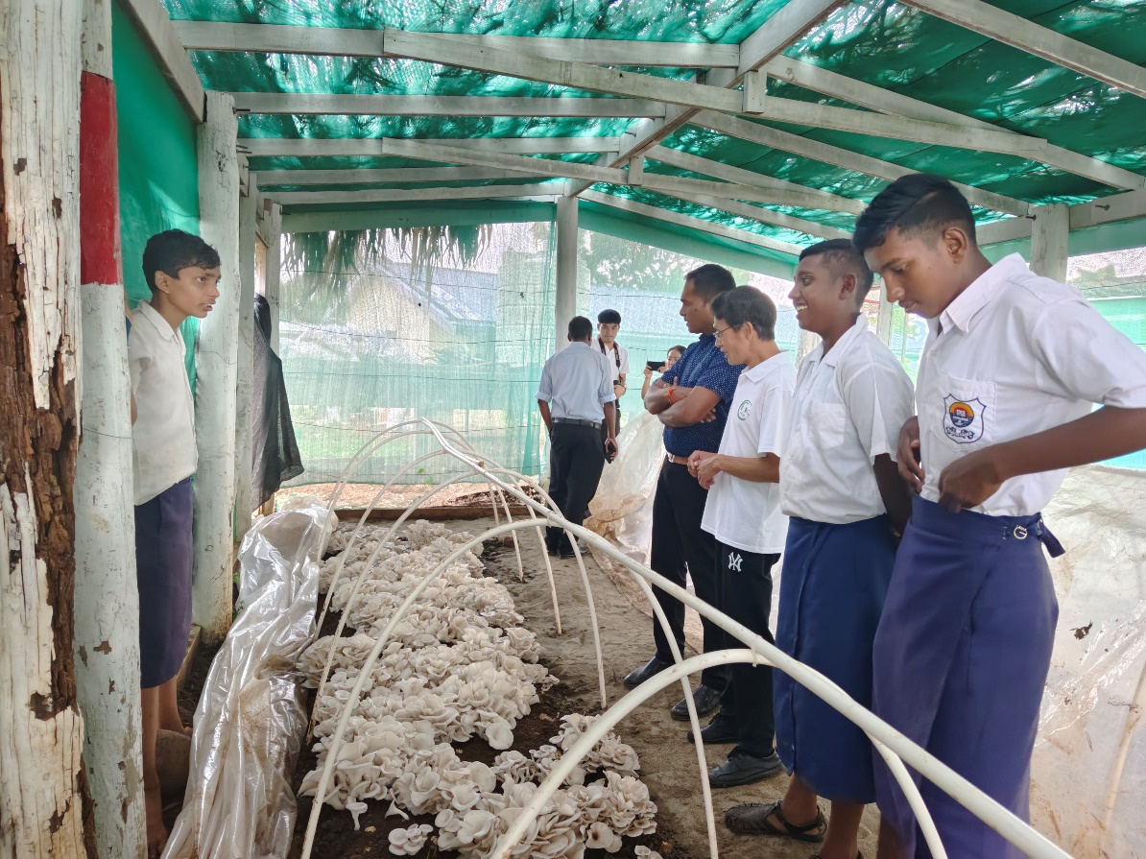
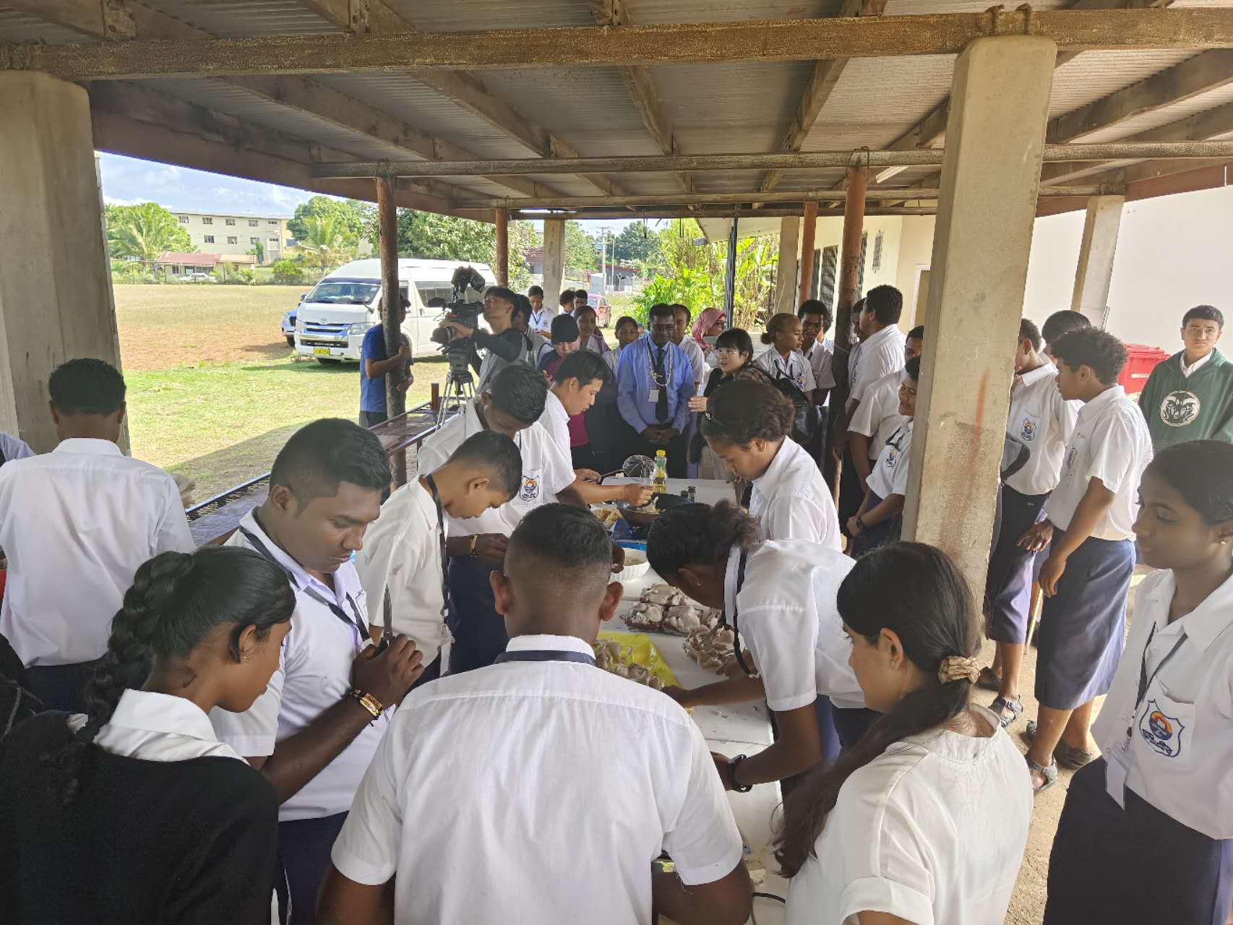
6. Guidance and Promotion
VTC
Mushroom growing well

Slide 10
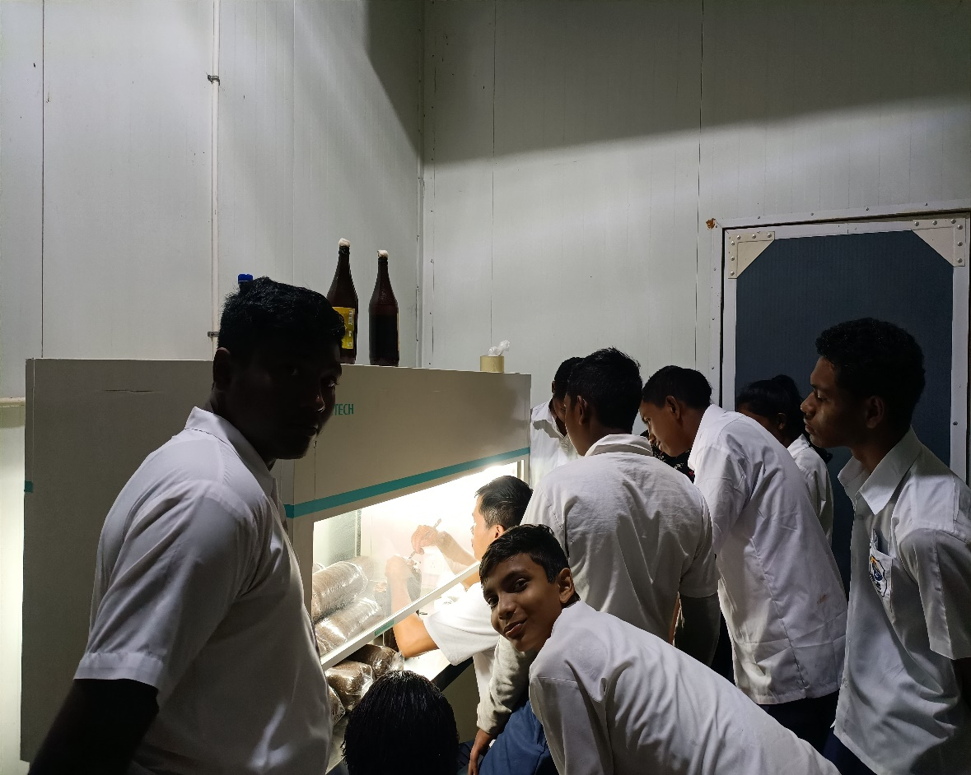
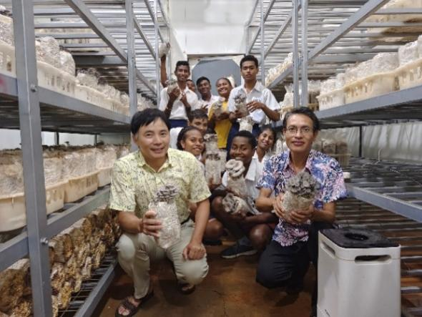
VTC
Votualevu College students learning and practicing in the Center

Slide 11
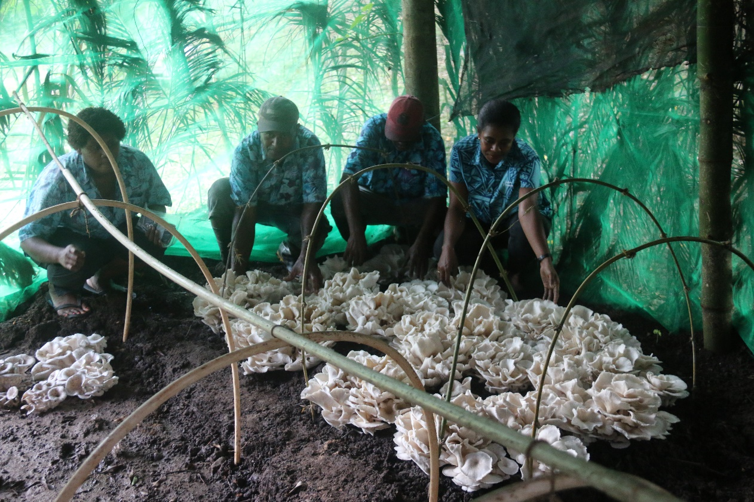
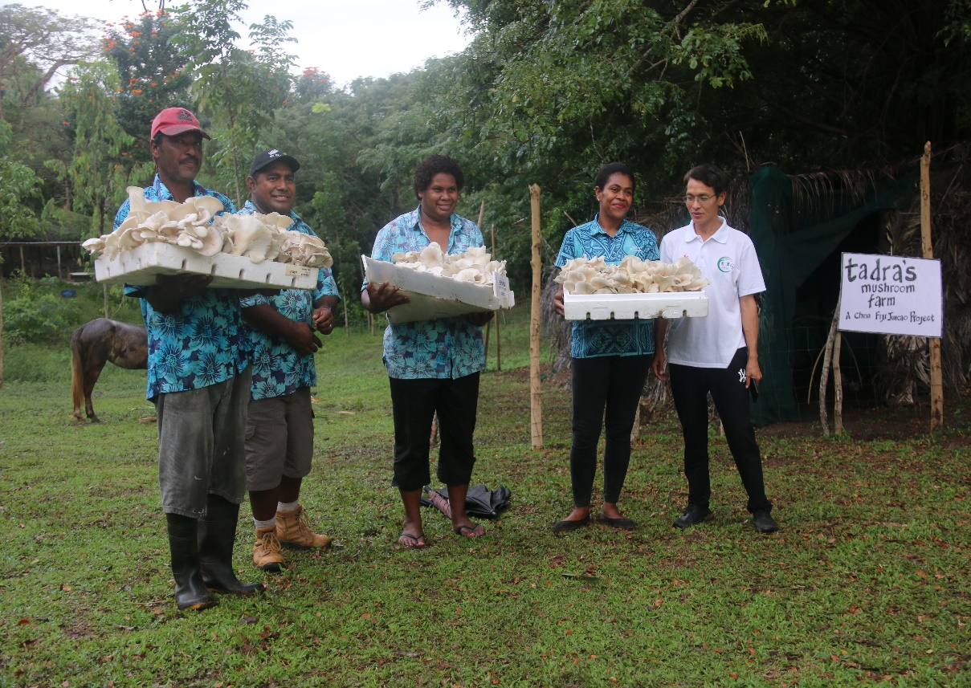
3. Tadra Farm Juncao Technolgy Demonstration Site
Providing technical guidance to Tadra farm

Slide 12
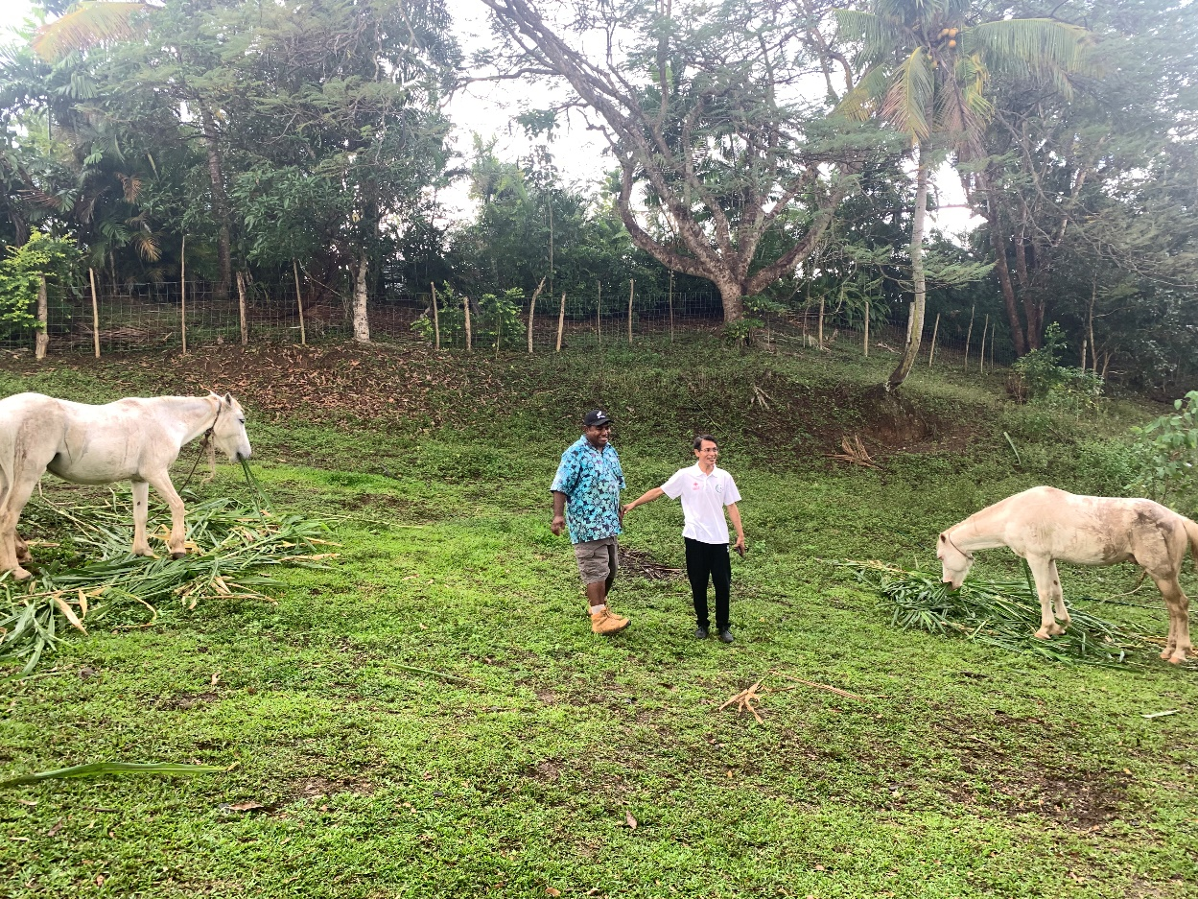
Demonstration of Juncao-feeding horses in Tadra farm

Slide 13
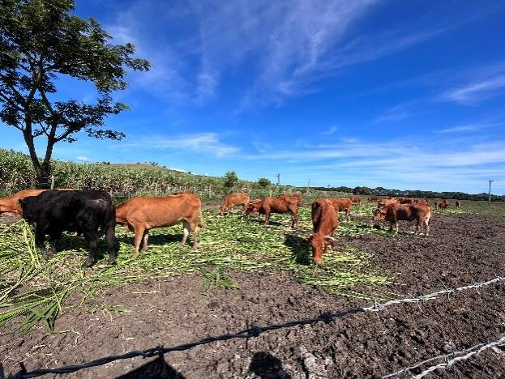
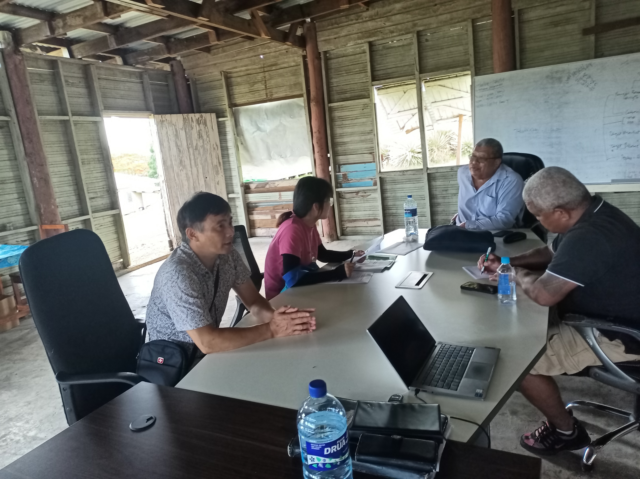
4. Yaqara Pastoral Company Juncao Technolgy Demonstration Site
Juncao-feeding cattle of Yaqara Pastoral Company

Slide 14
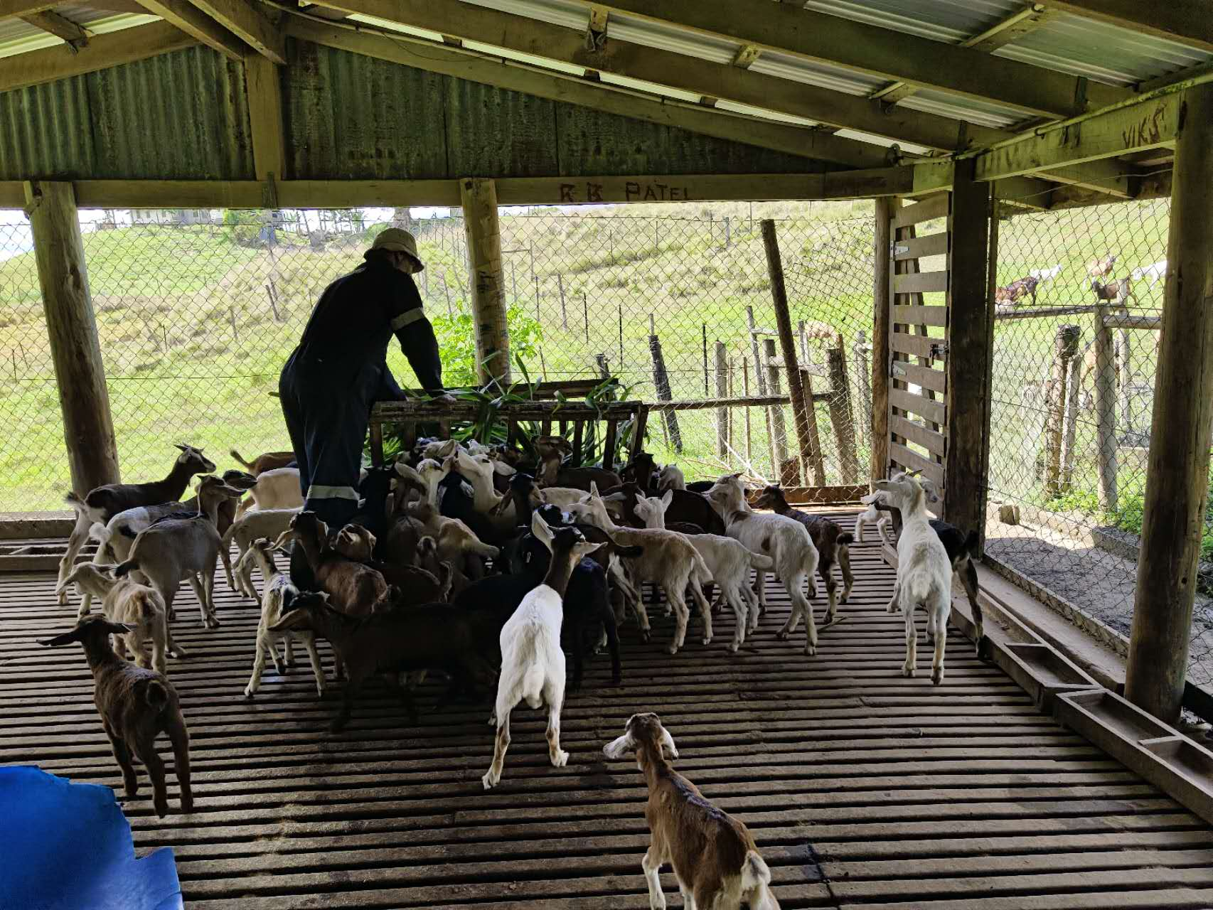
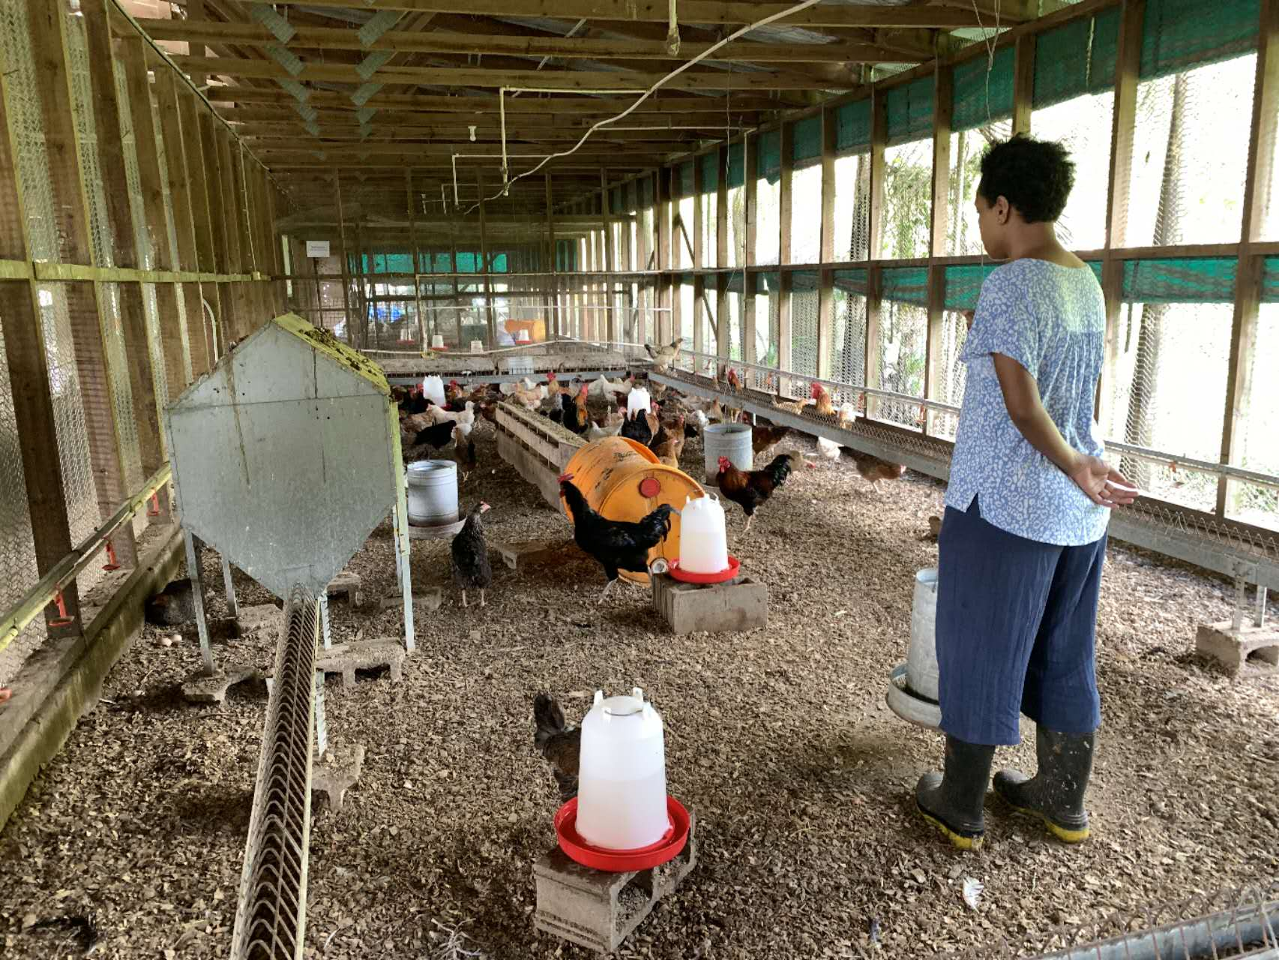
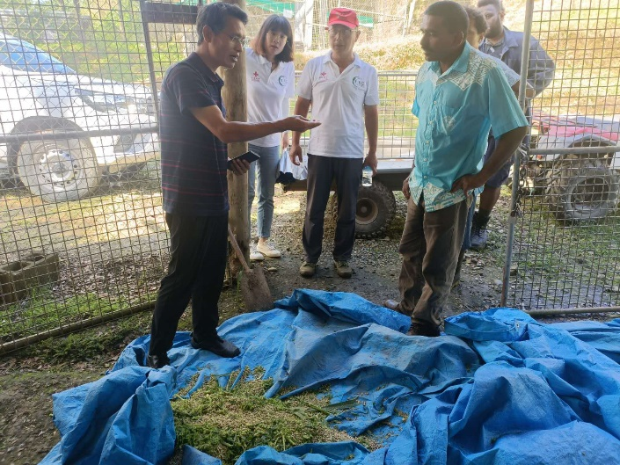
5. Sigatoka Research Station
Juncao-feeding goats and chickens in Sigatoka Research Station

Slide 15
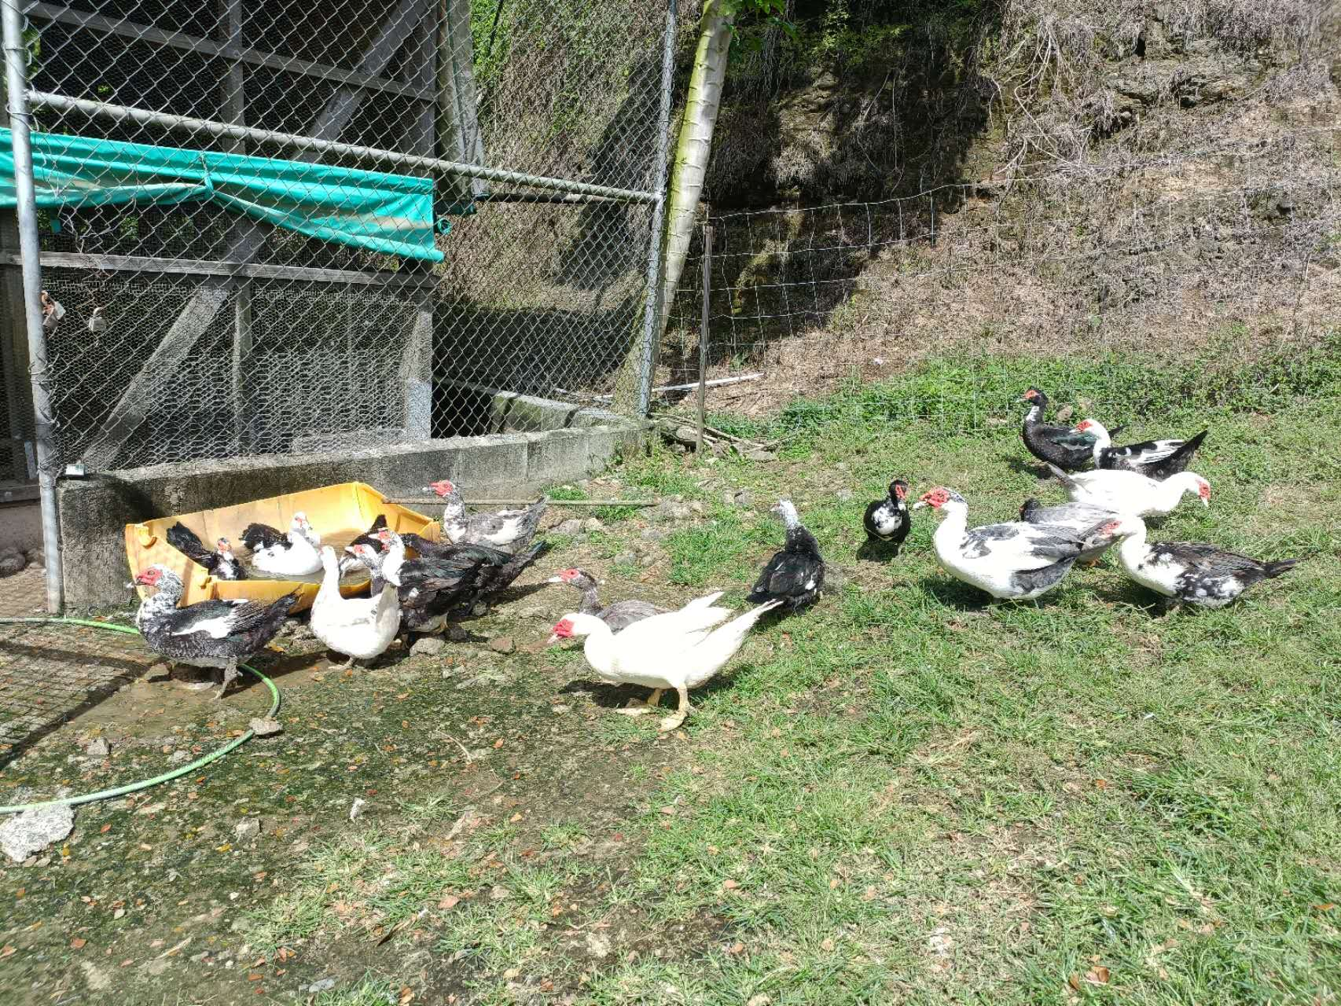
Juncao-feeding ducks in Sigatoka Research Station

Slide 16
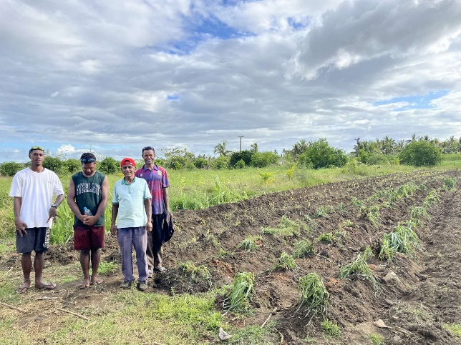
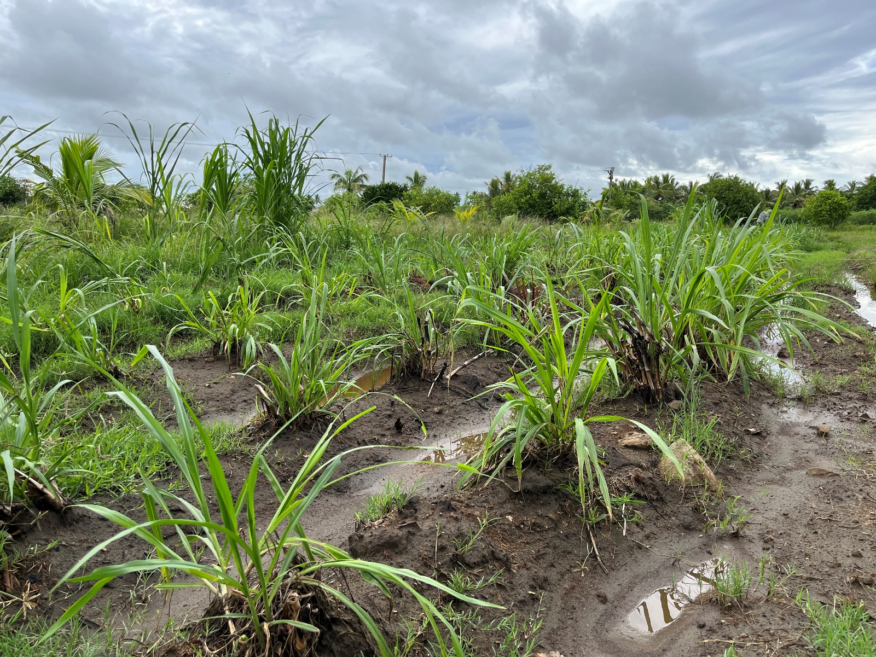
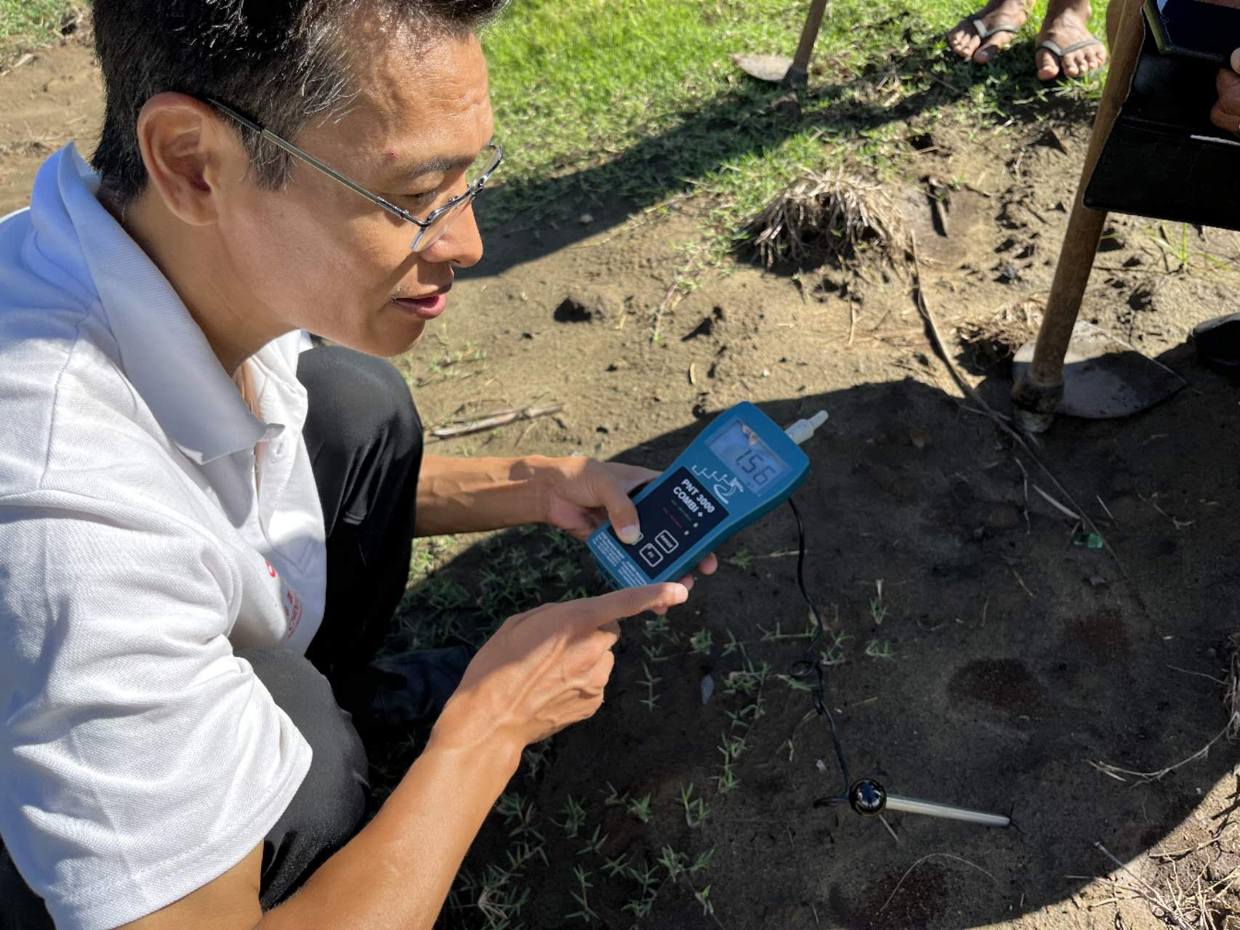
6. Double Tree Resort Juncao Technology Demonstration Site

