Slide 1
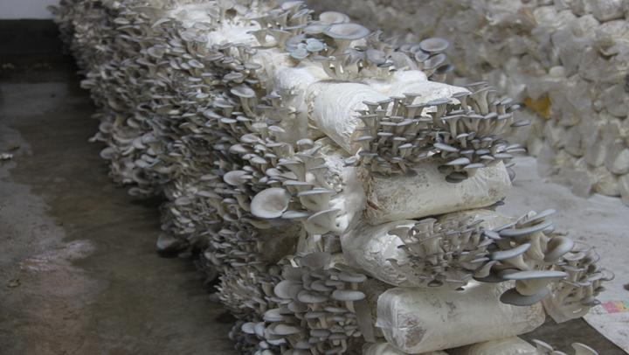
Mushroom Production through Juncao Technology and its Contribution to Livelihoods Improvement in Rwanda
Dr. Bellancile Uzayisenga
Rwanda Agriculture and Animal Resources Development Board (RAB)
Second African Regional Workshop on Applications of Juncao Technology and Its Contribution to the Achievement of Sustainable Agriculture and the Sustainable Development Goals in Africa, Addis Ababa, 18 – 19 December 2023

Slide 2
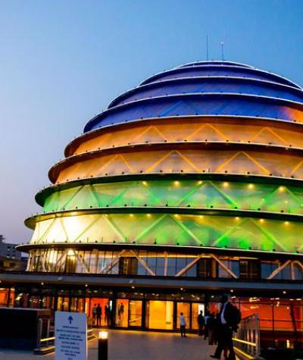
Rwanda at
a glance
Country Size
26,338 Sq. Km
Agric. Pop. Labor force
64.5% (2023)
Population (2022)
13.2 million
Agric. Share to GDP
25% (av. Last 5 years)
Agriculture land
1.4 Million Ha
Agric. Share to National Export
37% (FY 2021/2022)
Currency/exchange rate¹
Rwanda Francs (RWF)
~RWF 1,192/USD
~RWF 1,304/EUR
Food Secure Household
79.4% (2021)
As of 06 August 2023; Sources: BNR

Slide 3
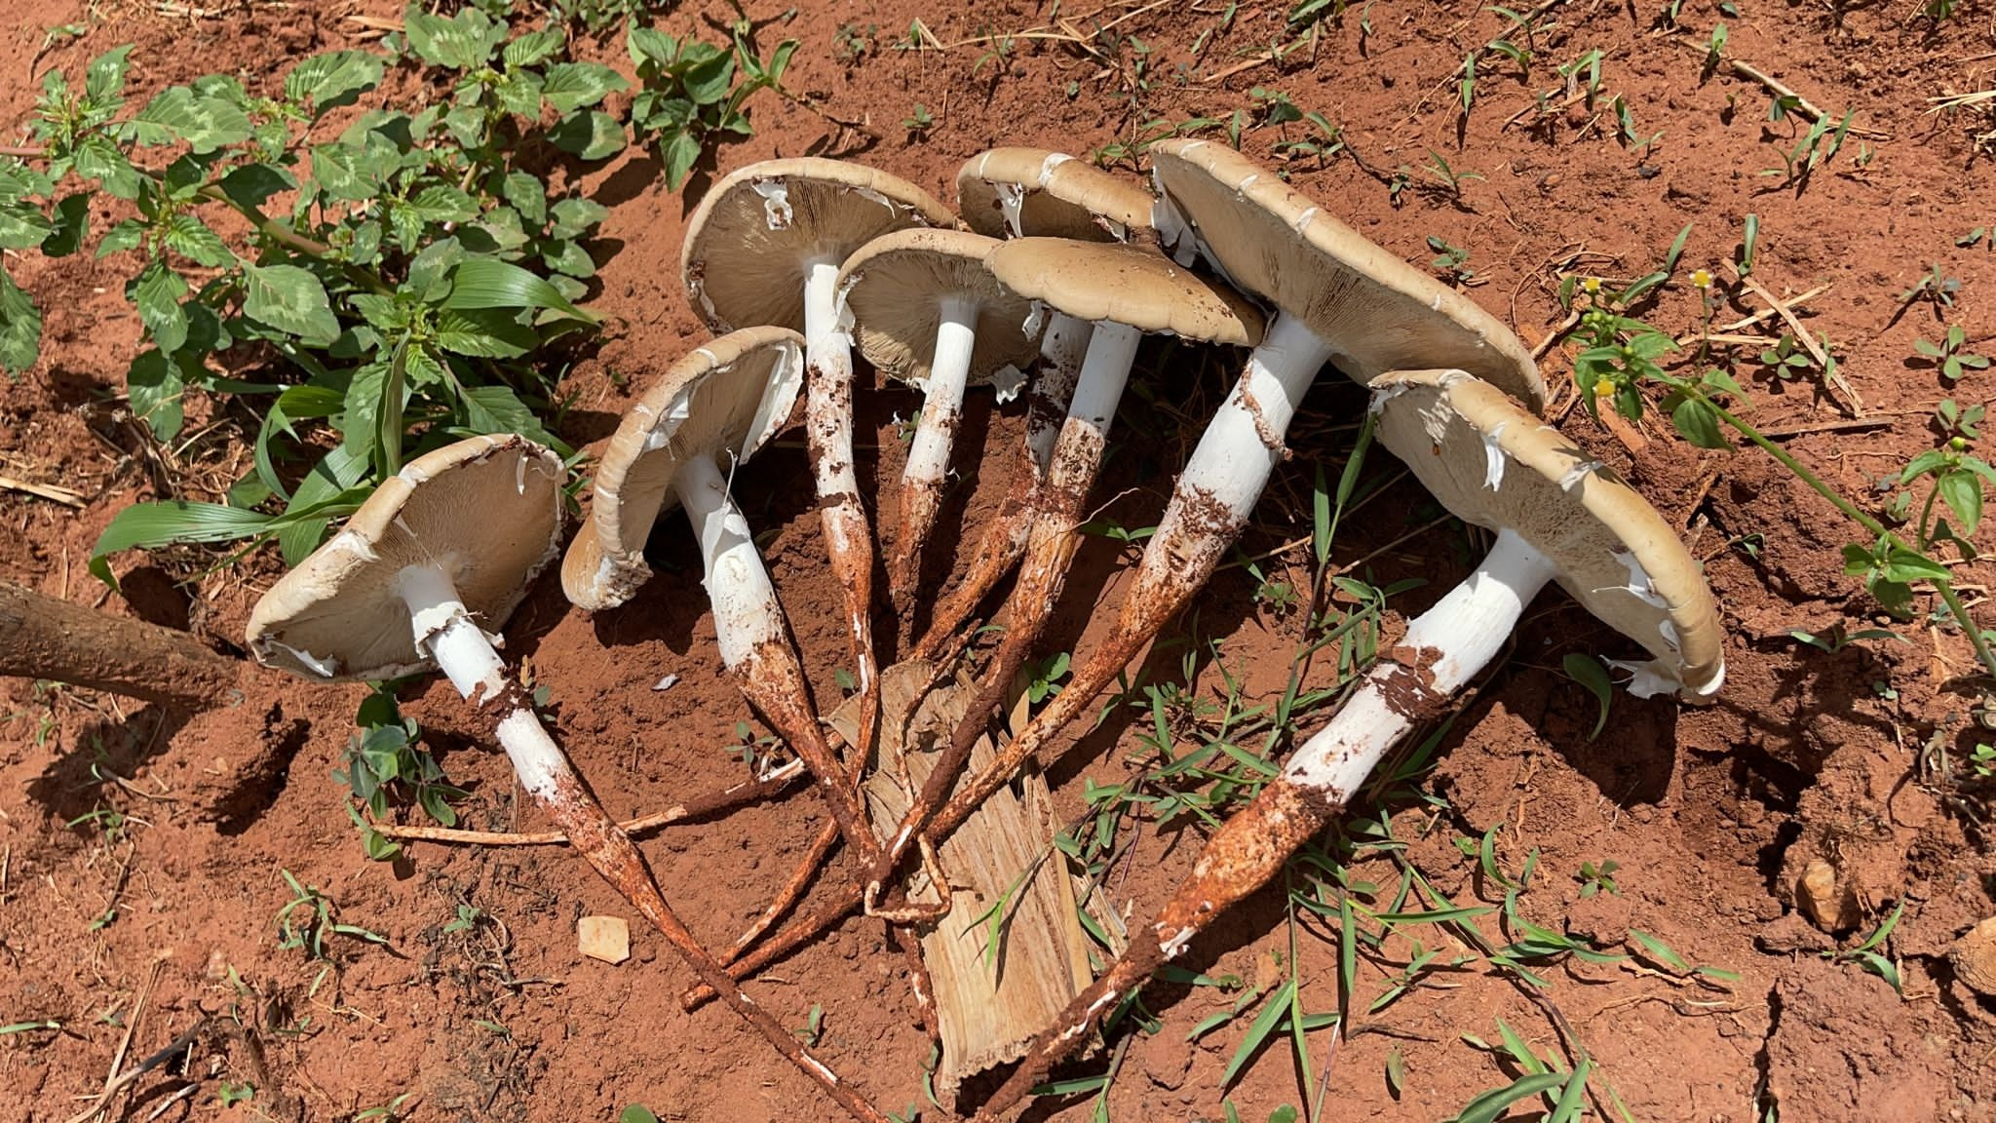
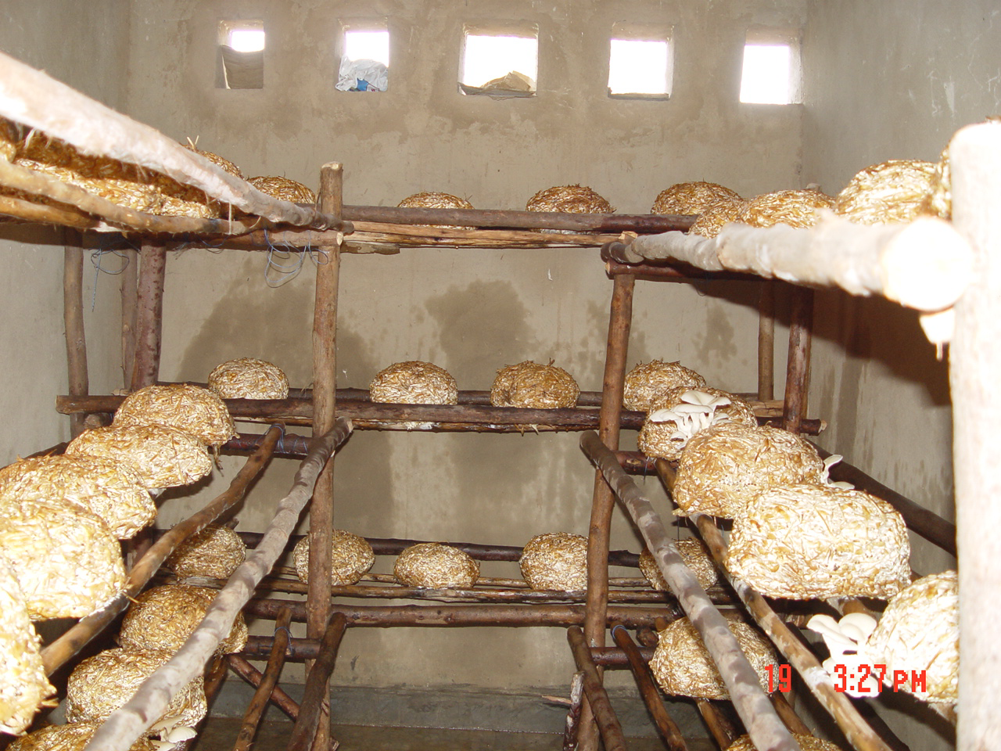
Background of mushroom production in Rwanda
Wild Mushroom collection period
Traditional mushroom production period
Juncao Technology Promotion

Slide 4
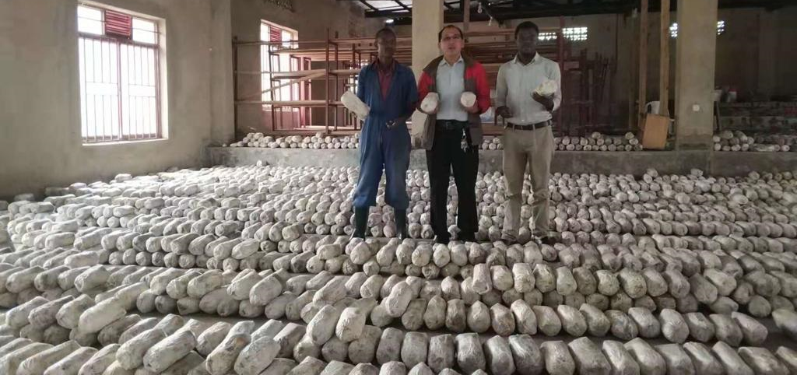
Introduction and Promotion of Juncao Technology in Rwanda
Juncao technology was agreed to be adopted in Rwanda in 2006 through the bilateral cooperation between the People's Republic of China and the Republic of Rwanda:
To replace the traditional mushroom production approach
To modernise the mushroom industry in Rwanda

Slide 5
Introduction and Promotion of Juncao Technology in Rwanda- key achievements
12 mushroom varieties were introduced
Currently one mushroom variety (Oyster ostreatus) is common and successfully adopted
4 different grass cultivars from China, are currently used in the production of mushroom substrates
5 mushroom substrate formulations based on Nitrogen and Carbon balance were formulated and are currently used by mushroom tubes producers
Awareness creation

Slide 6
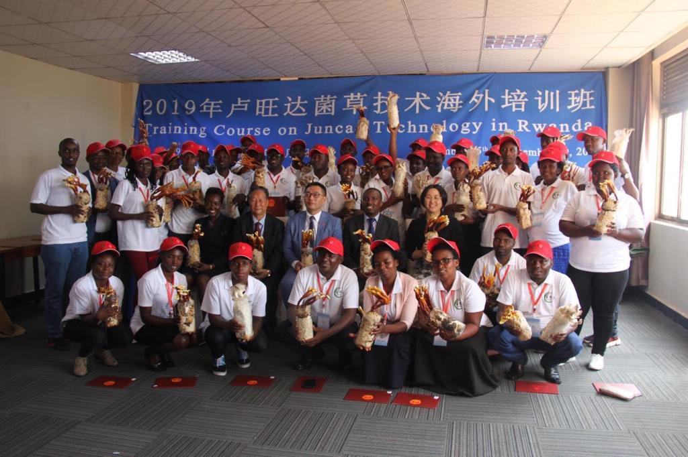
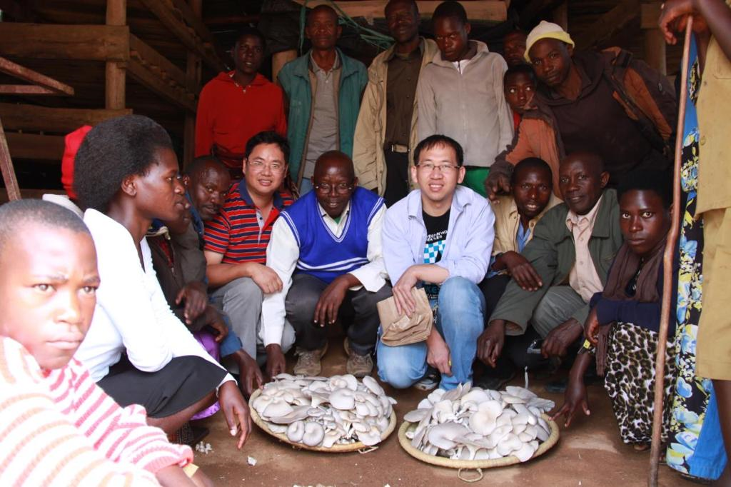
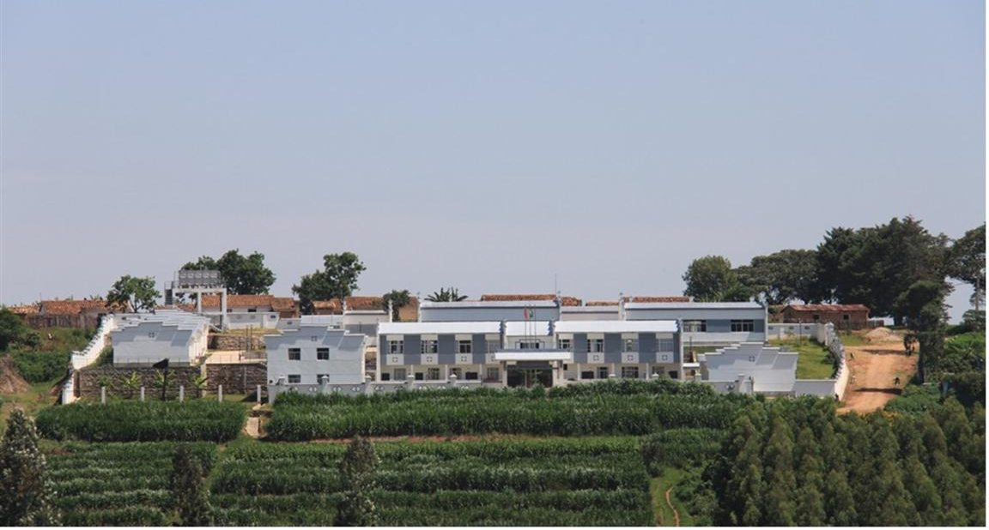
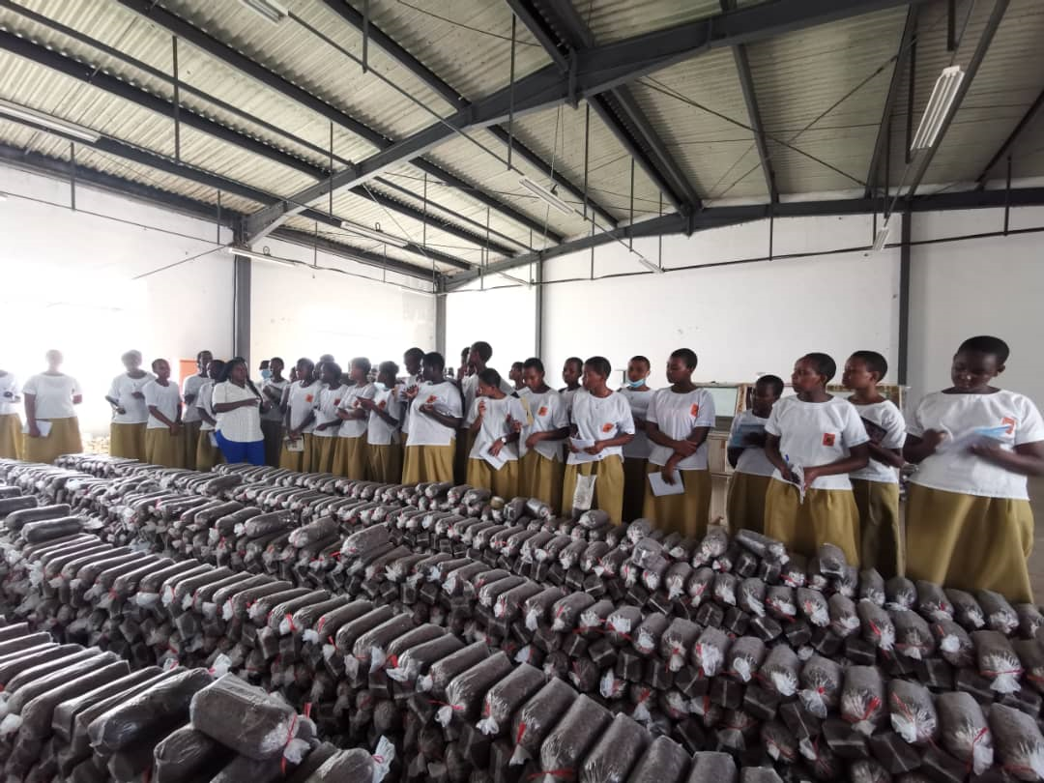
Awareness creation for Promotion of Juncao Technology
Trainings
Visits
Talks: TVs, Radios
Leaflets, booklets
Agriculture shows

Slide 7
Juncao technology adoption status
There are 52 companies and 14 cooperatives involved in mushroom production
Around 38,000 individual farmers are involved in mushroom cultivation
The mushroom production is estimated at 300 tons per year
More than 40,000 farmers have got training on mushroom production using Juncao technology

Slide 8
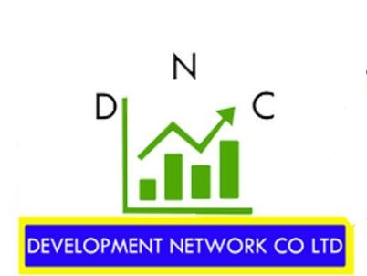
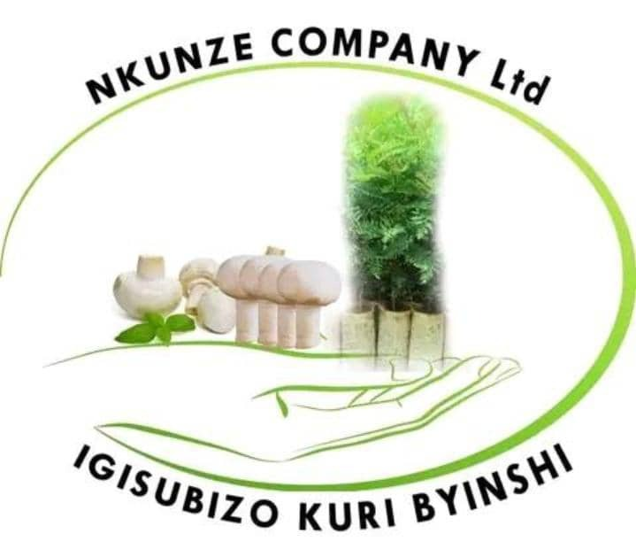
Income generation through Juncao technology
New businesses were generated

Slide 9
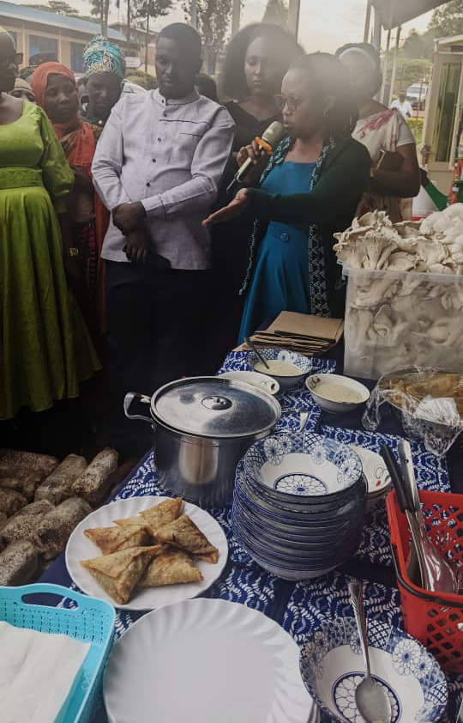
Contribution of Juncao Technology
Food security
Reduction of malnution
Reduction of poverty
Increase of income to afford medical insurance, school fees, and other family needs
Job creation
Income generation

Slide 10
Challenges in mushroom production
Low number of available varieties:
Pleurotus ostreatus
Agaricus Bisporus
Ganoderma Licidium
Lack of post harvest ad processing technologies and facilities
Lack of standards throughout the production value chain

Slide 11
Ongoing and future research and extension activities in mushroom production
Development of new mushroom varieties
Development new and cheapest substrate formulation without compromising the quality and quantity of mushroom production
Development of post-harvest and handling technologies
Maintaining available mushroom varieties
Training of mushroom farmers
Establishment of demonstration plots
Spawn and mushroom tubes production and distribution

Slide 12
Key expected outputs of mushroom production in Rwanda
Increased number of mushroom varieties
Strengthened mushroom value chain through specialisation of its actors
Established and empowered mushroom collection centers with cold room, dryers and processing facilities
Established mushroom shops similar to coffee shops

Slide 13
Acknowledgement
The People's Republic of China
Workshop Organisers
The Goverment of Rwanda
MINAGRI
RAB
Mushroom farmers

Slide 14
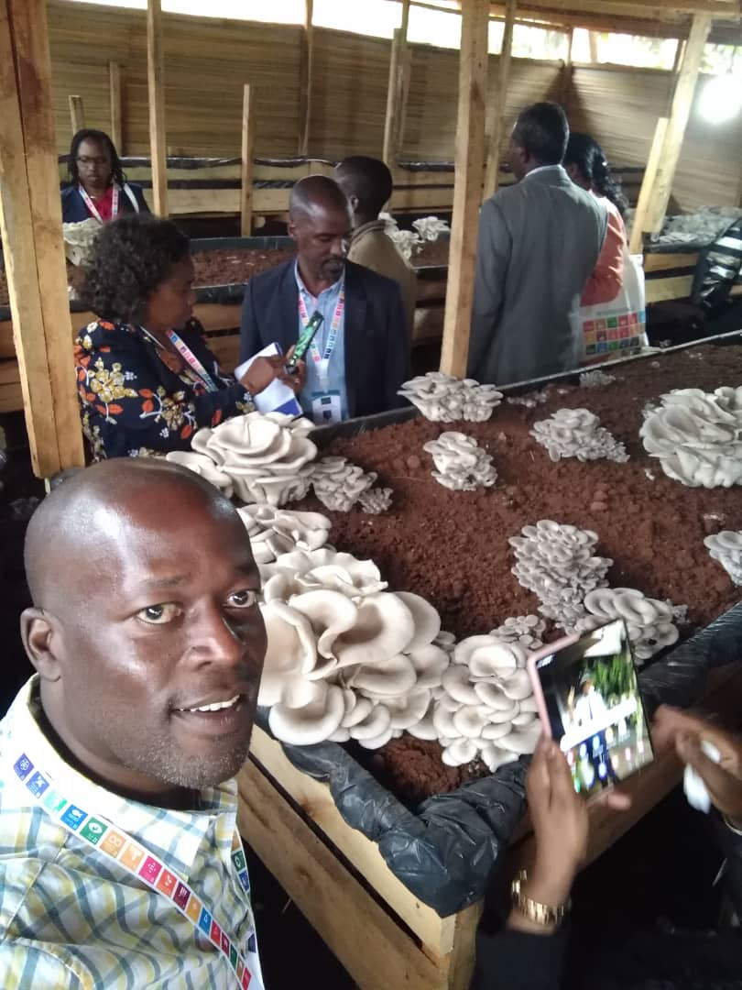
THANK YOU FOR YOUR ATTENTION

