Slide 1
WORKSHOP ON APPLICATIONS OF JUNCAO TECHNOLOGY AND ITS CONTRIBUTION TO THE ACHIEVEMENT OF SUSTAINABLE AGRICULTURE AND THE SUSTAINABLE DEVELOPMENT GOALS IN AFRICA
18-19 NOVEMBER 2023
ADDIS ABABA,
ETHIOPIA
LEVERAGING STRATEGIC PARTNERSHIPS TO ADVANCE AGENDA 2063 TARGETS THROUGH SCALING UPTAKE OF INNOVATIVE TECHNOLOGIES: A CASE OF JUNCAO TECHNOLOGY
Presentation by Ms. Beatrice Egulu
Policy Officer-African Union Commission

Slide 2
Outline of the Presentation
1. Juncao Technology: Context within the Aspirations of Agenda 2063 and the 2030 Sustainable Development Goals (SDGs)
2. Juncao Technology: Lessons from Shunchang, China
3. Enhancing uptake of the Juncao Technology through the African Seed and Biotechnology Programme
4. Conclusions and way forward

Slide 3
Juncao Technology: Context within the Aspirations of Agenda 2063 and the 2030 Sustainable Development Goals
Agenda 2063: ‘The Africa We Want’ is the blueprint and future master plan for transformation of the continent’s socio-economic development.
It is the strategic framework that is based on inclusive growth with the Pan-African drive for unity, progress, prosperity and Africa’s Renaissance.
The Second 10-year Implementation Plan cycle is geared towards ensuring that Africa delivers both quantitative and qualitative Transformational Outcomes for its people under the following Moonshots:
1. Prosperous: Every AU Member State attains at least middle-income status
2. Integrated: Africa is more Integrated and Connected
3. Democratic: Public Institutions are more Responsive
4. Peaceful: Africa Resolves Conflicts Amicably
5. Cultured: Africa Values are Explicit and Promoted
6. People driven: Africa Citizens are more Empowered and more Productive
7. Partnerships: Africa is a strong and an influential global player

Slide 4
Juncao Technology: Context within the Aspirations of Agenda 2063 and the 2030 Sustainable Development Goals cont’d
The Juncao Technology promotes Circular production involving plants, animals and mushrooms
Delivers economic, health, social and environmental benefits
Hence contributes delivery on Goals 1, 5 and 7 of Agenda 2063:
Goal 1 of Agenda 2063 is to have a high standard of living, quality of life and well-being for all citizens, incomes, jobs and decent work, End Poverty, inequality and hunger (SDG 2 and 8).
On Agriculture, Goal 5 of Agenda 2063 on Modern agriculture for increased productivity and production with Priority Area on Agricultural productivity and production (SDG 2)
On Environmental issues, Goal 7 of Agenda 2063 on Environmentally sustainable and climate resilient economies and communities (SDG 6, 7, 13, 15)

Slide 5
Lessons from Shunchang, China explaining the pictures
Livestock industry: Juncao technology used as livestock feed, improving animal nutrition and reducing the environmental impact of livestock farming.
Economic Benefits and Income Generation:
16 large scale enterprises;
1600 workers mostly women
Producing 99,000 tonnes of mushrooms annually;
169 million mushroom substrate bags used;
Accounting for 27.8% of agricultural output value and hence income generation, job creation, and poverty alleviation;
3. Environmental Conservation and Biodiversity as a result of soil erosion prevention, reforestation, and biodiversity preservation and hence climate change mitigation outcomes

Slide 6
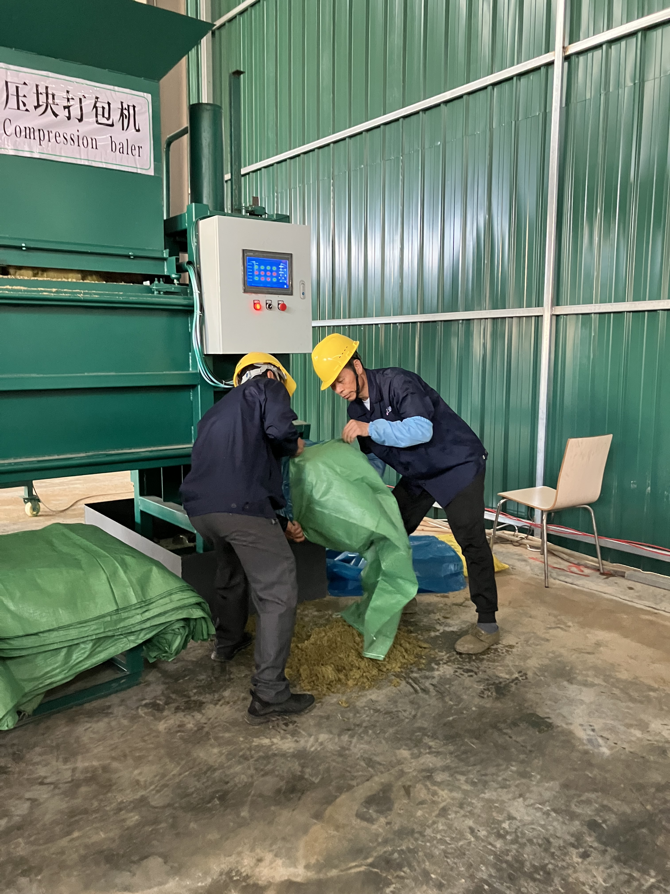
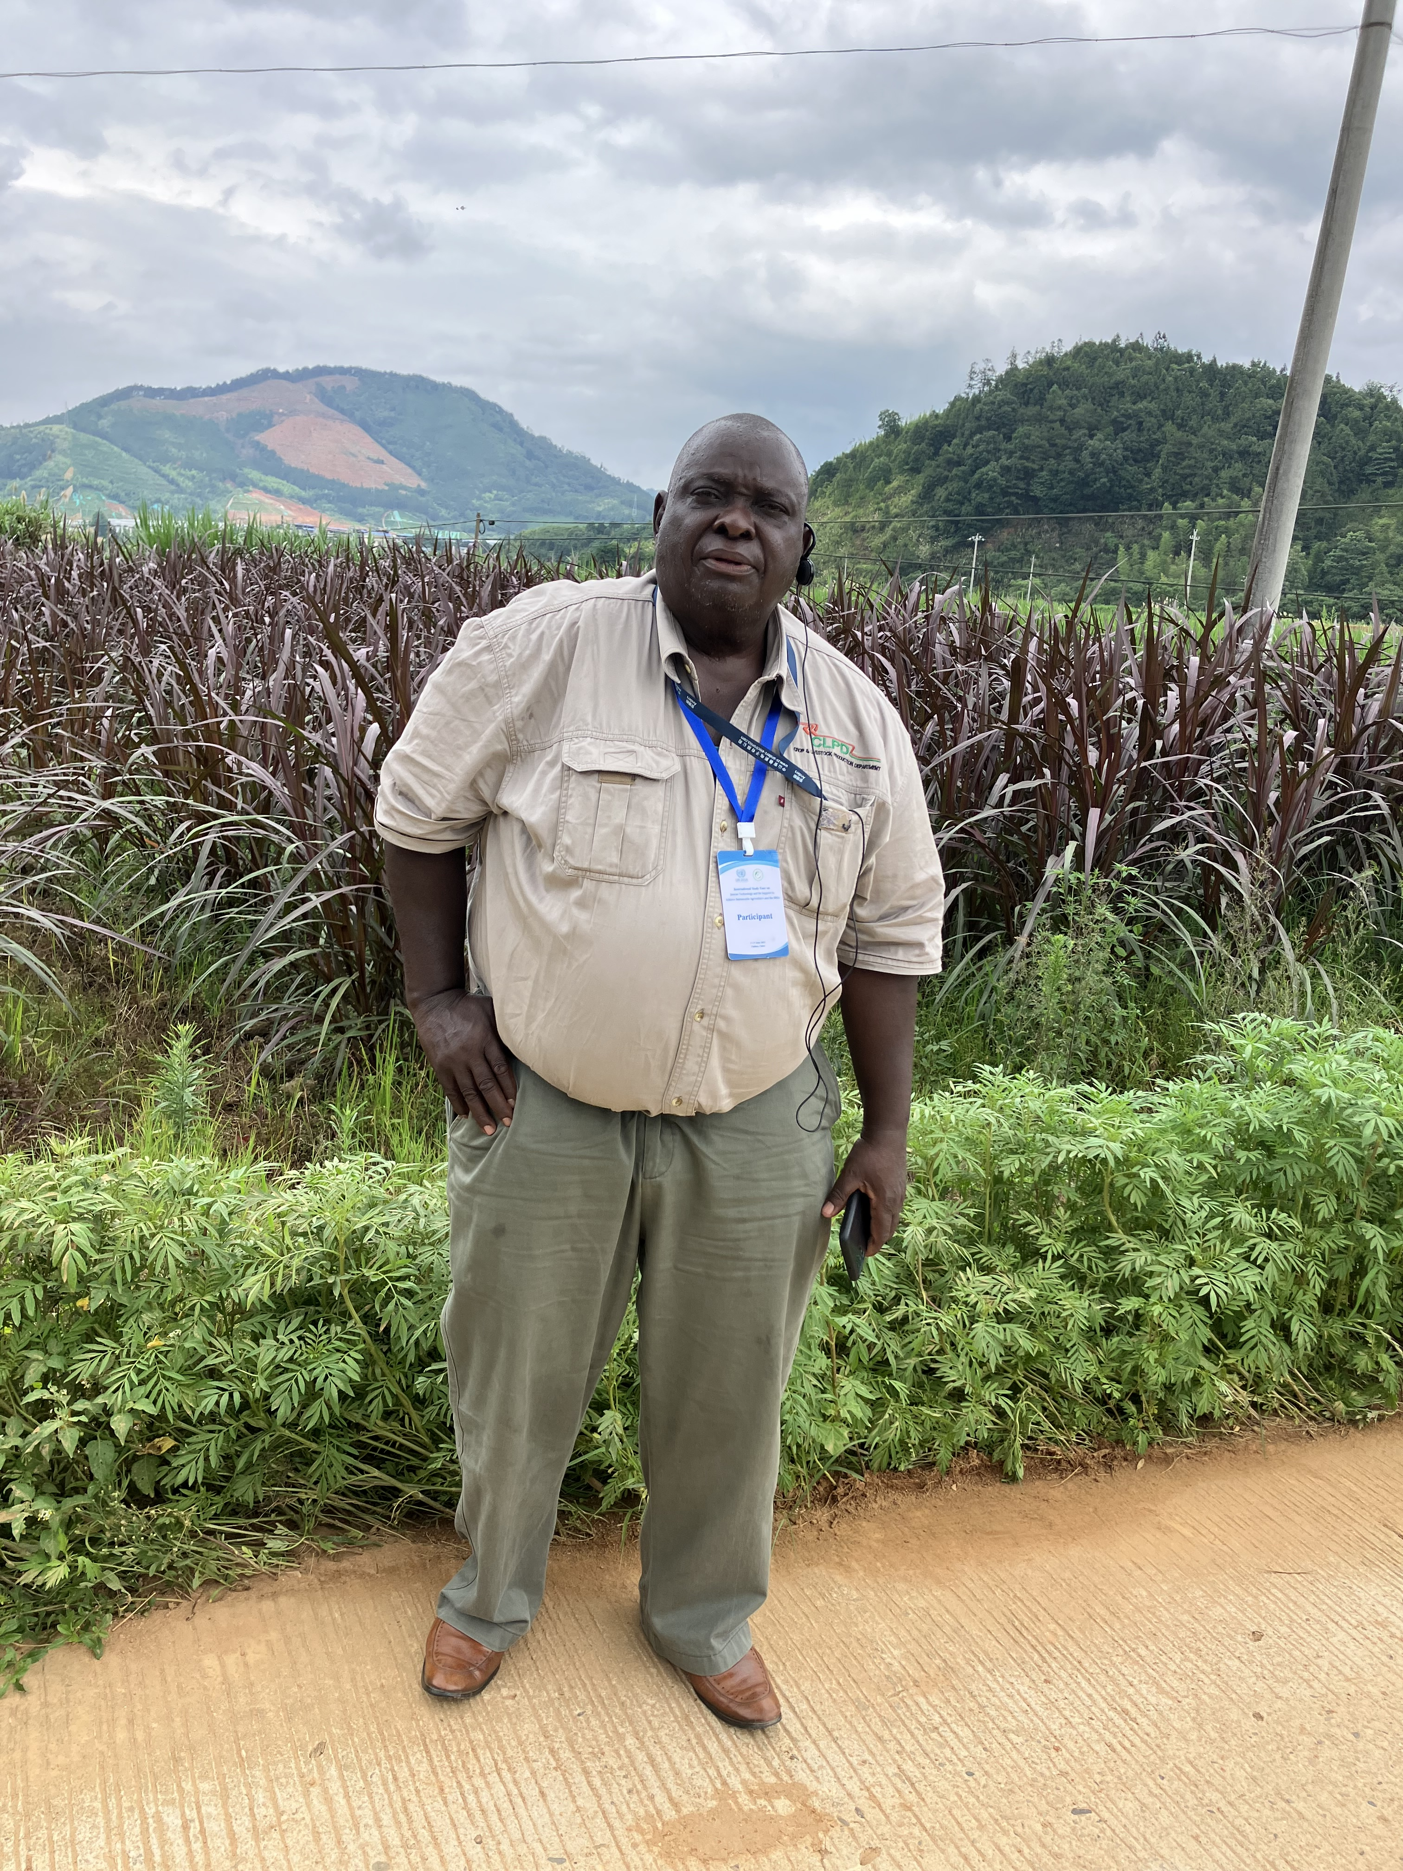
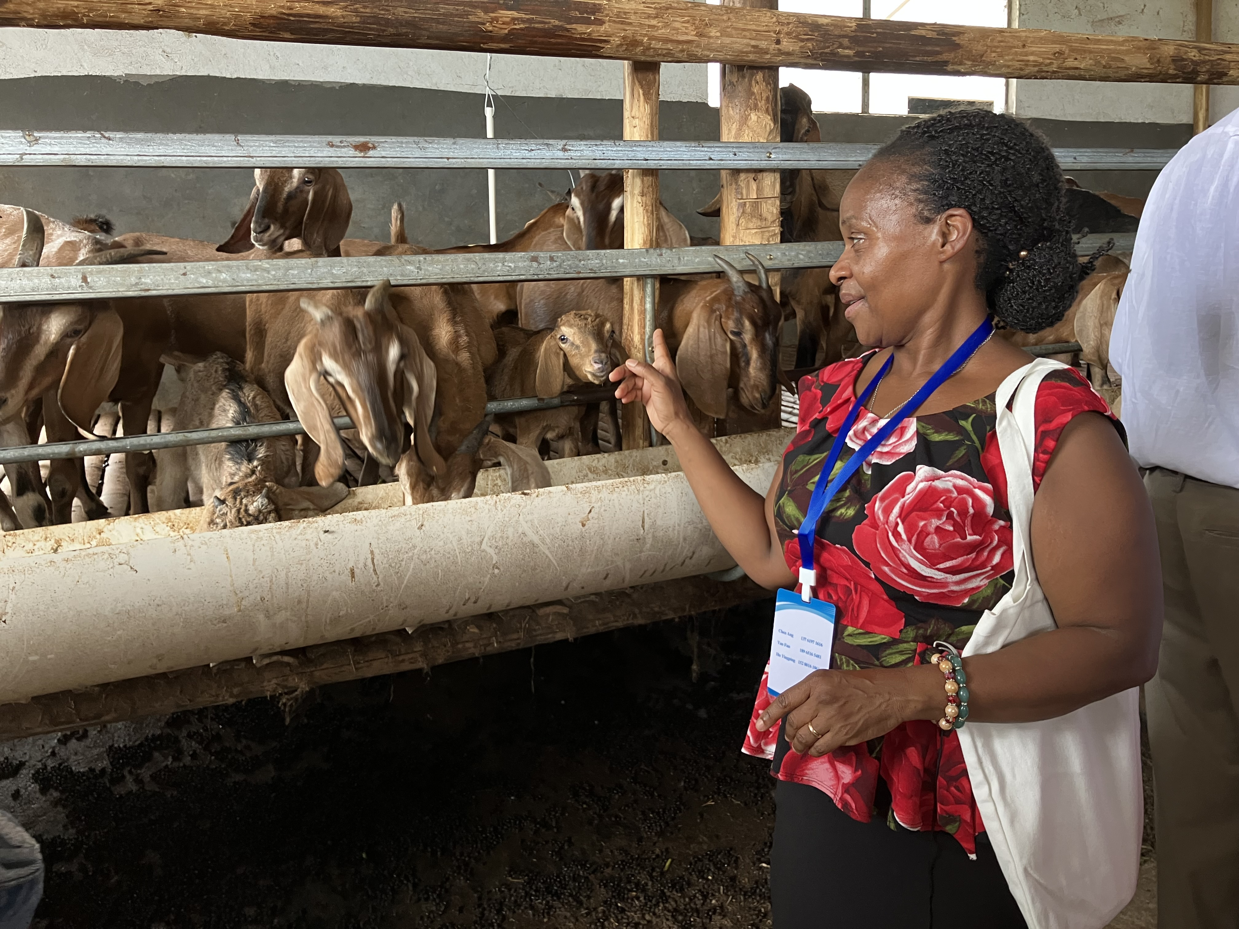
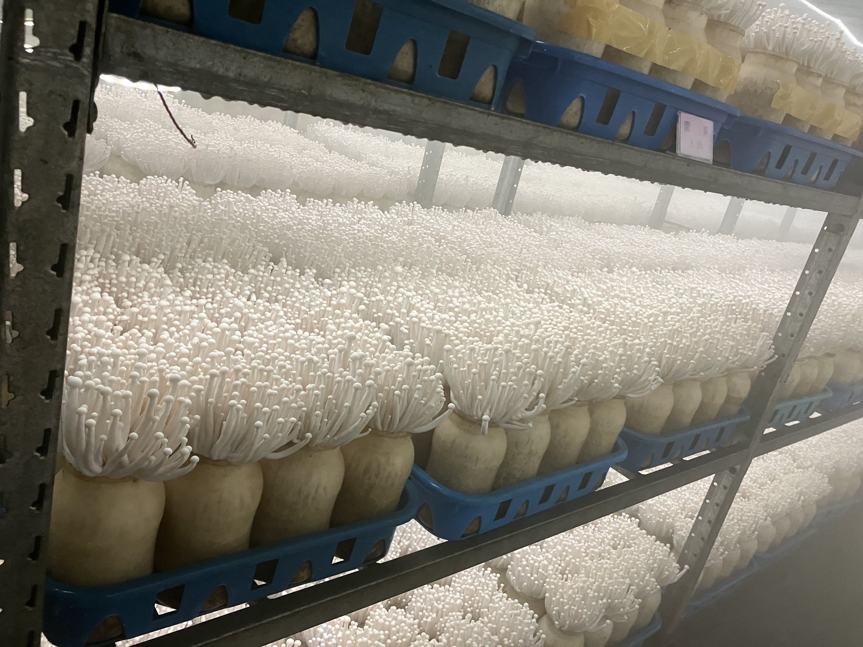
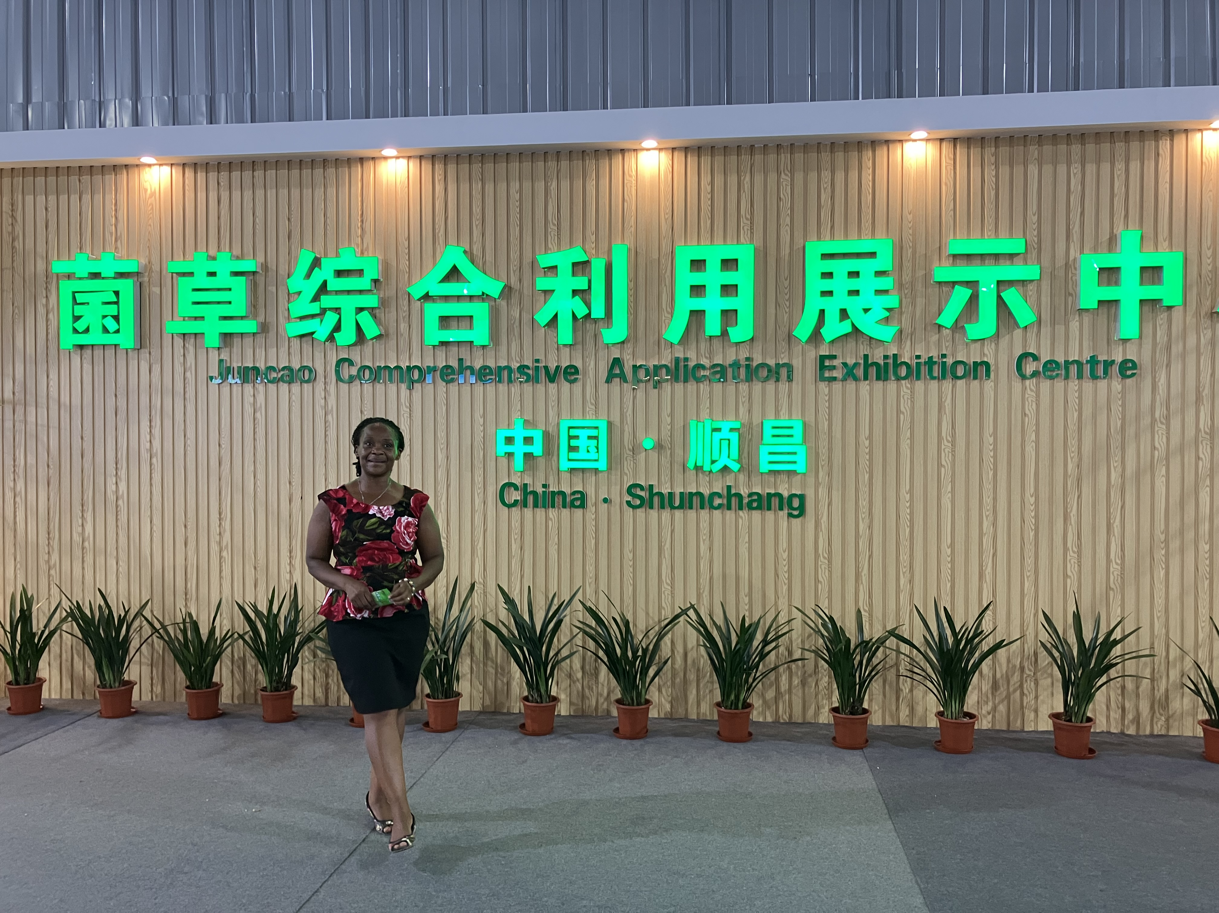
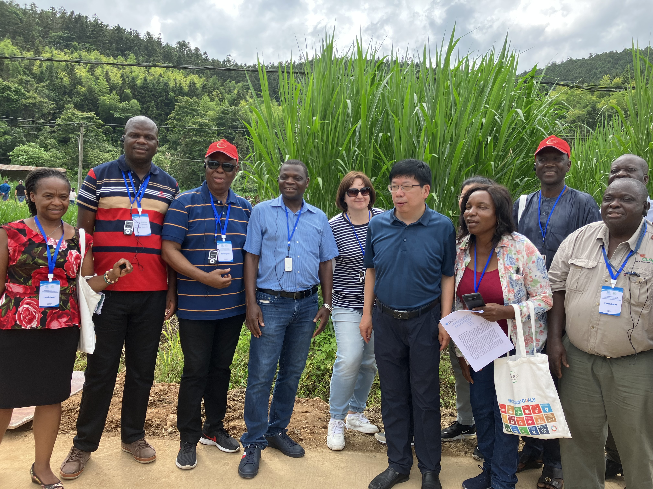
Economic, Health, Social and Environmental benefits of Juncao Technology: Lessons from Shunchang, China

Slide 7
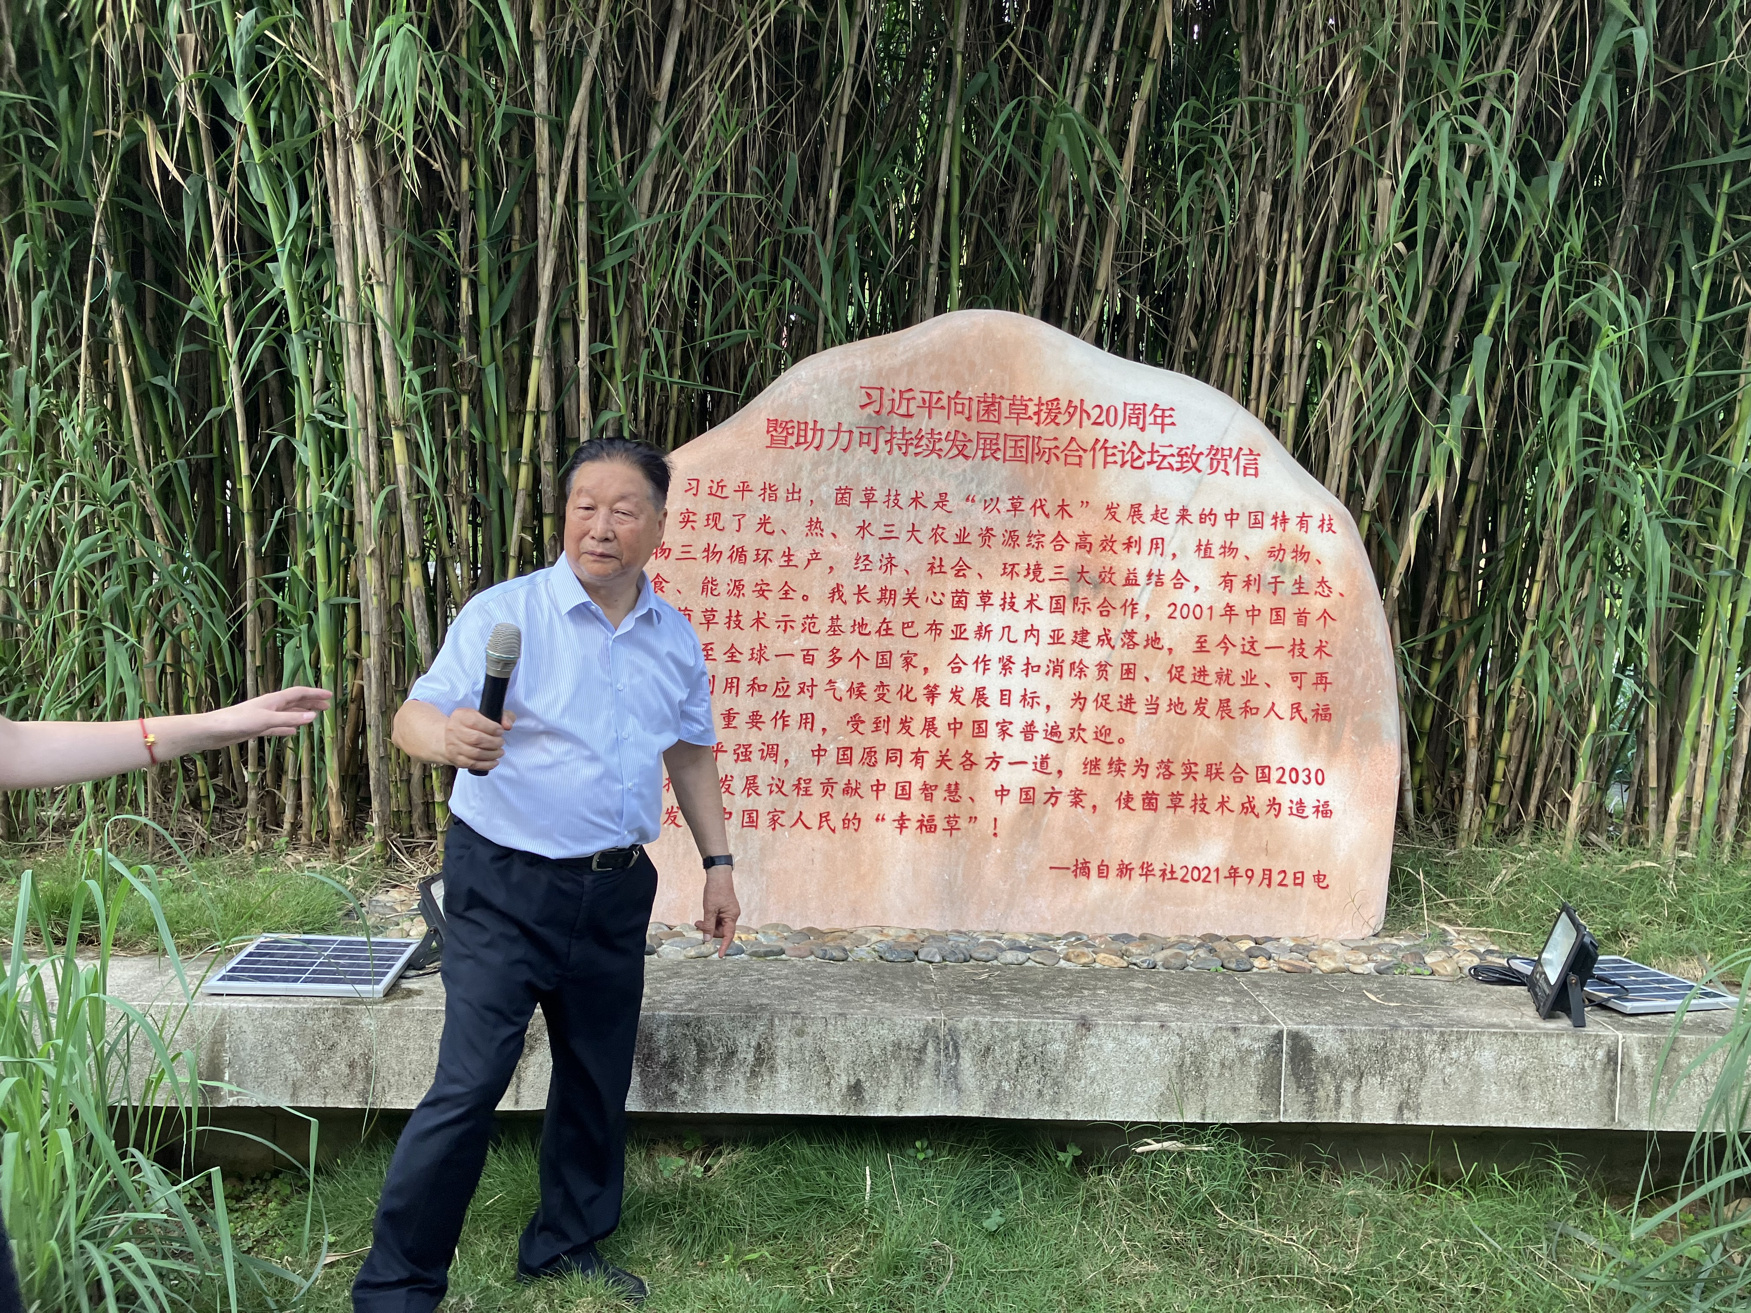
Win-Win Business Models involving Individual farmers, Cooperatives and Enterprises/Government
Individual farmers grow mushrooms in their fields and in contracted greenhouses
Cooperatives promote Quality assurance through standardization of spawns, mushroom substrate formula and cultivation techniques
Government-Enterprises-Farmers model supports development of livestock industry. The Jinfu goat farm provides breeding and sales service for resilient food systems.

Slide 8
Enhancing uptake of the Juncao Technology through the African Seed and Biotechnology Programme
The overall ASBP goal is to contribute to increased food security and nutrition and to poverty alleviation in Africa by establishing effective and efficient seed systems and enhanced application of biotechnologies and methodologies within the seed sector.
The programme is based on an interrelated set of components that collectively provide a strategic approach to address the main barriers and challenges to improving the seed sector in Africa including:
Enhance biotechnology uptake for an efficient seed system in Africa
Cross-cutting Issues: Capacity building, Environment, youth and gender

Slide 9
Enhancing uptake of the Juncao Technology through the African Seed and Biotechnology Programme cont’d
17-19 June 2023: International Study Tour on Juncao Technology and its contribution to achieving Sustainable Agriculture and the Sustainable Development Goals
23 August 2023: Small yet Smart” Programmes: The Case of Juncao Technology
06-10 November 2023: 4th Steering Group was held in Mombasa, Kenya and endorsed the Juncao Technology scaling
14-17 November 2023: 5th Ordinary Session of the Specialized Technical Committee (STC) on Agriculture, Rural Development, Water and Environment (ARDWE) endorsed leveraging strategic partnerships for scaling key innovations including Multi-harvest Rice and Juncao Technology)

Slide 10
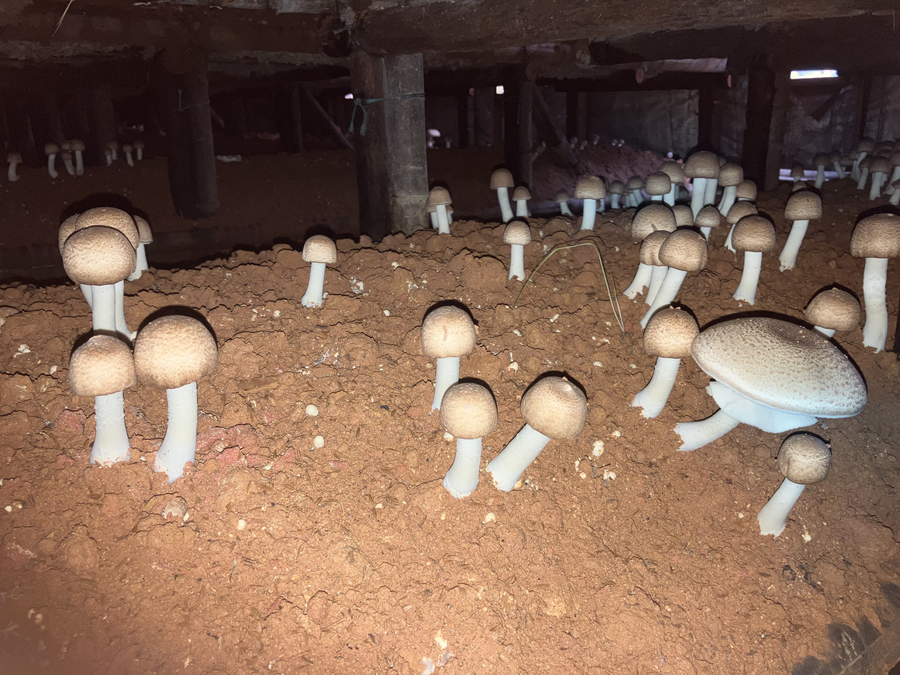
Conclusions
The Juncao Technology is a game changer in transforming food systems in Africa
Promotes agroecology, food, nutrition and energy security
Supports climate change mitigation and adaptation goals through reduction of deforestation since grass replaces wood for mushroom production;
Acts as livestock feed instead of competing for food land space;
Using mushroom substrates and bamboos as raw materials reduces carbon emissions.

Slide 11
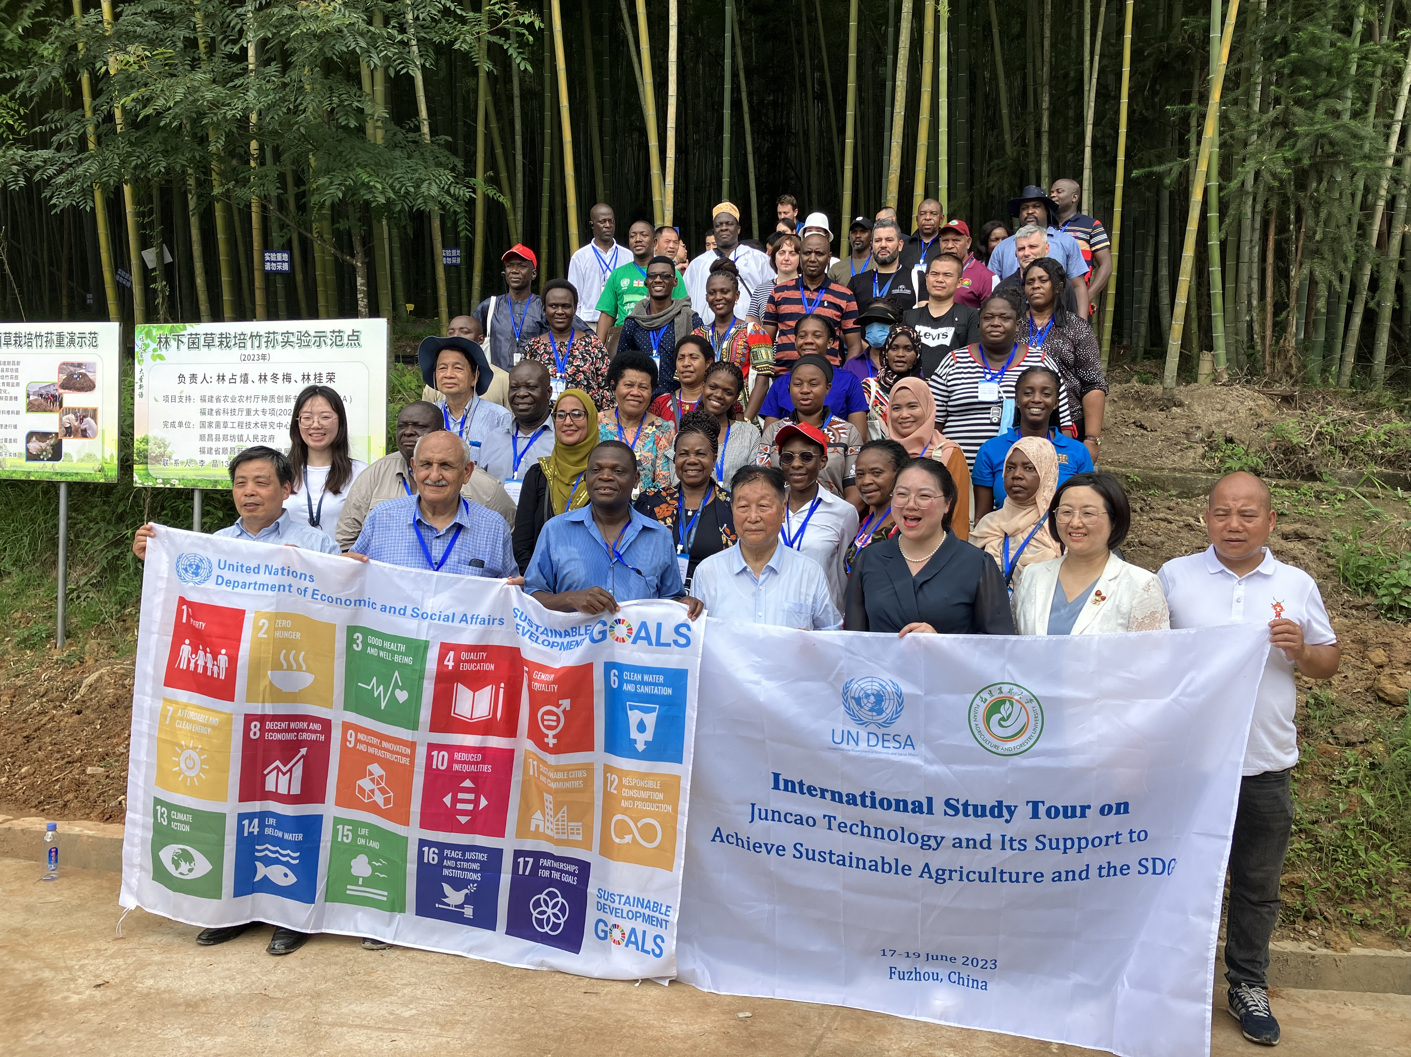
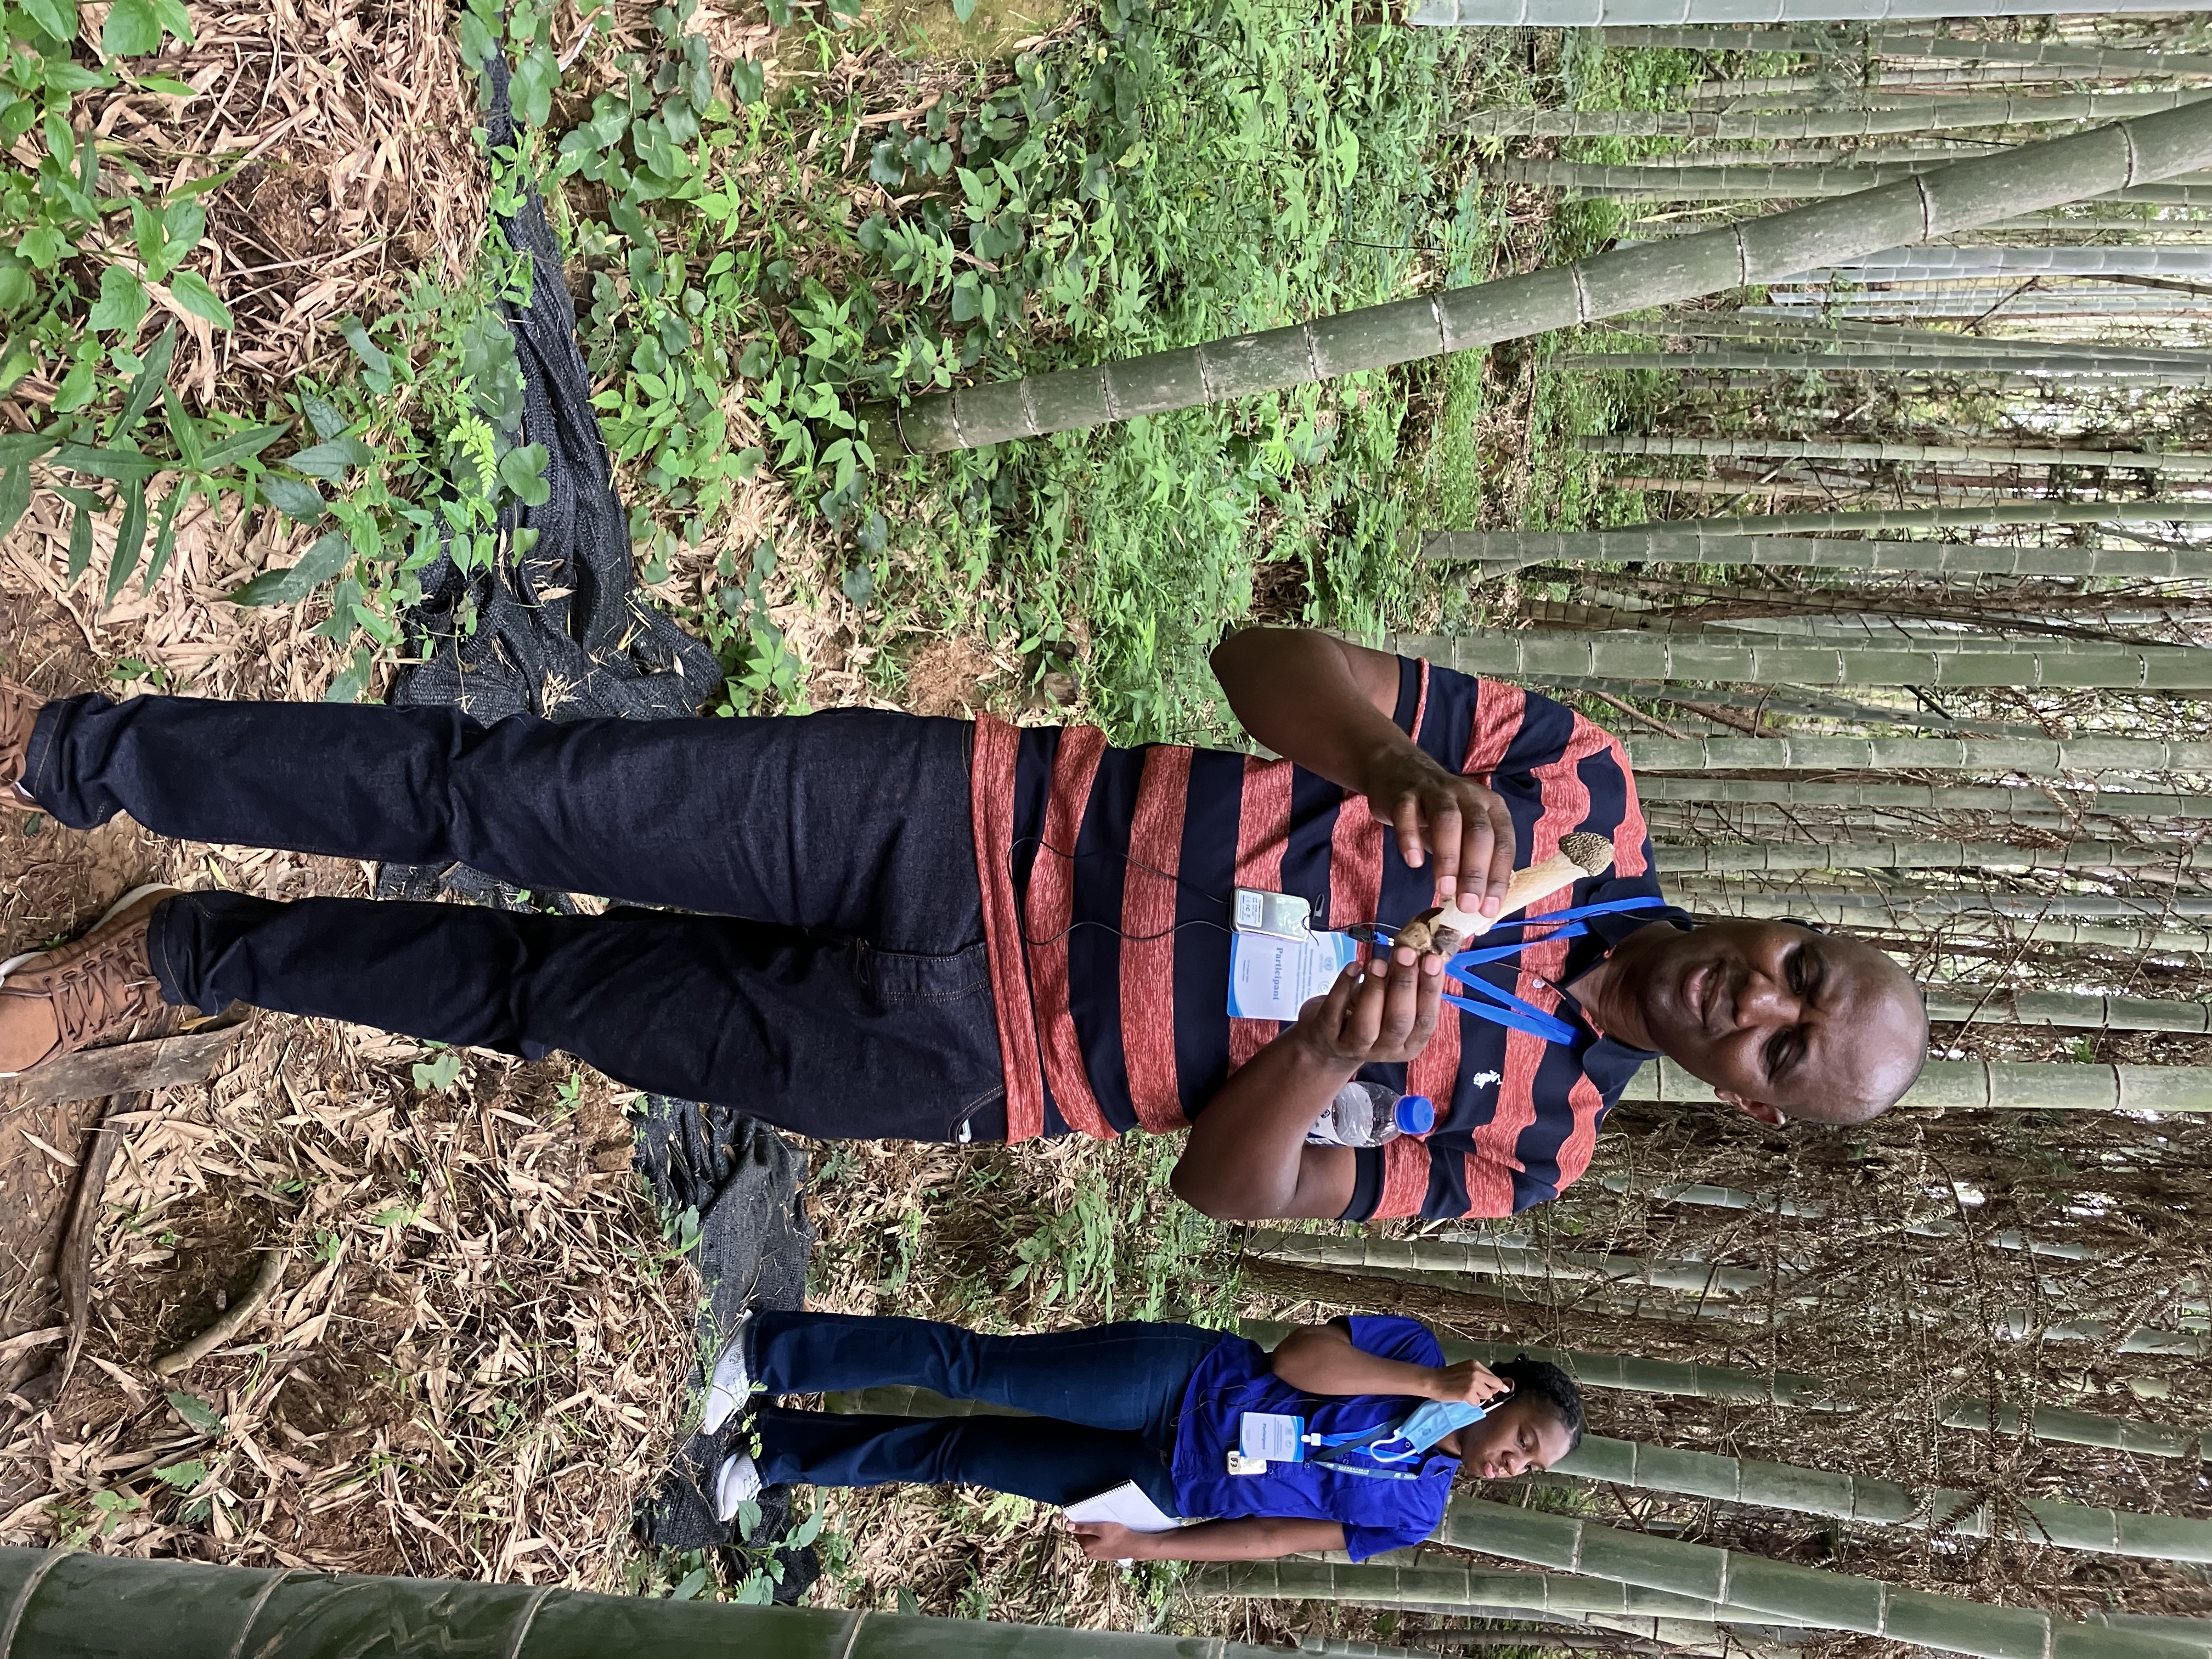
Way Forward
Provide information on African contacts for farmers interested in adapting/adopting the Juncao Technology;
Establish Regional Demonstration projects using existing initiatives for proof of Concept;
Guide on potential support along the value chain;
Provide contact information on the next steps in rolling out the technology including the process for applications.

Slide 12
Thank You for your kind attention

