Slide 1
ROLE OF KEPHIS IN FACILITATION OF JUNCAO TECHNOLOGY IN KENYA
George Momanyi,
KEPHIS Deputy Director Phytosanitary and Biosecurity
WORKSHOP ON “APPLICATIONS OF JUNCAO TECHNOLOGY AND ITS
CONTRIBUTION TO THE ACHIEVEMENT OF SUSTAINABLE AGRICULTURE
AND THE SUSTAINABLE DEVELOPMENT GOALS IN AFRICA”
18-19 December 2023
Addis Ababa, Ethiopia

Slide 2
OUTLINE
About KEPHIS
Importance of Phytosanitary Measures
Export certification
Import regulation
Pest risk analysis processes
Way forward

Slide 3
KEPHIS is a state corporation offer regulatory services in agricultural sector.
It is the official National Plant Protection Organisation (NPPO) of Kenya.
Signatory to the IPPC

Slide 4
IMPORTANCE OF PHYTOSANITARY MEASURES
Plants are increasingly facing pest and diseases threats resulting from:-
Trans boundary transfer of pests through international trade and travel.
Propagation of diseased plants (seeds and seedlings).
Climate change which makes pests and diseases thrive in previously unconducive environment.
FAO estimates that invasive pests and diseases are damaging as much as 40% of all crops globally each year.

Slide 5
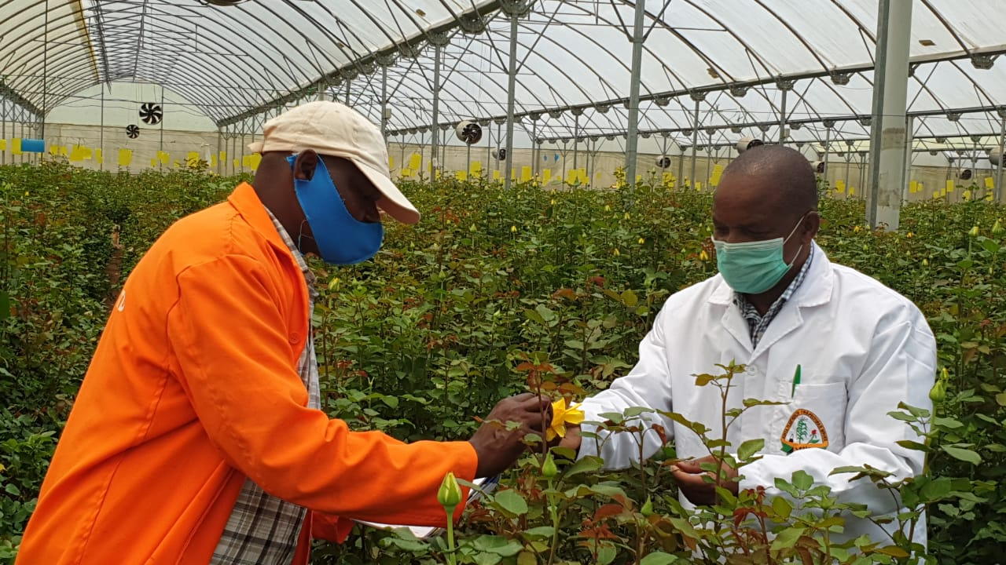
EXPORT CERTIFICATION
Plants for plant are inspected every three months for EU and one month for the USA markets; tests conducted during growth based on market requirements
KEPHIS undertakes quarterly farm inspections to supplement exit port inspections
Farm systems audit is done to confirm effectiveness of phytosanitary measures instituted.

Slide 6
IMPORT REGULATION & BORDER INSPECTION
inspection;
KEPHIS ensures compliances of imports to import requirements to prevention of the introduction of harmful foreign pests, diseases, weeds.
Sampling of consignments
inspection plus testing where permit provision stipulate
Releasing of consignment

Slide 7
Pest risk analysis
KEPHIS has a dedicated unit undertaking PRA work to establish phytosanitary requirement
PRA for import into Kenya; establish import condition and agreement to prevent pest introduction
All product being imported for the first time to Kenya or from new source or countries
weediness risk assessment system for Juncao grass undertaken gave Juncao grass a moderately low weediness potential.
Assessment recommended further containment measure, and upon monitoring no the individual risk elements identified as low to high have been are verified to be negligible.

Slide 8
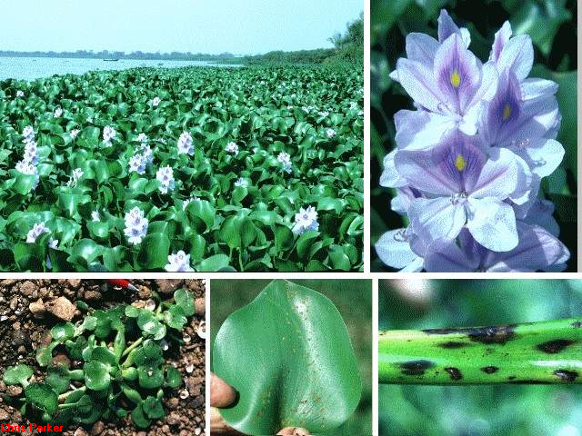
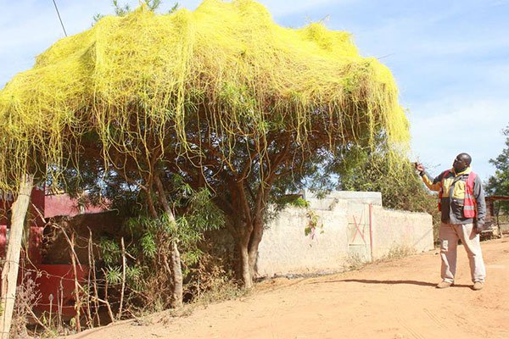
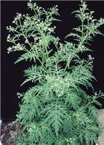
WATER HYACINTH
Noxious weeds
Parthenium Weed
Cascuta Weed
Notes:
Rwanda through River Kagera, Ornamenta, 1980

Slide 9
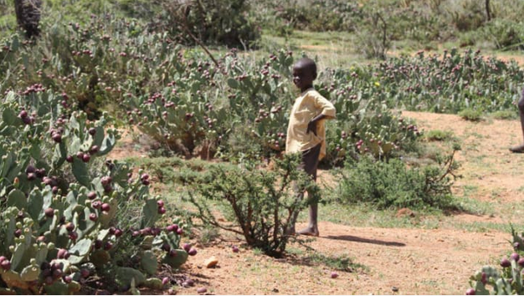
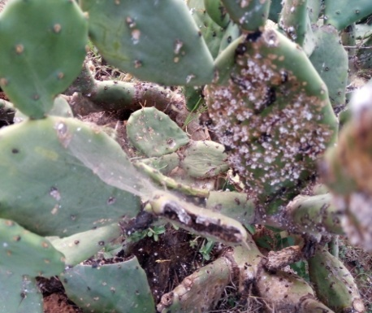
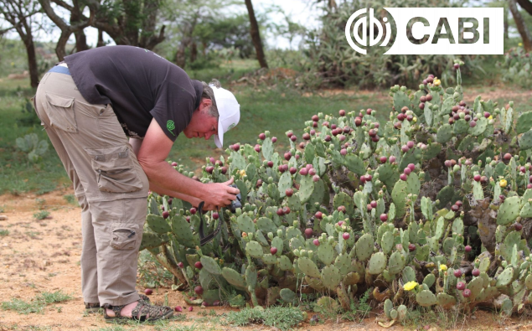
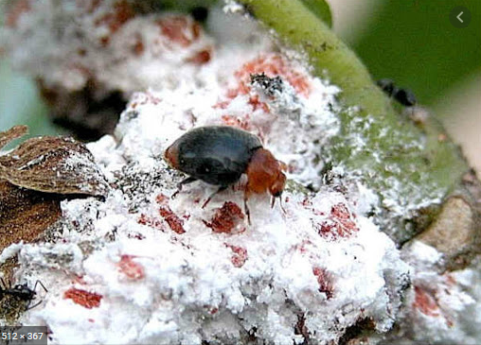
Opuntia stricta

Slide 10
Way Forward
KEPHIS will continue with issuance of permits after assessment of risks from individual countries of import.
Juncao grass graining traction in Kenya as more and more people start the production of the grass in several parts of the country due to its role in:
Soil Enrichment and Erosion Control-climate-resilient farming.
Livestock Fodder Excellence
income streams through the sale of surplus grass, mushroom cultivation, or by offering Juncao grass seeds to neighbouring farms.
Need for government agencies, NGOs, and NARIs to join forces to facilitate the widespread adoption of Juncao grass

Slide 11
THANK YOU

