Slide 1
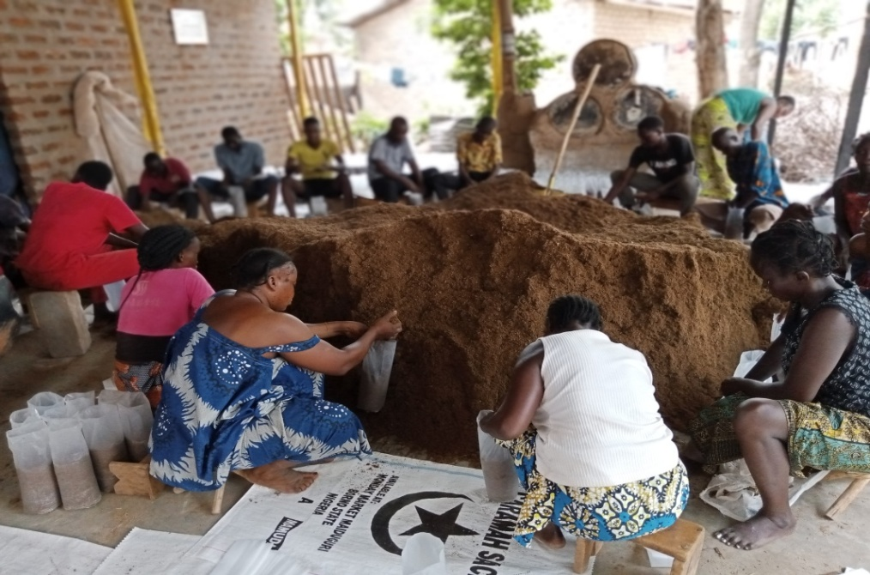
JUNCAO TECHNOLOGY DEMONSTRATION FARMER
CENTRAL AFRICAN REPUBLIC
Fatime ABBA REKYA

Slide 2
PRODUCTION’S INITIATIVE
The production initiative started in 2019 during the covid-19 pendemic where there is a restriction on working hours.
To landing for this time, Mrs Fatime initiated a small production unit after being trained in china in 2018.
A small quantity of spong was purchased to Cameroon
Small quantity sterilization equipment was manufactured.

Slide 3
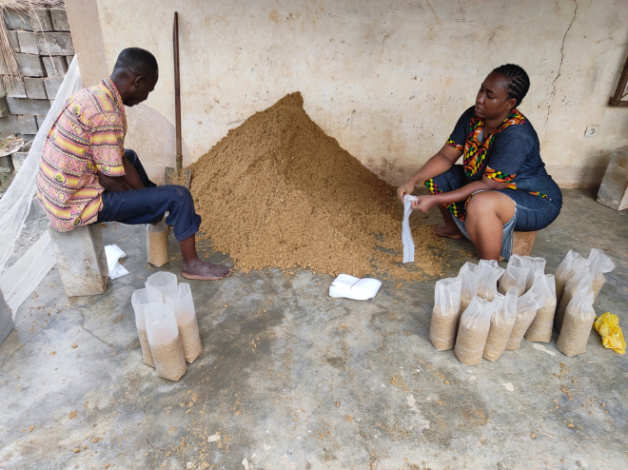
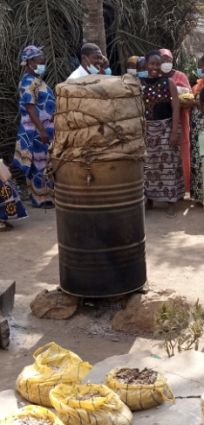
PRODUCTION’S INITIATIVE

Slide 4
CAPACITY BUILDING
As soon as the activities of the chinesse mission on the JUNCAO technology aid project in Central African Republic organized to access support needs .
Thus, a first bath of kit consisting of spong (tertiary and secondary) strains were given for the production of mushroom and spong.

Slide 5
CAPACITY BUILDING

Slide 6
CAPACITY BUILDING
Support for the construction of the production system:
The center built a 12mx4m building to serve as a mini spong production laboratory.
The mission supported the construction of a shed attenuating the 12mx6m building to serve as a production and sterilization platform for the substrate.

Slide 7
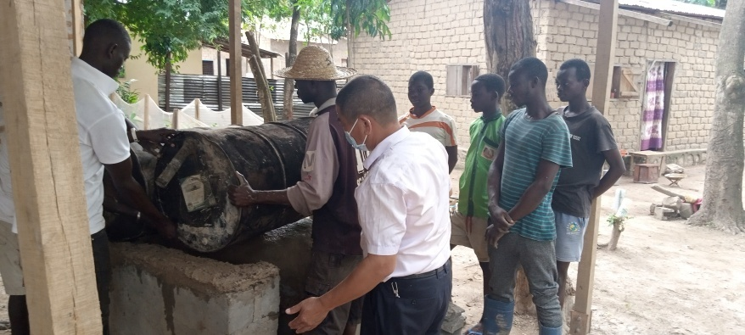
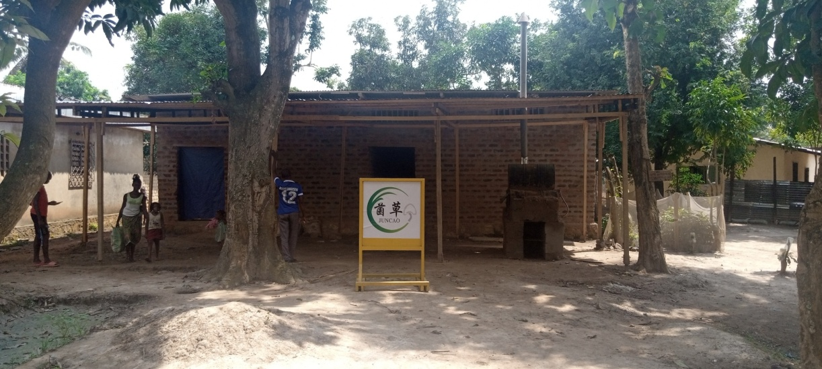
CAPACITY BUILDING

Slide 8
CAPACITY BUILDING
Technical visits were organized to supervise and train the center’s staff.
We note: training on substrate fermentation; Control of water and PH in the substrate;
Bagging and sterilization techniques; Seeding techniques; Monitoring of production.

Slide 9
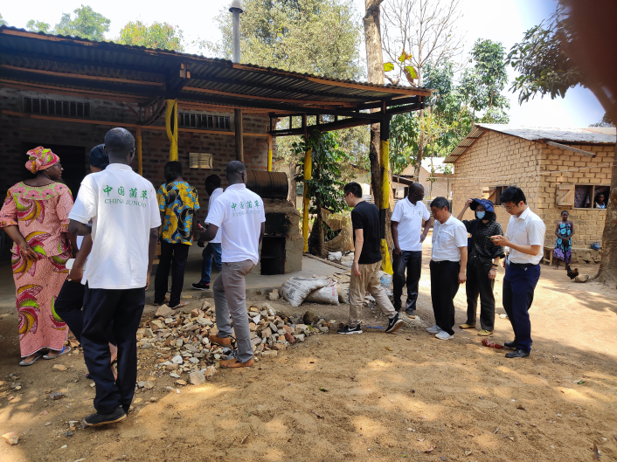
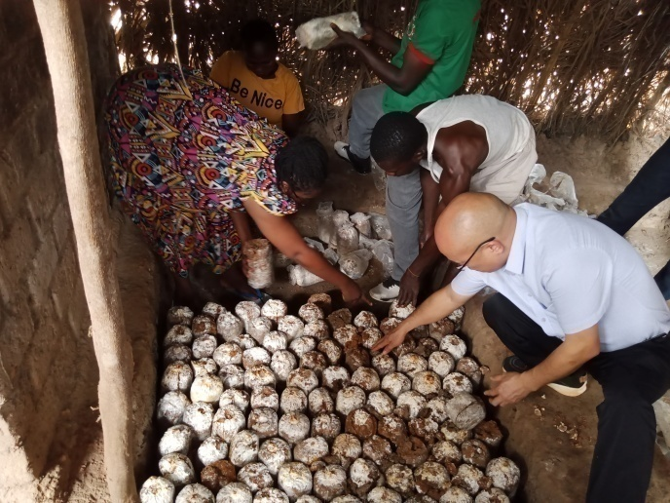
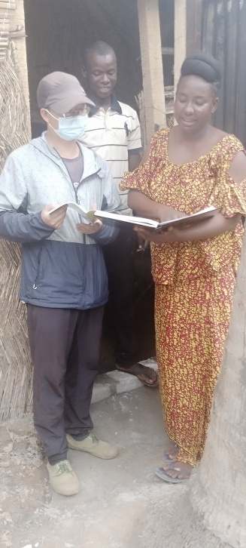
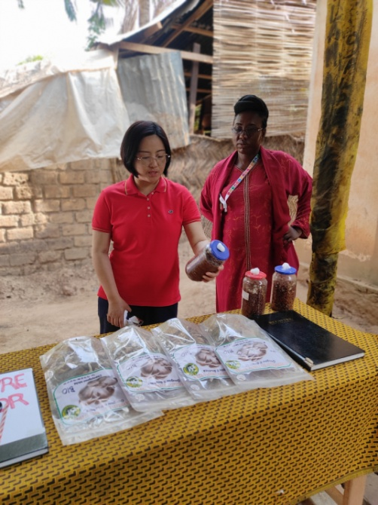
CAPACITY BUILDING

Slide 10
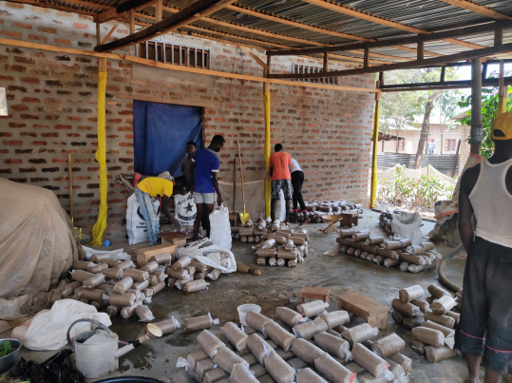
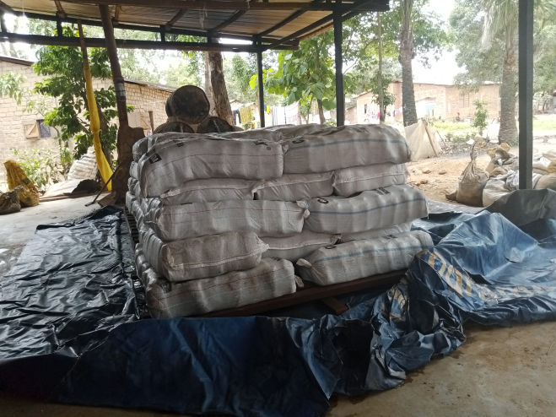
CAPACITY BUILDING

Slide 11
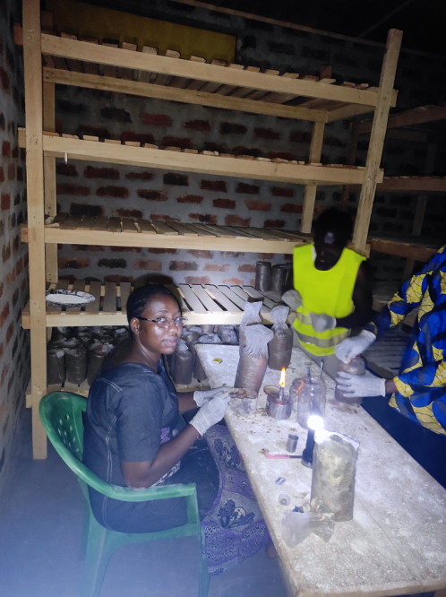
CAPACITY BUILDING

Slide 12
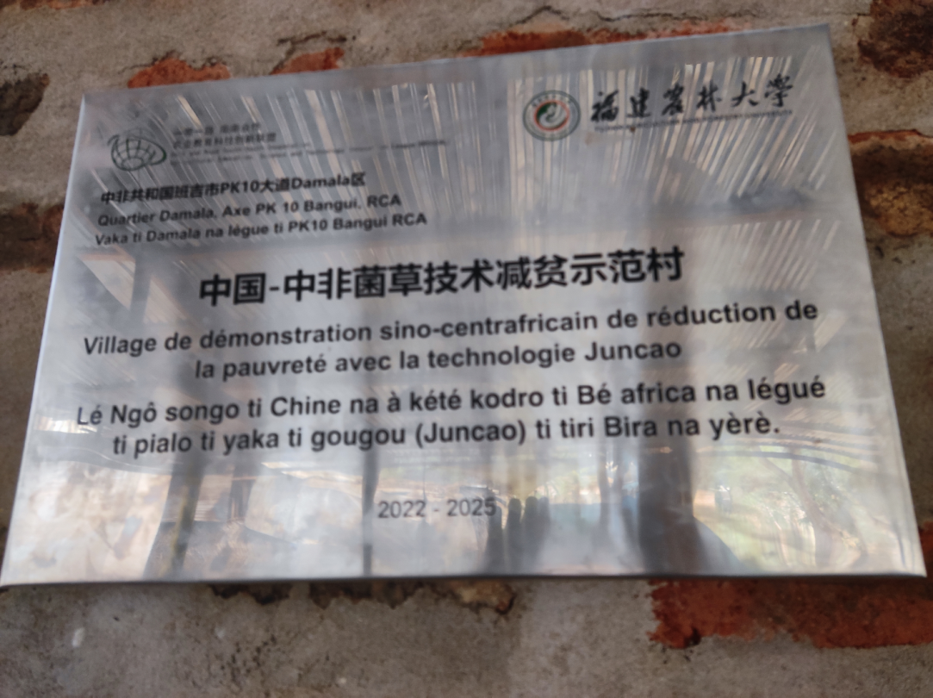
RECOGNITION
The center was established as a JUNCAO technology demonstration village on October 19, 2022

Slide 13
DEMONSTRATION FARMER’S OPERATIONAL CAPACITY
The center had to organize training for the community: 3 serial training courses are done;
126 people trained, including 96 women and 30 men.
12 small production units installed and supported.
A community mushroom farm of 21mx5m with a useful production area of ​​53m² allowing 14 people to produce 300 kg of mushrooms in two months.
Spong’s production capacity increased from 100 bags to 5000 bags of 1kg ; it’s mean 5 tonnes per week.

Slide 14
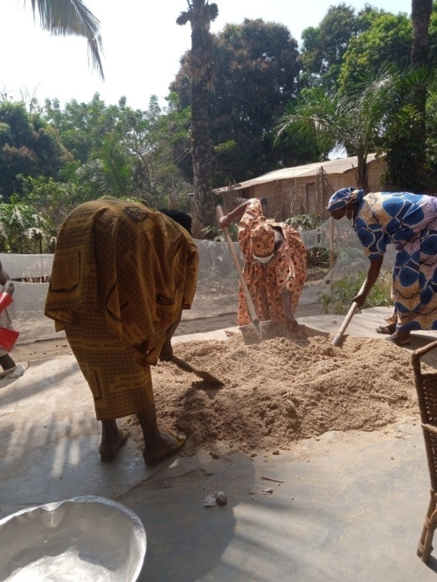
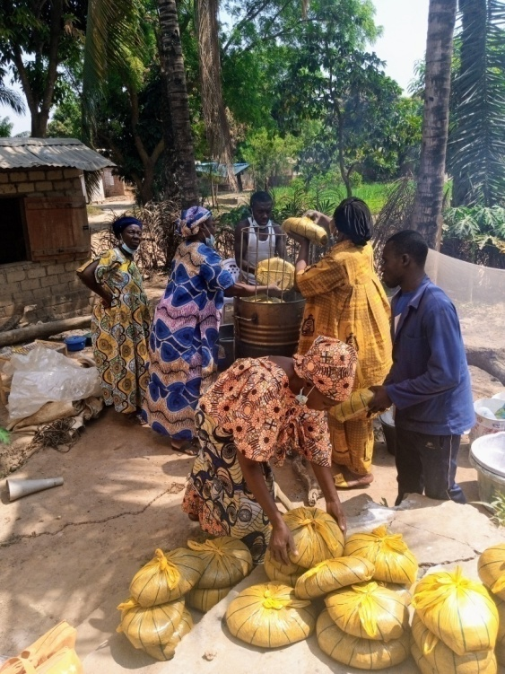
TRAINING

Slide 15
TRANSFORMATION AND MARKETING
For processing, a drying and packaging unit has been set up.
Marketing is done per kilogram 1Kg costs 5000FCFA or around 9 dollars. To facilitate access to all households, the mushroom is also sold in piles of 100 grams at 500FCFA or around 1 dollar.
The dried mushroom is sold in bags of 100 g at 5000FCFA

Slide 16
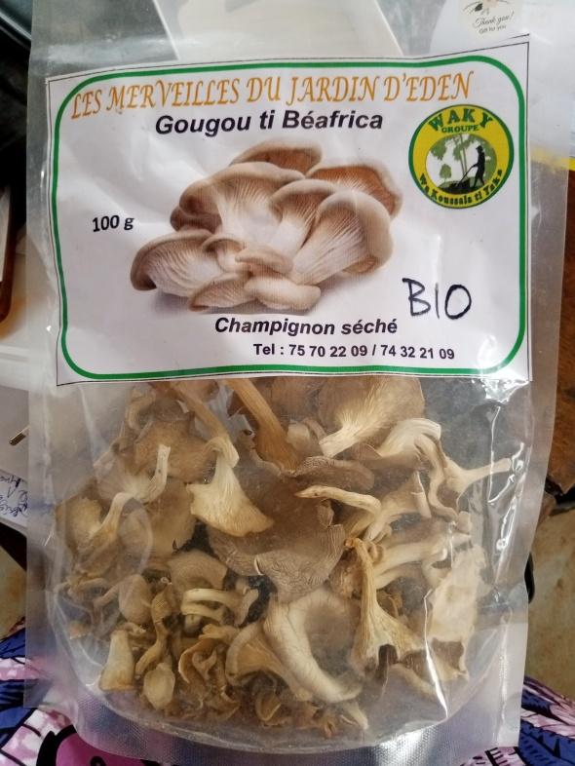
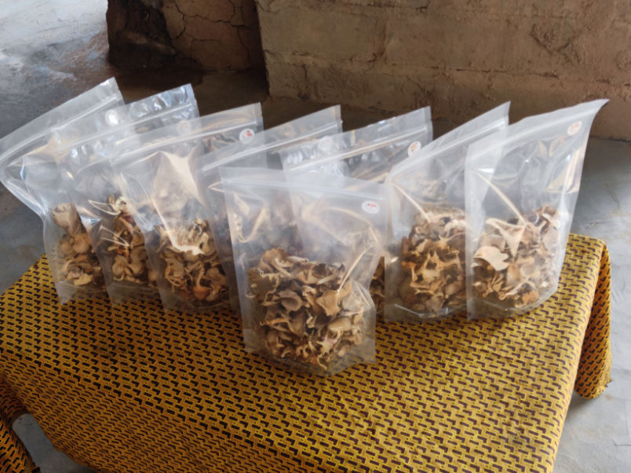
PROCESSING

Slide 17
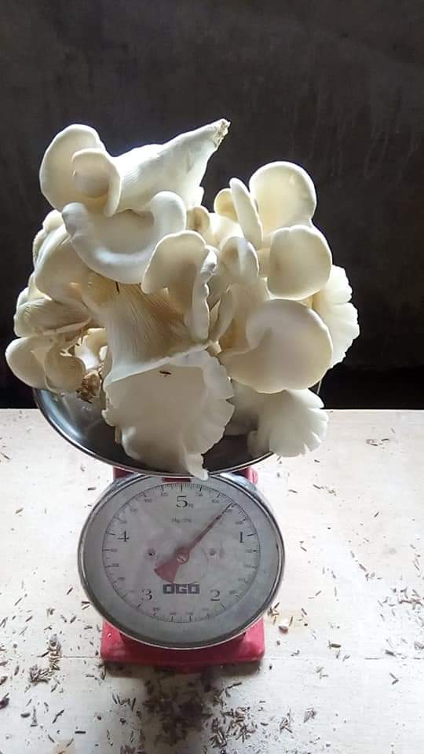
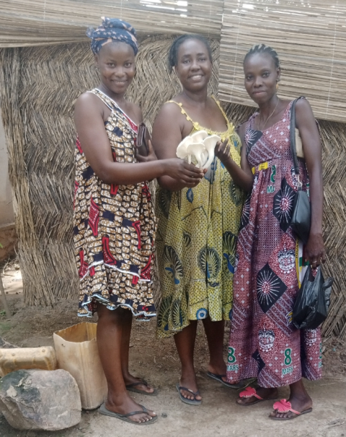
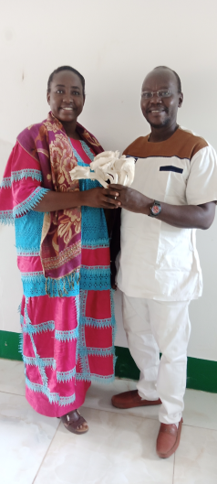
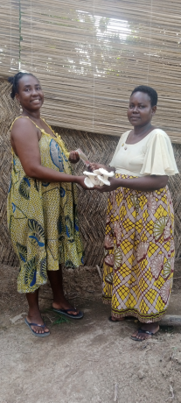
DISTRIBUTION

Slide 18
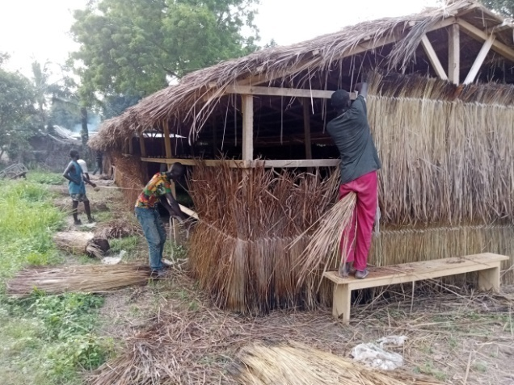
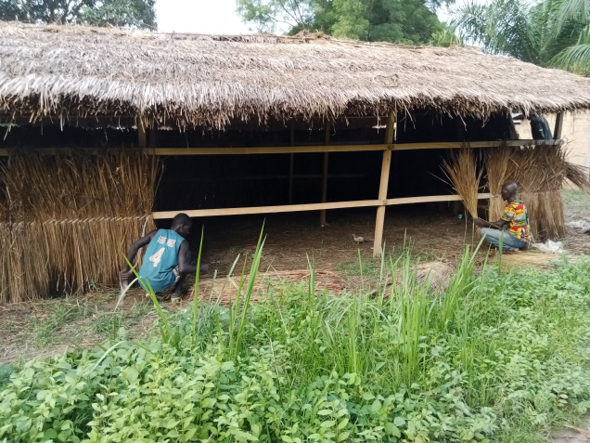
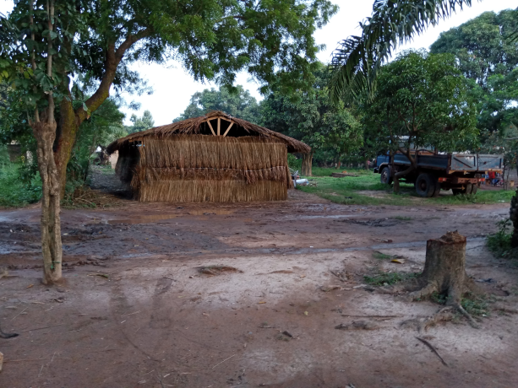
CHALLENGES

Slide 19
CHALLENGES
With all this response capacity, the center has a real need in terms of secondary spong supply chain for multiplication.
It depends on the production of primary and secondary spong at the level of the Central African Institute of Agricultural Research.
The supply is not regular, which does not promote stable production. Numerous cases of spong stock shortages do not favor the profitability of the center and the small production units affiliated with it.

Slide 20
PERPECTIVES
Use the extension method based on community mushroom farms to facilitate the creation of producer networks and learning.
The center must produce its own spong to avoid stock shortages and make production profitable.
Set up a processing unit to produce dried mushrooms and powder as food supplements.
Initiate certification procedures with a view to exporting to the sub-region.

Slide 21
PERPECTIVES

Slide 22
THANK YOU!

Slide 23
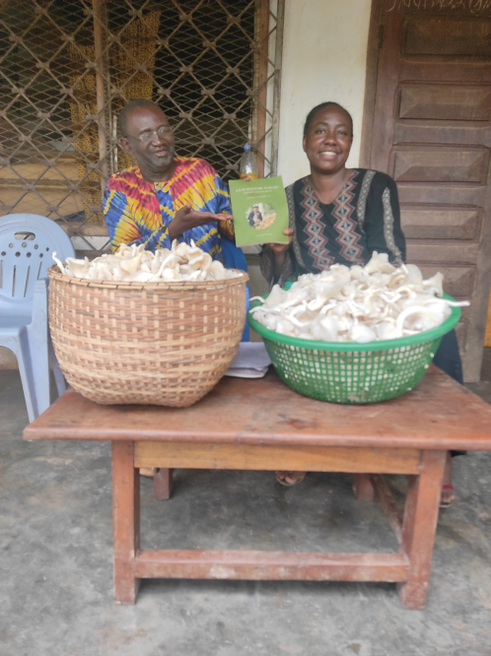
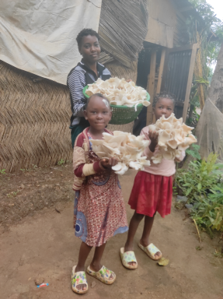
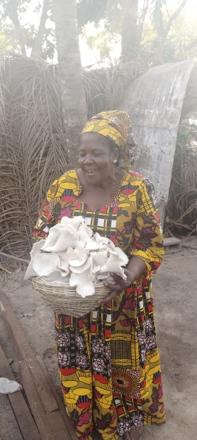
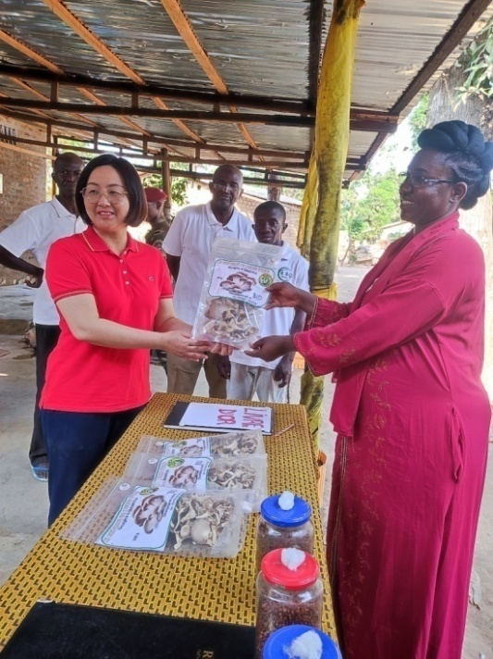
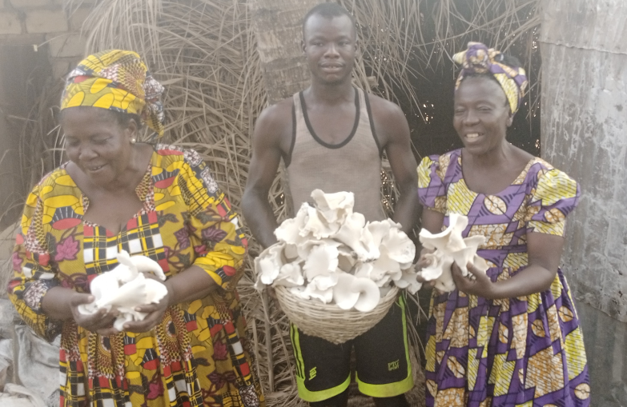
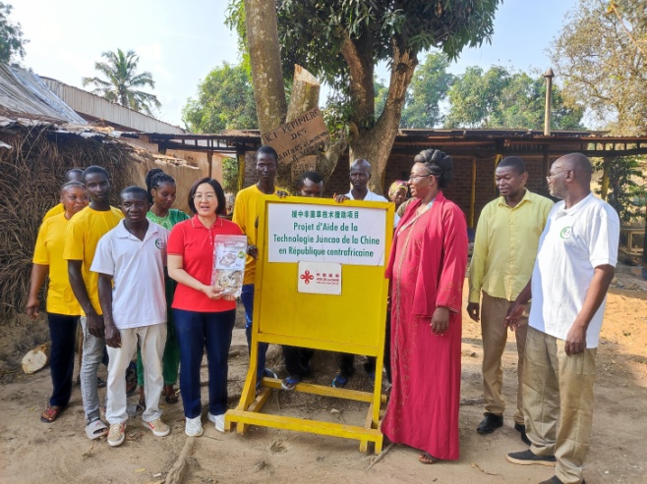
²

