Slide 1
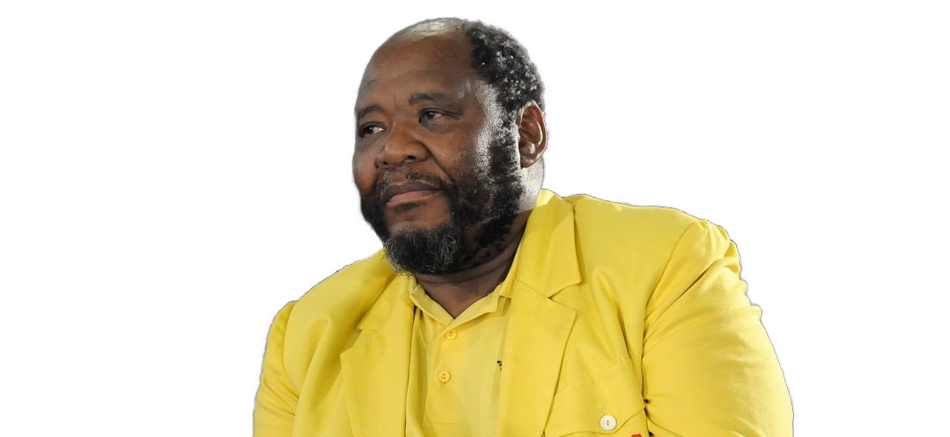
Addressing Sound Policy Making Deficits: Leveraging data and statistics in national and local development plans SDGs 27-29 -03-2023
Pali Lehohla

Slide 2
Outline
Scenarios unintentional
Summative view of South Africa@28
Being Intentional
Cultural Economic Geography
Levers of Sound Policy Making
Pre-Conditions For Sound Policy Making

Slide 3
Summative view of South Africa@28
Persistent South African economic challenges include: low economic growth, high unemployment rates, high poverty rates, and high income and wealth inequality.
These overall challenges are strongly inter-related, with direct and indirect impacts on future growth of companies and industries.
Yet, companies need to attract and nourish high caliber personnel who can make forward-looking assessments of the changing needs of the economy and the financial sector due to globalisation, economic restructuring, technological and organizational change, and changing demographics.
Globally economic models are used as part of regular and systematic early warning systems to forecast, develop scenarios and other means to inform firm level policy design and implementation.
South Africa has a shortage of high caliber personnel with these advanced analytical skills .

Slide 4
Scenarios unintentional
MONT FLEUR SCENARIO 1992 by SHELL had a set of policies but these were not quantified
GEAR

Slide 5
Scenarios unintentional
MEMORIES OF THE FUTURE by Government were a representation of storylines without policies but
was a course Correction to the Mont Fleur Scenarios which deviated from the initial RDP but did not sustain
ASGISA

Slide 6
Scenarios unintentional The Future We Chose Scenarios SA 2025 by government was an interpretation of post Polokwane and Was a representation of story lines without policies
Not yet uhuru | Nkalakatha | muvhango
A Government strongly committed to accelerating economic growth struggles in the face of deteriorating global conditions and severe ecological challenges Me first, you later. | Determined to play a more central role in the economy, Government prioritises poverty reduction and skills enhancement by articulating a national vision and fostering partnerships… The Dreamers become the Do-ers | Despite an initial resurgence of the economy, and positive world conditions, the Government battles to govern well Bang Goes the Boom
The Have-Lots vs the Have-Nothings. | One Nation, One Destiny | Politician vs Politician
Black Power, White Money The Earth Lies Screaming. | The environment matters too Time to Bite the Bullet | The Champ Slips Up The Brink of a New Era
NDP

Slide 7
Scenarios unintentional
NDP
Scenarios unintentional
Not a scenario
Not design quantified
Therefore not a plan
A story line of one scenario

Slide 8
A toy for the nation
Every two years
Since the dawn of democracy, South Africa applied a range of evolutionary planning approaches but these have had major material defects
ASGISA
GEAR
RDP
NDP
9 Point Plan
NGP
ERRP – DDM & Master Plans
14 Point Plan
8

Slide 10
There are 81 municipalities that have regressed including a metro

Slide 11
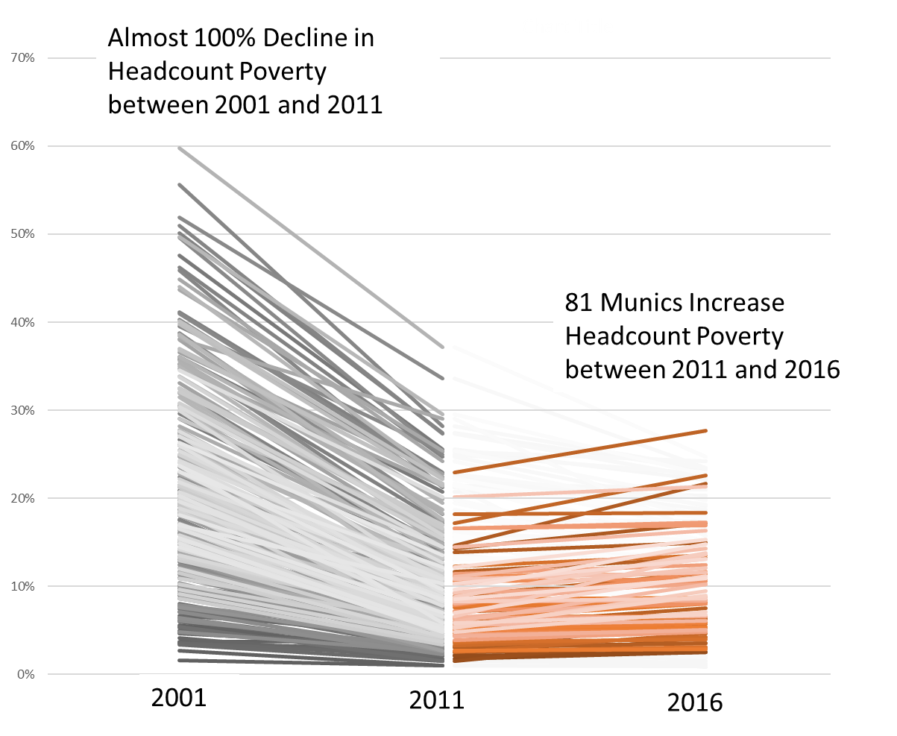

Slide 12
Level of Satisfaction by service category for KZN Municipalities

Slide 14
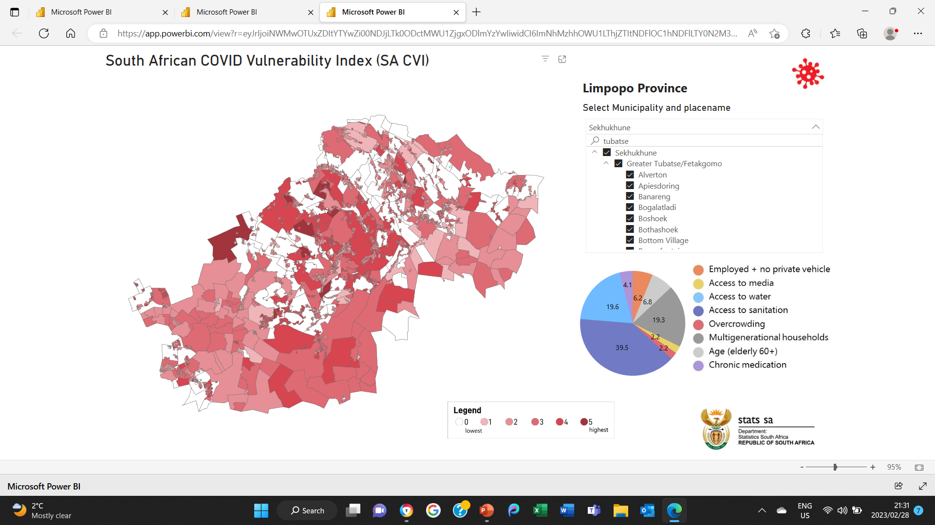

Slide 15
Summative Evaluation
AN ASSESSMENT MATRIX OF THE SYSTEM
Sound
Action is to Prioritise Capacity for
Bureaucracy
Action is to Maintain
Plan Design
Action is to Drop the Programme and
Build Planning Tools and Capacitate Bureaucrats
Action is to Innovate Design through design thinking
And System Design
Poor
Poor
Plan Execution
Sound

Slide 16
Summative Evaluation
AN ASSESSMENT MATRIX OF THE SYSTEM
How has the Gvnt performed on the Socio-Economic Transformation Agenda (Learning and Growth)
High
Monitoring &
Evaluation
Policy
development
Planning
Decision-
making
Capacity Building
Stakeholder
Expectation
Low
Low
Stakeholder Satisfaction
High

Slide 17
Summative Evaluation
AN ASSESSMENT MATRIX OF THE SYSTEM
How has the Gvnt performed on the Socio-Economic Transformation Agenda
High
IMPACT
Evidence for Decisions
Evidence of Tangibles and Enablers
Business process and stakeholder management
Learning and Growth
Stakeholder
Expectation
Low
Low
Stakeholder Satisfaction
High

Slide 18
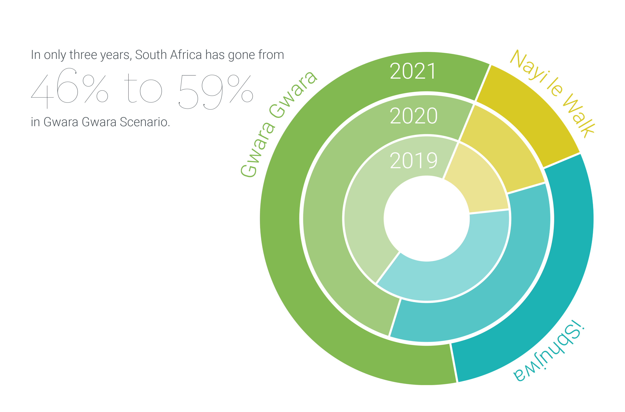
The End State is nigh and it is ugly

Slide 19
Summative Evaluation
ASSESSMENT MATRIX OF Plan Design and Plan Pxecution
Sound
Action is to prioritise capacity to
Execute
Action is to Maintain
Plan Design
Action is to Drop the Programme
And focus on total redesign with
Capacities in planning and execution
Action is to prioritise plan design
Poor
Poor
Plan Execution
Sound

Slide 20
Summative Evaluation
ASSESSMENT MATRIX OF Plan Design and Plan Pxecution
Sound
Action is to prioritise capacity to
Execute
Action is to Maintain
Plan Design
Action is to Drop the Programme
And focus on total redesign with
Capacities in planning and execution
Action is to prioritise plan design
Poor
Poor
Plan Execution
Sound

Slide 21
Levers of Sound Policy Making :Being Intentional
Role of the Executive and What They Should Deliver
They are Constitutionally Enjoined with the Legislature, Citizens and Corporates to Translate Socially Desirable Goals by Deploying a Politically Compelling and Economicallly Feasible Agenda Legally and, Managing Consequences by Holding the Executive to Account
NEEDS
(Socially Desirable Goal)
RE
RESOURCES
Economically
Feasible
SOCIETY
Politically
Mobilising
Delivered Legally
EXECUTION
In Short - Leading and Managing A Very Complex System

Slide 22
Levers of Sound Policy Making :Being Intentional
Policy Management and Leadership Framework
Political
Authority
All forms of authority in politics, business, and NGOs
Increasingly Digital Platforms but Traditional ones as well
Planning
Authority
Professional associations
Mass
Media
Specialist
Groups
Resources
Authority
Treasury
Planning ministry and related institutions
Statistical
Authority
(NSS)
Revenue, Treasury, Reserve Bank and their attendant policies
National Statistics Office and associated statistics producers

Slide 23
Effectiveness
Competence
Collaboration
Accountability
Integrity
Transparency
Inclusinvess,
Leaving no one behind
Participation
Sound policy making
Independent oversight
Non-discrimination
Subsidiarity
Integrational equity

Slide 24
Sound Policy making addresses
strategic planning
risk management,
policy coherence,
data sharing and national statistics,
regulatory impact analysis and
the role of science policy.
The study findings make a key point that:
“There is a clear lack of awareness and knowledge of the principles in many African countries. Ensuring the full success of the principles and strategies to ensure effective governance for sustainable development remains a challenge in many countries. Thus, developing more targeted reviews to identify gaps and examine the challenges faced in the implementation of the principles at national level well as the development of good practices for peer learning are needed.

Slide 25
Levers of Sound Policy Making Being Intentional By Designing Policies and Quantifying Impacts
ERRP – DDM & Master Plans
iSbhujwa Trickle-down Outlook
Gwara Gwara Immiserizing Outlook
Nayi-le-Walk Pro-Poor Outlook
iSibhujwa is a South Africa torn by deepening social divides, daily protests and cynical self-interest.
If the recovery policy framework continues with the post-1996 policy status quo, i.e., the BAU scenario, the past trickle-down path will resume after the pandemic with the economy stuck in low growth and high rates of unemployment, poverty and inequality during the next decade.
South Africa where growing social cohesion, economic expansion and a renewed sense of constitutionalism get South Africa going.
If the recovery policy framework reflects a shift from the post-1996 policy status quo and embraces a policy framework similar to the Six-Pillar scenario, the future outlook will trend more towards an inclusive pro-poor path of Nayi le Walk scenario, enabling South Africa to recover from its chronic economic crisis.
Is a nation torn between immobility and restless energy, Gwara Gwara embodies a demoralized land or disorder and decay.
If the recovery policy framework augments the post-1996 policy status quo with contractionary measures, such as a more austere fiscal policy, the future outlook will trend more towards an immiserizing growth path of Gwara Gwara Scenario.

Slide 26
Gwara Gwara: Immiserising growth Policy drivers
After the 2019 election, the new government’s main focus was on uprooting “state capture” as a way to reignite the economy.
Even less income and wealth trickle down to the masses as the austerity-focused approach imposed annual cuts in real spending on social services and government transfers.
After the 2024 election, under a coalition government, there were increasing talks of “shock therapy” from some key cabinet members.
Consequently, measures were adopted to withdraw state subsidies, cut public works programmes, reduce the real value of social grants, privatise more of the SOEs, abandon Buy South Africa and localisation policies, cut taxes and adopt a more restrictive inflation targeting approach.
As an outcomes of these measures, the country moved to an immiserising growth path, with the rich getting richer and the poor getting poorer.

Slide 27
Nayi le Walk:Pro-growth Pro-poor path Policy Drivers
Austerity gives way to a growth orientated approach that includes:
Pro-growth macroeconomic policy that provides a life raft for the country, with fiscal policy providing higher funding for economic and social infrastructure investment and service delivery.
Monetary policy supports economic growth and eases access to credit by the private sector (business and households)
Social policy is directed toward creating part-time jobs for the unskilled-unemployed and lowering poverty
Trade and industry policy is centered on a social contract where corporations get extra support in return for creating good paying jobs in the country
PIC significantly invest in the economy, especially the manufacturing sector

Slide 28
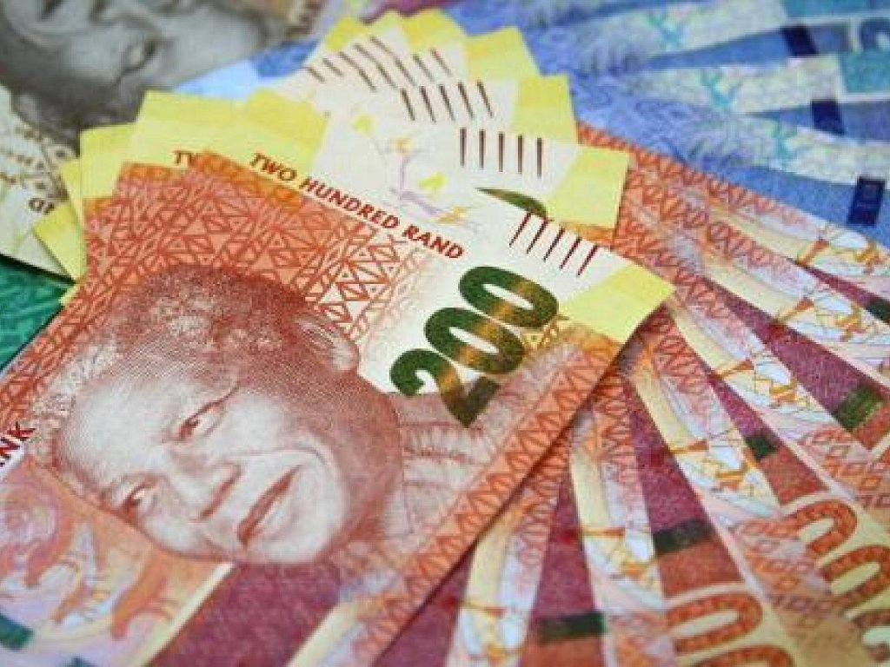
Isibhujwa: Trickle down path Policy Drivers
In this scenario, the policy status quo is retained after the 2019 election.
Microeconomic supply side measures are used to propel the economy onto a higher growth and employment path …
while the macroeconomic austerity approach is directed to reduce the debt through expenditure cuts.
Consequently, future performance of the economy continues to resemble the past.
The economy stuck in a low growth path and benefiting the rich more than the poor.
Continue on the austerity pathway…

Slide 29
Economic Geography The SA urban rank-size – 1996, 2003
Integration Tools as a Driving Force

Slide 30
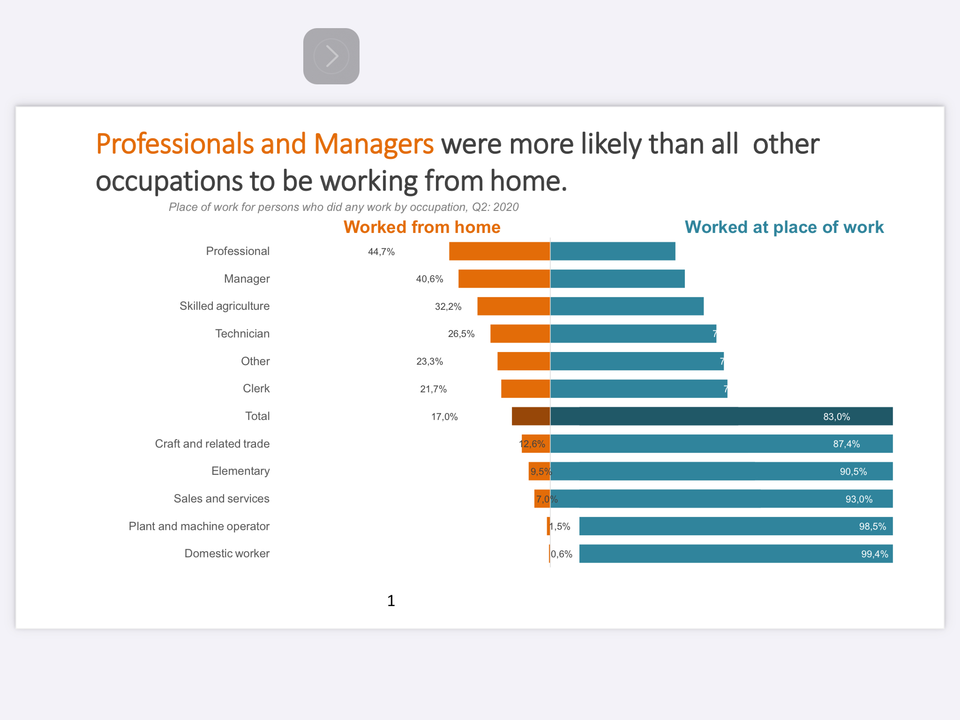
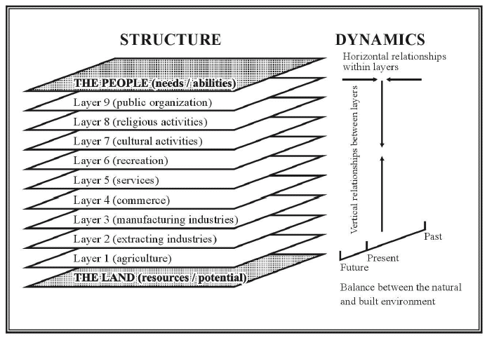
Economic Geography
Integration Tools as a Driving Force
Understanding the Space Economy Matters
especially in theContext of COVID19

Slide 31
Economic Geography
Of Locational attributes
Tertiary
Integration Tools as a Driving Force
UBER
Locational
Locational
Secondary
Primary Sector

Slide 32
Pre-Conditions For A Capacitated State
Scenarios matter because they Define a National Agenda that addresses a Socially Desirable Goal
Translating Scenarios into policies matters because they generate a Compelling and uniting Political Mobilisation towards achieving a Socially Desirable Goal
Quantifying scenarios matters because the Path Towards Impact is Knowable and Discoverable ahead of implementation thus it can be elaborated upon and thus
Sound choices can be made
Accountability can be exacted
Embedding scenarios as a necessary condition for public policy matters for consistency of foresight
Capacitating the state functionaries in government, private sector, civil society and general public with
Scenario design
Econometric quantification through tools of foresight and
Choice design
Should improve the quality of policy choices and create a unified assurance supervisory system

Slide 33
Pre-Conditions: Provision of Raw Data Intelligence (Level 1)
Post 1994, Stats SA developed the internal capacity to provide raw data intelligence to government and the public. Today, Stats SA collects and makes available extensive economic and demographic data.
Government and the public have utilised Stats SA data for research, policy analysis, and policy development.
Financial statistics |  | Labour force quarterly survey |  | Employment and Earnings |  | Census |  | Industry and trade statistics |  | Price data |  | Service delivery and poverty |  | Population profile |  | Community Survey

Slide 34
PreConditions Provision of Basic Analytical Intelligence (Level 2)
Beyond data collection, Stats SA has used its statistical database to built a number of basic economic policy tools.
These tools reflect accounting relationships that underlie the economy’s current structure with significant detail based on its collected economic and demographic data.
However, accounting frameworks are unable to forecast economic performance because they are static and do not include dynamic properties of the economy.
Input-Output Table |  | Supply & Use Table |  | Social Accounting Matrix (SAM) |  | Growth Accounting Framework (GAF)

Slide 35
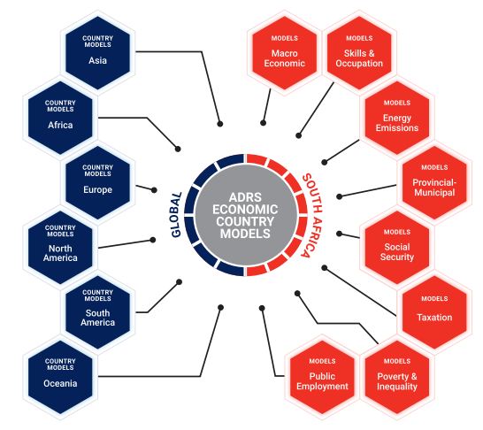
Deploying Econometric Tools of Foresight Built on Stats SA data
EMA is founded on more than 30 years of experience building economic models for 65 countries and delivering training workshops throughout the world.
This includes a suite of South African models that:
Built using a wide range of Stats SA time series and household survey data.
Directly linked to government departments
Designed to quantify, in a consistent manner, the economic and social impact of diverse national and provincial government plans and policies
Cloud based system with a user-friendly web-platform.
EMA courses provide learners access to these models and direct hands-on experience.

Slide 36
Pre-Conditions Being Intentional in understanding the role of Parliament?
The main functions of the SA Parliament are:
To check and challenge the work of the government (scrutiny)
To make and change laws (legislation)
To debate the important issues of the day (debating)
To check and approve government spending (budget/taxes)
In Short - Leading and Managing A Very Complex System
Notes:
THE PROBLEM

Slide 37
Precondition – Being intentional in understanding what local authorities need the most?
To effectively and progressively deliver better services over space but to do so they need knowledge of various social and economic topics, such as:
Macroeconomics and budget related issues and policies
Labour market, skills demand and supply and the 4IR
Poverty and inequality and role of social protection policies
Global warming and green economy options and implications
In Short - Leading and Managing A Very Complex System
Notes:
THE PROBLEM

Slide 38
Being Intentional Translate Socially Desirable Goals through a Politically Compelling and Economicallly Feasible Agenda Legally and, Managing Consequences by Holding the Executive to Account
A capable state with high caliber public sector personnel is needed to make regular forward-looking assessments for effectiveness of plans and policies to address the challenges and to anticipate the changing needs of the economy due to globalisation, economic restructuring, technological and organizational change, and demographic developments.
Utilising economic models as part and parcel of regular and systematic early warning systems that employ forecasting, scenario development and other approaches is essential for informed policy design and implementation. However, this presupposes high caliber public sector personnel.
The Need for economic modelling In the State
Notes:
THE PROBLEM

Slide 39
Translate Socially Desirable Goals through a Politically Compelling and Economicallly Feasible Agenda Legally and, Managing Consequences by Holding the Executive to Account
To support the development of a more capable public sector with innovative tools in their hands, Economic Modelling Academy (EMA) provides capacity building in economic analysis and modelling for current and future government officials, leaders and practitioners in South Africa and beyond.
EMA’s goal is to develop high caliber public sector personnel with the capacity to effectively plan, monitor and evaluate diverse national and sub-national policies using accessible economic models.
The Need for economic modelling In the State

Slide 40
EMA’s initial six certificate programmes
Certificate in Multi-Sector Macroeconomic Modelling
Certificate in Modelling Provincial-District-Municipal Economies
Certificate in Poverty-Inequality Modelling
Certificate in Modelling Social Protection
Certificate in Skills Demand and Supply Modelling
Certificate in Green Economy Modelling

Slide 41
The first is communist conceit; the second—illiteracy, and the third—bribery. The First Enemy—Communist Conceit A member of the Communist Party, who has not yet been combed out, and who imagines he can solve all his problems by issuing communist decrees, is guilty of communist conceit. Because he is still a member of the ruling party and is employed in some government office, he imagines this entitles him to talk about the results of political education. The Second Enemy—Illiteracy So long as there is such a thing as illiteracy in our country it is too much to talk about political education. This is not a political problem; it is a condition without which it is useless talking about politics. An illiterate person stands outside politics, he must first learn his ABC. Without that there can be no politics; without that there are rumours, gossip, fairy-tales and prejudices, but not politics. The Third Enemy—Bribery Here we have not even an approach to politics; here it is impossible to pursue politics, because all measures are left hanging in the air and produce absolutely no results. A law applied in conditions which permit of widespread bribery can only make things worse. Under such conditions no politics whatever can be pursued; the fundamental condition for engaging in politics is lacking. To be able to outline our political tasks to the people, to be able to say to the masses what things we must strive for (and this is what we should be doing!), we must understand that a higher cultural level of the masses is what is required.
In 1920 Lenin to the Russians could be saying this about us

