Slide 1


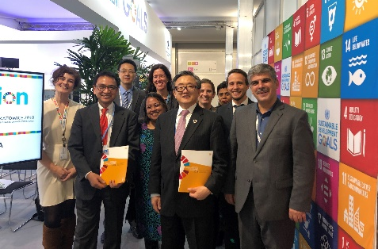

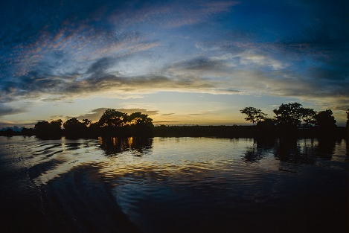

The VLR preparatory process: overview of approaches, milestones and deliverables Carol Pollack, Inter-Regional Advisor National Strategies & Capacity Building Branch, DSDG/DESA
Towards sustainable development for all

Slide 2



The Agenda 2030 And Voluntary Reviews
The 2030 Agenda creates a system for regular monitoring and review of progress made
“We commit to fully engage in regular and inclusive reviews of progress at subnational, national, regional and global levels"(2030 Agenda, para. 77).
Division for Sustainable Development Goals

Slide 3
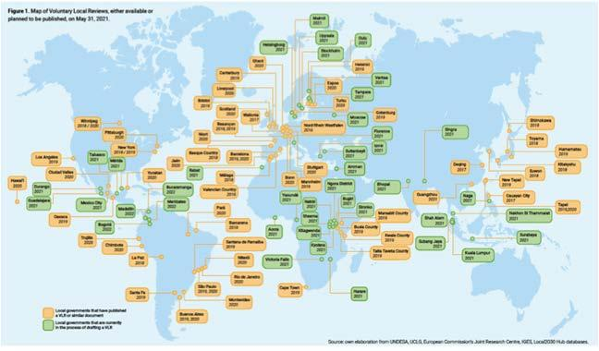
VLRS in the World

Slide 4
VLR Preparation – Phase I
Develop a work plan/roadmap
Determine institutional arrangements
Identify additional focal points
Estimate and identify the resources required
Collect data
Prepare the draft outline of the VLR and develop key messages.
Roadmap
Institutional arrangements
Focal points
Resources
Collect data
Draft and key messages

Slide 5
VLR Preparation – Phase II Stakeholder Engagement
Make contact within local government
Form a multisectoral committee
Develop a stakeholder engagement plan
Establish an awareness raising and public outreach component
Leave No One Behind - reach out to groups that are marginalized and at risk of being left behind.
Make contact
Forming a multisectoral committee
Stakeholder Engagement Plan
Communication and social media
Leave no one behind

Slide 6
VLR Preparation – Phase III
Review and incorporate data and information received
Prepare a zero draft
Internal review + open draft to comment
New and edited draft
Approval and publication
Including data
Open draft to comments
New and edited draft
Approval and publication
Advocacy and promotion of VLR
Zero Draft
Internal review
Comment space
Tracking of remaining data

Slide 7

GLOBAL GUIDING ELEMENTS​ fOR VLRS​
Draw from the Secretary-General’s common voluntary guidelines for the VNRs​
Provide a proposed shared structure for the reports, and at minimum, give a checklist of issues that could be reflected in the process
Fully compatible with other, more detailed guidance documents​
Aim at fostering a dialogue between the Voluntary National Reviews and the VLRs, where applicable​

Slide 8
Guiding Principles for a VLR
VLRs should guided by key principles from 2030 Agenda (para. 74) applying to all reviews, i.e.:
Longer-term orientation, identifying achievements, challenges, gaps and will help mobilize necessary means of implementation and partnerships;
Open, inclusive, participatory and transparent;
People-centered, gender-sensitive, respect human rights and have a particular focus on the poorest, most vulnerable and those furthest behind;
Rigorous and based on evidence

Slide 9
Possible VLR structure
Methodology and process for preparation of the review
Report on the full methodology for the VLR, including:
Policy and enabling environment
Describe the relationship between the subnational and national levels
Progress on goals and targets
Analysis of the progress of all/selected SDGs
What activities were undertaken to raise awareness on the SDGs?
Leaving no one behind
Institutional mechanisms/governance
Are reference data available? How is progress monitored?
Means of implementation (financial, capacity building)
Who was in charge of VLR preparation?
How were stakeholders engaged?
How was data collected and used?
How were priority SDGs identified?
How are SDGs included in local plans
Barriers faced
Conclusions and next steps
What lessons learned?
How will progress be monitored
What next?

Slide 10

Thank you.

