Slide 1

APRM : rationale, mandates and current programs for Agenda 2063/SDGs
National Capacity Building Workshop on Voluntary Local Reviews (VLRs) in South Africa
27-29 March 2023
Sara Hamouda, Agenda 2063 Unit- officer in charge, APRM - 2022

Slide 2
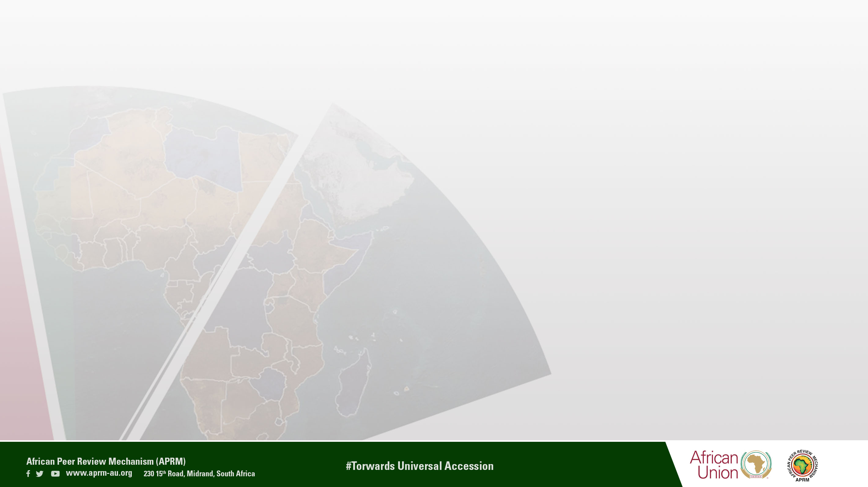
Content
The APRM in a nutshell
Congruence between SDGs and Agenda 2063 AND the role of APRM in monitoring and evaluation of Agenda 2063 and SDG
Covid-19 crisis and responsive actions, APRM targeted reviews
APRM cross-cutting engagement with youth, gender and civil society
Current progress towards SDGs and Agenda 2063

Slide 3

I. The APRM in a nutshell
Foundation & Rationale
2003 : 6th Summit of the NEPAD Heads of state and Government Implementation Committee - NEPAD Secretariat (Constitutive Act of the African Union -AU)
Rationale: a tool for sharing experiences, reinforcing best practices, identifying deficiencies, and assessing capacity-building needs to foster policies, standards and practices that lead to political stability, high economic growth, sustainable development and accelerated sub-regional and continental economic integration.
2021: Fully integrated into the AU system: process started since Jan 2017. The APRM is now a specialized agency of the AU voluntarily acceded to by member states of the AU
By 2023: 42 countries becomes members of APRM (latest is Comoros)
Notes:
‘Governance is the root cause of Africa’s problems, bottleneck for development and the solution for its challenges’
Membership : till date, 40 African countries joined the APRM and 24 peer review studies were conducted. Zimbabwe and Seychelles are the latest country to join APRM.

Slide 4
The APRM structure & Principles: Ensuring inclusiveness, Accountability and P2P exercise.
The APR Forum heads of states
Committee of Focal Points
Representatives
The APR Panel
Eeminent persons
4 years
National governance council (NGCs)
APRM Continental Secretariat
APR Focal Points President
Continental & National ownership
Notes:
Think out of the box and strengthen civil society and private sector engagement in the APRM reviews

Slide 5
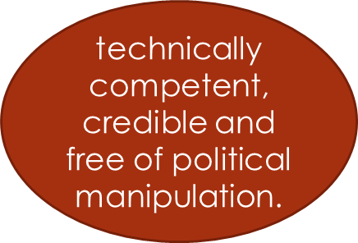
The Governance Assessment Review Process and critics
Ghana, Kenya, Cote d’ Ivoire, Chad, and Rwanda are among the most active APRM members
Deep analysis to the country cross-cutting issues
Country Visit
Consultation with national stakeholders
Gov-Business, NGOs, Media Academia
Report preparation
discussed with the Government concerned
To check the accuracy of data & circulation of APRM Questionnaire
Submit the report in the heads of states & Gov
Through the APRM Secretariat
+National Plan of Action

Slide 6
Countries accomplished with APRM Reviews
North Africa :Algeria and Egypt , Tunisia and Mauritania
West Africa (12) Ghana, Nigeria, Benin, BF, Mali, Sierra Leone, Senegal, Cote 'Ivoire, Liberia, Niger, Togo , the Gambia
East Africa : Kenya, Uganda (2), Rwanda, Djibouti, Ethiopia, Mauritania, sudan, Seychelles and Burundi
Southern Africa: Mozambique, South Africa (2), Lesotho, Zambia, Angola ,Botswana, Namibia, Malawi and Zimbabwe
Central Africa: Chad, Cameron, Congo DRC, Congo Republic, Gabon, Equatorial Guniea, Sao Tome and Principe.

Slide 7
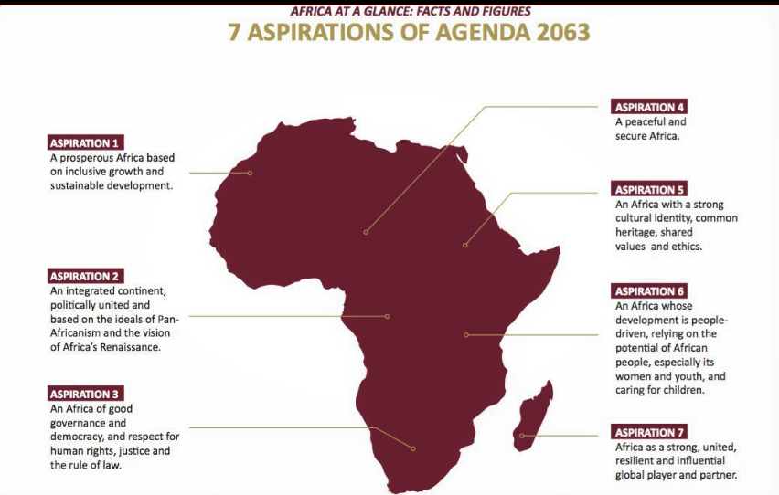
II. Congruence between Agenda 2063 & the 2030 for Sustainable Development Agenda 2063:
7 aspirations& 20 goals
Notes:
Africa’s blueprint for socio-economi prosperity, regional integration and African citizens voice (174 targets (reduced later) – 69 indicators (latest)
Adopted in 2013 at AU Summit heads of states 7 aspirations with goals, but there were no clear indicators https://au.int/en/agenda2063/goals. AU vision, constitutive act, revision of MDGs

Slide 8
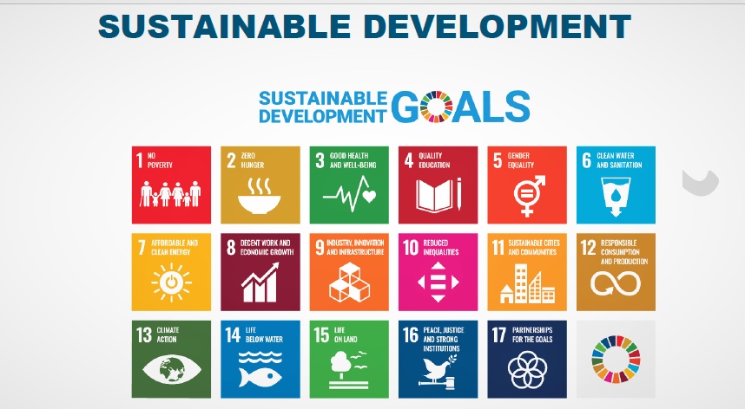
SDGs : 17 goals , 169 SDG Targets & 232 indicators
Notes:
https://unstats.un.org/sdgs/indicators/Global%20Indicator%20Framework%20after%202020%20review_Eng.pdf.
Comprehensive and aligned with other global frameworks i.e Sendi framework for disaster

Slide 9
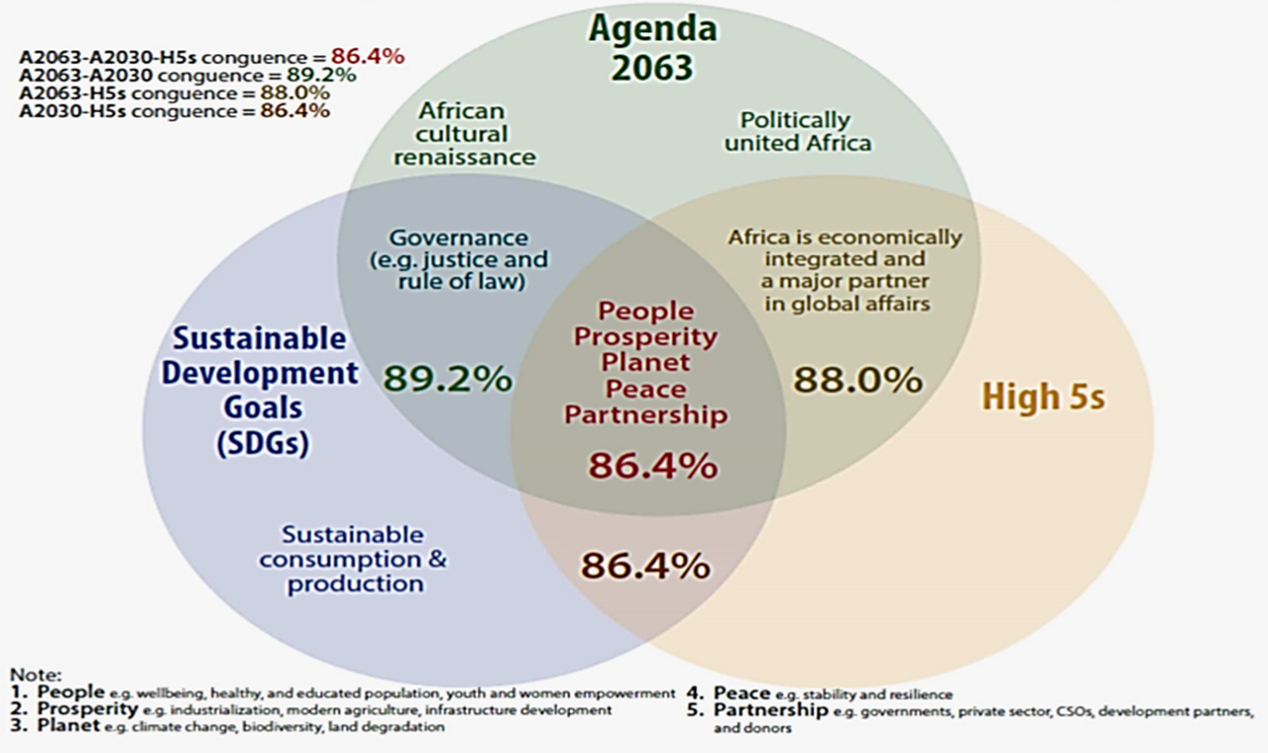
Agenda 2063, 2030 Agenda and African Development Bank - High 5

Slide 10
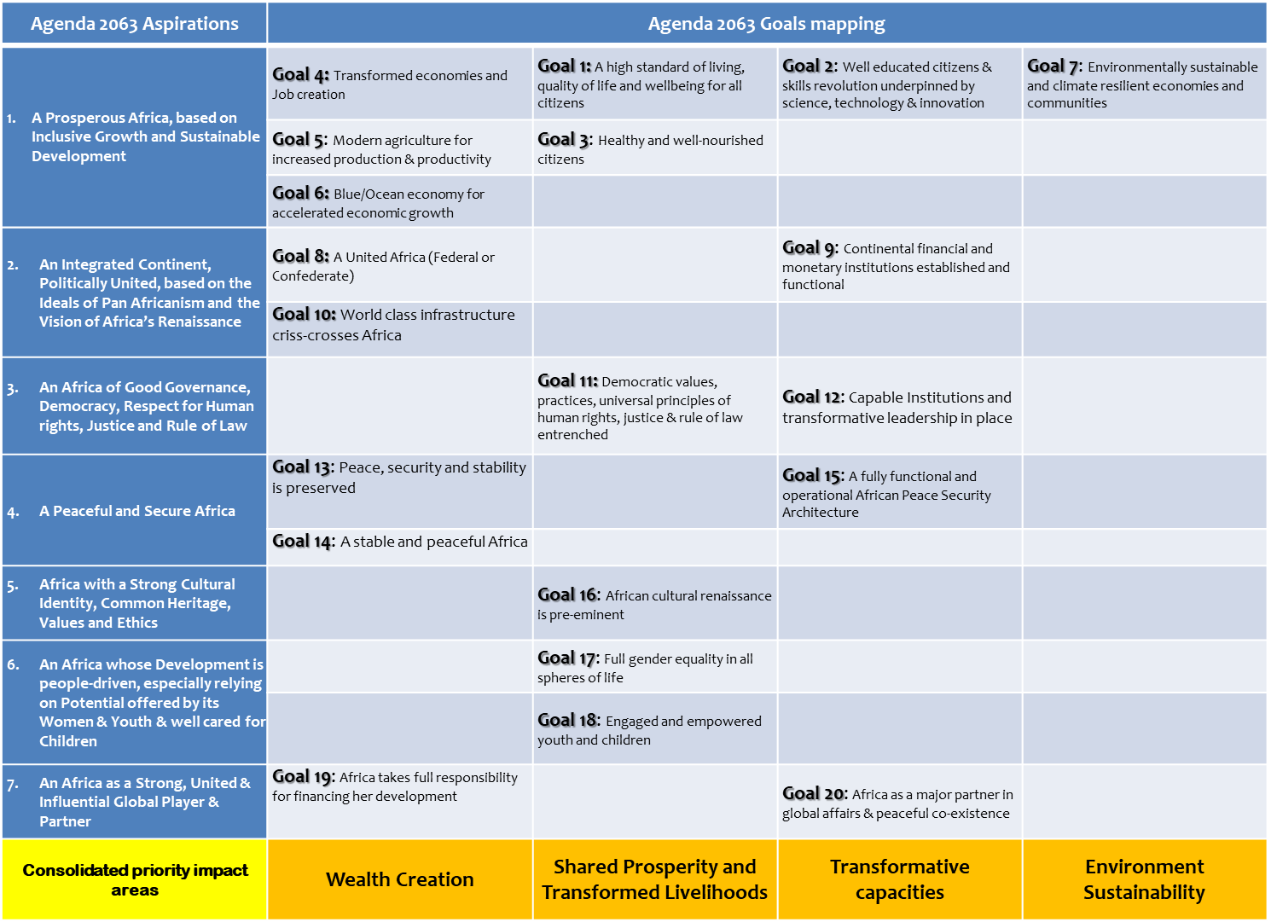

Slide 11
Agenda 2063 flagship projects
The Projects :
Africa Integrated High Speed Train Network
Grand Inga Dam Project
African Continental Free Trade Area
Pan-African Virtual and e-University
African Commodity Strategy
African Economic Platform
Single African Air Transport Market
Free Movement of Persons and the African Passport
Continental Financial Institutions
Pan African e-Network
Silencing the Guns by 2020
Africa Outer Space Strategy
Great Museum of Africa
Cyber Security
Encyclopaedia Africana

Slide 12
Stakeholders and Actors : multiplayers at different levels are engaged to implement, monitor and evaluate Agenda 2063/SDGs progress
Notes:
UNECA – AU-UN strategic framework to implement Agenda 2030 &Agenda 2063

Slide 13
III. APRM Revitalisation: Expanded Mandate and consequent actions
Aspiration 3: An Africa of good governance, democracy, respect for human rights, justice and the rule of law. (Governance-Dev nexus) ;
Aspiration 4: A peaceful and secure Africa (peace-governance nexus)
Expanded mandate tasks:
Widening the APRM approach from the current approach to capture local, homegrown and indigenous knowledge embedded in the African culture .
Revising the APRM questionnaire in sync with current development frameworks including the AU Agenda 2063 and UN Sustainable Development Goals.
Integrating APRM into national plans, RECs and regional development, including NEPAD and relevant international frameworks for greater coherence;
State of implementation of Agenda 2063 ( best practices and countries’ experience )
Enhance reporting on governance at national levels

Slide 14
APRM Expanded mandate and Role in the monitoring and evaluation of Agenda 2063&SDGs
GOOD GOVERNANCE ASSESSMENT
Africa Governance Report 2019&2021 (peace, development, rule od law and cross-cutting issues) https://au.int/sites/default/files/documents/36418-doc-eng-_the_africa_governance_report_2019_final-1.pdf.
Network with African Universities
Agenda 2063/SDGs monitoring and evaluation
Continental mechanism for VNRs/VLRs sharing experiences and training
Knowledge products on SDG 16- good governance for SDGs
Early warning for conflicts Prevention
APRM roadmap for integrating peace and conflict issues into the peer-review
Coordination with AUC and other partners to mainstream APRM disaster framework in governance assessment
Oriented-research on governance challenges in the continent
Engagement with UN organs ,UNDESA ,CEPA, UNECA for policy coherence (HLPF)
Collaboration with AUC to roll-out Agenda 2063 reporting framework
Supporting the UN-AU Framework for the implementation of Agenda 2030/2063 cluster 8&9 on governance (RCM)
Resilience , social contract and sustainability in post-conflict and fragile states
National Development Planning Community of Practice

Slide 15
Key Pillars of APRM Support for an Integrated M&E Governance System in Africa
NPOAs integration in NDPs
Providing technical assistance to MSs for proper integration of NPOA into NDPs
M&E training ( Knowledge hub)
Capacitating member states and governance structures with M&E basics and methods
VNRs: reporting on SDGs and Agenda 2063
reporting on CEPA Principles (SDG16/Aspiration three)
APRM Questionnaire on governance Alignment of APRM Governance questionnaire with SDGs and Agenda 2063 + new thematic area on Resilience

Slide 16
Thematic areas of APRM Governance assessment reviews
Socio-economic dev (SED)
Democracy and Political Gov (DPG)
Economic Governance and management (EGM)
Resilience and state of disaster
Corporate governance
Principles:
Avoid political manipulation and conflict of interest
Transparent
Credible
Based on clear methodological grounds
Inclusive
Latest (Kenya, SA, Egypt, Sudan, Uganda, Senegal, Sierra Leone, Niger and Mozambique)
Types of Review :thematic , targeted and comprehensive review

Slide 17
Supporting the UN-AU Framework for the implementation of Agenda 2030/2063 cluster 8&9 on governance
Continental mechanism for VNRs/VLRs peer learning /part of Agenda 2063 TWG
Knowledge products on governance of both agendas
Promoting CEPA Principles in Africa
Capacity building on NDPs
APRM engagement with AUC/UN agencies at the HLPF

Slide 18
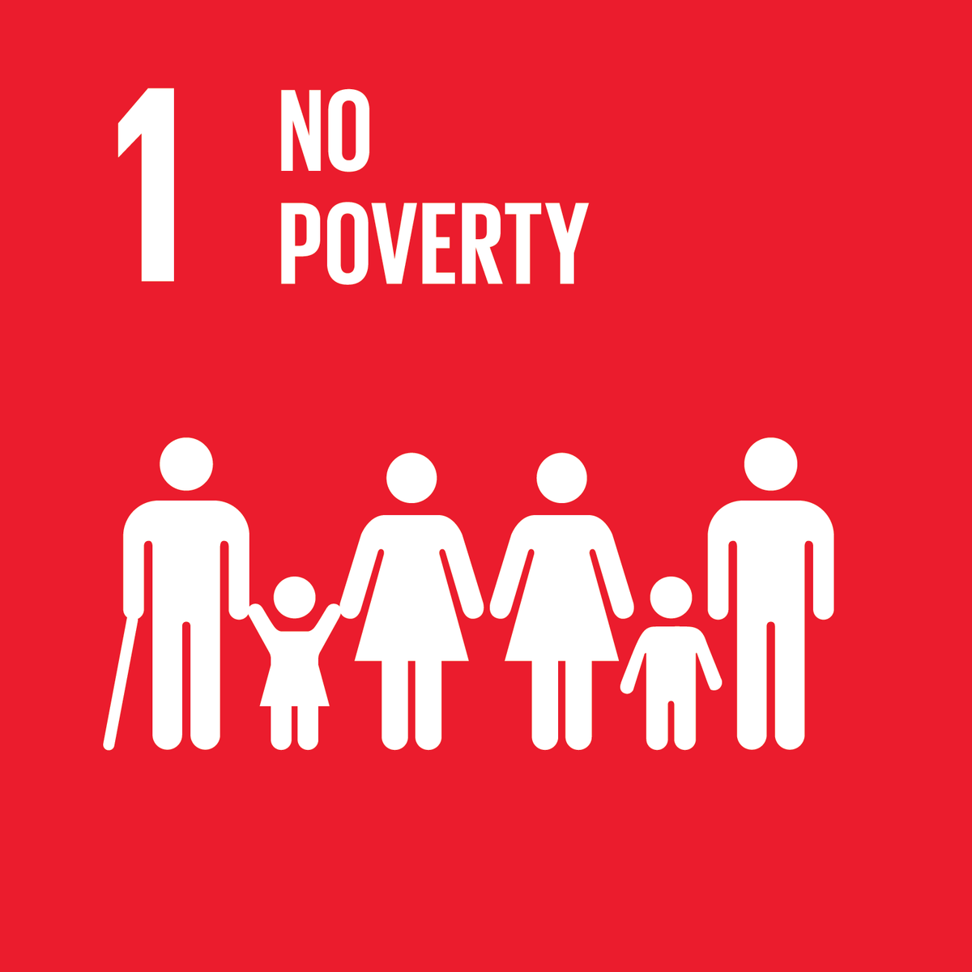





Other SDGs on focus
Notes:
Reducing poverty and hunger through agriculture-led growth is central to the Comprehensive Africa Agriculture Development Programme (CAADP)
APRM Collaboration with UAE (food security, governance accelerators, digitalization and planning for the future)
An additional 60 million Africans could be pushed into poverty and food insecurity is expected to nearly double.
Goal 10 (credit rating, Corporate governance and youth engagement)

Slide 19
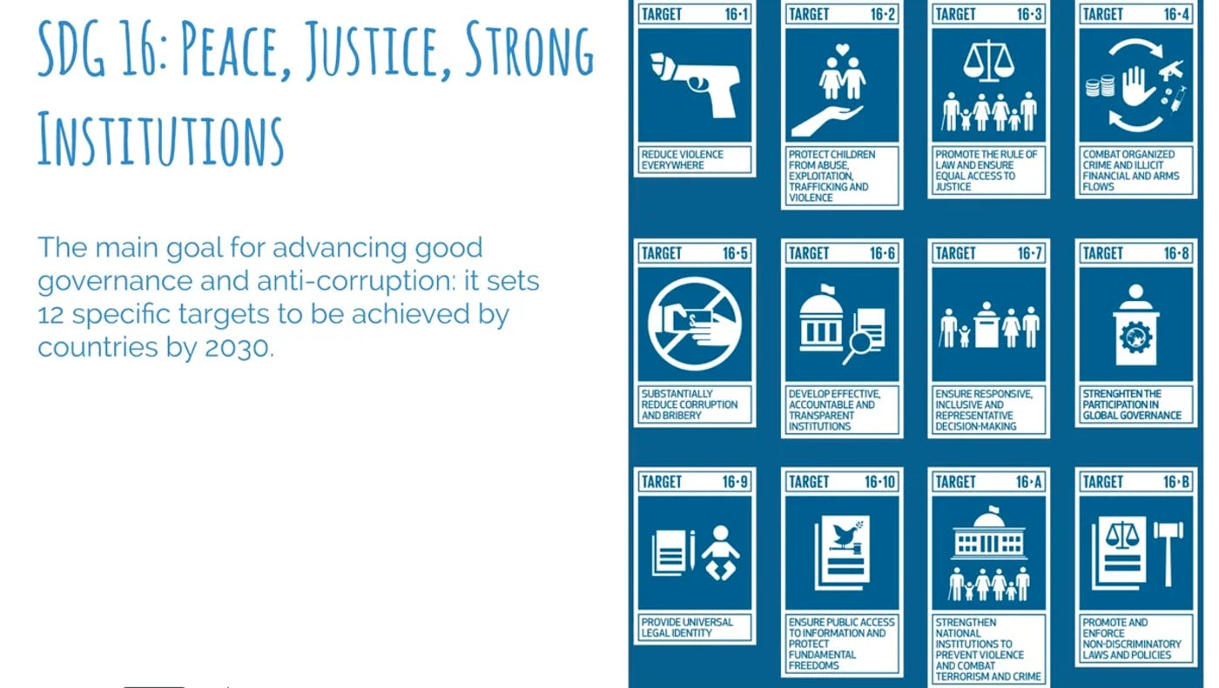
SDG 16: a goal and enabler for other SDGs

Slide 20

specific areas of intervention by APRM –SDG 16
Reducing illicit financial and arms flow ,combat organized crime
Rule of law & access to justice
SDG 16.4
SDG 16.3
Public Access to information 16.10
Effective, accountable and transparent Institutions/
SDG 16.6-CEPA
Reduce corruption
SDG 16.5
strengthen national institutions through incorporation & non-discriminatory laws
Broadening Africa’s participation in the institutions of global Governance
Inclusive and participatory decision making
SDG 16.7
SDG16. 8
Notes:
APRM role in promoting females representation in the national parliaments and executives in Africa (17 goals 231 indicators ) vs 7 aspirations and 66 indicators
Member states commitment to global and regional frameworks ensuring the implementation of legislations at local levels for the implementation of SDGs

Slide 21
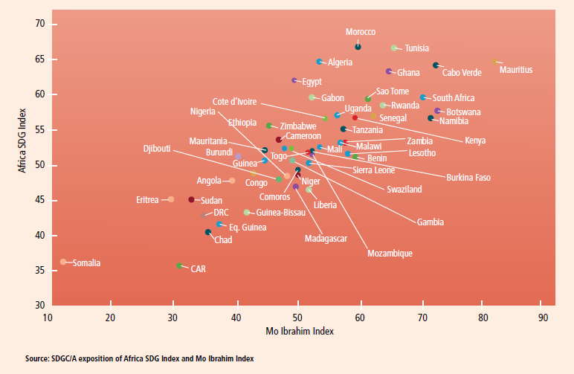
Correlation between good governance & SDGs
Notes:
The correlation coefficient is 0.82, demonstrating the importance of good governance in pursuing the SDGs.
Governance has 8 key characteristics; participatory, consensus, oriented, accountable, transparent, responsive, effective and efficient, equitable, and inclusive and follows the rule of law. In order to enhance governments' and regimes' legitimacy, national performance towards SDGs shall be improved.

Slide 22
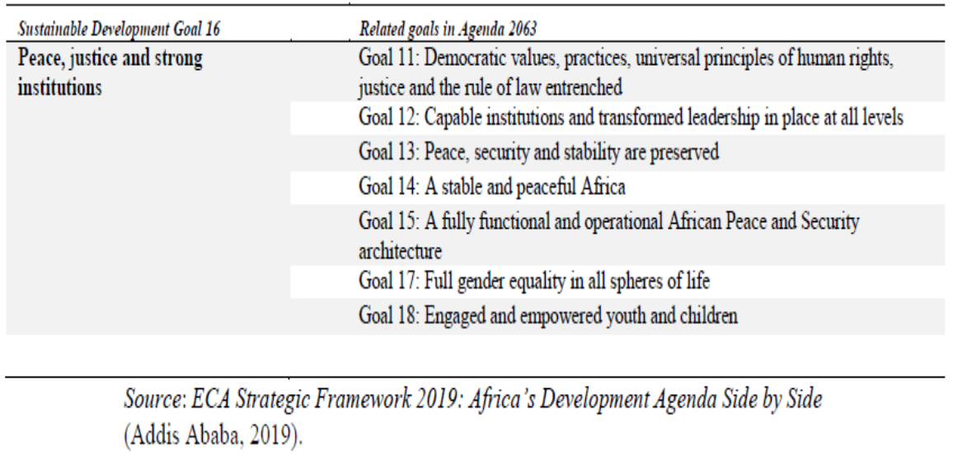

SDG 16 alignment with aspirations 3&4 of Agenda 2063
Notes:
23 indicators – till 2019, only 6 were measurable sufficiently

Slide 23
Different platforms to promote youth role in SDGs and Agenda 2063
AGR/AGA-APSA programs
AGOSS
Targeted-reviews and oriented-studies on youth &women
APRM South-south cooperation platform
APRM-CEPA taskforce
VNRs/Agenda 2063 continental reporting
Youth symposium
Civil society handbook
Non-state actors Network

Slide 24
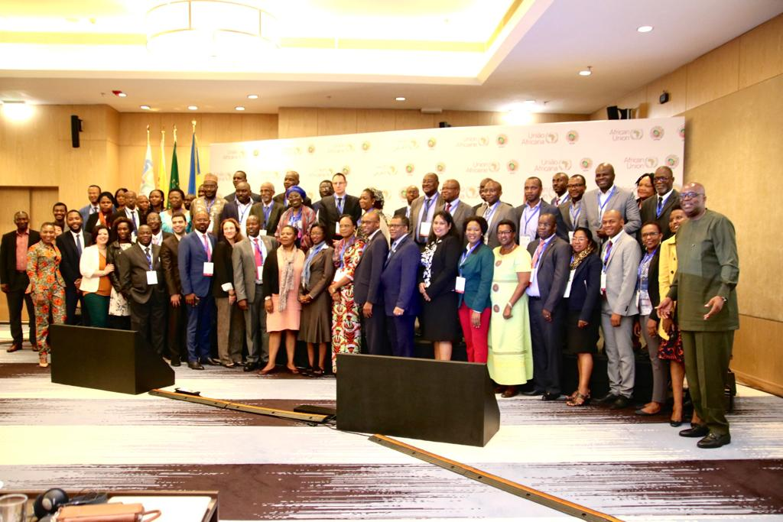
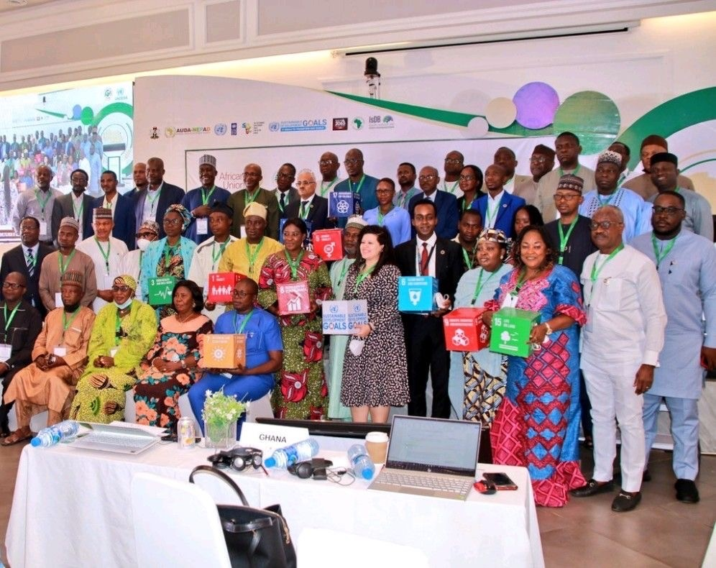
Capacity building for national experts: VNR &Agenda 2063 domestication in Kigali, Djibouti & Abuja and lately Durban (over 400 experts across the continent)

Slide 25
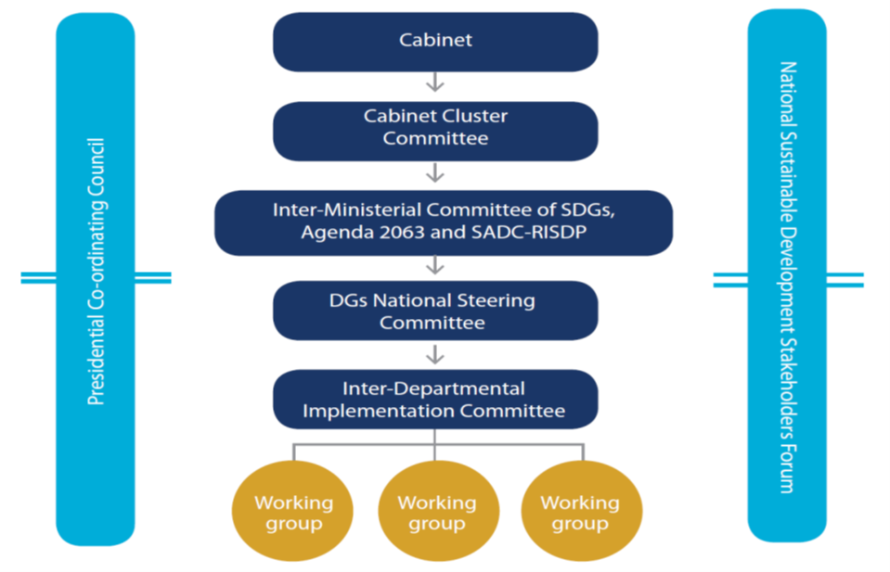
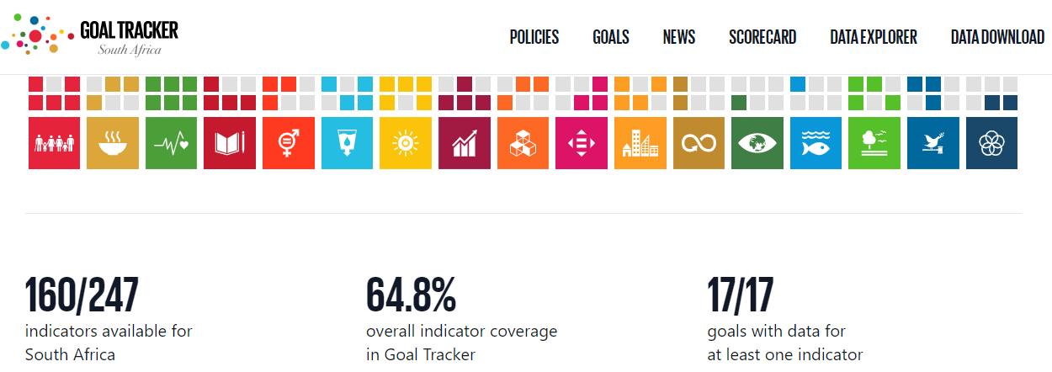
APRM platform for sharingg best practice for involvement of stakeholders in policy making (South Africa)
a National Coordinating Mechanism for national engagements and reporting on agendas 2030 for Sustainable Development and Agenda 2063
The SDGs tracker: E-platform aims to raise awareness among citizens and policymakers on the SDGs and provides a means to track progress made towards achieving the SDGs. It further helps to identify gaps and ultimately detect areas where greater action is needed

Slide 26
Significance & value-add of intervention
Stocktaking on the implementation of SDGs/Agenda 2063 in the APRM peer-review studies – promote strong, inclusive institutions and peaceful societies in Africa.
Developing a narrative on governance mechanisms and the role of partnerships (SDG 17) for the implementation of Agenda 2063 to develop adequate policies at national and regional levels (HLPF)
Presenting good practices from the continent on SDGs planning, monitoring and evaluation systems
Alluding the role of APRM National Governance structures in conducting NG reports while considering the SDGs national ecosystem. (relevance between APRM structures & national policies)
Developing precise studies on SDG 16 qualitative aspects (Inclusinvess, accountability and effectiveness of public sector in Africa)
Mainstreaming SDG 16 indicators in APRM Revised questionnaire
Tackling the fear of the state in governance surveys by utilizing APRM tools
promoting credibility and ownership of APRM secretariat and member states on monitoring SDGs through well-designed tools.
All reports are available on APRM website www.aprm-au.org

Slide 27

Advocacy and assessment of CEPA Principles in Africa
Effectiveness
Competence
Collaboration
Accountability
Integrity
Transparency
Inclusinvess,
Leaving no one behind
Participation-Gender sensitive budg
Sound policy making
Independent oversight
Non-discrimination
Subsidiarity
Integrational equity

Slide 28
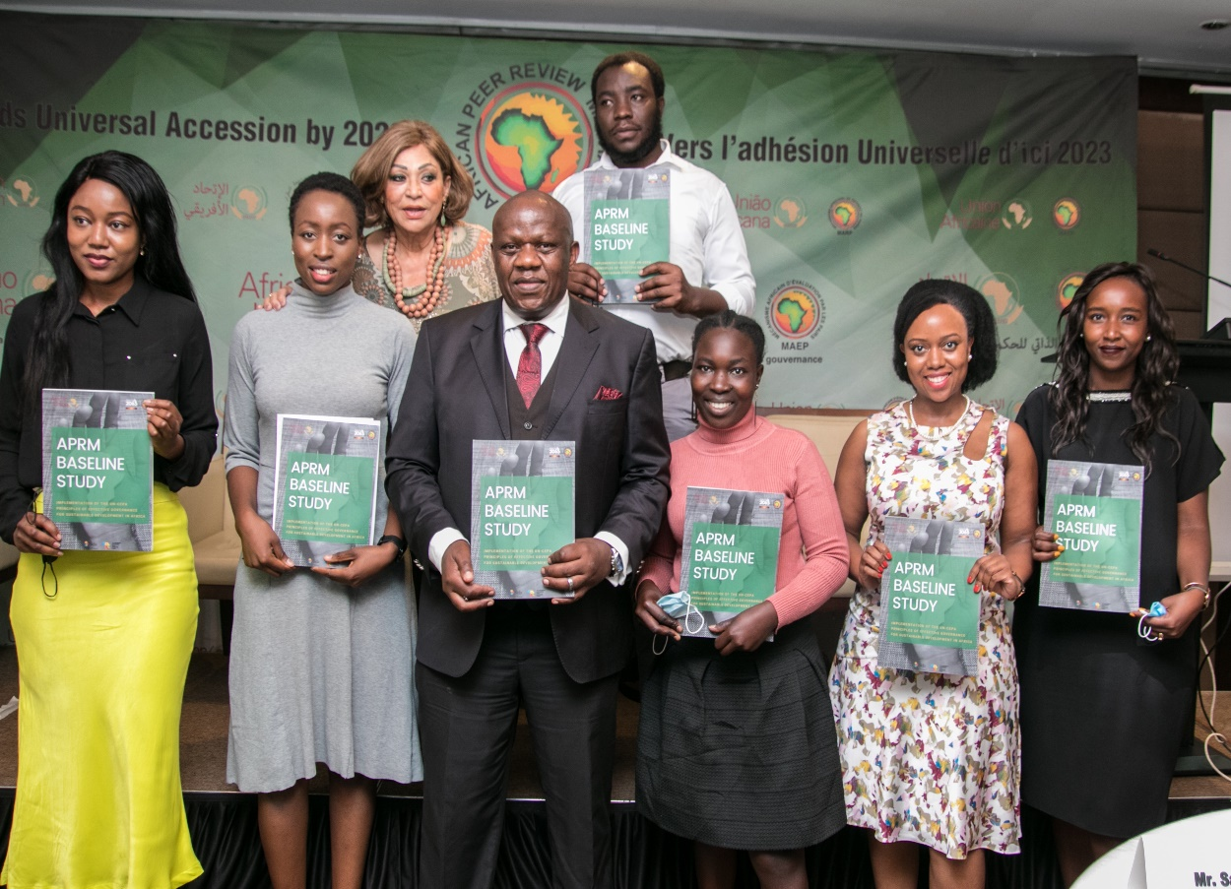
Awareness and Reporting on CEPA Principles for Effective Governance of SDGs
Key Objectives:
1. Enhancing awareness and knowledge of public civil servants and APRM national structures on principles of effective governance for sustainable development
2.Develop assessment tool regarding the implementation CEPA principles of which strategies of effectiveness, accountability, and inclusiveness are encapsulated ; and
3.Present Africa’s position as regard the implementation of CEPA principles at continental level.
Outputs
Two continental capacity building workshops on CEPA principles and sharing experiences on the implementation of CEPA principles at national level; (Pretoria 2019, Cape Town 2021)
APRM Study on the knowledge, implementation and challenges of CEPA principles in Africa- was conducted in 2020 and launched in Nairobi Sept 2021;
Present African countries experiences with CEPA principles especially within COVID-19 times. ;
Collaboration with UNDESA and other regional partners promoted to organize different webinars on the principles and associated strategies (62).
More countries become interested in conducting national assessment of CEPA Principles /or to be monitored within the VNR/VLR processes.
Congruence between Agenda 2063 & the 2030 for Sustainable Development

Slide 29
Perceived Impact of COVID 19 on all the strategies individually

Slide 30
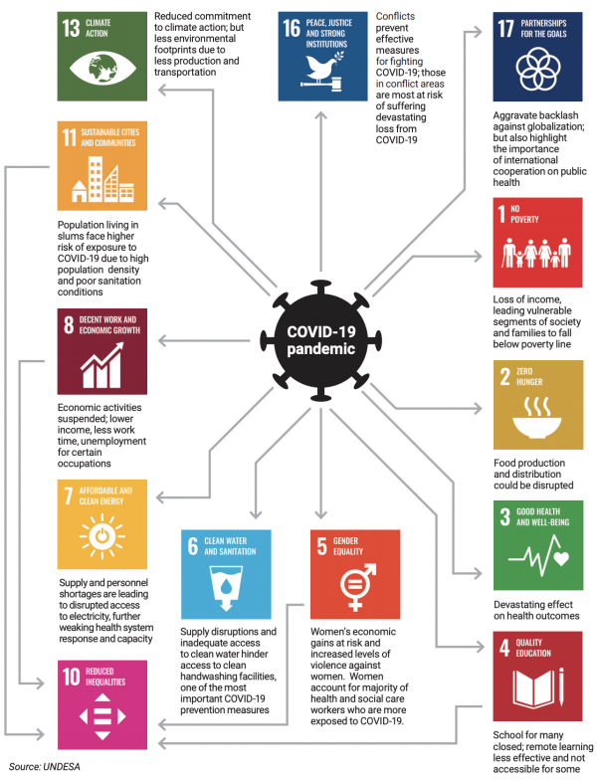
III. Implications of COVID-19 on regional integration and SDGs in Africa
Economic fallouts: restrictive measures, less FDI, unemployment, poverty rates, food crisis
Political: delays to implement regional initiatives and integration programs i.e. AFCFTA
Social and cultural tensions; xenophobia against foreigners in some African countries
Notes:
integrated nature of SDGs articulates interdependence between all indicators of SDGs as well as overall progress towards domestication and reporting on SDGs/Agenda 2063 at local levels.

Slide 31
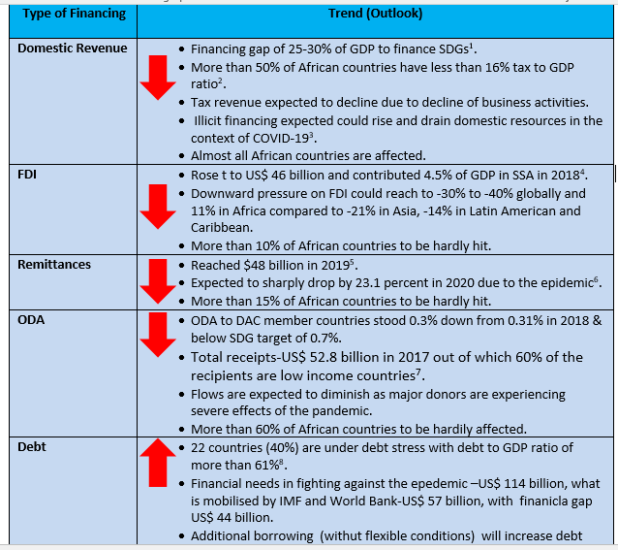
Source: SDGCA – various sources)

Slide 32
African Union & APRM Response to COIVD-19 (SDG3)
Africa Joint Continental Strategy for
COVID-19 Outbreak”
Prevent severe illness and deaths
Minimize social disruption and economic consequences of covid-19
Ensure synergies to avoid duplication through coordination with UN,WHO and regional blocks
Promote evidence-based public health practices for surveillance , prevention and control of the pandemic
Sharing accurate information and communications with member states
Centralized technical support
Testing capacities for COVID-19
infection prevention and control in healthcare facilities
Clinical management and safety protocols
laboratory diagnosis
Notes:
There is a Silver lining in the COVID-19 crisis for Africa to enhance policy coherence and address health issues
Africa Centre for Disease Control (Africa CDC),: Africa Task Force for Coronavirus
(AFTCOR) and Africa CDC’s Incident Management System. The strategy was approved by African health ministers- regional economic communities.

Slide 33
APRM responsive actions
COVID-19 TASKFORCE
UCT symposium on covid-19
The APRM launched a special taskforce to deliberate on COVID-19 solutions at national and regional levels. New Report on Africa’s Governance Response to COVID-19
Supporting AU- Continental strategy COVID-19
TARGETED REVIEWS (Mauritius COVID-19, Sierra Leon
YOUTH WEBINARS
Revising methodology of peer review (Resilience and disasters mitigation
The APRM initiates a series of virtual dialogues with youth in the continent to share ideas and digital solutions for covid-19 ; education and health awareness
https://www.aprm-au.org/publications/africas-governance-report-to-covid-19/.
COVID-19 TASKFORCE
CEPA assessment report
Notes:
creation of national platforms; , accountability for disaster risk management; preparedness; recognition of stakeholders and their roles; mobilization of risk-sensitive investment to avoid the creation of new risk; resilience of health infrastructure, cultural heritage and work-places; strengthening of international cooperation and global partnership

Slide 34


Showcase: APRM activities on Gender I. The case on Governance, Gender Equality and Women empowerment
In the context of Gender Equality and Women’s Rights, the APRM has developed indicators , as part of its questionnaire, to measure and assess the implementation of the set of gender equality and women’s rights’ instruments such as the Maputo Protocol amongst others.
By 2015, 100% of APRM reviewed countries indicated GBV and gender inequality as an overarching governance issue.
Most recently, the APRM assessment reviews centralizes gender as one of the issues convered under two thematic areas: Political Governance and Socio-economic governance.
Thus, APRM study on the nexus between Governance, Gender and Peacebuilding which both highlighted best practices in countries to be promoted or reinforced in other African countries and the rest of the world.

Slide 35
Gender equality in SDGs& Agenda 2063
Agenda 2063
Aspiration 6: An Africa, whose development is people-driven, relying on the potential of African people, especially its women and youth, and caring for children.
Goal 17: Full Gender Equality in All Spheres of Life
Agenda 2030
SDG 5: Achieve gender equality and empower all women and girls
(9 Targets)

Slide 36
Highlight of some Best Practises and experiences for the promotion of Gender Equality
The Study on Governance, Gender and Peacebuilding revealed the following Best Practices:
Local Peace Committees
Women’s Situation Rooms
Women’s coalitions across socio-political divides: The Sixth Clan
Peace Circles
Peace Huts
Female ex combatants redeployed in peacekeeping

Slide 37

More activities on gender
Develop APRM Gender Audit report
Provide details on mainstreaming Gender in APRM operations, structures and processes particularly review processes; for all types of reviews ii) Provide guidance on how to genderise CSAR, CRM and NPoAs; and 3) integrate gender-sensitive approach in governance reporting and analysis.
Assessment on opportunities in the African Continental Free Trade Area (AfCFTA) for Women in the Informal Cross-Border Trade
The study looks at the opportunities in the AfCFTA for women in the ICBT. The study has several research objectives including I) Identify the challenges that women in informal cross border trade within the context of AfCFTA; ii) Identify the opportunities presented by the AfCFTA for women operating in the informal cross border trade in Africa; iii) Propose possible policy and practical recommendations that can be considered in this regard; and Reflect on ways to improve regional and continental integration frameworks from a gender perspective.
https://au.int/sites/default/files/documents/41579-doc-STUDY_ON_OPPORTUNITIES_IN_THE_AFCFTA_FOR_WOMEN_IN_INFORMAL_AND_CROSS-BORDER_TRADE.pdf.

Slide 39
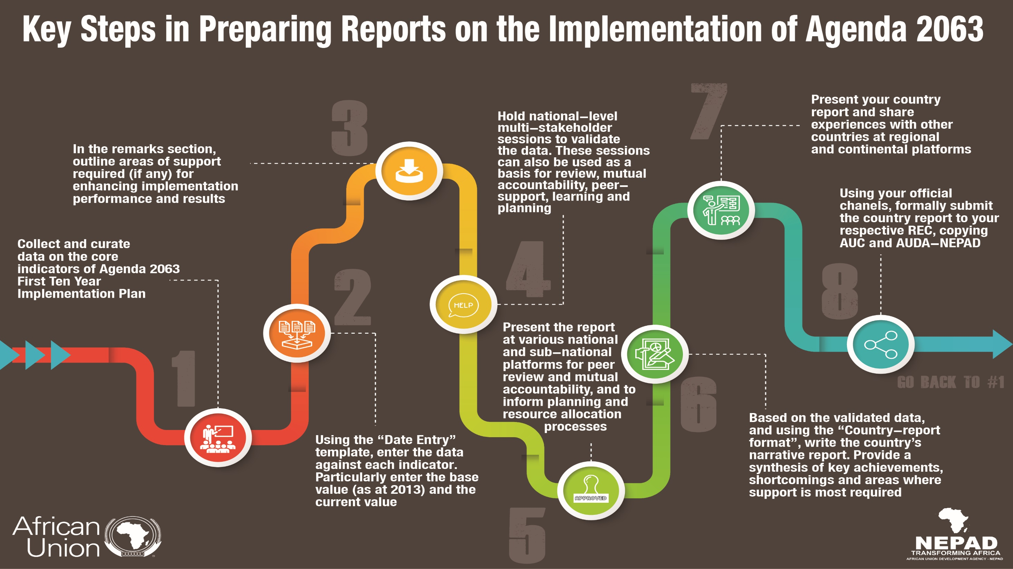

Slide 40
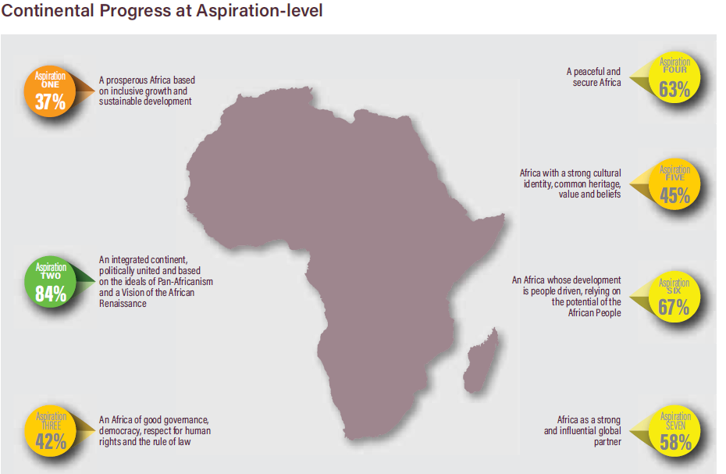
Where we stand as regard implementation?? : AUsecond continental report https://au.int/sites/default/files/documents/41480-doc-2nd_Continental_Progress_Report_on_Agenda_2063_English.pdf.

Slide 41
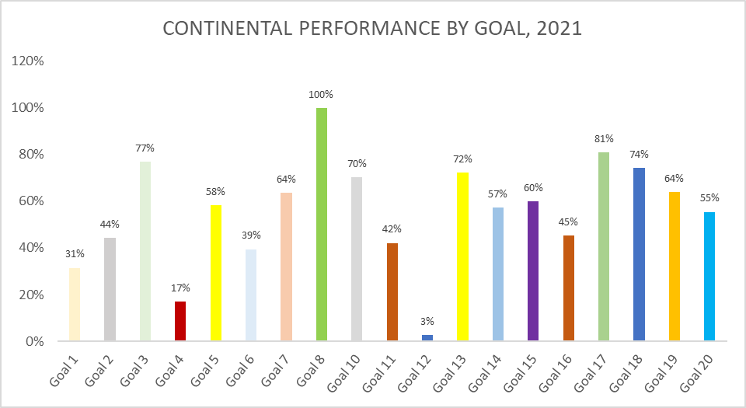

Slide 42
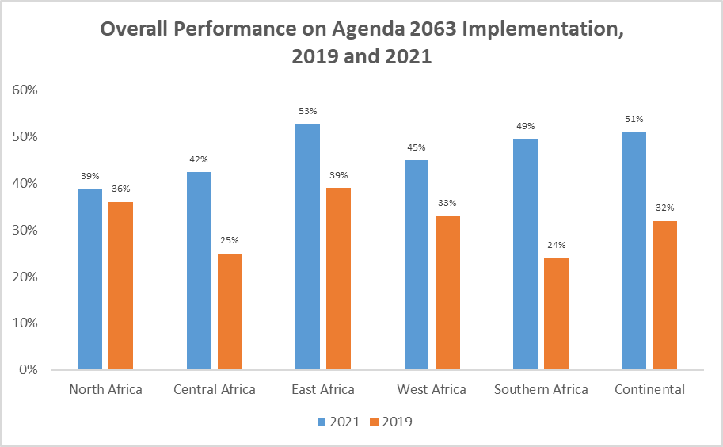

Slide 43
Kenya: 830,900 jobs were created in the period 2013 - 17
Govt increased budgetary allocation to the Youth & Women Enterprise Funds
Senegal: Govt adopted a national employment policy
To strengthen efficiency of the labour market, and promote self-employment in rural and urban areas
Togo: economic relief and stimulus packages and employment programmes
Contributed to a drop from 6.4% in 2013 to 2.6% in 2019. The target group are the youth
Madagascar: aligned national labour laws with ratified international conventions
The laws entitle the citizens to equal pay for equal work thereby eliminating all forms of discrimination
Labour intensive employment program
Interventions undertaken by Member States to reduce unemployment rates

Slide 44
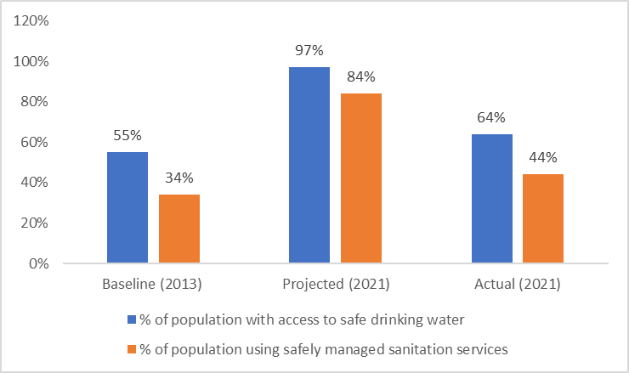
Access to Basic Services in Africa in 2013, Current Year and Projected Value for 2021

Slide 45
Interventions Taken by AU MS to Increase Access to Basic Social Services
Côte d’Ivoire: Millennium Water and Sanitation Programme implemented to accelerate sustainable access to water, hygiene and sanitation.
Madagascar: Targeted geographical areas saw access to drinking water increased from 23.95% in 2013 to 47% in 2020
Niger: Adopted a decree establishing the National Housing Fund to guarantee access to social housing credit, which saw a reduction in proportion of urban pop’n living in slums.
Kenya: Construction of water projects across the country saw an increase in the proportion of population with access to safe drinking water from 53.3% in 2014 to 65.5% in 2021.

Slide 46
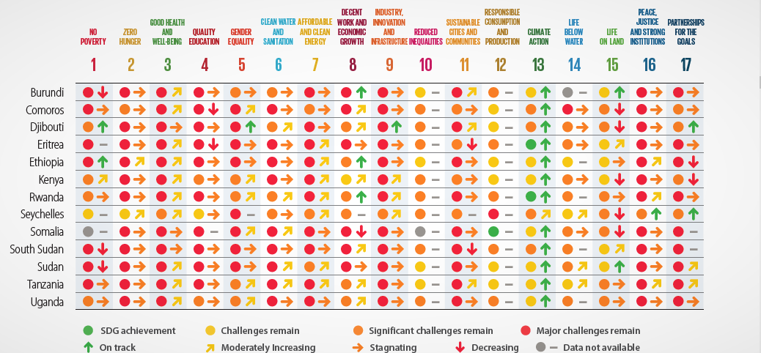
SDGs index for Africa- Dashboard
Notes:
Only 92 indicators are collected out of 232 indicators of SDGs

Slide 47
The UN Voluntary National Review in a nutshell
The voluntary national review sets a framework for countries to track the implementation of SDGs at national, regional and global levels.
The voluntary national reviews (VNRs) aim to facilitate the sharing of experiences, including successes, challenges and lessons learned, with a view to accelerating the implementation of the 2030 Agenda.
The VNRs also seek to strengthen policies and institutions of governments and to mobilize multi-stakeholder support and partnerships for the implementation of the Sustainable Development Goals.

Slide 48
Where Africa stands regarding the VNRs?
By 2022, 46 African countries would be completing VNRs submissions since the adoption of Agenda 2030 for sustainable development. For more info please visit
https://sustainabledevelopment.un.org/vnrs/.

Slide 49
What’s reviewed ?
Every year, the ECOSOC in agreement with member states agree on certain goals to be reviewed.
2017: Goals 1, 2, 3, 5, 9 and 14;
2018: Goals 6, 7, 11, 12 and 15;
2019: Goals 4, 8, 10, 13 and 16.
2021: SDG 1 on no poverty; 2 on zero hunger, 3 on good health and well-being, 8 on decent work and economic growth, 10 on reduced inequalities, 12 on responsible consumption and production, 13 on climate action, 16 on peace, justice and strong institutions, and 17 on partnerships
2022: SDGs: 4 (quality education), 5 (gender equality), 14 (life below water), 15 (life on land), and 17 (partnerships for the Goals
Countries are encouraged to report on all gaols.

Slide 50
The role of stakeholders in VNR process
The 2030 Agenda refers back to Resolution 67/290, which clarifies the need to include “other stakeholders active in areas related to sustainable development . Therefore, non-state actors are encouraged to be involved in the process of reporting on Agenda 2030 and Agenda 2063.
tbc
Business and Industry
· Children and Youth
· Farmers
· Indigenous Peoples
· Local Authorities
· Non-Governmental Organizations
· Scientific and Technological Community
· Women
· Workers and Trade Unions
Local Communities
· Educational and academic entities
· Faith groups
· Foundations and private philanthropic organisations
· Migrants and their families
· Older persons
· Parliamentary networks and associations
· Persons with disabilities
· Volunteer groups

Slide 51
How stakeholders – major groups are engaged?
What about your country’s experience? ☺
Inform :This is one-way communication, where governments
inform stakeholders of their plans for implementation and review
of the 2030 Agenda
Consult : This is where governments present plans and options
for implementation and review of the 2030 Agenda and receive
feedback from stakeholders. The aim is to benefit from the experience
and knowledge of stakeholders
InvolveThis is where stakeholders are meaningfully engaged with
governments in generating plans and options for implementation and
review of the 2030 Agenda and carrying out actions based on decisions
emerging from this input
Collaborate : This is where governments and stakeholders decide together on the implementation and review of the 2030 Agenda. It is long-term, complex and demanding, requiring resources. (Ideal model)

Slide 52

شكراً
Thank you
Merci

