Slide 1
Side Event COP27
Sustainable Water and Energy Solutions supporting Climate Change and Biodiversity Objectives through Innovation and Clean Technologies
9 November 2022 14:45
Case Studies: Sharing experiences on sustainable water and energy solutions
Sergio D. Mendez Gaona
Climatologist – Reservoir Division
Itaipu Binacional
Notes:
Comentarios

Slide 2
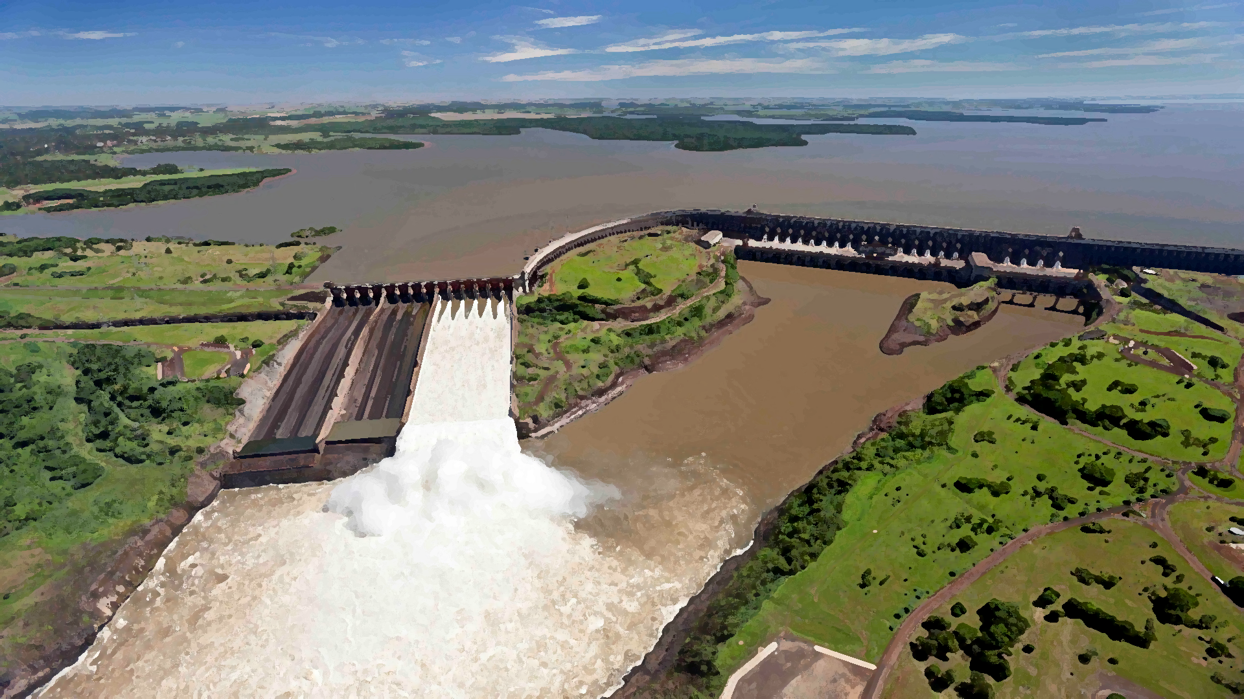
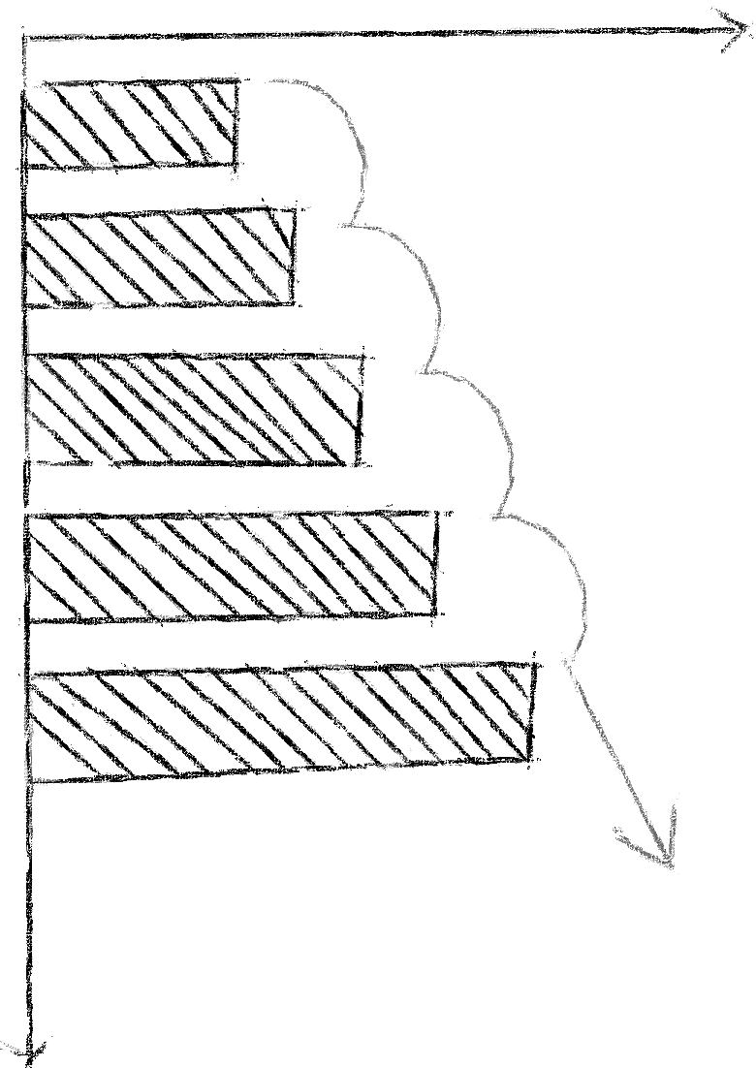
Climate change affects the “normal” conditions in hydroclimatic regime
Fish fauna
Water quality
Transport and deposition of sediments
(bathymetric studies)
Forest reforestation and management
AR6 (IPCC) report: “The intensity and frequency of extreme precipitation and pluvial floods are projected to increase”
MONITORING
Take actions for prevent the consequences of the changes in the hydroclimatic regime
These actions will be done based on the changes observed in the environment

Slide 3
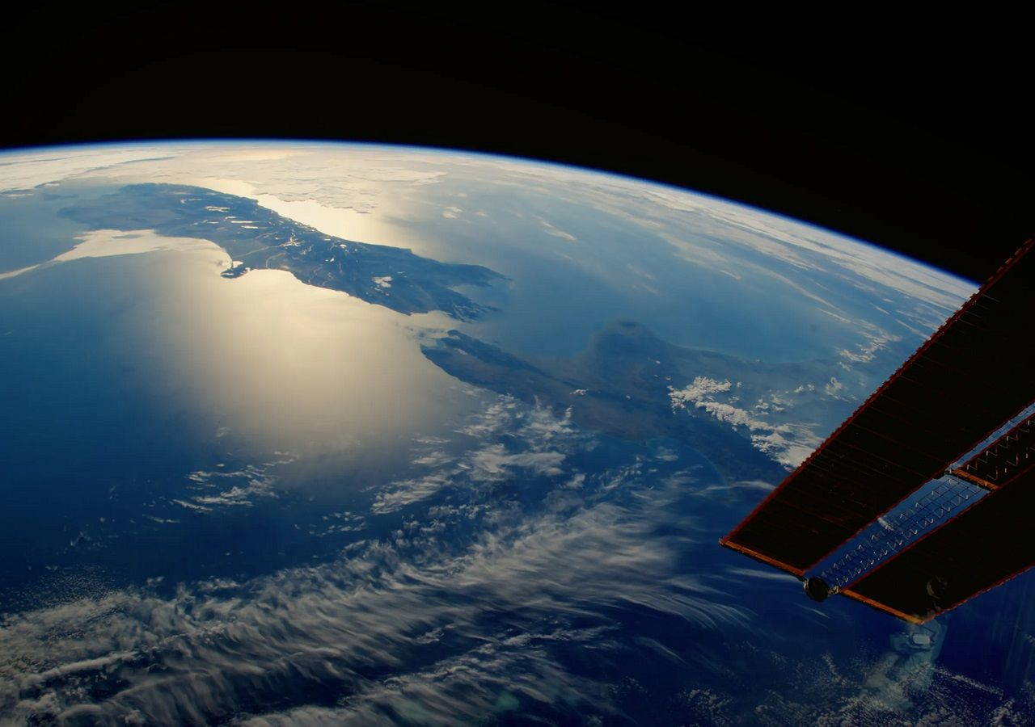
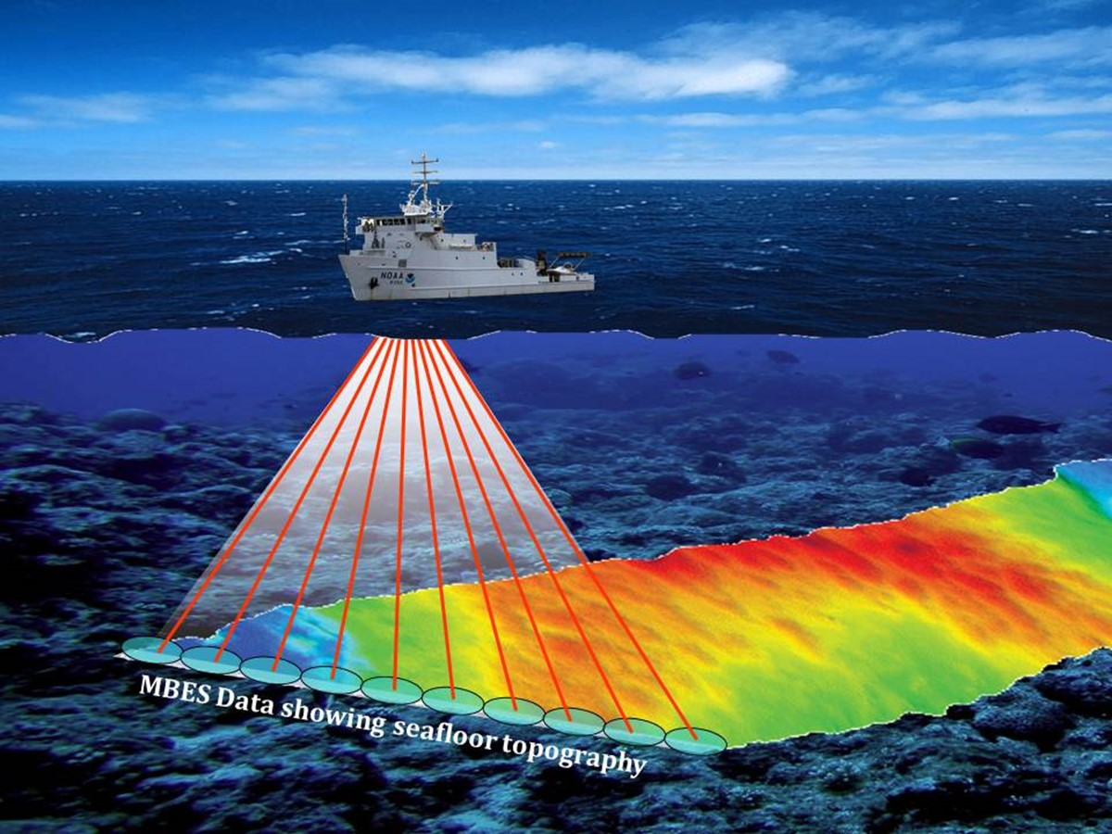
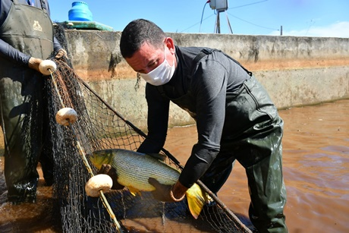
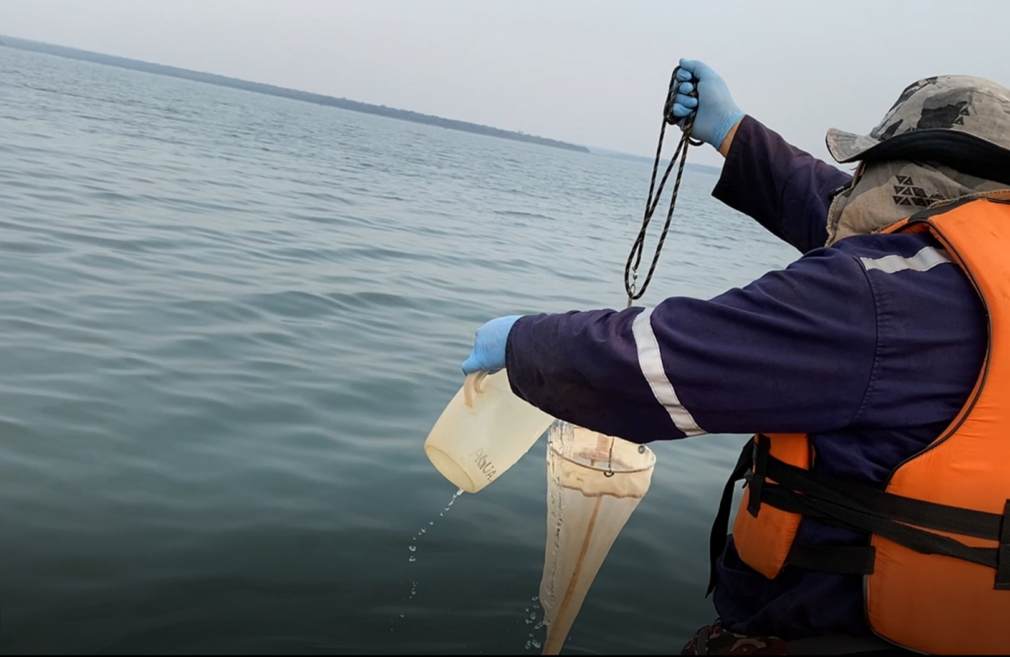
MONITORING
CLIMATE MONITORING AND ANALYSIS
BATHYMETRIC STUDIES
CLIMATE CHANGE
FISH MONITORING
WATER QUALITY

Slide 4
CLIMATE MONITORING AND ANALYSIS
+1.03°C
TEMPERATURE
Red line – average annual temperature Blue line – normal annual temperature*
Black line – linear regression *Normal: 1981 – 2010 period
Red bars – positives temperatures anomalies Blue bars – negatives temperatures anomalies Black line – linear regression
PRECIPITATION
Conventional weather stations
Automatic weather stations
Red bars – total annual precipitation Blue line – normal total precipitation*
Black line – linear regression *Normal: 1981 – 2010 period
Blue bars – positives precipitation anomalies Red bars – negatives precipitation anomalies
Black line – linear regression

Slide 5
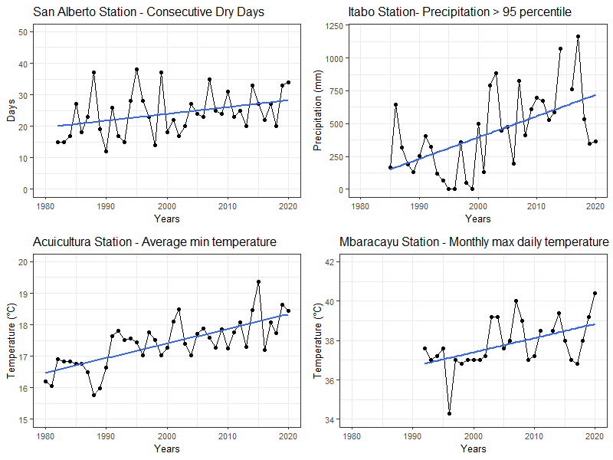
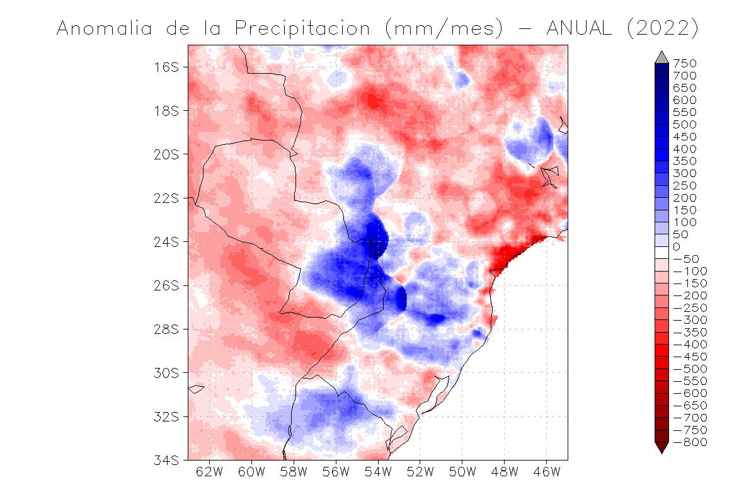
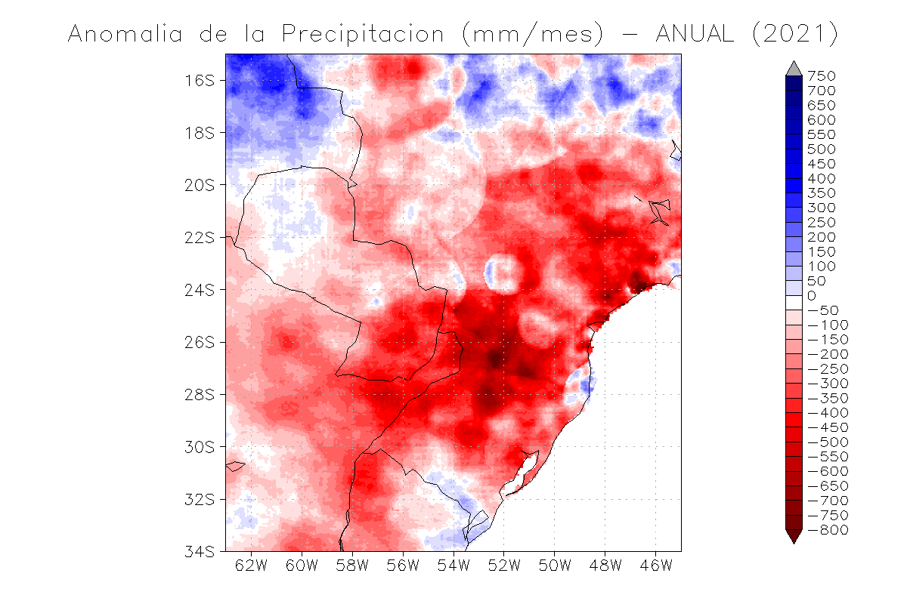
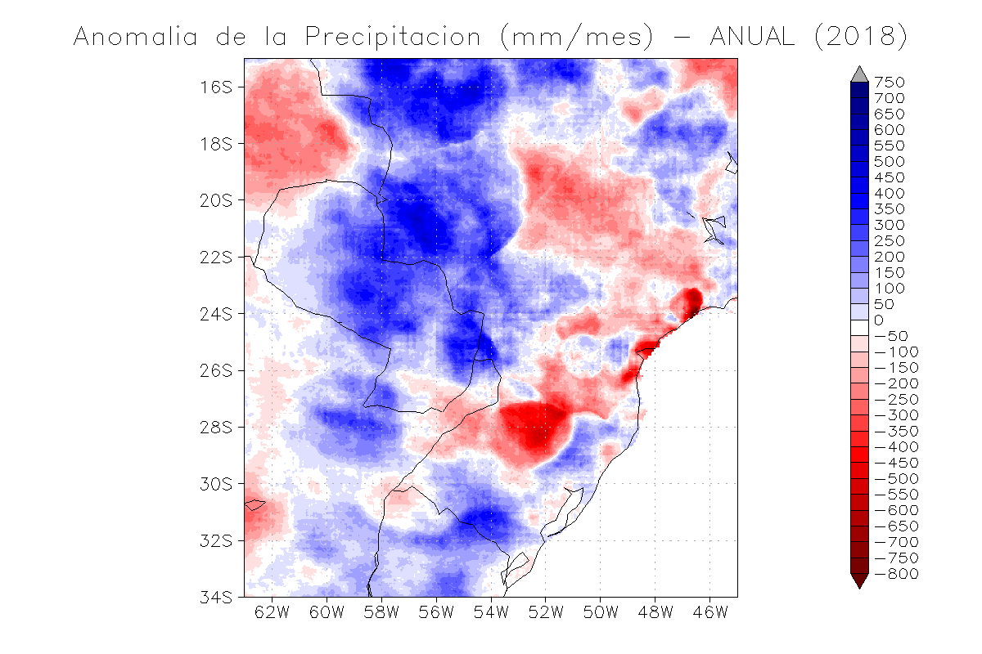
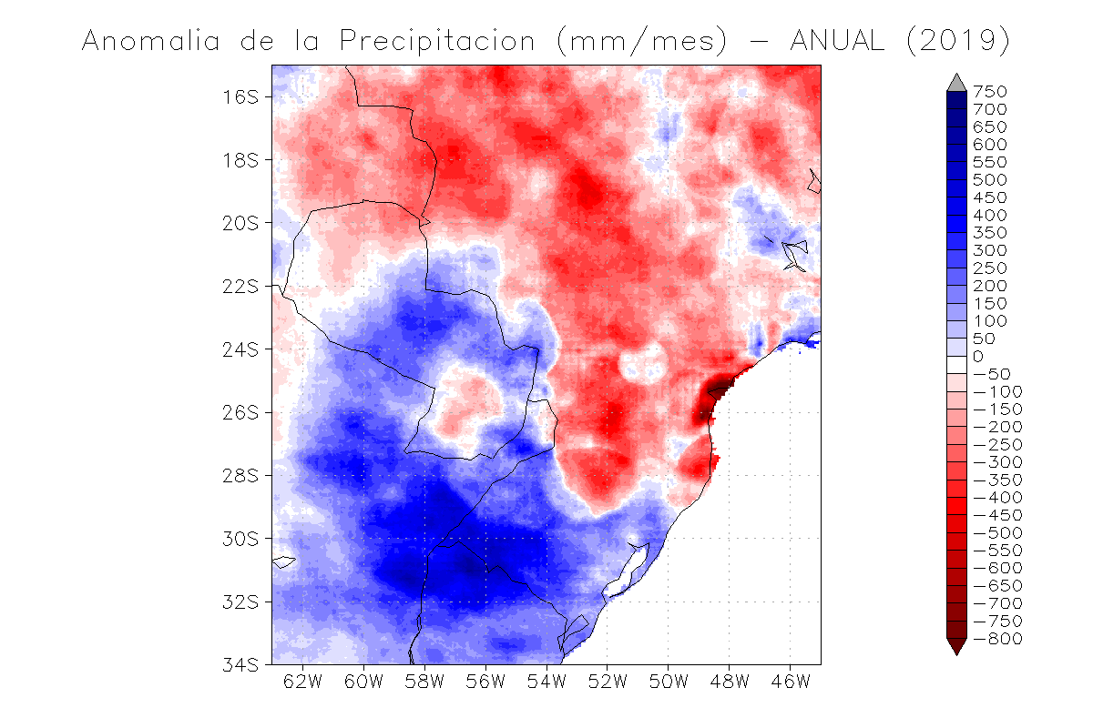
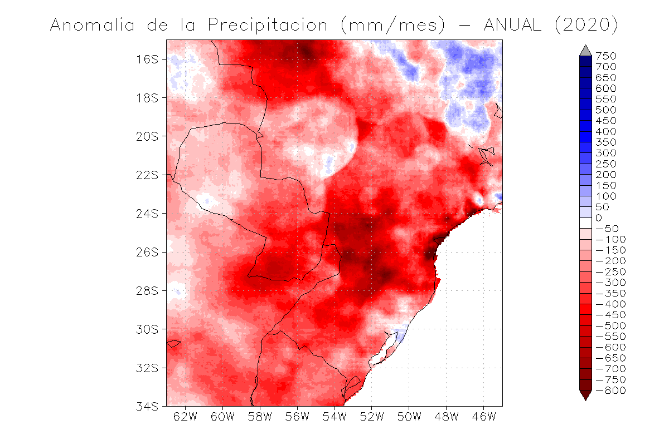
CLIMATE MONITORING AND ANALYSIS
Precipitation on La Plata Basin
Some Climatic Extreme Indices - ETCCDMI
CHIRPS DATA. Available in https://www.chc.ucsb.edu/data/chirps

Slide 6
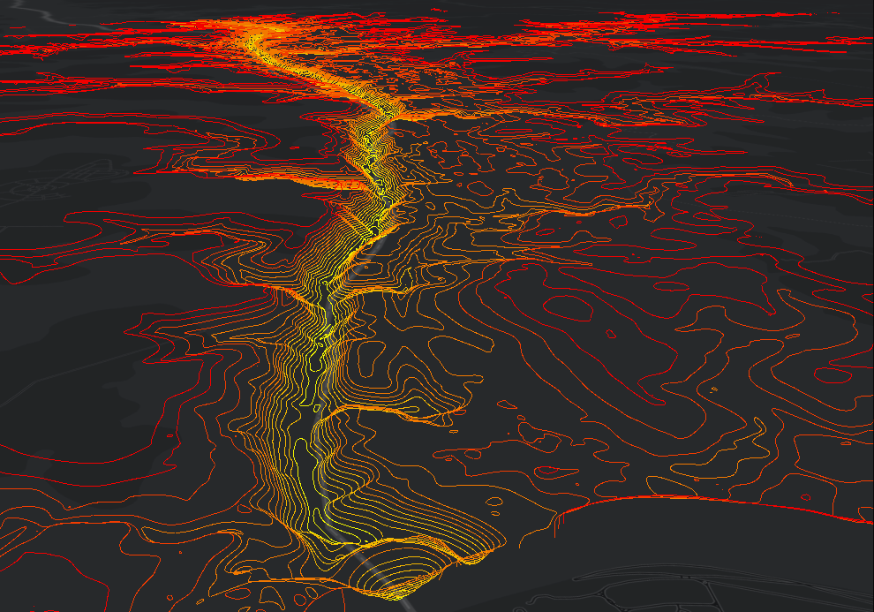
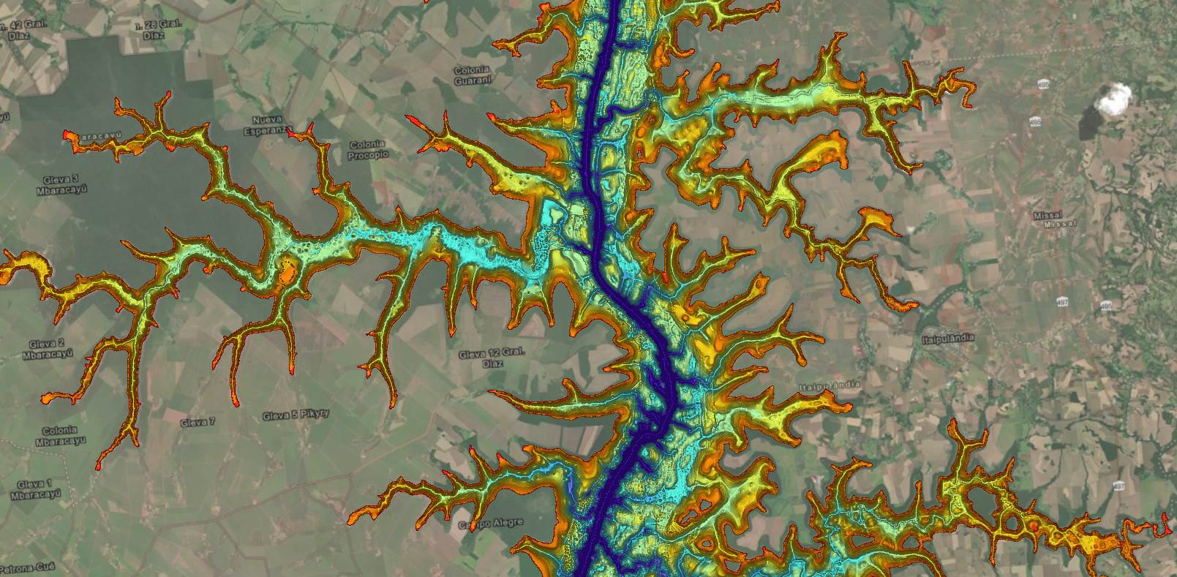
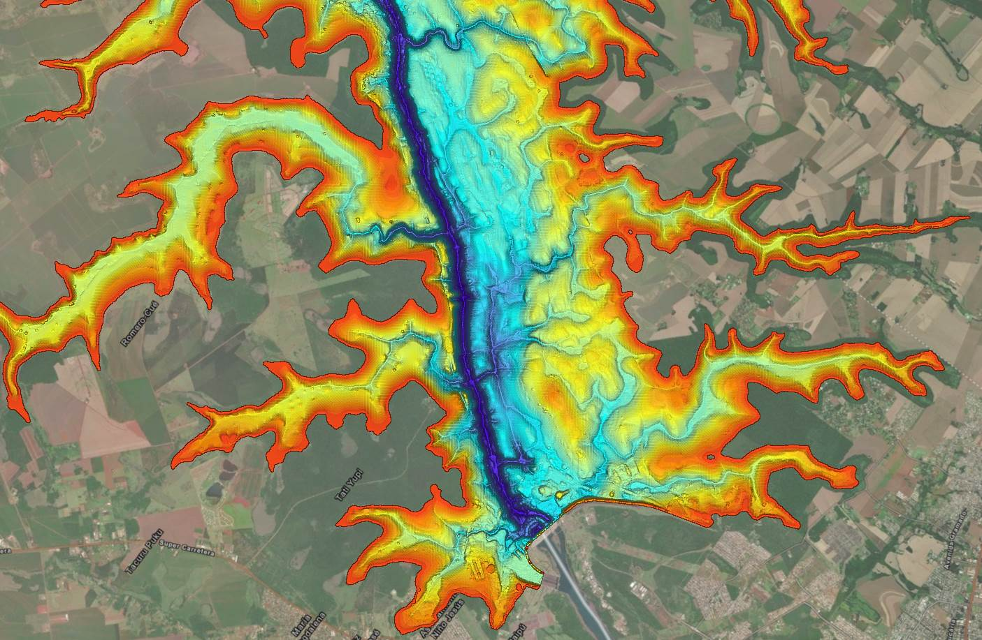
BATHYMETRIC STUDIES
Annual campaigns in control areas
ITAIPU RESERVOIR
Fuente MARR.CE
Fuente MARR.CE
EXTENSION: 170 KM
MAX DEPTH: 190 M
AVERAGE WIDTH: 7 KM
FLOODED SURFACE: 1350 KM2
Every 5 years campaigns in all the reservoir
Fuente MARR.CE

Slide 7
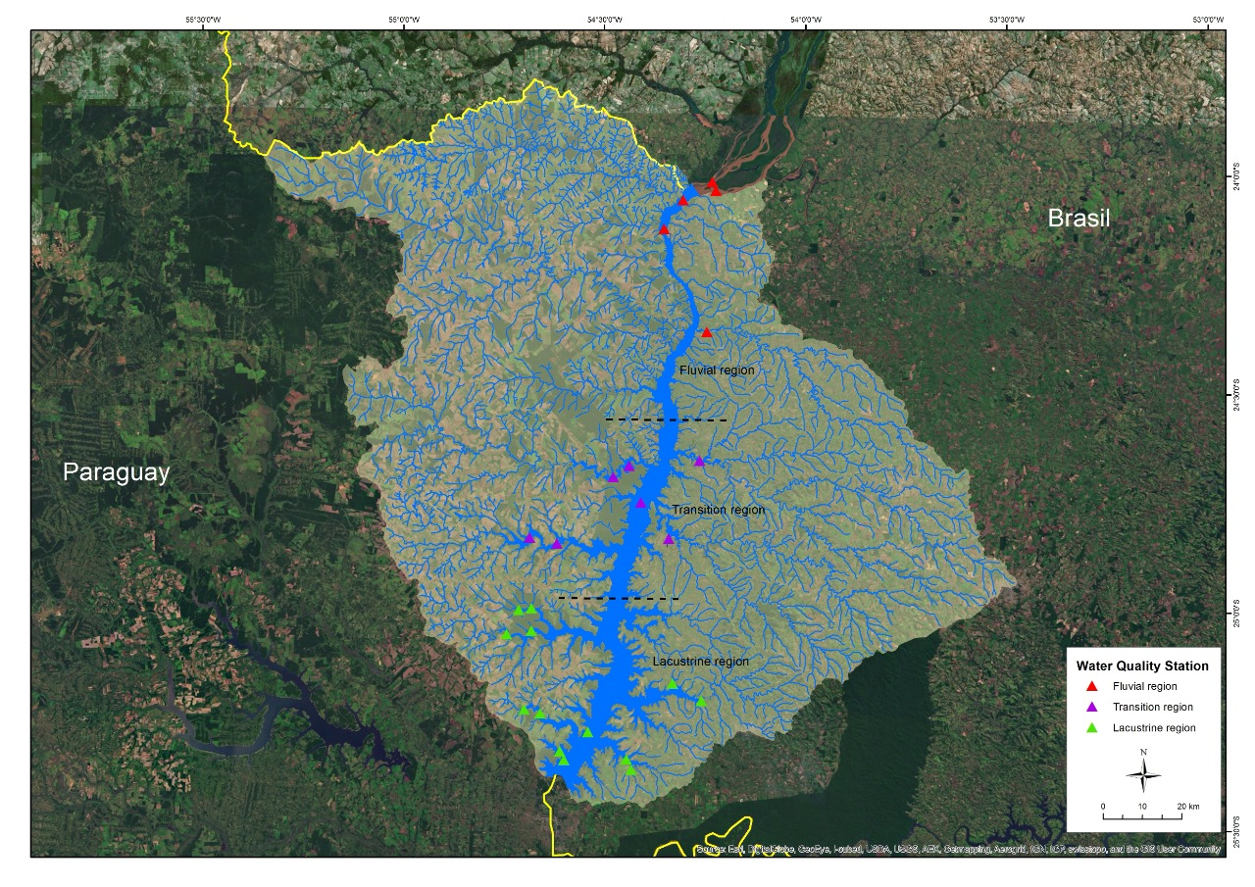
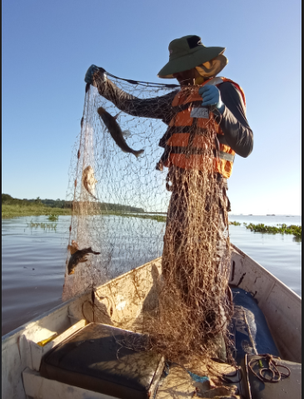
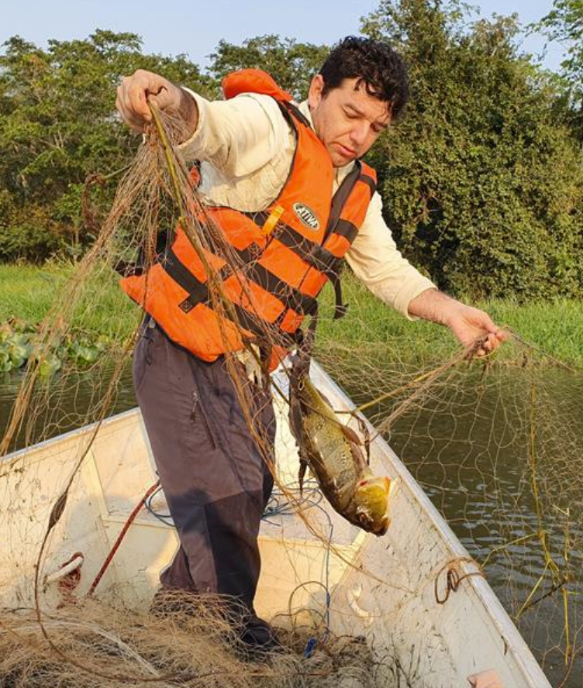
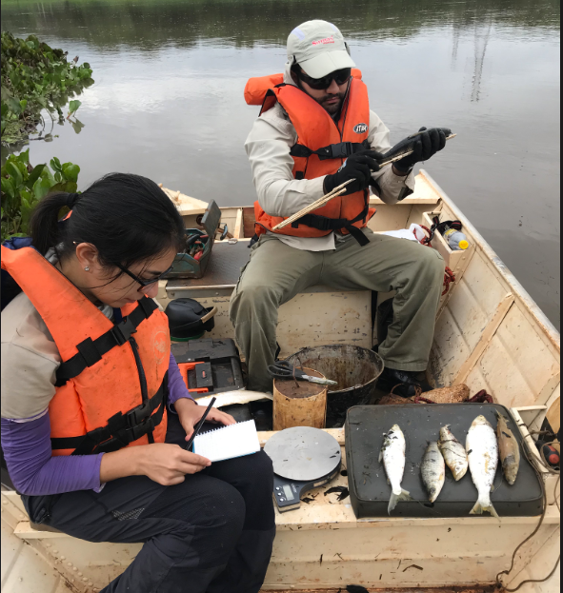
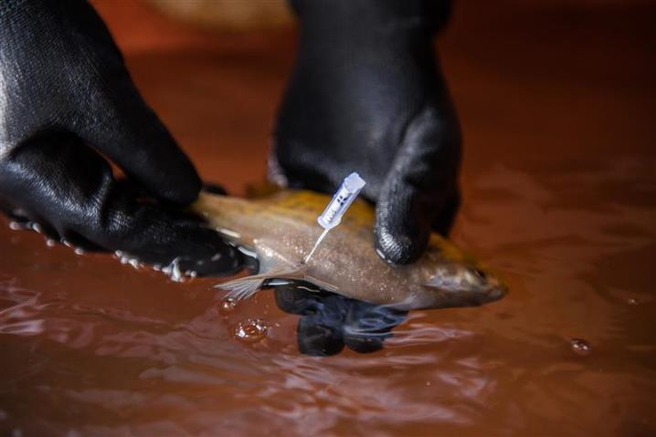
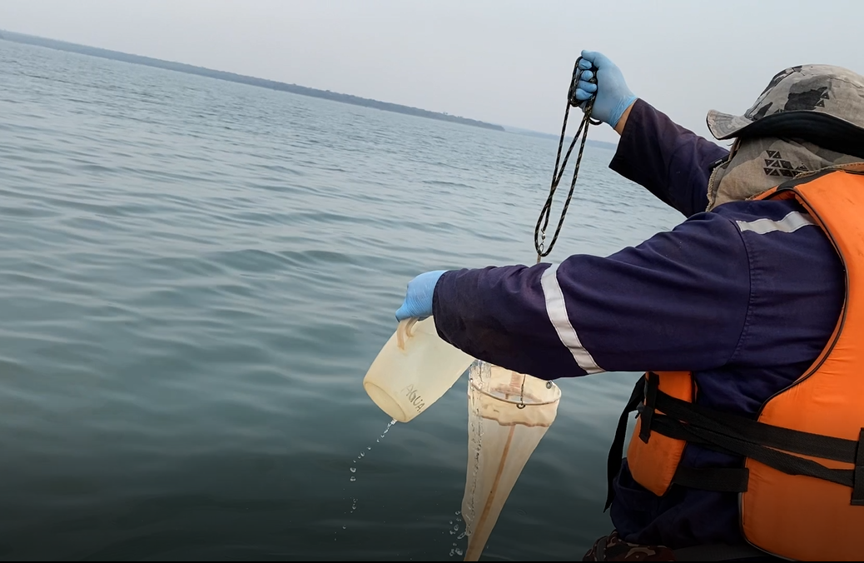
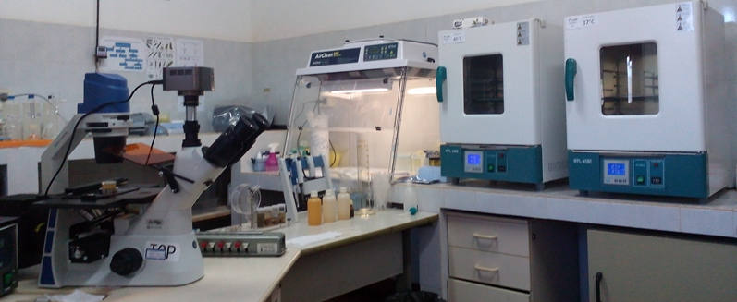
WATER QUALITY
FISH MONITORING

Slide 8
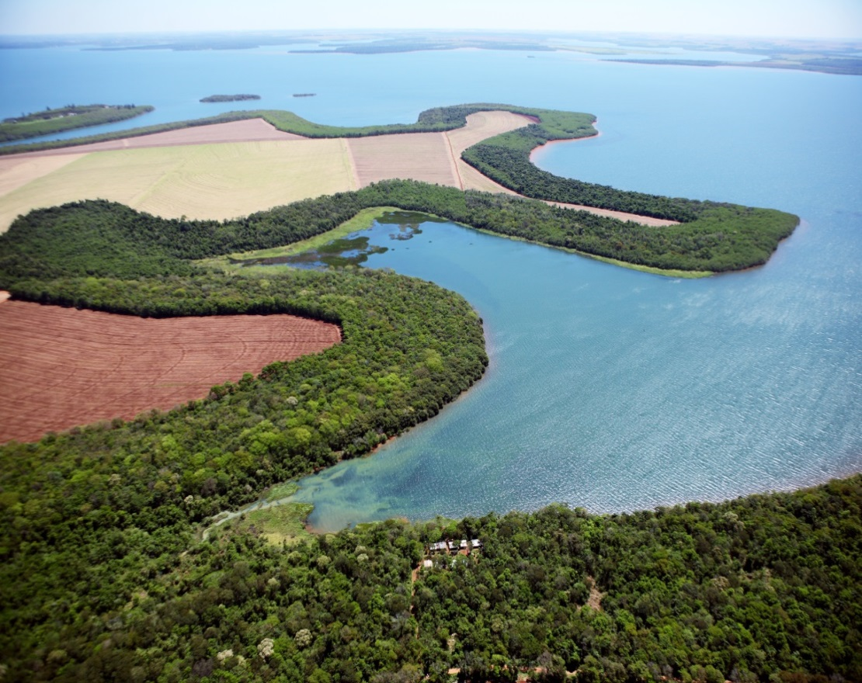
FINAL REMARKS
Our goal is to understand climate change from the perspective of the “new climatic conditions” and how it is affecting the Itaipu Basin
The use of various state-of-the-art technologies for continuous environmental monitoring plays an essential role in deepening our understanding of the effects of climate change and supports climate mitigation and adaptation planning
Integrating data will validate the decision-making process and will increase the effectiveness of long-term solutions
All this work is vital in making the right forecasts and implementing the necessary mitigations and adaptations plans to increase the lifespan of the reservoir and the preservation of natural resources in the region

Slide 9
Thank you very much for your attention !
Sergio D. Mendez Gaona
sergiodm@itaipu.gov.py
+595 61 599 8795
Reservoir Division
Itaipu Binacional - Paraguay

