Slide 1
IMPACTS OF COMMUNITY BASED RENEWABLE ENERGY SYSTEMS TO THE INDIGENOUS PEOPLE IN THE PHILIPPINES
CLIMATE RESILIENT SOLUTIONS TO HYDRO MINI-GRIDS
UNDESA Sustainable Water and Energy Solutions Network
Virtual side event
12 July 2022
7:30 – 9:00 (New York Time)

Slide 2
OVERVIEW
HPNET’s knowledge-to-impact approach
HPNET’S
Community-Scale Hydro for Climate Resilience
Water-Energy-Food Nexus
Community Based Renewable Energy
Inclusive Approaches to Hydro Mini-Grids
Role of Indigenous & Women-Centric Approaches

Slide 3
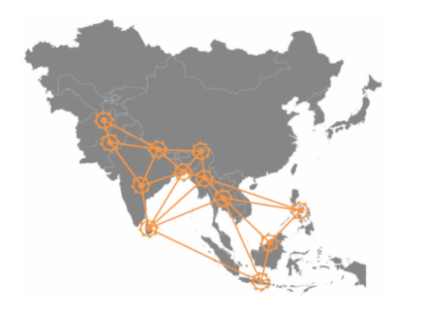
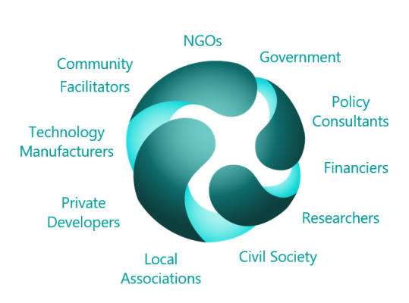
HYDRO EMPOWERMENT NETWORK (HPNET)
KNOWLEDGE EXCHANGE
Evidence building tools for multi-actors
Capacity building events (online and in-person)
South-South and peer-to-peer exchange
STRATEGY ADVOCACY
Platform for local practitioner voices
Coalition-building for advocacy to impact
Advocacy products for thematic solutions
THEMATIC FOCUS AREAS
Technology and skills advancement
Socio-environmental sustainability
Enabling financing and policy for scalability

Slide 4
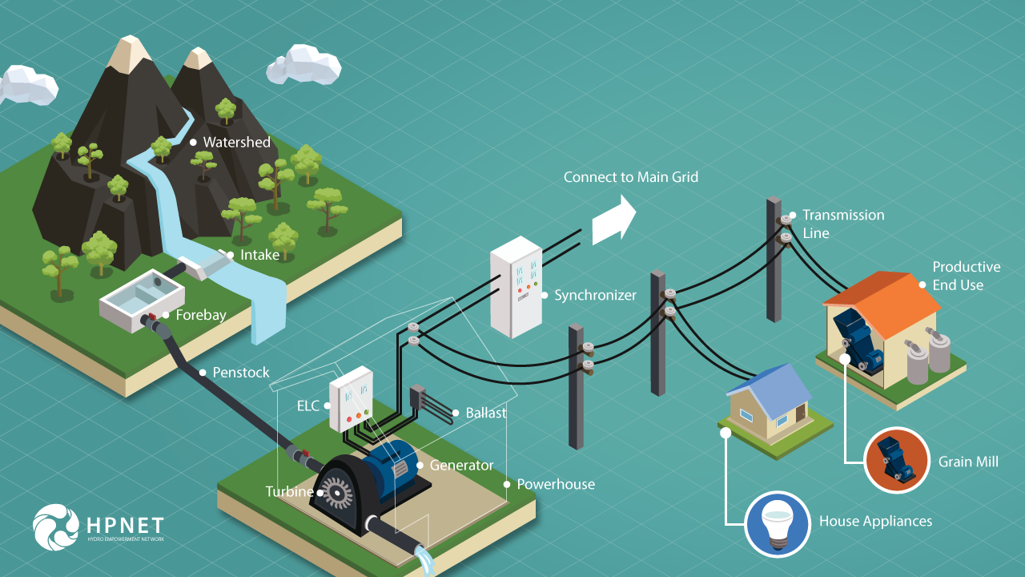
TECHNICAL COMPONENTS OF
SUSTAINABLE HYDRO MINI-GRIDS

Slide 5
Social Enterprise for Energy,
Ecological and Economic Development
Hydro Mini-Grid Sustainability
Socio-Economic Impact
of Hydro Mini-Grid
Empowerment Beyond Kilowatts

Slide 6
CORE ELEMENTS OF SEEED
- Equitable local social enterprise models
- Alignment with indigenous values
- Strengthened local social capital
- Empowerment beyond mini-grid
Socio-Economic Impact Community Empowerment
- Access to appropriate finance
- Dynamic tariff & connection fee
- Financial & HR management
- Consumer service and grievance
Hydro Mini-Grid run as Local Social Enterprise
- Value-add to agri-value chains
- Multi-village scale
- Women-centric productive end use
- Increased household income
Livelihood-based
Value-Add
Productive End Use
Operates 24-7
Locally manufactured
- Reliable village technicians
- Prompt technical maintenance & repair
Reliable
Mini-Grid Technology
&
Sustainable Watersheds
- Baseline of indigenous practices for watershed management
- Solutions for eco-restoration and climate resilience of micro hydro watersheds, e.g. re-forestation, food forests, and bio diversity.

Slide 7
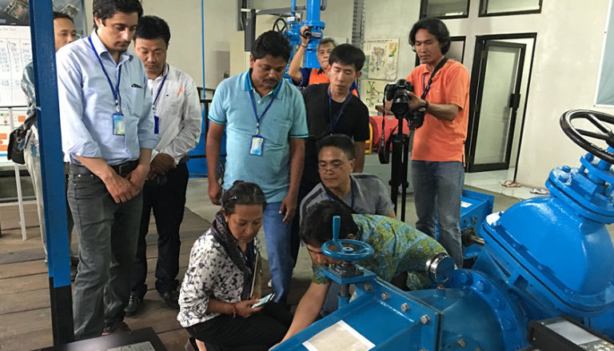
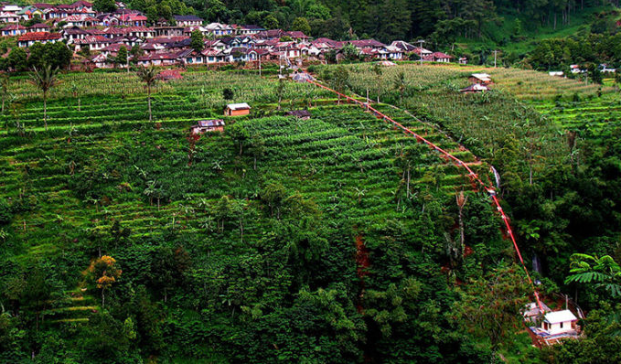
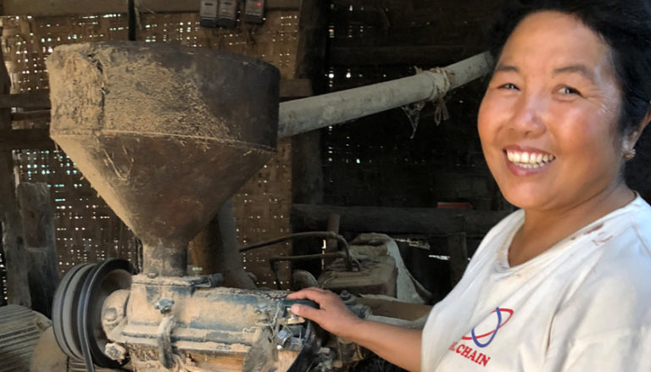
SEEED ACCELERATOR: E-COURSES
FUNDAMENTALS OF COMMUNITY HYDRO
6-WEEKS: FEB 7 - MAR 18
FORMAT: ONLINE
REGISTRATIONS: 200
WOMEN: 15%
TOPICS:
HYDRO ORIENTATION
SOCIAL ENTERPRISE
DEMAND ASSESSMENT
SITE ASSESSMENT
POWER OUTPUT
CLIMATE RESILIENT SOLUTIONS TO COMMUNITY HYDRO
1-WEEK: MAR 21 - 27
FORMAT: ONLINE & FIELD-BASED
REGISTRATION: STARTS SOON
WOMEN: 50% (FIELD-BASED)
TOPICS:
CLIMATE RESILIENCE OF WATER-ENERGY-FORESTS
LOCAL GOVERNANCE
WATERSHED MANAGEMENT
PHASES
AGRI-PROCESSING BENEFITS TO COMMUNITY HYDRO
4-DAYS: MAR 28 - 31
FORMAT: ONLINE & FIELD-BASED
REGISTRATION: STARTS SOON
WOMEN: 50% (FIELD-BASED)
TOPICS:
CLIMATE RESILIENCE OF WATER-ENERGY-FOOD
SOCIAL ASPECTS
FOOD FORESTS
AGRI-PROCESSING

Slide 8
E-LEARNING PLATFORM
Learning Management System (LMS) at https://seeedlearning.org/

Slide 9
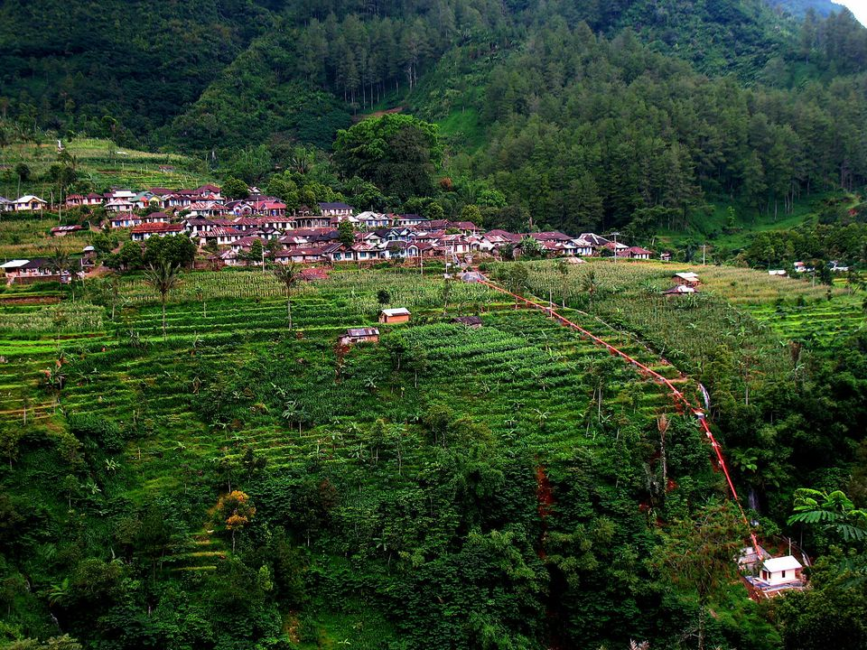
NEXUS OF
WATER
ENERGY
FOOD
LIVELIHOODS
FORESTS
CLIMATE RESILIENCE
Curugmuncar Micro Hydro Village, Pekalongan Regency,Central Java, Indonesia
Credit: Asosiasi Hidro Bandung

Slide 10
WATERSHEDS & CLIMATE RESILIENCE
What is the role of watersheds in the forests-water-energy-food-livelihoods nexus?
HYDRO MINI-GRIDS
CLIMATE RESILIENT
RURAL COMMUNITIES
WATER
LIVELIHOODS
FORESTS
ENERGY
FOOD
ROLE OF CLIMATE RESILIENT WATERSHEDS OF HYDRO MINI-GRIDS
WATER-ENERGY-FOOD NEXUS

Slide 11
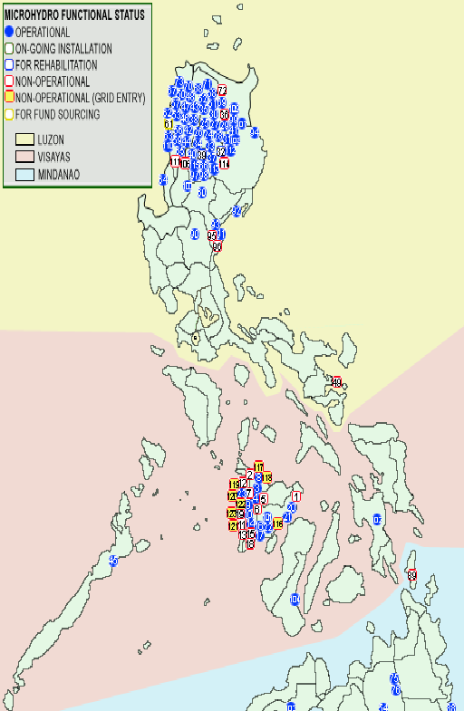
And there are about 125 small MHP systems built by the NGOs, as well as by the DOE’s ARECs. All of these Microhydros are distributed in the following places in the country.

Slide 12
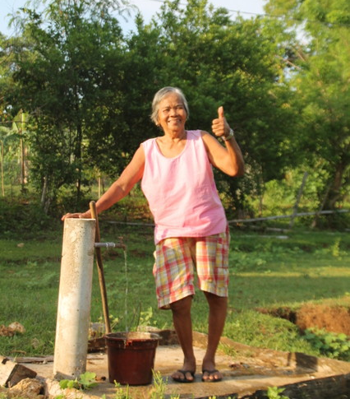
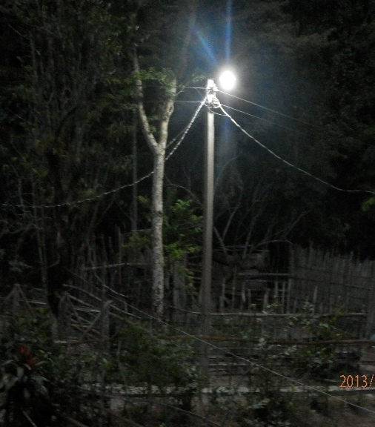
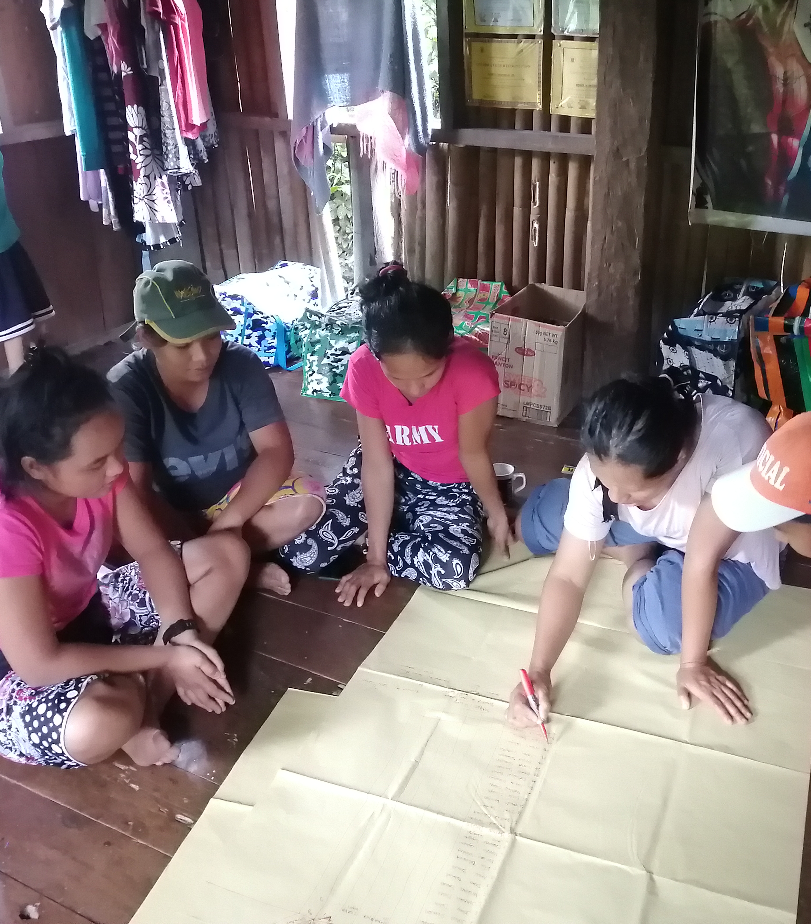
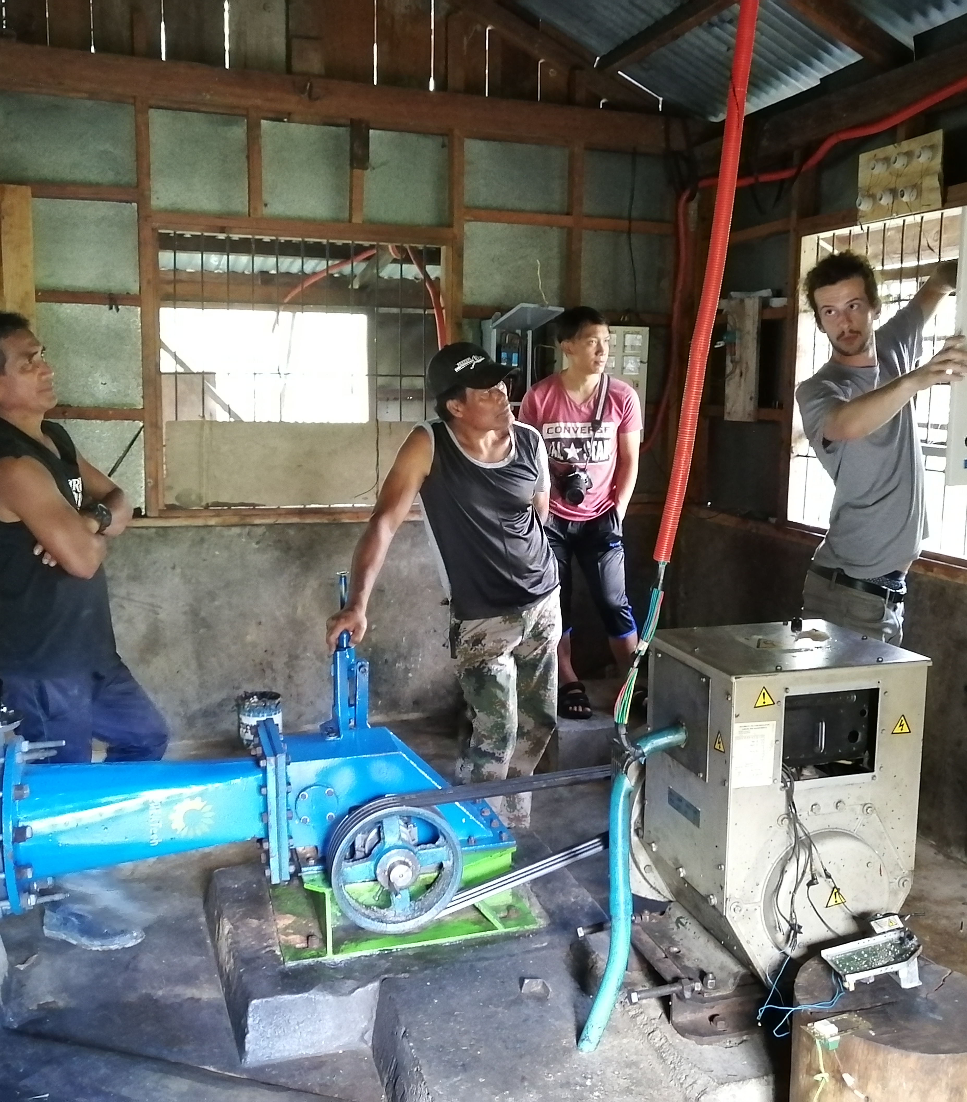
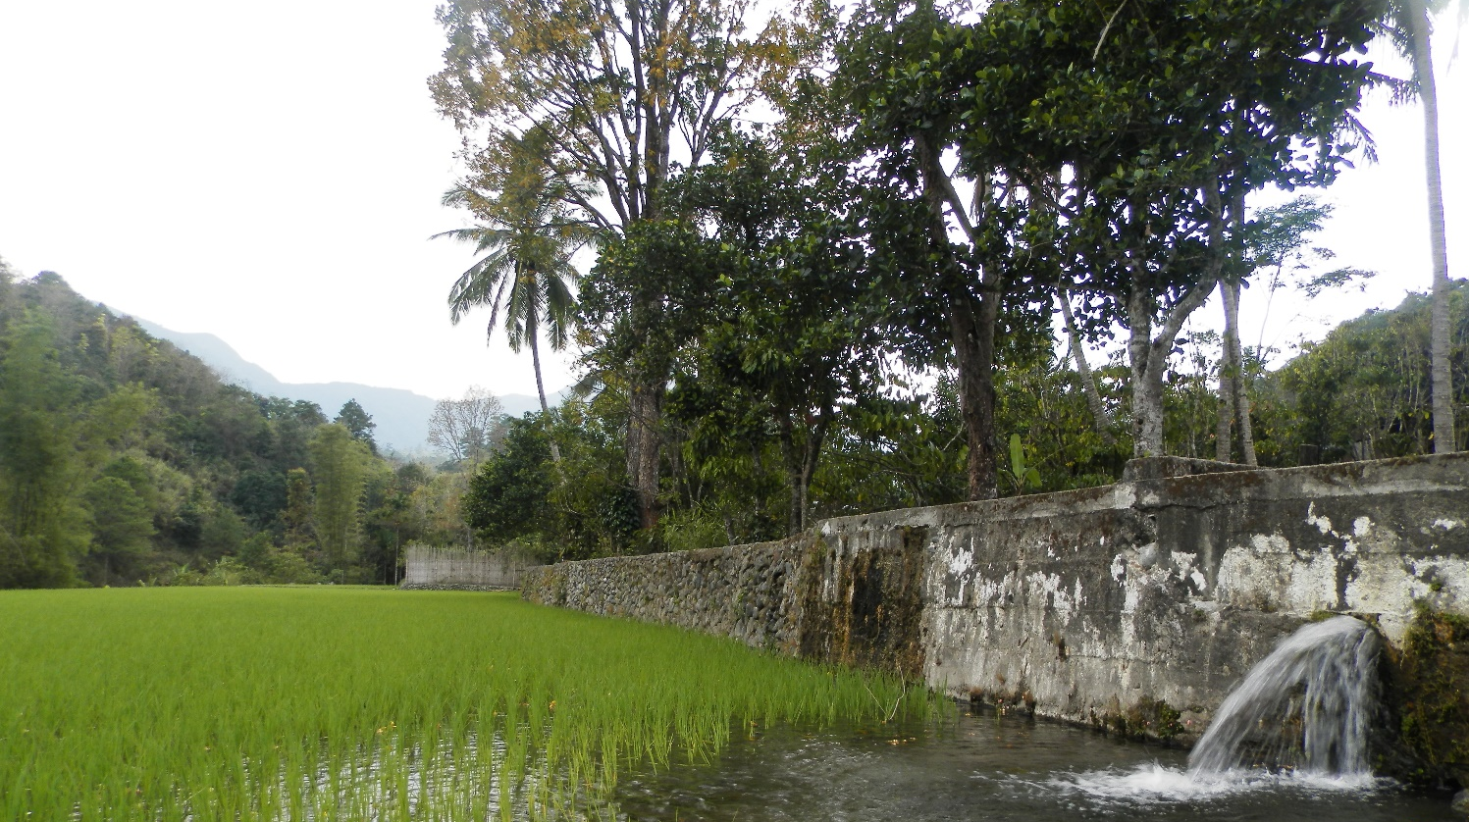
CBRES provides need-based energy, and in the rural context of the country, these are household and community lighting, community services, livelihood, and non-power needs.

Slide 13
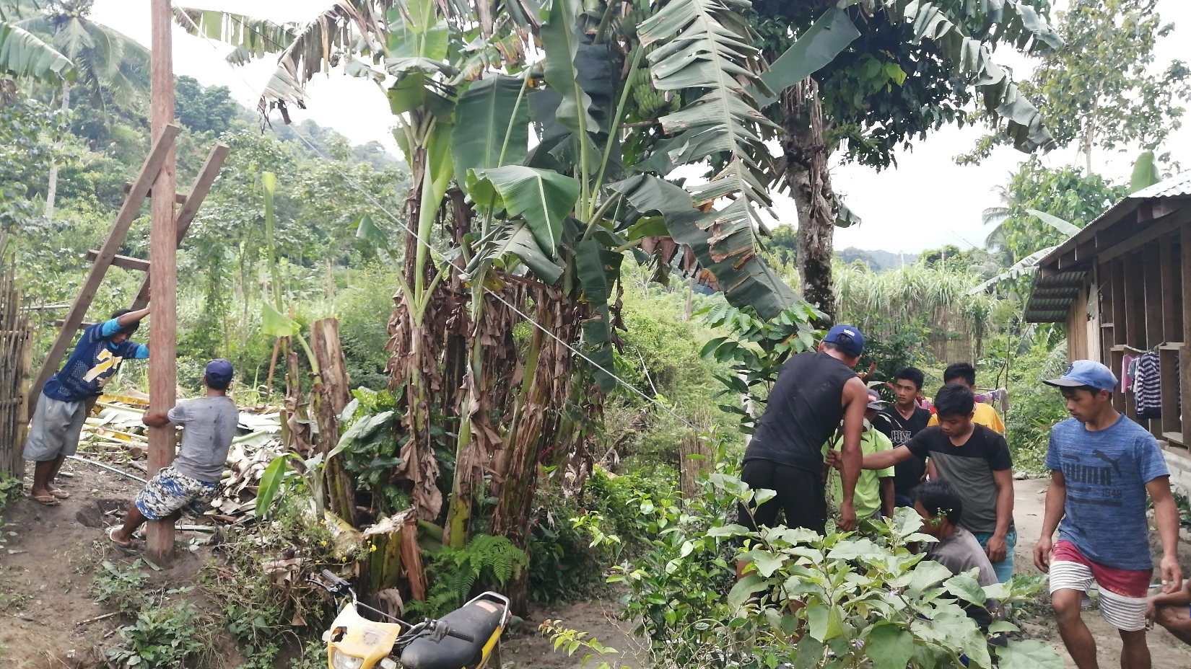
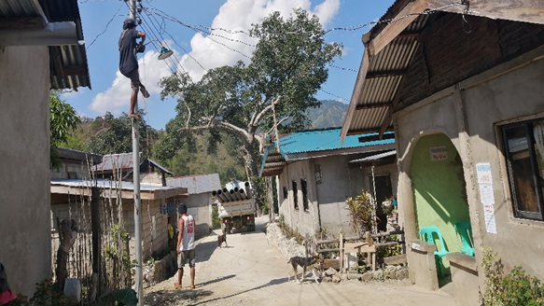
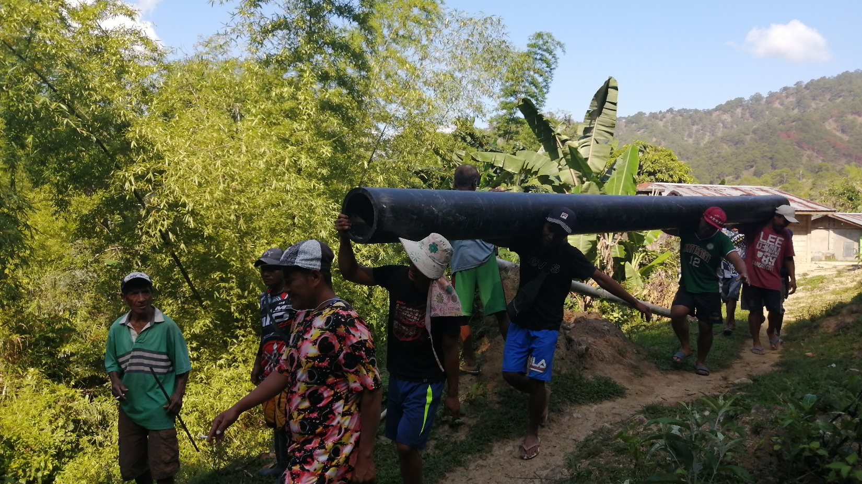
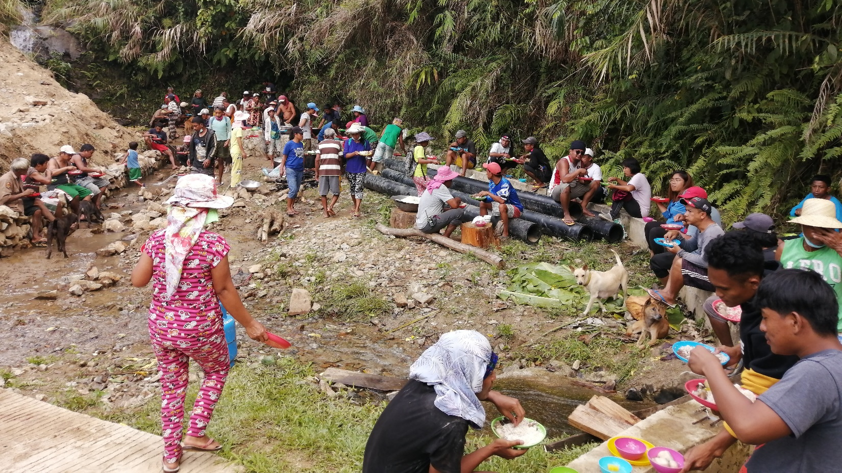
Collectively built by the community

Slide 14
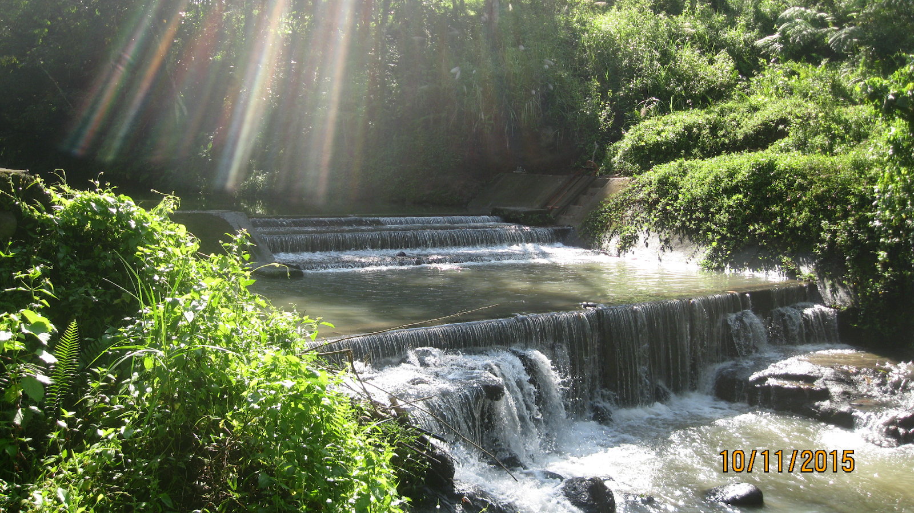
What is the role of indigenous knowledge and governance traditions? in Cordillera Administrative Region, Philippines
Hydro mini-grid site in Visayas Region of the Philippines.
Credit: J. Angngalao
Climate Resilient Solutions
to Hydro Mini-Grids
Notes:
Within the context of restoring watersheds and hydro mini-grid catchment areas, much can be learned from Indigenous knowledge.

Slide 15
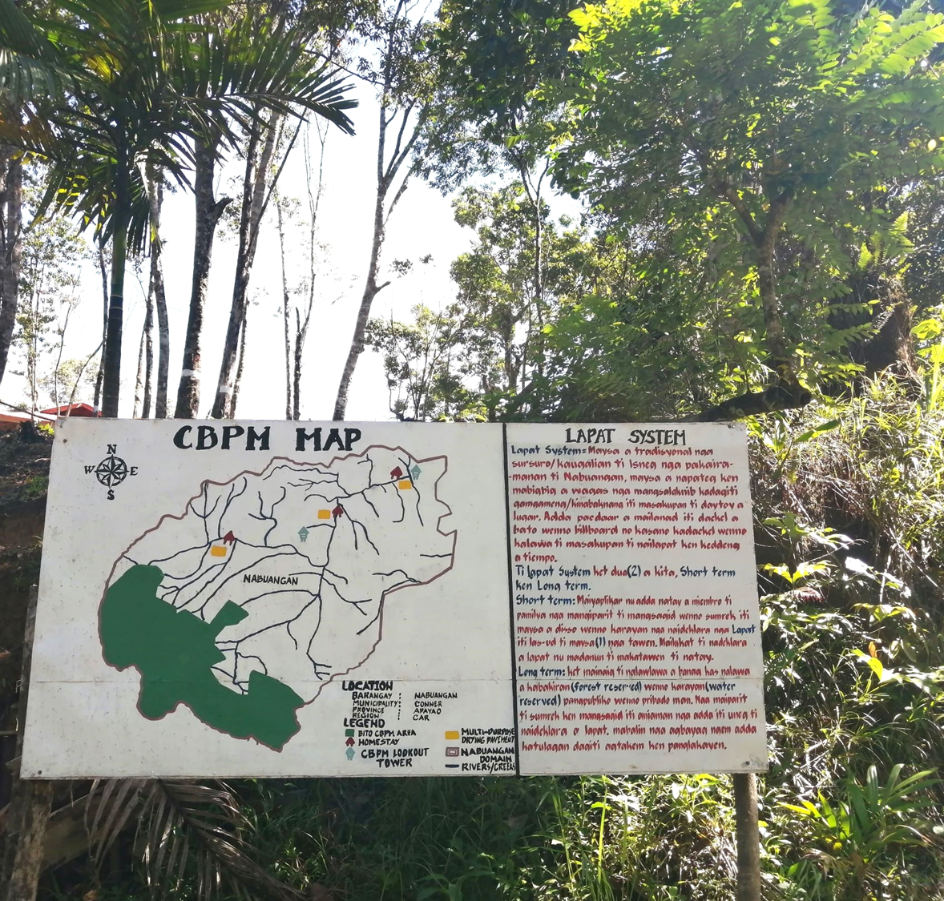
CBRES Watershed Protection
The indigenous community have a strong policy in protecting natural resources. They called it Lapat system; this is a customary law within the ICCA (Indigenous Community Conservation Area) set up by ancestors regarding the preservation of natural resources.
Lapat system contributed to the sustainability of the CBRES.
View deck in Nappugawan, Apayao Province, Philippines.
Credit: J. Angngalao

Slide 16
Lapat Sanctions
View deck in Nappugawan, Apayao Province
Credit:_’. J.Angngalao
Barangay Gawaan, Kalinga,Province, Philippines
Credit: J. Angngalao
Any violation of these prescribed customary laws has appropriate penalties or punishments prescribed by the council of elders & leaders.

Slide 17
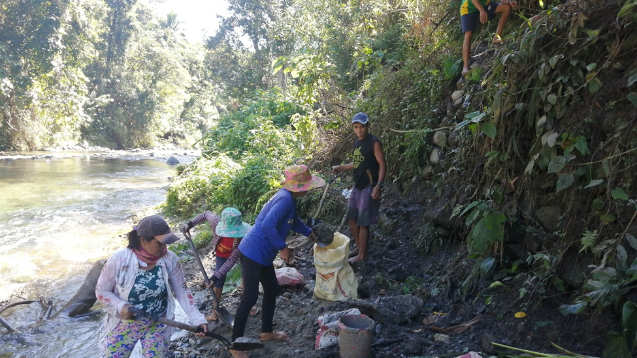
Construction of hydro mini-grid power canal in Apayao Province, Philippines
Credit: J. Angngalao
Women-centric Approach to Hydro Mini-Grid Development
Enable rural women to
Provide more than just labor
Govern implementation & management
Become financial shareholders

Slide 18
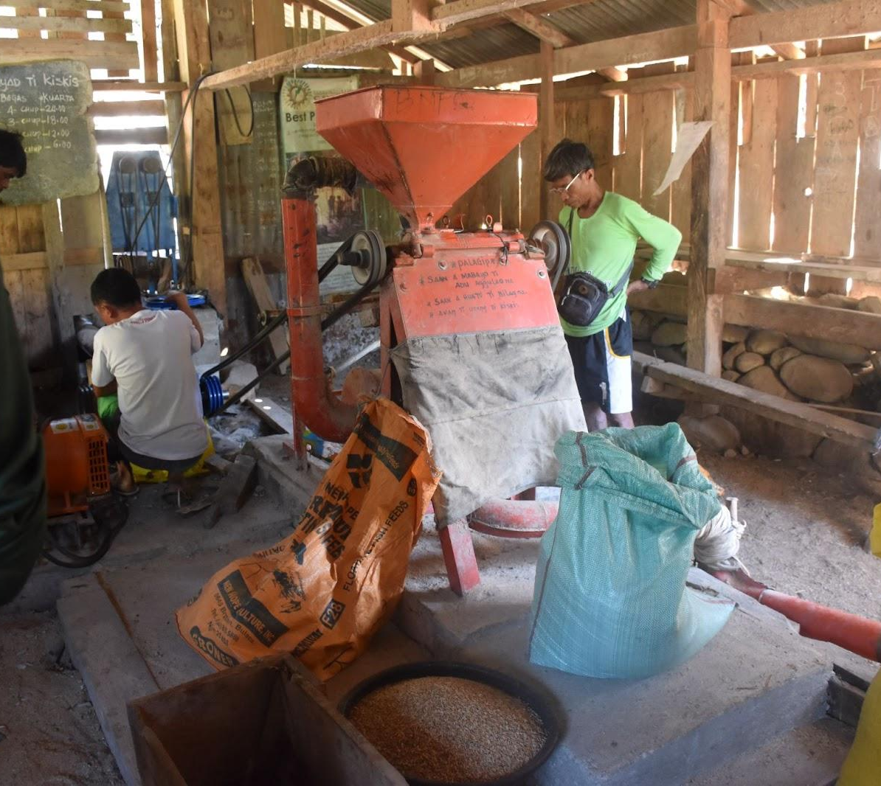
Economic Benefits of Hydro Mini-grids for Women
Alleviation of post harvest workload
Increased farm production
Poverty alleviation
Mechanically driven rice milling machine in Buneg, Apayao, Province
Credit: J. Angngalao

Slide 19
The integration of gender mainstreaming in the CBRES processes strengthen the CBRES concept and delivered more fruitful outcomes and benefits for the community, especially for the women.

Slide 20
For more information, visit us at:
www.hpnet.org

