Slide 1
Plenary 1: Resilience & Rebuilding
MSME Day 2022
R. Bredel, Director & Representative
UNIDO Liaison Office
27 June 2022

Slide 2
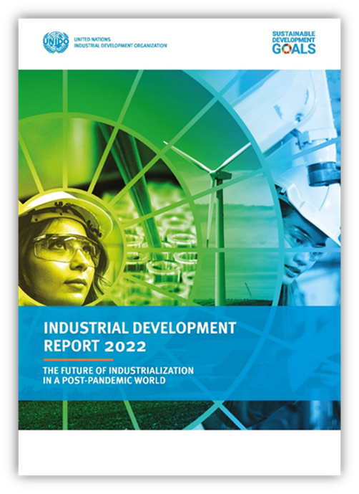
Survey of 4,000 firms around the world
Data collected from policymakers in 44 developing economies

Slide 3
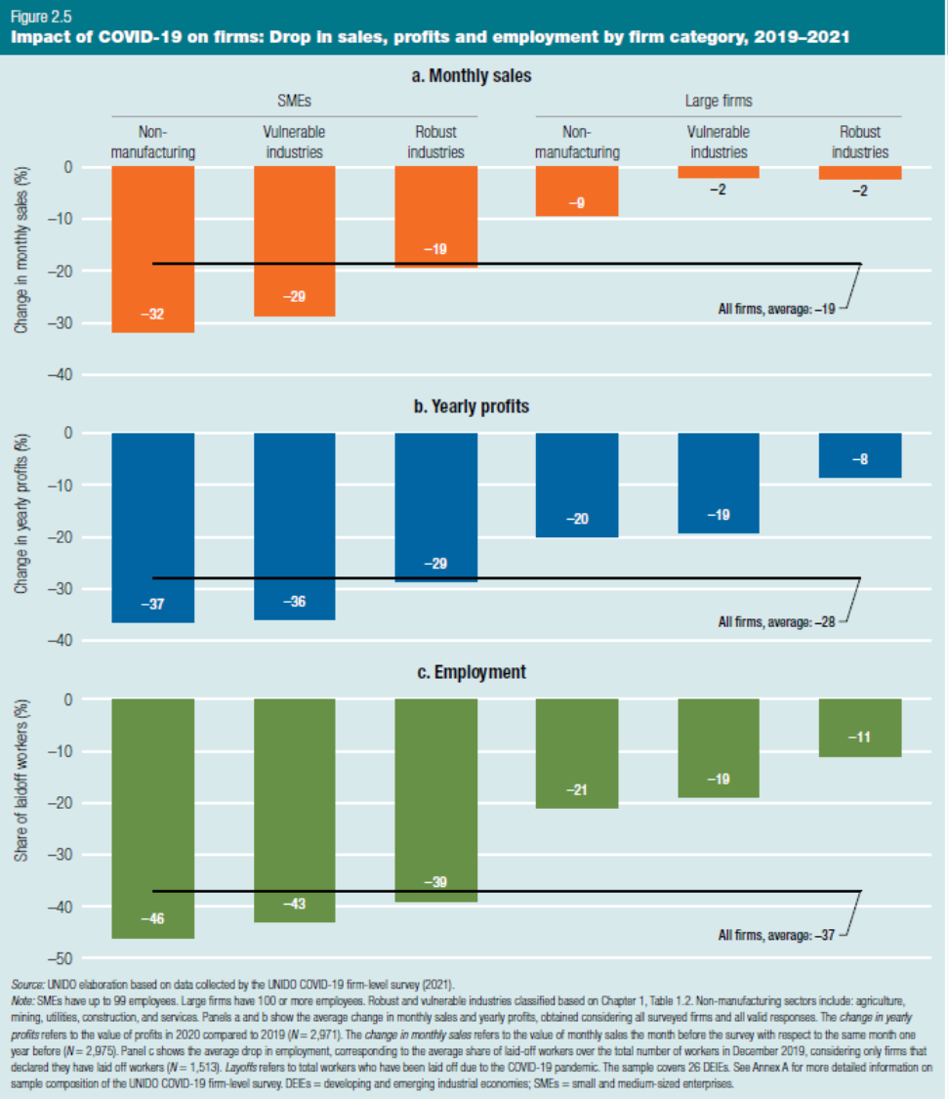
How SMEs have been affected by COVID-19
Non-manufacturing SMEs hit worse than manufacturing SMEs

Slide 4
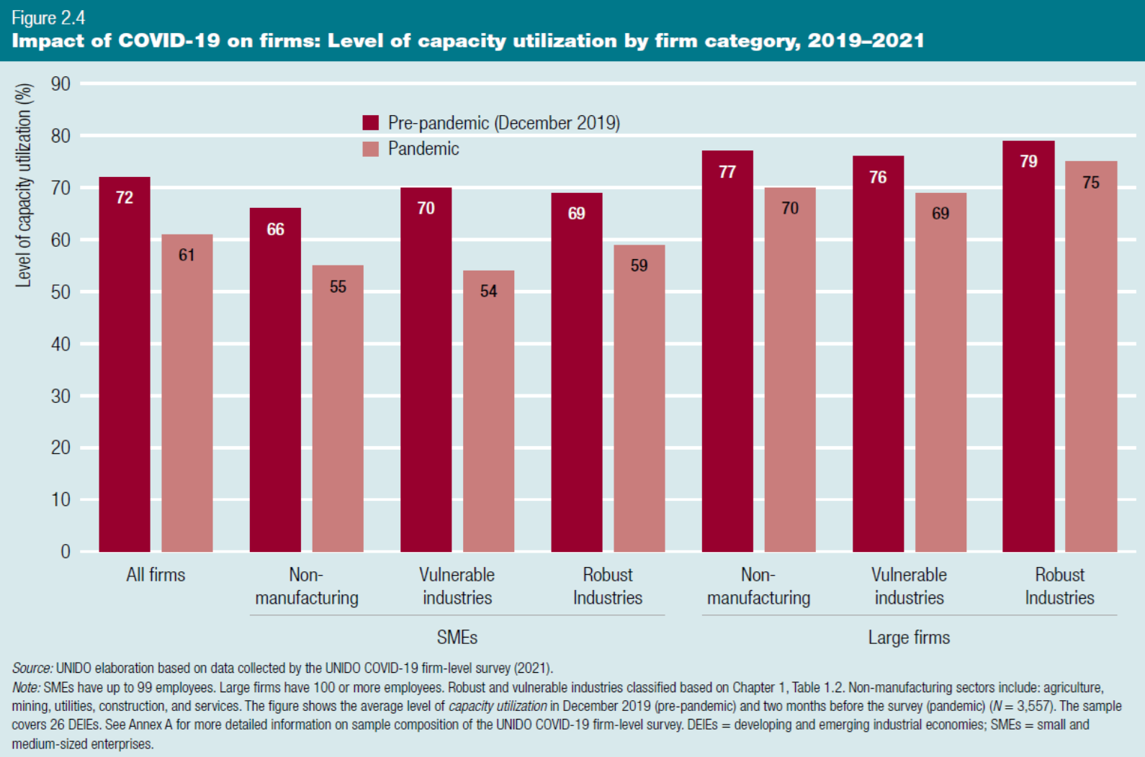

Slide 6
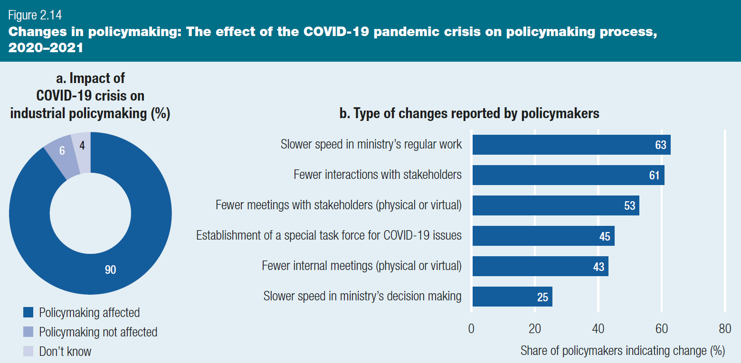
How government policymaking has been affected by COVID-19
90% indicated that policymaking changed since the start of the pandemic
Slower speed and fewer interactions were the main changes reported

Slide 7
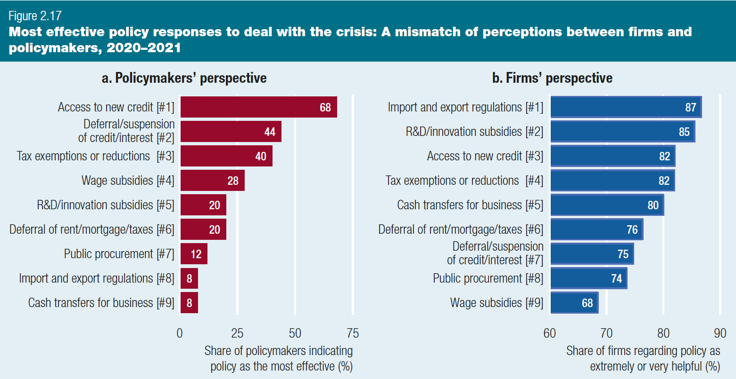
Different perceptions on the effectiveness of policies implemented during the pandemic
Policymakers expected short-term relief measures to be the most effective
But firms indicated long-term measures (trade regulations and R&D subsidies) as the most helpful

Slide 8
Different levels of policy support
…A number of policy tools at each level
…Application depends on circumstances of countries
…But three common mega-trends accelerated by the pandemic which all countries need to face…

Slide 9
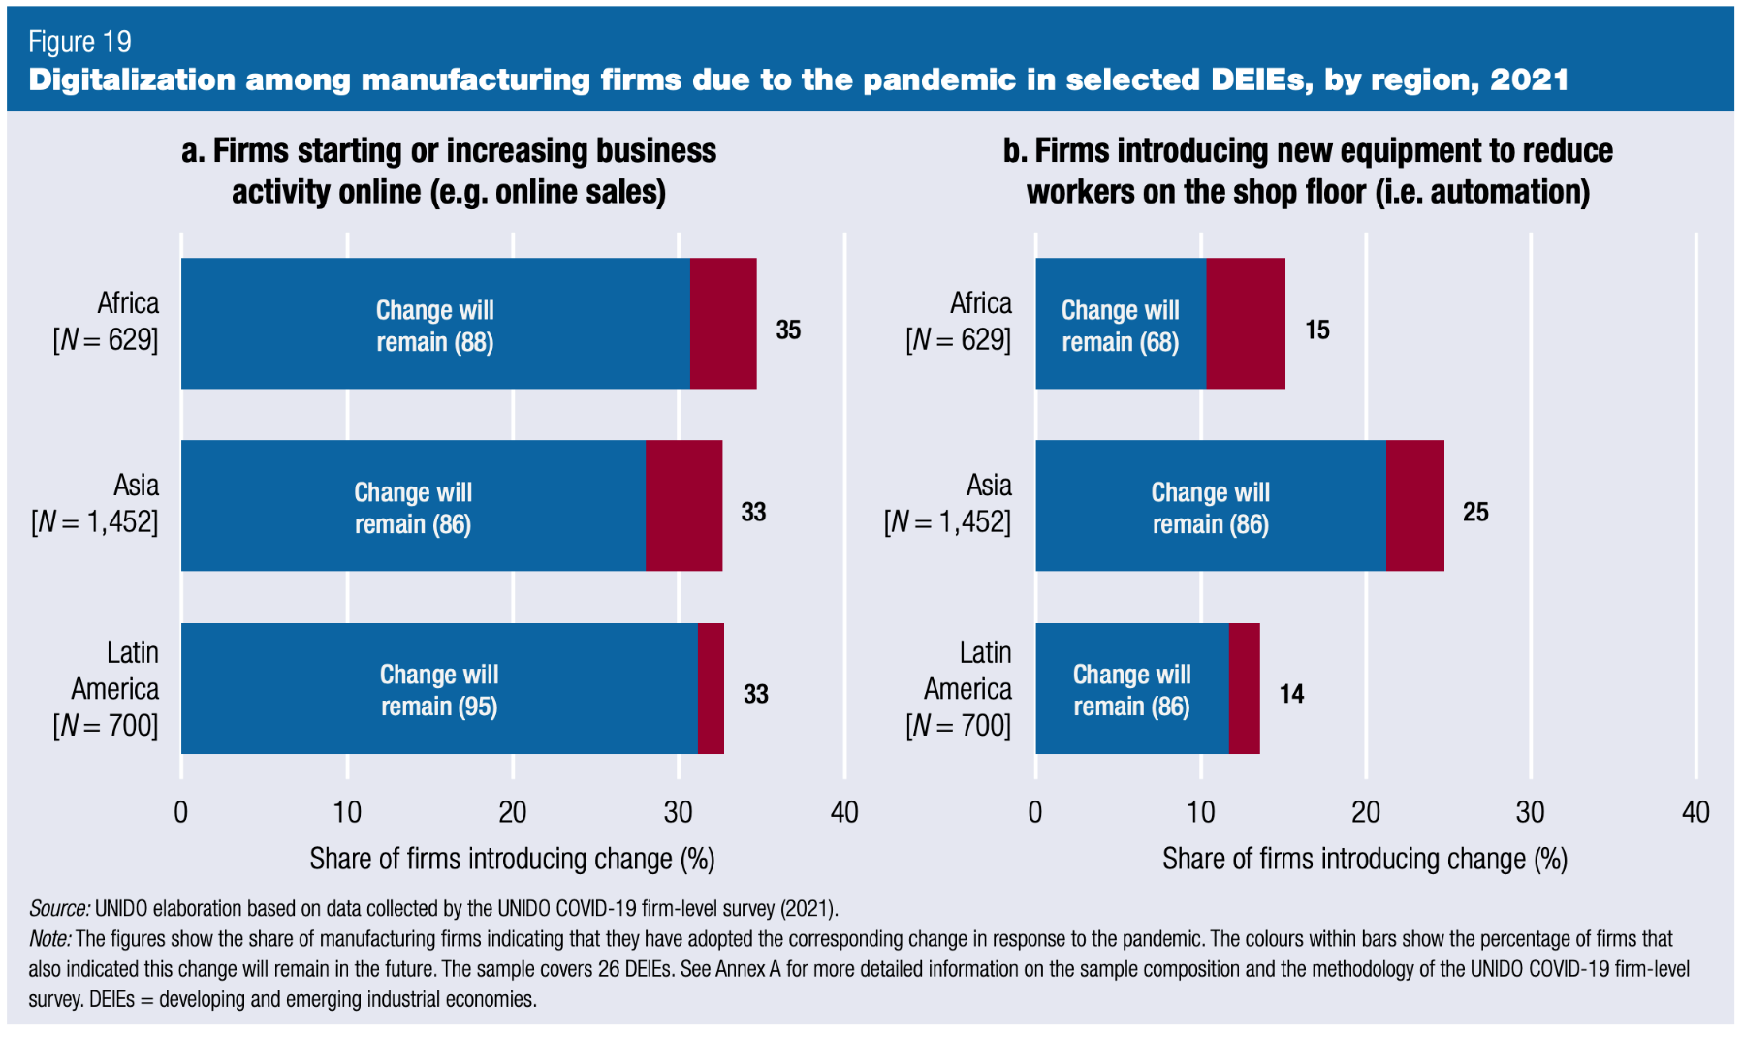
(1) Accelerated digitalization and automation of production
Due to the pandemic (automation, online sales) increased
Need to address growing digital divide related to enterprise size and gender, and facilitate uptake of advanced digital production technologies by SMEs in developing countries
SME policies: government-led investments in enterprise-level digital skills and access to digital infrastructure

Slide 10
(2) Changes in the organization of global production
COVID 19 has not only affected the geography of global production (shift towards Asia), but how it is organized through Global Value Chains:
Risk of shortening of value chains/reshoring could exclude SMEs from participation
Some signs that TNCs are opting for supplier diversification rather than reshoring
Policies: Enable SMEs to meet quality and standard for participation in GVCs

Slide 11
(3) Greening is likely to shape the future of industrialization
Signs that green stimulus packages have incentivized firms to increasingly adopt green practices
Awareness of economic benefits of resource efficiency growing
Private sustainability standards in GVCs growing
In the long run this will define competitive advantage of firms, including SMEs.
SME policies: Low-interest loans and grants to facilitate commercialization of new and adoption of existing green technologies (renewable energy, energy efficiency), etc.

Slide 12
Formality an important element of policy support to SMEs
During COVID-19 some countries attracted SMEs to temporarily self-identify in exchange for liquidity support
Given the costs of formality (registration, taxes and labour regulations) many SMEs likely to opt for informality after the crisis
To attract SMEs to transition to formality, government policies need to combine:
        Simplification of business registration systems (e.g. through digitalization and one-stop-shops)
        With direct access to additional business services and policies to increase productivity and competitiveness of newly registered SMEs (e.g. entrepreneurship and skills training)
Notes:
Distinguish between short-term and long-term effects of a disaster. Emergency interventions should accompany other solutions that address more structural challenges and that contribute to enhancing industry’s resilience against future disasters. Building back better is an opportunity to trigger behavioural changes while also minimizing the environmental impacts of production.
Include multi-stakeholder approaches to policymaking, with greater levels of dialogue and cooperation from all parties. Private sector involvement in short-term recovery, and in fostering long-term industrial development and resilience, should be part of any recovery and long-term development strategy. Nurture public sector capabilities, leverage the business sector as a key contributor to industrial development and resilience, and in its ability to create social value including at the time of global disasters.
Address the risks and opportunities opened by mega-trends expected to shape industrialization in the future.
Target systemic, structural change by enhancing local manufacturing capacities and other industrial commons, including research and development (R&D), manufacturing infrastructure and expertise.
Contribute to strengthened multilateralism and international coordination around industrial policy issues, resilience and global disaster risk management. Due to the transnational nature of disaster risk, the multidimensional nature of resilience and the multistakeholder approaches to disaster risk management, the best strategy is to pool resources across jurisdictions. Improved collaboration would reaffirm commitments made around the Decade of Action to Deliver the SDGs.

Slide 13
Principles for post-pandemic policies, incl. for SMEs
Non-manufacturing SMEs hit worse. Importance of industrial capabilities (technological capabilities of manufacturing SMEs) for long-term resilience
Prioritize local manufacturing capacities for production of essential health products.
Policies need to support converting the risks inherent in the three mega trends into opportunities for SMEs, without forgetting the most vulnerable (informal women-led SMEs)
Align government and firm perceptions on the importance of different short-term (liquidity support) and long-term measures (structural support) at different levels
Focus on multi-stakeholder approaches to national and sub-national policy-making (business sector, etc.) for joint policy “experimentation”
Strengthen international policy coordination and joint learning

Slide 14


UNIDO support tools
Digitalization of SMEs
GVC integration of SMEs
through standards compliance
Green Start-ups
and SMEs
SME COVID-19 recovery

Slide 15
Thank you

