Slide 1
From Energy Justice to Youth inclusion in sustainable water-energy initiatives
Joyce Najm Mendez. Latin American and Caribbean Regional Focal Point of the SDG7 Youth Constituency

Slide 2
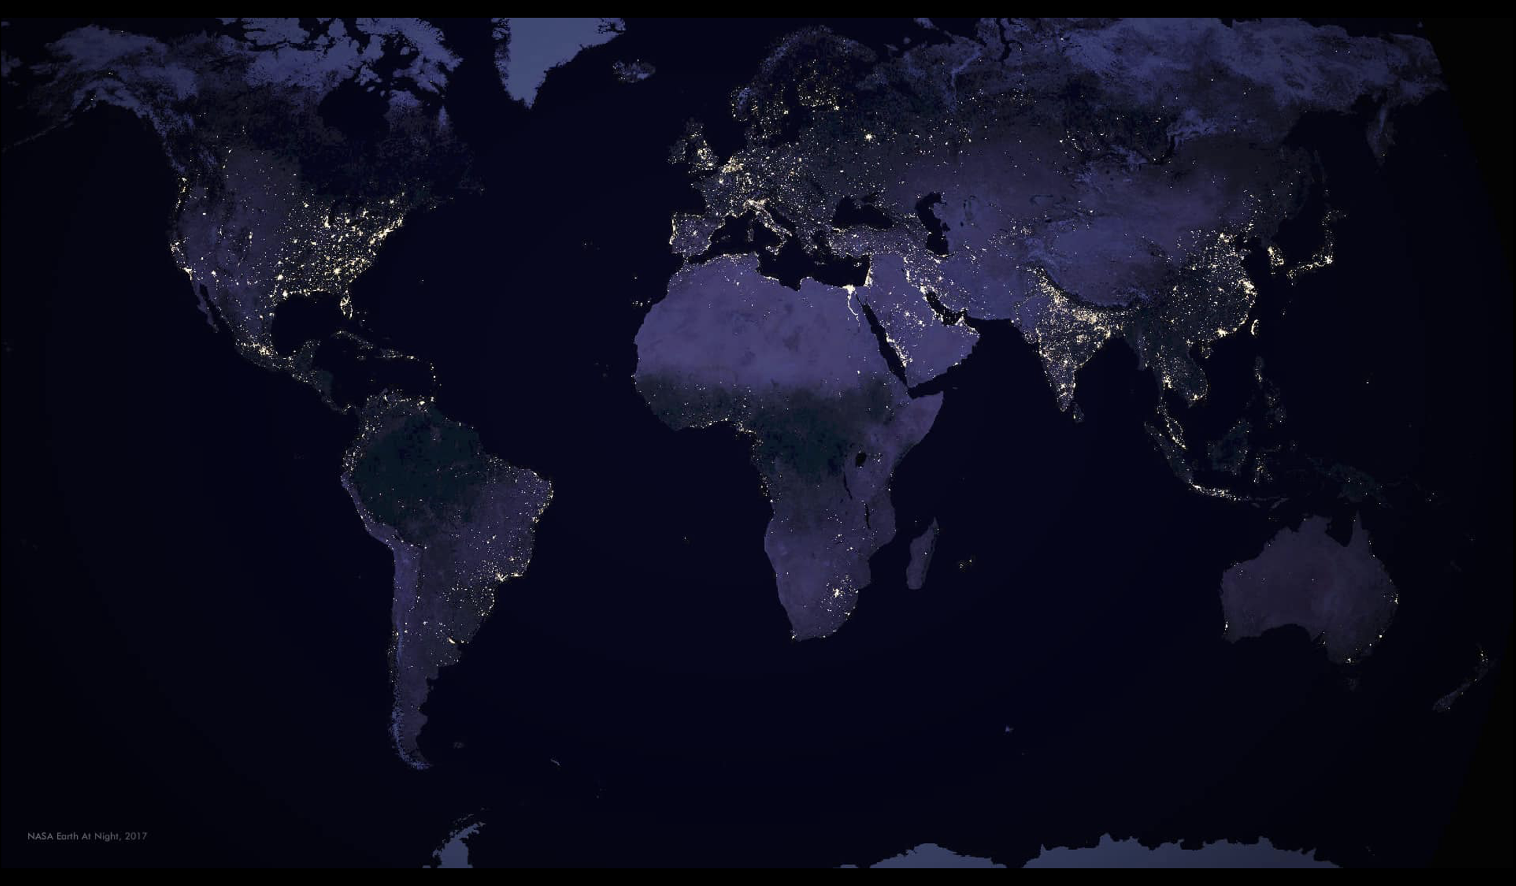

Slide 3
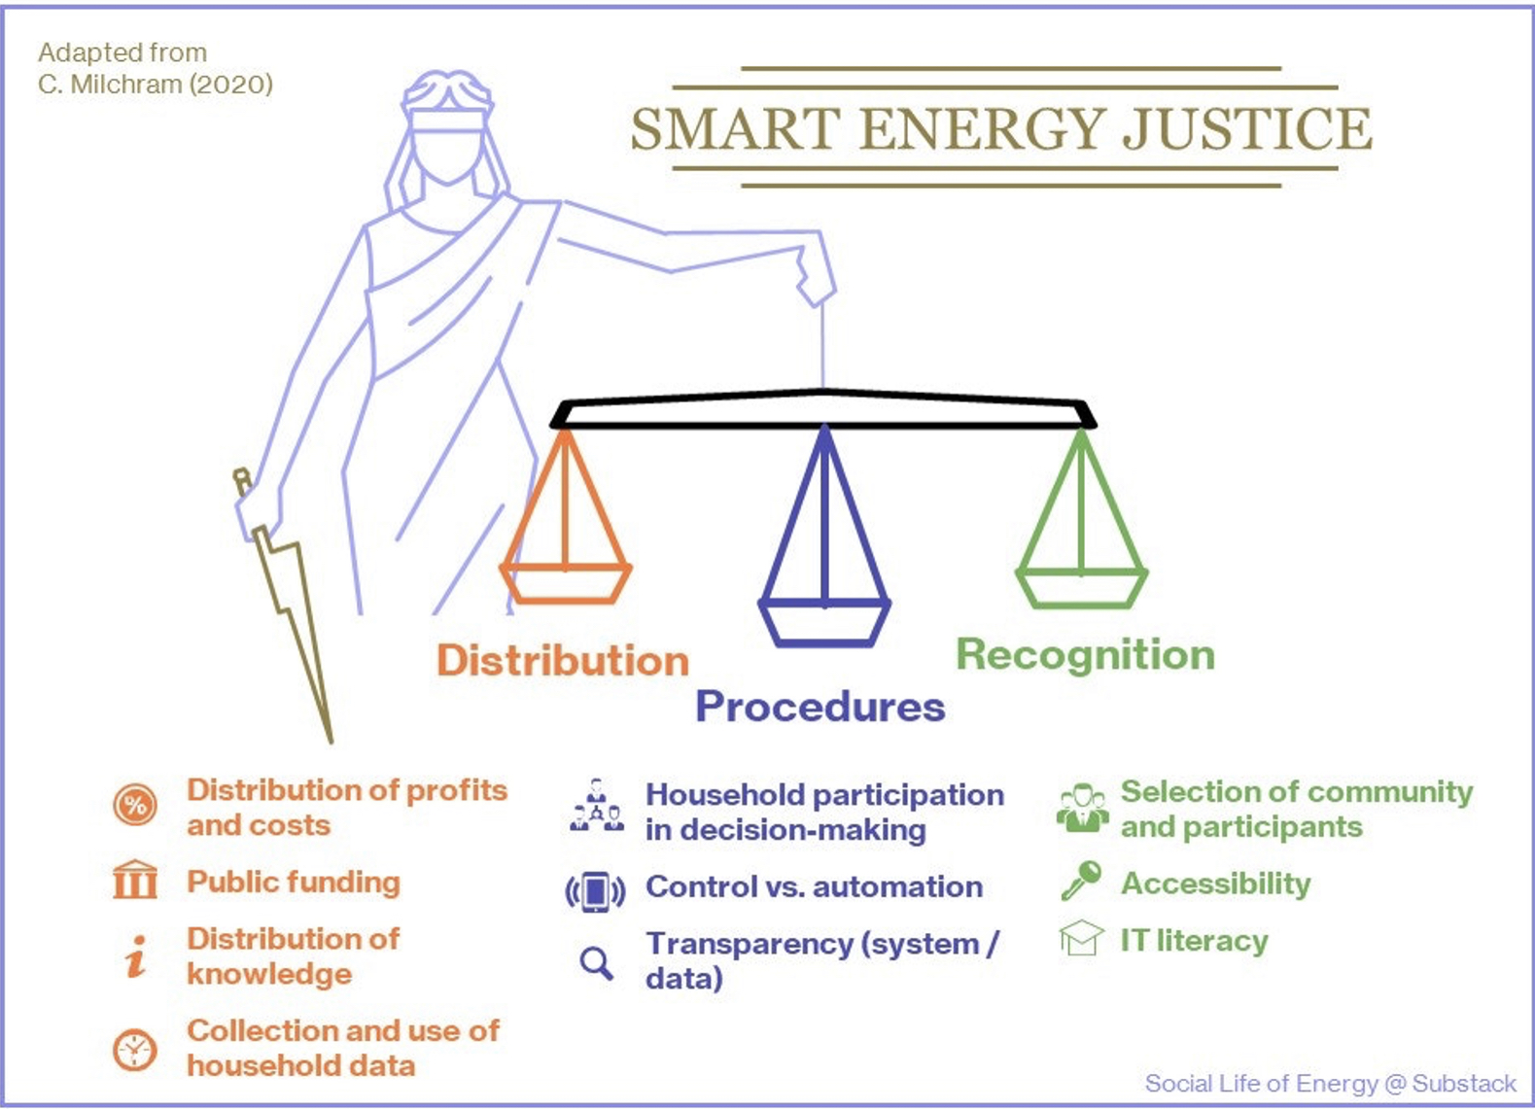
Energy Justice

Slide 4
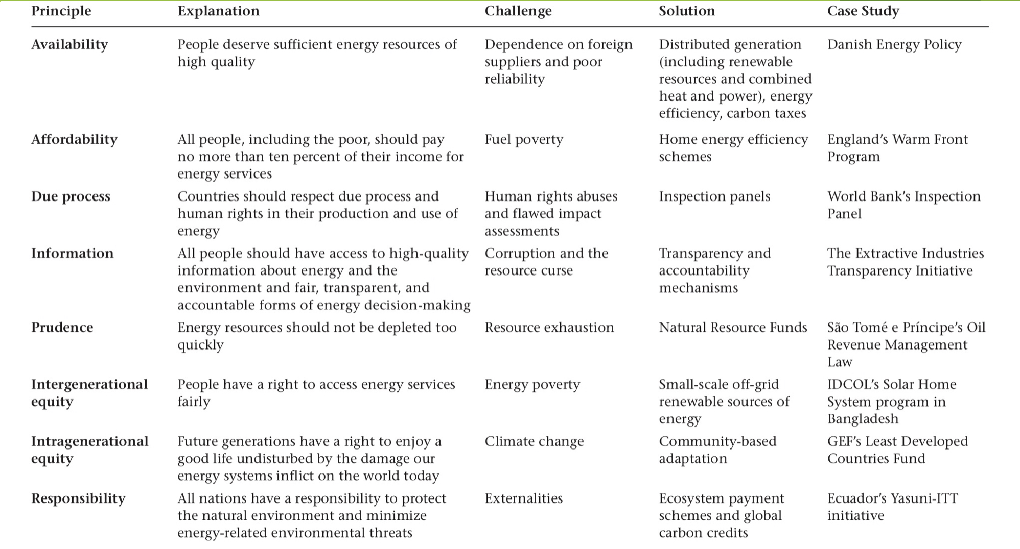
Energy Justice

Slide 7
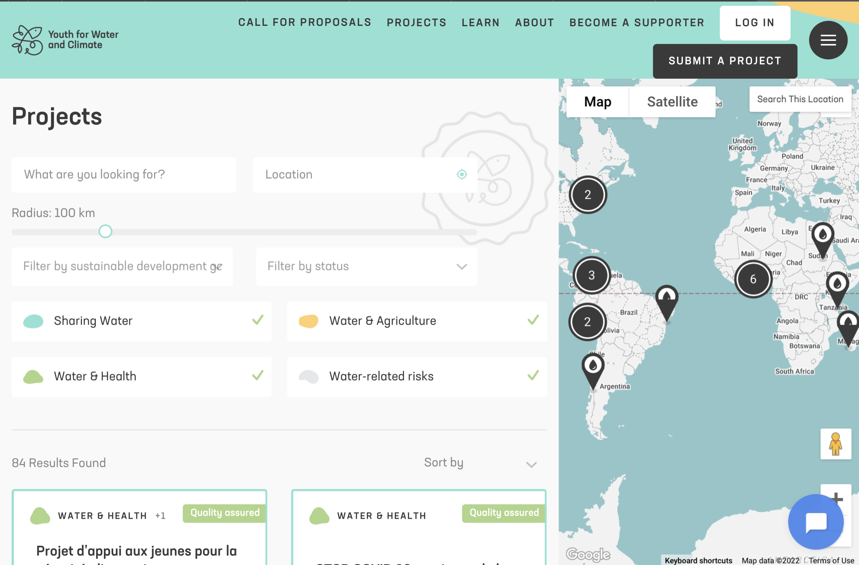

Slide 9
SDG7 Youth Constituency
Overview and Introduction to the UN Major Group for Children andYouth (UN MGCY)

Slide 10
www.sdg7youth

Slide 11
www.sdg7youth

Slide 12
Youth Sustainable Energy Hub
SDG7 Youth Constituency 2022

Slide 14
2022 Application Pool Breakdown
www.sdg7youth

Slide 15
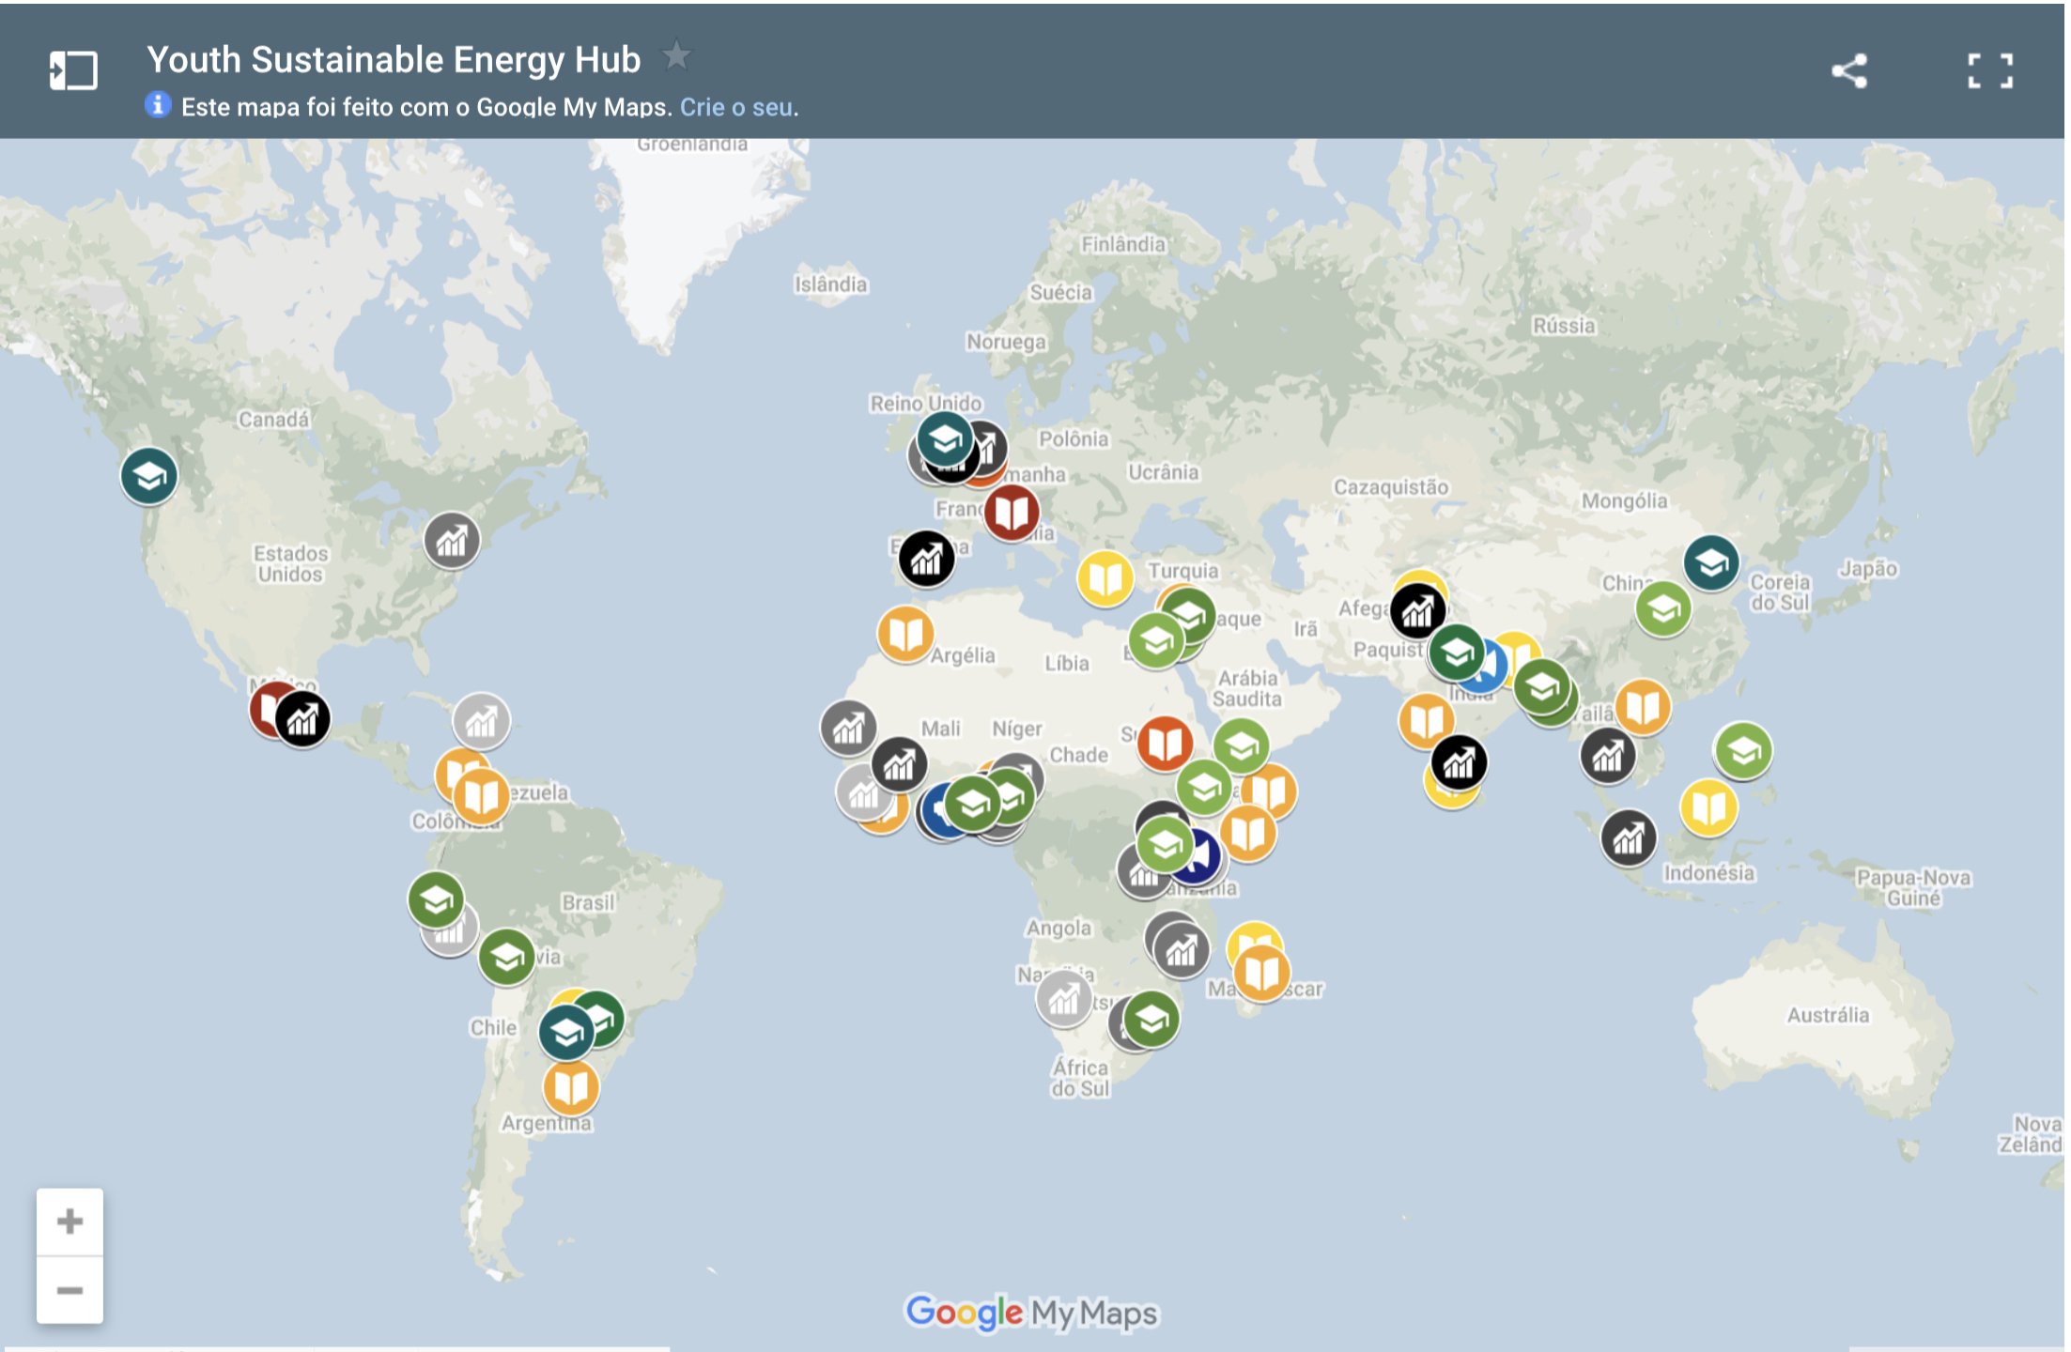
youthsehub.org

Slide 16
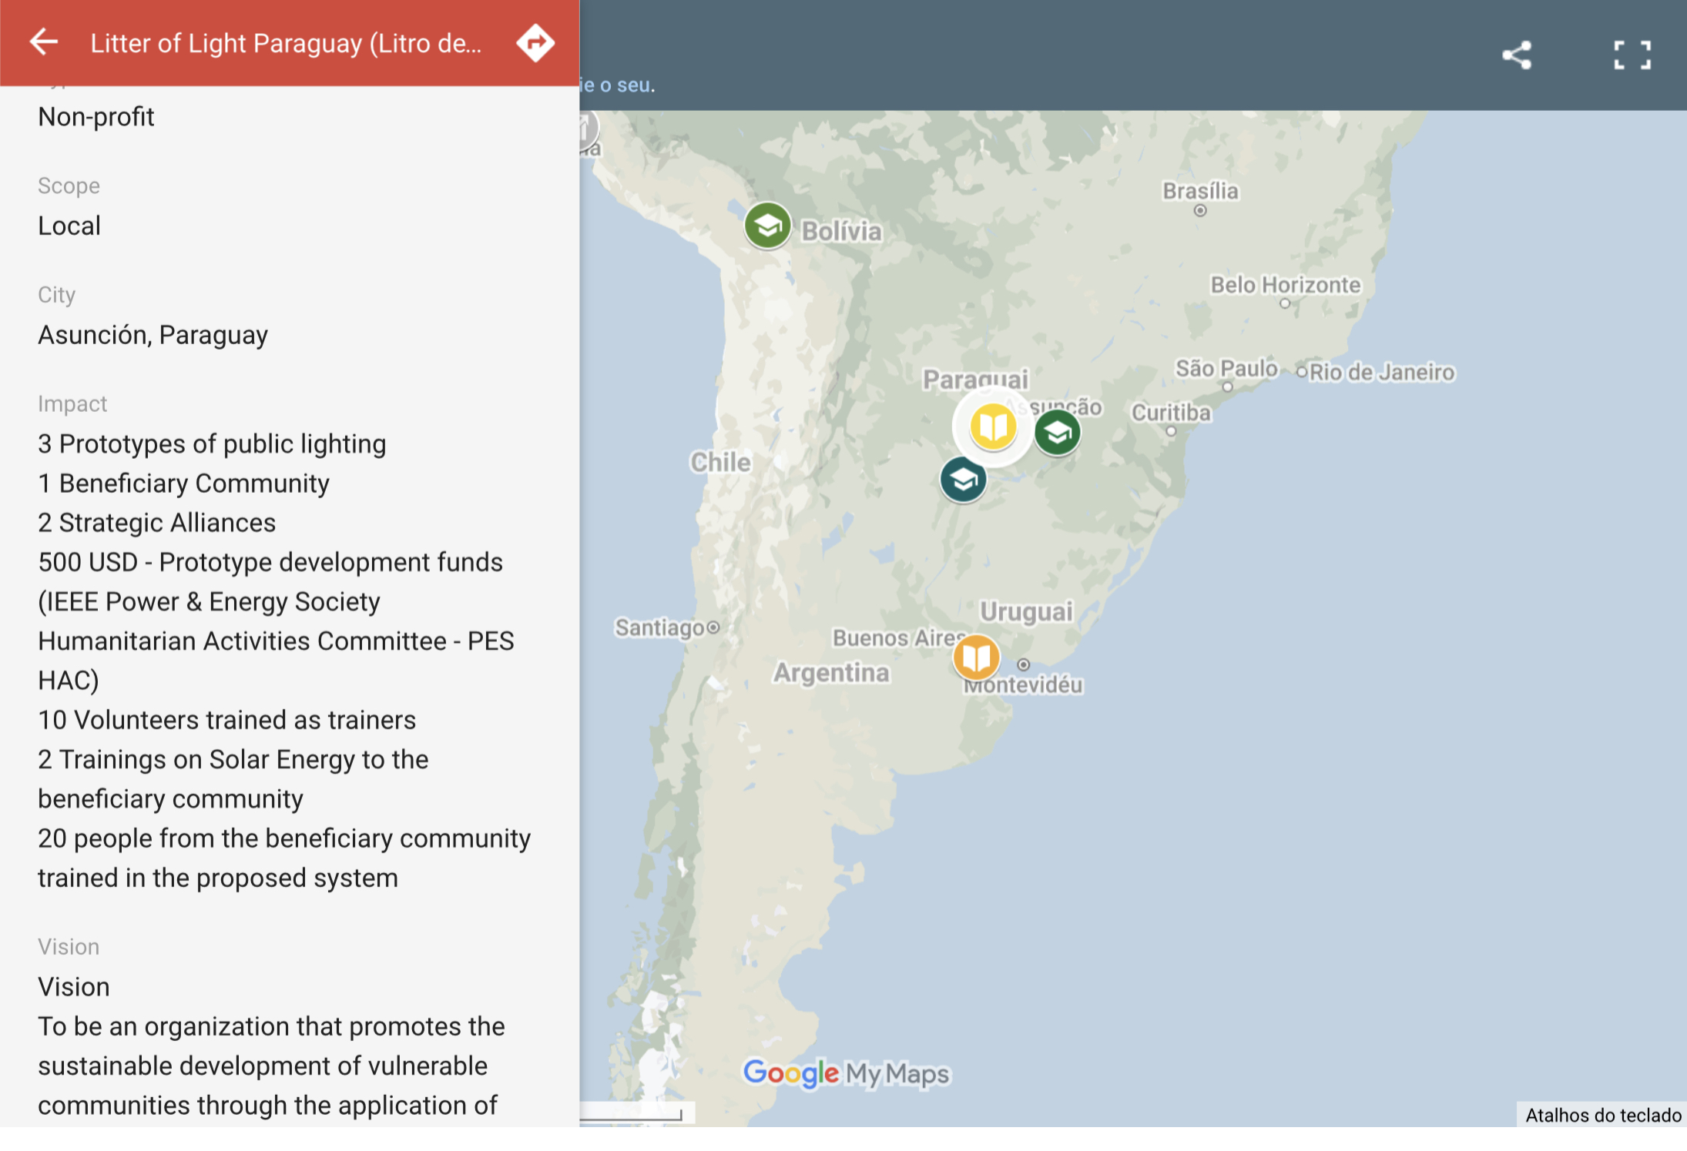
Youth Sustainable Energy Hub (YSEH)

Slide 17
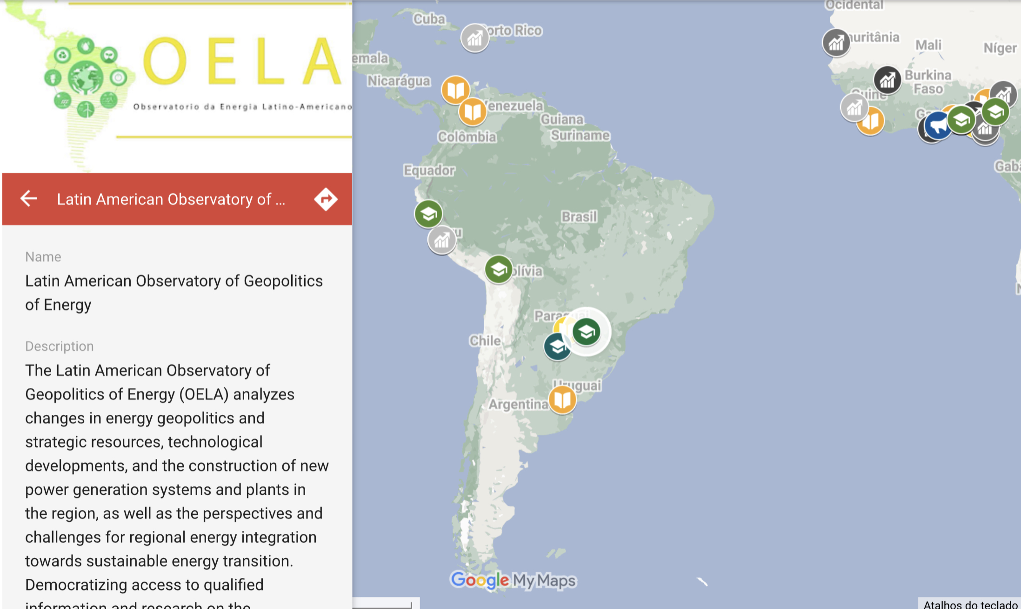
Youth Sustainable Energy Hub (YSEH)

Slide 18
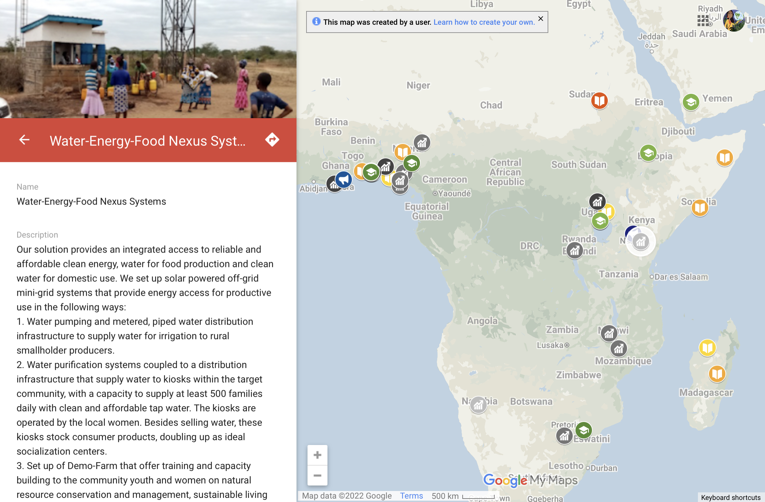
Youth Sustainable Energy Hub (YSEH)

Slide 19
Topics
This year, our team will work to focus on building the students’ skills to allow them to independently manage a sustainable financial system:
Fundraising Techniques
Pitch Development
Grant/Proposal Writing
Digital Marketing and Branding
Business Modeling
Intergovernmental Support
Legal Agreements
Project Risk Assessment
YSEH Workshop Topics
www.sdg7youth

Slide 20
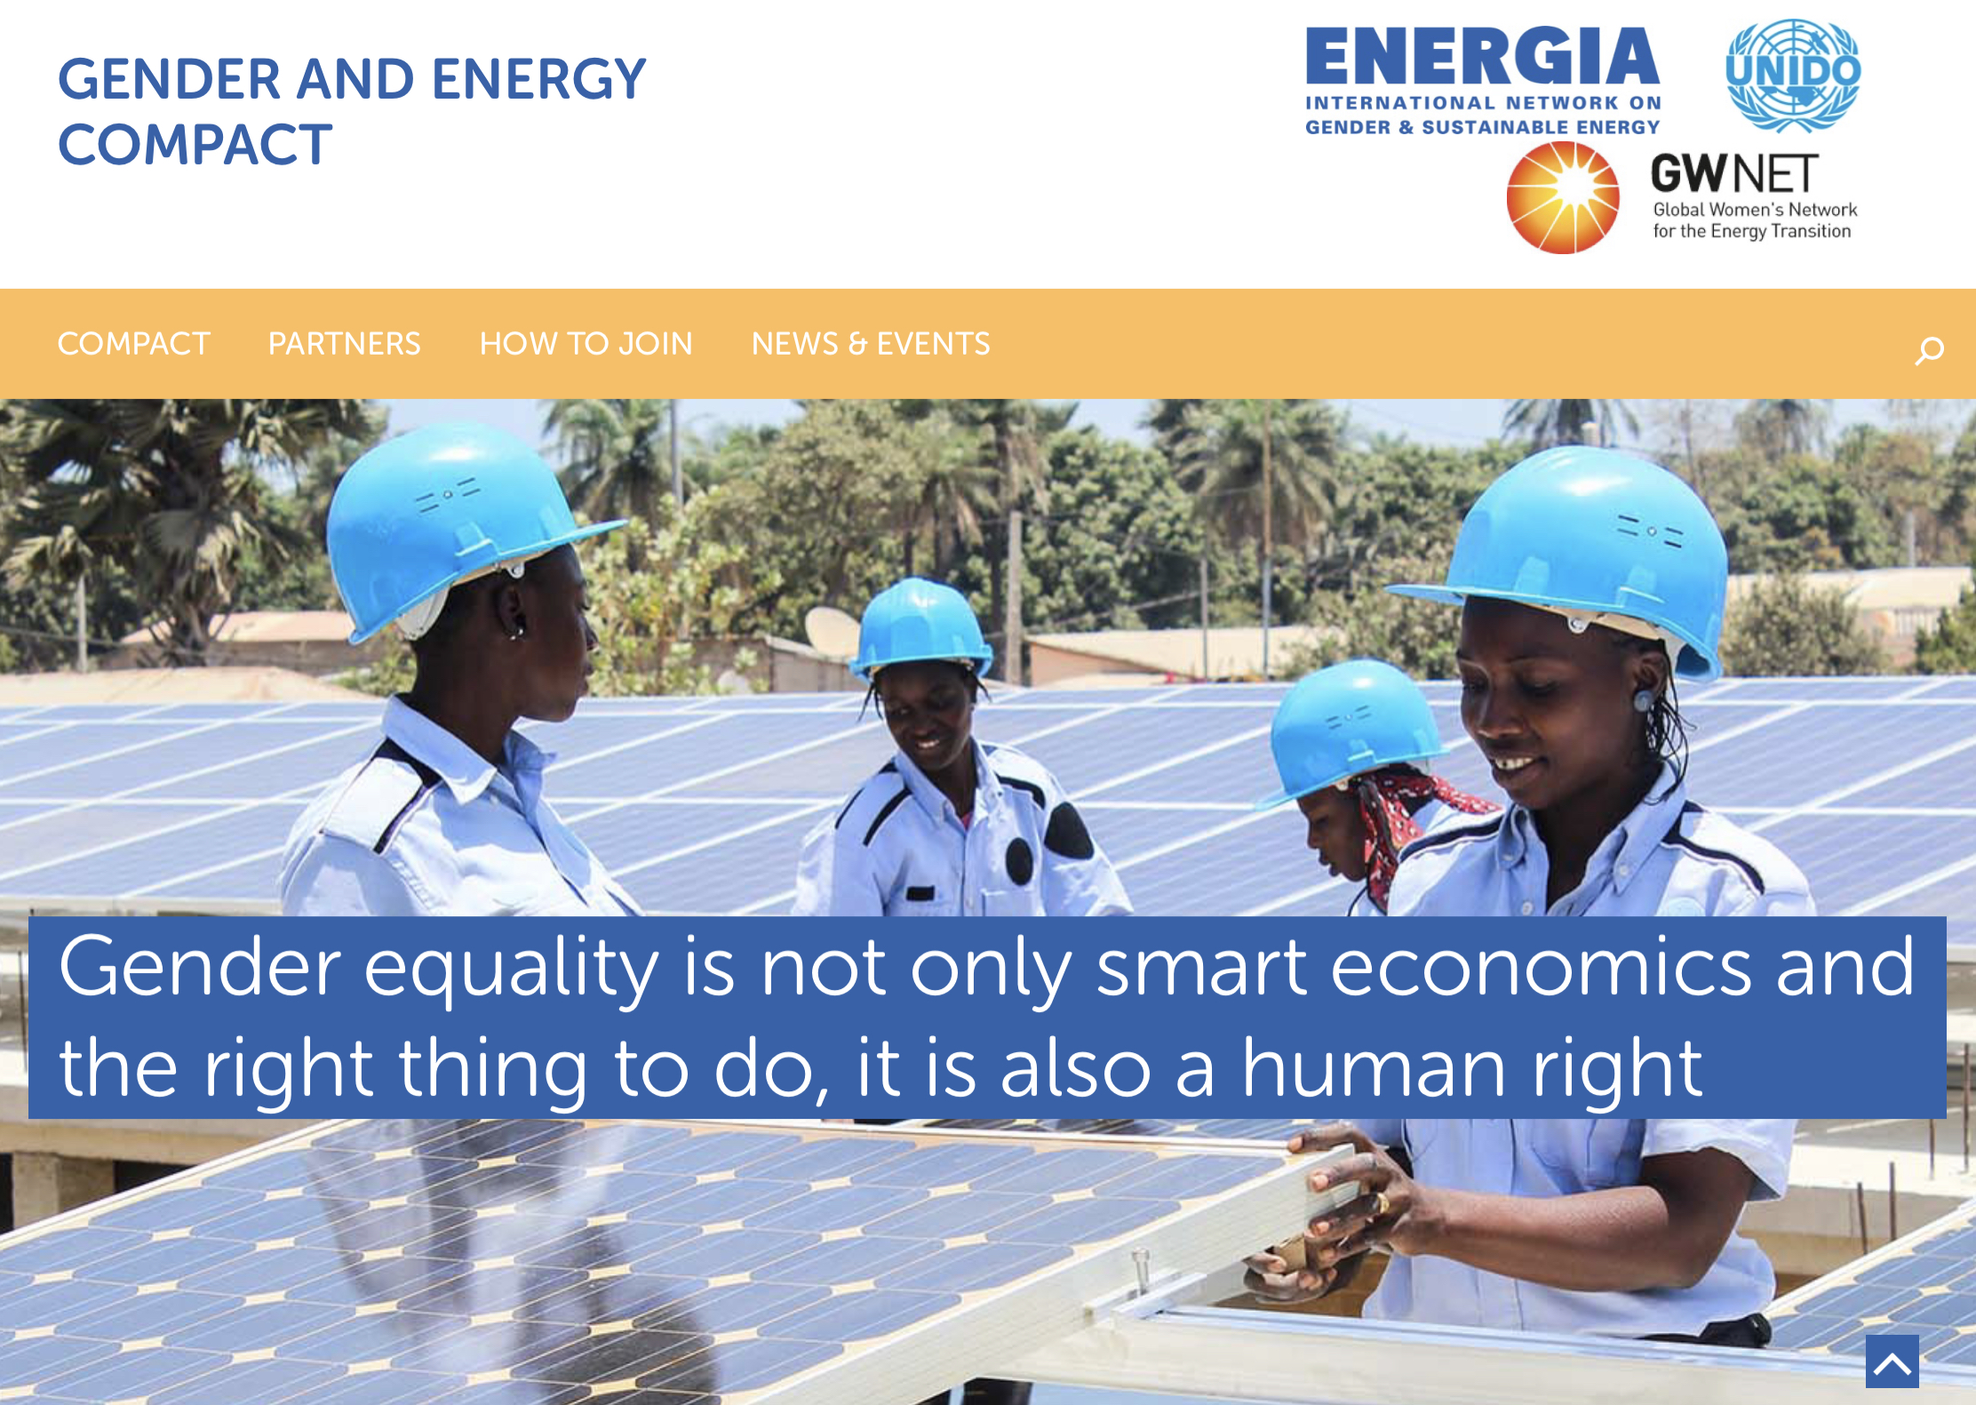
Gender and Energy Compact
Gender and Energy Compact
genderenergycompact.org

Slide 21
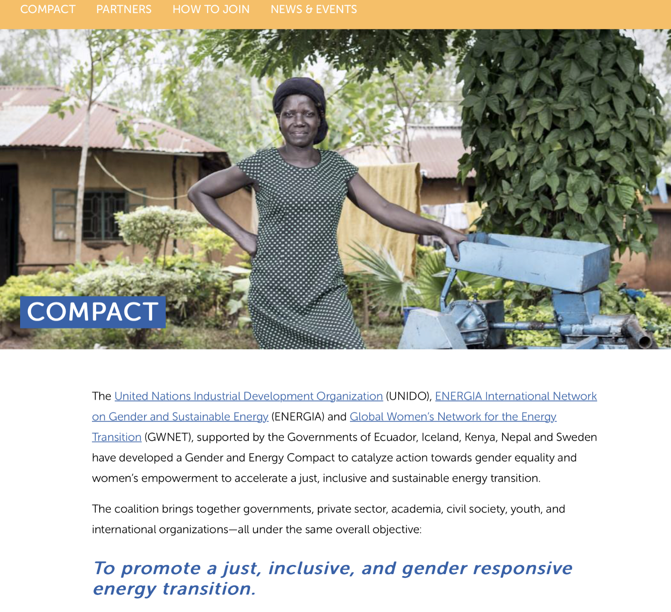
Gender and Energy Compact
genderenergycompact.org

Slide 22
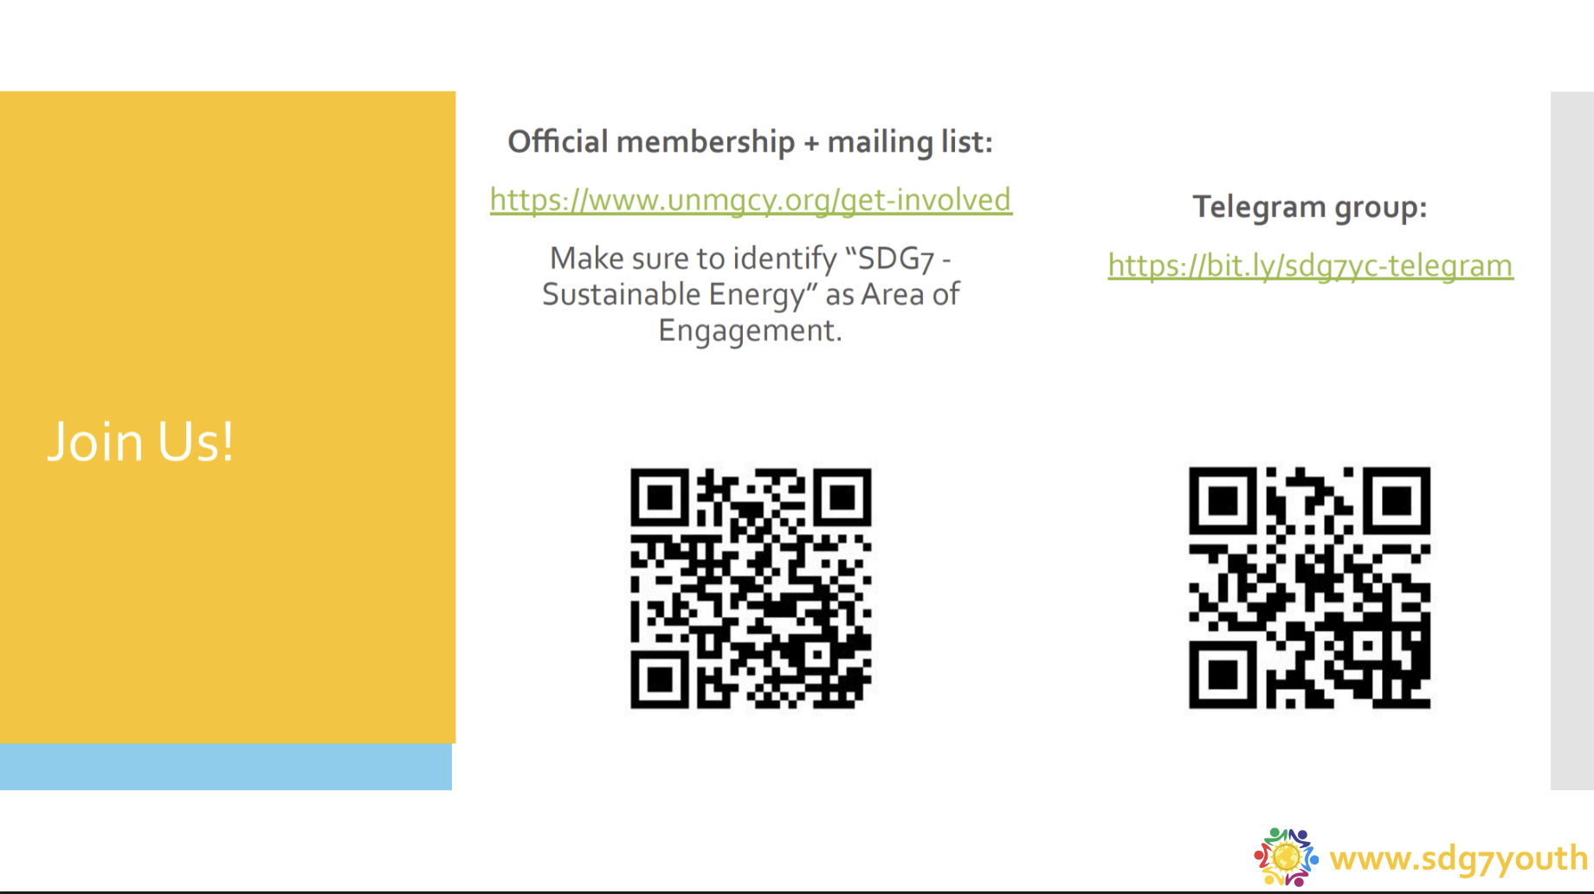

Slide 23
@sdg7youth

