Slide 1
Resilience and Rebuilding: Policies environment and institutional ecosystem to support MSMEs
Good practices from country experience and recommendations for future crises/ situations
Severine Deboos, ILO, ENT/ SME Unit

Slide 2
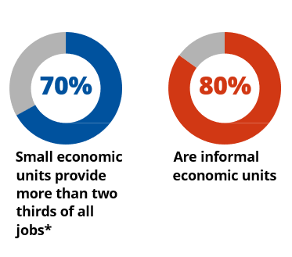
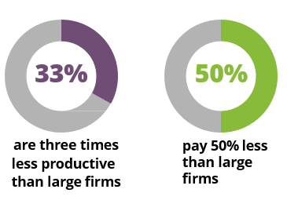
Why Small matters and need policies on resilience and rebuilding
In crisis contexts, MSMEs are more vulnerable, few recent evidence:
Lower productivity firms and sectors and lower-paid workers were disproportionately affected by the pandemic, while high-productivity enterprises and high earners saw far less damage
Small firms in low- and lower-middle-income countries have less benefited from government assistance programmes
The number of informal jobs plunged by 20 per cent at the height of the crisis in the second quarter of 2020, twice the impact registered among workers in formal employment.
*https://www.ilo.org/global/publications/books/WCMS_723282/lang--en/index.htm
Notes:
Refer to speech of DG
Refer to ILO Monitors; check if possible SME closure rate
Relevance of R189: normative basis that provide guidance on the policies and roles of respective partners to promote SME

Slide 3
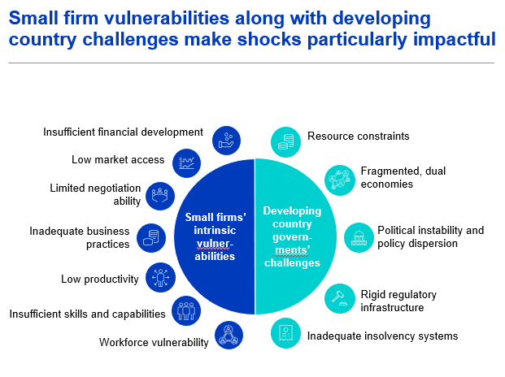

Slide 4
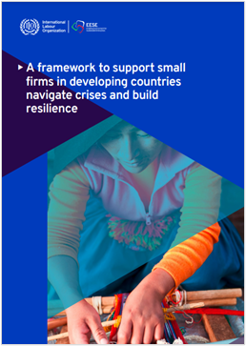
First question: What are good policy practices at national and sub-national levels that enhance MSME resilience to tackle uncertainties and capture high-value market opportunities for growth?
A joint Paper with Mc Kinsey
The objective: to help small businesses in developing countries manage shocks and adapt to them in a structured and innovative way
The 2 pillars: crisis management and resilience building

Slide 6
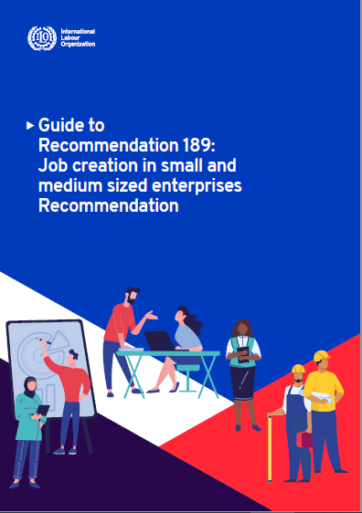
Second question: How can countries design and deliver sustained policy support that enhances MSME competitiveness and facilitates sustainable business transformations in the recovery from the Covid-19 pandemic and other external shocks?
The various dimensions included in R189 (1998):
Policy and legal framework
Development of an enterprise culture
Development of an effective service infrastructure
Roles of organizations of employers and workers
International cooperation
Notes:
Relevance of R189: normative basis that provide guidance on the policies and roles of respective partners to promote SME
Underline systemic approach, ecosystem…

Slide 7
Third question: how can countries build enabling institutional ecosystems that promote MSME formalization and growth
1. Make it easier to register and comply (simplified procedures & requirements)
2. Make it more attractive to formalize (incentives)
Dialogue & Voice
3. Make it more feasible to formalize (productivity)
4. Make it less attractive to be informal (enforcement & compliance)
www.ilo.org/ef
Notes:
The formalization and growth of MSMEs requires the engagement of a broad range of government and non-government actors. Relevant actors include those that deal with business registration, taxes, enterprise development, access to finance, social security- and labour regulations and sectoral regulations, amongst others. Social dialogue with entrepreneurs and workers in the informal sector, through their representative organisations, is key to achieving good results. Evidence has shown that formalization is best achieved through integrated approaches, that address barriers to formalize for enterprises in general and for those led by vulnerable groups in particular. This requires a comprehensive approach, in which these key stakeholders engage to identify and overcome formalization barriers for MSMEs. When ILO works with governments in the area of enterprise formalization, is supports government and other stakeholders to establish a steering committee to oversee the process to develop and implement a national formalization strategy. ILO has also developed an enterprise formalization ecosystem approach to (i) identify the relevant organisations in the public and private sector that play an active or potential role to formalize enterprises, (ii) map the regulations, incentives and services that they provide to facilitate formalization. Such mapping is an entry point to engage with these institutions on best ways to address gaps and move towards a stronger enterprise formalization ecosystem, including through inter-ministerial coordination.
From May Monitor:
Informal women workers have been hit harder than their male counterparts The number of informal jobs plunged by 20 per cent at the height of the crisis in the second quarter of 2020, twice the impact registered among workers in formal employment. And within informal employment, women were hit harder than men. In the second
quarter of 2020, the number of women in informal employment declined by 24 per cent relative to the pre-crisis situation, compared to a decrease of 18 per cent among men. The sectors in which women are typically engaged informally and their disproportionate care responsibilities accounted for this highly unequal impact. By the last quarter of 2021, the recovery in informal employment had overtaken that of formal employment, increasing the share of informal employment in total employment. Overall,
the speed of employment recovery has been slower for women than for men, which has contributed to a growing gender employment gap globally.

Slide 8
One country example: Senegal and its commitment on formalization

Slide 9
Thank you

