Slide 1
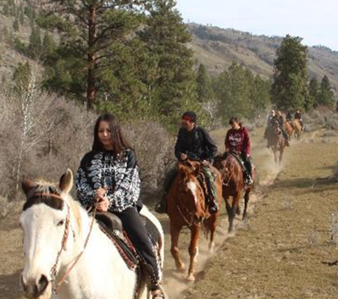
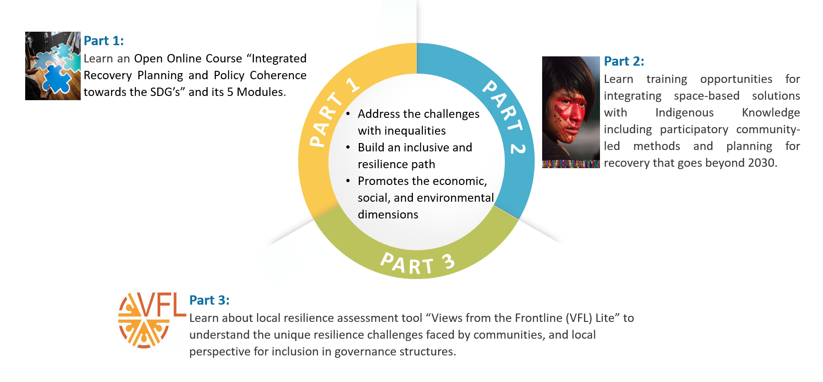
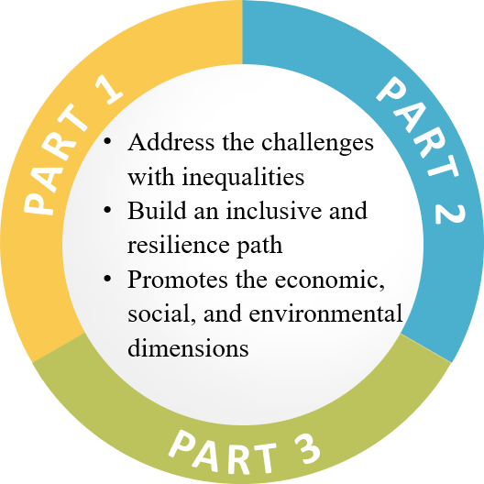
Latest methodologies and approaches
HLPF 2021 SDG Learning session
Integrating Recovery Planning from COVID-19,
Building Resilience and Strengthening Policy Coherence
Towards the SDGs
Making progress in the implementation of SDGs
Contributing
to sustainable recovery of the COVID-19 pandemic
7th July, 2021

Slide 2
Latest methodologies and approaches
Organizing Partners
UNDESA
UNITAR
CANEUS
FILAC
UNOOSA
GNDR
Making progress in the implementation of SDGs
Contributing
to sustainable recovery of the COVID-19 pandemic
7th July, 2021

Slide 3
OBJECTIVES
Part 1:
Learn an Open Online Course “Integrated Recovery Planning and Policy Coherence towards the SDG’s” and its 5 Modules.
Latest methodologies and approaches
Part 2:
Learn training opportunities for integrating space-based solutions with Indigenous Knowledge including participatory community-led methods and planning for recovery that goes beyond 2030.
Making progress in the implementation of SDGs
By leveraging expertise from multi-stakeholder partners
Contributing
to sustainable recovery of the COVID-19 pandemic

Slide 4
STRUCTURE
Part 1:
Learn an Open Online Course “Integrated Recovery Planning and Policy Coherence towards the SDG’s” and its 5 Modules.
Part 2:
Learn training opportunities for integrating space-based solutions with Indigenous Knowledge including participatory community-led methods and planning for recovery that goes beyond 2030.
PART 1
PART 2
Address the challenges with inequalities
Build an inclusive and resilience path
Promotes the economic, social, environmental dimensions
Define key building blocks of an integrated recovery planning and policy coherence exercise towards change in the SDGs
Capture the specific social, economical, and environmental threats and vulnerabilities faced by the displaced population
PART 3
Part 3:
Learn about local resilience assessment tool “Views from the Frontline (VFL) Lite” to understand the unique resilience challenges faced by communities, and local perspective for inclusion in governance structures.
Supporting Indigenous sustainability’s by developing integrated knowledge forms and applications work together without boundaries.

Slide 5
EXPECTED OUTCOME AND NEXT STEPS
Increased awareness of UNDESA-UNITAR Open Online Course available for national stakeholders and everyone involved in recovery planning from COVID-19 pandemic and rebuilding back better towards the SDGs
Supporting Indigenous sustainability’s by developing integrated knowledge forms and applications work together without boundaries.
Capture the specific social, economical, and environmental threats and vulnerabilities faced by the displaced population
Contributing to "Sustainable and resilient recovery from the COVID-19 pandemic”

Slide 6
Welcoming Remarks by Session 3 Partners:
UNDESA and UNITAR
CANEUS
FILAC
UNOOSA
GNDR
Latest methodologies and approaches
Making progress in the implementation of SDGs
Contributing
to sustainable recovery of the COVID-19 pandemic
7th July, 2021

Slide 7
Welcoming Remarks by Session 3 Partners:
UNDESA and UNITAR
By Mr. Amson Sibanda, Chief of National Strategies and Capacity Building Branch (NSCBB/DSDG/UNDESA)
Latest methodologies and approaches
Making progress in the implementation of SDGs
Contributing
to sustainable recovery of the COVID-19 pandemic
7th July, 2021

Slide 8
Continuation of Welcoming Remarks by Session 3 Partners:
Moderated by Mr. Milind Pimprikar
Founder & Chairman, CANEUS
Latest methodologies and approaches
Making progress in the implementation of SDGs
Contributing
to sustainable recovery of the COVID-19 pandemic
7th July, 2021

Slide 9
Part 1:
Introduction and overview of the Open Online Course “Integrated Recovery Planning and Policy Coherence Towards the SDGs” and its 5 Modules:
Moderator:
Mr. Sami Areikat, Sustainable Development Officer, UNDESA/DSDG
Participant polling @ this course
Panellists:
Ms. Veronique Verbruggen, Senior Interregional Advisor Governance and Public Institutions, UNDESA/DPIDG
Ms. Elena Proden, Senior Specialist, Strategic Implementation of the 2030 Agenda Unit, UNITAR
Part 1 Program (30 minutes)
Panelists (17 minutes)
Poll 1 (3 minutes)
Q&A (10 minutes)
7th July, 2021

Slide 10
Part 1:
Introduction and overview of the Open Online Course “Integrated Recovery Planning and Policy Coherence Towards the SDGs” and its 5 Modules:
Panellists:
Ms. Veronique Verbruggen,
Senior Interregional Advisor Governance and Public Institutions, UNDESA/DPIDG
Linkages Between the Building Blocks on Institutional Arrangements for Policy Coherence and
the Steps for Integrated Recovery Planning and Policy Coherence
7th July, 2021

Slide 11
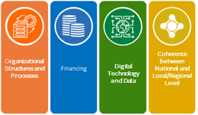
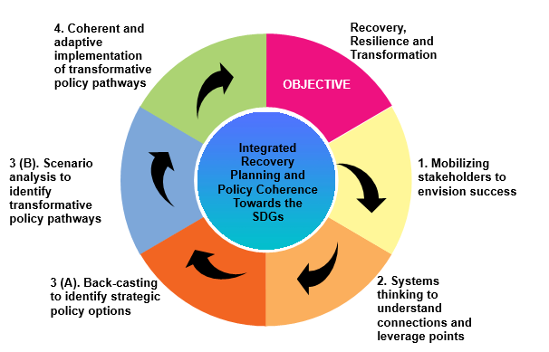
Linkages Between the Building Blocks on Institutional Arrangements for Policy Coherence and
the Steps for Integrated Recovery Planning and Policy Coherence

Slide 12
Mobilise whole of government action
Support present needs and those of future generations
Capitalize on synergies btw social, economic and environmental policy areas
Resolve divergence between policies
Promote coordinated action across different levels of government
Engage all relevant actors to identify priorities and challenges, align actions and mobilize resources
Political Commitment
Transformational Leadership, Human Resources and Changing Mindsets
System Thinking and Policy Linkages
Organizational Structures and Processes
Financing
Digital Technology and Data
Coherence between National and Local/Regional Level
Stakeholders’ Engagement
Monitoring, Reporting and Evaluation Processes
12

Slide 13
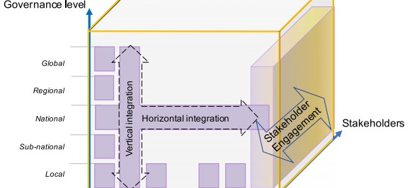
13

Slide 14
Part 1:
Introduction and overview of the Open Online Course “Integrated Recovery Planning and Policy Coherence Towards the SDGs” and its 5 Modules:
Panellists:
Ms. Elena Proden, Senior Specialist, Strategic Implementation of the 2030 Agenda Unit, UNITAR
Overview of the course Modules and the building blocks for integrated recovery planning towards the SDGs
7th July, 2021

Slide 15
15

Slide 16
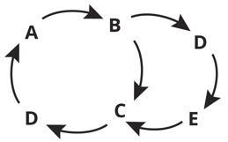
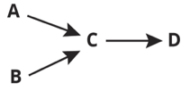
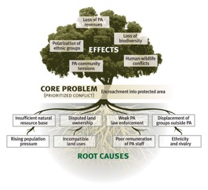
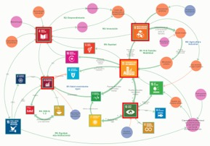
From linear problem-tree analysis to system maps
Picture source: IISD.
Causal Loop Diagram (system map), Costa Rica & UNDESA
16

Slide 17
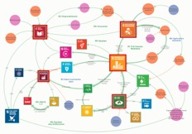
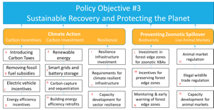
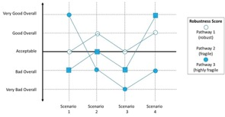
Identify policy pathways that are:
Transformative: address the leverage points
Coherent and strategic: make sense when combined, with minimum trade-offs
Robust and adaptive: can perform across a range of plausible scenarios
17

Slide 18
Transformative
Leverage points & system map
SDG
Feedback Loop
Driver
Positive relation
Negative relation
Actor
Emergent properties (e.g. peace)
Leverage point
18

Slide 19
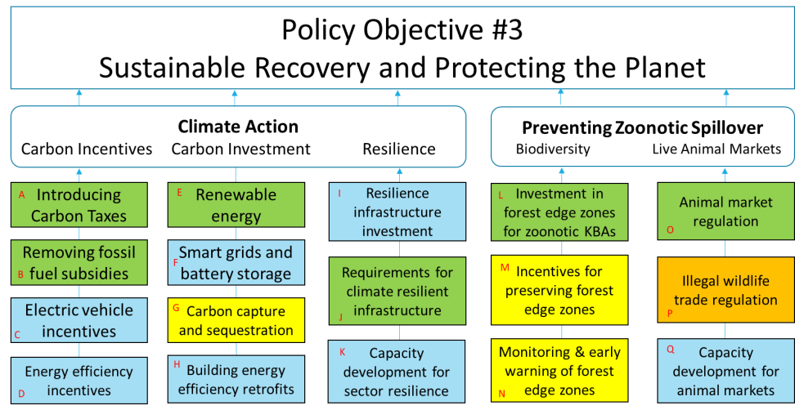
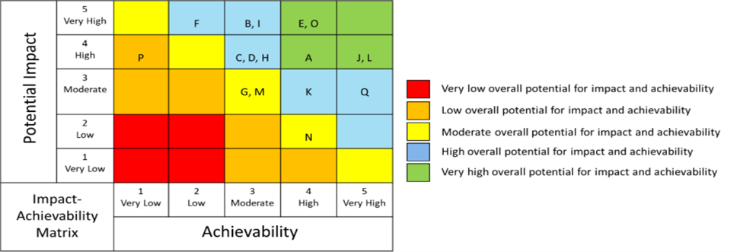
Coherent and strategic
Policy options matrix
19

Slide 20
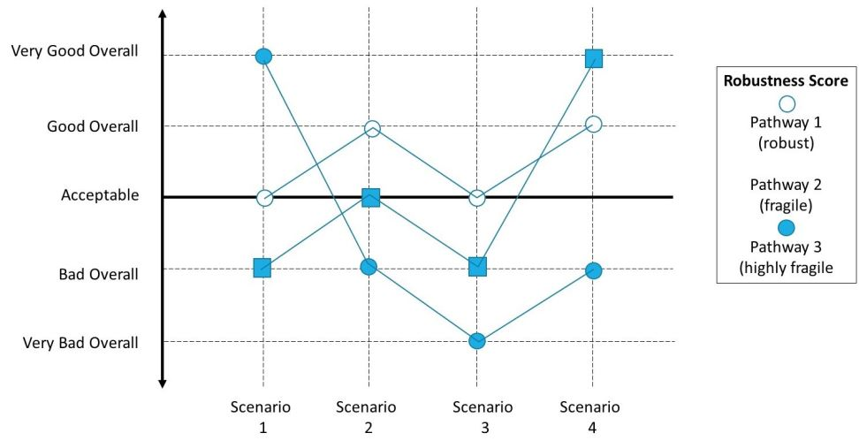
Robust
Robustness testing
20

Slide 21
Part 1:
Introduction and overview of the Open Online Course “Integrated Recovery Planning and Policy Coherence Towards the SDGs” and its 5 Modules:
Access to the Massive Open Online Course:
From UNITAR Platform:
http://bit.ly/Intrgrecovery
From SDGs Knowledge Platform:
https://sdgs.un.org/courses/undesa-unitar-e-learning-course-32915
7th July, 2021
Notes:
Access to the Massive Open Online Course
that is self-paced, flexible, and free of charge for the benefit of member states, their national stakeholders, and anyone interested to take it. Especially those involved in countries’ recovery planning from COVID-19 pandemic and rebuilding back better towards SDGs implementation

Slide 22
Part 1:
Introduction and overview of the Open Online Course “Integrated Recovery Planning and Policy Coherence Towards the SDGs” and its 5 Modules:
Poll 1
(3 minutes)
7th July, 2021
Notes:
Poll 1: Part 1
(After the presentations and Q&A)
Following the overview by the Panelist, we need to conduct a poll for 3 minutes, with assistance from our colleagues at UNITAR New York Office
1. Are you interested in this course?
a. Yes, I am already enrolled
b. Yes, I am planning to enroll
c. Yes, but I don't have time to take it now, maybe later
d. No, I am not interested at all
2. To what extent this course preview has increased your understanding of possible approaches to and the value of integrated planning to ensure consistency between short-term and long-term responses and across sectoral policies?
a. Very significantly
b. To a large extent
c. To some extent
d. Slightly
e. Not at all

Slide 23
Part 1:
Introduction and overview of the Open Online Course “Integrated Recovery Planning and Policy Coherence Towards the SDGs” and its 5 Modules:
Q&A
(10 minutes)
7th July, 2021

Slide 24
End of Part 1
Introduction and overview of the Open Online Course “Integrated Recovery Planning and Policy Coherence Towards the SDGs” and its 5 Modules:
7th July, 2021
Notes:
End of Part 1
Thank you in all languages of the world

