Slide 1
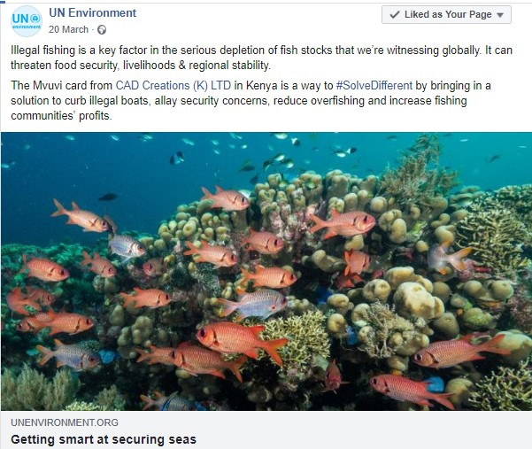
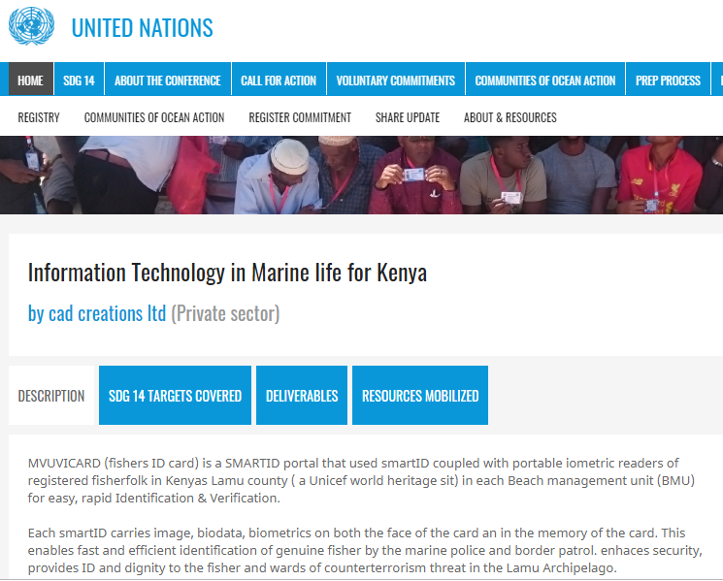
Voluntary Commitment VC
MVUVICARD2.0 SMARTID

Slide 2
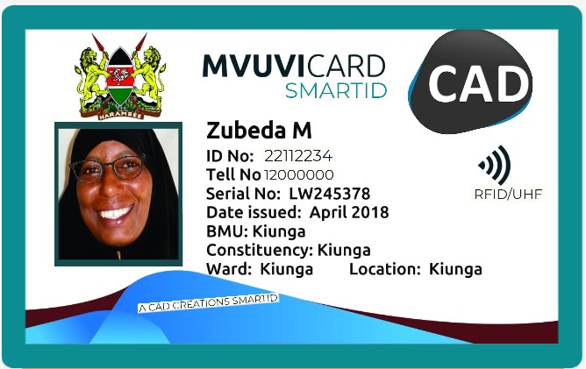
CAD Voluntary Commitment (VC)? #OceanAction26161
Information Technology in Marine life for Kenya
What is Mvuvicard? MVUVICARD is a Cloud based Software system solution for the
IDENTIFICATION,
VERIFICATION &
AUTHENTICATION
OF FISHERMEN(WOMEN),
Onsite (Land Or Sea),
Immediately,
Accurately &
Repeatably

Slide 3
1. What are the main gaps and challenges faced and how did you address them?
Life Before Mvuvicard…
CAD Voluntary Commitment (VC)? #OceanAction26161

Slide 4
CAD Voluntary Commitment (VC)? #OceanAction26161
Problem Questions That Led To Mvuvicard
ADMINISTRATION ASK:-
Who is going fishing/who is in the vessel?
Where did the vessel originate from?
Are these the authorized fishers?
TRADERS ASK:-
What has been fished? In what quantities?
Where is the haul stored?
When is it stored?
RESEARCHERS ASK:-
What species, where, in what size & quantities are being fished ?
Are there noticeable changes/trends?
FISHERS ASK:-
Who is in the market for the fish I have?
How can I get them to know what I have?
What is the prevailing market price for carp/cod/tuna?
Notes:
Paper based
Risk of rain or soak in water
No PhotoID
A lot of time lost on verification by returning to shore

Slide 5
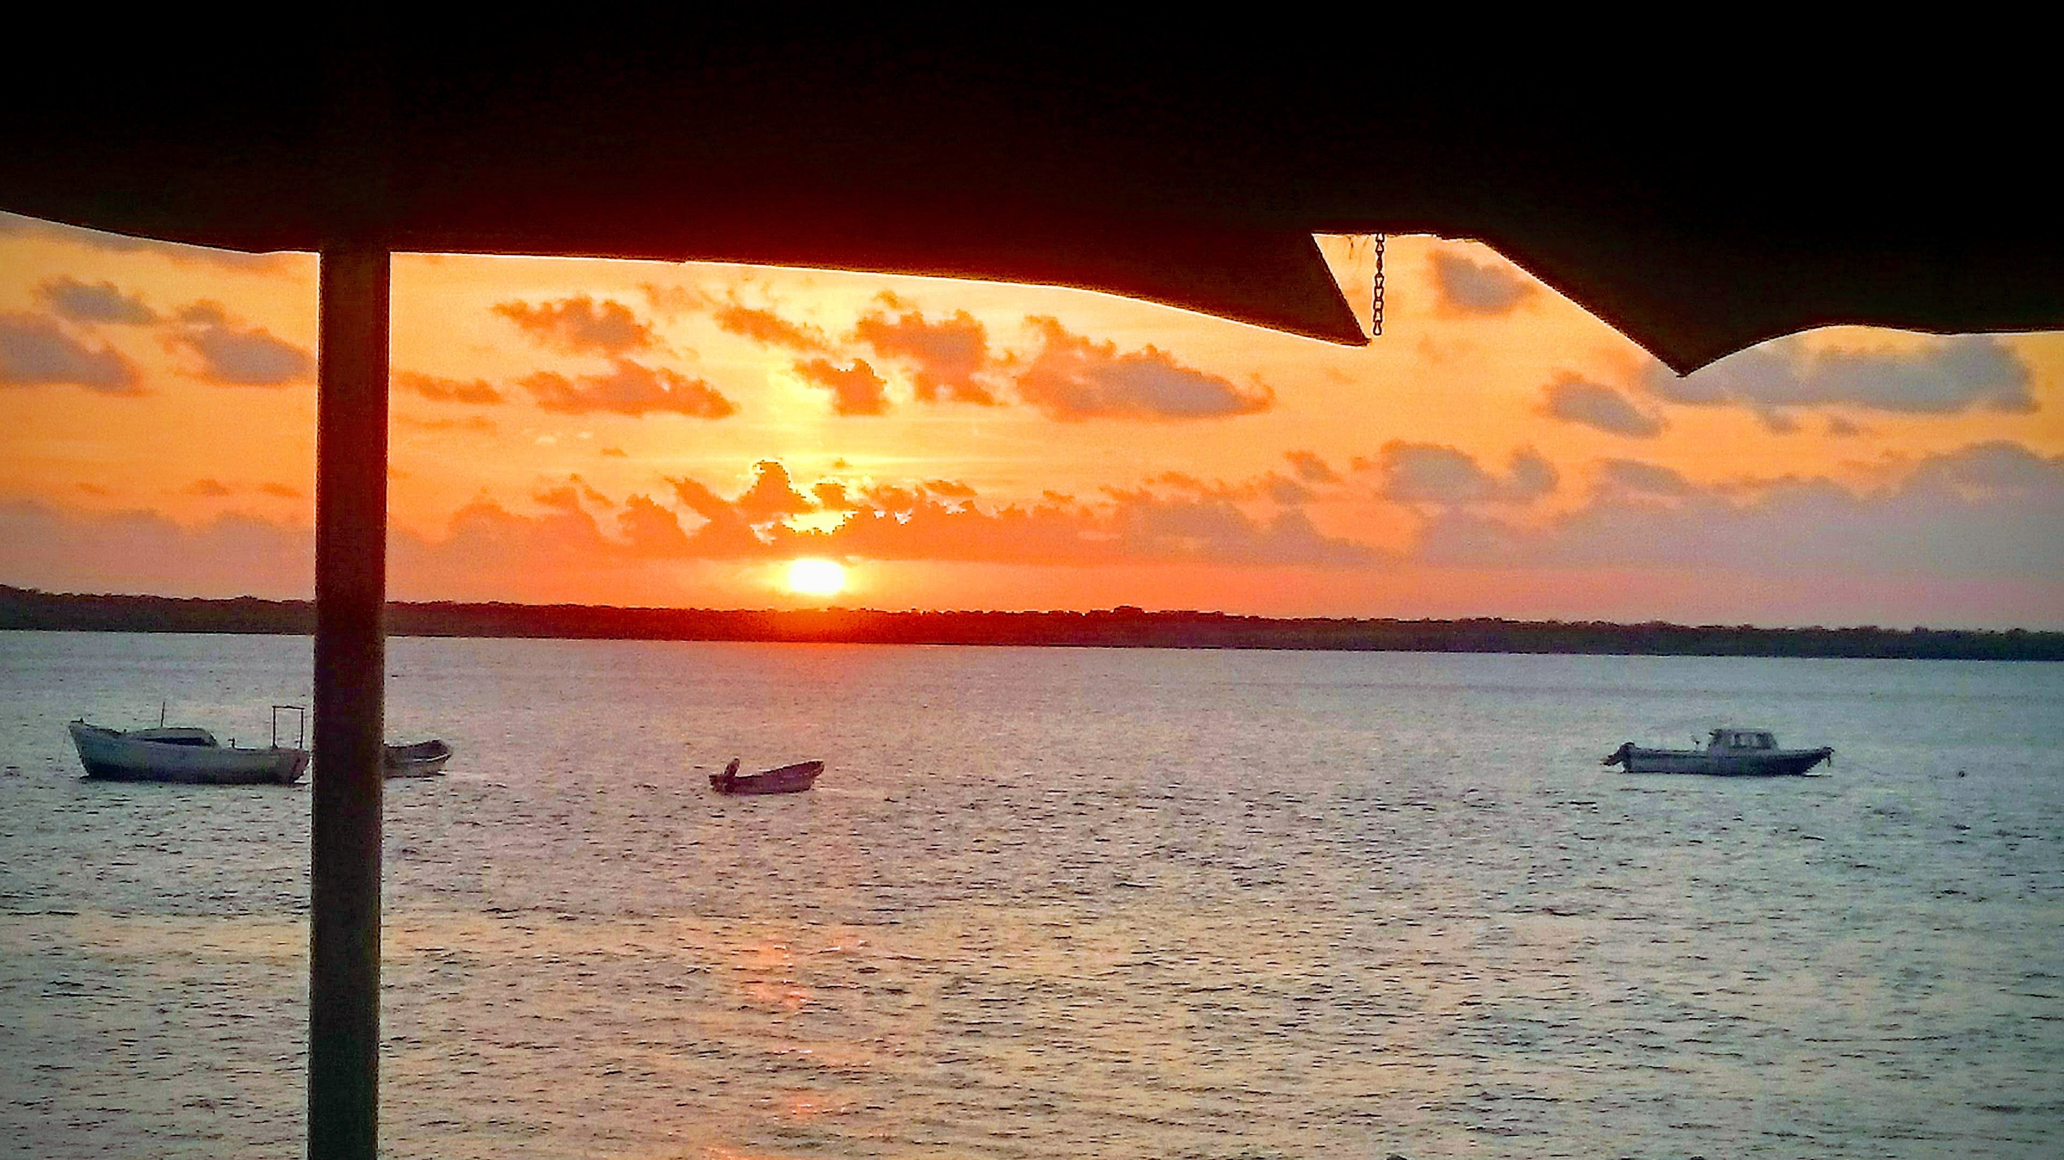
CAD Voluntary Commitment (VC)? #OceanAction26161
Marine life for Kenya Before Mvuvicard
BEFORE MVUVICARD
Hire vessel & assemble crew
Local administrator apply for permit to attach National ID of all crew
Carry permit & ID for production on demand by security
Go fishing
Fisherman
Typical Vessels
Notes:
Paper based
Risk of rain or soak in water
No PhotoID
A lot of time lost on verification by returning to shore

Slide 6
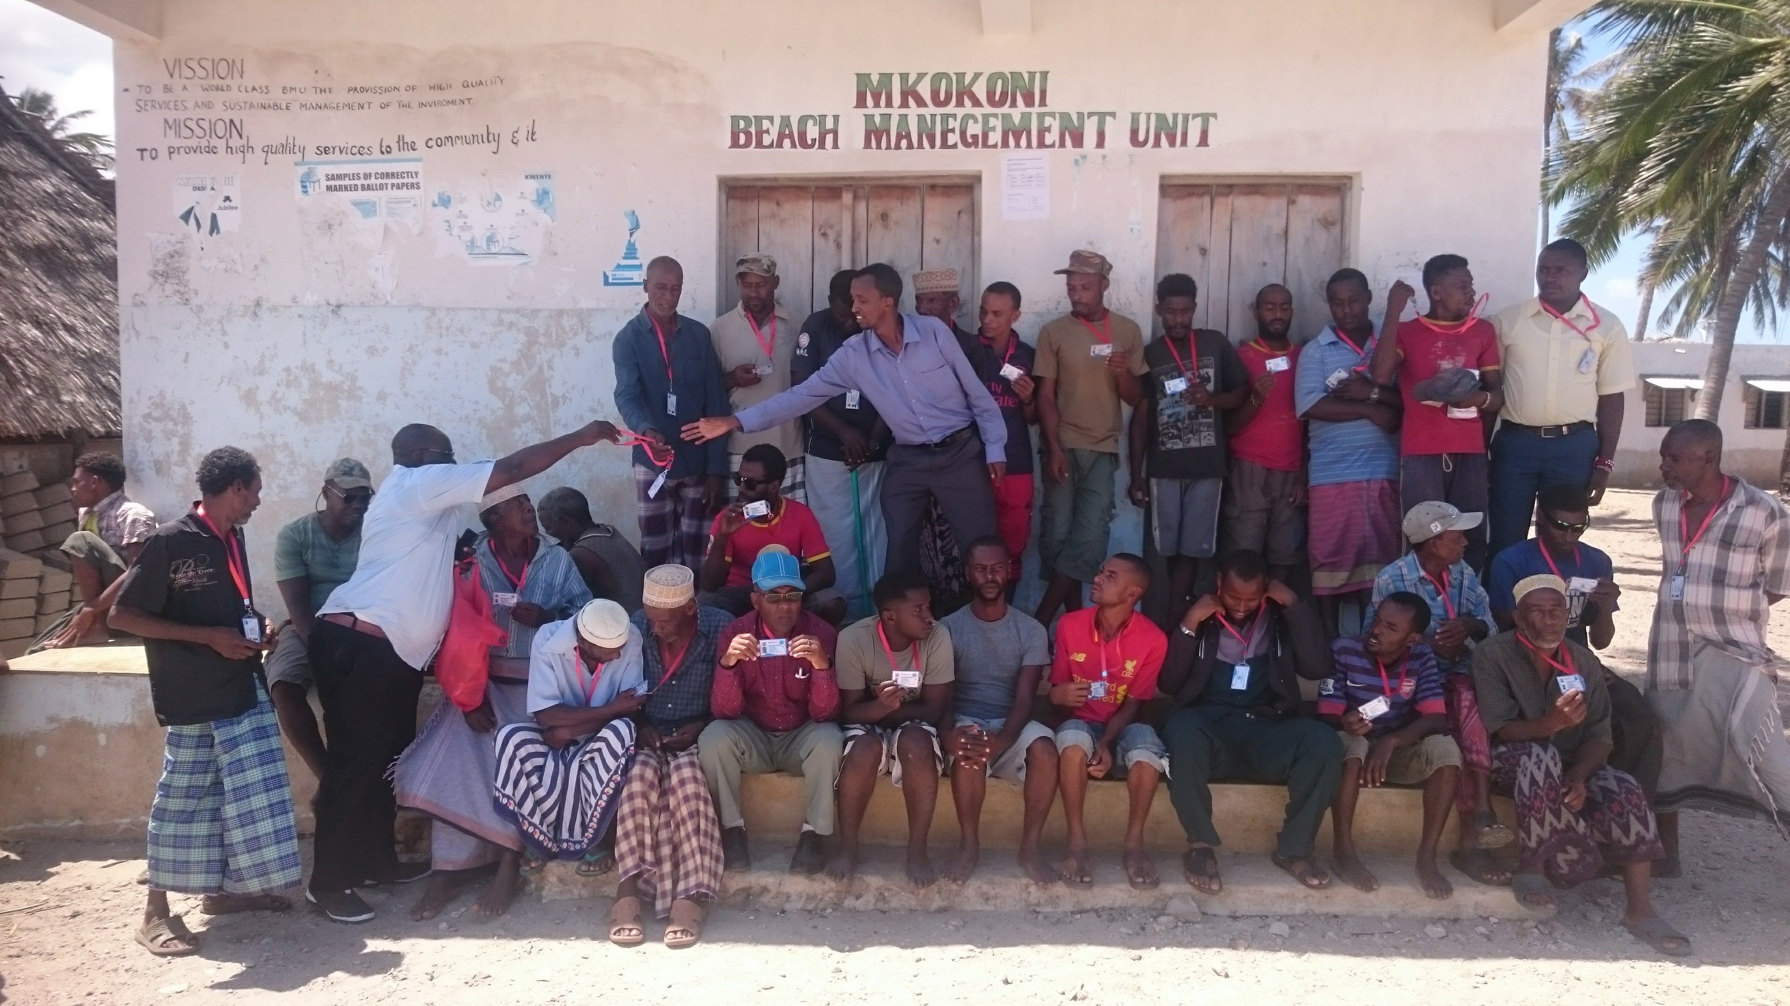
MVUVICARD PORTAL
360 ECOSYSTEM
MVUVI
SECURITY TEAM
TRADERS
DATABASE MANAGEMET
USER ACCESS/INTERACTION
DATA SECURITY/INTEGRITY
CAD Voluntary Commitment (VC)? #OceanAction26161

Slide 7
CAD Voluntary Commitment (VC)? #OceanAction26161
Marine life for Kenya With Mvuvicard
Towards a Sustainable Blue economy
Cloud
Small footprint chip enabled PVC card, hardy, waterproof & small footprint easy to carry
Data embossed on the card (name, picture, location, BMU)
Data imposed in card microchip
Integrated biometrics
Integrated small form factor NFC card reader
With GSM & GPS with Database read/write
Notes:
Paper based
Risk of rain or soak in water
No PhotoID
A lot of time lost on verification by returning to shore

Slide 8
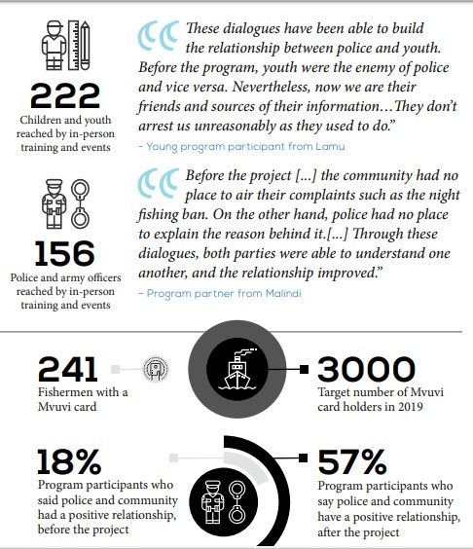
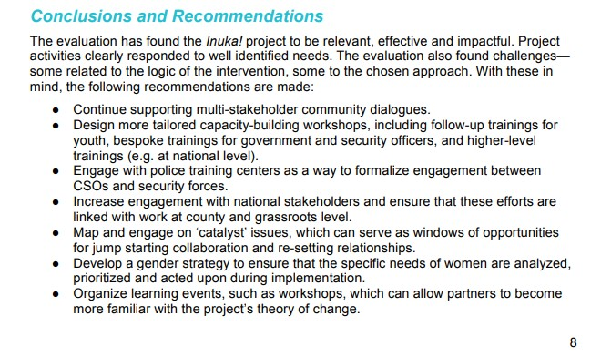
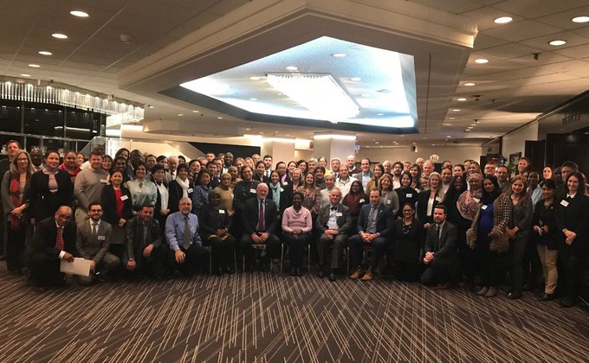
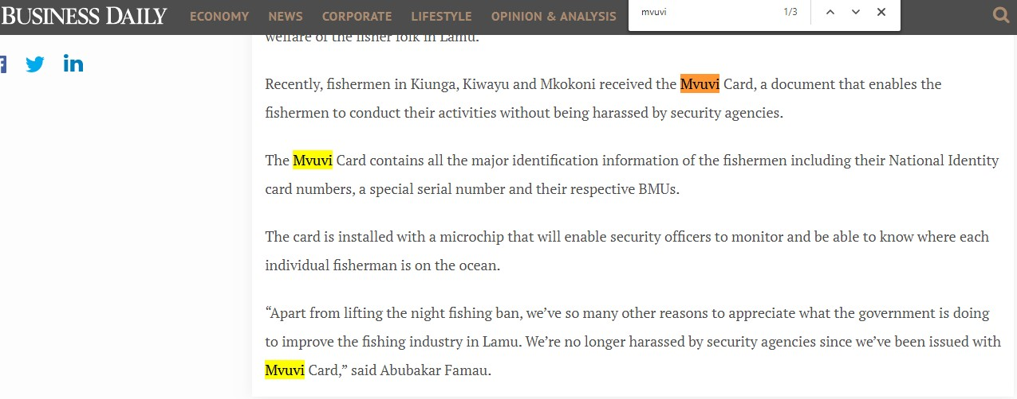
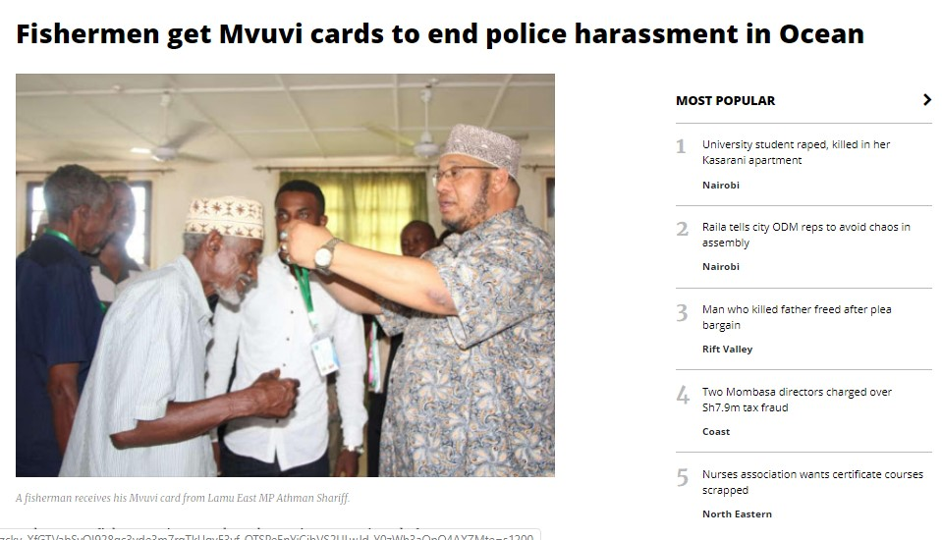
CAD Voluntary Commitment (VC)? #OceanAction26161
Mvuvicard IMPLEMENTATION Reviews
UNEP On Mvuvicard
Mvuvicard Impact Report SFCG
Mvuvicard UN Biodiversity conference Montreal 2019
Mvuvicard Newspaper articles
Notes:
Paper based
Risk of rain or soak in water
No PhotoID
A lot of time lost on verification by returning to shore

Slide 9
2. In regard to best practices and lessons, what was the main important factor that made your VC successful/on-track/impactful?
Sustainable Project With Direct Benefit To Communities.
Planning: Mooted Largely For Security Operation BUT More Useful In Advocacy, Policy & Research.
Job Security: Use Of Data for Trade And Conservation
Appropriate Technology
- Can it easily be replicated in other areas?
YES: Can be implemented at a local, country or regional level with data sharing.
Requests from Kisumu, Turkana, Liberia & Uganda.
CAD Voluntary Commitment (VC)? #OceanAction26161

Slide 10
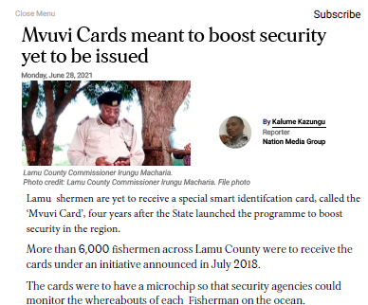
3. What is the current overall status of implementation of your VC?
Pilot distribution of 700 cards
Formal launch of project by the stakeholders
Creation of a local database of Beach management Unit
Sensitisation & Collaboration with community & government entities
In the Daily Newspaper last week
How much do they contribute to advancing Sustainable Blue Economy?
& implementation of SDG14 as well as other interlinked goals?
CAD Voluntary Commitment (VC)? #OceanAction26161

Slide 11
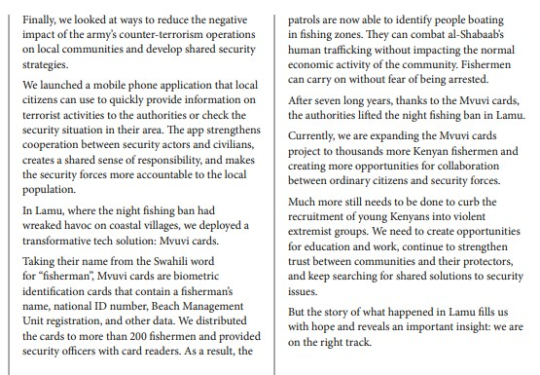
4. What innovative and science-based solutions emerging from implementing your VCs can be scaled up at the global or national level to address the common challenges in implementing SDG14?
Mvuvicard 2.0 a data source and access tool that plays a vital role in
Trade – etrade platform
Conservation
Research – data collected daily
Primary users not burdened.
Make the project self sustaining.
connect the fish trader app
Data continually gleaned for research/ conservation
SFCG report Mvuvicard implementation
CAD Voluntary Commitment (VC)? #OceanAction26161

Slide 12
Mvuvicard Conclusions & Lessons
Though initially mooted as a security tool its
Multi dimensional
Scalable
Replicable
Versatile
Self sustaining
More useful to science based initiatives like
Science
Research &
Policy
Has wide acceptance on individual community and governance

Slide 13
Thank you
Francis Munyeki
munyekif@cadcreations.co.ke
254 (0)700 1971 19
Skype: Munyekif
Social Media
@cadcreationsK
CAD Voluntary Commitment (VC)? #OceanAction26161

