Slide 1
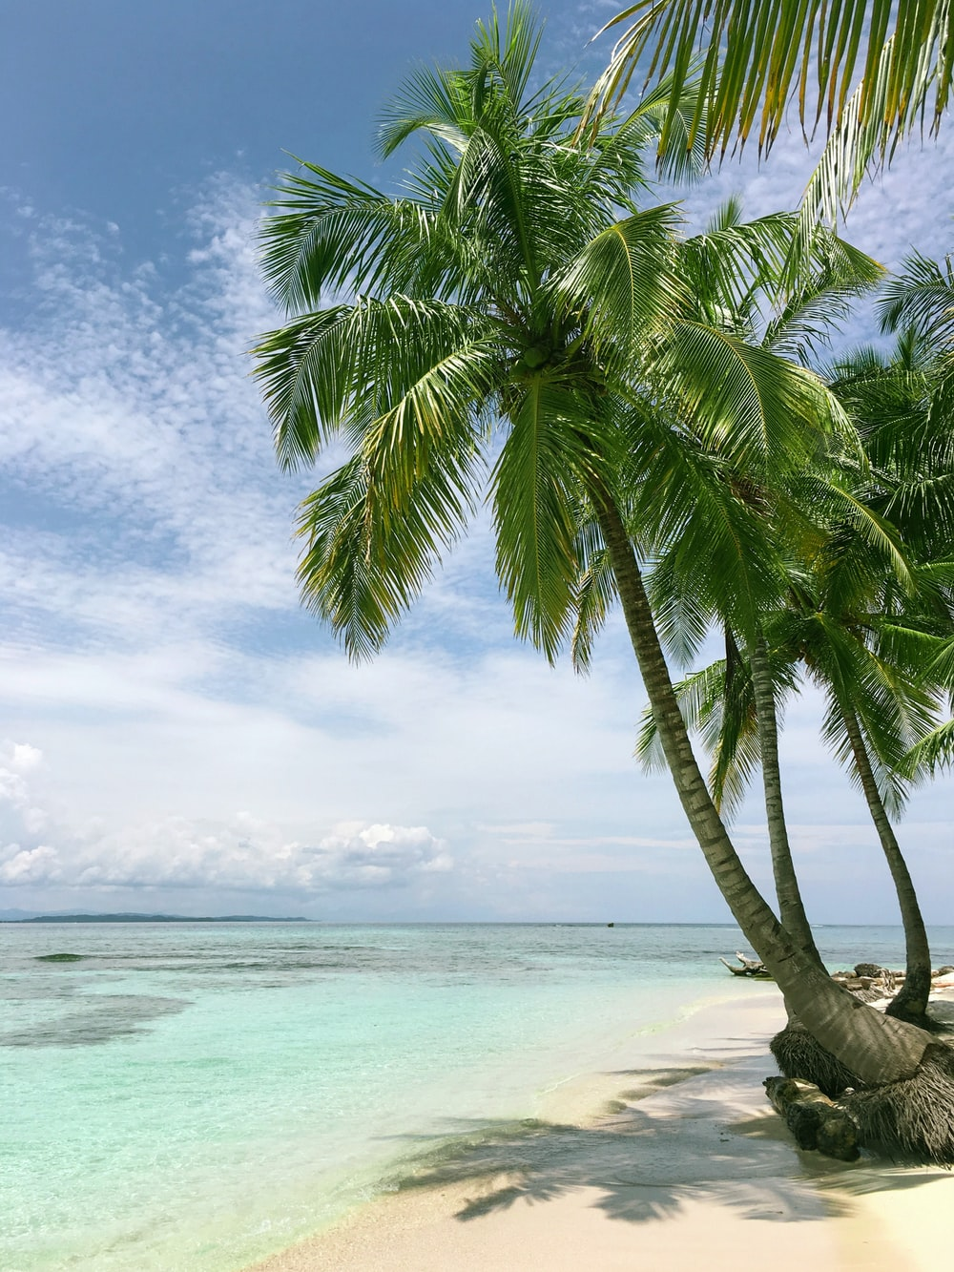
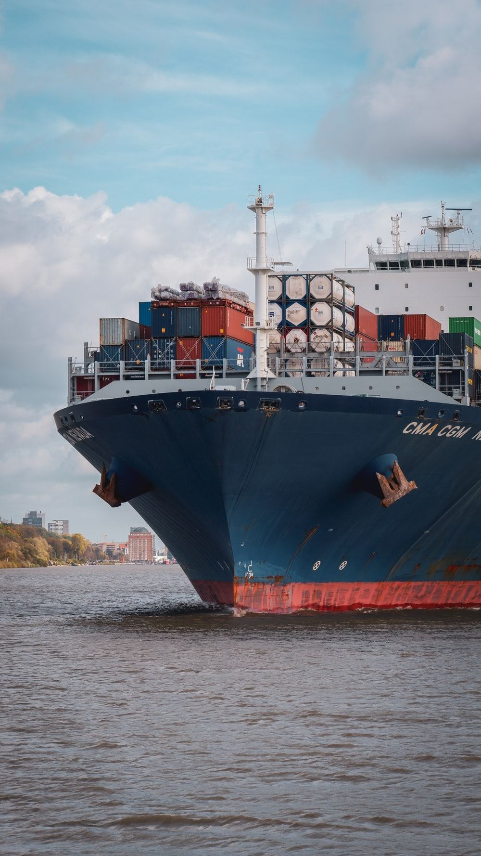
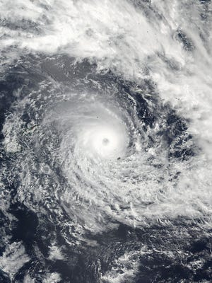
Briefing to Members UN Member States and Observers Update on the potential development of a Multidimensional Vulnerability Index for SIDS
10 May2021 Mr. Sai S. Navoti Chief, SIDS Unit, DSDG, UNDESA
Division for Sustainable Development Goals
Notes:
Greetings and salutations

Slide 2
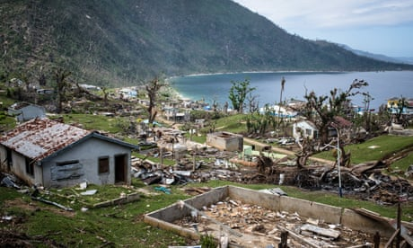
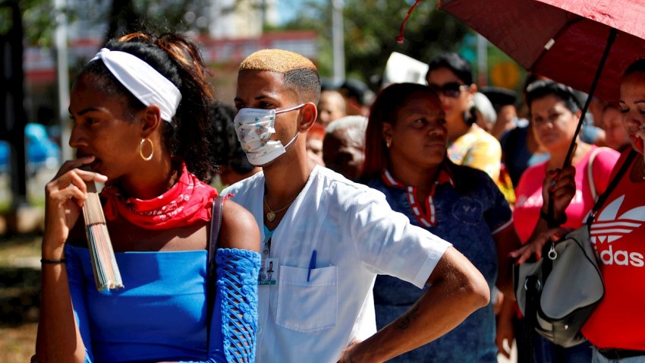
TABLE OF CONTENTS
CONTEXT & BACKGROUND
MVI DEVELOPMENT
MVI USE / USERS
Division for Sustainable Development Goals

Slide 3
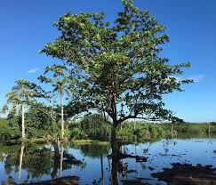
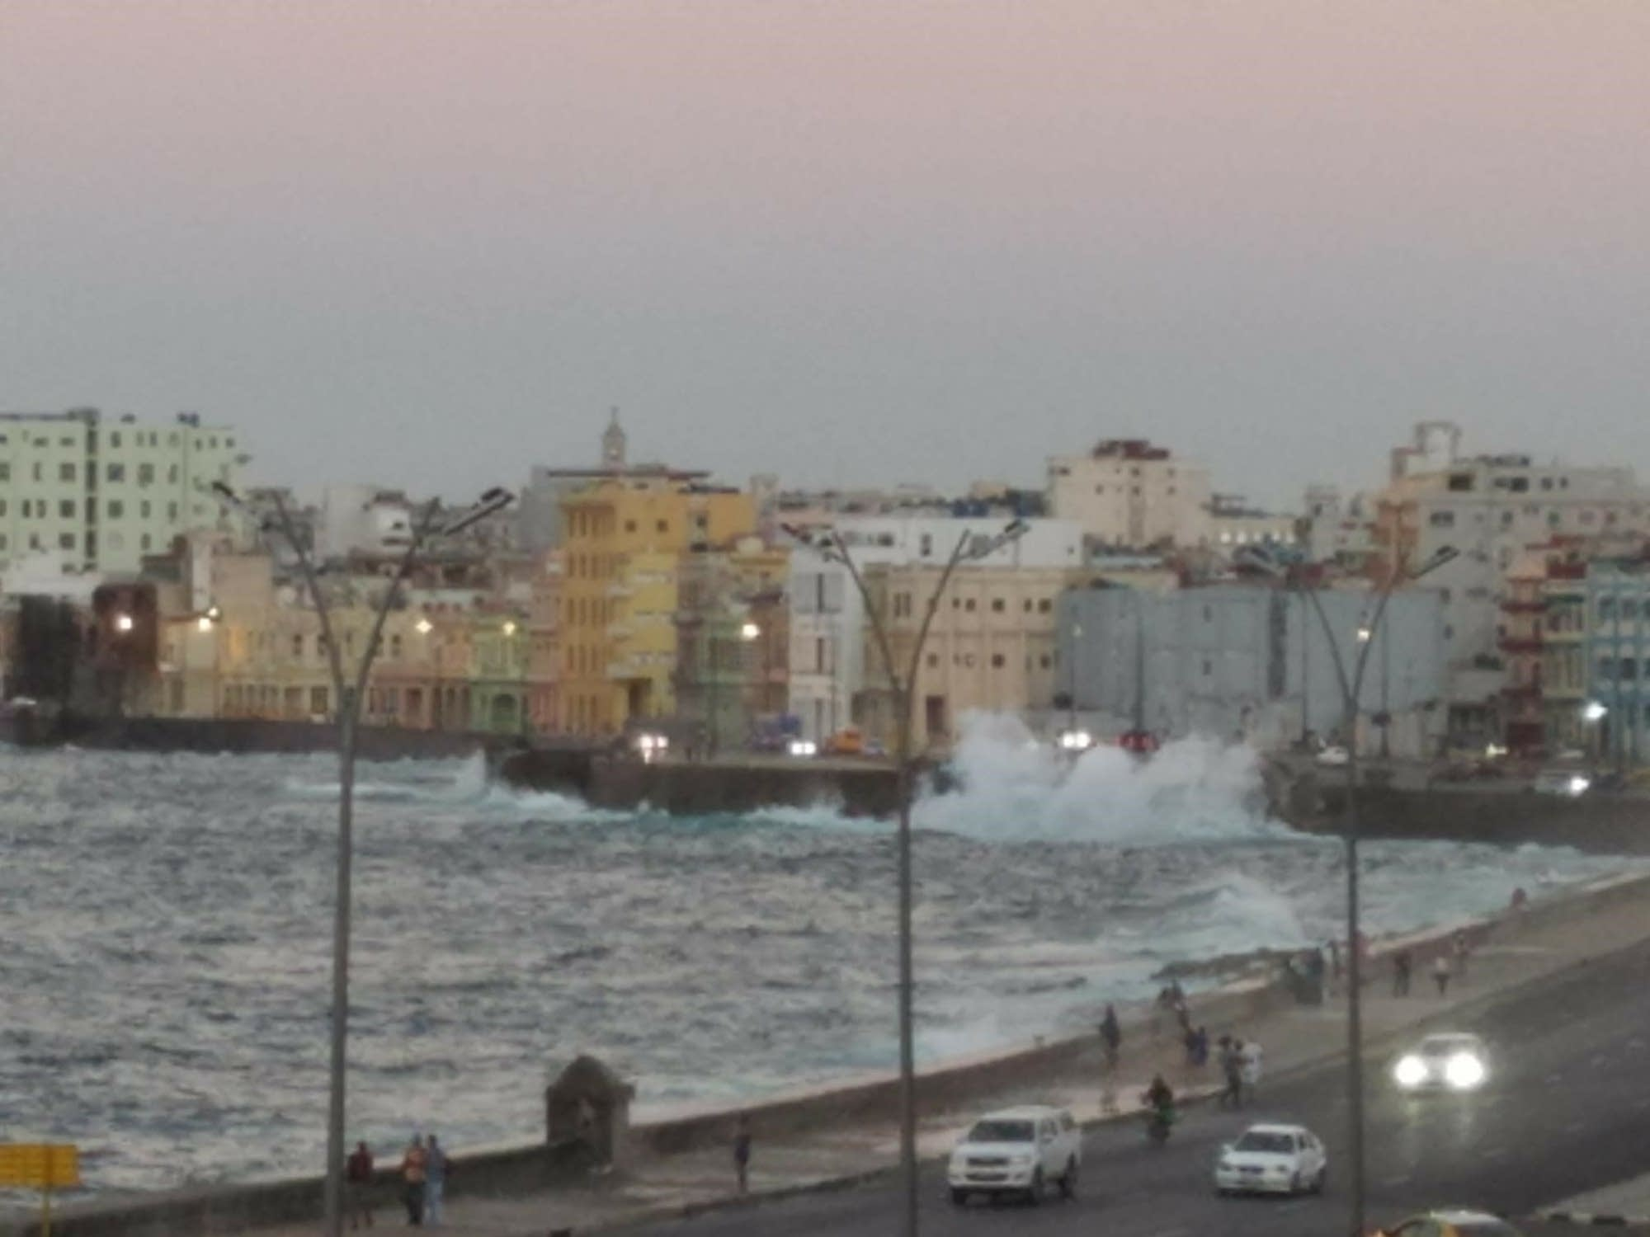
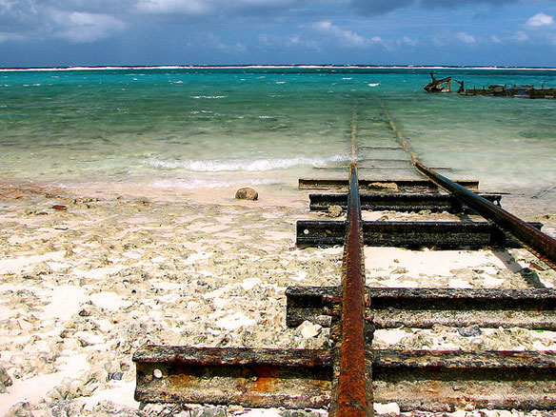
CONTEXT & BACKGROUND
Division for Sustainable Development Goals

Slide 4
CONTEXT
GA Mandate: RES 75/215; 8a To provide recommendations (…) on the potential development and coordination of work within the United Nations system on a multidimensional vulnerability index for small island developing States, including on its potential finalization and use”
8 MVI Technical Sessions: April 2021- 19 Institutions; Average participants 77
Session 1: UNDP, Malta University, ADB
Session 2: OECD, Com-Sec Session 3: UNEP, UNDRR
Session 4: DESA, CDB
Session 5: IMF, UNCTAD
Session 6: FAO, WMO, Oxford
Session 7: RCO, CDP, UNESCO
Session 8: AfDB, UNFPA
Division for Sustainable Development Goals

Slide 5
MVI DEVELOPMENT
Division for Sustainable Development Goals
Notes:
The next section focus on….

Slide 6
MVI DEVELOPMENT
Multidimensional Indices
UNDP
UNCTAD
CDB
CPD
COMSEC
RCO Network
Thematic Indices
and Frameworks
AfDB
FAO
IMF
OECD
Oxford University
UNDRR
UNEP
UNESCO
UNFPA
WMO
Comments & Observations
ADB
University of Malta
UNDESA
Division for Sustainable Development Goals
Notes:
The next section focus on….

Slide 7
“Multidimensional” Indices: Strategic elements
STRATEGIC ELEMENTS | UNDP | UNCTAD | CDB | CDP (Original) | ComSec | RCO
Foundation | EVI | EVI | EVI | EVI | Original | Original
Data (easy access/management?) | Yes | Yes | Yes (proxy indicator) | Yes | Yes (proxy indicator) | Yes (proxy indicator)
Geographical Coverage (Universal/SIDS?) | Universal | Universal | SIDS only but could be exp. | Universal | Universal | Universal
Debt (is debt included?) | No | No | Yes | No | Yes | No
3 Dimensions of S.D | 2 | 2 | 3 | 2 | 3 | 2
LDC Comparison/ranking (are SIDS more vulnerable than LDC?) | “Of the top 25 most vulnerable countries in MVI, 14 are SIDS. MVI has more SIDS in its top ranks than the EVI” | “SIDS are more vulnerable than other developing countries” (without quantitative measurement) | n/a | “SIDS on average more vulnerable than non-SIDS SIDS that are LDCs are more vulnerable than SIDS that are non-LDCs“ | “SIDS are second to LDC small states most vulnerable group.” Also interesting to note => below | “SIDS are more vulnerable than other countries in the world”
Resilience (Is resilience included?) | No | No | Yes Albeit not separable and not defined as such | Considered independently HAI and GNIpc + 48 SGI | Yes separable Structural and non-structural resilience | Maybe (ongoing)
Shocks (are the effects of past shocks included or only exposure factors?) | Past Shocks & Exposure | Past Shocks & Exposure | Past Shocks & Exposure | Past Shocks & Exposure | Past Shocks & Exposure | Exposure & Past natural disasters only
Focus on SIDS (is the index considering only unique sids characteristics or a broader set of factors?) | Broad | Broad | SIDS | Broad | Broad | SIDS
Number of indicators | 11 | 65 (46 for PCI, 10 for PVCCI, 7 for EVI) | 24 | 8 (48 SGI) | 48 (30 for vulnerability & 18 for resilience) | 11
=> “Small states structural vulnerability driven mainly by vulnerability to economic and natural disaster shocks and climate change rather than social and political issues”.

Slide 8
EVI Related Index
Division for Sustainable Development Goals

Slide 9
Committee for Development Policy Economic & Environmental Vulnerability Index (EVI)
EVI
Structure:
The Economic Vulnerability sub-index | The Environmental Vulnerability sub-index
• Share of agriculture (as well as fishing, forestry, and hunting) in GDP • Remoteness and landlockedness • Merchandise export concentration • Instability of exports of goods and services | • Share of population in low elevated coast zones • Share of population living in drylands • Victims of disasters as a proportion of the population • Instability of agricultural production
=> Focus on exogenous components
- Already Official UN index,
- Consistent coverage across countries (143) and time (since 2000)
- Methodology agreed and reviewed every three years
- Already used to assess the vulnerability beyond the income criterion by some IFIs and MDBs
EVI Advantages:
Division for Sustainable Development Goals

Slide 10
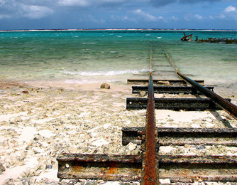
Observations on the EVI
Other Elements Not included in the EVI :
Social
Governance
Ecosystem elements
Debt
Trade-openness
Digital divide
Migration
Demographic factors
Other Comments
Social and Governance: Not exogenous ; Small states structural vulnerability driven mainly by external shocks rather than social and political issues.
Biodiversity is not a direct measure of the vulnerability. Partly a natural endowment, negligible statistical significance
Debt: SIDS total debt service (% of exports) vs other developing countries
Division for Sustainable Development Goals

Slide 11
INDICES USING THE EVI AS THEIR BASIS
Variations on the EVI: Considering SIDS Characteristics (EVI+):
3 Institutions: UNDP, UNCTAD, Caribbean Development Bank (CDB)
UNDP
UNCTAD
CDB
International tourism, receipts (percentage of total exports)
Personal remittances, received (percentage of GDP)
Foreign direct investment, net inflows (percentage of GDP)
An exposure to climate change indicator: FERDI’s Physical Vulnerability to Climate Change Index (PVCCI)
An economic exposure indicator: UNCTAD’s Productive Capacities Index (to replace the “share of primary sectors in GDP”) Note: UNCTAD’s Productive Capacities Index does not appear to be strictly structural (institutions, governance, etc.).
covering the 3 dimensions of SD
biodiversity -tree cover, etc. (not only climate change)
debt.
Openness
Migration (only some aspects)
Tourism
Financial flows
Homicide & Gender based violence
Poverty
Division for Sustainable Development Goals

Slide 12
“Multidimensional” Indices: Strategic elements
STRATEGIC ELEMENTS | UNDP | UNCTAD | CDB | CDP | ComSec | RCO
Foundation | EVI | EVI | EVI | EVI | Original | Original
Data (easy access/management?) | Yes | Yes | Yes (proxy indicator) | Yes | Yes (proxy indicator) | Yes (proxy indicator)
Geographical Coverage (Universal/SIDS?) | Universal | Universal | SIDS only but could be exp. | Universal | Universal | Universal
Debt (is debt included?) | No | No | Yes | No | Yes | No
3 Dimensions of S.D | 2 | 2 | 3 | 2 | 3 | 2
LDC Comparaison/ranking (are SIDS more vulnerable than LDC?) | “Of the top 25 most vulnerable countries in MVI, 14 are SIDS. MVI has more SIDS in its top ranks than the EVI” | “SIDS are more vulnerable than other developing countries” (without quantitative measurement) | n/a | “SIDS on average more vulnerable than non-SIDS SIDS that are LDCs are more vulnerable than SIDS that are non-LDCs“ | “SIDS are second to LDC small states most vulnerable group.” Also interesting to note => below | “SIDS are more vulnerable than other countries in the world”
Resilience (Is resilience included?) | No | No | Yes Albeit not separable and not defined as such | Considered independently HAI and GNIpc + 48 SGI | Yes separable Structural and non-structural resilience | Maybe (ongoing)
Shocks (are the effects of past shocks included or only exposure factors?) | Past Shocks & Exposure | Past Shocks & Exposure | Past Shocks & Exposure | Past Shocks & Exposure | Past Shocks & Exposure | Exposure & Past natural disasters only
Focus on SIDS (is the index considering only unique sids characteristics or a broader set of factors?) | Broad | Broad | SIDS | Broad | Broad | SIDS
Number of indicators | 11 | 65 (46 for PCI, 10 for PVCCI, 7 for EVI) | 24 | 8 (48 SGI) | 48 (30 for vulnerability & 18 for resilience) | 11
=> “Small states structural vulnerability driven mainly by vulnerability to economic and natural disaster shocks and climate change rather than social and political issues”.
Notes:
A focus on last 2 colomns

Slide 13
The Commonwealth Approach - A Universal Vulnerability Index
UVI
Structure:
Structural Vulnerability Index | Resilience Index
- Economic Vulnerability to External and Natural Shocks Index: exposure and shock - Physical Vulnerability to Climate Change Index (PVCCI) - Internal Violence Index | - Structural Resilience Index (built-up) - Non-structural resilience index (policy performance)
UVI Advantages:
- The matrix allows the isolation of exogeneous (structural) factor from non-exogeneous (non-structural) ones => allowing for smart resources allocations (key sectors)
Division for Sustainable Development Goals
Notes:
Strong emphasis on resilience and introduces notion of net vulnerability
Large coverage with limited data imputation.

Slide 14
SIDS UN Resident Coordinators developed Multidimensional Vulnerability Index
Economical Vulnerability | Structural Development Limitations | Environmental Vulnerabilities
-Economic diversification -Trade openness -Income dependency from abroad (remittances, tourism receipts, ODA) -Dependence on strategic imports (food, fuel) | -Physical size -Location -Water scarcity -Arable land | -Frequency of hydrometeorological and seismic disasters -Severity of hydrometeorological and seismic disasters (deaths and damages) -Land area vulnerable
RCO MVI
Structure:
RCO MVI Advantages:
Indicators precisely chosen to reflect SIDS specific vulnerability
Division for Sustainable Development Goals

Slide 15
SIDS UN Resident Coordinators developed Multidimensional Vulnerability Index
Not included (observations based on discussions)
- Social vulnerability
- Migration
- Digital
- Biodiversity
- Debt
Division for Sustainable Development Goals
Notes:
N.B. While providing a large coverage (196 countries), it does not include vulnerabilities of other categories of developing countries (e.g. non-SIDS LDCs) making it somewhat less universal than its coverage might suggest.

Slide 16
“Thematic Indices & Frameworks
Division for Sustainable Development Goals

Slide 17
Multidimensional poverty indices:
Disaster risk and Humanitarian risk index
/indicators
Oxford University - Poverty index (Oxford)
WMO - Global Draught Risk
FAO - Rural poverty index (FAO)
UNFPA - Population adjusted INFORM index and the Demographic explorer for climate adaptation (DECA)
UNDRR- Global Risk Assessment Framework
UNEP - Inclusive Wealth Index
Human, Fragility and Other frameworks
OECD - Fragility Framework
KEY MESSAGE:
Those thematic indices and frameworks strengthen the rationale for the integration of economic, environmental and social factors in a multidimensional vulnerability index
AfDB - Country Resilience and Fragility Assessment (CRFA) framework
IMF – Debt Sustainability Analysis Framework
UNESCO – Human and Institutional Capacity

Slide 18
USE / USERS (potentially)
Division for Sustainable Development Goals

Slide 19
Advocacy - Emphasis on the vulnerability of SIDS; Leave no one behind
Monitoring, Evaluation & Measurement - Measurement of vulnerability (including exogenous shocks); Monitoring and evaluation of vulnerability and targeted policies
Evidence-based decision making - Supports evidence-based policy formulation and smart resource allocation (Tool for policy makers, development of country strategy papers, country vulnerability profiles, policy-based loans, theories of change etc)
Debt - Could assist in addressing debt vulnerability and support the achievement of debt sustainability
Finance - Access to concessional finance; MVI might co-exist with GDP per capita criteria; Potentially could be used to improve resource allocation in IFIs

Slide 20
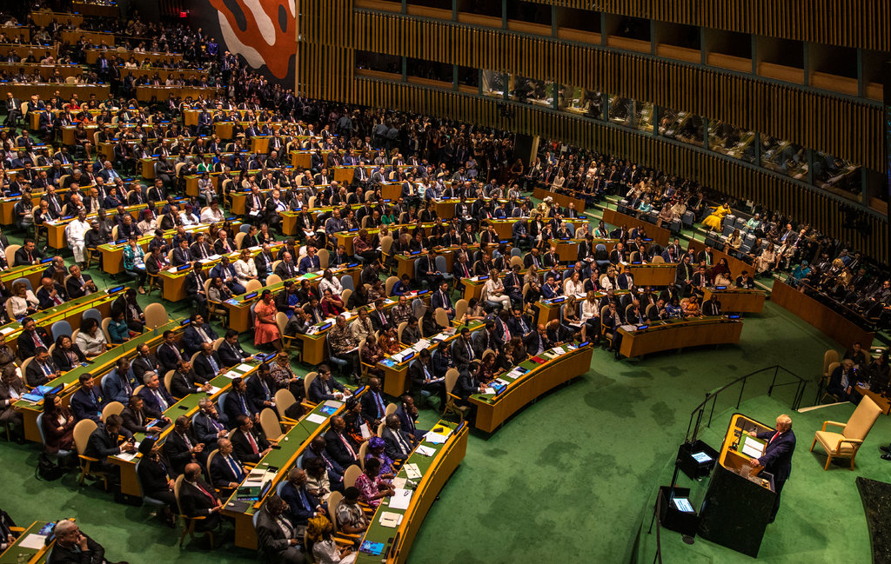
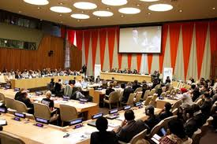
Thank you
https://sdgs.un.org/topics/small-island-developing-states/mvi
Division for Sustainable Development Goals

