Slide 1
Fostering a sustainable recovery with more and better jobs
UNFCCC-UNDESA
Harnessing Climate & SDGs Synergies to
Recover Better and Stronger from the Covid-19 Pandemic
Webinar 2: Synergies for Just Transitions & Economic Recovery
Thursday, 11 June, 10:00-11:30AM (NY time)
  Moustapha Kamal Gueye, Head, ILO Green Jobs Programme

Slide 2
Winning the narrative on a green and just recovery from COVID-19
  The COVID-19 pandemic exposed the multiple links between public health and the environment and made it evident that a healthy life and workplace and productive economies depend on a healthy environment.
  The lockdown measures and economic downturn resulted in improvements in air quality and emissions reduction.
  However, we must engage actively to correct what could be a false public perception and negative message, that the natural corollary of improving environmental conditions is economic and social damage of the scale experienced today, which could lead people to draw the wrong conclusions of what a green deal requires.
  The way governments, workers, employers and society at large responded to the COVID-19 pandemic shows that “where there is a will, there is a way”.
  There are no mutually exclusive choices to be made between environmental sustainability on the one hand, and vibrant economic activity, jobs and incomes, on the other.

Slide 3
ILO policy response based on International Labour Standards

Slide 4
Capturing the quick wins
Fostering innovation, entrepreneurship and decent work in ITC-based solutions, telemedicine, urban farming, and sustainable mobility. Some examples:
    In many low-income countries, several prototypes of touch-less hand washing systems were produced using recycled and/or reused materials from carpenters and welders.
    The REMA Medical technologies platform, based in Benin, allowed more than 5000 African medical doctors from more than 20 countries to exchange information and data in real time and to develop a community of practice.
    In Ghana, a start-up is using drones to deliver medicines, blood and medical materials to health centres located in rural area, avoiding traditional road-based transportation.
  Taking a just transition perspective in fostering a green and sustainable recovery.

Slide 5

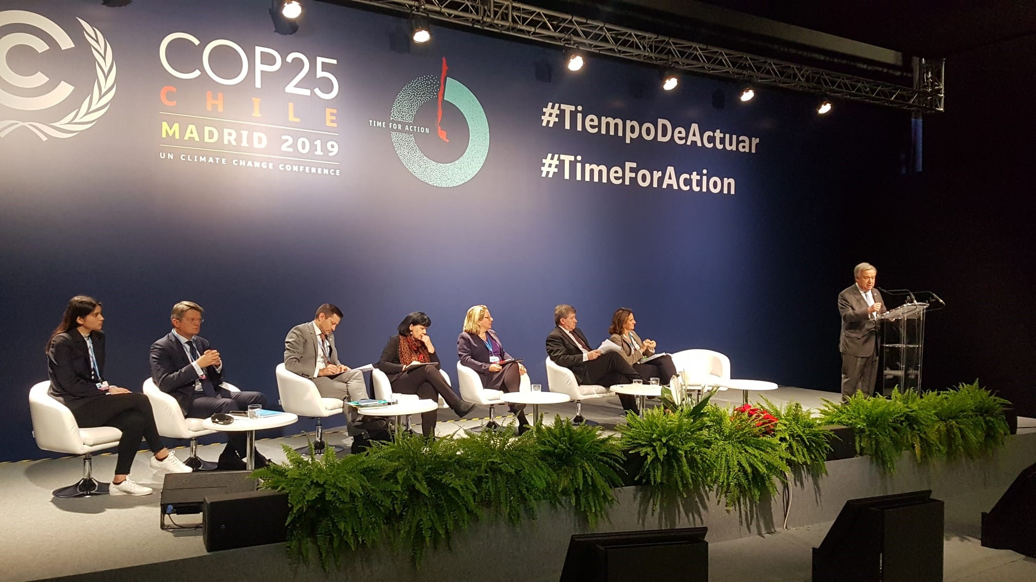
The Climate Action for Jobs Initiative
Action area resulting from the 2019 UN Climate Action Summit
46 countries made a commitment on just transition
Announced by the UN Secretary-General in Sept. 2019 and launched at COP25, Madrid, 12 December 2019
Placing decent work and livelihoods at the heart of climate action and a green recovery based on just transition principles

