Slide 1

Multidimensional Poverty and Vulnerability Indices in SIDS
Sabina Alkire, 27 April 2021
OPHI, University of Oxford

Slide 2
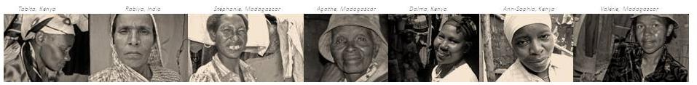
Multidimensional Indices:
National and Global

Slide 3
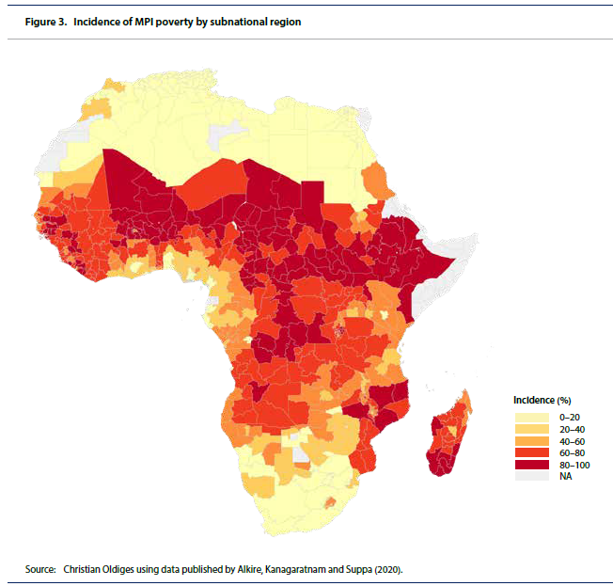
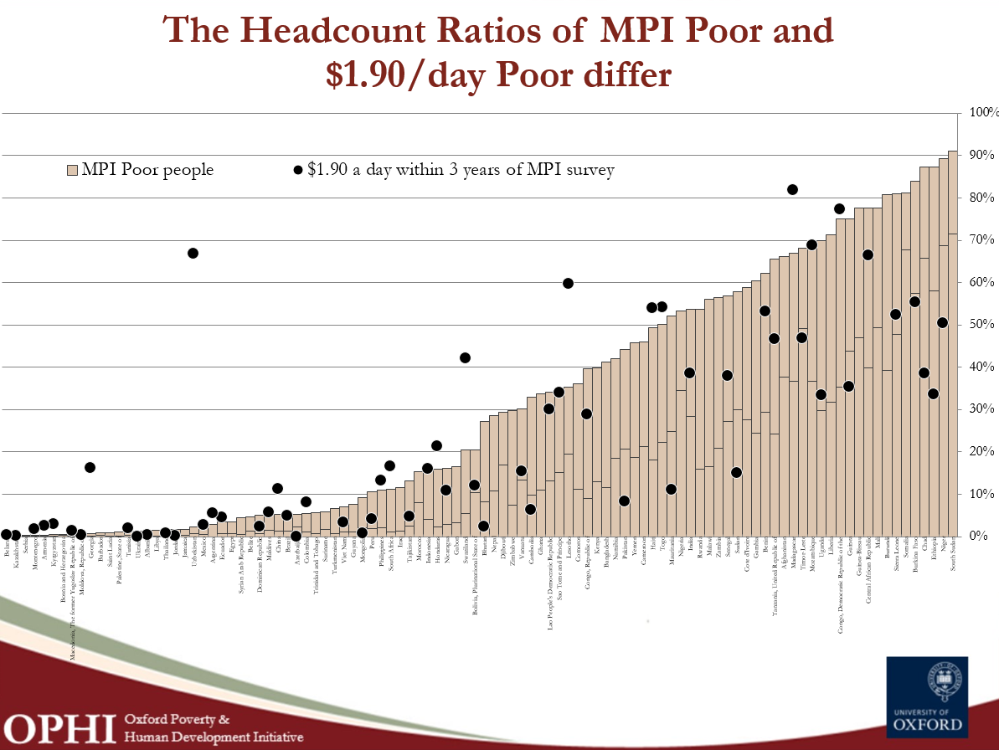
Comparable MPIs (Global MPI, ECLAC MPI)
- Like $1.90/day and $3.10/day poverty measures
- Can also compare countries (& subnational groups, over time)
- Could track SDG-1: halve poverty in its many dimensions;
- Useful to compare progress and learn from each other.

Slide 4
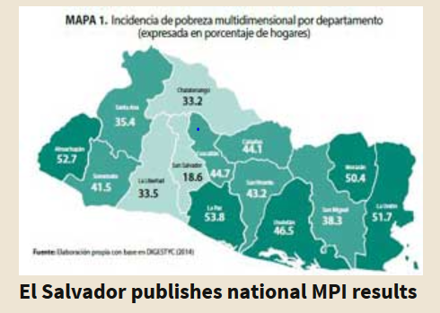
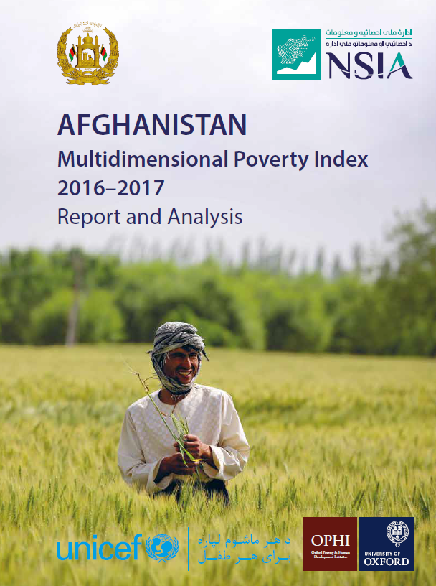

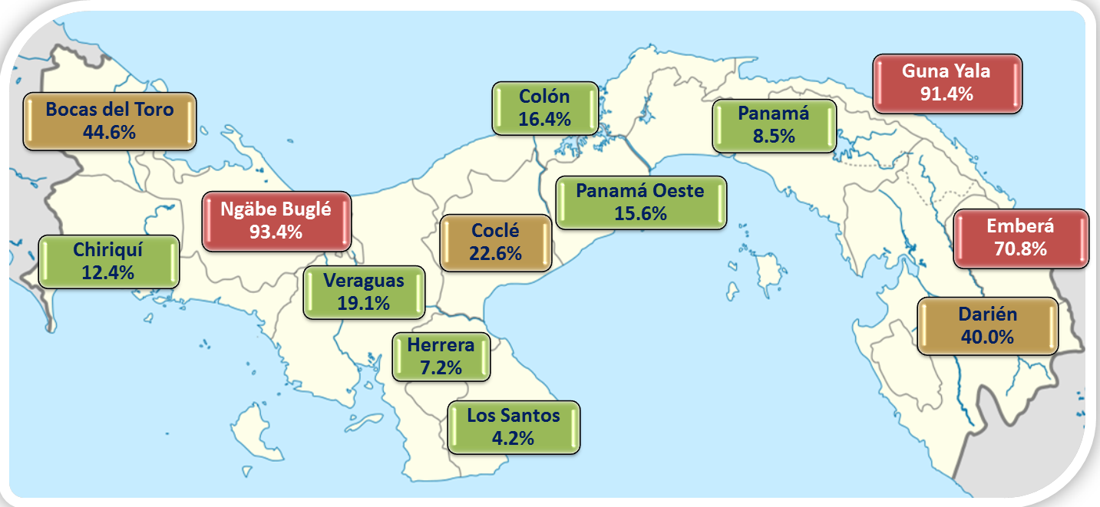
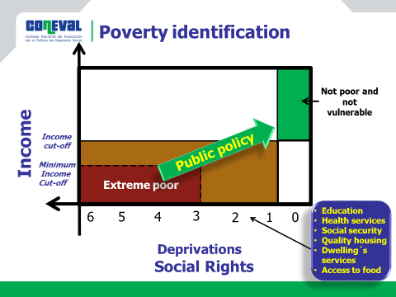
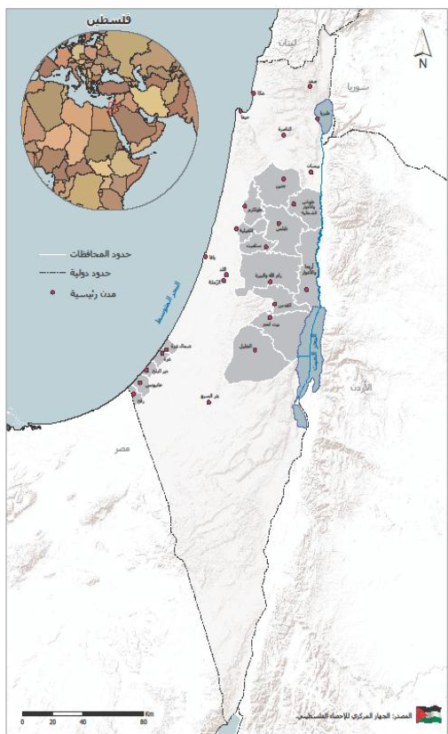
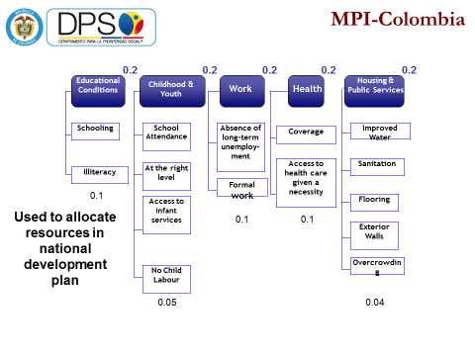
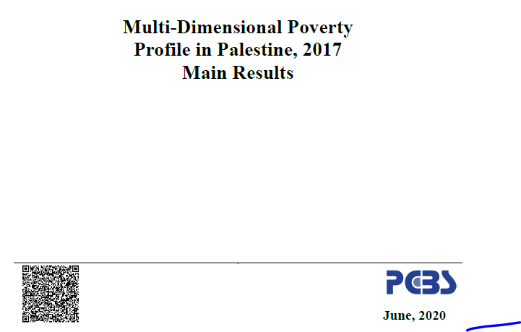
National MPIs: Tailor made for policy
Tailored to what poverty means
Compute as official national statistics
- Vital for policy: budget, target, coordinate, monitor
- Compare over time, groups, provinces…
Panama
Mexico

Slide 5
Transforming Our World (SDGs) 2015
National MPI tracks Target 1.2 and Indicator 1.2.2
Target 1.2: by 2030, reduce at least by half the proportion of men, women and children of all ages living in poverty in all its dimensions according to national definitions.
Preamble. We recognise that eradicating poverty in all its forms and dimensions, including extreme poverty, is the greatest global challenge and an indispensable requirement for sustainable development.
Preamble Sept 2015:
The interlinkages and integrated nature of the Sustainable Development Goals are of crucial importance.

Slide 6
National MPIs in the 1.2.2. Database
64 countries have reported against 1.2.2 including the following National MPIs.
Afghanistan
Armenia
Bhutan
Chile
Colombia
Costa Rica
Dominican Republic
Ecuador
El Salvador
Ghana
Guatemala
Guinea
Guinea-Bissau
14. Malaysia
15. Mali
16. Mexico
17. Morocco
18. Mozambique
19. Nepal
20. Nigeria
21. Pakistan
22. Panama
23. Philippines
24. Rwanda
25. Saint Lucia
26. Seychelles
27. South Africa
29. Sri Lanka
28. Thailand

Slide 7

The link with action
Learning about the extent of poverty is important… but it is the link with action that marks out this issue from many other subjects of study in the social sciences. Poverty statistics matter because they motivate people to tackle a key challenge. (p 1)

Slide 8
How do you calculate the MPI?
The MPI uses the Alkire & Foster (2011) Method:
1) Incidence or the headcount ratio (H ) ~ the percentage of people who are poor.
2) Intensity of people’s deprivation (A) ~ the average share of dimensions (proportion of weighted deprivations) people suffer at the same time. It shows the joint distribution of their deprivations.
Formula: MPI = M₀ = H × A

Slide 9

What is a Multidimensional Poverty Index?
Who is deprived in what?
Matrix of deprivation scores for 4 persons in 4 dimensions
 | Health | Years of Education | Housing Index | Mal-nourished
y = | ND | ND | ND | ND | Miriam
 | D | ND | ND | D | Lynda
 | D | D | D | D | Theo
 | ND | D | ND | ND | David

Slide 10
Intuitive explanation!
(to simplify we assume equal weights in this example)
Who is poor?
Fix poverty cut-off k, identify as poor if ci >= 2
 | Housing | Years of Education | Housing Index | Mal-nourished | c
y = | ND | ND | ND | ND | 0
 | D | ND | ND | D | 2
 | D | D | D | D | 4
 | ND | D | ND | ND | 1
Multidimensional Poverty Headcount (H)= 2/4
[50% of the population are poor]

Slide 11
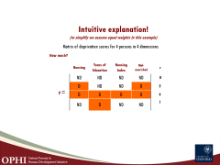

Intuitive explanation!
(to simplify we assume equal weights in this example)
Matrix of deprivation scores for 4 persons in 4 dimensions
How much?
 | Housing | Years of Education | Housing Index | Mal-nourished | c
y = | ND | ND | ND | ND | 0
 | D | ND | ND | D | 2
 | D | D | D | D | 4
 | ND | D | ND | ND | 1

Slide 12
Intuitive explanation!
(to simplify we assume equal weights in this example)
Who is poor?
Fix poverty cut-off k, identify as poor if ci >= 2
 | Housing | Years of Education | Housing Index | Mal-nourished | c
y = | ND | ND | ND | ND | 0
 | D | ND | ND | D | 2
 | D | D | D | D | 4
 | ND | D | ND | ND | 1
2/4
4/4
Intensity of deprivation among the poor (A)=(2/4+4/4)/2= 3/4 [on average the poor are deprived in 75% of the dimensions]

Slide 13
The Multidimensional Poverty Index
 | Housing | Years of Education | Housing Index | Mal-nourished | c
 | ND | ND | ND | ND | 0
 | D | ND | ND | D | 2
 | D | D | D | D | 4
 | ND | D | ND | ND | 1
Av. dep
2/4
4/4
Multidimensional Poverty Headcount Ratio H= 2/4
Intensity of deprivation among the poor A= (2/4+4/4)/2 = 3/4
MPI = H x A
= (2/4)x(3/4) = 6/16

Slide 14
The Multidimensional Poverty Index
INTERVENTION
 | Housing | Years of Education | Housing Index | Mal-nourished | c
 | ND | ND | ND | ND | 0
 | D | ND | ND | D | 2
 | D | D | D | D | 4
 | ND | D | ND | ND | 1
Av. dep
2/4
4/4
Multidimensional Poverty Headcount (H)= 2/4 = 50%
Intensity of deprivation among the poor (A)=(2/4+4/4)/2= ¾ =75%
MPI = H x A = (2/4)x(3/4) = 6/16

Slide 15
The Multidimensional Poverty Index
INTERVENTION
 | Housing | Years of Education | Housing Index | Mal-nourished | c
 | ND | ND | ND | ND | 0
 | D | ND | ND | D | 2
 | ND | D | D | D | 3
 | ND | D | ND | ND | 1
Av. dep
2/4
3/4
Multidimensional Poverty Headcount (H)= 2/4
Intensity of deprivation among the poor (A)=(2/4+3/4)/2= 5/8 = 62.5%
MPI = H x A = (2/4)x(5/8) = 10/32=5/16

Slide 16
the Global MPI 2020 all materials are online!
Use them for your research!

Slide 17
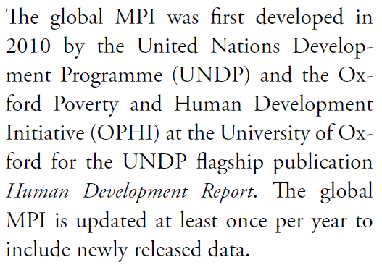
What is the global MPI?

Slide 18
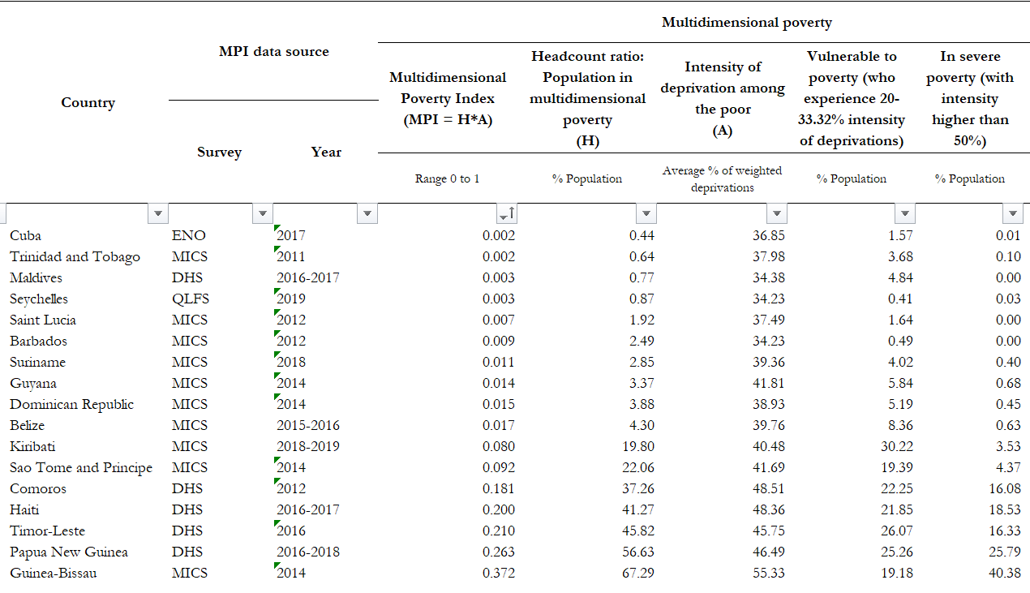
17 SIDS in the global MPI
Range from 0.4% to 67.3%; 10 < 5%
Including Vulnerability from 2% to 87%

Slide 19
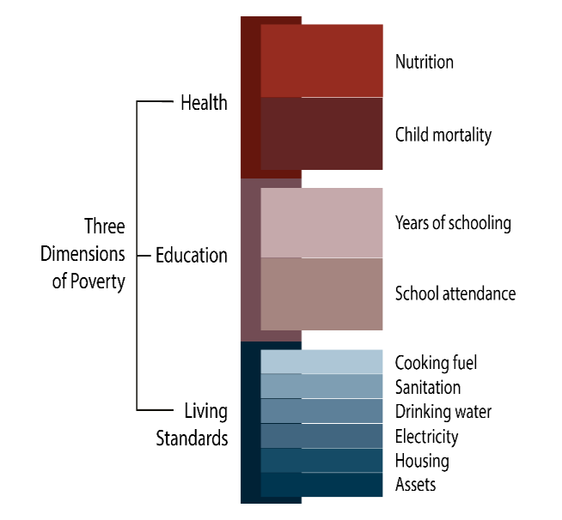
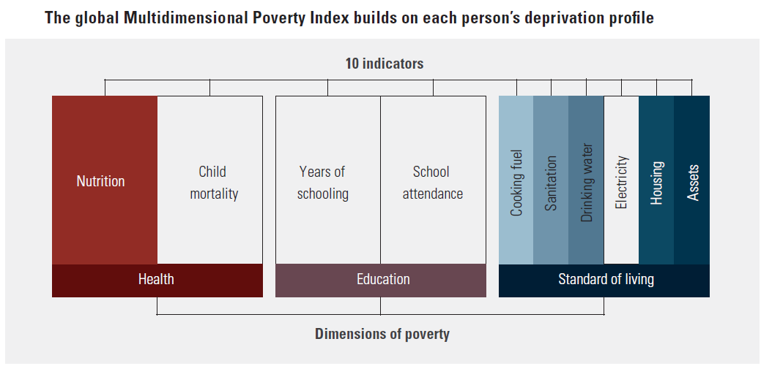
Computing an MPI
1. Consider the indicators
2. Build a Deprivation Profile for each person
3. Identify Who is Poor
A person who is deprived in 1/3 or more of the weighted indicators is MPI poor.
Amutha’s deprivation score: 44.4%
She is MPI poor.
4. Compute MPI (AF methodology)
MPI = H x A
H (Incidence) = Headcount ratio
A (Intensity) = Average deprivation score among poor
Notes:
In sum, the global MPI examines each person’s deprivations across 10 indicators in three equally weighted dimensions—health, education and standard of living and offers a high-resolution lens to identify both who is poor and how they are poor.
The MPI is the product of the incidence of poverty (proportion of poor people) and the intensity of poverty (average deprivation score of poor people).
The MPI is therefore sensitive to changes in both components – the H & A. The MPI ranges from 0 to 1, and higher values imply higher poverty

Slide 20
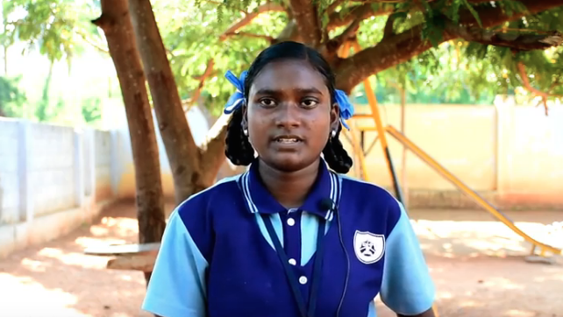
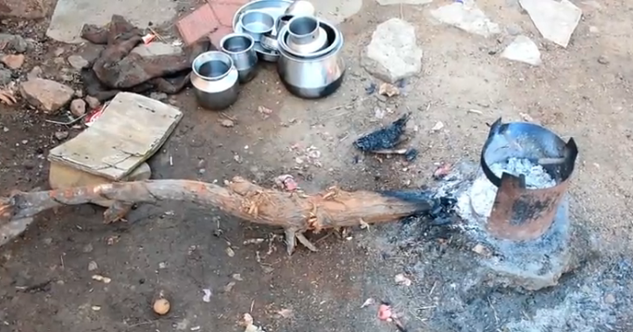
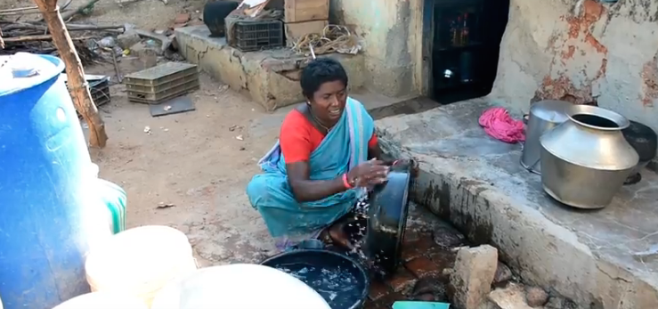
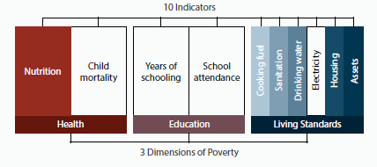
14-year old Amutha, India
Amutha and her family are deprived in 44.4%
of the MPI weighted indicators. That’s over 33.3% so is poor.

Slide 21
Understanding Poverty
What does an MPI or MVI show?

Slide 22
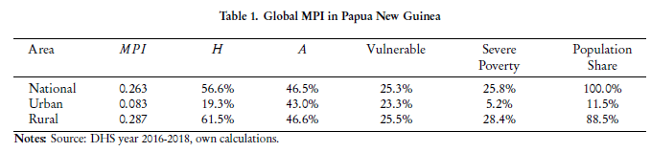
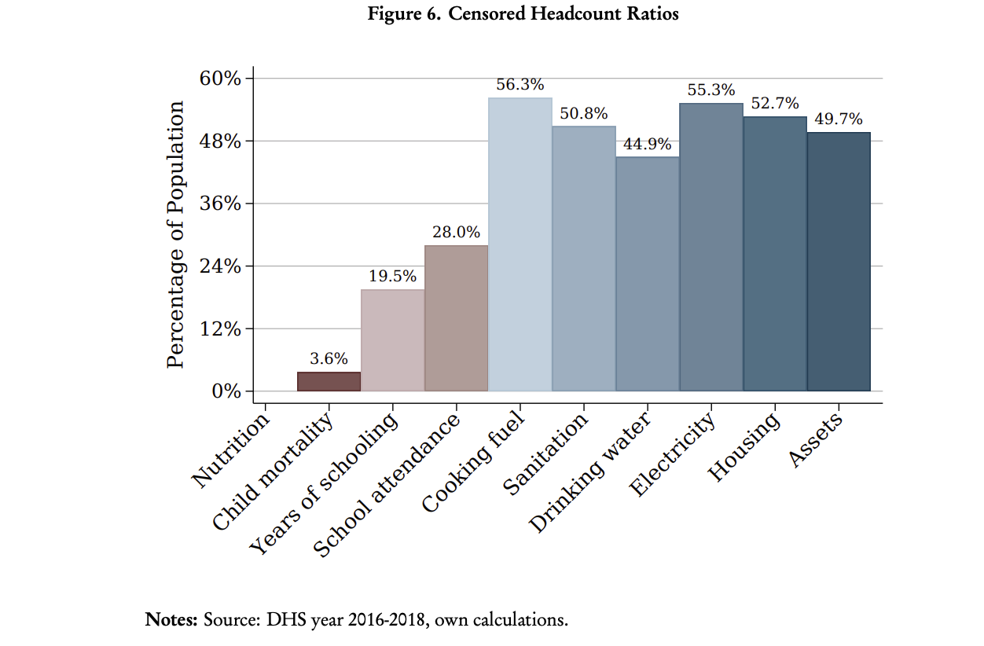
Papua New Guinea

Slide 23
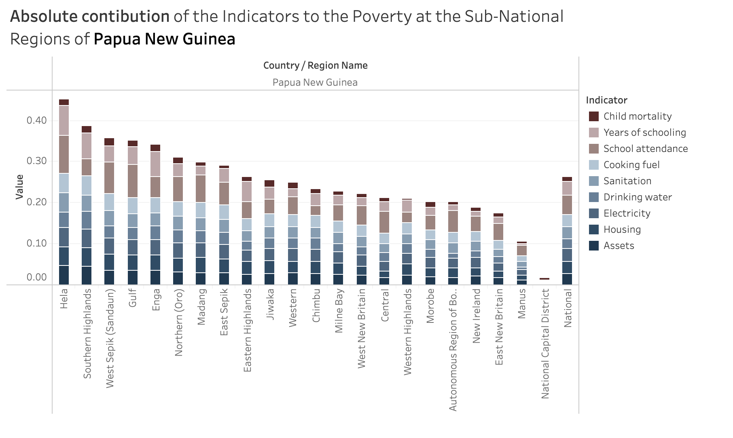
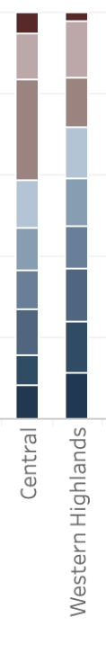
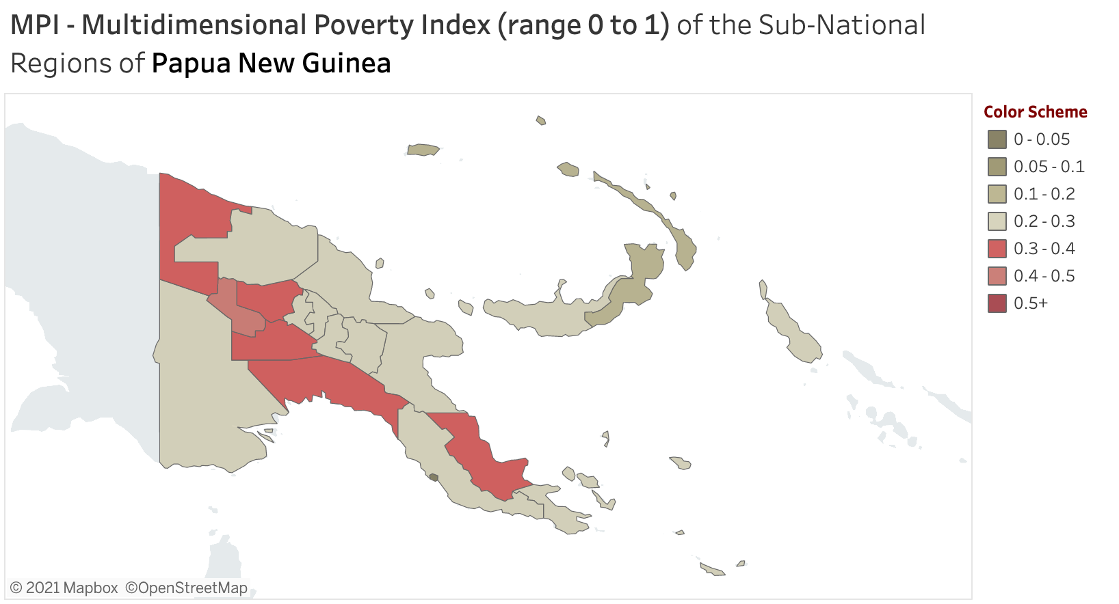
Papua New Guinea: 5-87% across regions

Slide 24
Possible way forward:
Moderate MPI
Measures same dimensions of poverty (same as the global MPI)
Adjusts most or all indicators to a higher level of wellbeing
By construction, MMPI is a superset of global MPI
  Allows global comparison
  Provides a meaningful gradiant to multidimensional poverty
  Benefits from the familiarity and wide recognition of the dimensions
The MMPI parallels Destitution (a subset of global MPI poor)
  Also adjusts indicator definitions (deprivation cutoffs) using the same weights and poverty cutoff.
Notes:
The proposed MMPI builds on the same principles and aligns itself with these three dimensions of well-being: Health, Education, and Living Standards.
This choice of dimensions enables comparisons between the global MPI and MMPI estimates of poverty and facilitates communication around the indices as the main structure is widely known in the international policy fora.
MMPI – like the global MPI – is geared towards defining a set of universal, enhanced capabilities required to enable people to move out of poverty in any development context.

Slide 25
National MPIs in SIDS
What Indicators are Currently used?

Slide 26

Maldives National MPI:
A Tool to Track SDG Target 1.2
The Global SDGs, adopted on 25 Sept 2015, address poverty in all its forms and dimensions.
The first SDG target (1.1) is to end $1.90/day monetary poverty.
The second target (1.2): to halve multidimensional poverty.
Target 1.2: by 2030, reduce at least by half the proportion of men, women and children of all ages living in poverty in all its dimensions according to national definitions.

Slide 27
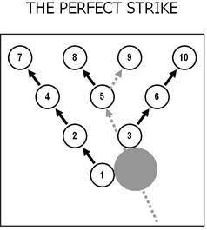

Maldives National MPI:
To Monitor Progress in the SDGs
National MPI Dimension | National MPI Indicator (Deprivation) | SDG Target | Starting level | Absolute change 2009-16 (pp)
 |  |  | (% deprived & MPI poor)
Health & Education | Obesity | 2.2 | 12.2% | -0.4%
 | Underweight | 2.2 | 13.7% | -1.8%
 | Access to Health Care | 3.8 | 50.5% | -29.2%
Education & Information | Years of Schooling | 4.1 | 60.0% | -47.8%
 | Access to internet | 9.c | 61.4% | -46.1%
Housing | Safe drinking water | 6.1 | 52.7% | -34.7%
 | Toilet/Sewage | 6.2 | 50.8% | -31.0%
 | Overcrowding | 11. | 21.5% | -13.7%

Slide 28
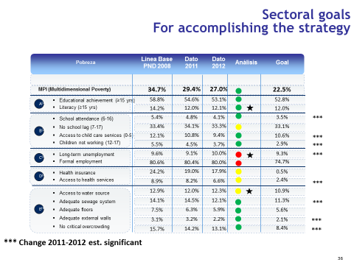
Maldives National MPI:
To Inform Policy & Planning
Complement monetary poverty statistics
Track poverty over time (official statistics)
Allocate resources by sector and by region
Target marginalized regions, groups, or households
Coordinate policy across sectors and subnational levels
Adjust policies by what works (measure to manage)
Leave No One Behind see the poorest & track trends
Be Transparent so all stakeholders engage – NGOs,
    private sector and all parts of government.

Slide 29
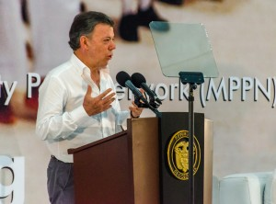
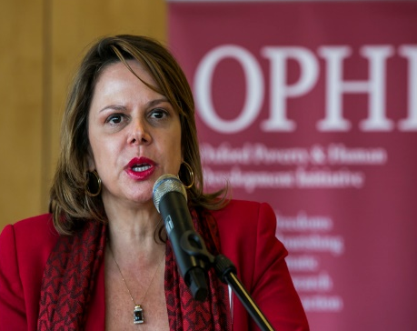
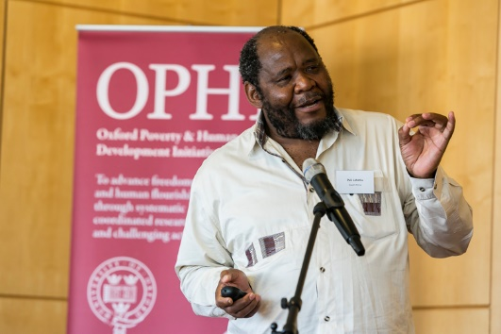

Maldives joined the International Community Adopting the MPI as an Official Statistic of Poverty
In South Asia: Bhutan, Nepal Pakistan, Afghanistan
SIDS: Seychelles, Dominican Republic
Across the world: Colombia, Mexico, Panama, Chile, Sierra Leone …
The Multidimensional Poverty Peer Network (MPPN) brings together countries working on multidimensional poverty

Slide 30
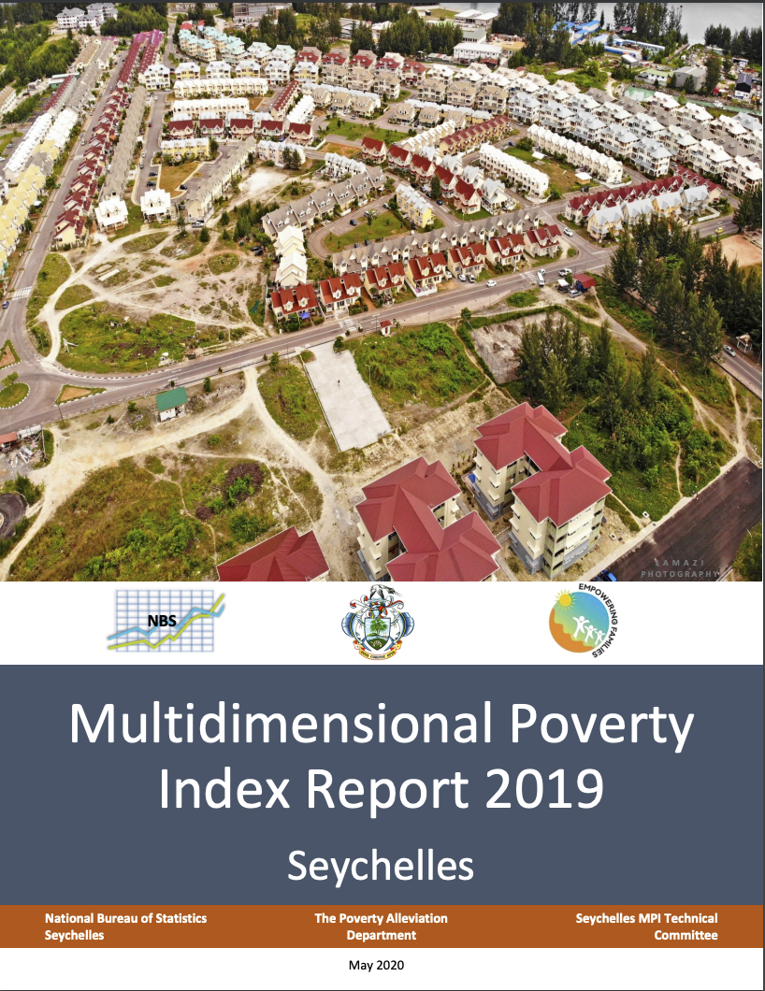
Seychelles National MPI: Purpose
Joined MPPN in 2014
“identify the range of deprivations that people in Seychelles face”
inform the initiation of GOV programmes to “eradicate multidimensional poverty”
“enable policy-makers to track changes and monitor poverty”

Slide 31
Seychelles National MPI: ‘Pilot’
Existing African National MPIs all for the Mainland and Low-Income-Countries
Special Situation of Seychelles as SIDS and Middle-Income Country
Pilot MPI constructed to explore feasible indicators (2018)
This Pilot was then revised to obtain the final National MPI structure

Slide 32
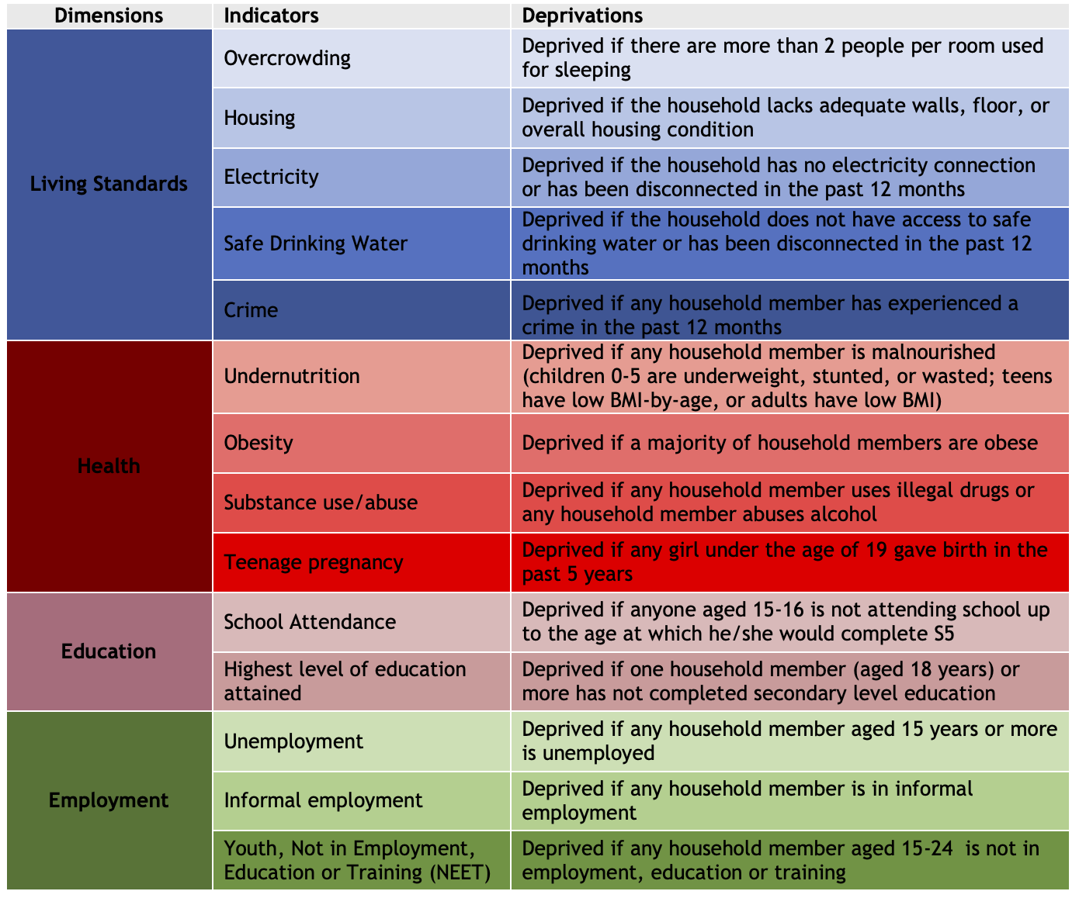
Structure
of the
Seychelles
National MPI
Equal
Nested
Weights
Multidimensional
Poverty
Cutoff
= 25%

Slide 33
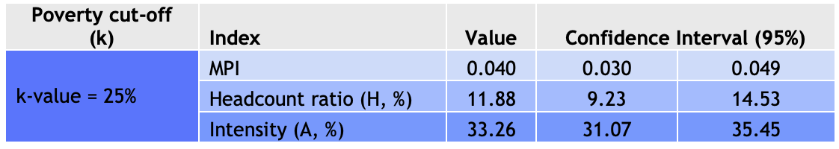
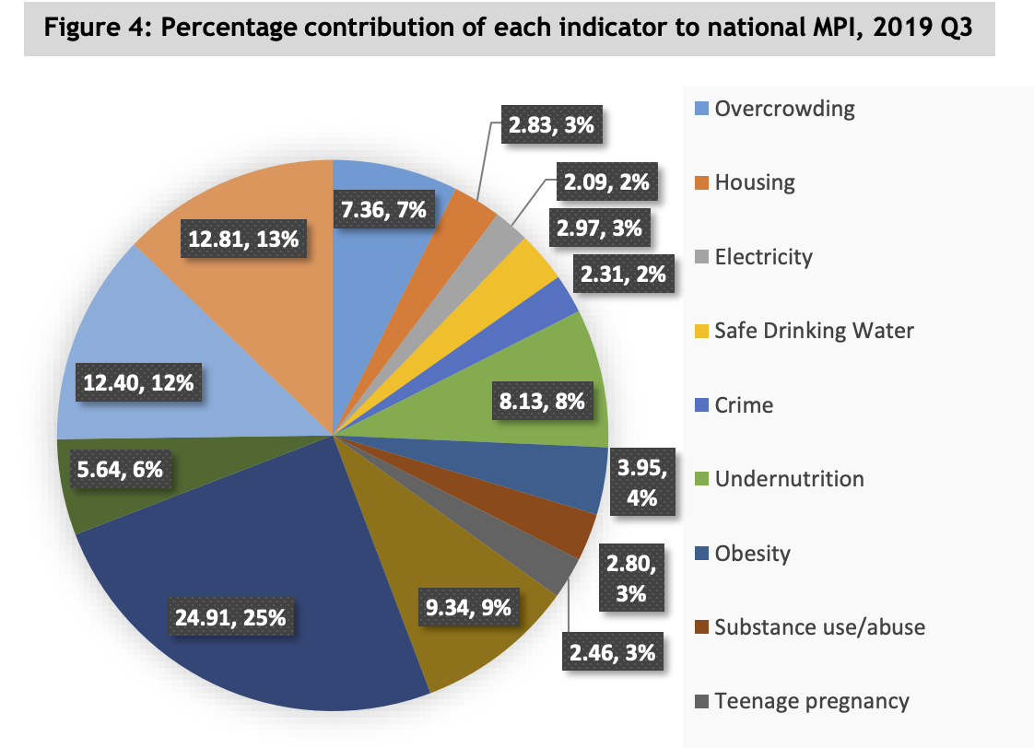
Seychelles National MPI: Results
Disaggregated by:
Household Size
Sex of Household Head
Age
Labour Force Status
Education of Household Head
Island

Slide 34

Dominican Republic National MPI
Joined MPPN in 2013
Launched in 2017
Most recent report: 2020
Based on data from unique MPI-Questionnaire that captures deprivations identified through participatory exercises
Provides information for social policy interventions, resource allocation and governance

Slide 35
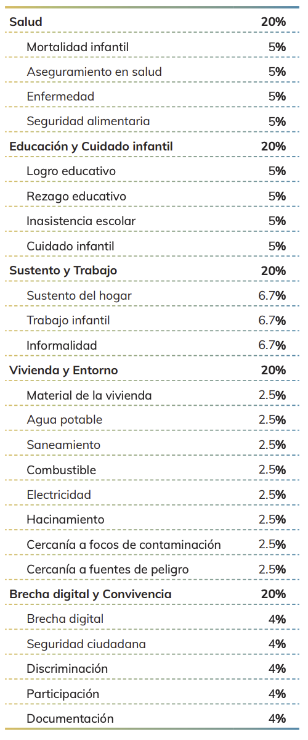
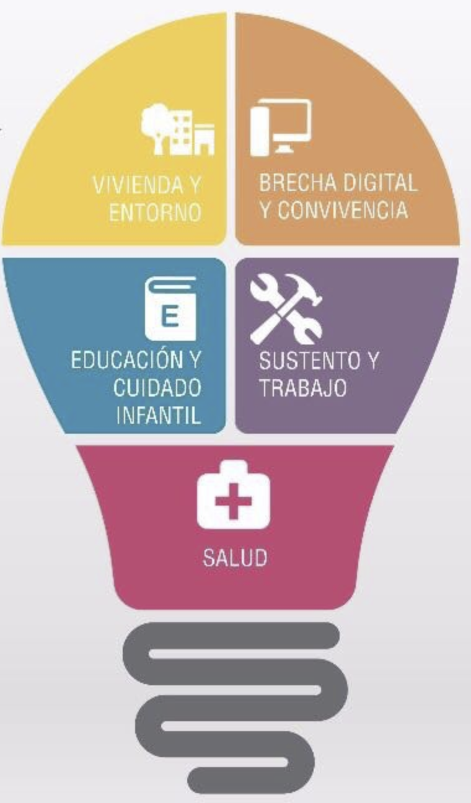
Dominican Republic
National MPI: Structure
5 Dimensions
24 Indicators
Equal Nested Weights
Multidimensional
Poverty Cutoff
= 33%

Slide 36
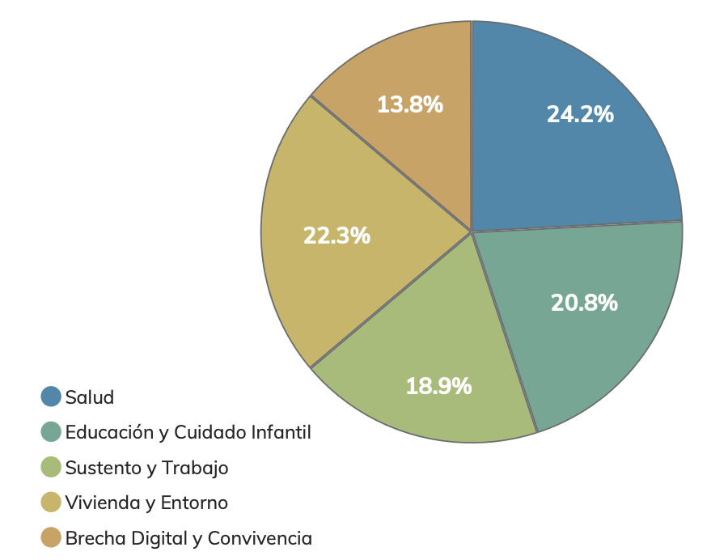
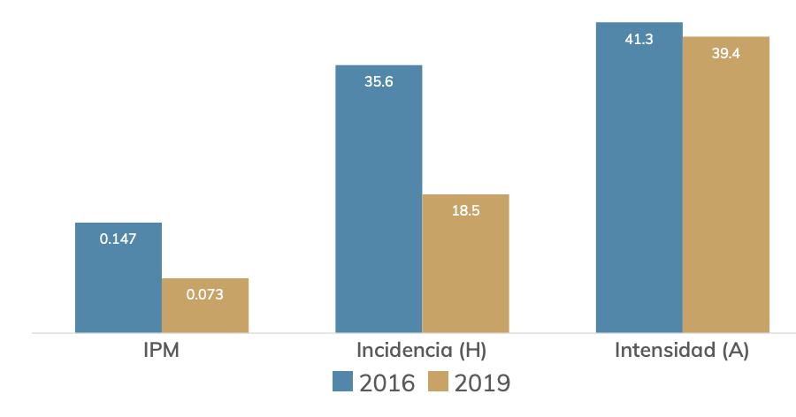
Dominican Republic National MPI: Results
Disaggregated by:
Geographical Region (Urban/Rural/Metropolitan)

Slide 37
SIDS Multidimensional Poverty Indices in VNRs / SDG 1.2.2
VNRs
Dominican Republic
Seychelles
Tonga
SDG 1.2.2 Database
Dominican Republic
Guinea-Bissau
Saint Lucia
Seychelles

Slide 38
Closing thoughts
SIDS have widely varying levels of poverty. It could be useful to have a consistent but ‘nested’ structure
  Either with multiple poverty cutoffs (MPI, MVI)
  Or with alternative deprivation definitions (like Destitution vs MPI, but now a MPI and Moderate MPI or MVI).
  In this case, one adjusts indicator definitions to have two levels, but keep the same weight and cutoffs, so that the MPI is a strict subset of the Moderate MPI / MVI.
However is there a ‘core’ set of indicators for all SIDS?
A challenge is consistent datasets and disaggregation, but other regions are innovating (UNECE, ESCWA, LAC)
A key is to go beyond measurement to policy.

Slide 39
In Progress
OECS: St Lucia, St Vincent, Granada, Antiga and Bermuda
Samoa: Training on National MPI
St Lucia: MVI
Jamaica:National MPI
Belize: Training on MPI
Mauritius: Preliminary National MPI

Slide 40
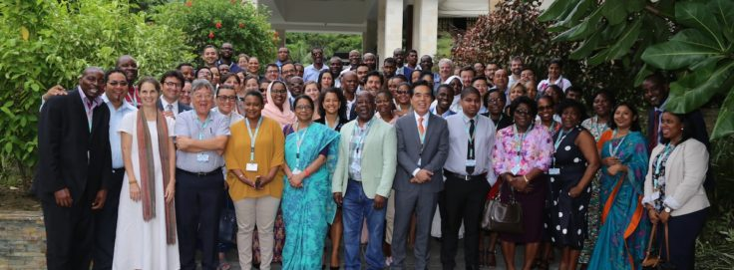
MPPN seventh Meeting, Seychelles
2019, 58 country participants + 19 agencies

Slide 41
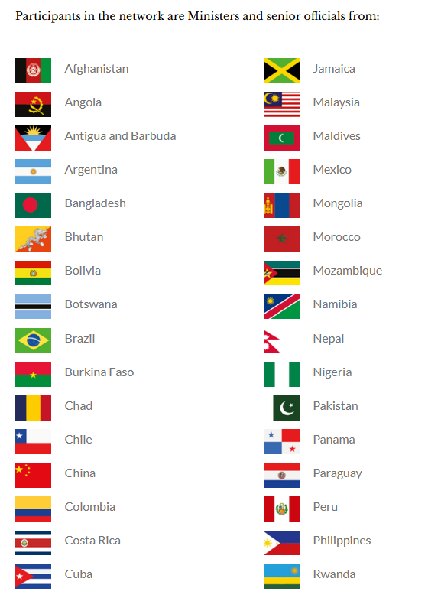
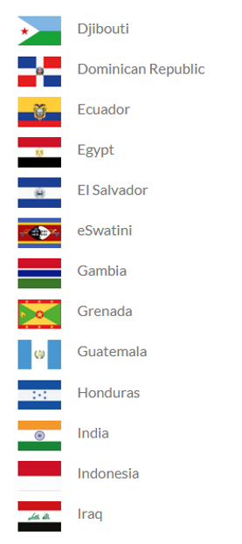
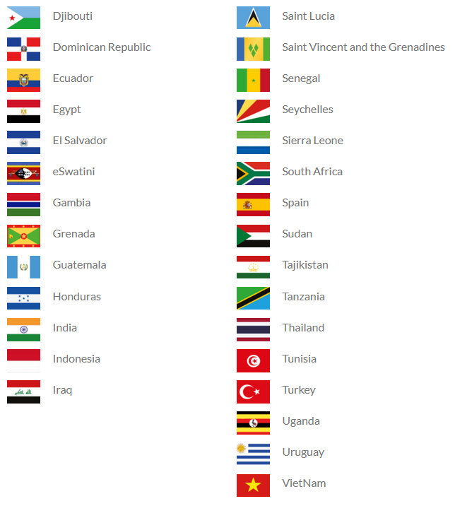
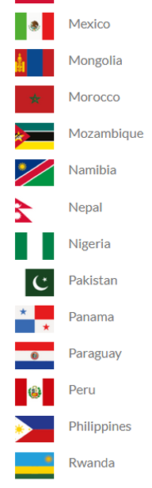
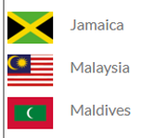
Multidimensional Poverty Peer Network (MPPN) = 60 countries; Join us!
www.ophi.org.uk www.mppn.org

