Slide 1
Challenges for Debt Sustainability Analysis in Small States: Incorporating Natural Disaster Risks in the DSA
Presented by: Modeste Some
Debt Policy Division
Strategy, Policy, and Review Department
International Monetary Fund

Slide 2
IMF Definition of Small States
Countries with a population below 1.5 million that are not advanced market economies or high-income oil exporting countries: 34 IMF members
Of which 20 are using the LIC DSF (the focus in this presentation) and the rest are using the MAC DSA.
The vast majority are small islands developing states (SIDS) by the UN

Slide 3
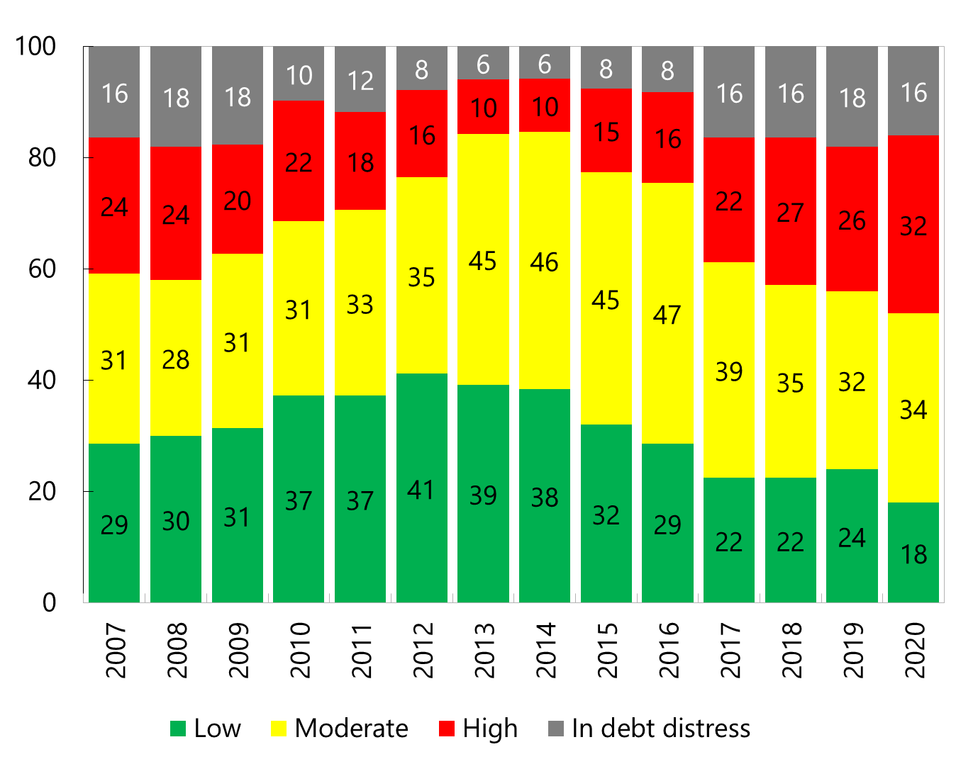
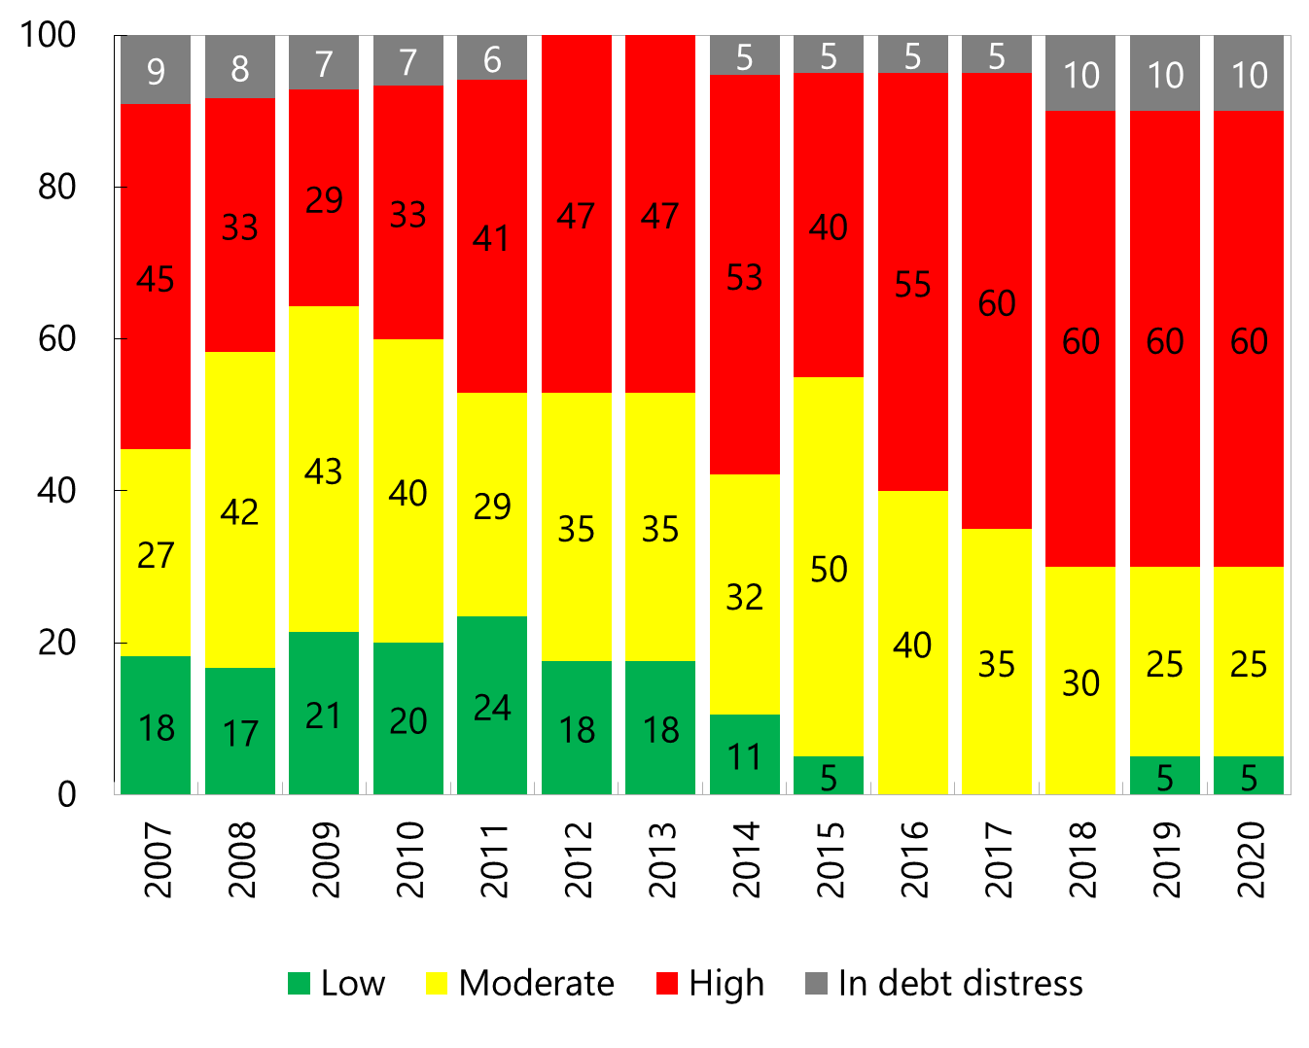
1. Small states have higher debt vulnerabilities than the average LIC…
Risk ratings in LICs have been worsening before the COVID-19 shock
Small State LICs: higher share of high- risk cases
Evolution of Risk of Debt Distress
(In percent of total number of LICs excluding SS with DSAs)
Evolution of Risk of Debt Distress
(In percent of total number of SS LICs with DSAs)
Source: LIC DSA database
* As of end-December 2020

Slide 4
…with significant challenges in assessing sustainability
General guidance on sustainability
Specific challenges in Small States
Sustainability is fundamentally a matter for judgment (high risk rating ≠ unsustainable). The LIC-DSF GN covers general considerations:
Whether debt burden indicators are at high levels and continuously rising.
Whether breaches of benchmarks are significant (in magnitude) or sustained (beyond four to five years); cover both debt stock and debt service indicators; and only turn-around after some time.
Whether the projected debt path is one in which we have strong confidence (thus the importance of realism tools).
High volatility due to narrow economic structure: how to assess?
Standard time horizon may not capture risks (resource depletion, loss of grants, climate etc.)
Projecting grants: LIC DSF cannot assume a level that would not result in grants. (Donor consultations needed.)
Regional consistency accounting for natural disaster risks. [e.g., Caribbean countries use similar baseline assumptions].

Slide 5
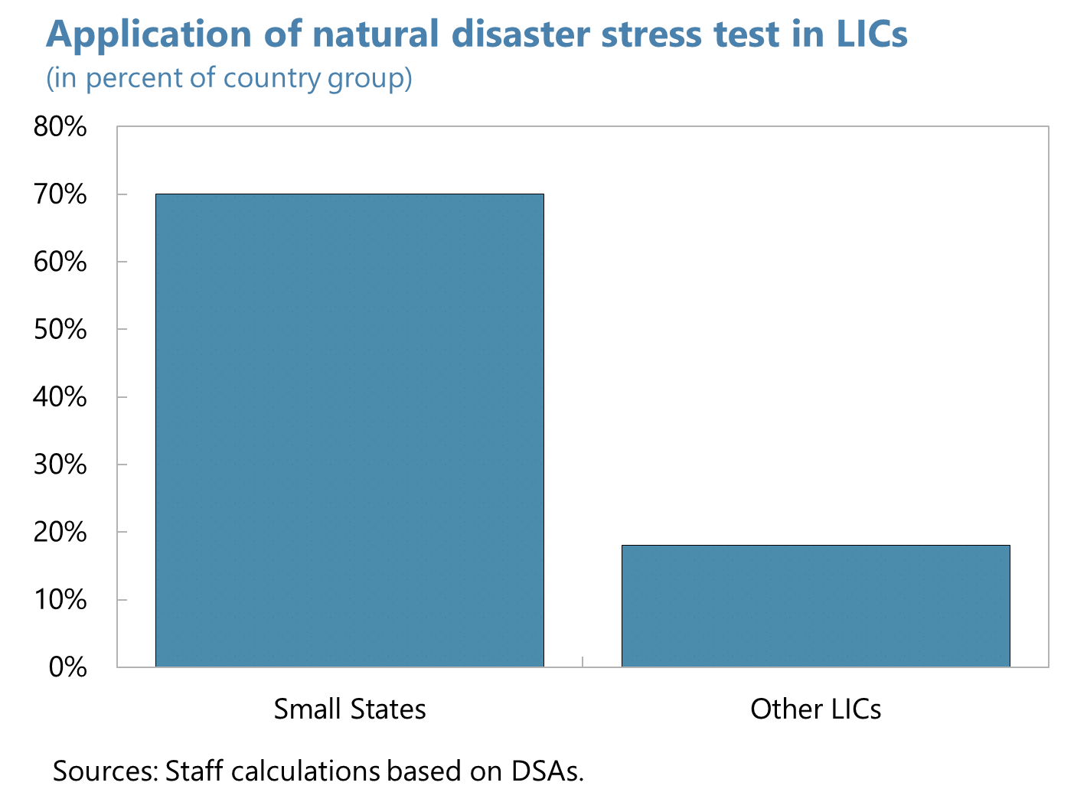
2. Incorporating climate/disaster risk is critical…
Small States are far more vulnerable than other countries to natural disasters…
…which are more frequent and cause considerably more damage.
Notes:
annual cost of disasters (can be more than four times that of larger countries).
Natural disaster shock. Applies to small states vulnerable to natural disasters (IMF 2016), and LICs that meet a frequency criteria (2 disasters every 3 years) and economic loss criteria (above 5 percent of GDP per year), based on the EM-DAT database during 1950–2015. Users are expected to adjust the default parameters if assumptions about the impact of natural disasters are already embedded in the baseline scenario.
Group 1: Small-state LICs identified as vulnerable to natural disasters in IMF (2016). Out of 20 Small States, there are 14 triggered: Comoros, Dominica, Grenada, Kiribati, Maldives, Micronesia, Samoa, São Tomé and Príncipe, Solomon Islands, St. Lucia, St. Vincent and the Grenadines, Tonga, Tuvalu, and Vanuatu.
Group 2: LICs that meet a frequency (around 2 disasters every 3 years) and economic losses (above 5 percent of GDP per year) criteria, based on the EM-DAT database during 1950-2015. These criteria lie between the 75th and 90th percentile of the respective distributions. Out of 50 non-Small States, this triggers 9 countries: Bangladesh, Haiti, Honduras, Nepal, Madagascar, Mozambique, Myanmar, Nicaragua, and Tajikistan.
References:
IMF Policy Paper (2016), “Small States’ Resilience to Natural Disasters and Climate Change—Role of IMF”.
The International Disaster Database (EM-DAT) prepared by Center for Research on the Epidemiology of Disasters (CRED) http://www.emdat.be/
Baseline: Average annual cost example: If a hurricane occurs once every 5 years on average and reduces growth by 2.5 percentage points, projected growth would be reduced by 0.5 percentage point per year.
For such states, emerging from a period of instability/disaster may involve a temporary boost to growth and the macroeconomy more generally, and care needs to be taken not to extrapolate too far into the projection period.

Slide 6
3. IMF Staff Account for Natural Disaster Risks in the DSA: Baseline + Triggered Stress Tests…
Triggered stress test for LIC DSF countries
One-off shock to public debt of 10 percent of GDP in the second year of projection;
Real GDP growth lowered by 1.5 percentage points in the year of the shock
Nominal growth of exports is lowered by 3.5 percentage points in the year of the shock.
New feature in the upcoming update to the DSA for Middle Income and Advanced Economics (SRDSF, old MAC DSA): triggered natural disaster stress test
One-off shock to public debt of 7 percent of GDP;
Real GDP growth lowered by 5 percentage points in the year of the shock
Users can customize default parameters to account for country specificities (baseline assumptions, recent empirical studies, etc.)
Notes:
annual cost of disasters (can be more than four times that of larger countries).
Natural disaster shock. Applies to small states vulnerable to natural disasters (IMF 2016), and LICs that meet a frequency criteria (2 disasters every 3 years) and economic loss criteria (above 5 percent of GDP per year), based on the EM-DAT database during 1950–2015. Users are expected to adjust the default parameters if assumptions about the impact of natural disasters are already embedded in the baseline scenario.
Group 1: Small-state LICs identified as vulnerable to natural disasters in IMF (2016). Out of 20 Small States, there are 14 triggered: Comoros, Dominica, Grenada, Kiribati, Maldives, Micronesia, Samoa, São Tomé and Príncipe, Solomon Islands, St. Lucia, St. Vincent and the Grenadines, Tonga, Tuvalu, and Vanuatu.
Group 2: LICs that meet a frequency (around 2 disasters every 3 years) and economic losses (above 5 percent of GDP per year) criteria, based on the EM-DAT database during 1950-2015. These criteria lie between the 75th and 90th percentile of the respective distributions. Out of 50 non-Small States, this triggers 9 countries: Bangladesh, Haiti, Honduras, Nepal, Madagascar, Mozambique, Myanmar, Nicaragua, and Tajikistan.
References:
IMF Policy Paper (2016), “Small States’ Resilience to Natural Disasters and Climate Change—Role of IMF”.
The International Disaster Database (EM-DAT) prepared by Center for Research on the Epidemiology of Disasters (CRED) http://www.emdat.be/
Baseline: Average annual cost example: If a hurricane occurs once every 5 years on average and reduces growth by 2.5 percentage points, projected growth would be reduced by 0.5 percentage point per year.
For such states, emerging from a period of instability/disaster may involve a temporary boost to growth and the macroeconomy more generally, and care needs to be taken not to extrapolate too far into the projection period.

Slide 7
…but there are various challenges in practice.
Calibrating natural disaster stress tests
Assessing adaptation measures
Netting out the “average” impact that may already be in the baseline, reflected in average growth and other variables (which itself is difficult to model).
Getting the size of the shock right. For LIC DSF countries, the default—10 percent of GDP—is based on a backward-looking event analysis that may not properly signal future costs.
Assessing the probability of the natural disasters and their impact (should it impact risk rating more? Or even sustainability?). Again, data is backward looking and may not capture future well.
Climate-resilient debt instruments (e.g. with hurricane clauses). Modeling these in shock scenarios.
Investments in resilient infrastructure
Immediate cost (debt and debt service) and thus adverse impact on DSA
Is the benefit in shock scenarios enough to offset baseline impact? (Depends on how frequent shocks are, and how costly the investment is.)
Notes:
For countries assessed at high risk of debt distress or already in debt distress, the natural disaster shocks tends not to inform the risk rating because the countries are either at high risk of debt distress or in debt distress already. And the tailored natural disaster shock results in a sharper deterioration of debt sustainability in all cases.
The impact of a natural disaster can vary across countries in terms of the magnitude of the damage as well as the approach taken to rebuild: some countries may not necessarily choose for frontloaded rebuilding of infrastructure in the aftermath of a natural disaster.
Out of 24 cases where shock applied: [7] countries customized the size (average 15 percent); [8] customized the interactions.
Shock was the most extreme in around 10-20 percent of cases where it was applied.
For cases of high risk of debt distress and in debt distress, the shock makes debt sustainability challenging.

Slide 8
4. Natural Disaster Shocks in Small States
7 of 20 small states have used the natural disaster tailored stress test in the new LIC-DSF
Grenada, Maldives, Samoa, Solomon Islands, St. Vincent and the Grenadines, Kiribati, and Vanuatu
3 countries customized the shock to be larger than default (10 percent of GDP) & 5 countries customized the interaction between the macro variables for the shock
Notes:
In most of the other cases, the natural disaster shocks tends not to inform the risk rating because the countries are either at high risk of debt distress or in debt distress already (five out of the eight countries).
Solomon islands assumes 14 percent of GDP natural disaster shock based on the country’s largest damage from natural disasters
Tailored natural disaster shock result in a sharper deterioration of debt sustainability in all cases
Grenada D
St. Vincent, Maldives, Samoa H
Solomon islands, Vanuatu (downgraded by the natural disaster shock) M
DSA shows that is extremely challenging to maintain debt sustainability in cases of the natural disaster
The natural disaster shocks results in a sharper deterioration of debt sustainability in remaining cases of high and in debt distress.
Makes debt sustainability challenging
10 percent—address all infrastructure destroyed all at once.
Countries can take a gradual to rebuild and not necessarily replace all the infrastructure destroyed by the infrastructure.

Slide 9
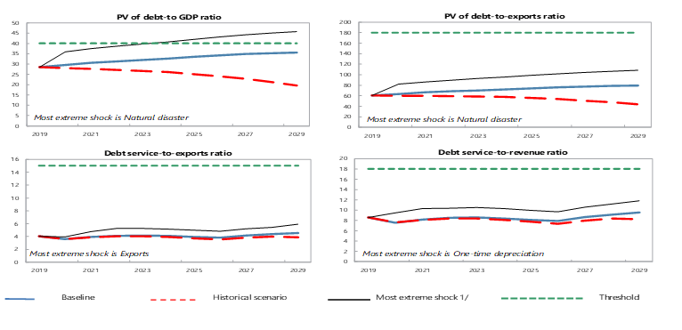
4. Natural Disaster Shocks in Small States
A small state was downgraded to moderate risk of debt distress due to breaches of the PV of debt to GDP ratio under the natural disaster stress test.
For cases of high risk of debt distress and in debt distress, the COVID-19 and natural disaster shocks make debt sustainability challenging.
Notes:
In most of the other cases, the natural disaster shocks tends not to inform the risk rating because the countries are either at high risk of debt distress or in debt distress already (five out of the eight countries).
Solomon islands assumes 14 percent of GDP natural disaster shock based on the country’s largest damage from natural disasters
Tailored natural disaster shock result in a sharper deterioration of debt sustainability in all cases
Grenada D
St. Vincent, Maldives, Samoa H
Solomon islands, Vanuatu, M
DSA shows that is extremely challenging to maintain debt sustainability in cases of the natural disaster
The natural disaster shocks results in a sharper deterioration of debt sustainability in remaining cases of high and in debt distress.
Makes debt sustainability challenging
10 percent—address all infrastructure destroyed all at once.
Countries can take a gradual to rebuild and not necessarily replace all the infrastructure destroyed by the infrastructure.

Slide 10
Key messages and policy recommendations
Policies should focus on building greater resilience to shocks while closely monitoring whether the level of debt remains sustainable.
IMF advice: Countries to contain debt, to seek concessional financing, to prioritize expenditures, to maintain fiscal buffers to cope with natural disasters and to improve revenue-raising capacity.
The Fund stands ready to meet the needs of small states, including through policy advice, lending and its capacity development and training programs.
To weather natural disasters, countries can have recourse to quick IMF financing through the Rapid Credit Facility and Rapid Financing Instruments (Dominica 2015 and Vanuatu 2015 RCF), with no ex-post conditionality.
Notes:
Use state contingent debt instruments??

Slide 11
Thank you!

