Slide 1
An Economic Vulnerability Premium for SIDS based on Economic Vulnerability Index
Multi-Dimensional Vulnerability Index for SIDS
Technical Webinar Series
Webinar 1

Slide 2
Objective
The objective of the presentation is to outline the application of the Economic Vulnerability Index (EVI) to create an Economic Vulnerability Premium for SIDS during the ADF 13 cycle.

Slide 3
ADF Grants for Which Countries?
Group Aª |  |  | Group B Access to COL and regular OCR
Access to ADF Grants only | Access to ADF grants and COL | Access to COL
Afghanistan ƒ Micronesia, Federated States of ƒσ Kiribati ƒσ Maldives σ Marshall Islands ƒσ Nauru ƒσ Samoa σ Tajikistan Tonga σ Tuvalu ƒσ | Kyrgyz Republic Solomon Islands ƒσ Vanuatu σ | Bhutan Cambodia Lao PDR Myanmar ƒ Nepal | Bangladesh Mongolia Pakistan Palau σ Papua New Guinea ƒσ Timor-Leste ƒσ Uzbekistan
ƒ = fragile and conflict-affected situation
σ = small island developing states
ª Country classification expected in 2021, subject to confirmation of debt sustainability assessments. Country classification can change during an ADF cycle.

Slide 4
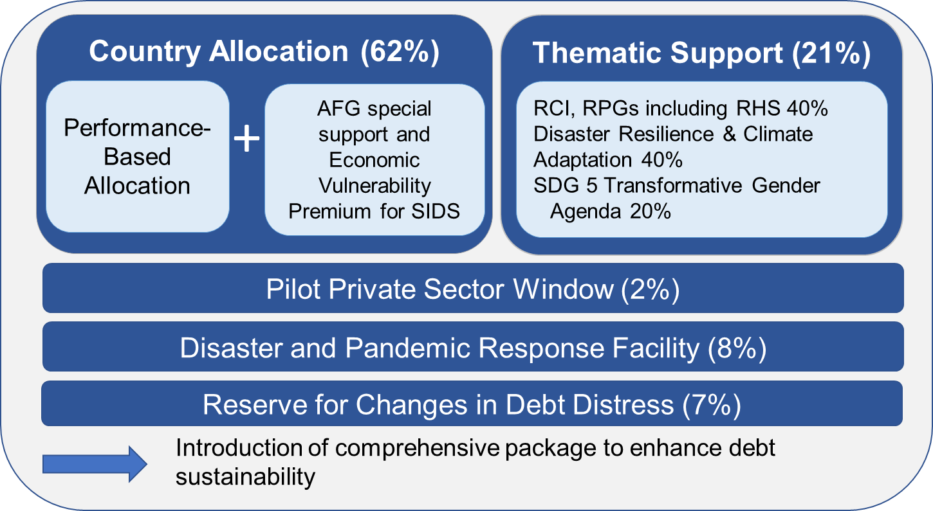
ADF 13 Grant Allocation Framework
AFG = Afghanistan, RCI = regional and cooperation integration, RHS= regional health security, RPGs = regional public goods, SDG =Sustainable Development Goal, SIDS = small island developing states. Source: Asian Development Bank.

Slide 5
Performance-based Allocation System
Performance-based allocation (PBA) system is widely used by MDBs and favored by donors of concessional finance due to clarity and transparency of the formula-based approach and reliance on a limited number of key development-related variables, and its reward of improvements in institutional capacity.
PBA system is core of ADB’s resource allocation framework for concessional resources.
PBA formula is a weighted geometric function of the composite country performance rating, per capita income, and population.

Slide 6
Limitations of PBA system
PBAs for SIDS are generally very small mainly due to their small population size, and they are not sufficient to meet the country needs for key development programs.
PBA system to be modified to increase allocations for SIDS, to ensure sufficient financing, and build resilience and address the causes of vulnerability.
Vulnerability and fragility indices can be integrated in ADF resource allocation framework to provide a tailored supplementary allocation for eligible SIDS

Slide 7
Fragility Indices
Major constraint of using vulnerability and fragility indices as part of the ADF resource allocation framework is limited coverage of ADB developing member countries
Available fragility indices do not sufficiently cover ADF grant-eligible SIDS
Fragility indices also tend to reflect a wide range of indicators related to political, economic and social aspects as well as experts’ qualitative analyses in some cases, which increases the complexity of their methodologies

Slide 8
Vulnerability Indices
Among three vulnerability indices [Economic Vulnerability Index (EVI), Climate Risk Index and World Risk Index] only EVI covers all ADF grant-eligible countries
Climate Risk Index country ranking is narrowly focused on disasters and tends to change drastically according to whether actual disasters occurred each year
The World Risk Index consists of 27 indicators which makes calculation complex and prone to the issue of data collection
The EVI is considered to be the most suitable vulnerability index for use in ADF resource allocation framework, based on country coverage, data availability, simplicity and comprehensiveness.
EVI covers all 10 ADF grant-eligible SIDS, and measures the structural vulnerability of countries to economic and environmental shocks
EVI scores are relatively stable as some of the parameters (e.g., remoteness from world market and share of population in low elevated costal zones) do not significantly change over time. This means that update of scores does not cause significant fluctuations in resource allocation from one ADF cycle to the other.

Slide 9
Two Options to Amend the Resource Allocation Framework
Integrating vulnerability indices in the PBA formula
Determining the size of a premium for SIDS based on vulnerability indices outside the PBA system

Slide 10
Integrating Vulnerability Indices in the PBA Formula
(Tentative Results)
Integration of vulnerability indices into the PBA formula by itself (i) does not ensure sufficient resource allocations to all ADF grant-eligible SIDS; (ii) creates a wide range of country allocations among SIDS; and (iii) cannot replace the special support to Afghanistan.
In summary, integrating vulnerability indices in the PBA formula does not generate adequate resource allocations for SIDS.

Slide 11
Economic Vulnerability Premium
Introducing a premium outside the PBA system for ADF grant eligible SIDS to provide tailored support based on the degree of vulnerability of countries.
Based on the Economic Vulnerability Index (EVI).
SIDS are divided into groups based on their EVI scores.
SIDS are allocated amount for economic vulnerability premium (EVP) based on EVI classification.
The allocation of EVP is limited to ADF-grant eligible SIDS because other ADF-grant eligible countries benefit from much larger PBAs.
The premium amount will not change during the ADF 13 cycle to ensure predictability.

Slide 12

Based on the Economic
Vulnerability Index (EVI)
Range of $40–55 million per cycle
Economic Vulnerability Premium for ADF Grant-Eligible SIDS
EVI Score | Country | Premium per cycle ($ million)
70-80 (more vulnerable) | Kiribati | 55
60-70 | Marshall Islands | 50
50-60 | Federated States of Micronesia, Maldives, Nauru, Solomon Islands, Tonga and Tuvalu | 45
40-50 (less vulnerable) | Samoa and Vanuatu | 40
21

Slide 13
Conclusions
Introduction of EVP ensures more adequate allocations for ADF grant-eligible SIDS to build resilience and address the causes of vulnerability.
Indicative ADF grant country allocations for SIDS during ADF 13 total $576 million or about 28% of total country allocations and are about 46% higher than provided under ADF 12.
EVI is considered to be the most suitable vulnerability index for use in ADF concessional resource allocation framework, based on country coverage, data availability, simplicity and comprehensiveness.

Slide 14
Thank you
19

