Slide 1
Measuring Vulnerability:
The Caribbean Development
Bank’s Approach and its Application
Presented by:
Ian Durant, Director, Economics Department and
Jason Cotton, Country Economist

Slide 2


AGENDA
1
CDB’s mandate
2
Measurement of Vulnerability
3
Application
4
Takeaways

Slide 3

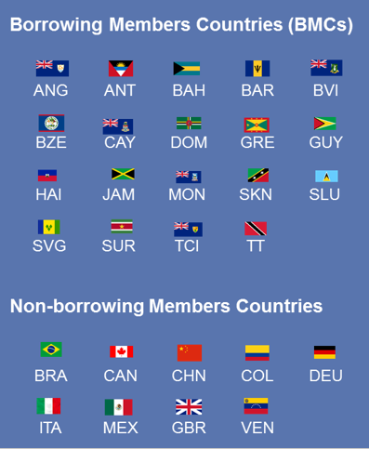
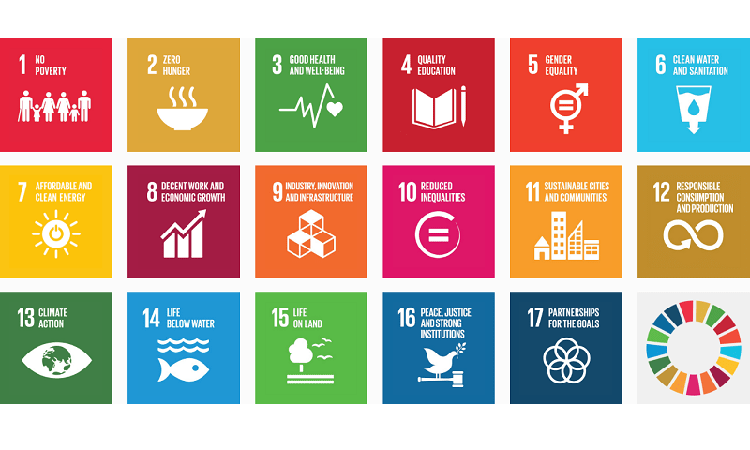
Purpose:
Reducing poverty and transforming lives through sustainable, resilient and inclusive development.
CDB embraces the Sustainable Development Goals and is working to facilitate their attainment for the people living in BMCs.

Slide 4
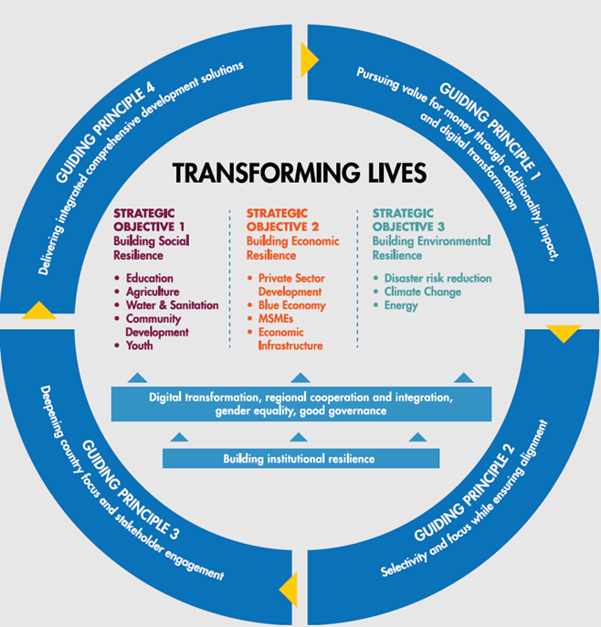

Strategic Plan 2020-24

Slide 5
1
CDB’s mandate
2
Measurement of Vulnerability
3
Application
4
Takeaways

Slide 6
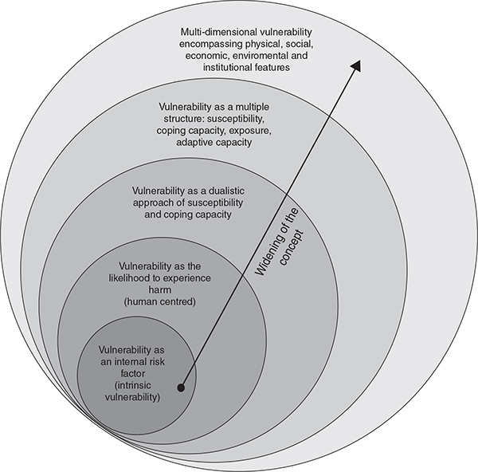



Objective:
To quantify an index that captures the relative vulnerability of CDB BMCs to external shocks.
Why is this important?
It gives further legitimacy to the challenges in BMCs.
It supports evidence-based policy formulation.
It can guide the allocation of concessional resources.
Updates the CDBs vulnerability index.
VULNERABILITY
Definitions range from “fragility and lack of resilience in the face of outside forces”; “a state of defenselessness, insecurity and exposure to risk, shocks and stress”(Wratten,1994);
“vulnerability relates to risk”(Gordon and Spicker,1999) and “the well being of individuals, households or communities in the face of a changing environment”(Moser,1996).
Birkmann, 2005

Slide 7
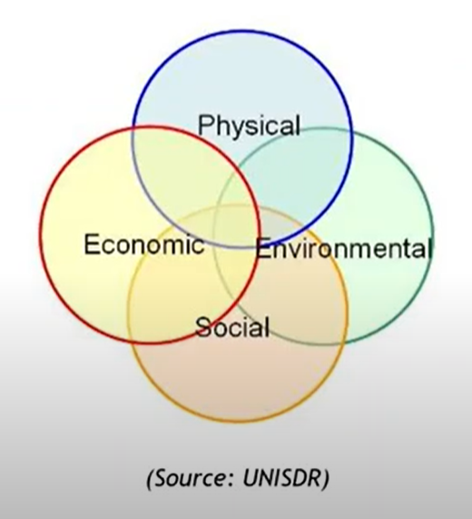
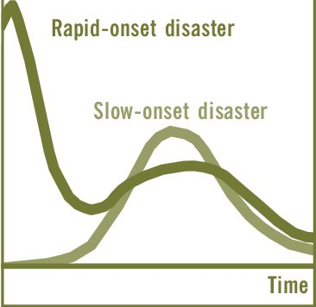
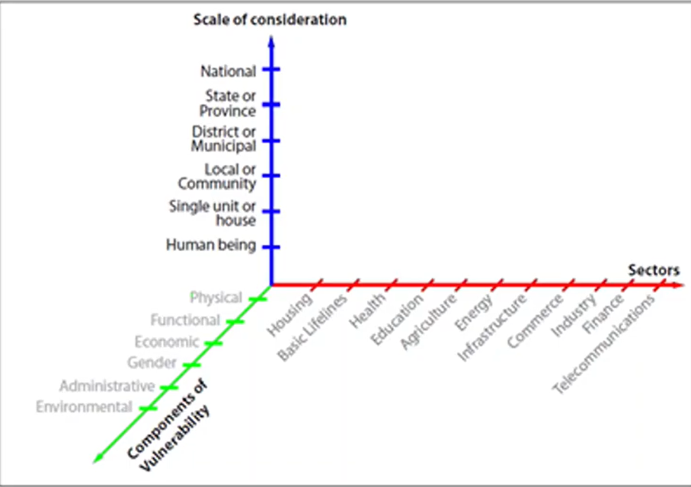
Multidimensional
Sustainable
Development
Speed of Disaster
Scale Dependent

Slide 8
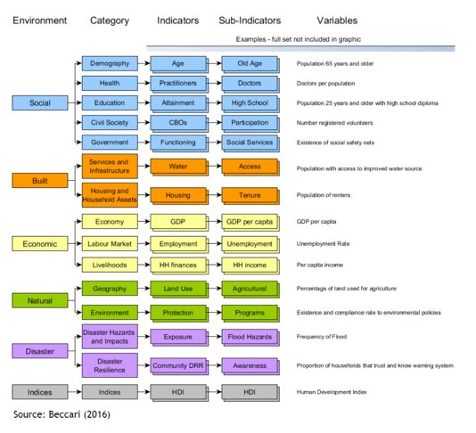
Literature Review

Slide 9



Vulnerability Index
Previous Work
Recent Work
Economic Vulnerability Index
Crowards (2000)
Hartman (2011)
Multidimensional Vulnerability Index
Working paper published in 2019
Economic
Social
Environmental
Basic Criteria
Simple
Comprehensive
Comparable

Slide 11




RESEARCH OBJECTIVES?
To assist BMCs’ assess vulnerabilities.
To support evidence-based policy formulation within CDB.
To quantify BMCs’ vulnerability to external shocks.
OBJECTIVE
Update vulnerability component of formula for financial resource allocation.
Explore innovative financing mechanisms.

Slide 12
Vulnerability Index Construction
01
Determine the risk factors
02
Compile proxy indicators
03
Data normalization methodology
X_{ij} = (X_{ij} – Min X_{j})/ (Max X_{j} – Min X_{j})
04
Compute sub-indices
In combining the indicators, a number of studies have recommended and embraced the assignment of equal weight to the different items (Briguglio, 1995; Crowards and Coulter, 1999; Morris, 1979; UNDP, 1991; Commonwealth (2014); St. Bernard (2007) and and Ogwang, 1994).

Slide 13
Framework: EVI and MVI (2019)
UN EVI
MVI
Economic (66.68%)
Export concentration (16.67%)
&
Destination (16.67%)
Social​ (16.67%)
Environmental (16.67%)
Dependence on strategic imports (16.67%)
Dependence on foreign capital (16.67%)
Natural hazards & Climate change (16.67%)
Tourists from top 3 source countries
Exports to top 3 trading partners
Exports to top 3 export categories
Exports (% of GDP)
Food imports (% of total imports)
Net fuel imports (% of total imports)
FDI inflows (% of GDP)
Personal remittances receipts (% of GDP)
Unemployment rate
Poor share of total population
Murders per 100K
Social susceptibility (16.67%)
Economic losses of carbon
Economic losses of climate change
Number of deaths (% of total population)
Number affected (% of total population)
CDB MVI
EVI
Exposure Index​
(1/2)
Size sub-index​
(1/8)
Location sub-index​ (1/8)​
Remoteness​ (1/8)​
Population (1/8)
Economic structure sub-index​
(1/8)​
Merchandise export concentration​ (1/16)
Share of agriculture, hunting, forestry and fishing​ (1/16)​
Environment
sub-index​
(1/8)
Share of population in low elevated coastal zones ​(1/8)
Shock index
​(1/2)​
Trade shock
sub-index ​
(1/4)
Instability of exports of goods and services​ (1/4)​
Natural shock
sub-index​
(1/4)​
Victims of natural disasters​ (1/8)​
Instability of agricultural production​ (1/8)​

Slide 14
Preliminary Framework: Revised MVI (2021)*(2021)*
MVI
Economic
(33.3%)
Exposure
(16.65%)
Environmental
(33.3%)
Exposure
(16.65%)
Volatility
(16.65%)
Exposure
(16.65%)
Volatility
(16.65%)
Years of schooling (Education)
SDG 4.3
Homicides (Public safety)*
Life Expectancy; NCDs; Out-of-pocket health expenditure (Health)
SDG 3.8.2
Population 65+ (Demography)
Unemployment*, Poverty*
(Economic capability)
Openness*
Merchandise export concentration*
Strategic imports*
Remoteness*
Debt stock
Share of agriculture in GDP
Instability of real GDP growth
(20-year trend)
Instability of exports of goods and services
(20-year trend)
Mobile broadband & Access to internet (Technology)
SDG 9
Natural disasters deaths/affected*
SDG 1.5.1
Population in coastal zones
Instability of agricultural production
(20-year trend)
Volatility of tourist arrivals
(20-year trend)
Share of population living in drylands
Tree cover/Grassland/Wetland loss
Social
(33.3%)
Volatility
((16.65%)
Volatility of current health expenditure
(20-year trend)
FLFPR (Gender)
SDG 5
External finance*
Volatility of financial flows
(20-year trend)
* New blended approach

Slide 15
What’s New?
Proxy Indicators
 | Social | Economic | Environmental | Total
2019 MVI | 3 | 8 | 4 | 15
2021 MVI | 12 | 13 | 7 | 32
Social Dimension
 | Education | Public Order/Safety | Health | Demography | Economic Capability | Technology | Gender
2019 MVI |  | x |  |  | x
2021 MVI | x | x | x | x | x | x | x
Environmental Dimension
 | Natural Hazard | Climate Change | Biodiversity and Habitat
2019 MVI | x | x
2021 MVI | x | x | x

Slide 16
1
CDB’s mandate
2
Measurement of Vulnerability
3
Application
4
Takeaways

Slide 17
Application
The practice:
The possibilities:
EVI
Access to Special Development Fund is based solely on per capita income. Only then, are concessional resources allocated using a number of metrics, including the vulnerability index score.
The vulnerability index score is one of several criteria that is used to determine the size of the allocation of each country that has access to Special Development Fund.
Country Strategy Papers
MVI
Special Development Fund
Policy Based Loans
Functional & Operational Decisions

Slide 18
Takeaways
1
2
3
MVI provides a holistic perspective
on exposure to risk.
MVI supports evidence-based policy formulation
MVI has potential role in CDB’s Financial resource allocation framework
CDB’s approach seeks to consolidate the diverse vulnerability literature into a composite index well suited to the mandate of the bank, relevant to our BMCs and diverse in its application.
CDB and BMCs can utilize the MVI alongside other available information to support evidence-based policy formulation.
Pending the completion of this research consideration will be given to how the MVI can be used to improve the allocation of financial resources.

