Slide 1
Disaster Resilience Strategy Building Resilience in Developing Countries Vulnerable to Large Natural Disasters, IMF Policy Paper, 2019
Saad Quayyum
Strategy, Policy and Review Department
International Monetary Fund

Slide 2
Key Challenges in Small States
Under-investment in resilience
Limited domestic resources
Donor support focused more towards post-disaster recovery compared to building ex-ante resilience
Weak capacity
Limited fiscal space to deal with large recovery costs, low insurance coverage, dependence on donors for post-disaster recovery
Resilience plans not well-developed (or missing); capacity constraints
Fragmented donor support

Slide 3
Disaster Resilience Strategy (DRS)
Three Complementary Pillars for Ex-Ante Intervention
PILLAR I
Structural resilience
- Resilient infrastructure
- Appropriate building codes
- Proper land use/zoning rules
- Early waring systems
PILLAR II
Financial resilience
- Macro-Fiscal/reserve buffers, incl. dedicated saving funds
- Contingency loans
- Insurance
- State contingent debt instruments
PILLAR III
Post-Disaster resilience
- Effective systems for emergency response, reconstruction and smooth recovery after a disaster

Slide 4
Pillar I: Structural Resilience
Significant returns to investing in ex-ante structural resilience
Resilient infrastructure 10-30% more costly than non-resilient options
But lower rebuilding/recovery costs & output loss over the long term

Slide 5
Pillar I: Structural Resilience
DRS based on comprehensive forward-looking diagnostic.
Risk assessment
Project identification, costing and prioritization
Investment scale-up needs to be accompanied by:
Strong public financial management
Medium term-fiscal and budgeting framework
Robust public asset and investment management
Sound regulations (building codes, zoning rules, land use) are important
Notes:
PFM and PIM systems that allow to build resilience infrastructure and facilitate agile/transparent responses are especially important

Slide 6
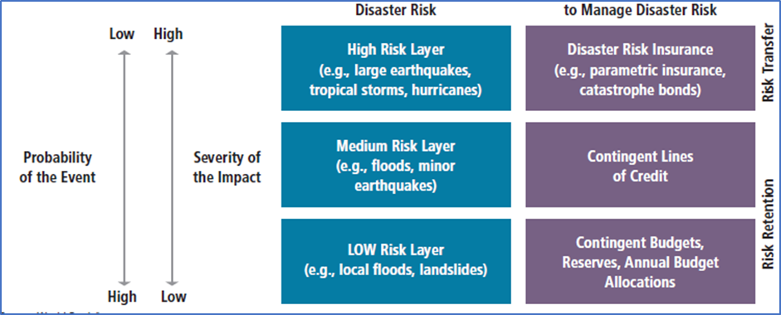
Pillar II: Financial Resilience
Risk-layered approach to disaster risk management:
(different instruments for different disaster frequency and cost)
Strong macro-fiscal management and buffers
Self-insurance: disaster funds and contingency budgets
Disaster Funds: Jamaica; Tuvalu
Contingent loans:
World Bank CAT-DDO (soft trigger): Dominican Rep., Seychelles, Sri Lanka
IDB Contingent Credit Facilities (parametric triggers)
AsDB Pacific Disaster Resilience Program: Tonga
Traditional insurance:
Regional insurance pools with parametric triggers
(CCRIF, PCRIC, Africa Risk Capacity)
Catastrophe (CAT) bonds:
Similar to insurance, but risk transferred to capital markets
Limited sovereign uptake; CCRIF issued cat bond to reinsure
State-contingent debt instruments (SCDI):
Hurricane clauses (Grenada, Barbados debt restructuring)
Source: World Bank
Notes:
It is important to have fiscal buffers, good macro-fiscal management, good fiscal rules that effectively account for bad times with logical escape clauses
Parametric insurance
Caribbean. The Caribbean Catastrophe Risk Insurance Facility (CCRIF), supported by the World Bank and international donor community was launched in 2007. The expansion of the CCRIF to include Central America is projected to reduce premiums for the Caribbean countries by 25 percent and 36 percent for Central America. Caribbean countries already enjoy a 50 percent reduction in premiums from what they would have paid individually.
Pacific. In 2013, a similar facility was created for Pacific countries—the Pacific Catastrophe Risk Insurance Pilot. This program was made possible through the collective efforts of the Government of Japan, the World Bank, and the Global Facility for Disaster Reduction and Recovery.
Africa. African Risk Capacity, an Africa insurance pool for droughts (flood risks to be added at a later date) issued its first policies in May 2014 to cover events with a frequency of I in 5 years. It has a current membership of 32 countries including three small states—Comoros, Djibouti, and Sao Tome and Principe.
Catastrophe bonds. Mexico is, to date, the only sovereign to issue a CAT bond, with a 2012 issue providing coverage against earthquakes and hurricanes. The World Bank has also issued a CAT bond to finance CCRIF, the parametric insurance facility for Caribbean countries.

Slide 7
Pillar III: Post-Disaster Resilience
Detailed action plan to guide the post-disaster response of government agencies
Clarify institutional arrangements & responsibilities
Plans for quick resumptions of public services
Social protection mechanism to extend support to the vulnerable
Strong PFM/procurement system to aid recovery
Notes:
Parametric insurance
Caribbean. The Caribbean Catastrophe Risk Insurance Facility (CCRIF), supported by the World Bank and international donor community was launched in 2007. The expansion of the CCRIF to include Central America is projected to reduce premiums for the Caribbean countries by 25 percent and 36 percent for Central America. Caribbean countries already enjoy a 50 percent reduction in premiums from what they would have paid individually.
Pacific. In 2013, a similar facility was created for Pacific countries—the Pacific Catastrophe Risk Insurance Pilot. This program was made possible through the collective efforts of the Government of Japan, the World Bank, and the Global Facility for Disaster Reduction and Recovery.
Africa. African Risk Capacity, an Africa insurance pool for droughts (flood risks to be added at a later date) issued its first policies in May 2014 to cover events with a frequency of I in 5 years. It has a current membership of 32 countries including three small states—Comoros, Djibouti, and Sao Tome and Principe.
Catastrophe bonds. Mexico is, to date, the only sovereign to issue a CAT bond, with a 2012 issue providing coverage against earthquakes and hurricanes. The World Bank has also issued a CAT bond to finance CCRIF, the parametric insurance facility for Caribbean countries.

Slide 8
Other Key Features of DRS
Country Ownership
Sound Financing Plan
Domestic Revenue Mobilization
Debt
Donor support
Consistency with multi-year macro-fiscal framework
How will the plan impact growth, debt, current account ?
Will debt remain sustainable?

Slide 9
Small States need significant support from other stakeholders
World Bank (and other development banks): diagnostics, disaster risk reduction & financial resilience strategies, technical assistance for post-disaster resilience
IMF: TA in macro-fiscal areas, making investment needs consistent within a sustainable macroeconomic framework in medium and long term
Bilateral donors: support technical assistance, subsidize insurance, provide concessional financing
Climate funds: unlock funding (simplify access)
Official sector insurance companies: help design financial resilience strategy

Slide 10
Two DRS Pilots Completed
Dominica
Significant exposure to natural disasters
Category 5 hurricanes in 2015 and 2017
Fiscal sustainability challenges
Country elaborated climate resilience and recovery plan
Unique role of CREAD
Grenada
Relatively lower exposure to hurricanes
Slow moving disasters (sea level rise) a major concern
IMF/WB Climate Change Policy Assessment
Recent track record of fiscal responsibility
Major World Bank and Green Climate Fund operations

Slide 11
Conclusion
DRS based on a three-pillar strategy to improve structural, financial and post-disaster resilience
Critical: DRS are home-grown
Based on sound diagnostics, credible financing plan and sustainable multi-year macro-fiscal framework
Implementation must be supported by multiple, coordinated stakeholders (TA & Financing)
It should help to mobilize more resources towards building ex-ante resilience!

