Slide 1
Addressing Fragility & Building Resilience in Africa Erick Mariga Ph.D. Senior Fragility and Policy Analyst

Slide 2
Approach
1. Reinforcing
Tools
2. Leveraging limited
Resources
3. Strengthening
Partnerships
to understand and target root causes of fragility
for high impact operations
to enhance delivery

Slide 3
Root Causes and Manifestations of Fragility
Conflicts
Extreme Poverty & Exclusion
Security / Terrorism
Spillover/ Regional Fragility
Fragile Economy
Fragility
Poor Governance
Disaster Triangle
Weak State Capacity
Youth Unemployment & Underemployment
Environmental degradation
Youth Unemploy-ment
Climate Change

Slide 4
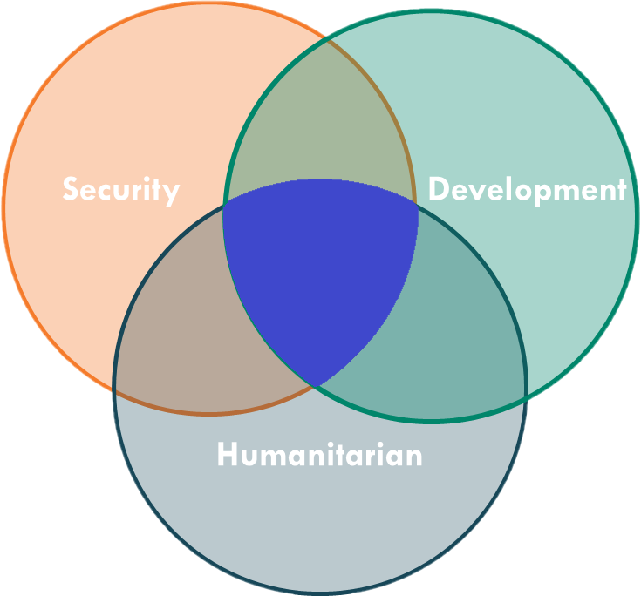
The Security-Humanitarian-Development Nexus
… required collaboration of IFIs, Bilaterals, Security Forces Governments, CSOs and the Private Sector
Nexus

Slide 5
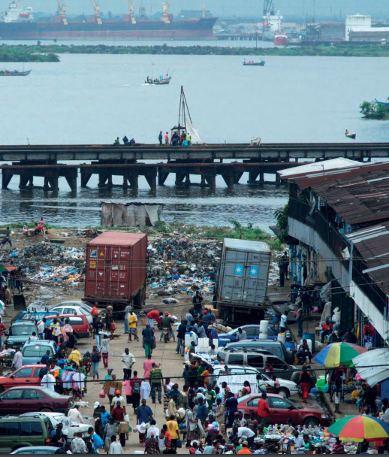
Engagement in fragile situations to assist RMCs with transitioning out of fragility and building resilience
1. Fragility requires a regional approach
2. Systematically applies a fragility lens to identify, respond to, and prevent fragility and build resilience
3. Focuses upon strengthening state capacity and establishing effective institutions

Slide 6
Building Resilient Communities, Countries and Regions
Step 1: Assess fragility at country and regional level
Step 2: Apply a fragility-lens to the design of strategies and operations
Step 3: Implement operations and adapt engagement
Build Resilience is key to lifting populations out of fragility and poverty

Slide 7
Thank You!

